Slide 1



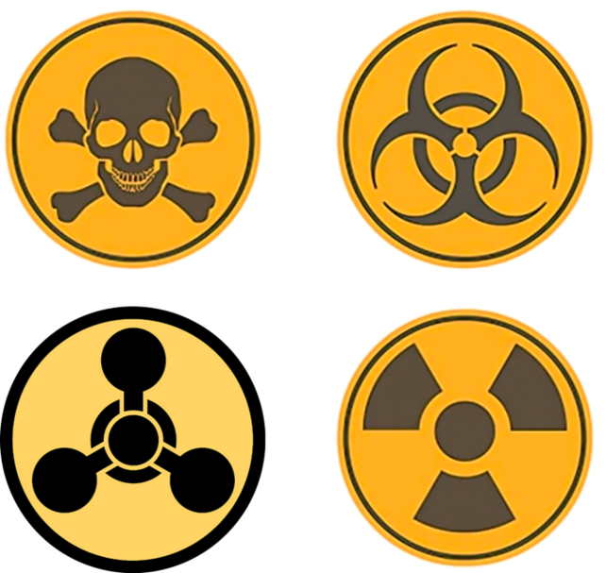
CBRN Module: CAPF
CASE STUDY GOIANIA ,BRAZIL SEPT. 13, 1987
Presented by:- Pavan Dev Gaur, 2IC

Slide 2
OBJECTIVES
Upon completing this lesson, you will be able to:
1
About Goiania, Brazil.
Cause of radiological accidents of Goiania.
Effect of radiological accidents.
Lesson learnt of this accident.
Review
2
3
4
5
6

Slide 3
The accident occurred in September 1987 in Goiania where a group of people and the environment were contaminated by Cs-137as a consequence of the rupture of a medical therapy source.
Goiania is the capital of the Brazilian state of Goias. It had about 8 hundred thousand inhabitants at the time of the accident.
Goiania is located 1000 miles from Rio de Janeiro and 600 miles from São Paulo, where the main Brazilian radiation protection centers are located.
What is it about ?
PPT 2 -

Slide 4
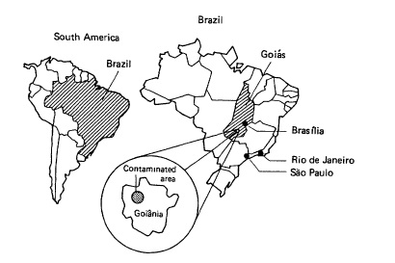
GOIANIA, BRAZIL
PPT 2 -

Slide 5
What led to the accident ?
In 1985, the Goiania Institute of Radiotherapy moved to a new location taking a Cobalt-60 teletherapy and discharging an obsolete Cesium-137 teletherapy unit in a partially demolished session of the old building in downtown Goiania.
Hospital owners informed Brazilian authorities about the Cobalt-60 unit but not about the Cesium-137 unit.
Brazilian authorities argued the owners of the hospital two times by regular mail about the destination of the Cs-137 unit but no reply was received until the accident occurred.
PPT 2 -

Slide 6
How did it happen?
Two young men without permanent jobs looking for a way to make some money learned that there was a heavy equipment at an abandoned and partially demolished hospital building in downtown Goiania
Possibly on September 13, they forced the entrance of the building and decided to remove the shielding head of the teletherapy unit and sell it to a junkyard.
So they did. The two men, the owner of the junkyard and his two employees initiated attempts to dismantle the equipment
PPT 2 -

Slide 7
The rotating assembly and a capsule containing about 1400 Curies of Cesium-137 were dismantled presumably on September 18.
The capsule was ruptured and the cesium released.
Pieces of the source were distributed among the junk yard owners relatives, neighbors and most close friends.
Everyone was impressed with the power of the stone as it glowed blue in the dark.
Some of them scrubbed the material on the skin in order to appreciate.
Residences about 100 miles from Goiania were found with cesium contamination
How did it happen?
PPT 2 -

Slide 8
How did it happen?
The owners wife observed the occurrence of the first symptoms of acute radiation syndrome among her relatives and decided to look for medical assistance at the Hospital for Tropical Diseases.
Pieces of the source were put in a bag that she took along with her by bus to the hospital.
On September 29, the Brazilian Nuclear Energy Commission was notified by a goianian physicist about the occurrence of a serious radiological accident.
PPT 2 -

Slide 9
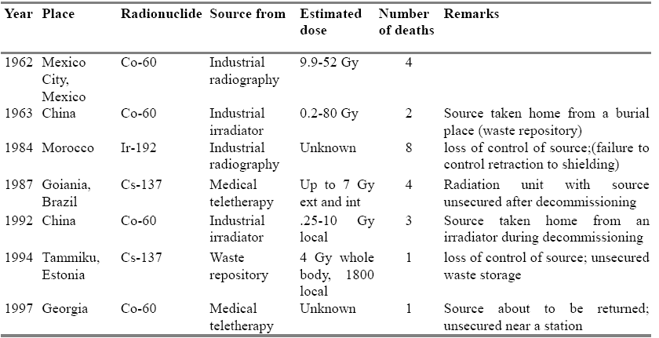
Major Radiological Accidents
PPT 2 -

Slide 10
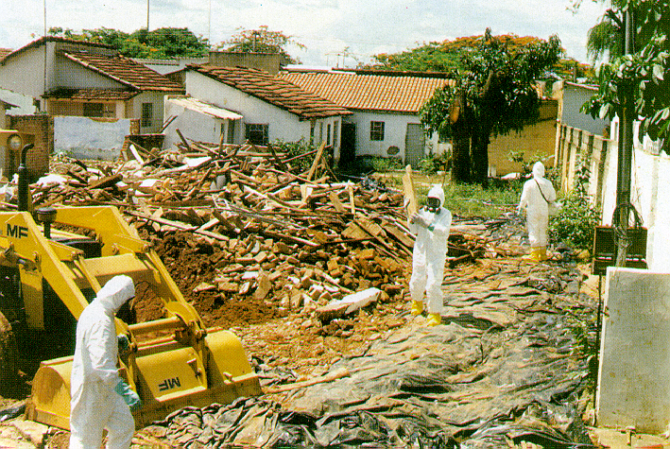
PPT 2 -

Slide 11
Nuclide Cs-137
Activity (Sept.87) 1375 Ci
Chemical form CsCl
Physical form powder
CsCl mass 93 g
Cs-137 mass 19.3 g
Half-life 30 years
PPT 2 -

Slide 12
About 112800 people (11 of the total population) were monitored at the Olympic Stadium using survey meters
271 were identified as contaminated
50 contaminated people were isolated in a camping area inside the Olympic Stadium for more detailed screening
20 people were hospitalized or transferred to special housing with medical and nursing assistance
8 patients transferred to the Navy Hospital in Rio de Janeiro
Contamination survey in the residences was initiated
First countermeasures and contamination survey
PPT 2 -

Slide 13
Response
Surveyed = 112,800
Persons contaminated = 271
contamination on clothing, shoes = 120
internal, external contamination = 151
Local radiation injuries (burns) = 28
Bone marrow failure = 14
Acute radiation syndrome = 8
Fatalities = 4 ( 2 men, 1 woman and 1 child)
PPT 2 -

Slide 14
More Response Statistics
Decontamination of city: 730 workers required
Houses affected: 98
41 evacuated
6 demolished
51 repaired
Decontaminated public places: 58
pavements, squares, shops and bars
Number of vehicles decontaminated: 64
PPT 2 -

Slide 15
More Response Statistics
Waste storage site:
20 km from the city to accommodate 4,000-5,000m³
Types of waste packaging used:
4,500 metal drums (200L)
1,400 metal boxes (5 tonnes)
10 shipping containers (32m³)
6 sets of concrete packaging
Volume of waste stored: 3,500 m³,
PPT 2 -

Slide 16
The Consequences
Four early fatalities
A large number of persons contaminated
The environment severely contaminated
Large quantities of RW generated
Significant economic loss and burden
Substantial physiological impact
PPT 2 -

Slide 17
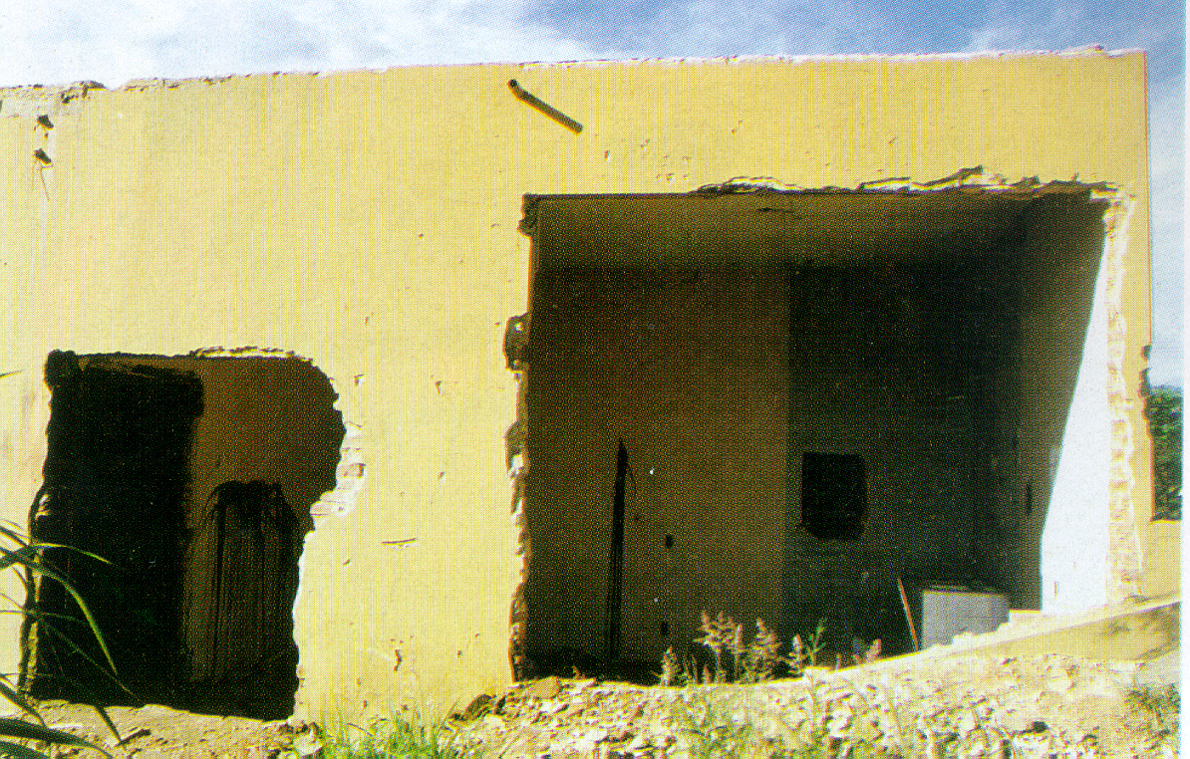
Abandoned Radiotherapy Clinic
PPT 2 -

Slide 18
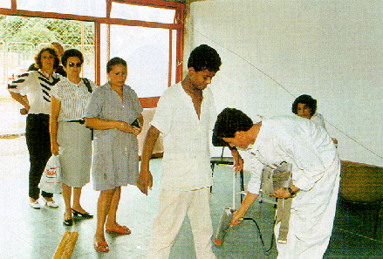
CONTAMINATION CHECK
PPT 2 -

Slide 19
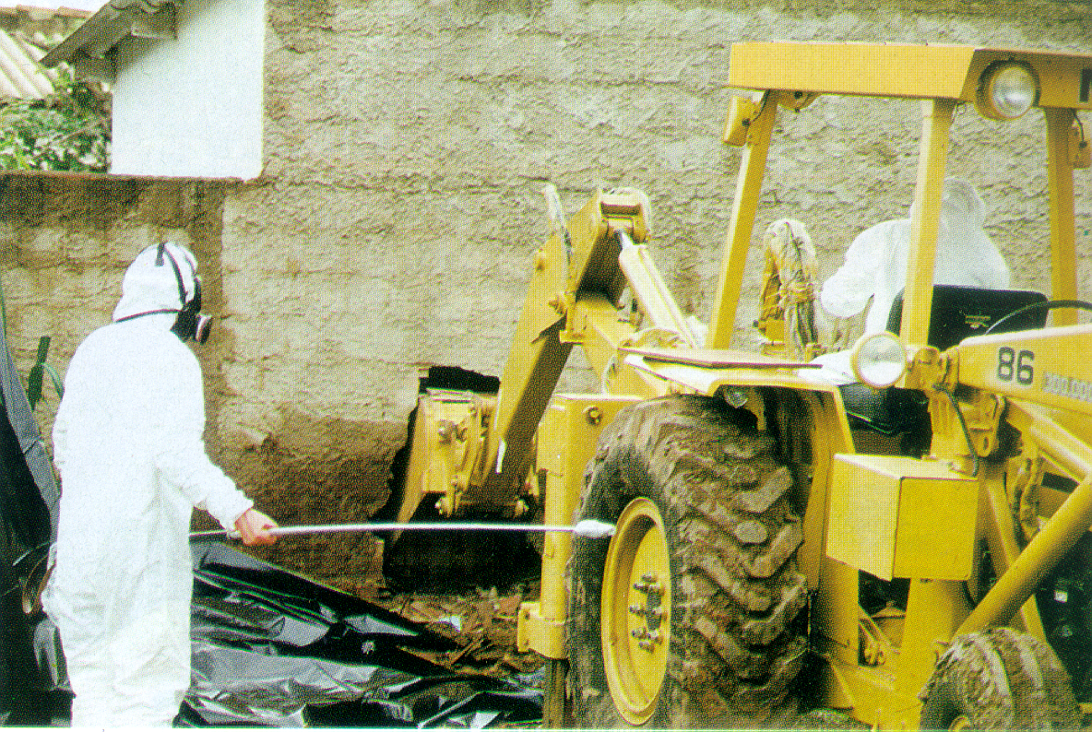
LOOKING FOR HOT SPOTS
PPT 2 -

Slide 20
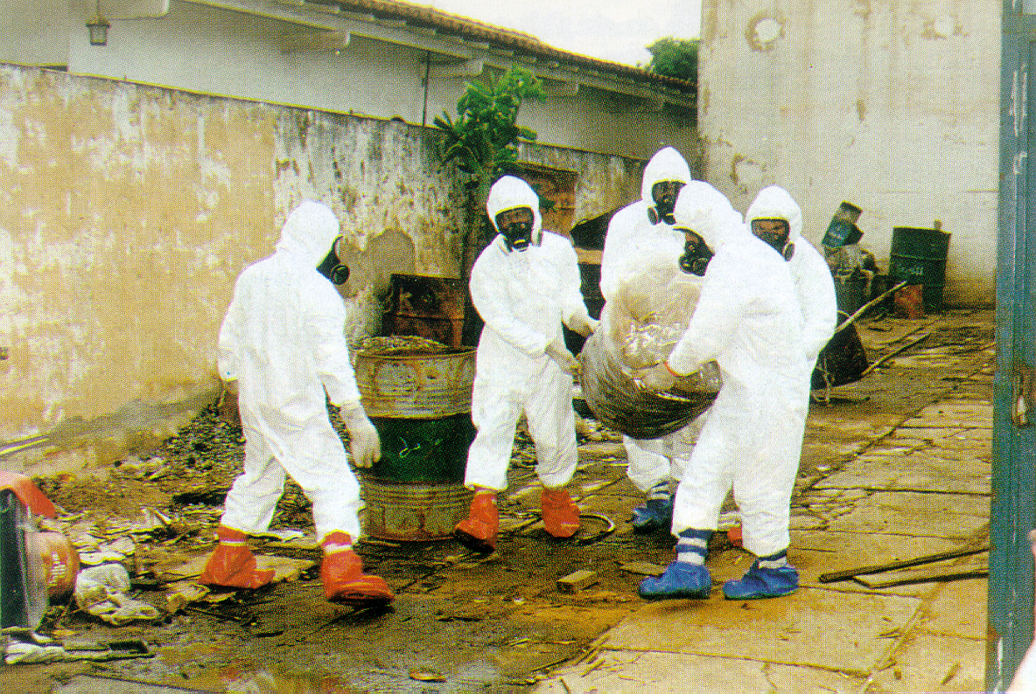
REMOVING CONTAMINATED ITEMS
PPT 2 -

Slide 21
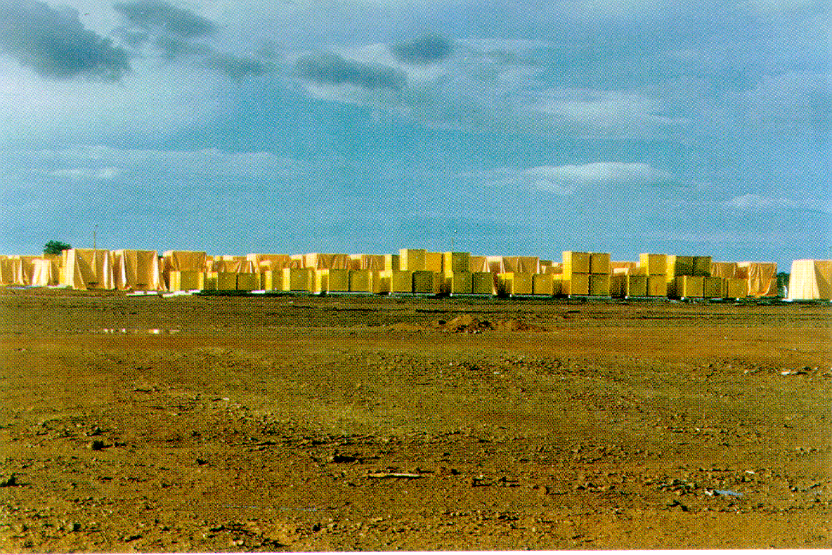
TEMPORARY STORAGE SITE
PPT 2 -

Slide 22
Lesson learnt
A radiological accident entailing contamination due to the breaking up of a radioactive source can be aggravated if much time elapses before the discovery of the accident.
(2) The physical and chemical properties of a radioactive source are important factors in an accident. The records of sealed sources should contain that information.
PPT 2 -

Slide 23
Lessons Learned
Public should be made aware of what radiation is and of its applications.
(4) An adequate system of social and psychological support should be provided following a radiological accident causing serious contamination.
(5) Emergency training courses should be held in developing countries as well as in developed countries where facilities are available and work well.
PPT 2 -

Slide 24
Lessons Learned
(6) Appropriate international organizations should consider having ready for use of radiological equipment available.
(7) The provision of a temporary waste storage site near the area affected by a radiological accident should be considered.
(8) An infrastructure of civil engineering personnel should be available to participate in decontamination work.
(9) A program of periodic inspection of radiological equipment and facilities should be organized.
PPT 2 -

Slide 25
Review
About Goiania, Brazil.
Cause of radiological accidents of Goiania.
Effect of radiological accidents.
Lesson learnt of this accident.
Conclusion
PPT 2 -

Slide 26
ANY QUESTION ?
PPT 2 -

Slide 27


THANK YOU

