Slide 1
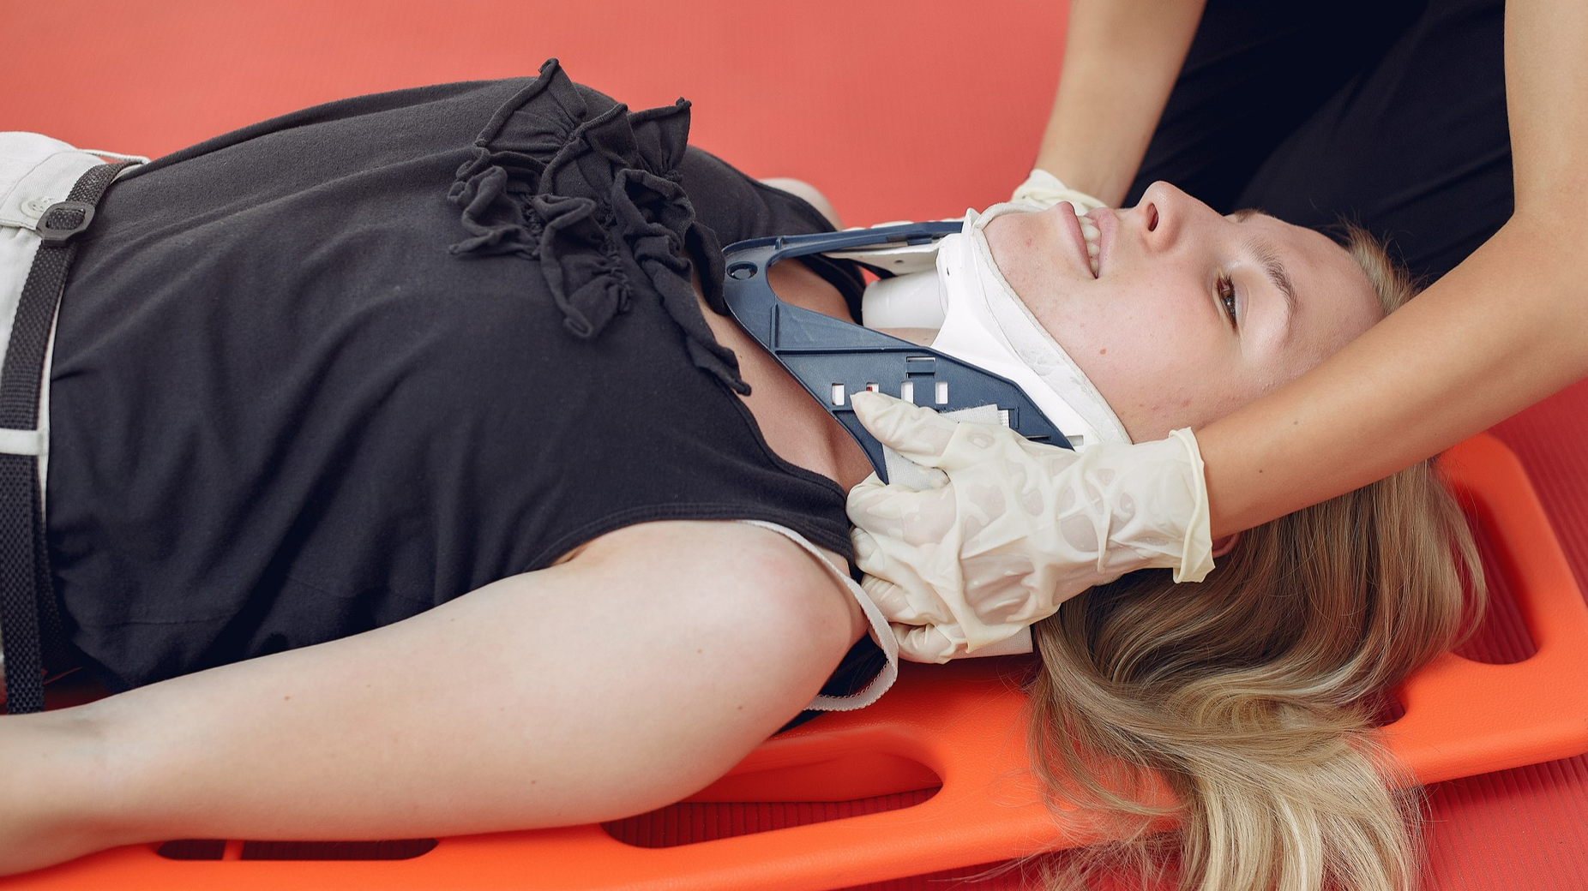



LESSON 12
Injuries to the Skull, Spinal Column and Chest
Photo Credit: Freepik
MFR | INDIA
PPT 12 -

Slide 2

OBJECTIVES
Upon completing this lesson, you will be able to:
1
  List five signs and symptoms of a skull fracture.
  List six signs and symptoms of a spinal injury.
  List five signs and symptoms of chest injuries.
2
3
PEER | MFR | INDIA
PPT 12 -

Slide 3
OBJECTIVES
Upon completing this lesson, you will become familiar with:
4
  Demonstrate the procedures for the evaluation and pre-hospital treatment of injuries to the skull and spine.
  Demonstrate the procedures for the evaluation and pre-hospital treatment of rib fractures, flail chest and penetrating chest injuries.
5
PEER | MFR | INDIA
PPT 12 -

Slide 4
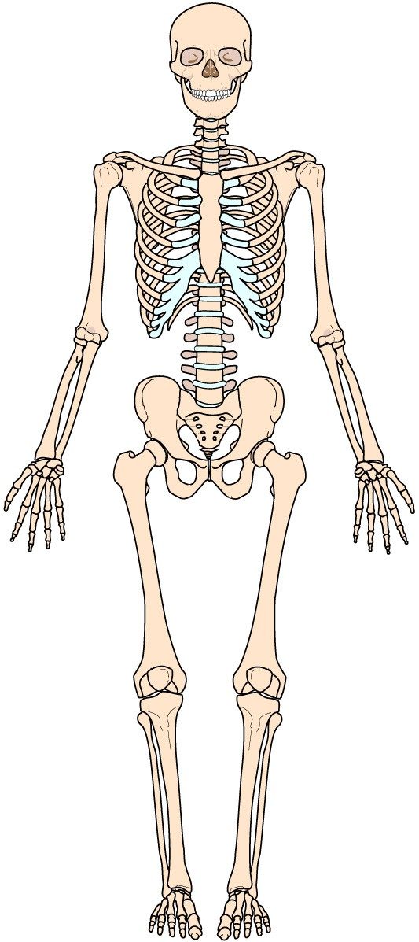
Skeletal System
PEER | MFR | INDIA
PPT 12 -

Slide 5
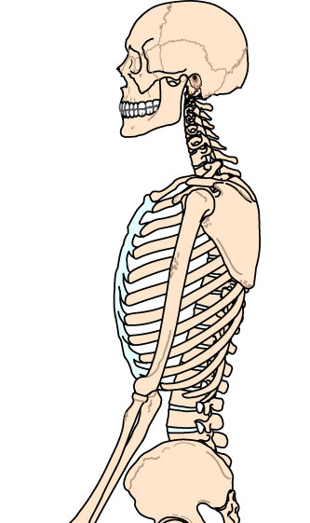
Cranium
Skeletal System
Thorax
Vertebrae
PEER | MFR | INDIA
PPT 12 -

Slide 6
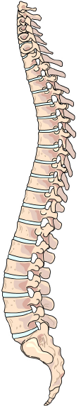
Cervical vertebrae
Spinal Column
Thoracic vertebrae
Lumbar vertebrae
Sacral vertebrae
Coccygeal vertebrae
PEER | MFR | INDIA
PPT 12 -

Slide 7
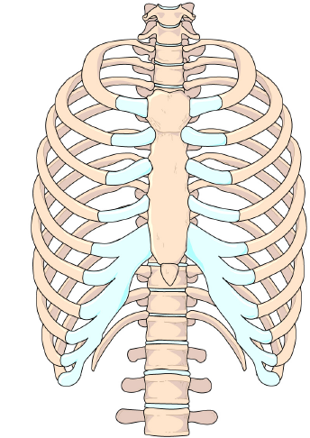
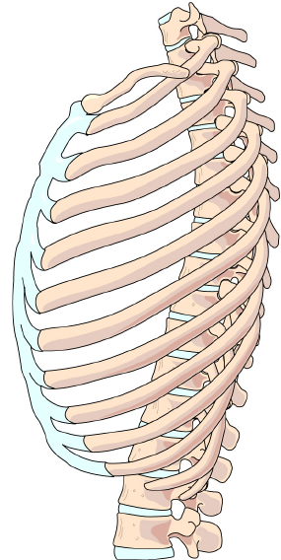
Thorax
Sternum
Ribs
PEER | MFR | INDIA
PPT 12 -

Slide 8

Photo Credit: Freepik
PEER | MFR | INDIA
PPT 12 -

