Slide 1
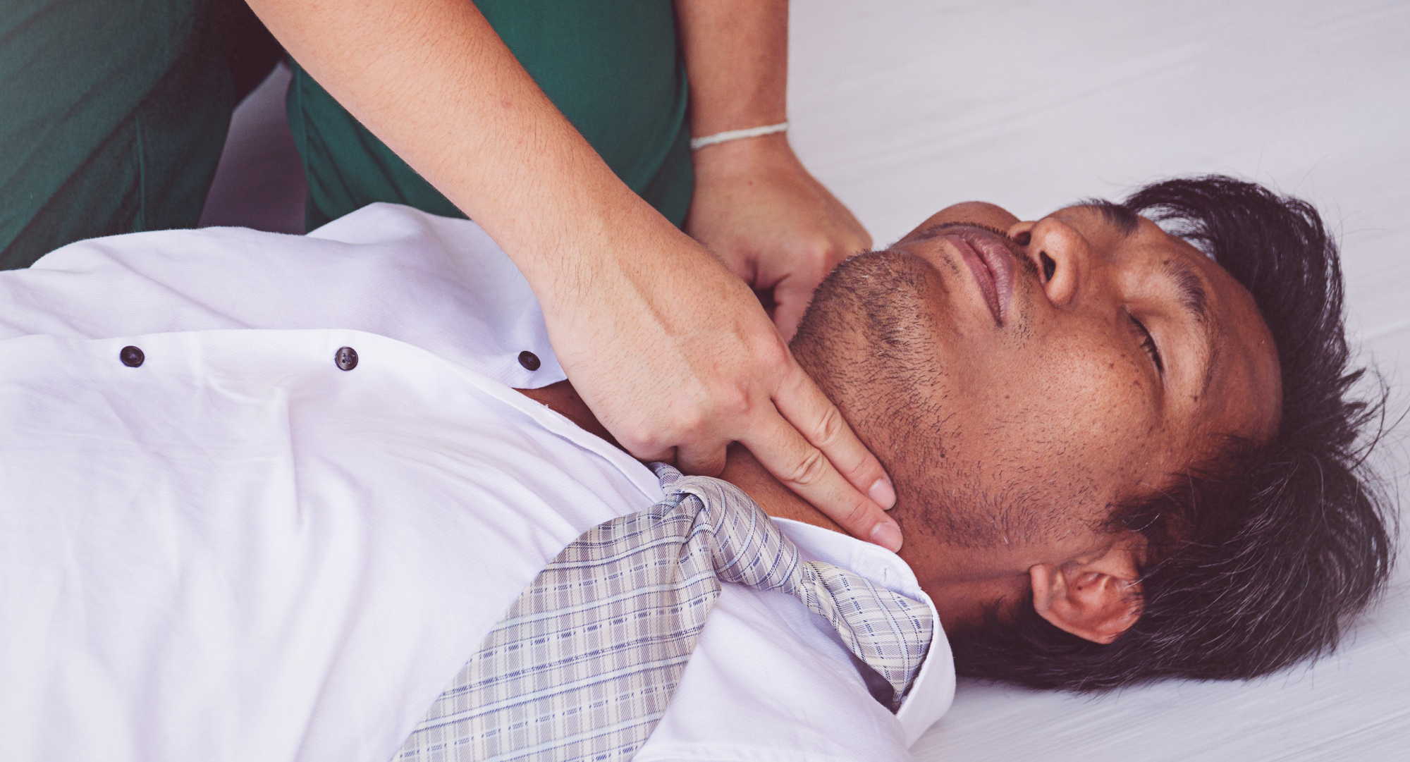



LESSON 6
Patient Assessment
Photo Credit: Freepik
PPT 6 -
MFR | INDIA
PPT 6 - 1

Slide 2

OBJECTIVES
Upon completing this lesson, you will be able to:
1
  List the five general procedures a medical first responder should complete when arriving at the scene.
  List the six phases of the patient assessment plan.
2
PEER | MFR | INDIA
PPT 6 -

Slide 3
OBJECTIVES
Upon completing this lesson, you will become familiar with:
3
  List the six steps of the initial assessment.
  Demonstrate a complete physical examination as defined in this lesson.
4
PEER | MFR | INDIA
PPT 6 -

Slide 4
Arrival on the Scene
Ensure your own personal safety.
Ensure patient safety.
Establish a general impression of the scene and begin initial assessment of the patient.
PEER | MFR | INDIA
PPT 6 -

Slide 5
Arrival on the Scene
Identify and treat life-threatening conditions.
Stabilize and continue to monitor the patient.
PEER | MFR | INDIA
PPT 6 -

Slide 6
Immediate Sources of Information
1
2
3
The scene itself (observe, plan, react)
Patient
(if responsive)
Relatives or bystanders
PEER | MFR | INDIA
PPT 6 -

Slide 7
Immediate Sources of Information
4
5
6
The mechanism of injury (forces that caused the injury; kinematics).
Any remarkable deformity or obvious injury.
Any sign or characteristics of certain types of injury or illness.
PEER | MFR | INDIA
PPT 6 -

Slide 8
Initial Assessment
A process used to identify and treat conditions posing an immediate threat to
the patient’s life.
PEER | MFR | INDIA
PPT 6 -

Slide 9
Physical Exam
The main purpose of the physical exam is to reveal any injury or medical problem that could pose a threat to patient survival if left untreated.
PEER | MFR | INDIA
PPT 6 -

Slide 10

Photo Credit: Freepik
PEER | MFR | INDIA
PPT 6 -

