Slide 1




COLLAPSE STRUCTURE SEARCH & RESCUE
LIFTING & STABILIZING LOADS
Presented by:- Pavan Dev Gaur, 2IC
CAPF | MFR | INDIA
-

Slide 2


OBJECTIVES
1
List three factors that you must determine before lifting a load.
List and describe three methods for lifting a load.
Define a lever, its three components and the three classes of a lever.
List at least three applications of the hoist.
Upon completing of this lesson, you will be able to :-
2
3
4

Slide 3
5
List two types of cribbing used to stabilize a load.
List the five steps to build cribbing for lifting and stabilizing a load.
List the steps to roll a load using pipes.
Demonstrate in two practical stations the techniques for lifting, stabilizing and rolling loads
6
7
8

Slide 4
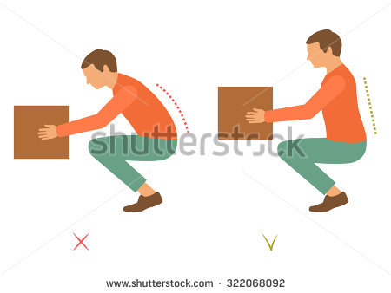
The following factors must be examined before lifting or moving a load:
Weight of the load
Consequences when the load is moved (what will happen)
Selection of the method for lifting or moving the load.
BEFORE LIFTING OR MOVING A LOAD

Slide 5
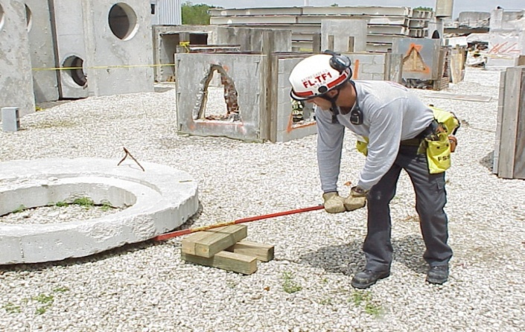
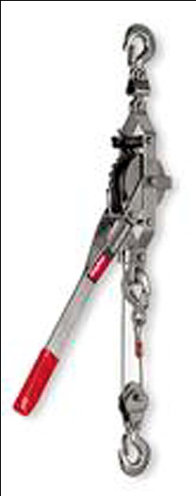
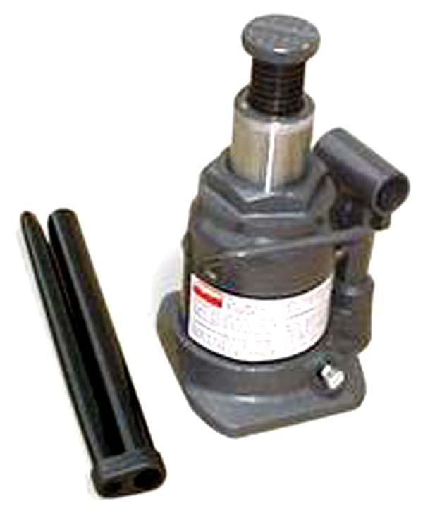
There are Three method for lifting loads, They are:
Levers Come-along
Jacks
METHODS FOR LIFTING LOADS

Slide 6
The lever is the simplest method for lifting a load . A lever is a rigid bar, either straight or bent, that is free to move on a fixed point called a fulcrum.
The fulcrum is the object or place that supports the load when a lever is used to move another object.
The Lever

Slide 7
To move a load that is too heavy to move by hand
Pulling / hauling
Raising
APPLICATIONS OF LEVERS:

Slide 8
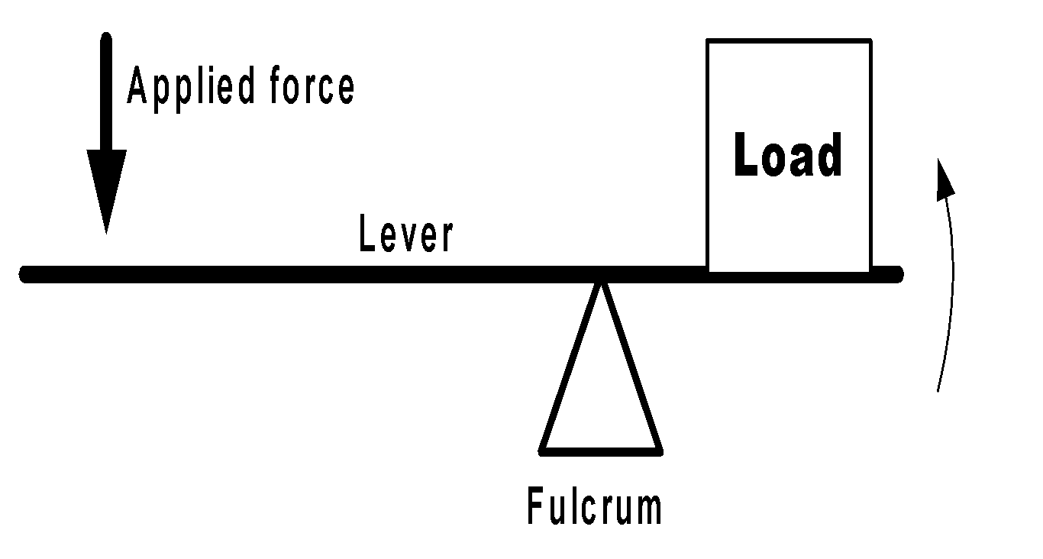
There are three components that make-up a lever:
fulcrum
Load and
force.
COMPONENTS OF A LEVER:

Slide 9
Levers are divided into three classes based on where the fulcrum is located in relation to both the load and force. They are:
▶ Class One Lever
▶ Class Two Lever
▶ Class Three Lever
Classes of Levers

Slide 10
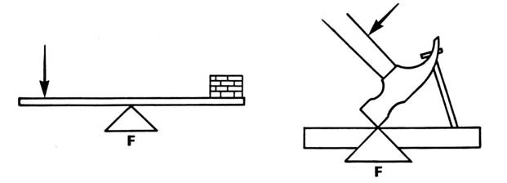
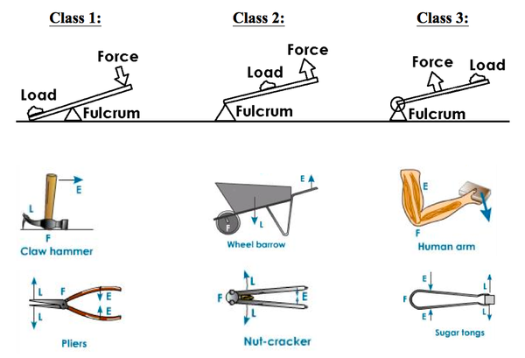
In Class One Lever The fulcrum is placed between the force and the load, which provides the greatest mechanical advantage when lifting a load vertically. You can increase the mechanical advantage by using a longer lever
CLASS ONE LEVER

Slide 11
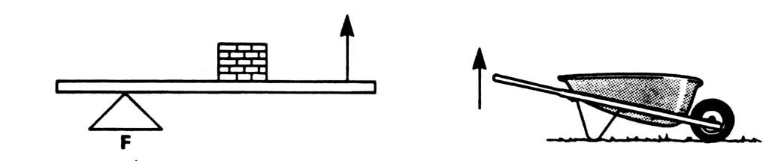
In Class Two Lever The load is placed between the force and the fulcrum. This is the most useful and efficient lever for moving objects horizontally
CLASS TWO LEVER

Slide 12
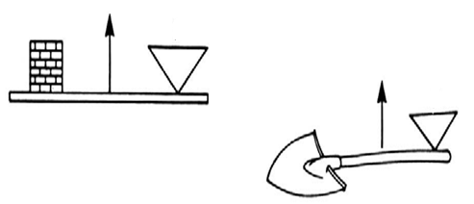
In Class Three Lever The force is placed between the load and the fulcrum. This type of lever is used when force may be sacrificed for distance, and reduces mechanical advantage.
CLASS THREE LEVER

Slide 13
The come-along provides mechanical advantage for lifting and pulling using a lever and gear ratcheting system. It consists of an anchor hook on one end and another hook attached to a retractable chain or steel cable.
THE COME-ALONG

Slide 14
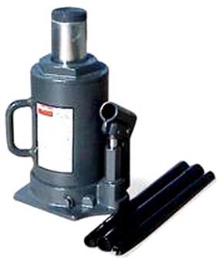
These devices are operated with a lever to apply hydraulic pressure to a ram. Hydraulic jacks are used primarily for lifting heavy loads. Though they usually have only a short reach, they are extremely powerful – a hand-operated bottle jack can lift as much as 50 tons. It is important to keep the hydraulic jack perpendicular to the ground – the jack is not designed to handle lateral loads.
HYDRAULIC JACKS

Slide 15
The construction of a stable platform using wood pieces, which is used to stabilize and support loads.
Cribbing is constructed of 10 x 10 cm - sized wood pieces arranged as a column to support the weight of an object.
CRIBBING:

Slide 16
Shims are used to fill in small spaces and secure the object in its position as it is being lifted. Shims are also used to change the angle of thrust in order to achieve optimum contact with uneven or sloping surfaces
Failure of a wood cribbing system is slow and noisy as the wood fibres are crushed.
This usually provides ample warning of impending failure for rescuers.
CRIBBING:

Slide 17
The material must be flat on both surfaces
The material must be able to withstand the weight of the object being supported.
Examples include: Furniture, bricks,
concrete blocks, tires, and rims
THE REQUIREMENTS FOR IMPROVISED CRIBBING ARE:

Slide 18
There are two types of Cribbing:
1. Box Cribbing
2. Platform (cross-tie) Cribbing
TYPES OF CRIBBING

Slide 19
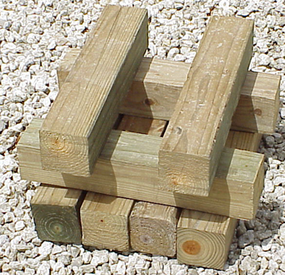
Built with wood blocks in a square configuration, using two parallel blocks per layer.
Layers are set at 90 degrees to each other with the ends of the wood blocks overlapping each other by 10 cm. The box crib has an open center.
Box Cribbing Capacity 10 cm x 10 cm beams: 11,000 kilos and15 cm x 15 cm beams: 27,000 kilos.
BOX CRIBBING

Slide 20
Built with wood blocks in solid layers of or more wood pieces each.
Layers are set 90 degrees to each other. Little or no space is left between the wood pieces. The ends of the wood pieces must also overlap each other by 10 cm
Box Cribbing Capacity 10 cm x 10 cm beams: 48,000 kilos and15 cm x 15 cm beams: 120,000 kilos.
PLATFORM (CROSS-TIE) CRIBBING

Slide 21

The first layer should be solid to fully distribute the load, especially on softer surfaces, such as soil and asphalt.
Height limit: The general rule is to limit cribbing to three times the width of the pieces of wood being used for cribbing (3:1 height-to-width ratio). example, if the pieces of wood are one meter wide from one side of the first crib to the outer side of the last crib (across), the cribbing should not exceed three meters in height.
GENERAL GUIDELINES FOR CRIBBING

Slide 22
Always overlap corners by approximately 10 cm. This prevents splitting off corners of individual pieces, which can affect overall stability
GENERAL GUIDELINES FOR CRIBBING

Slide 23
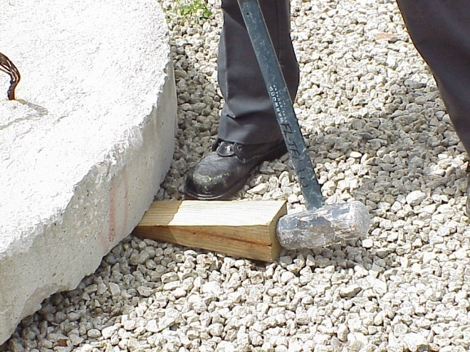
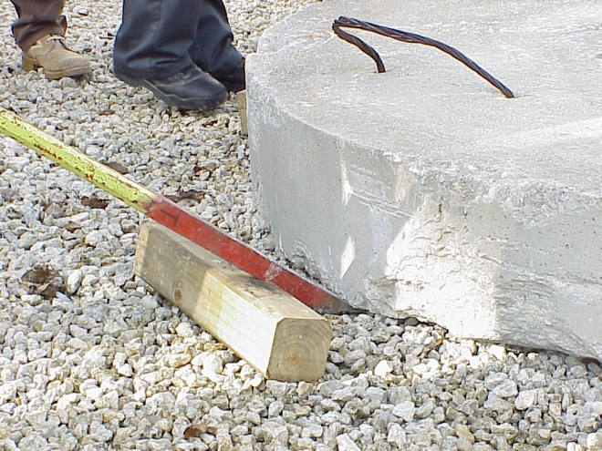
This procedure consists of gradually lifting the target object or load and inserting one layer of cribbing after another until sufficient clearance and stability are obtained. Make sure to use full PPE before starting any work.
Make an initial opening using a shims or similar tool.
Set up a lever system with the pry bar.
PROCEDURE FOR LIFTING AND STABILIZING A LOAD

Slide 24
Lift the load gradually to create an opening large enough to set up the first layer of cribbing under it. Use wedges to prop up the load gradually as you are lifting; if the pry bar slips or breaks, this will prevent the load from dropping any distance. It is not necessary to lift the full height of the next layer of cribbing all at once.
PROCEDURE FOR LIFTING AND STABILIZING A LOAD

Slide 25
Raise the fulcrum, raise the load again, and set up the next level of cribbing with the wood pieces at 90 degrees to the previous layer.
Reposition and raise the fulcrum and continue to raise the load until enough clearance is obtained to extricate the victim safely.
PROCEDURE FOR LIFTING AND STABILIZING A LOAD

Slide 26
“Lift an inch, crib an inch.”
Never place hands beneath a load while cribbing!
For maximum stability, the height cribbing should not exceed three times the width of the cribbing blocks (3:1 ratio).
SAFETY MEASURES FOR CRIBBING

Slide 27
You can use metal tubes to roll heavy loads instead of lifting them.
Follow this simple steps and seeing the picture as a guide.
Raise the load slightly using a Class One lever, just enough to slide three metal tubes underneath it (use the lifting technique for cribbing).
Using Class Two levers, push the load in the desired direction. The tubes may be fanned to turn the load as it rolls
ROLLING A LOAD

Slide 28
Now you are able to describe -
List three factors that you must determine before lifting a load.
List and describe three methods for lifting a load.
Define a lever, its three components and the three classes of a lever.
List at least three applications of the hoist.
1
2
REVIEW
3
4

Slide 29
5
List two types of cribbing used to stabilize a load.
List the five steps to build cribbing for lifting and stabilizing a load.
List the steps to roll a load using pipes.
Demonstrate in two practical stations the techniques for lifting, stabilizing and rolling loads
6
7
8

Slide 30

ANY QUESTIONs ?

Slide 31



THANK YOU

