Slide 1




COLLAPSE STRUCTURE SEARCH & RESCUE
SHORING
Presented by:- Pavan Dev Gaur, 2IC
CAPF | CSSR | INDIA
-

Slide 2


OBJECTIVES
1
Define shoring and identify its components.
List the factors that determine the design and method of shoring.
Describe four types of shoring.
Upon completing of this lesson, you will be able to :-
2
3

Slide 3
OBJECTIVES
List the positions and functions of the members of a shoring team.
List the procedures for building a window/door shore and a vertical shore. Demonstrate these procedures in a practical exercise
4
Upon completing of this lesson, you will be able to :-
5

Slide 4
SHORING
The temporary support of only that part of a damaged, collapsed, or partly collapsed structure that is required for conducting search and/or rescue operations at reduced risk to the victims and rescue team.

Slide 5
SHORING
Shoring can also be applied to the following:
Structures with severely damaged panels
Structures with loose pieces of concrete
Cracked or broken pre-fabricated panels
Cracked masonry walls

Slide 6
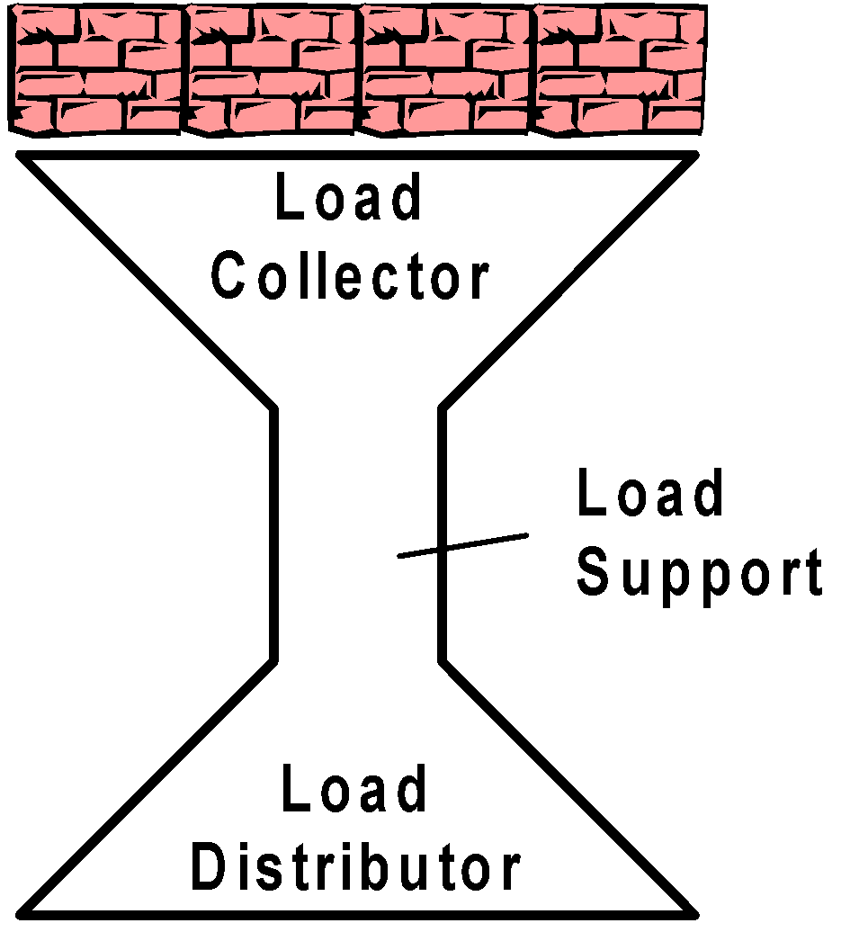
SHORING
Shoring follows a Double-Funnel Principle, which means that a shore collects a load, channels it and redistributes it safely to another surface or structure that can support it.
Double-funnel Principle

Slide 7
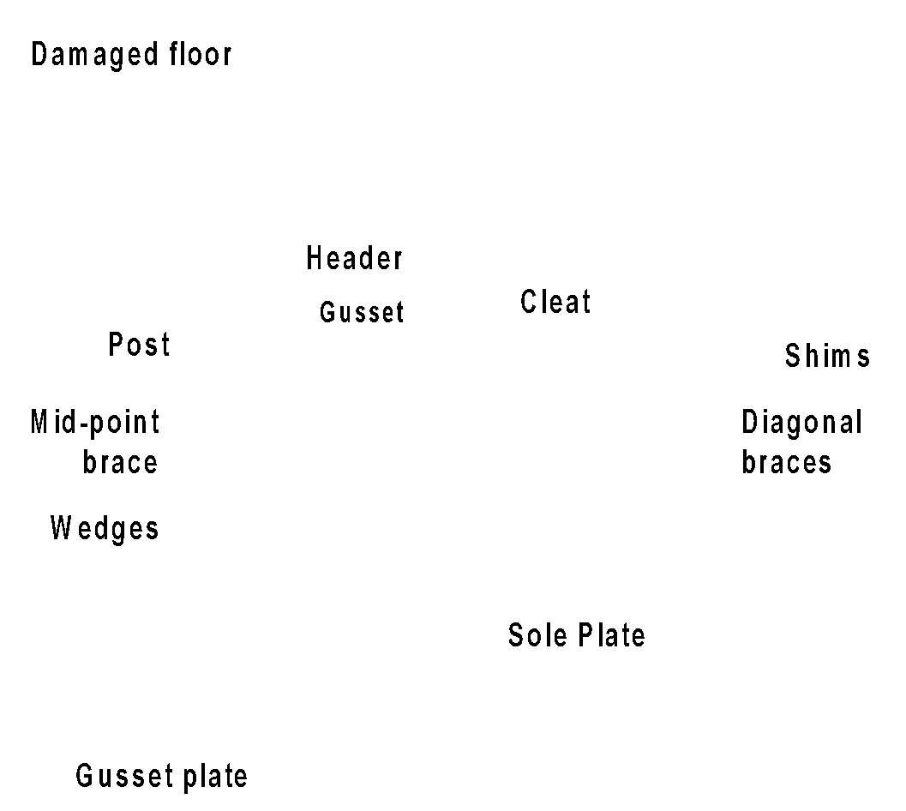
COMPONENTS OF A SHORE
1.Sole plate.
2. Header beam.
3. Post.
4. Diagonal bracing.
5. Gusset plate.
6. Wedges/shims.

Slide 8
COMPONENTS OF A SHORE
Sole plate: provides a foundation for the shoring system by supporting the weight being transferred from above and distributes it over a wider area.
Header beam: collects the weight from above and spreads it throughout the shoring system

Slide 9
COMPONENTS OF A SHORE
Post: supports the weight collected by the header and transfers it to the sole plate where it is distributed.
Diagonal bracing: locks the entire shoring system together as one unit, supporting against possible eccentric loads. It is the last component to be installed.

Slide 10
COMPONENTS OF A SHORE
Gusset plate: a small piece of 13 mm or 18 mm plywood nailed to the top and buttom of posts to aid in placement of the header and secures the posts to the header and sole plate.
Wedges/shims: Two wooden inclined planes married together and placed under the bottom of the posts. These provide compression for the shoring system. The shim is a single wedge used to fill in gaps above the shoring system.

Slide 11
COMPONENTS OF A SHORE
Cleat: A 5 cm x 10 cm wooden piece nailed to the post and header or sole plate to secure the shoring; small pieces of wood used to secure other parts of a shoring system. A cleat should be 30 cm long or they will tend to split.

Slide 12
DETERMINING FACTORS
A variety of factors will determine what
method of shoring is required in a particular situation.
Weight of construction materials
Weight of the structural elements to be supported
The normal load capacity of the existing undamaged structure

Slide 13
DETERMINING FACTORS
Condition of the structure to be supported
Condition of the foundation and floor/surface angle to determine stability of shoring
Availability of shoring materials
Lateral and vertical instability

Slide 14
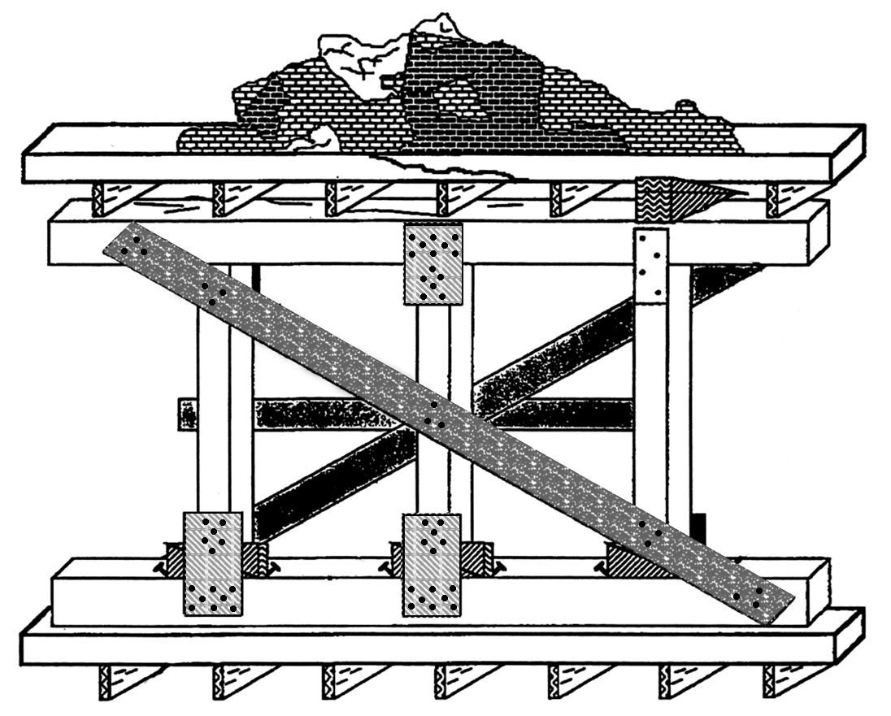
TYPES OF SHORING
Vertical Shoring
The main purpose of the vertical shore is to stabilise damaged floors, ceilings or roofs. It can also be used to replace missing or unstable bearing walls or columns
Vertical Shore

Slide 15
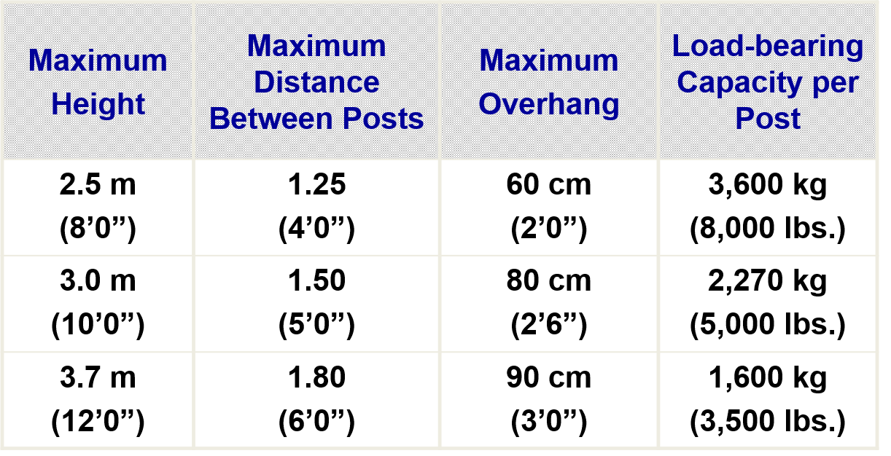
VERTICAL SHORE SPECIFICATIONS
WITH 10X10 CM POST, HEADER AND SOLE PLATE

Slide 16
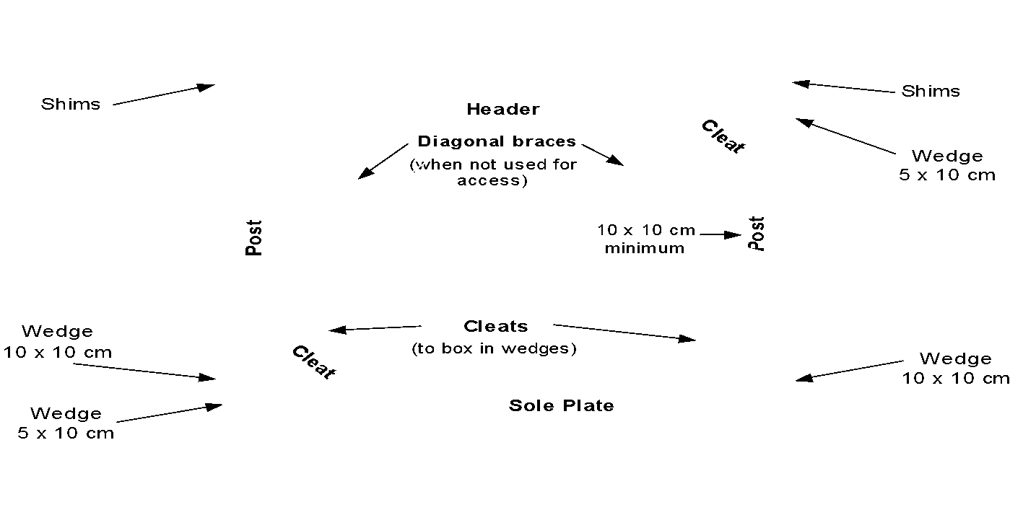
TYPES OF SHORING
2. Window/Door Shoring
This type of shore supports a window or door that is in danger of collapse. Diagonal braces are only used when the opening is not needed for access or egress.

Slide 17
TYPES OF SHORING
3. Other Types of Shoring
Several additional types of shores can be used in collapsed structures, though they will not be taught in this course. Your reference material discusses them in further detail. Some examples include:.

Slide 18
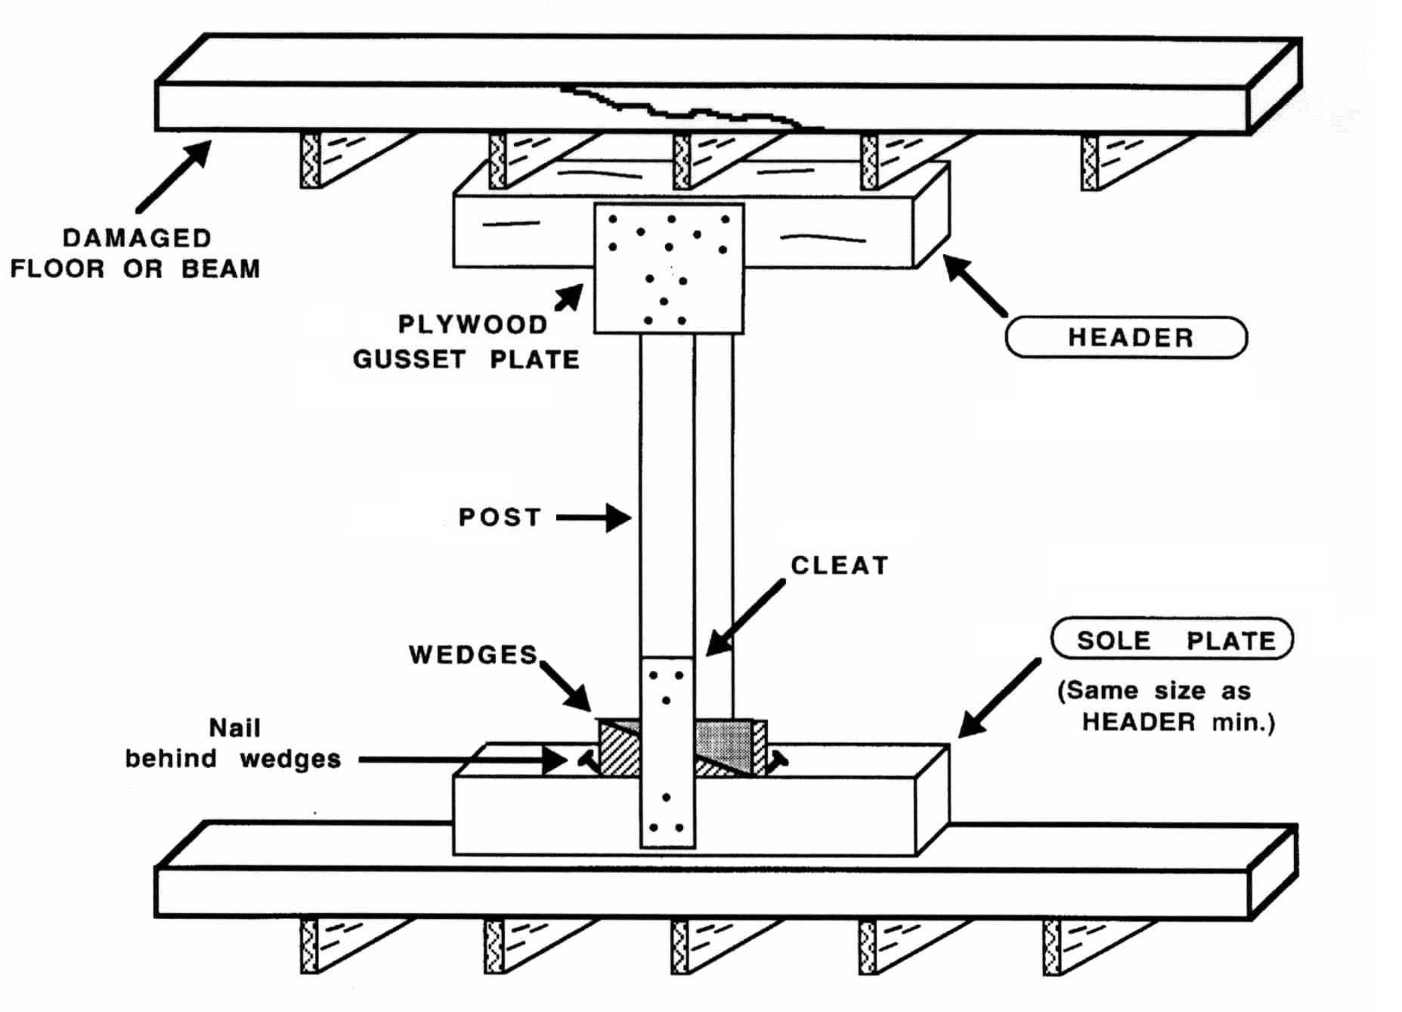
OTHER TYPES OF SHORING
i. T-Spot Shore:
The main purpose of the T-shore is to initially stabilize damaged floors, ceilings or roofs, so that the more substantial shoring can be constructed at less risk. This shore is quickly placed and only temporary, also used during quick extrication of a victim

Slide 19
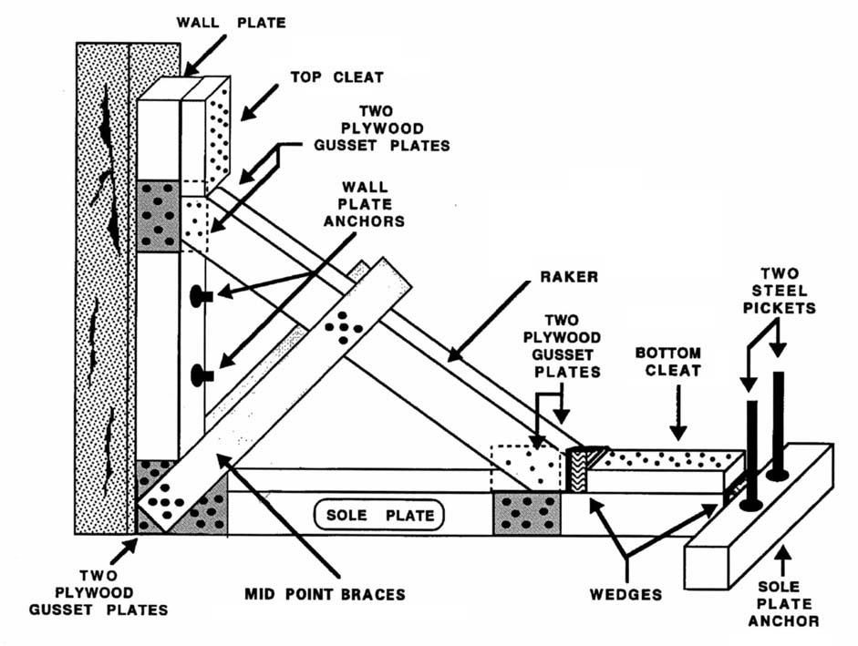
OTHER TYPES OF SHORING
ii. Raker Shore:
A triangular system of shoring used to support leaning or unstable walls or columns. Rakers must always be installed in series; at least two must be erected in any given situation

Slide 20
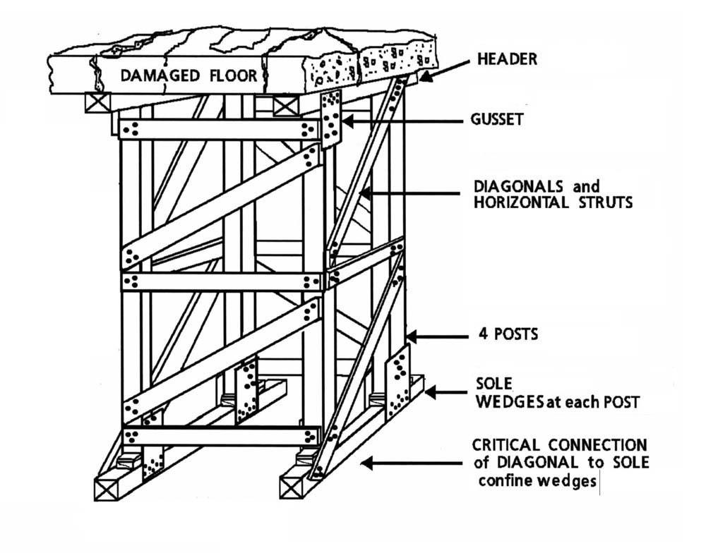
OTHER TYPES OF SHORING
iii. Laced Post Shore:
A high-capacity, four-post system that is used to support sagging floors and ceilings, or other overhead hazards. It can be used as a safe haven.

Slide 21
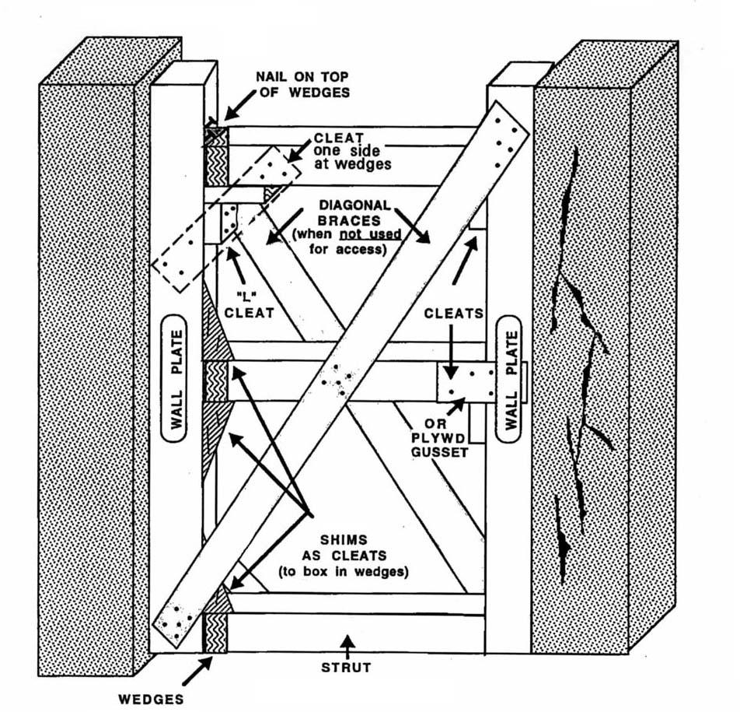
OTHER TYPES OF SHORING
iii. Horizontal Shore :
Used to stabilize a damaged wall against another undamaged wall in hallways, corridors or between buildings.

Slide 22
OTHER TYPES OF SHORING
iv. Improvise shoring :
Sometimes people have to improvise shoring methods, as dictated by the availability of materials. A building shored with bamboo is shown in the pictures.

Slide 23
MEMBERS AND FUNCTIONS OF A SHORING TEAM
If sufficient manpower were available, a shoring team could be organized using two separate 6person squads,
one squad as an assembly team and another as a cutting team.
However, a single squad may be required to perform both sets of duties.

Slide 24
MEMBERS AND FUNCTIONS OF A SHORING TEAM
Assembly Group
Perform actual shoring size up and construction of shore. Whenever possible, the members of the Assembly Group should be assigned the following functions:

Slide 25
Members and Functions of a Shoring Team
Assembly Group
Shoring Officer (Rescue Squad Officer): is in charge of the operation. Also works with structural specialists (if available) to determine where to place shores. If a Safety cannot be designated, the Shoring Officer will also take on this role.
Measurer: measures all shoring components and relays the information to the layout person of the cutting team.
Two Shorers: these work together assembling and erecting shores in place.

Slide 26
Assembly Group
Safety: responsible for overall safety of the assembly team.
Runner: Ensures tools, equipment and shoring materials are moved from the shoring operation primary access point to the shoring site and assists in the erection of shores as needed.
Members and Functions of a Shoring Team

Slide 27
Members and Functions of a Shoring Team
Cutting Group
Establish the equipment area and cut the shoring lumber. Whenever possible, the members of the Cutting Group should be assigned the following functions:

Slide 28
Members and Functions of a Shoring Team
Cutting Group
Cutting Group Officer (Rescue Squad Officer): in charge of selecting the cutting site. The site should be close to the shoring operation. The Cutting Team Officer doubles as the Safety.
Layout: sets up the cutting station and records measurements. Performs all measuring and layout of angles.
Feeder: moves and feeds measured and marked shoring material from the Layout to the Cutter and helps secure it during cutting.

Slide 29
Cutting Group
Members and Functions of a Shoring Team
Cutter: cuts the measured materials.
Tools and equipment person: directs where materials and equipment are to be placed and moved, and is responsible for keeping track of all tools. This person is assigned to both the Cutting Group and the Assembly Group.
Runner: ensures tools, equipment and shoring materials are moved from the cutting area to the shoring operation primary access point..

Slide 30

Members and Functions of a Shoring Team
Cutting Group
Cutter: cuts the measured materials.
Tools and equipment person: directs where materials and equipment are to be placed and moved, and is responsible for keeping track of all tools. This person is assigned to both the Cutting Group and the Assembly Group.
Runner: ensures tools, equipment and shoring materials are moved from the cutting area to the shoring operation primary access point..

Slide 31
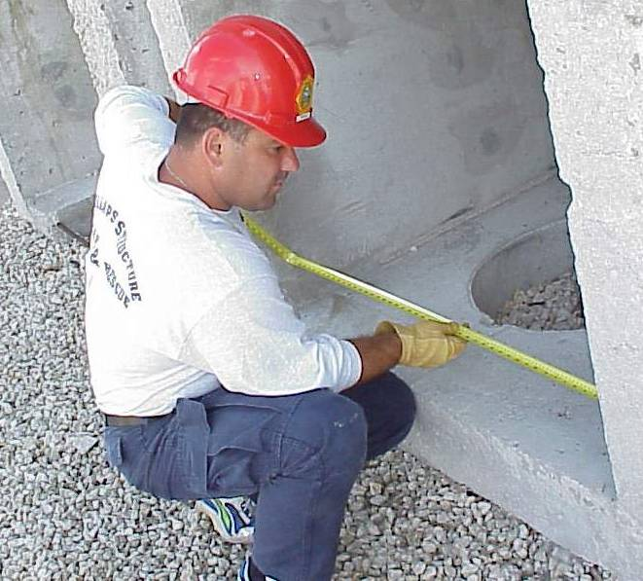
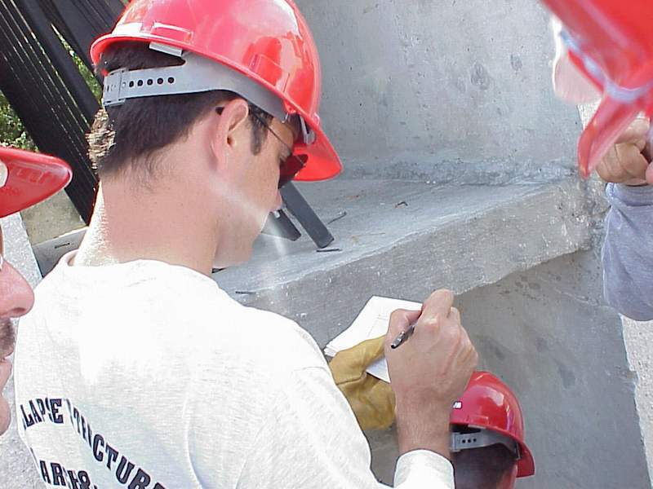
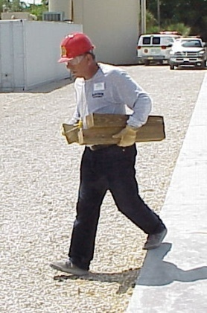
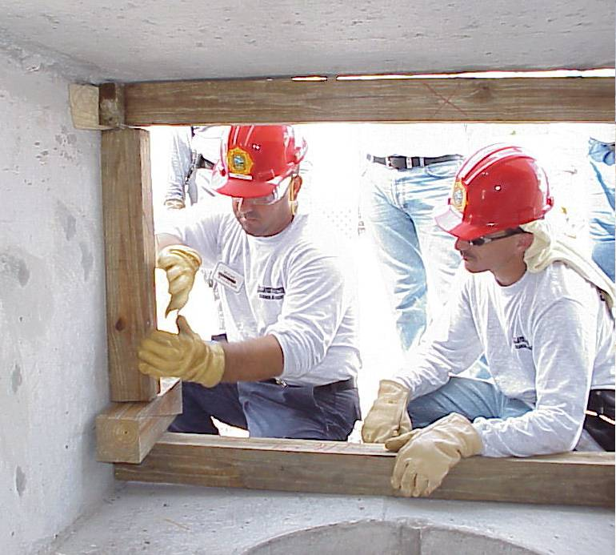
Assembly Group
Members and Functions of a Shoring Team
Shoring Officer
Measurer
Shorers
Safety
Runner

Slide 32
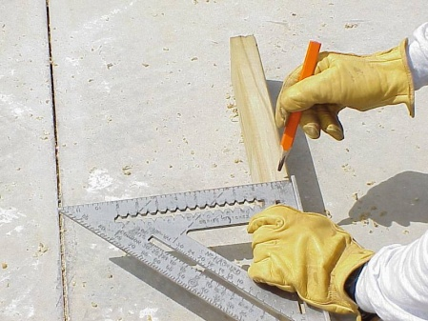
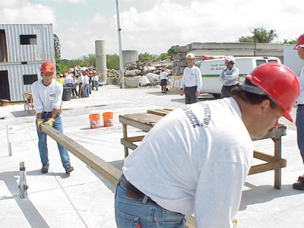
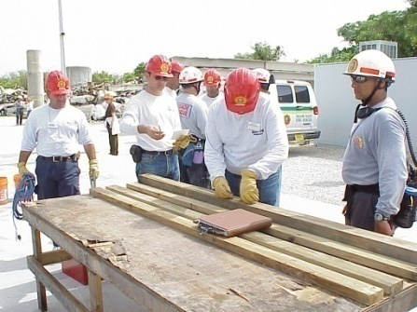
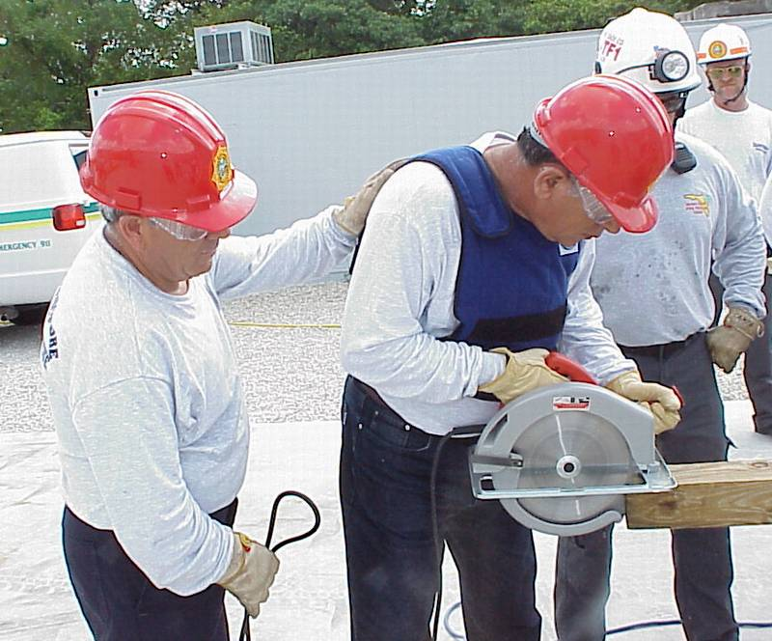
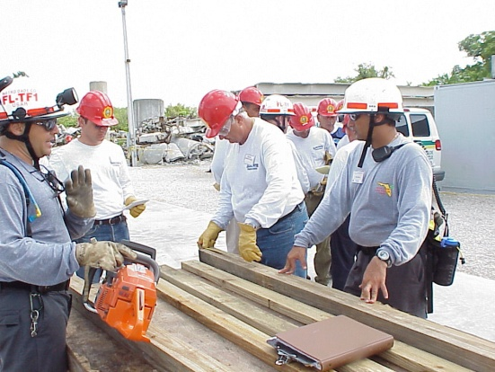
Members and Functions of a Shoring Team
Cutting Group
Cutting Officer
Layout
Runner
Feeder
Tools/Equipment
Cutter
Note: This person is assigned to both the Cutting Group and the Assembly Group.

Slide 33
NAIL SPECIFICATIONS
For the CSSR Course, duplex/common (double-headed) nails of two sizes will be used. Using these nails makes disassembly easier. However, under actual rescue conditions, common nails of a similar size can be used. All plywood (gusset plates) must be nailed using 8d common nails only

Slide 34
NAIL SPECIFICATIONS
All plywood (gusset plates) must be nailed using 8d nails only.
8d nail, approximately actual size (6.5 cm.)
All dimensional wood must be nailed using 16d nails only.
16d nail, approximately actual size (9 cm.)

Slide 35

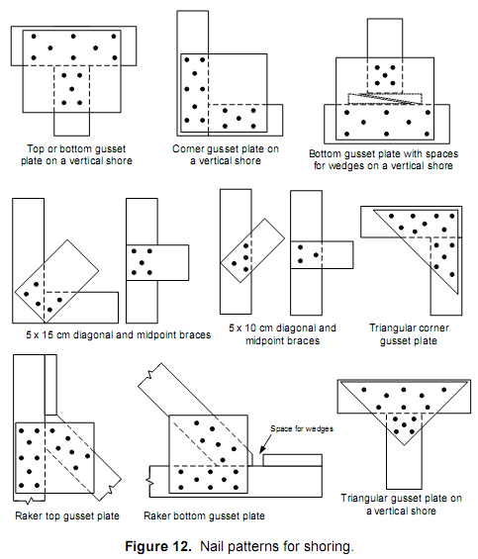
The following diagrams show the correct nailing patterns that should be used when shoring:

Slide 36
BUILDING SHORES (TWO TYPES)
Vertical Shore
The two sizes of lumber most commonly used in vertical shoring are 10 x 10 cm and 15 x 15 cm. The estimated weight of the floor and its contents will help to determine the size of shoring materials and their spacing.
Businesses and commercial occupancies with heavier structural elements and greater floor height and/ or loading may require 20 x 20 cm or even 30 x 30 cm lumber. The Structural Specialist should be used to help determine the correct size and placement of shoring materials

Slide 37
BUILDING SHORES(TWO TYPES)
Vertical Shore
STEP 1
Determine where to erect the vertical shore.
After installing initial temporary shoring as needed, clear the area of debris, down to the floor, removing thick carpeting if necessary. A clearance of approximately one meter wide is usually adequate.
If the vertical shore is to bear directly on soil, examine the ground for stability. If the earth is soft, you should install additional supports under the sole plate to transfer the load over a wider area.

Slide 38
Building Shores (Two Types)
Vertical Shore
STEP 2
Measure and cut sole plate and header.
Lay the sole plate on the floor or ground directly under and in line where the header will be installed.
The sole plate should be as level as possible.

Slide 39
BUILDING SHORES (TWO TYPES)
Vertical Shore
STEP 3
Measure and cut the posts to the proper height.
Place the header on top of the sole plate.
With the end of the tape measure on top of the header where the posts are to be installed, slide the tape up to the bottom of the structural element to be shored. Measure in at least three places deducting the width of the wedges to be used and use the shortest measurement..

Slide 40
BUILDING SHORES (TWO TYPES)
Vertical Shore
STEP 4
Attach cleats or gusset plates to the header and posts, on opposite ends and opposing sides.
The posts should be at least 30 cm, but less than 60 cm from each end of the header.
This will allow the diagonal braces to be attached directly to the header, posts, and sole plate.

Slide 41
Vertical Shore
BUILDING SHORES (TWO TYPES)
STEP 5
Install the posts and the header on top of the sole plate to support the damaged structural element.
The first two posts are installed at opposite ends at least 30 cm, but less than 60 cm from each end of the sole plate.
Keep the posts in line and plumb with header and sole plate.
Shim the structural elements down to the header to keep it as level as possible.

Slide 42
BUILDING SHORES (TWO TYPES)
Vertical Shore
STEP 6
Install a set of wedges under the bottom of each post.
Tap them together simultaneously until the posts are under compression and tight.
Nail behind the wedges to secure them in place.

Slide 43
Vertical Shore
BUILDING SHORES (TWO TYPES)
STEP 7
Attach cleats or gusset plates on opposite ends and opposing sides of the sole plate and posts and nail in place
STEP 8
Attach the diagonal braces to each side of the vertical shore.
Mid-point braces, when needed, should be installed prior to the diagonal braces (except when 5 cm material is used, and then the mid-point braces are placed over the diagonals)

Slide 44
BUILDING SHORES (TWO TYPES)
Vertical Shore
STEP 8
The diagonal braces should be long enough to span its entire length and be attached to the sole plate and header and each post.
If possible, diagonal braces should be installed in an X-pattern on opposite sides of the system.
Vertical shoring systems that span a long area may require several sets of diagonal braces to connect multiple posts

Slide 45
BUILDING SHORES (TWO TYPES)
Vertical Shore
STEP 9
Secure the wedges with each other using a duplex nail. Never drive the nail completely.

Slide 46
BUILDING SHORES (TWO TYPES)
Window/Door Shore
The window and door shore is usually installed in entry points intended for use by rescue personnel to hold up or stabilize loose headers or lintels that have lost their integrity.
Additional load stress is usually exerted from above and therefore, constructed similar to the vertical shore. If additional load stress is exerted from the side, the window and door shore is constructed similar to the horizontal shore.

Slide 47
BUILDING SHORES (TWO TYPES)
Window/Door Shore
STEP 1
Determine where to erect the window/door shore.
After initial temporary shoring has been installed, clear the area of debris or remaining framing material.
STEP 2
Measure and cut the sole plate to the proper length deducting the width of the wedges to be used

Slide 48
Window/Door Shore
BUILDING SHORES (TWO TYPES)
STEP 3
Measure and cut the header to the proper length deducting the width of the wedges to be used.
Prefabricate a built-up header, if required (see end of procedure).

Slide 49
Window/Door Shore
BUILDING SHORES (TWO TYPES)
STEP 4
Measure and cut the posts to the proper height.
Place the header on top of the sole plate.
With the end of the tape measure on top of the header where the posts are to be installed, slide the tape up to the bottom of the structural element to be shored on both sides deducting the width of the wedges to be used.
If you get two different measurements, use the shorter of the two.

Slide 50
BUILDING SHORES (TWO TYPES)
Window/Door Shore
STEP 5
Install the sole plate with a set of wedges at one end and tap them together simultaneously until the sole plate is under compression and tight.
The sole plate should be as level as possible, using shims as necessary under the sole plate.

Slide 51
Window/Door Shore
BUILDING SHORES (TWO TYPES)
STEP 6
Install the header with a set of wedges at the opposite end of the sole plate and tap them together simultaneously until the header is under compression and tight.
The header should be as level as possible, use shims as necessary above the header.

Slide 52
BUILDING SHORES (TWO TYPES)
Window/Door Shore
STEP 7
Install the posts between the header and sole plate and against the sides of the opening.
Install the first post under the wedge-side of the header to prevent accidental movement if the header wedges loosen up.

Slide 53
Window/Door Shore
STEP 7
Keep the posts in-line and plumb with the header and sole plate.
Install a set of wedges under each post, on top of the sole plate. Then tighten the wedges to lock the shore in place.

Slide 54
BUILDING SHORES (TWO TYPES)
Window/Door Shore
STEP 8
Attach cleats or gusset plates to at least one side of the header and posts and nail in place.

Slide 55
BUILDING SHORES (TWO TYPES)
Window/Door Shore
STEP 9
Confine the wedges by placing a cleat against the inside face of each post at the bottom and nail them in place with five 16d nails to each post and two 16d toe-nails to the sole plate.
Future adjustment of the wedges may be required. Duplex nails can be used to allow for this.

Slide 56
Window/DoorShore
BUILDING SHORES (TWO TYPES)
STEP 10
Install diagonal braces on the window and door shore when the opening is not used for access or egress.

Slide 57
BUILT-UP HEADER
A built-up header is used when additional support is needed or if the opening is more than 1.8 metres wide and only 10 x 10 cm material is available.
Prior to installation of the header, cut two 10 x 10 cm beams to proper length for header and set them one on top of the other. Place 15 cm-wide plywood strips (same length as the headers) on each side to join the two pieces, and hammer 8d nails at 8 cm on-centre from each strip of plywood to each 10 x 10 beam.

Slide 58
BUILT-UP HEADER
Total nailing will be two rows of 8d nails spaced at 8 cm on-centre, per side.
The header will be 20 cm thick, equivalent to a 10 x 20 cm beam

Slide 59
REVIEW
1
Define shoring and identify its components.
List the factors that determine the design and method of shoring.
Describe four types of shoring.
Upon completing of this lesson, you are able to :-
2
3

Slide 60
REVIEW
List the positions and functions of the members of a shoring team.
List the procedures for building a window/door shore and a vertical shore. Demonstrate these procedures in a practical exercise
4
Upon completing of this lesson, you are able to :-
5

Slide 61
ANY QUESTIONS?

Slide 62



THANK YOU

