Slide 1




COLLAPSE STRUCTURE SEARCH & RESCUE
RESCUE STRATEGIES
AND TECHNIQUES
Presented by:- Pavan Dev Gaur, 2IC
CAPF CSSR| INDIA
-

Slide 2


OBJECTIVE
Upon completing of this lesson, you will be able to :-
Describe the two ways of approaching a located trapped victim.
List the four techniques for accessing and rescuing a victim.
List the five factors to analyze when evaluating access conditions.
1
2
3

Slide 3
Describe the procedures for penetrating five different materials: wood, metal, concrete, brick and cinder block.
Demonstrate in a practical exercise the procedure for cutting and penetrating the five materials listed above, correctly using the required TEA.
List the steps for removing rubble.
4
5
6

Slide 4
APPROACH STRATEGIES
Approach Strategies Once the search has ended and the trapped victim has been located, it is then necessary to make a decision on how to approach the victim.
There are two type of Approach
Vertical Approach
Horizontal Approach

Slide 5
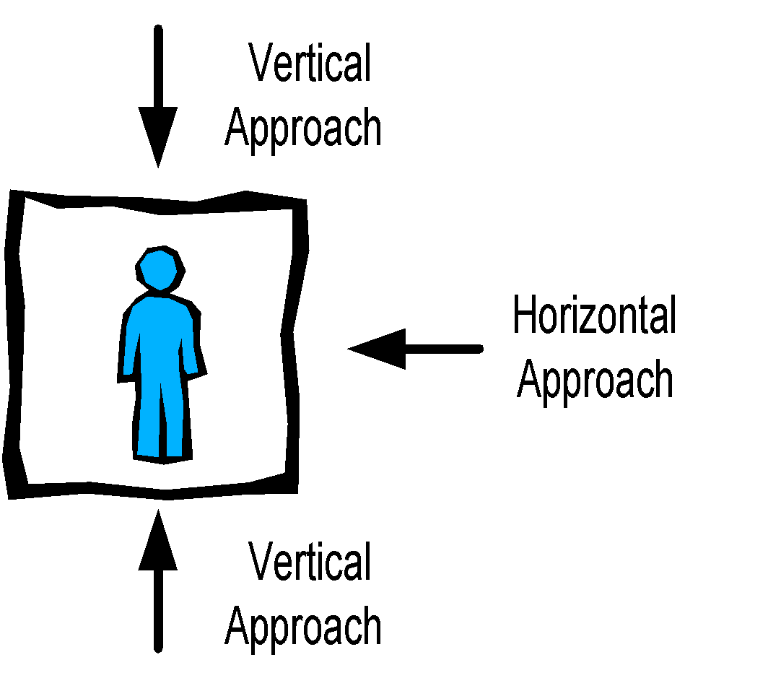
APPROACH STRATEGIES

Slide 6
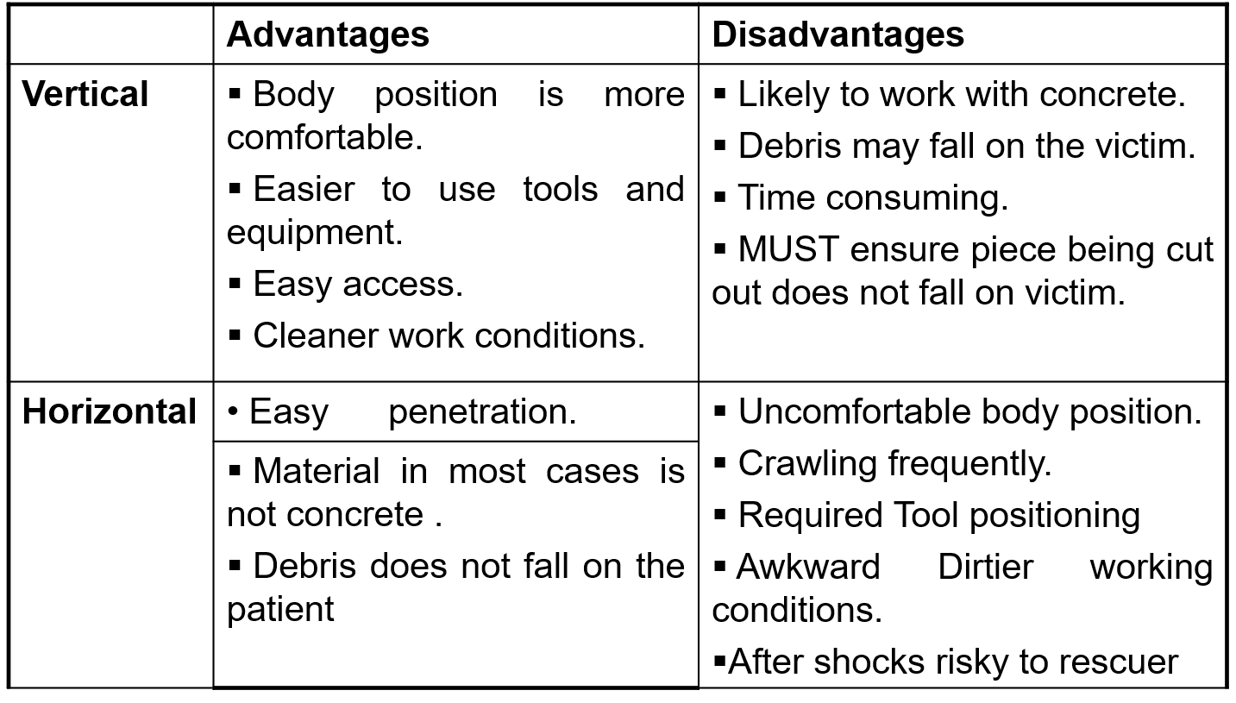
APPROACH STRATEGIES

Slide 7
ACCESS AND RESCUE TECHNIQUES
Removing rubble
Shoring
Cutting and penetrating
Lifting and stabilizing loads

Slide 8
EVALUATING ACCESS CONDITIONS
At this point, the search has been conducted and victims located. Now the focus is to analyses access points to make sure the route is safe for victim extrication efforts to begin.
The following five steps must also be taken:

Slide 9
EVALUATING ACCESS CONDITIONS
1.Ensure utilities are cut off.
Water lines
Gas pipes
Electrical system
Air conditioning system
2.Proceed to victim marking location.

Slide 10
EVALUATING ACCESS CONDITIONS
3.Mitigate hazards.
Shoring
4.Establish safety zones and escape routes.
5.Secure your access area and remove rubble.

Slide 11
REMOVING RUBBLE
When victims are trapped near the surface of a collapsed structure, you will need to remove the rubble surrounding them in order to extricate them. It is very important to be very methodical and work gradually when removing rubble.
Use the following procedure:

Slide 12
REMOVING RUBBLE
Determine the manner in which the building collapsed and verify the condition of its components.
Remove small pieces first and only large pieces that may be loose. Never remove any pieces that are under pressure or wedged in place.
Caution: Be careful not to move pieces that may affect the stability of the structure or rubble pile. When in doubt, consult a structural engineer

Slide 13
REMOVING RUBBLE
To remove pieces that are under pressure it may be necessary to shore first.
Avoid cutting into load-bearing walls.
Note: Simple methods such as a bucket brigade may be very effective for removing rubble.

Slide 14
PROCEDURES FOR CUTTING AND PENETRATING MATERIALS
When breaching a wall or floor, always be aware that a trapped victim may be in direct contact with the other side of the material you are cutting through. Therefore, you must use extreme caution when cutting and penetrating to avoid accidentally injuring the person you are trying to save. Additionally avoid cutting too deeply to prevent damaging structural elements, wires, water pipes, etc.

Slide 15
PROCEDURES FOR CUTTING AND PENETRATING MATERIALS
To properly select a tool for a task, you should have a good understanding of the capabilities and limitations of the tools available to you. You must always work within the capabilities of the tool and use it properly.

Slide 16
CUTTING AND PENETRATING METAL AND WOOD
Several tools and pieces of equipment are used in cutting and penetrating metal and wood:
Tools for Cutting Wood
Axe
Hatchet
Hand saw
Chainsaw
Power drill or hand drill
Circular saw
Reciprocating saw
Rotary rescue saw

Slide 17
CUTTING AND PENETRATING METAL AND WOOD
Tools for Cutting Metal
Tin snips
Bolt cutters
Hacksaw
Reciprocating saw
File
Power drill
Rotary rescue saw
Circular saw (with metal-cutting blade)
Air chisel
Acetylene torch

Slide 18
PROCEDURE FOR CUTTING METAL AND WOOD
Use full PPE.
Select the proper tool.
Make the work area is free of hazards.
Knock on the metal or wood to find a hollow area.
Make an inspection hole. Use caution when breaking through the other side.

Slide 19
PROCEDURE FOR CUTTING METAL AND WOOD
Cut a triangular access hole, large enough to permit access. Additionally avoid cutting too deeply.
Remove the piece you have cut. Protect against any sharp edges by filing, covering them, or bending the metal back.
Shore if necessary

Slide 20
CUTTING AND PENETRATING CONCRETE BLOCK AND BRICK
The procedure discussed in this section refers to vertical walls that are still in or close to their original position. Penetration is horizontal. Other techniques would be used for these materials when collapsed or in a horizontal position.
A word of caution: It is best to avoid cutting through walls. Breaching through unreinforced masonry (URM) walls may cause additional collapse or building instability. Instead, you should look for existing natural or created horizontal openings.

Slide 21
CUTTING AND PENETRATING CONCRETE BLOCK AND BRICK
Tools for Cutting Brick and Concrete Block
Large and small sledgehammer
Chisel
Pick
Pry bar or crowbar
Chipping hammer
Impact hammer
Impact drill
Rotary hammer drill
Rotary rescue saw

Slide 22
PROCEDURE FOR CUTTING AND PENETRATING CONCRETE BLOCK AND BRICK
Use full PPE.
Select the proper TEA.
Make the work area is free of hazards.
Make an inspection hole. Use caution when breaking through the other side.

Slide 23
PROCEDURE FOR CUTTING AND PENETRATING CONCRETE BLOCK AND BRICK
Break into the block or brick, cutting a triangular hole, starting at the bottom (base of triangle). Additionally avoid cutting too deeply. With concrete block, first break into the hollow area (cell), which is weaker. With bricks, first break into the mortar between the bricks.

Slide 24
PROCEDURE FOR CUTTING AND PENETRATING CONCRETE BLOCK AND BRICK
Remove the broken pieces. Always move the pieces out of the hole; do not push them in.
Shore if necessary

Slide 25
CUTTING AND PENETRATING REINFORCED CONCRETE
Tools for Cutting Reinforced Concrete
Large and small sledgehammer
Chisel
Pick
Pry bar or crowbar
Chipping hammer
Impact hammer
Impact drill
Rotary hammer drill

Slide 26
CUTTING AND PENETRATING REINFORCED CONCRETE
For cutting steel reinforcements:
Reciprocating saw
Hacksaw
Bolt-cutter
Acetylene torch

Slide 27
PROCEDURE FOR CUTTING AND PENETRATING REINFORCED CONCRETE
Cable reinforcements need to be identified early to ensure the rescue team can recognise the difference between cables and rebar. Cutting pre-tensioned cables can result in the immediate failure of the slab or structural member. Generally, rescue teams should not cut tensioned cable or should cut them only under the direction of a structural engineer.

Slide 28
PROCEDURE FOR CUTTING AND PENETRATING REINFORCED CONCRETE
Use full PPE.
Select the proper tool.
Make sure the work area is free of hazards.
If possible, make a inspection hole. Use caution when breaking through the other side.

Slide 29
PROCEDURE FOR CUTTING AND PENETRATING REINFORCED CONCRETE
5. Horizontal approach:
Your goal is to cut a triangular
hole in the concrete.
Make the two upper cuts at a slight angle off perpendicular (80-85 degrees). This will prevent the cut portion from falling inward, where it could potentially injure a victim.

Slide 30
PROCEDURE FOR CUTTING AND PENETRATING REINFORCED CONCRETE
5. Horizontal approach:
If the concrete is thicker than the depth of the saw blade, begin chiselling and remove pieces, starting from the bottom (base) and working upward

Slide 31
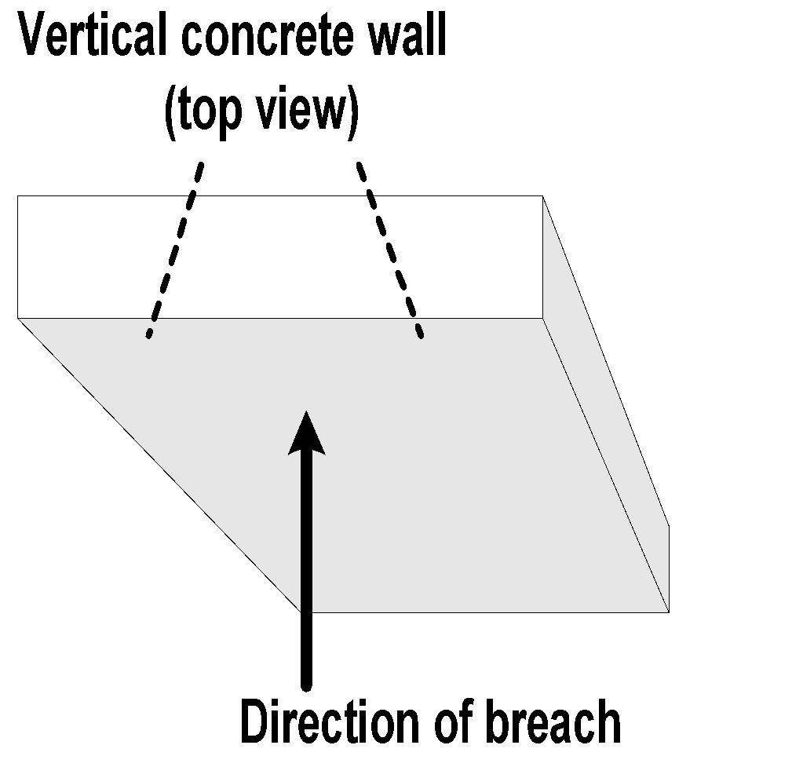
PROCEDURE FOR CUTTING AND PENETRATING REINFORCED CONCRETE
5. Vertical approach: Your goal is to
cut a square/ rectangular hole in
the concrete.
Make a small hole in the centre of the piece you will be cutting out, that you will use to lift the cut portion.
Cut two opposing sides of the square at a slight angle off perpendicular
(70-80 degrees). This will later prevent the cut portion from falling downward.

Slide 32
PROCEDURE FOR CUTTING AND PENETRATING REINFORCED CONCRETE
6. Vertical approach:
Complete the square by cutting the remaining two sides in a normal perpendicular fashion.
6.4 Then lift out the piece using the hole in the center. If the concrete is thicker than the depth of the saw blade, you will need to chisel and remove pieces.

Slide 33
PROCEDURE FOR CUTTING AND PENETRATING REINFORCED CONCRETE
7. Cutting reinforcements: A different approach is required when encountering reinforced concrete with steel rebar or stranded cable. Loosen the concrete around the rebar to make room for tools. Then you can use a reciprocating saw, bolt cutters, rebar cutters or a torch to cut the individual bars away. If for any reason it becomes necessary to cut cables, you should use a torch to cut one strand at a time to allow for slow de tensioning.
8. Shore if necessary

Slide 34
REVIEW
Upon completing of this lesson, you are able to :-
1
Describe the two ways of approaching a located trapped victim.
List the four techniques for accessing and rescuing a victim.
List the five factors to analyse when evaluating access conditions.
2
3

Slide 35
Describe the procedures for penetrating five different materials: wood, metal, concrete, brick and cinder block.
Demonstrate in a practical exercise the procedure for cutting and penetrating the five materials listed above, correctly using the required TEA.
List the steps for removing rubble.
4
5
6

Slide 36



Any question ?

Slide 37

THANK YOU

