Slide 1




COLLAPSE STRUCTURE SEARCH & RESCUE
TOOLS, EQUIPMENT AND
ACCESSORIES
Presented by:- Pavan Dev Gaur, 2IC
CAPF | CSSR| INDIA
-

Slide 2

OBJECTIVES
1
Define tools, equipment and accessories (TEA).
List four categories of TEA according to their use.
List five power sources for equipment and tools.
Upon completing of this lesson, you will be able to :-
2
3

Slide 3
List the general steps for use and maintenance of tools and equipment (before, during and after their use).
Demonstrate in four practical exercises the correct use of TEA.
OBJECTIVES
4
5

Slide 4
TOOLS
A TOOL IS A DEVICE THAT IS USED TO PERFORM OR FACILITATE MANUAL OR MECHANICAL WORK, USING ONLY THE STRENGTH OF THE OPERATOR.
Examples:
Crow Hammer
Pick Mattock
Hack Saw

Slide 5
A piece of equipment is a machine or device that performs a physical task, whose operation depends on an external power source in order to increase work capacity.
EQUIPMENT
Examples:
Chain Saw
Chipping Hammer
Electric Drill

Slide 6
An accessory is a component that supplements or completes a tool or piece of equipment, and which increases the operator’s ability to perform a task.
ACCESSORIES
Examples:
Drill Bit
Hack Saw Blade
Hack Saw Blade

Slide 7
1.Search TEA
Search tools, equipment and accessories are used in searching for potentially trapped victims and locating them in collapsed structures.
They can be used individually or in conjunction with each other.
CLASSIFYING TOOLS, EQUIPMENT AND ACCESSORIES ACCORDING TO THEIR USE

Slide 8
CLASSIFYING TOOLS, EQUIPMENT AND ACCESSORIES ACCORDING TO THEIR USE
2.Rescue TEA
Rescue tools, equipment and accessories are those used to penetrate a structure and gain access to a victim in a CSSR operation.

Slide 9
CLASSIFYING TOOLS, EQUIPMENT AND ACCESSORIES ACCORDING TO THEIR USE
3.Operations Support Equpt. and Accessories
This category includes all items and devices used to aid in conducting a CSSR operation and which support rescue activities.

Slide 10
4. Personal Protective Equipment
Personal Protective Equipment Personal protective equipment (PPE) is required in order to prevent injury while working on a CSSR operation. Some basic PPE items are:
CLASSIFYING TOOLS, EQUIPMENT AND ACCESSORIES ACCORDING TO THEIR USE

Slide 11
CLASSIFYING TOOLS AND EQUIPMENT ACCORDING TO POWER SOURCE
1.Electrically-powered
Electric tools and equipment are used to cut, penetrate and break materials. Examples: circular saws, electric drills

Slide 12
2.Pneumatic (Air-Powered)
Pneumatic tools and equipment use pressurized air to cut, hammer and lift. They can be powered by a motor-driven compressor or pressurized air cylinders.
Examples: pneumatic cutters, breaker hammer and air bag
CLASSIFYING TOOLS AND EQUIPMENT ACCORDING TO POWER SOURCE

Slide 13
CLASSIFYING TOOLS AND EQUIPMENT ACCORDING TO POWER SOURCE
3.Internal Combustion
These tools use fuel-burning, 2-cycle or 4-cycle motors. These are most commonly cutting tools.
Examples: chainsaw, rotary rescue saw.

Slide 14
CLASSIFYING TOOLS AND EQUIPMENT ACCORDING TO POWER SOURCE
4.Hydraulic
These tools use the same principle as pneumatic tools, using pressurized hydraulic fluids instead of air.

Slide 15
CLASSIFYING TOOLS AND EQUIPMENT ACCORDING TO POWER SOURCE
5.Other Types
Some tools do not fall into any of the four categories mentioned above.
Examples of these include the acetylene torch, come-along, and multi cable winch.

Slide 16
GENERAL STEPS FOR USE AND MAINTENANCE
There are seven general steps you should follow when using any tool or piece of equipment in a CSSR operation.
These steps are in addition to the specific instructions for each particular tool or piece of equipment.

Slide 17
GENERAL STEPS FOR USE AND MAINTENANCE
Before
Put on all required PPE.
Verify availability of fuel and power sources.
Verify proper operation of tool.
Check required accessories for each tool or piece of equipment.
Follow all safety rule (course rules and manufacturer’s rules)

Slide 18
GENERAL STEPS FOR USE AND MAINTENANCE
During
Use proper technique when using a tool or piece of equipment.
After
Follow proper cleaning and maintenance procedures for each tool or piece of equipment.

Slide 19
TIPS FOR USING EQUIPMENT
Follow these important guidelines when using various pieces of equipment:
Always use the proper bit or blade for the material to be penetrated and make sure that it is firmly installed in the equipment before operating.
Do not operate a drill until it is in contact with the material to be penetrated

Slide 20
TIPS FOR USING EQUIPMENT
Conversely, when operating a rotary saw, bring it up to full speed before making contact with the material to be penetrated.
When drilling, do not stop the drill while the bit is inside the material – doing so may cause the bit to jam in the material. Likewise, do not allow the blade of a rotary saw to come to a stop while cutting material – remove it fully first.

Slide 21
TIPS FOR USING EQUIPMENT
If a drill bit becomes jammed in the material and you are unable to remove it with normal drill action, do not use the whole drill as a lever on the bit – remove the drill from the bit and try to loosen it with hand tools.

Slide 22
EQUIPMENT MONITORING FORM
The Equipment Monitoring Form on the following page is as a sample for tracking all activity and usage for a piece of equipment. The Maintenance Log and Use Log portions can be broken out onto separate pages, as those portions can become lengthy. Because the form records maintenance, it is essential from the safety standpoint.

Slide 23
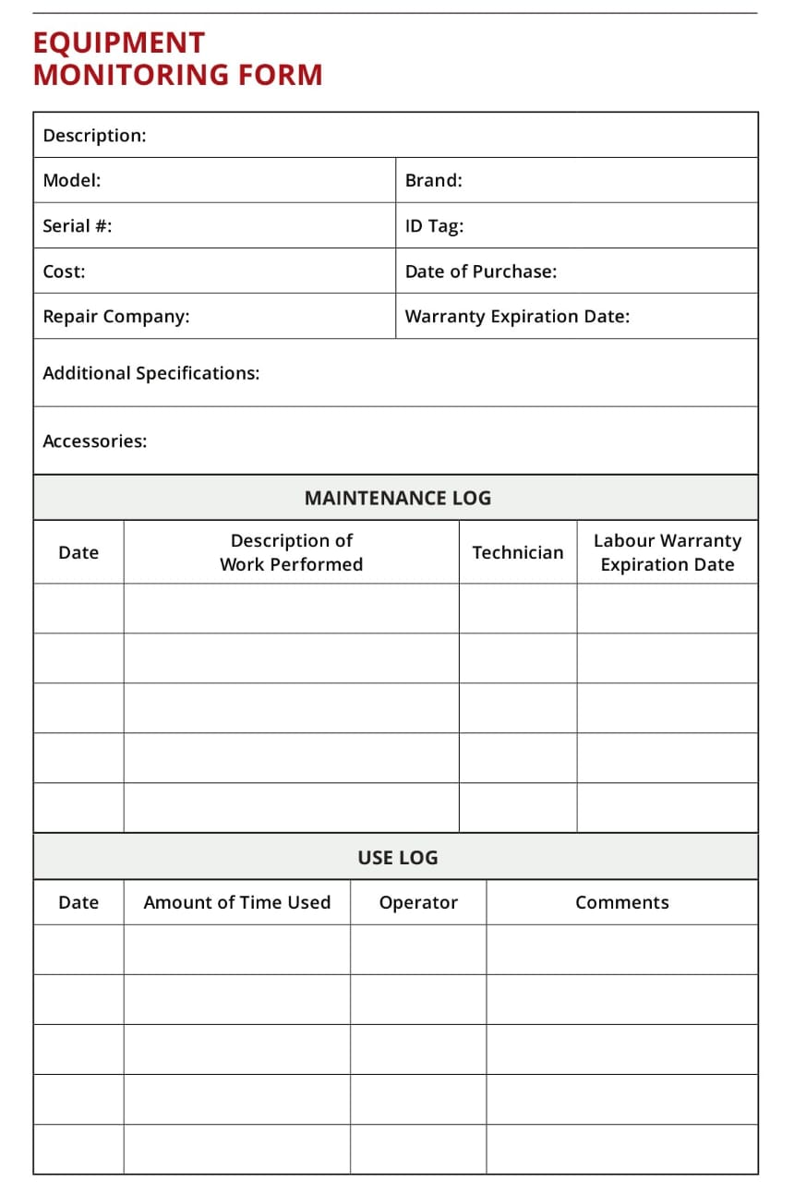
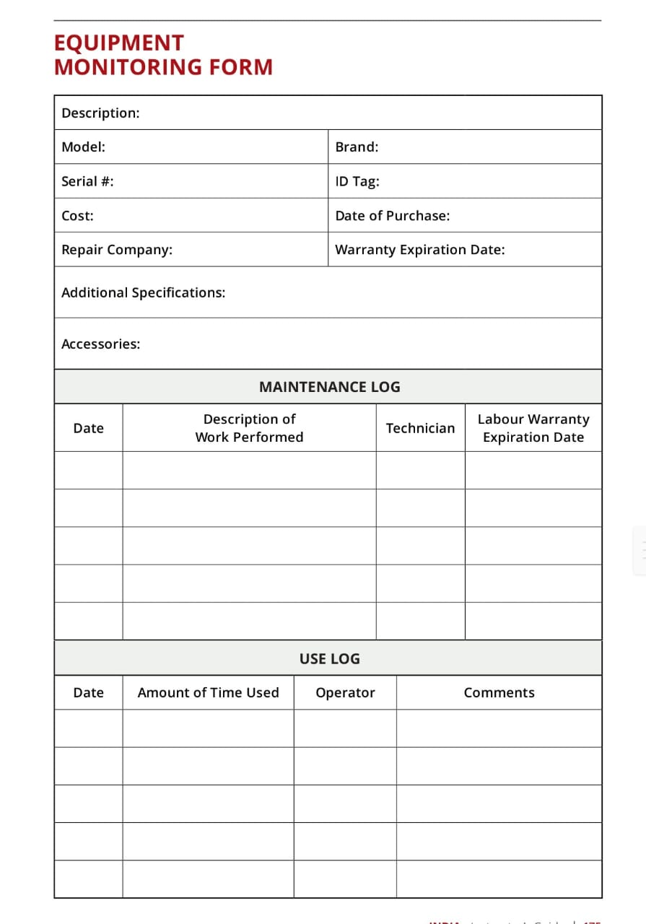
EQUIPMENT MONITORING FORM

Slide 24
REVIEW
1
Define tools, equipment and accessories (TEA).
List four categories of TEA according to their use.
List five power sources for equipment and tools.
Upon completing of this lesson, you are able to :-
2
3

Slide 25
REVIEW
List the general steps for use and maintenance of tools and equipment (before, during and after their use).
Demonstrate in four practical exercises the correct use of TEA.
4
Upon completing of this lesson, you are able to :-
5

Slide 26


ANYQUESTIONS ?

Slide 27




THANK YOU

