Slide 1




COLLAPSE STRUCTURE SEARCH & RESCUE
SEARCH AND LOCATION
TECHNIQUES
Presented by:- Pavan Dev Gaur, 2IC
CAPF | CSSR | INDIA
-

Slide 2


Objectives
Upon completing of this lesson, you will be able to :-
Define search and location and describe its importance in the success of a CSSR operation.
Describe the composition of a search team and the basic equipment used.
List and describe the steps for searching and locating.
1
2
3

Slide 3
Define void space and identify probable locations in the four basic collapse patterns.
Describe the modes, types and patterns of conducting a search.
Demonstrate in two practical exercises the steps for a physical search and location, using two different patterns.
4
5
6

Slide 4


SEARCHING AND LOCATING
A set of techniques and procedures whose purpose is to obtain a response or indication of the presence of live victims in a void space within the collapsed structure.

Slide 5
(L) – squad members rotate positions as logistics person.
Squad Leader
CSSR SQUAD ORGANIZATION
Rescue Specialist
R/S
R/S
R/S
R/S (L)
Notes:
(L) – Squad members rotate positions as Logistics person

Slide 6
Responsible for developing the search plan, drawing diagrams, keeping documentation and making recommendations to the Incident Commander.
Performs the duties of the Safety Officer and is responsible for monitoring security during the search operation
SQUAD LEADER

Slide 7
Physically carry out the search operation as outlined by the squad leader.
RESCUERS

Slide 8

Complete set of personal protective equipment and emergency medical kit.
Minimum personal supplies required to function unassisted for at least 12 hours. These supplies includes:
Drinking water
Food
Proper clothing
BASIC EQUIPMENT REQUIRED FOR PHYSICAL SEARCHES

Slide 9
BASIC EQUIPMENT REQUIRED FOR PHYSICAL SEARCHES
Basic tools
Radio equipment to communicate with team members and Command Post
Portable radios (walkie-talkie)

Slide 10
BASIC EQUIPMENT REQUIRED FOR PHYSICAL SEARCHES
Building and work site marking supplies.
Paint
Chalk
Flags
Cones
Markers

Slide 11
BASIC EQUIPMENT REQUIRED FOR PHYSICAL SEARCHES
Warning and alert devices
Megaphone
Whistle
Hammer
Flags
Horn

Slide 12
BASIC EQUIPMENT REQUIRED FOR PHYSICAL SEARCHES
Reconnaissance and vision
Binoculars
Photo camera
Flashlight
Drone

Slide 13
Search diagrams, pencils, color pens, clipboards
Technical search equipment, specialized or improvised
Additional materials
North American Hazardous Materials Response Guide
Hazardous gas detector
Basic Equipment Required for Physical Searches

Slide 14
STEPS FOR SEARCHING AND LOCATING
Compile and analyze available information.
Secure the scene.
Inspect and evaluate the structure.
Rescue victims with easy access on or near
the surface, if this has not already been done.

Slide 15
Make INSARAG markings on the structure as needed, if not already done.
Create a diagram of the structure. Refer to handout.
Select the area to be searched.
Select a search method.
STEPS FOR SEARCHING AND LOCATING

Slide 16
Conduct an appropriate search pattern and place INSARAG markings where potential victims are detected, both on the structure and on the diagram.
Continually analyze the results and re-evaluate the search plan (make necessary
adjustments).
STEPS FOR SEARCHING AND LOCATING

Slide 17
STEPS FOR SEARCHING AND LOCATING
Initiate pre-hospital treatment of the victim.
Confirm the presence and location of potential victims with the resources and equipment available..

Slide 18
A physical space in a collapsed structure where a person trapped within could remain alive for a short period.
Possible location of void spaces in typical collapse patterns
VOID SPACES

Slide 19
Basement
Elevator shaft
Bathrooms
Inside hallways
Concrete walls
STRUCTURALLY RESISTANT AREAS

Slide 20
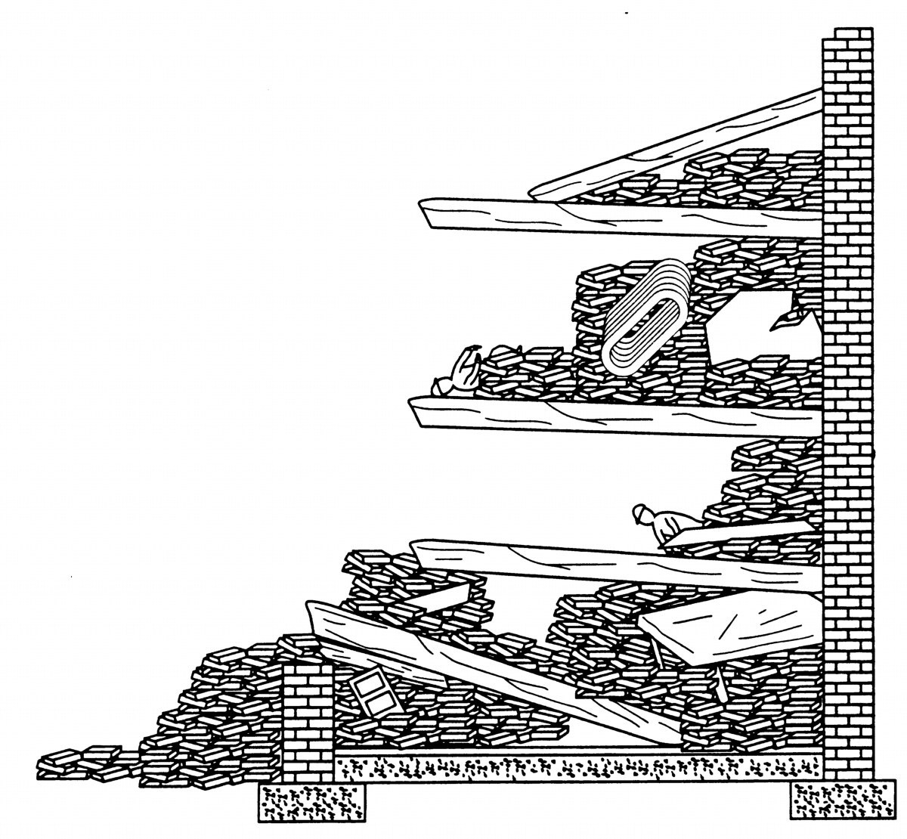
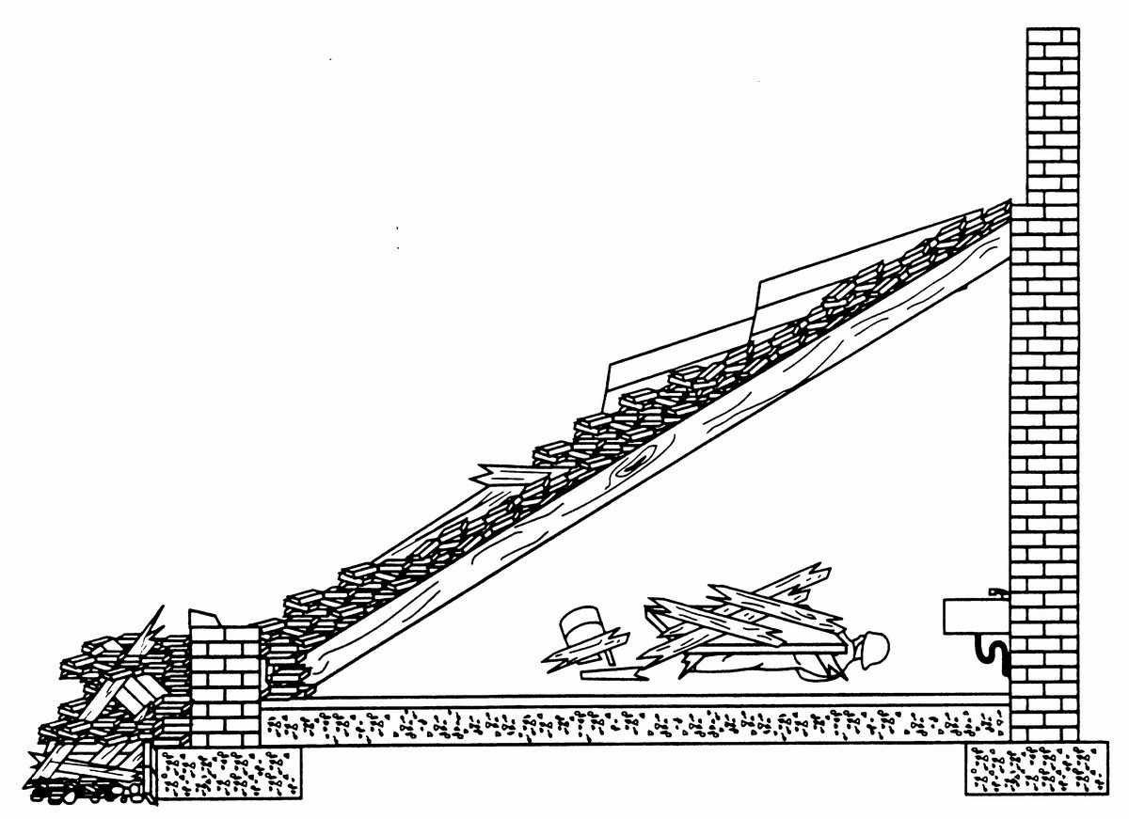
CANTILEVER
LEAN-TO

Slide 21
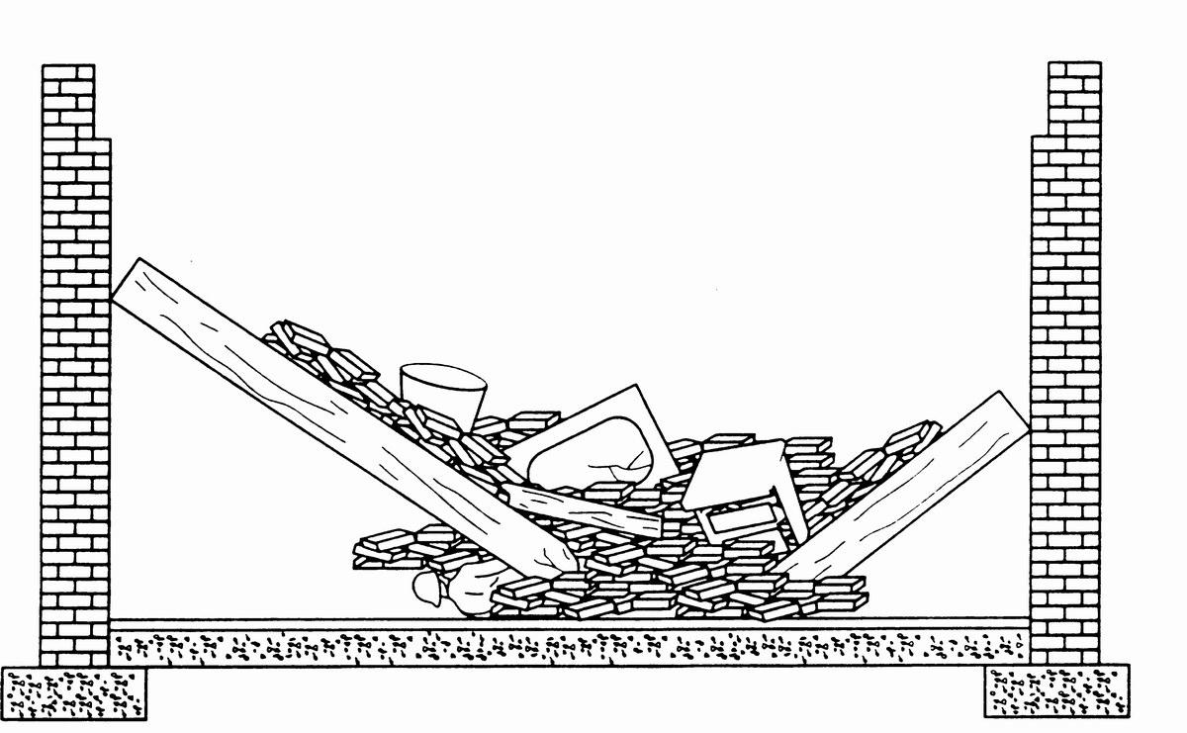
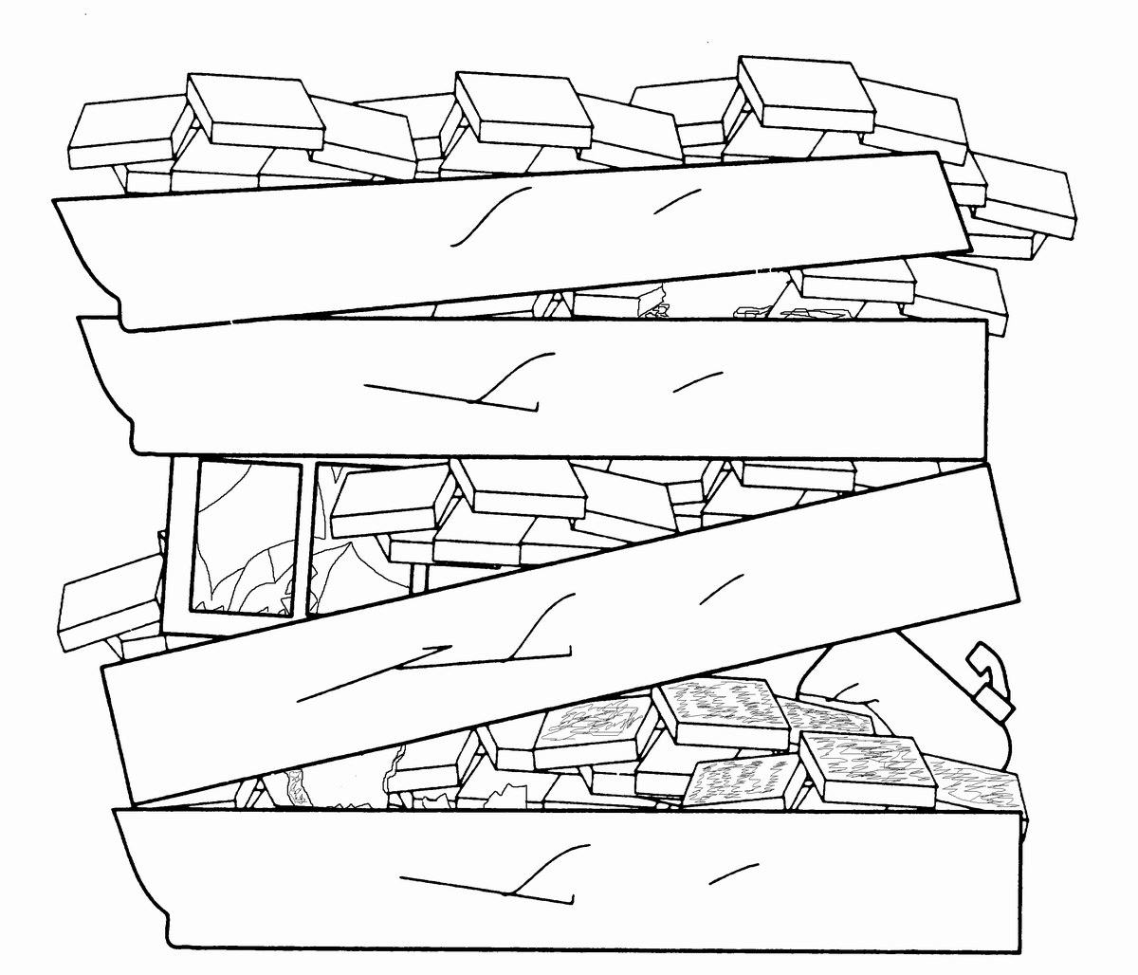
PANCAKE
V-SHAPE

Slide 22
Hasty Search (Primary)
This type of search is conducted to quickly detect the presence of survivors on the surface or easily accessible void spaces. Hasty search accomplishes the following:
Rapid detection of victims
Scene assessment (information gathered as a result aids in size-up of the rescue problem)
Sets priorities
SEARCH MODALITIES

Slide 23
2.Extensive (Grid) Search (Secondary)
This type of search is conducted in a methodical manner to pinpoint the exact location of victims. It is designed to cover the entire assigned search area carefully and in detail. An extensive or grid search accomplishes the following:
A thorough, systematic search
Redundant checks
Allows for use of alternate search resources
SEARCH MODALITIES

Slide 24
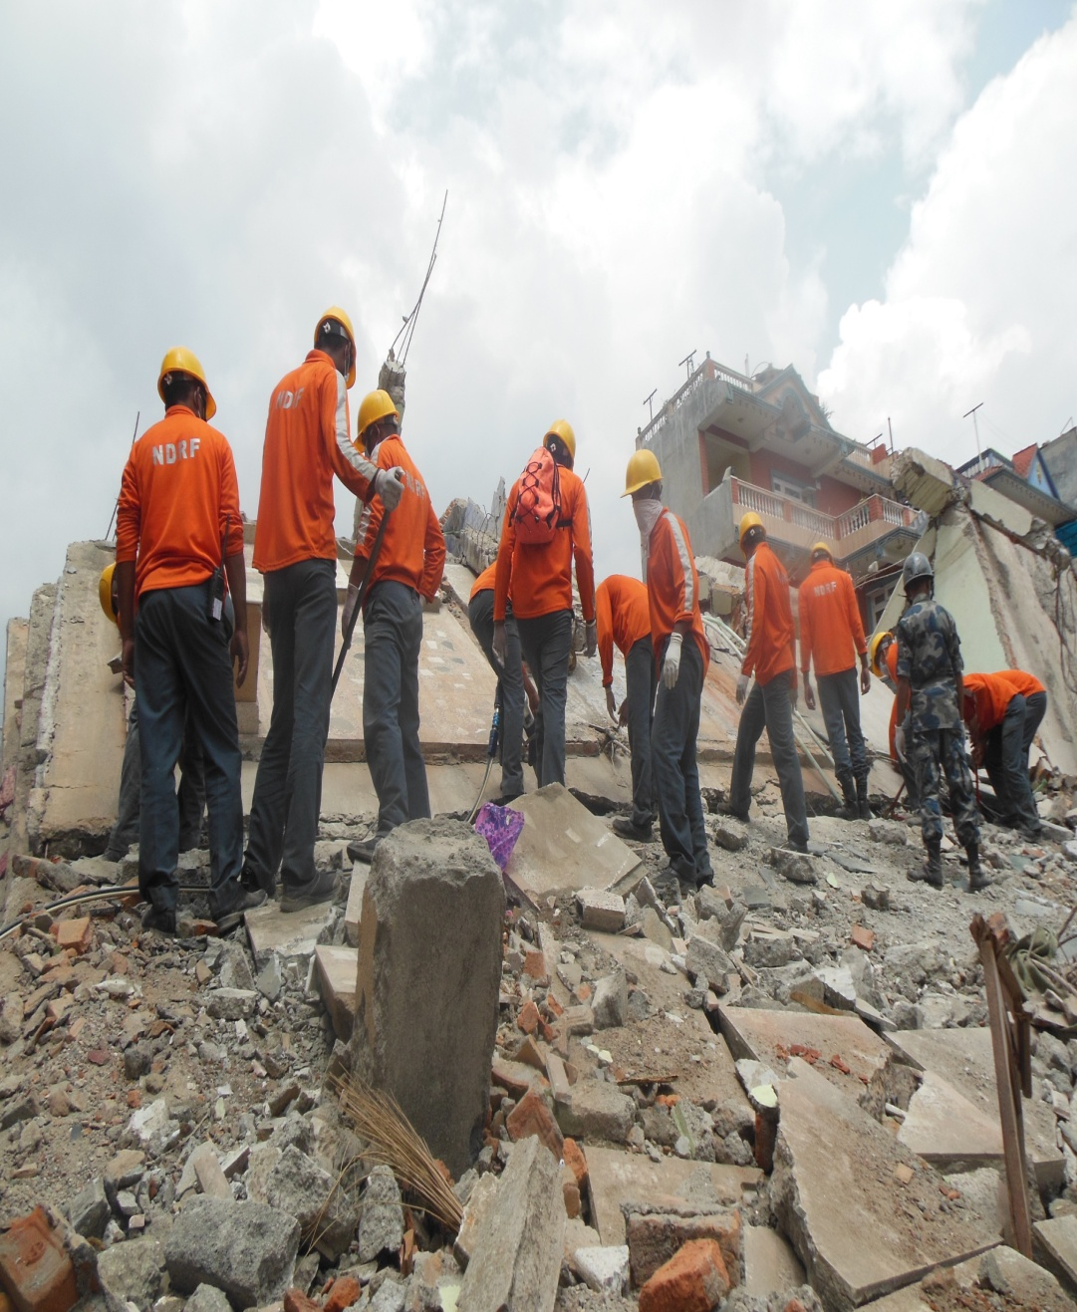
1.Physical Search
Physical search operations do not require specialists or unique, expensive equipment. They only require the senses and some established procedures.
SEARCH METHODS
This search tactic is the first, and sometimes the only, search method used by local emergency service agencies that do not possess technical or canine search resources

Slide 25
Physical Search
Local first responders must rely on fundamental search techniques. A readily accessible and willing group of volunteers can be quickly trained and supervised to safely conduct physical search operations after a disaster. Basic physical search is usually performed immediately after an incident, and may be done by locals.
SEARCH METHODS

Slide 26
2.Canine Search
Uses the acute sense of smell of dogs specially trained to detect live humans.
Certified canine teams with highly specialized dogs provide the best
SEARCH METHODS
way to locate trapped victims in a large area in the shortest amount of time. They are able to access areas too small or too unstable for humans to enter. Canines can be used for hasty and extensive operations.

Slide 27
Canine Search
A thorough site search with two well-qualified search dogs has a high probability of conclusive results. The disaster trained search canine is trained to detect those victims that are still alive. Rescuers should coordinate their activities with that of the canine team during their search operation.
SEARCH METHODS

Slide 28
Technical Search
Technical Search Requires highly trained personnel and specialized equipment for sound and temperature detection, video, vibration, etc. Can be carried out using specially manufactured or locally improvised equipment.
SEARCH METHODS

Slide 29
Technical Search
The latest state-of-the-art electronic search equipment has added a new dimension to the search function by extending its range. Whenever possible, dogs and electronic devices should be utilized together. Technical search equipment can be classified into two groups:
Visual search instruments
Electronic listening devices.
SEARCH METHODS

Slide 30
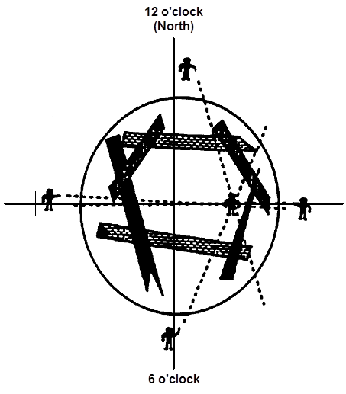
The search team leader signals for silence and all work to stop around the area. Four team members form a cross pattern, spaced at intervals of approximately 8-16 metres, in safe locations as close as possible around the search area.
HAILING SEARCH METHOD PROCEDURE

Slide 31
Going ‘around the clock,’ each searcher calls out loudly or with a megaphone, “If you can hear me call for help or knock five times on something solid.” (Use both English and local language) Instead of hailing, searchers may also knock something solid (usually metallic) that is a contiguous part of the site debris in order to elicit a response.
HAILING SEARCH METHOD PROCEDURE

Slide 32
HAILING SEARCH METHOD PROCEDURE
All searchers then listen and point in the direction of any potential response to the instructions. If more than one searcher hears the sound, the direction in which they point will triangulate on the source of the sound of the victim. This must be noted on the site sketch or on personal notes, where each rescuer makes a rough sketch of the area and the direction of the source of sound. Use a coordinate grid system and/or the clock system (using North as 12 o’clock).

Slide 33
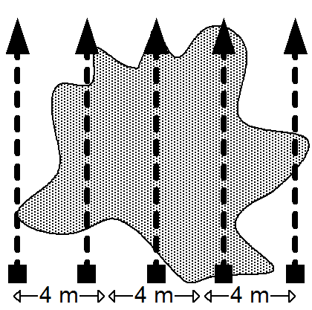
A variation of the hailing method is to set up several searchers in a straight line across the site, or in grid patterns, as when performing the physical/void search. In this scenario, rescuers are also aligned next to, but off, the rubble pile to detect sound the others on the pile may not hear. The rescuers will hail in the order given, listen and then advance as safety permits. This ensures the entire structure is covered in an extensive grid-pattern search
HAILING SEARCH METHOD PROCEDURE

Slide 34
PHYSICAL SEARCH PATTERNS FOR INTERIOR SPACES
Occasionally you will encounter structures that have not totally collapsed and contain large, open areas or a building with many intact rooms, in which live victims, unable to remove themselves or communicate, will be found. An organized approach will yield the best opportunity to locate a victim, and to declare the area searched.

Slide 35
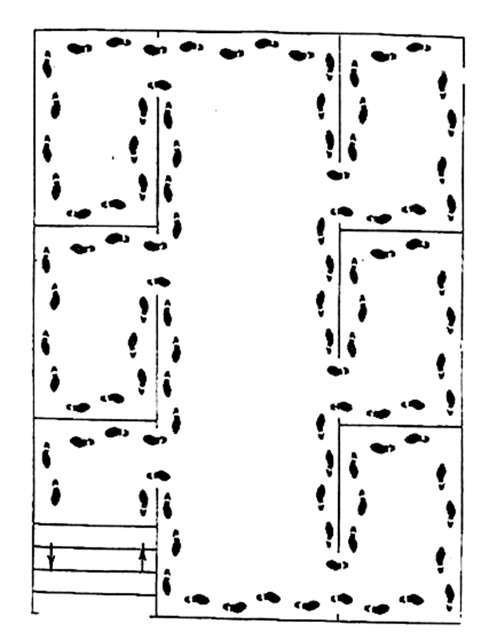
Multiple Rooms
The basic instruction for searching multiple rooms is “go right, stay right.”
PHYSICAL SEARCH PATTERNS FOR INTERIOR SPACES

Slide 36
After entering the structure, turn to the right, stay in contact with the right wall, either visually or physically, until the entire accessible area has been searched and the team returns to the starting point.
If the search team needs to exit and cannot remember the direction they entered, simply turn around and stay in contact with the same wall, either physically or visually, keeping it on your left
MULTIPLE ROOMS

Slide 37
Use the line search method in auditoriums, cafeterias, and offices with multiple partitions.
Spread search team members in a straight line across the open area, 3 to 4 metres apart.
Slowly walk through the entire open area to the other side
LARGE OPEN AREAS (LINE SEARCH)

Slide 38
Team members on the ends of the line search perimeter rooms using the go right-stay right method.
The procedure may be repeated in the opposite direction.
LARGE OPEN AREAS (LINE SEARCH)

Slide 39
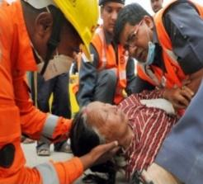
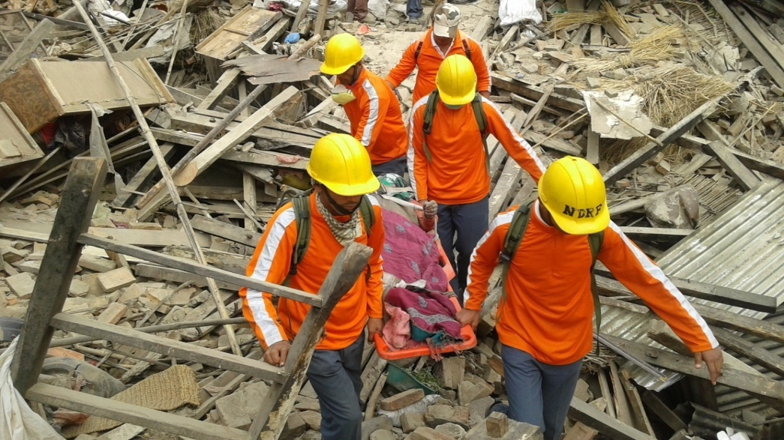
The following concepts and procedures should be applied the moment the search is initiated until the last victim is found.
VICTIM MANAGEMENT

Slide 40
Never make inappropriate comments the victim should not hear. Keep your comments on a positive note. Always assume someone is listening to you.
The victim is in the worst possible position and fighting to stay alive, and you can enhance their chances of survival by being positive about the possibility of finding and extricating them.
You may be the first person the victim is able to communicate with; therefore it is important to project a sense of confidence and hope..
PRECAUTIONS DURING A SEARCH

Slide 41
STEPS FOR INITIAL CONTACT WITH A LOCATED VICTIM
Identify and overcome language barriers.
Identify yourself as a rescuer, projecting confidence and calm in your voice and choice of words.
Obtain the following information:
Name
Adult or child (approximate age)
Type and extent of injury
Hydration status
Warmth
Degree of confinement

Slide 42
Provide emergency medical treatment as quickly as possible.
Ask about other potential victims and their condition.
Inform the victim of rescue operations.
Inform the victim if you have to leave for short periods.
Provide protection from the environment as much as possible.
Consider direct or indirect intervention of a relative or friend, etc.
STEPS FOR INITIAL CONTACT WITH A LOCATED VICTIM

Slide 43
Acoustic detection (use to amplify sound through a crack or opening in a building)
Stethoscope
Recorder with microphone mounted on a pole
Visual detection
Telescopic mirror with illumination
Common video camera
IMPROVISED SEARCH EQUIPMENT

Slide 44
Sound transmission
Loudspeaker mounted on an extension, with microphone .
Portable radios
Other
IMPROVISED SEARCH EQUIPMENT

Slide 45
REVIEW
Upon completing of this lesson, you are able to :-
1
Define search and location and describe its importance in the success of a CSSR operation.
Describe the composition of a search team and the basic equipment used.
List and describe the steps for searching and locating.
2
3

Slide 46
Define void space and identify probable locations in the four basic collapse patterns.
Describe the modes, types and patterns of conducting a search.
Demonstrate in two practical exercises the steps for a physical search and location, using two different patterns.
4
5
6

Slide 47



Any question ?

Slide 48

THANK YOU

