Slide 1




COLLAPSE STRUCTURE SEARCH & RESCUE
CONSTRUCTION MATERIALS,
STRUCTURES AND DAMAGE TYPES
Presented by:- Pavan Dev Gaur, 2IC
CAPF | CSSR | INDIA
-

Slide 2

OBJECTIVES
Define construction materials and classify them by their composition types and uses.
List and describe three forces that can affect construction materials
List three properties of each material: concrete, steel and wood.
Describe two methods of construction.
1
Upon completing of this lesson, you will be able to :-
2
3
4

Slide 3
OBJECTIVES
List four types of structures.
List at least three characteristics of a building in each of the following four categories:
• General
• Architecture
• Structural elements
• Non-structural elements
List and describe two types of damage in a structure and their potential resulting failures.
Name and describe the four basic collapse patterns.
5
6
Upon completing of this lesson, you will be able to :-
7
8

Slide 4
CONSTRUCTION MATERIALS
Natural materials processed by man and used in the construction of buildings, which consist of structural and non-structural elements.

Slide 5
Stone: Marble, granite, slate.
Organic materials: Wood, plywood,
paper, particleboard
Metal: iron, steel, aluminium.
Conglomerates: concrete, plaster,
adobe, clay
CLASSIFICATION BY COMPOSITION

Slide 6
Ceramics: Tiles
Glass: windows, glass block
Plastics: polyurethane, polyethylene,
thermosetting adhesive.
CLASSIFICATION BY COMPOSITION

Slide 7
Structural/load-bearing elements
Decorative elements and façades or veneer
Non-structural walls and partitions
Covering elements (roofing)
CLASSIFICATION BY USE IN THE STRUCTURE

Slide 8

Tension: force that act to
elongate or stretch a material.
FORCES ACTING ON CONSTRUCTION MATERIAL

Slide 9
Compression:
Forces that act to crush or compress a material.
FORCES ACTING ON CONSTRUCTION MATERIAL

Slide 10
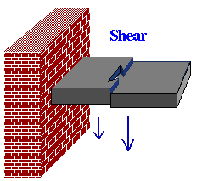
FORCES ACTING ON CONSTRUCTION
MATERIAL
Shear: Forces acting in opposite, parallel directions and on different planes so that they cut or break a material.

Slide 11
Concrete: A construction material consisting of a mix of cement, rock, sand and/or other inert materials, water and a small amount of air.
Characteristics
Resistant to fire and compression.
Weak under tension and shear.
Continues to harden with time .
Very heavy: one cubic meter (m3) weighs almost 3,000 kg.
PROPERTIES OF CONSTRUCTION MATERIALS

Slide 12
Steel
Characteristics
Can be bent without breaking (malleable).
Easily conducts heat, sound and electricity.
Resistant to fire and compression. It starts to
lose strength above 700 degree Fahrenheit.
PROPERTIES OF CONSTRUCTION MATERIALS

Slide 13
Wood
Characteristics
Easy to cut
Light
Not fire-resistant
Good insulator (will not transmit electricity)
Provides warning — creaks before breaking
PROPERTIES OF CONSTRUCTION MATERIALS
Notes:
(L) – Squad members rotate positions as Logistics person

Slide 14
The type of construction will give some indication of the way a building will collapse.
Experience has shown that there are patterns in the way structures collapse.
The knowledge is useful in determining the probable location of voids and spaces where victims may be trapped, and in selecting the methods to employ in extricating them.
Buildings can be divided into two main categories: framed and unframed
METHODS OF CONSTRUCTION

Slide 15
Unframed structures are those in which the weight of the floors and roof are supported by the bearing wall.
As a general rule, Unframed structures do not exceed seven stories in height.
UNFRAMED STRUCTURES

Slide 16
FRAMED STRUCTURES
Framed structures are erected by constructing a structural steel or reinforced concrete skeleton made of horizontal beams and vertical columns.
The floors and roof are not dependent on the walls for support. but older concrete structures can suffer a pancake failure, and some steel structures with poor joints have overturned.

Slide 17
Based on experience with earthquakes and collapses, building types can be also divided into four separate groups, with each exhibiting a distinctive collapse pattern.
These groups are:
1. Light Frame
2. Heavy Wall (URM) Unreinforced
Masonry
3. Heavy Floor
4. Pre-Cast Concrete Buildings
STRUCTURAL TYPES

Slide 18
LIGHT FRAME
Residential homes and apartments of up to four stories.
Constructed mainly of wood.
The principal weakness is the lateral strength of the walls and the connections.
Stability problems by looking for badly cracked or leaning walls.
Leaning first story in multi-floor dwellings.

Slide 19
HEAVY WALL (URM) UNREINFORCED MASONRY
These buildings are one to six stories in height, and may be residential, commercial, industrial, or institutional.
They have heavy masonry walls and wooden floors.

Slide 20
HEAVY WALL (URM) UNREINFORCED MASONRY
When operating in an unreinforced masonry building make sure to check for loose and broken parapet walls and ornamental masonry, broken connections between walls and floors, cracked wall corners, and unsupported and partially collapsed floors

Slide 21
HEAVY FLOOR
Structures in this category can be residential, commercial , industrial and highway bridges.
They have concrete frames and may be up to 12 stories tall.

Slide 22
RESCUERS SHOULD EVALUATE THE STABILITY OF THE STRUCTURE BY CHECKING:
The confinement of the concrete within the reinforcement of the columns
Cracking of columns at each floor line
Diagonal sheer cracking in major beams adjacent to supporting columns
Cracks in sheer walls

Slide 23
PRE-CAST CONCRETE BUILDINGS
Pre-Cast Concrete Buildings with fairly heavy floors and some heavy walls.
It may be commercial or residential and also include pre-cast parking facilities.
It is generally one to twelve stories in height.
Principal weakness is in interconnection of parts: slabs to walls/beams; beams to columns; walls to slabs, etc.

Slide 24
RESCUERS OPERATING AT A PRE-CAST BUILDING COLLAPSE SHOULD CHECK
Badly cracked walls, beam-to-column connections for broken welds and cracked corbels, column cracking at the top and the bottom of joints, and wall panel connections and shear wall connections at floor areas.

Slide 25
CHARACTERISTICS OF A STRUCTURE
After seismic activity or other force causes structural and non-structural damage, it is important to relate the characteristics of the structure to the damage it has suffered.

Slide 26
GENERAL CHARACTE -RISTICS
General characteristics of a structure include the following elements:
Occupancy type
Modifications to the original structure/plans (if applicable)
Location of utilities
Contents
Number of occupants

Slide 27
ARCHITECTURAL CHARACTERISTICS
Architectural characteristics of a structure include the following elements:
Shape of building and foundation • Height and number of floors
Number of basement levels
Major cantilevers
Location of chases (stairwells, elevator shafts and service chutes)
Primary materials used

Slide 28
STRUCTURAL ELEMENTS CHARACTERISTICS
THE STRUCTURAL OR LOAD-BEARING ELEMENTS OF A STRUCTURE INCLUDE THE FOLLOWING:
COLUMNS
BEAMS, GIRDERS, TRUSSES, JOISTS, RAFTERS, PURLINS, STUDS
FLOOR SLABS, ROOF
LOAD-BEARING WALLS
FOUNDATIONS

Slide 29
NON-STRUCTURAL ELEMENTS CHARACTERISTICS
The Non-structural elements of a structure include the following:
Non-load-bearing walls, partitions, in-fill
Windows, doors and other openings (fenestrations)
Façades, veneers, parapets, and other

Slide 30
DAMAGE TYPES AND POTENTIAL HAZARDS
Damage to buildings can be categorized as structural and non-structural.
Structural damage affects the structural elements of a building.
Non-structural damage affects the non-structural elements of a building.
Both types of damage are capable of causing injury, death, contamination and other hazards.

Slide 31
STRUCTURAL DAMAGE
Total structural collapse
Leaning floors, roofs and walls
Collapsed and roofs
Collapsed columns in one or more floors
Substantial, permanent lateral shift in the structure
Cracks in columns, floor slabs and/or bearing walls
Cracked foundation
Cracked elevator shaft

Slide 32
NON-STRUCTURAL DAMAGE
Generalized cracking
Cracked or fallen exterior façades and veneers
Fallen staircases
Shift in the elevator shaft
Damaged utilities
Building signs and balconies

Slide 33
TYPES OF HAZARDS
In damaged, partially and fully collapsed structures, we can identify three types of hazards:
Falling: Part of the structure or its contents are in danger of falling.
Collapse: The volume of enclosed space made by the structure will be reduced, as stability is lost.
Other: Electricity, water, fuels, toxic gases (carbon monoxide), hazardous materials (asbestos), biohazards (industrial, medical), etc.

Slide 34
BASIC COLLAPSE PATTERNS
1. Cantilever
2. Lean-to
3. Pancake
4. V-Shape

Slide 35
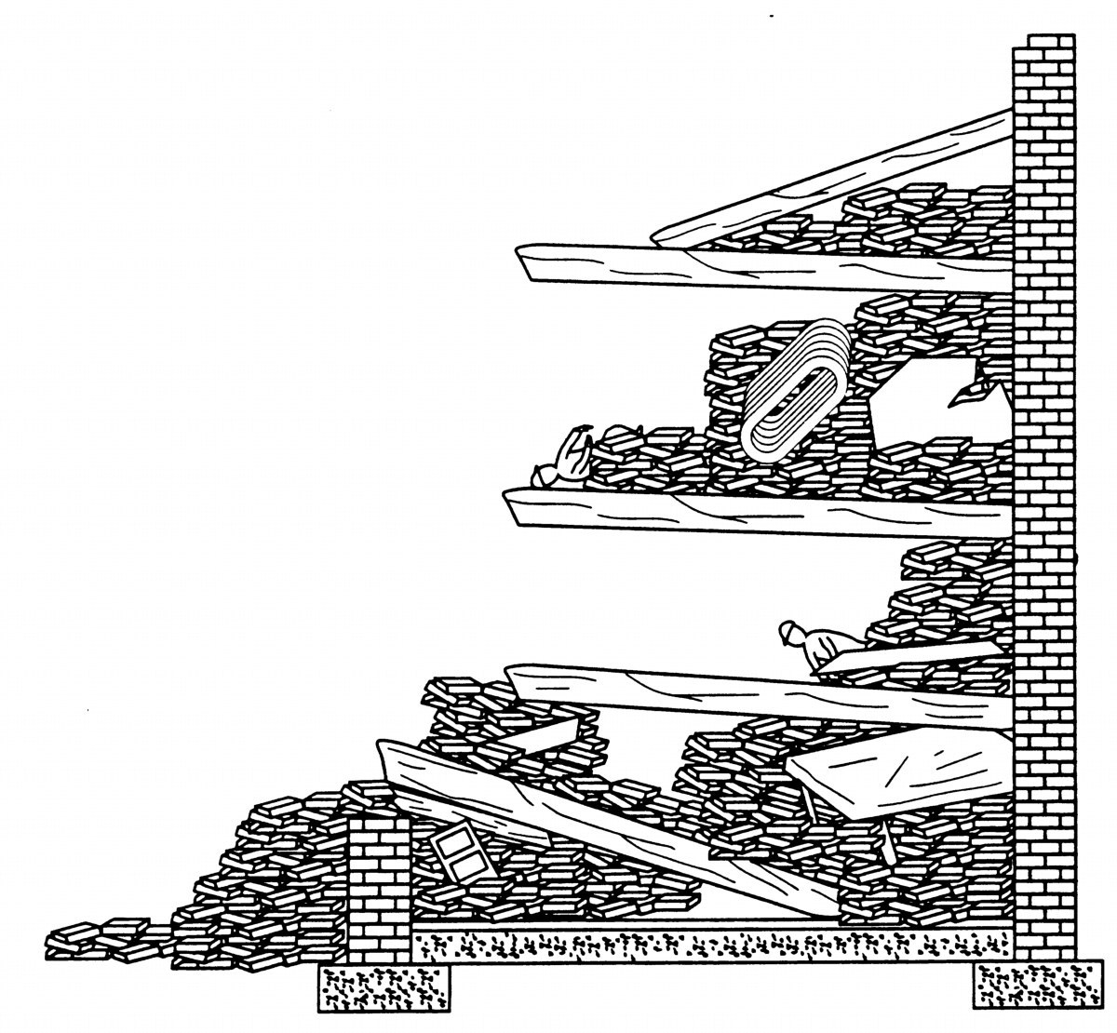
CANTILEVER
Results from a wall collapse which allows a floor or roof assembly to drop partially, but to remain suspended above the floor or base below on the side where the wall failed.
The opposite end of the floor assembly remains attached to the wall and at its original connection point. This type of collapse is extremely unstable and dangerous

Slide 36
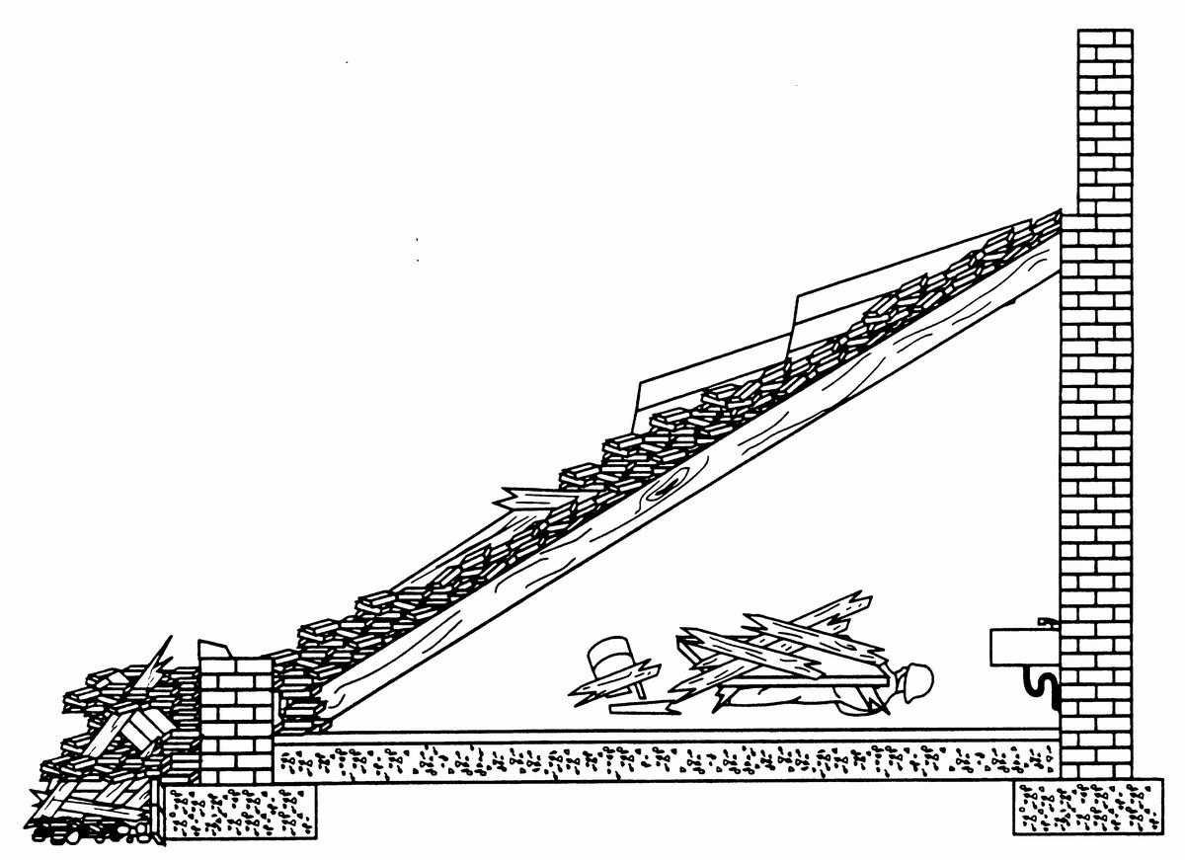
LEAN-TO
Found where a wall failure causes a floor or roof section to fall completely on one side, while the other end remains supported .
This collapse usually results in a triangular void. Remember that the remaining supported end of the fallen section may be precariously supported

Slide 37

PANCAKE
Refer to multi-floor collapses where several floor slabs completely fail and stack up on top of each other. The resulting voids are limited in space and are difficult to access, especially in concrete structures.

Slide 38
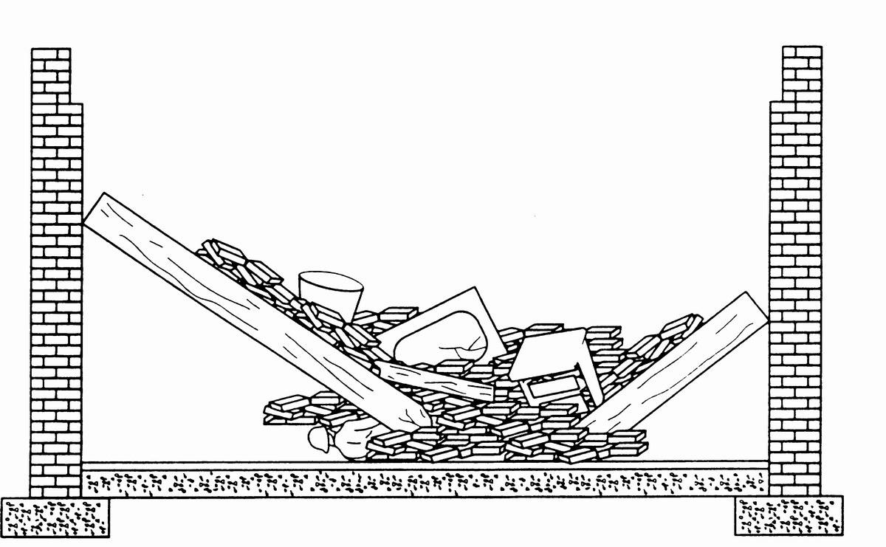
V-SHAPE
This collapse will be created when a floor assembly collapses in the middle due to failure of center supports or overload of the floor. The result is two identifiable voids which are created on each side of the broken floor assembly

Slide 39
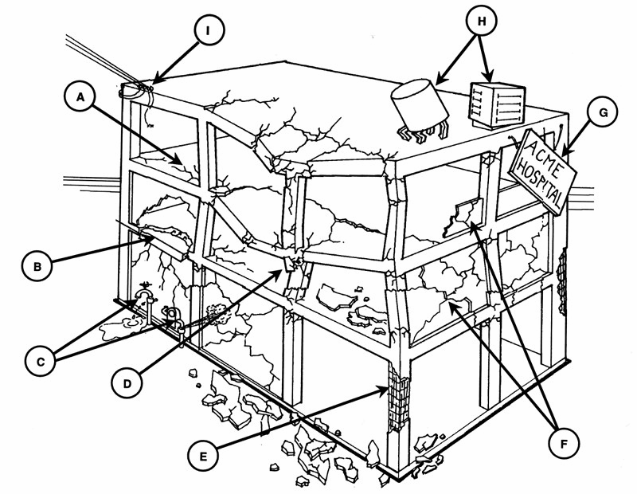
IDENTIFY THE FAILURE TYPES ABOVE AND WHETHER THEY ARE STRUCTURAL OR NON-STRUCTURAL

Slide 40
Cracked floor at column (Structural)
Concrete floor or wall piece hanging by rebar (Structural)
Broken gas and water lines (Non-Structural)
Badly cracked concrete walls (Structural)
Concrete missing from inside rebar cage (empty basket) (Structural)
Badly cracked in-fill walls of un-reinforced masonry (Non-Structural)
Loose signs or wall panels and ornaments may fall (Non-Structural)
Loose H.V.A.C. equipment and/or water tank (Non Structural)
Broken electrical lines (Non-Structural)
IDENTIFY THE FAILURE TYPES ABOVE AND WHETHER THEY ARE STRUCTURAL OR NON-STRUCTURAL

Slide 41
REVIEW
Define construction materials and classify them by their composition types and uses.
List and describe three forces that can affect construction materials
List three properties of each material: concrete, steel and wood.
Describe two methods of construction.
1
Upon completing of this lesson, you are be able to :-
2
3
4

Slide 42
REVIEW
List four types of structures.
List at least three characteristics of a building in each of the following four categories:
• General
• Architecture
• Structural elements
• Non-structural elements
List and describe two types of damage in a structure and their potential resulting failures.
Name and describe the four basic collapse patterns.
5
Upon completing of this lesson, you are be able to :-
6
7
8

Slide 43

ANY QUESTIONS?

Slide 44




THANK YOU

