Slide 1


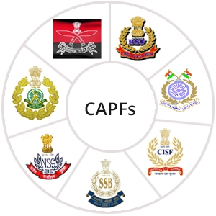

COLLAPSE STRUCTURE SEARCH & RESCUE
ORGANIZING AND STARTING A
CSSR OPERATION
Presented by:- Pavan Dev Gaur, 2IC
CAPF | MFR | INDIA
-

Slide 2


OBJECTIVES
1
Define a collapsed structure search and rescue operation.
Describe the structure of a CSSR squad and the positions within it.
List the five phases of a CSSR operation.
List the six stages of the Operations Phase.
Upon completing of this lesson, you will be able to :-
2
3
4

Slide 3
5
List the five steps of the initial assessment.
Describe how a CSSR squad fits into the Incident Response System.
Name the four levels in the scope of operations as they pertain to CSSR.
6
7

Slide 4
According to the U.S. National Fire Protection Act (NFPA 1670) CSSR is an operation to conduct safe and effective search and rescue operations at collapsed structure incidents involving the collapse or failure of reinforced and unreinforced masonry, concrete, tilt-up and heavy timber construction.
COLLAPSED STRUCTURE SEARCH AND RESCUE

Slide 5
The Incident Command System (ICS) provides a clear management framework for all types of incidents, such as multiple-casualty, multi-jurisdictional and multi-agency disasters, and wide-area search and rescue operations.
A flexible system for managing people and resources.
INCIDENT COMMAND SYSTEM

Slide 6
ICS was adopted in India in the form of Incident Response System (IRS) in 2010 and the guidelines on the Incident Response System (IRS) was issued by the National Disaster Management Authority (NDMA) under Section 6 of the DM Act, 2005.
The IRS is built around five major management activities: Responsible officer, command, operations, planning and logistics.
Responsible Officers (ROs) have been designated at the State and District level as overall in charge of the incident response management.
INCIDENT COMMAND SYSTEM

Slide 7
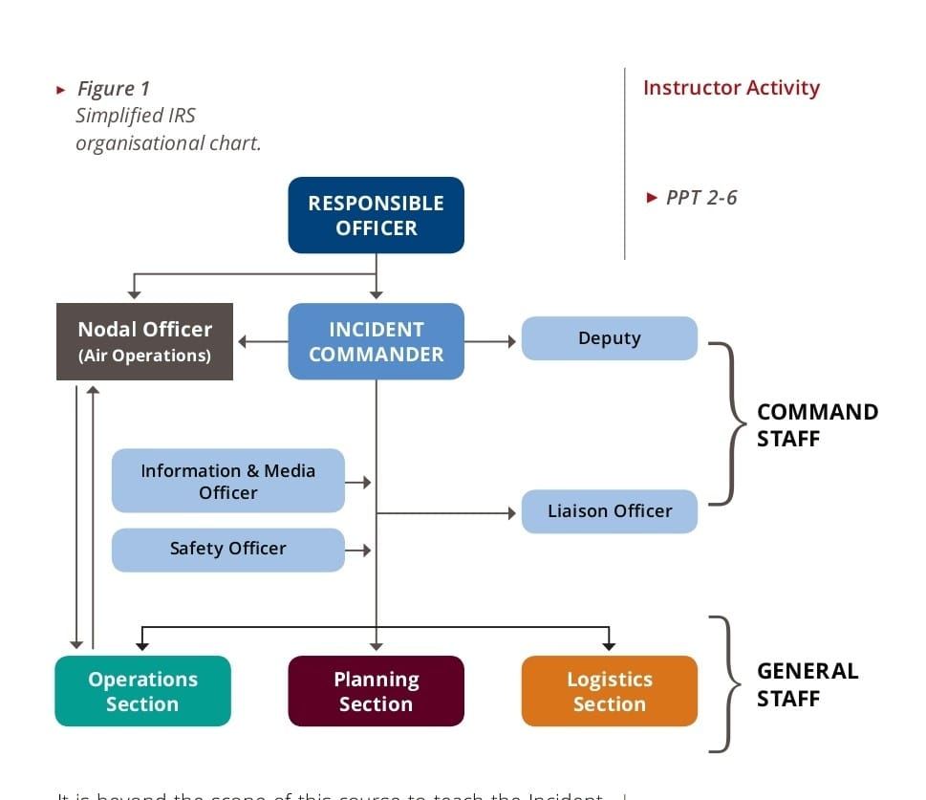
INCIDENT COMMAND SYSTEM

Slide 8
The Incident Commander (IC) is the person in charge at the incident who must be fully qualified to manage the incident.
Incidents grow in size or become increasingly complex, a more highly qualified IC may be assigned by the responsible jurisdiction or agency.
The IC manage the incident by assigning tactical resources and overseeing operations, delegating authority to others as required and not involved in hands-on activities.
INCIDENT COMMANDER

Slide 9
The Incident Command Post (ICP) is the location from which the IC oversees all incident operations.
Only one ICP for each incident or event.
The various section chiefs and Incident Commander’s support staff will work out of the ICP.
INCIDENT COMMAND POST

Slide 10
An Active component of an emergency response system whose purpose is to search for , locate , gain access to , stabilize and extricate trapped victims from a collapsed structure.
In accordance with NEPA guidelines (For safety reason in a hazardous environment), the CSSR squad should have a maximum of six (6) members.
The CSSR Squad

Slide 11
Remain in contact of CP or EOC.
Receive work instructions.
Assign task to Rescuer.
Decide which specific TEA is to be used.
Monitor work rotation.
Update the CP on progress & completed task.
Safety officer for the squad.
Maintain a log of all events, actions & expenditures.
TASKS OF A SQUAD LEADER

Slide 12
Carry out work instructions from the Squad Leader.
Use the tools, equipment and accessories correctly and safely.
Update the Squad Leader on task progress.
Request to the Squad Leader the resources necessary to complete the task.
TASK OF RESCUERS

Slide 13
The logistics position is a rotating position within the squad.
Logistic is responsible for the tools, equipment and accessories, and other resources; squad members will take turns assuming this responsibility.
Standard procedure to work in pairs. The second rescuer stands behind the first, providing physical support and monitoring safety.
Working in pairs also provides the opportunity for rotations and rest.
TASK OF RESCUERS

Slide 14
A manageable span of control is defined as the number of individuals one supervisor can manage effectively.
In the Incident Response System (IRS), the span of control for any supervisor falls within a range of 3 to 7 resources, with five being the optimum.
SPAN OF CONTROL

Slide 15
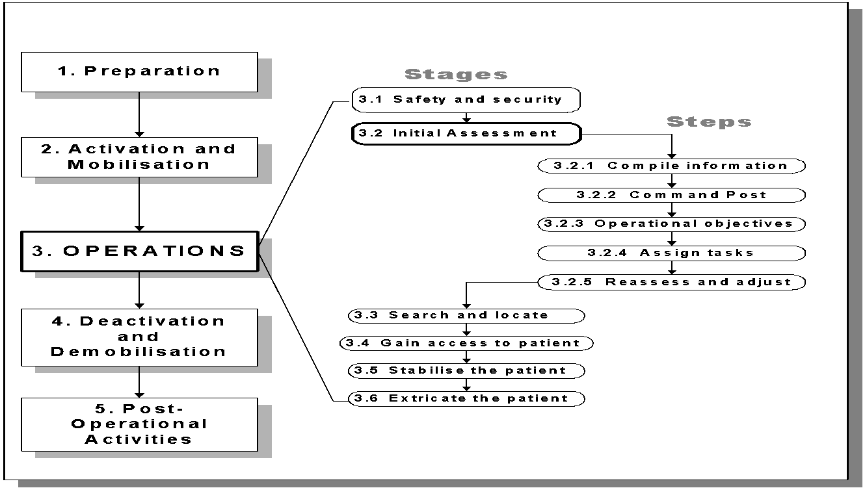
PHASES OF A CSSR OPERATION

Slide 16
Selection of Team members.
Training of Team members.
PPE.
Maintaining TEA in working condition.
Make general transport arrangement.
PHASE 1:
PREPARATION (ON GOING - BEFORE DISASTER )

Slide 17
Request transportation.
Pack & load EQPT.
Notify Team members.
Obtain info on Disaster (Type, location, topography, magnitude, No of victims trapped, building affected, weather, route , etc)
Brief Team members on current situation
PHASE 2 :
ACTIVATION AND MOBILIZATION(REQUEST TO RESPOND)

Slide 18
The operations phase relates directly to Search & Rescue work, and is divided into six stage. The second stage or initial assessment, consist of five steps.
Stage 1 : securing the scene A procedure is carried out to ensure safety and protection to the fullest extent possible for the rescuers, bystanders and victims.
PHASE 3:
OPERATIONS

Slide 19
This stage consists of a systematic and ordered procedure for analysing conditions during a CSSR operation.
The purpose is to ensure safety and protection to the fullest extent possible for the rescuers, bystanders and victims (hazard mitigation).
It begins with the operations phase and continues until the
rescue operation is complete.
STAGE 2 : INITIAL ASSESSMENT

Slide 20
Step1: Compile Information
Once at the scene, consult local authorities, gather data and conduct a needs analysis. Confirm and update all information obtained in the activation phase
THE INITIAL ASSESSMENT CONSISTS OF THE FOLLOWING FIVE STEPS:

Slide 21
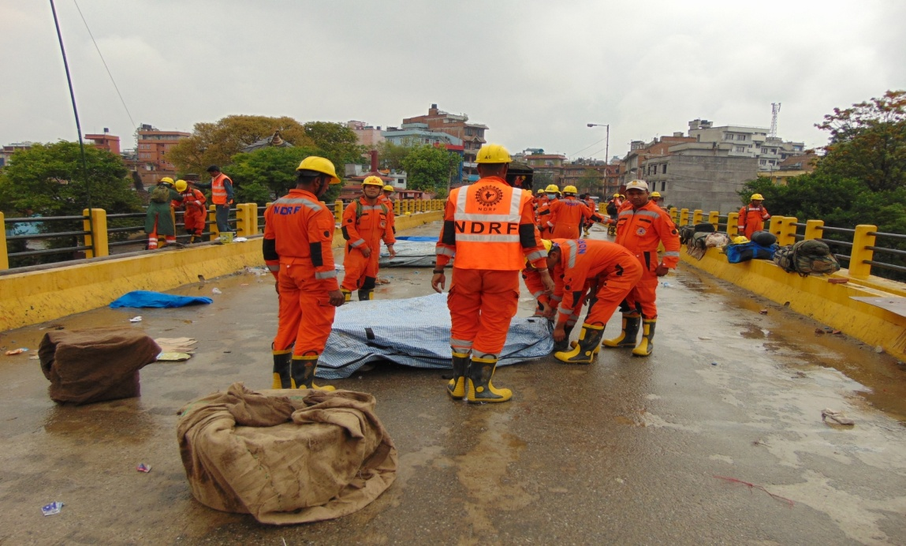
Establish Command Post outside the hot zone.
STEP 2: ESTABLISH COMMAND POST

Slide 22

Such as:
General access to the disaster site
Strategic planning and priorities
Allocating resources and personnel managing operations begun by neighbours or other organizations
STEP 3: ESTABLISH OPERATIONAL OBJECTIVE

Slide 23
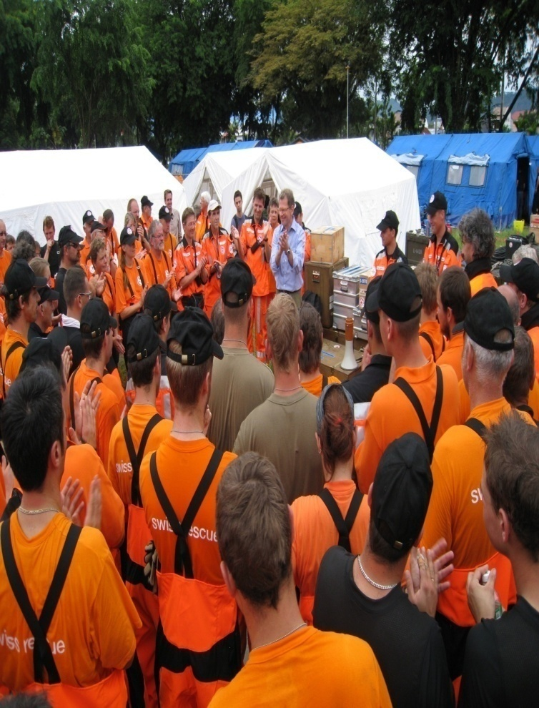
Assign Tasks To Rescue Squads
STEP 4: ASSIGN TASK

Slide 24
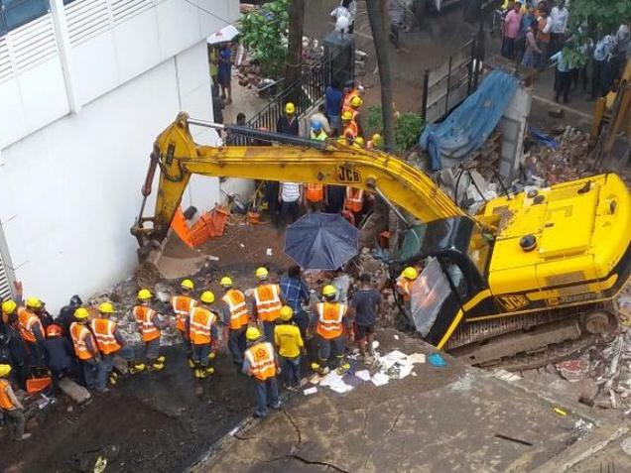
Reassess The Situation And Make Necessary Adjustment
STEP 5: REASSESS AND ADJUST

Slide 25
Conduct a search using a specific set of techniques to obtain a response or indications of the presence of live victims in a void space inside a collapsed structure.
STAGE 3: SEARCH AND LOCATE

Slide 26
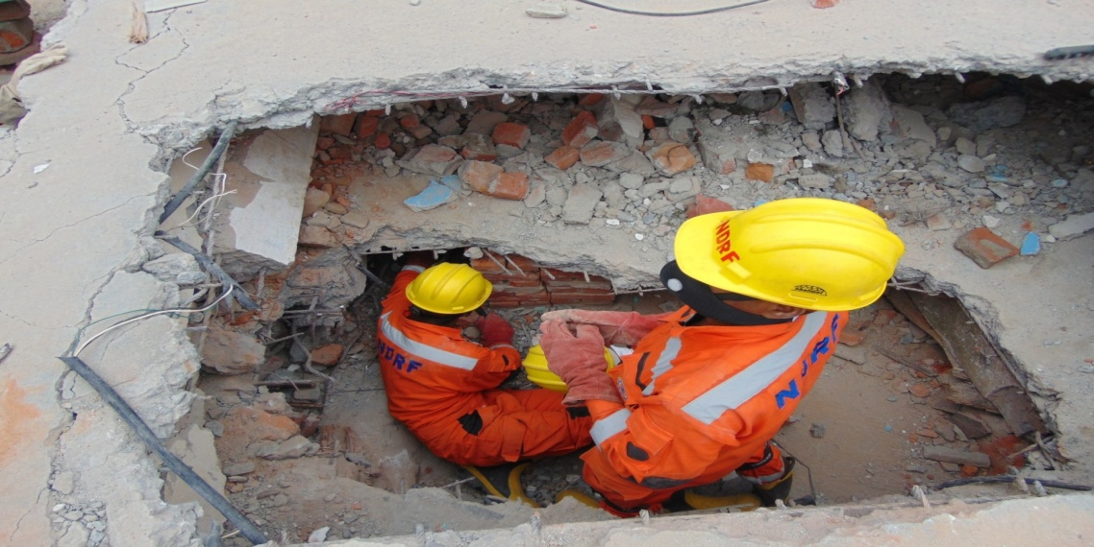
Remove rubble, break and breach materials and create a passageway to access the void space where a live victim is believed to be located.
STAGE 4: GAIN ACCESS TO VICTIM

Slide 27
Perform basic life support on-site before extricating the patient in order to improve later chances of survival.
You will hand off the patient to more advanced medical care after extrication.
STAGE 5: STABILIZE THE PATIENT

Slide 28
Remove rubble surrounding the patient, ensuring no further injury.
Shore loads as needed.
Ensure no additional pressure is applied to any trapped portions of the body.
STAGE 6: EXTRICATE THE PATIENT

Slide 29
Confirm no other operations are needed
Account for all TEA
Account for personnel items
Arrange for transportation
PHASE 4:
DEACTIVATION & DEMOBILIZATION

Slide 30
Critical Incident Stress Management (CISM)
Medical, Physical exam for rescuer
Equipment rehabilitation
Operational debriefing with rescue team
After action report for institutional management.
PHASE-5
POST OPERATION ACTIVITY

Slide 31
In a large-scale emergency such as an earthquake, the area of impact will usually be over a wide area, possibly covering many cities. As a result, the incident will be managed by different groups at various levels, depending on their type of responsibility
SCOPE OF OPERATION

Slide 32
Affected Region
2. City or Area
3. Scene
4. Work site
THERE ARE FOUR TYPE OF SCOPE OF OPERATION

Slide 33
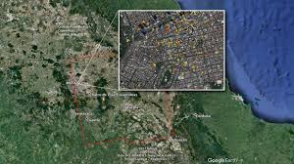
Affected Region, refers to the overall area of impact, such as the country or cities affected.
        AFFECTED REGION

Slide 34

City or Area refers to a smaller section of the affected region, such as a city or area with many collapsed building
        CITY OR AREA

Slide 35
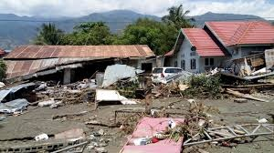
scenes refers to one particular building or collapsed structure
        SCENE

Slide 36
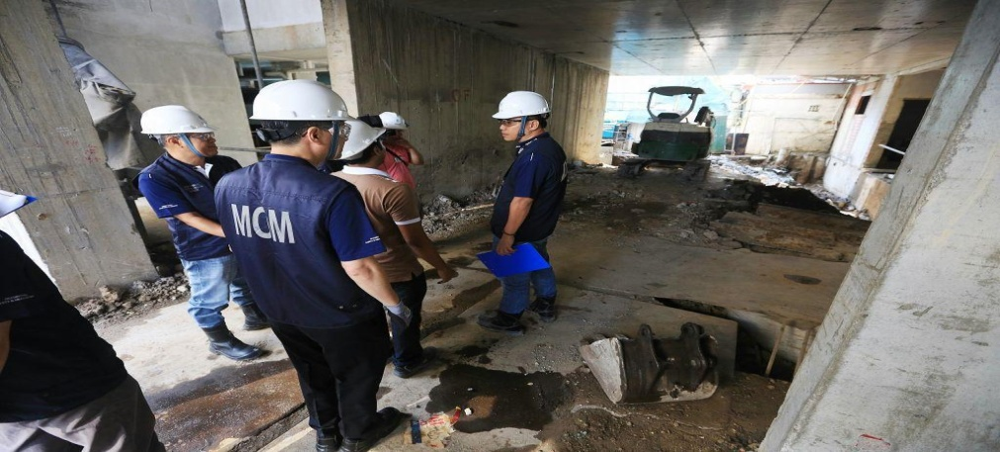
Work Site a specific area within the building or collapsed structure where a rescue squad is assigned to work
The work site is the scope of operation for a CSSR squad.
        WORK SITE

Slide 37
Now you are able to describe -
Define a collapsed structure search and rescue operation.
Describe the structure of a CSSR squad and the positions within it.
List the five phases of a CSSR operation.
List the six stages of the Operations Phase.
1
2
REVIEW
3
4

Slide 38
Now you are able to describe -
List the five steps of the initial assessment.
Describe how a CSSR squad fits into the Incident Response System.
Name the four levels in the scope of operations as they pertain to CSSR.
5
6
REVIEW
7

Slide 39

ANY QUESTIONs ?

Slide 40



THANK YOU

