Slide 1


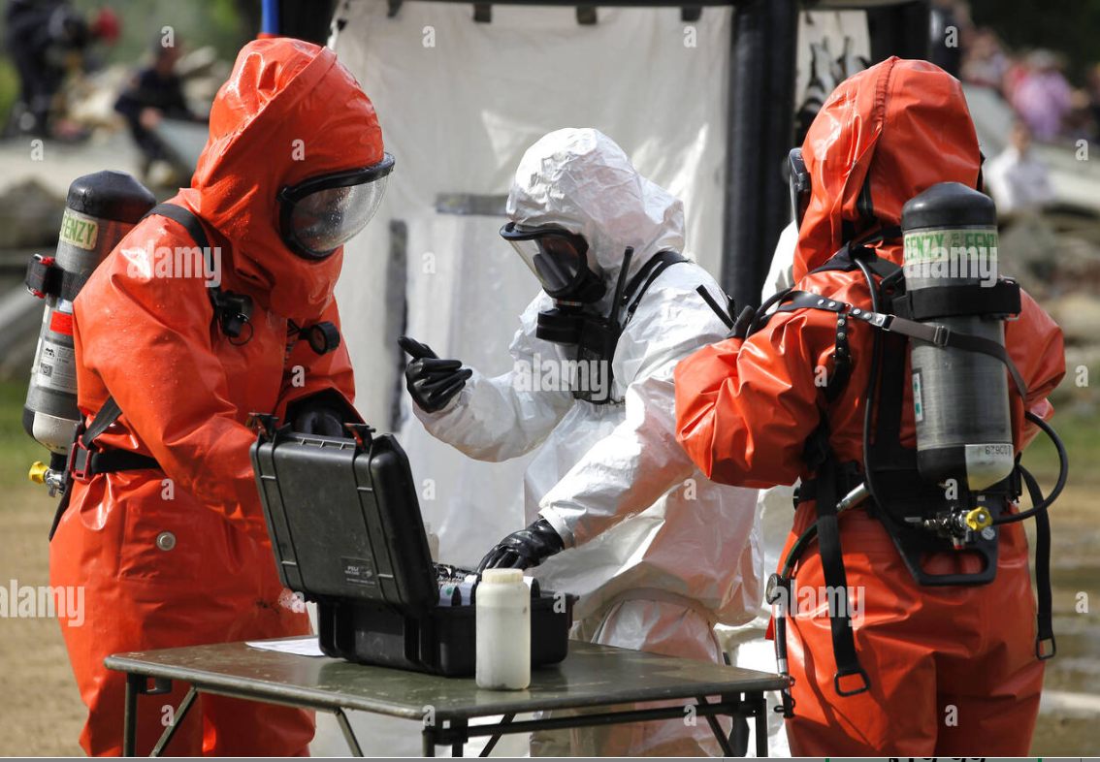
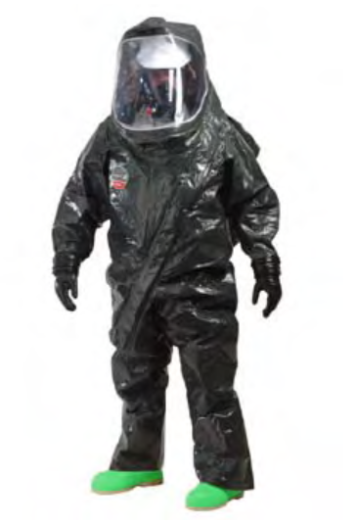
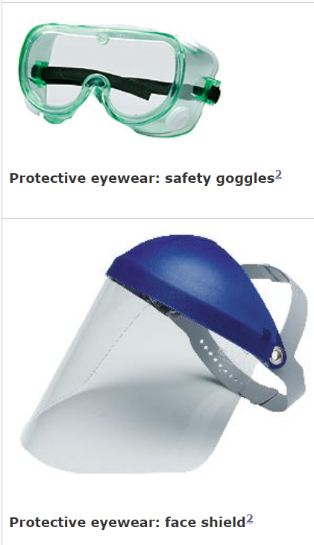
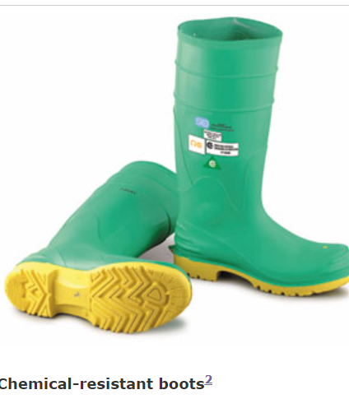
PERSONAL PROTECTIVE EQUIPMENT (PPE) SELECTION AND USE

Slide 2
OBJECTIVES
Upon completion of this lesson you will be aware about-
Introduction
Definition and parts of PPE
Steps of wearing of PPE
Determination level of protection in CBRN Emergencies
Selection of PPE depending on various emergency.
Limitation of PPE.

Slide 3
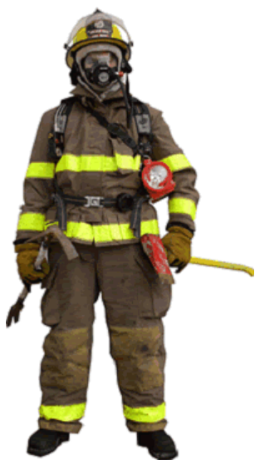
INTRODUCTION
As a responder, the first and foremost duty is to rescue / safe life in any emergency considering self safety precaution. Therefore the only precautionary steps to protect and prevents ourself and victim from any hazard(CBRN) is Personal Protective Equipment.
It is a specialized clothing or equipment which can create a barrier between a potential hazard and the user.

Slide 4
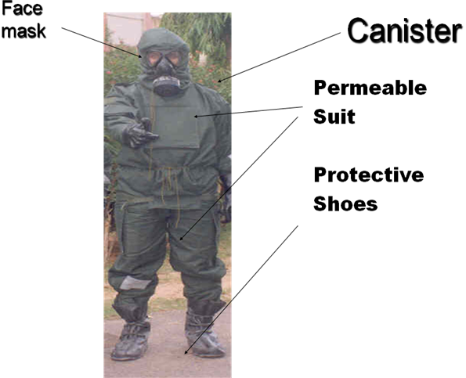
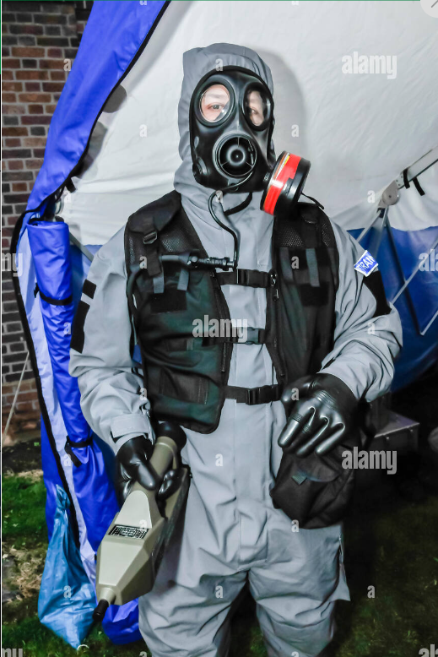
DEFINATION AND PARTS OF PPE
Protective equipment which is used for respiratory and body protection by an individual to achieve physical protection is termed as PPE
Gas Mask
Trousers
Jacket with hood
Over boots/gumboots
Gloves

Slide 5
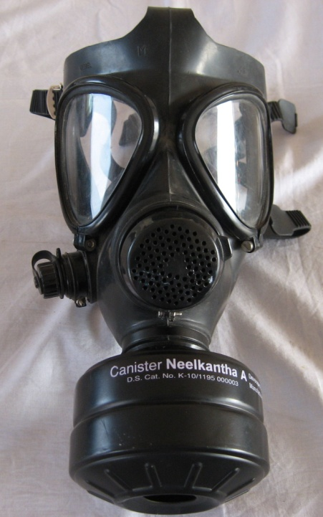
PARTS OF CBRN PPE
NBC RESPIRATOR
NBC respirator has been developed by DEBEL Bangalore.
It is a twin eye gas mask made-up of Bromo butyl rubber.
It provides protection of more than 24 hours against Sulphur Mustard.
It incorporates water drinking facility to take nutrients or water to overcome
the fluid loss from body.

Slide 6
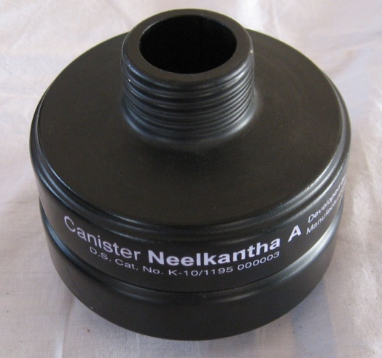
NBC CANISTER
NBC Canister, Neelkanth has been developed by DRDE, Gwalior in aluminum body.
It consist of HEPA filter for removal of nuclear dust, aerosols, particulates and bacteria.
Impregnated carbon for removal of chemical vapour and gases.
It provides protection against persistent gases for 02 Hours of contaminant concentration.

Slide 7
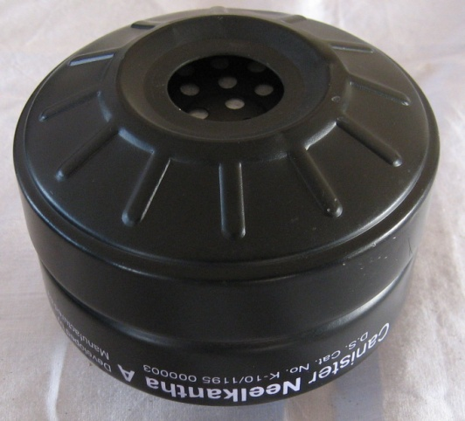
Air Filtration Capacity: 95 L/min
Particulate Removal Efficiency:
Not less than 99.97 % against
0.3 Micro size particulate.
Protective Potential: 120 Minutes (02 Hours)
Self Life & Storage Condition: 05 year life store at damp free location
NBC
CANISTER

Slide 8
WHEN CANISTER IS REQUIRED TO BE CHANGE
  Sudden feeling of the effect of agent
  When breathing resistance become excessive
  When canister is emerged in water
  When canister is damage
  Expiry of self life of 7 years
  When order by leader
  After Two hours of chemical emergencies

Slide 9
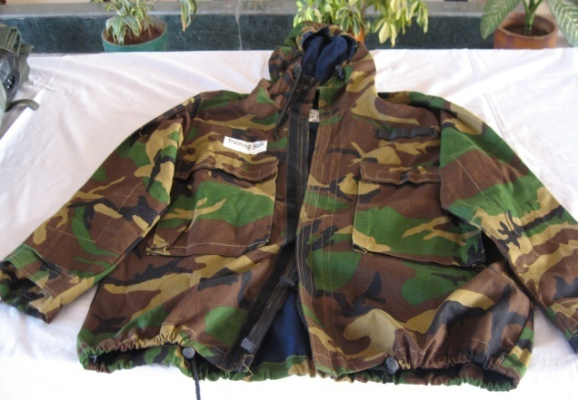
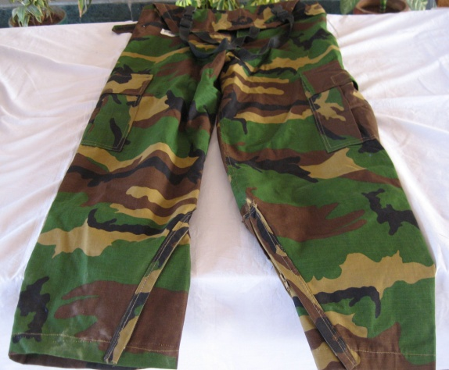
PROTECTIVE CLOTHING
This has been made by DMSRDE, Kanpur and it consist of three layers.
Upper Layer : Oil, water, fire-retardant, nylon fabric.
Middle Layer : Carbon coated,
non-woven fabric.
Third Layer : Simple cotton fabric layer.
The clothing provides 06 to 08 hrs protection against Sulphur mustard.

Slide 10
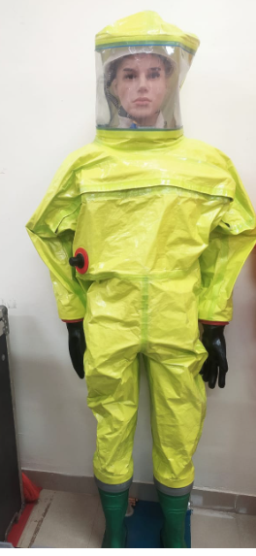
IMPERMEABE PROTECTIVE
CLOTHING
It is a clothing impermeable both to air, chemical
vapors and gases.
It has been developed by DMSRDE, Kanpur.
It is made up of nylon fabric coated outside with neoprene
and another side with butyl rubber.
It gives protection against sulphur mustard for 02 to 03 Hours.
It is used for decontamination purpose.

Slide 11
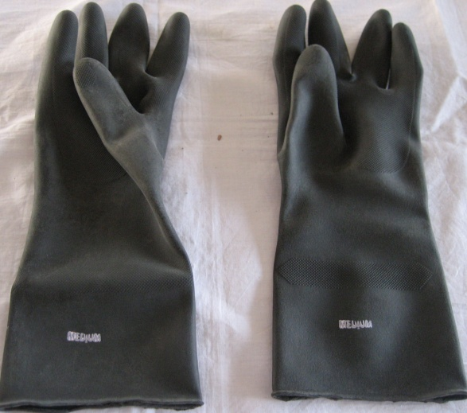
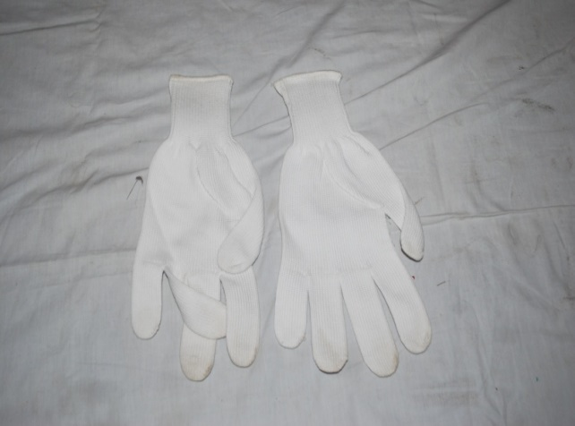
GLOVES
The item has been developed by DMSRDE, Kanpur
Inner gloves are made up of cotton to absorb moisture.
Outer gloves are made of butyl rubber.
Protection against Sulphur-Mustard for more than 20 Hours.

Slide 12
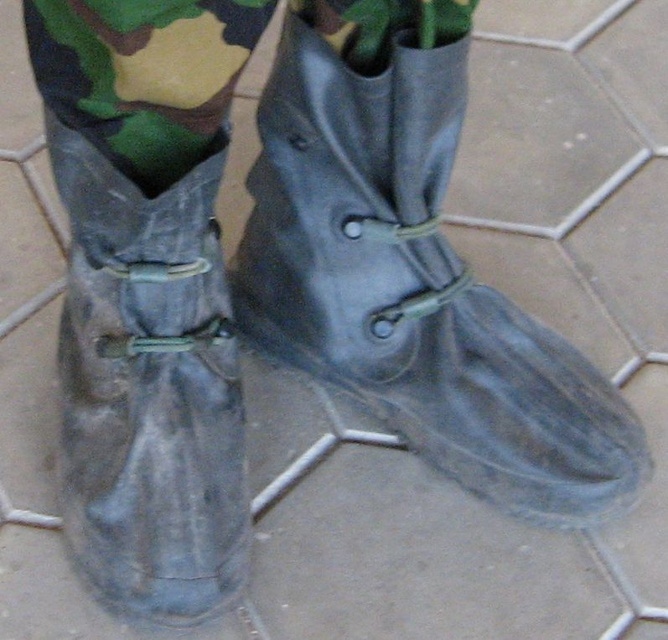
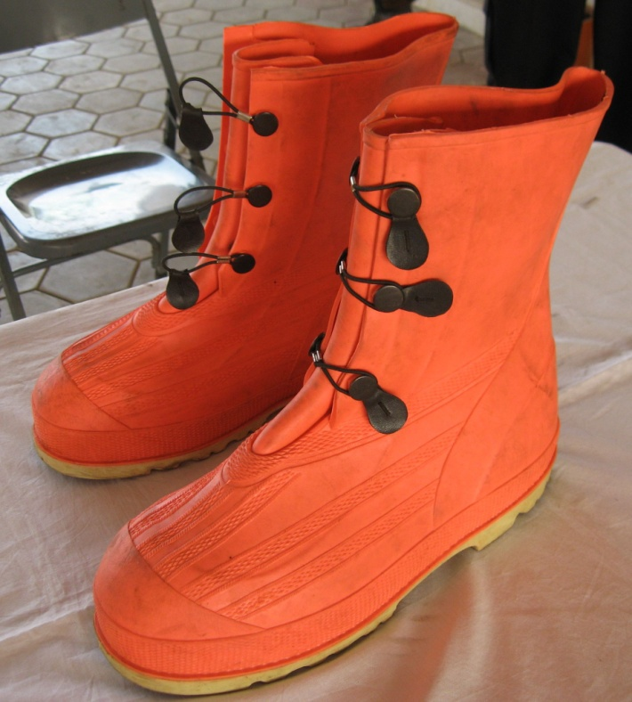
OVER
BOOTS
Over boots has been made by DMSRDE, Kanpur.
Over boots made up of butyl rubber.
Provide protection against Sulphur Mustard for more than 24 hours.

Slide 13
STEPS
TO
WEAR PPE
Mission Oriented Protected Posture
(MOPP) :-
MOPP (0)- Normal dress with PPE in hand
MOPP (1)- Trouser with smock (Jacket) total time 4min 30 sec.
MOPP(2)-Boot & Inner Gloves Total time- 2 min 30 sec
MOPP(3) – Face mask & Outer Gloves 1min 30sec , close eye stop
breathing and shout gas gas..
MOPP(4)- Canister 9 sec.
Total time- 8min 39sec

Slide 14
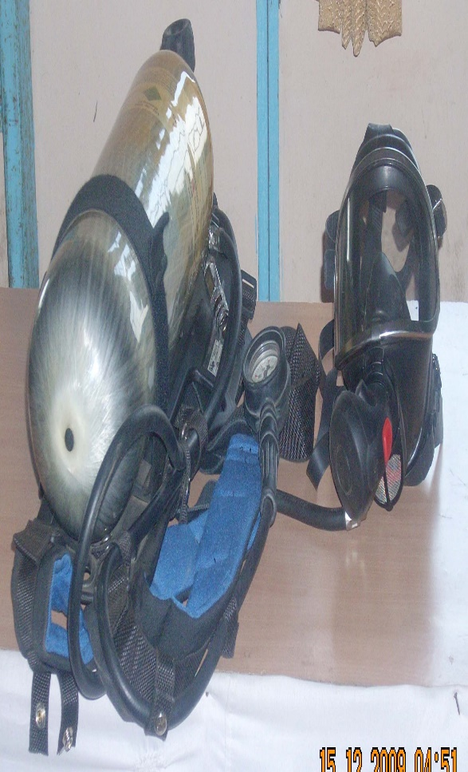
Determination of level of protection
The combination of chemical protective clothing & Respiratory protection determines the level of protection.
Level of Protection
Level “A”. (SCBA + Impermeable suit)
Highest level of respiratory and skin protection.
Level “B”.(SCBA+ Permeable suit)
Highest level of respiratory and lower level skin protection.
Level “C”. (respirator/ canister + over all Chemical Suit(PVC)
Lowest level of respiratory and skin protection.
Level “D”. ( Pocket mask + PVC Apron)
No respiratory protection.

Slide 15
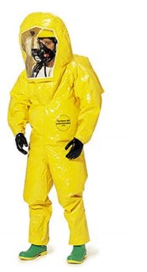
LEVEL ‘A’ PROTECTION
Protection should be worn when the highest level of respiratory, skin, eye and mucous membrane protection is needed.
Positive pressure, SCBA or positive pressure supplied air
respirator.
Fully encapsulating chemical protective suit.
Gloves inner chemical resistant.
Gloves outer chemical resistant.
Boots chemical resistant, steel toe and shank.

Slide 16
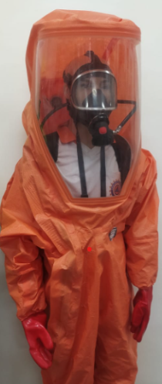
LEVEL ‘B’
PROTECTION
This level of protection should be selected when the highest level of respiratory protection is needed, but a lesser level of skin and eye protection is needed.
Positive pressure, SCBA or positive pressure
supplied air respirator.
Chemical resistant clothing.
Gloves inner chemical resistant.
Gloves outer chemical resistant.
Boots chemical resistant, steel toe and shank.

Slide 17
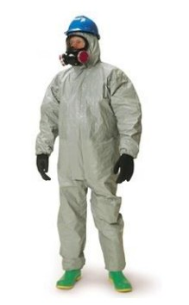
LEVEL ‘C’ PROTECTION
This level of protection should be selected when the type of airborne substance is known, concentration measured, criteria for using air-purifying respirators met and skin and eye exposure is unlikely.
Full face or half-mask, air purifying respirator.
Chemical resistant clothing (disposable
chemical resistant coverall)
Gloves inner chemical resistant.
Gloves outer chemical resistant.
Boots chemical resistant, steel toe and shank, chemical resistant

Slide 18
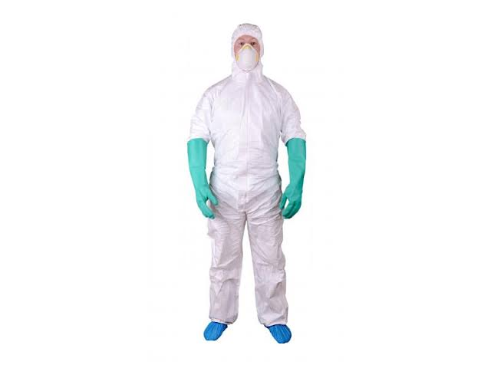
LEVEL ‘D’ PROTECTION
This level of protection is prionlymarily a work uniform and is used for nuisance contamination only. It requires coveralls and safety shoes.
Other PPE is based upon the situation.
It should be worn on any site where respiratory or skin hazards exist.

Slide 19
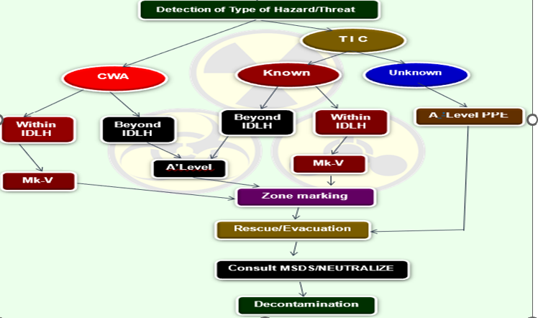
Selection Of Ppe In Chemical Emergency

Slide 20
LIMITATIONS OF PPE
Physiological discomfort
Breathing resistance & heat stress
Less vision & difficulty in comm.
Loss of feel and touch
Cumbersome handing of equipment with gloves

Slide 21
REVIEW
Introduction
Definition and parts of PPE
Steps of wearing of PPE
Determination level of protection in CBRN Emergencies
Selection of PPE depending on various emergency.
Limitation of PPE.

Slide 22


ANY QUESTION ?

Slide 23
EVALUATION
Q. What will be your PPE level for unknown chemical emergency?
Ans: Level ‘A’ .

Slide 24

THANK YOU

