Slide 1


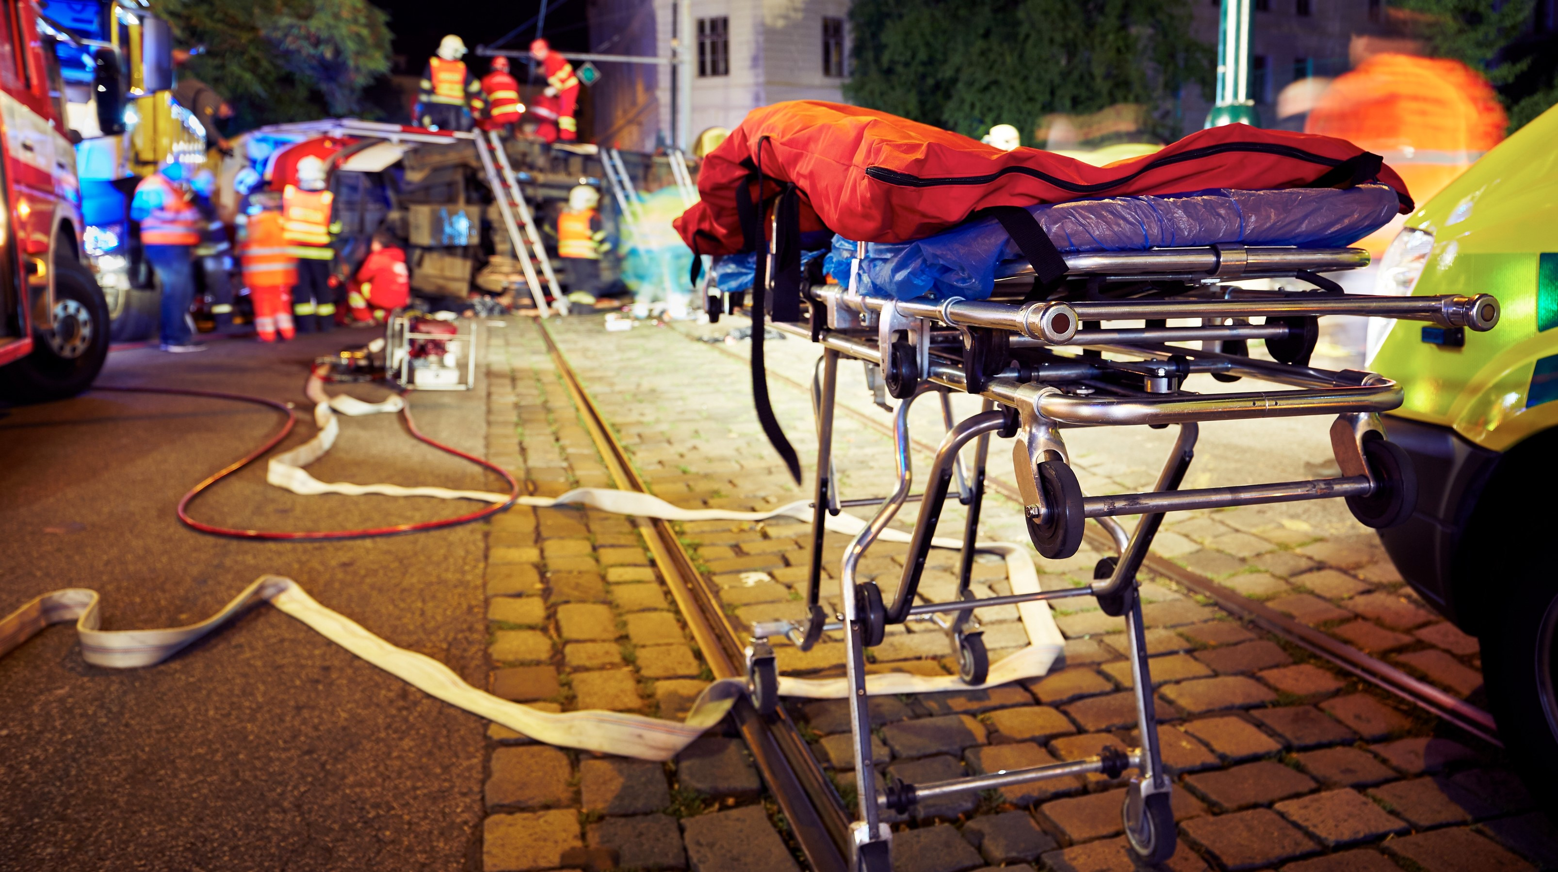

MEDICAL FIRST RESPONDER
LESSON 19
Lifting and Moving Patients
NDRF | MFR | INDIA
PPT 19 - 1

Slide 2
OBJECTIVES
Upon completing this lesson, you will be able to:
1
  List three emergency moves and two non-emergency moves for lifting and moving a patient.
  Demonstrate the techniques for immobilising and transporting
  a patient using a backboard.
2

Slide 3
OBJECTIVES
Upon completing this lesson, you will be able to:
3
  Name five examples of situations that might require you to make
  an emergency move with a patient.

Slide 4
Body Mechanics
The proper use of your body to facilitate lifting and moving, and to prevent injury.

Slide 5
Emergency Moves
Make an emergency move only when there is immediate danger to the patient.

Slide 6
Situations Requiring Emergency Moves
1
2
3
Inability to protect the patient
from hazards
Fire or
threat of fire
Explosion or threat of explosion

Slide 7
Situations Requiring Emergency Moves
Cont.
4
5
To gain access
to other patients who need care
Life-saving care cannot be given
at location

Slide 8
Moving Patients
Moves and Carries
Emergency Moves | Non-Emergency Moves
Shirt drag | Direct Ground Lift
Forearm / Shoulder | Extremity Lift
Blanket / Sheet drag
Cradle Carry
Firefighter Drag
One-rescuer Crutch

Slide 9
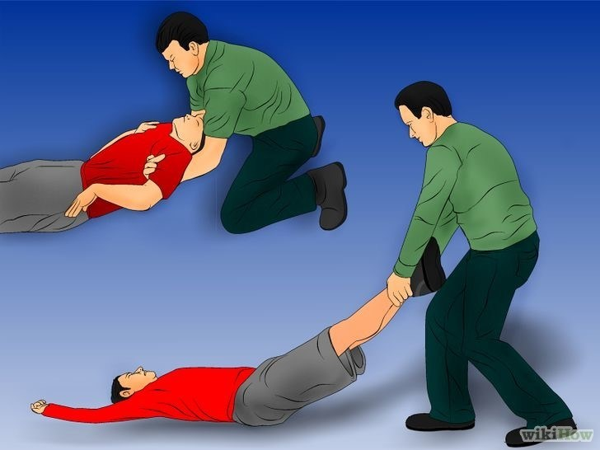
GROUND LEVEL RESCUE/ EVACUATION
Shoulder pull
ONE RESCUER
Evacuation techniques.
“Pull with your legs not your back”
Ankle pull(fastest and for smooth surface)

Slide 10
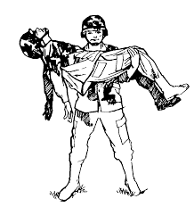
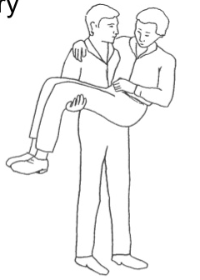
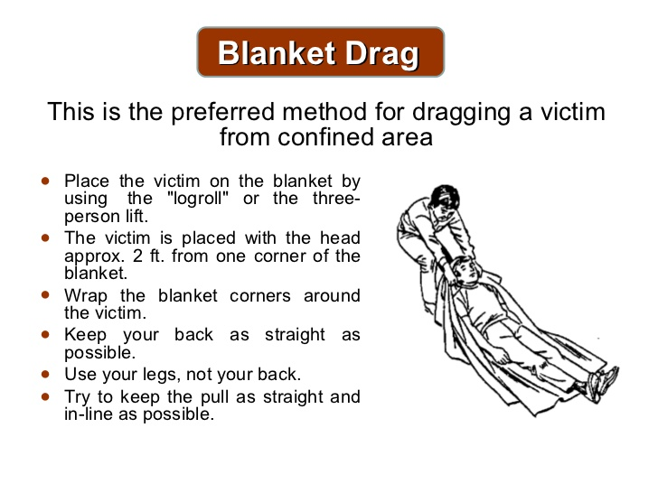
Cradle method
(one person arm carry)
Blanket Drag.
Preferred method for dragging victim in confined space
This only works with a child or a very light person.

Slide 11

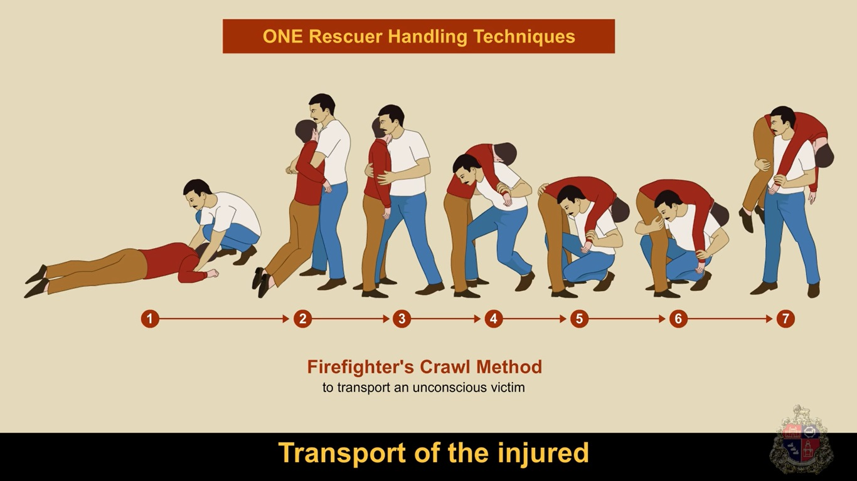
Firefighters carry.

Slide 12
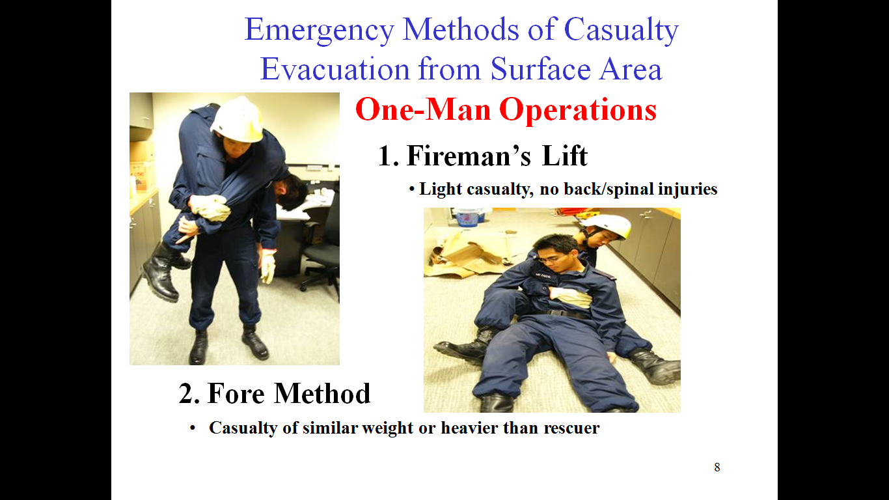
Emergency methods of casualty evacuation from surface area one-man operation:-
1. Fireman lift.
2. Fore Method
Casualties of similar weight/heavier.

Slide 13
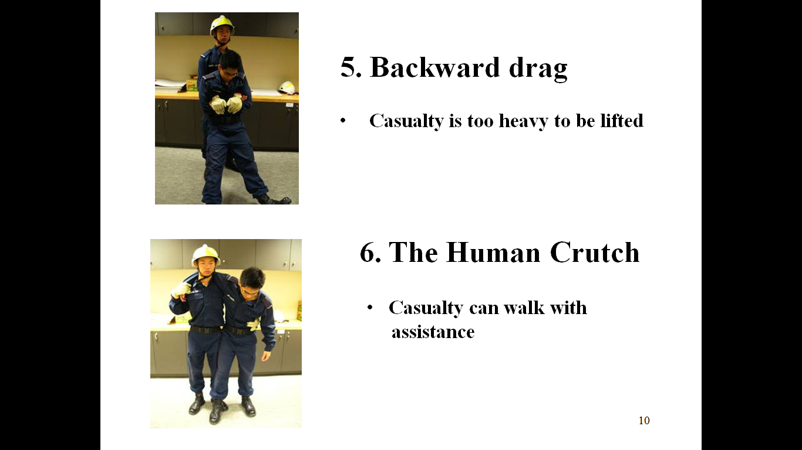
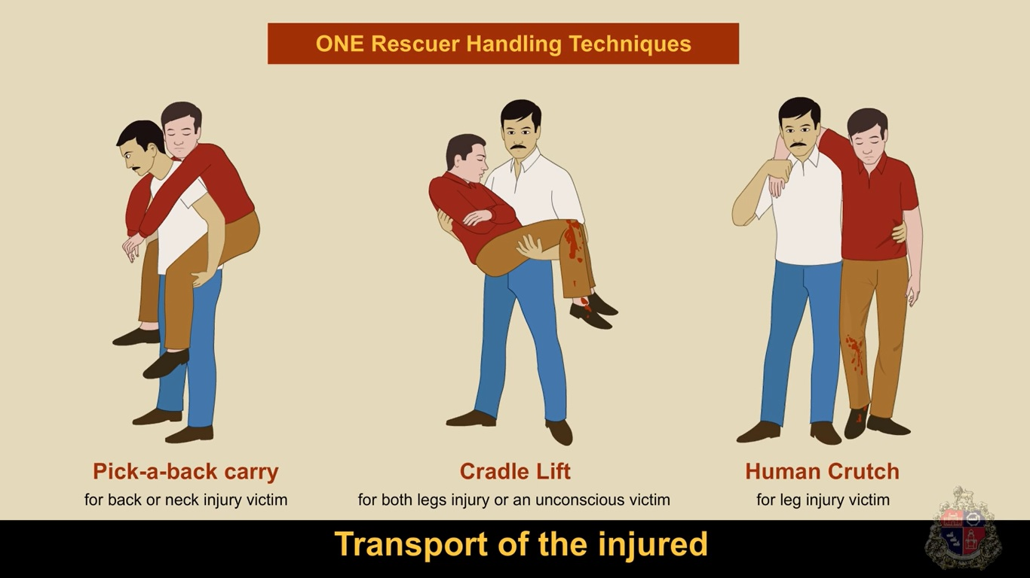
Backward Drag.
Human Crutch.
Casualty is too heavy to be lifted.
Casualty can walk with assistant.

Slide 14
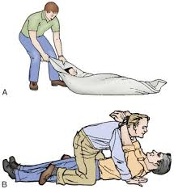
Pack-Strap Carry (Piggy Back Carry).
Tied Hand Crawl.
Used to drag an unconscious victim for a short distance. Not preferred as victim head is not supported.
For long distances to lift a victim safely.

Slide 15
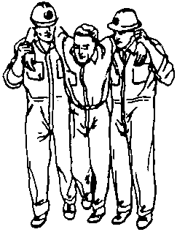
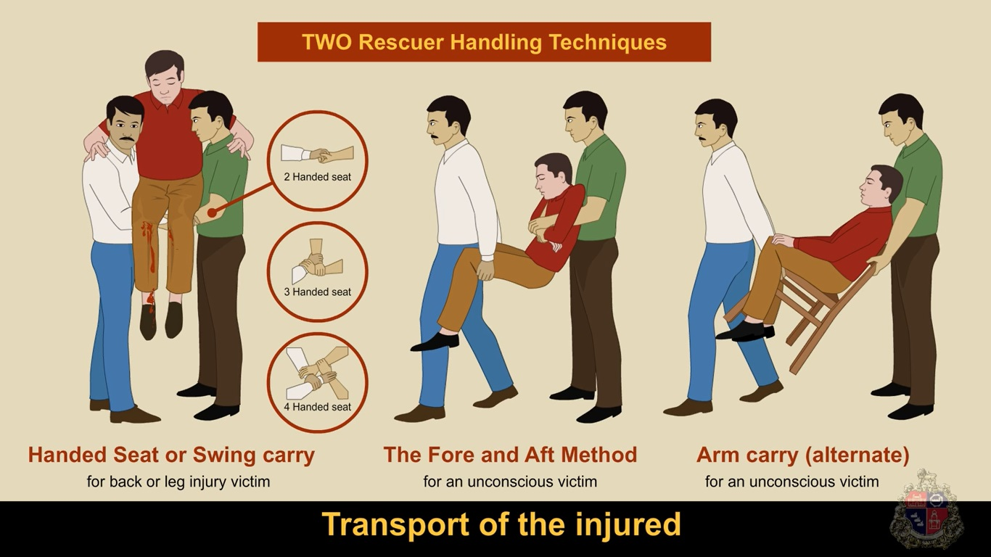
Two rescuer evacuation techniques
Two rescuer Human Crutch.
2. Two/Three/Four Handed seat.

Slide 16
3. The fore and Aft Method.
4.Chair carry.

Slide 17
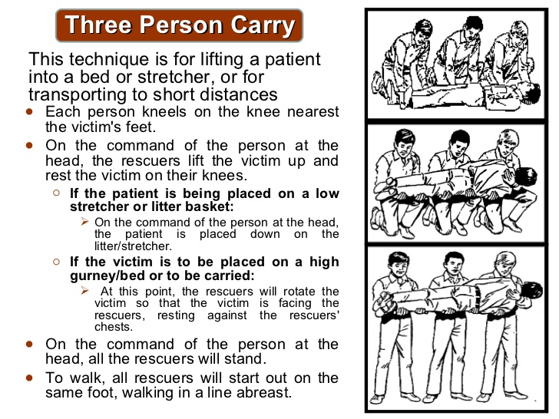
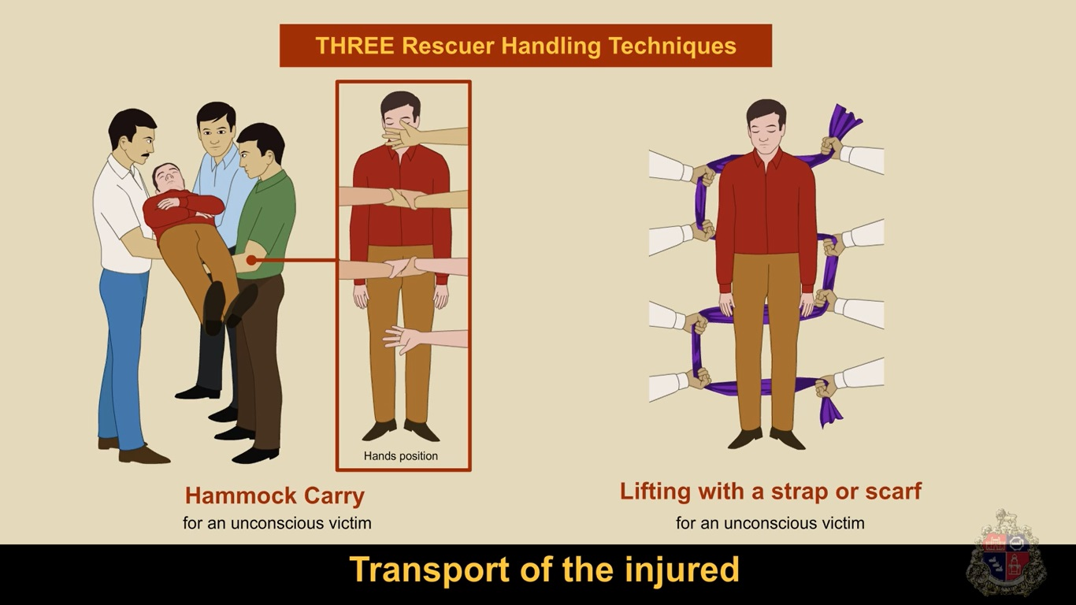
Three/more rescuers evacuation techniques.
2. Three person carry
(Three-person stretcher carry)
Hammock carry.

Slide 18
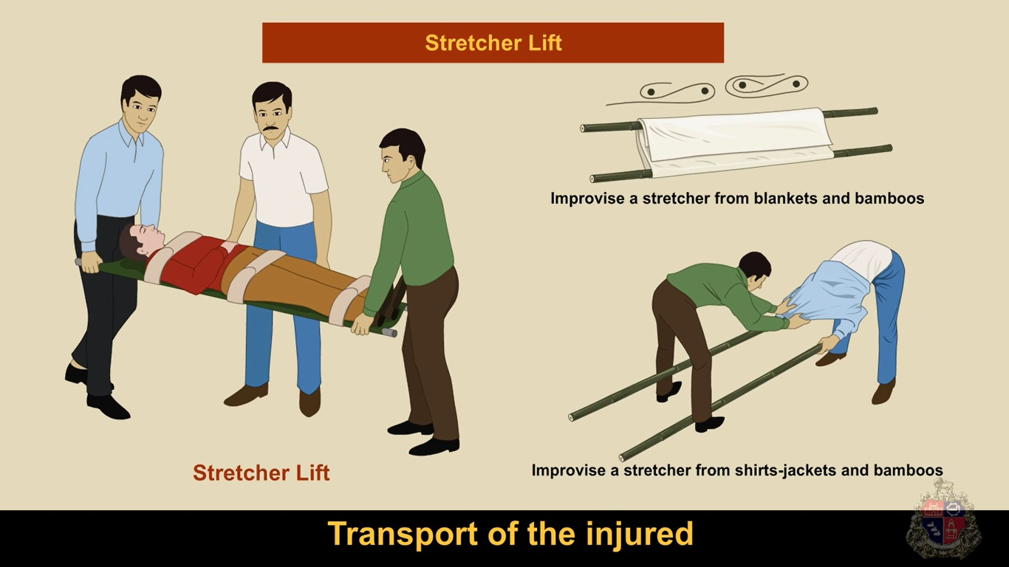
EMERGENCY STRETCHER
1. Improvised stretcher.
2. Blanket Stretcher.

Slide 19
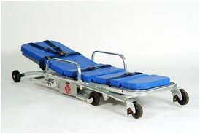
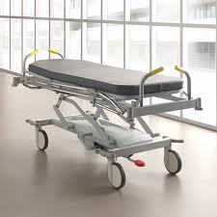
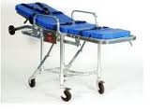
Patient Carrying Equipment
Wheeled stretchers

Slide 20
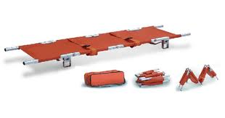
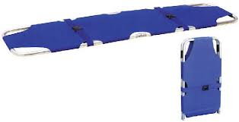
Patient Carrying Equipment
Folding stretchers

Slide 21
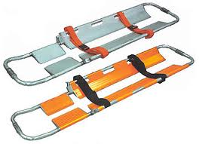
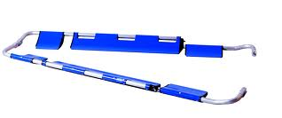
Patient Carrying Equipment
Scoop stretchers

Slide 22
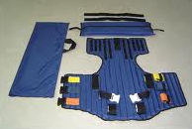
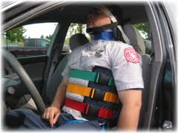
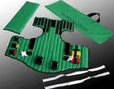
Patient Carrying Equipment
Vest-type extrication device

Slide 23
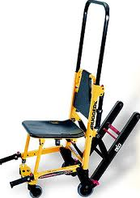
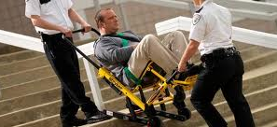
Patient Carrying Equipment
Stair chair

Slide 24
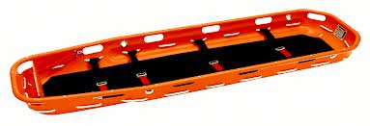
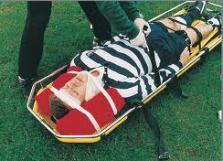
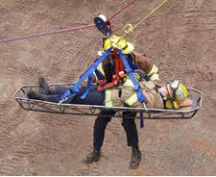
Patient Carrying Equipment
Basket stretcher

Slide 25
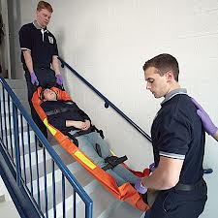
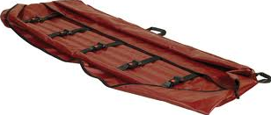
Patient Carrying Equipment
Flexible stretcher

Slide 26
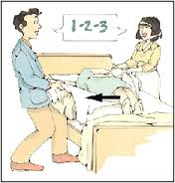
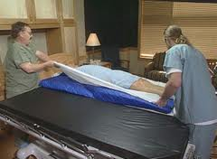
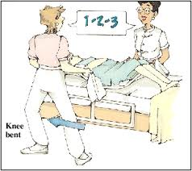
Patient Carrying Equipment
Draw Sheet

Slide 27


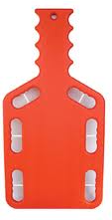
Patient Carrying Equipment
Backboards

Slide 28


THANK YOU

