Slide 1


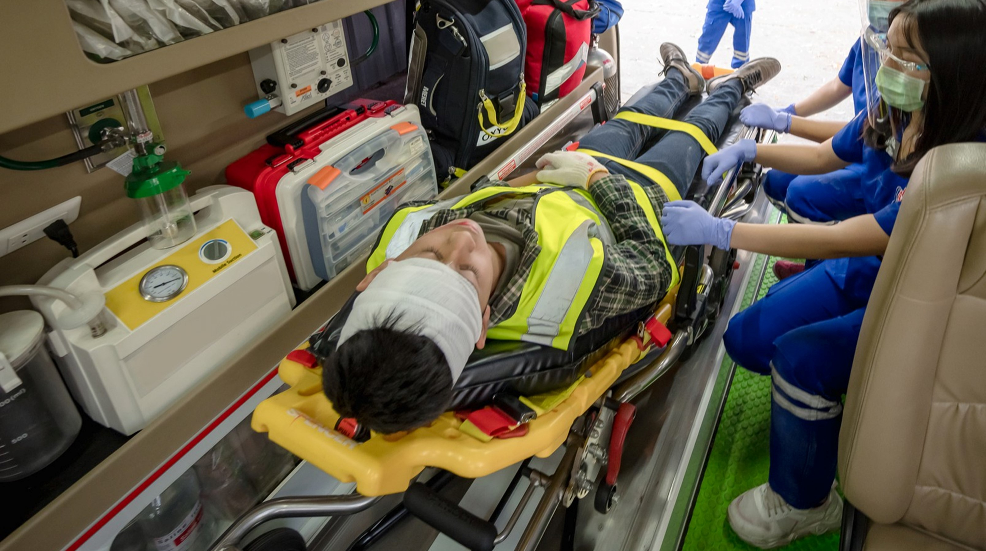

MEDICAL FIRST RESPONDER
LESSON 22
Course Review
Presented By:- Kamal Mehra,2IC
PPT 22 - 1
NDRF | MFR | INDIA
PPT 2 -

Slide 2
OBJECTIVES
Upon completing this lesson, you will be able to:
1
  To answer questions and resolve issues that were recorded in the “File” by participants.
  To review the most important practical procedures that were demonstrated and practiced throughout the course.
2

Slide 3
OBJECTIVES
Upon completing this lesson, you will be able to:
3
  To outline what is expected in
  the Final Practical Evaluation and answer any questions regarding the Evaluation.

Slide 4


THANK YOU

