Slide 1





MEDICAL FIRST RESPONDER
MULTI CASUALTY INCIDENTS AND TRIAGE
Presented By:- Kamlesh Dhoundiyal,2IC
PEER | CSSR | INDIA
PPT 2 -

Slide 2

OBJECTIVES
Define Incident Command System (ICS)
List the five function sectors of the (ICS)
Define Triage.
List the four categories of triage.
List the three benchmarks of the START system of the Triage.
Upon completion of this lesson, you will be able-

Slide 3
INCIDENT COMMAND SYSTEM (ICS)
A Flexible System (collection of organized things) for Managing People & Resources.
This provides a frame work for all types of incidents.
The ICS provides a command structure through which to manage multiple casualty incidents.

Slide 4
INCIDENT COMMAND SYSTEM (ICS)
The incident command system one component of the system will take care of triage ,treatment and transportation of the victims.
The ICS is command in many systems used to deal with multiple casualty incidents.

Slide 5
INCIDENT COMMAND SYSTEM (ICS)

Slide 6
EMS SECTORS & FUNCTIONS
Triage sector –provides patient assessment, tagging and removal of patients to a designated treatment area
Treatment sector – sets up a treatment area .

Slide 7
EMS SECTORS & FUNCTIONS
Transportation sector- arranges for ambulance and track patients
Staging sector (A place to support) - releases and distributes resources when they are needed
Safety officer- maintain scene safety

Slide 8
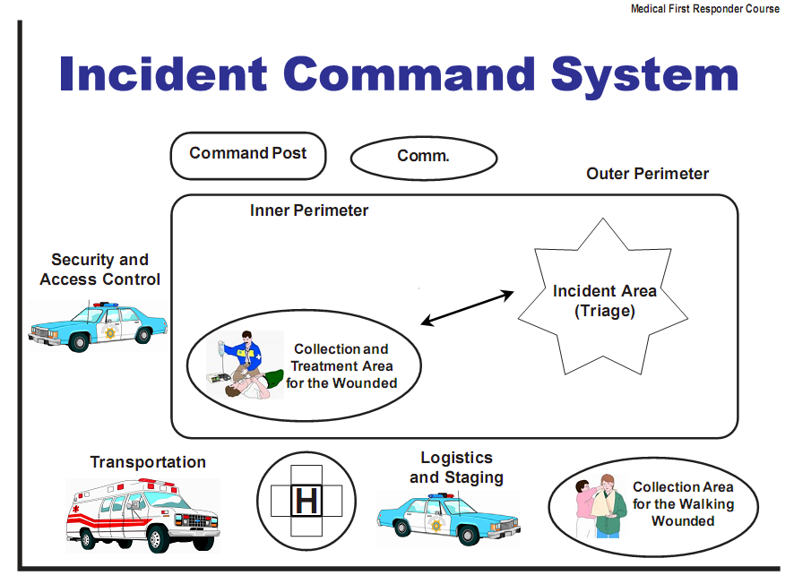
INCIDENT COMMAND SYSTEM (ICS)

Slide 9
ROLE OF MEDICAL FIRST RESPONDER
Establish command
Assess the scene
Request additional resources
Begin triage

Slide 10
SCENE ASSESSMENT
Scene safety
Number of patient
Needs for extrication
Estimated number of ambulances required

Slide 11
SCENE ASSESSMENT
No. of sectors required
Area to stage resources
Make an initial scene report to EMS dispatch. Give all info. neccessary for other rescuers to react to MCI appropriately

Slide 12
TRIAGE
The process of sorting patients to determine the order in which they will receive care.
It is French word meaning ‘Pick” or ‘Sort’.

Slide 13
WHY TRIAGE AND TAG ?
Sorting of patients to provide for the survival of the most patients.
Assignment of resources in the most efficient method.
Most severe survivable injuries receive rapid treatment.
Accountability of patients.

Slide 14
“S.T.A.R.T.” Method of Triage (Simple Triage And Rapid Treatment)
Priority -1 RED
Priority -2 YELLOW
Priority -3 GREEN
Priority -0 BLACK

Slide 15
“S.T.A.R.T.” METHOD OF TRIAGE (SIMPLE TRIAGE AND RAPID TREATMENT)
Priority 1-RED: Highest priority, assigned to patients with critical conditions such as.
Airway and breathing difficulties, uncontrolled or severe bleeding and decreased mental status.

Slide 16
“S.T.A.R.T.” METHOD OF TRIAGE (SIMPLE TRIAGE AND RAPID TREATMENT)
Priority 2- YELLOW : Second priority or urgent care category. Assigned to patients with conditions such as.
Burns without airway problems and major or multiple painful, swollen or deformed extremities; and back injuries.

Slide 17
“S.T.A.R.T.” METHOD OF TRIAGE (SIMPLE TRIAGE AND RAPID TREATMENT)
Priority 3 – GREEN : Lowest priority or delayed .
Assigned to patients who are not seriously injured, need minimum care, and can wait for treatment without getting worse.
This includes patients with minor painful, swollen, or deformed extremities, minor soft-tissue injuries.

Slide 18
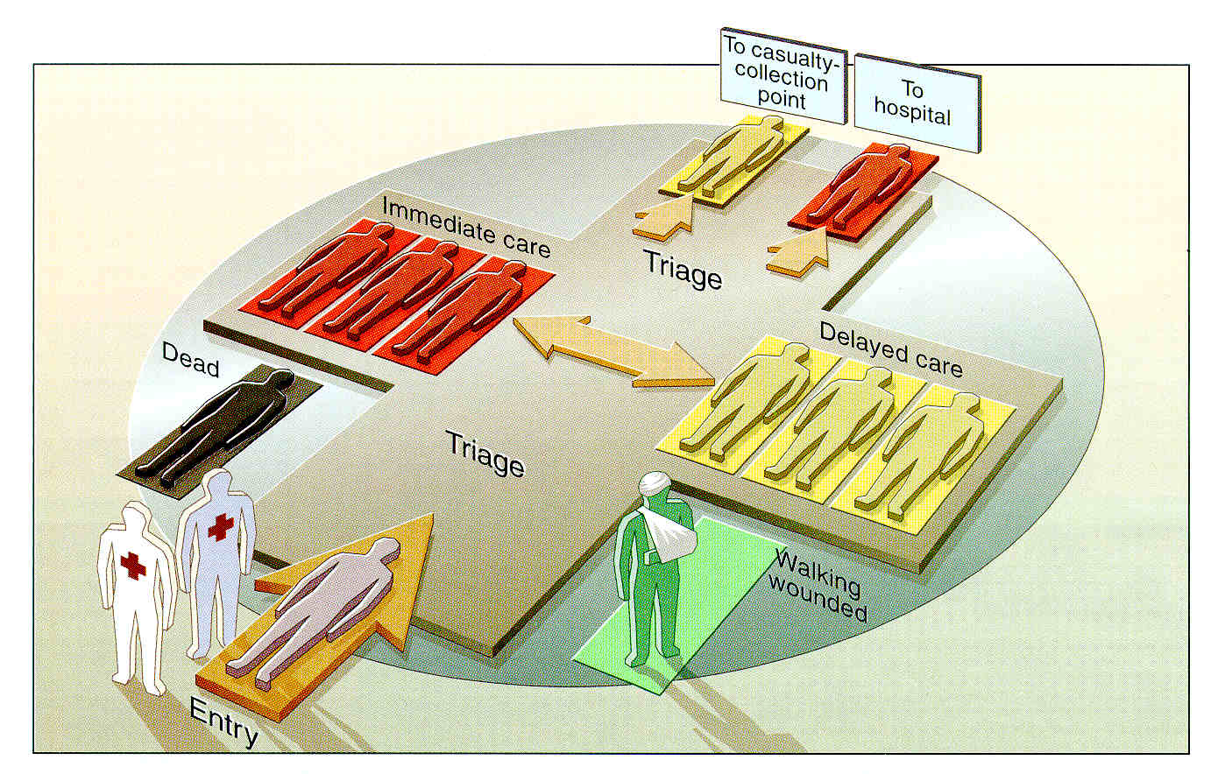

Slide 19
S.T.A.R.T. SYSTEM BENCHMARKS:
R- Respiration
P - Perfusion
M- Mental status

Slide 20
RESPIRATION
Breathing is faster than 30 and less than 11 respirations per minute, assign Priority 1 – RED
Not breathing. Make one attempt to open the airway and clear foreign material from the mouth. If unassisted breathing resumes- Priority 1 – RED.
If breathing does not resume-Priority 0- BLACK.

Slide 21
PERFUSION
Assess Capillary refill. more than 2 second
indicates inadequate perfusion, Priority 1 –RED.
Control all major hemorrhages.
If capillary refill is less than 2 seconds, perform
mental status assessment.
In case of poor lighting, check radial pulse.
Absent pulse indicates low BP and inadequate
perfusion.

Slide 22
MENTAL STATUS
If patient is unable to respond to simple commands such as “close your eyes,”
assign Priority 1- RED.
If the patient is able to respond, assign
priority 2-YELLOW.

Slide 23
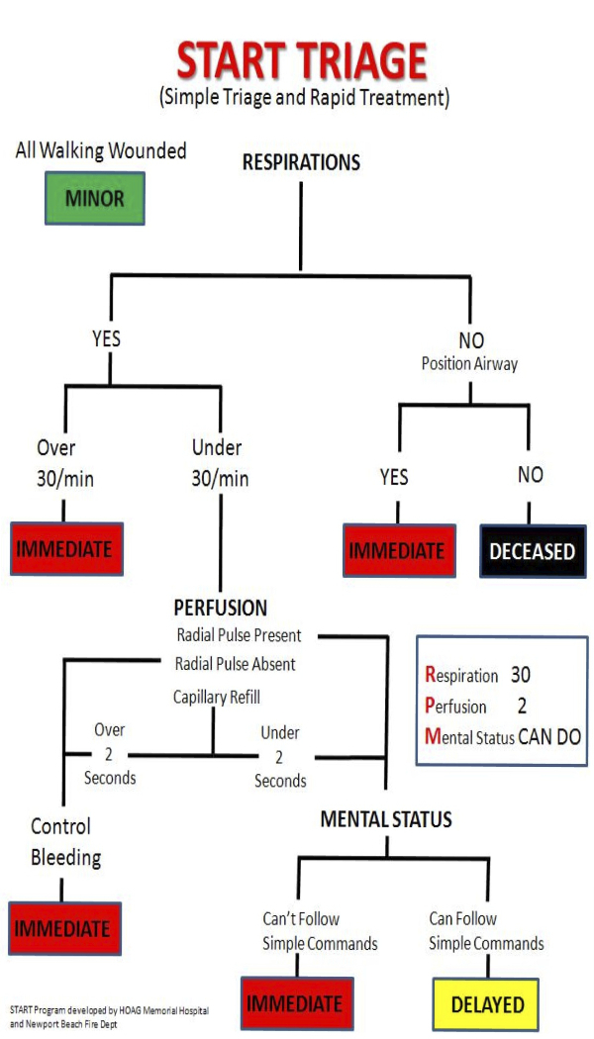
START TRIAGE

Slide 24
REVIEW
Now you are able to –
Define Incident Command System (ICS)
List the five function sectors of the (ICS)
Define Triage.
List the four categories of triage.
List the three benchmarks of the START
system of triage.

Slide 25
ANY QUESTIONS?

Slide 26
EVALUATION
Q.01-How many categories of triage with their associated colours?
Ans.-Four.
Q.02-How many benchmarks of START in triage?
Ans.-Three.

Slide 27



THANK YOU

