Slide 1





MEDICAL FIRST RESPONDER
POISONING
Presented By:- Kamlesh Dhoundiyal,2IC
PEER | CSSR | INDIA
PPT 2 -

Slide 2

OBJECTIVE
01. List the signs and symptoms of poisoning, and steps for pre-hospital treatment.
02. List four specific signs and symptoms of ingested, inhaled and absorbed poisons.
03. List the signs and symptoms of injected poisons, including snakebites and the steps for pre-hospital treatment.
04. List the signs and symptoms for alcohol and drug abuse and the steps for pre-hospital treatment.
Upon completion of this lesson, you will be able to:

Slide 3

-Any substance that can impair or cause death of cell’s structure or function.
POISONS

Slide 4
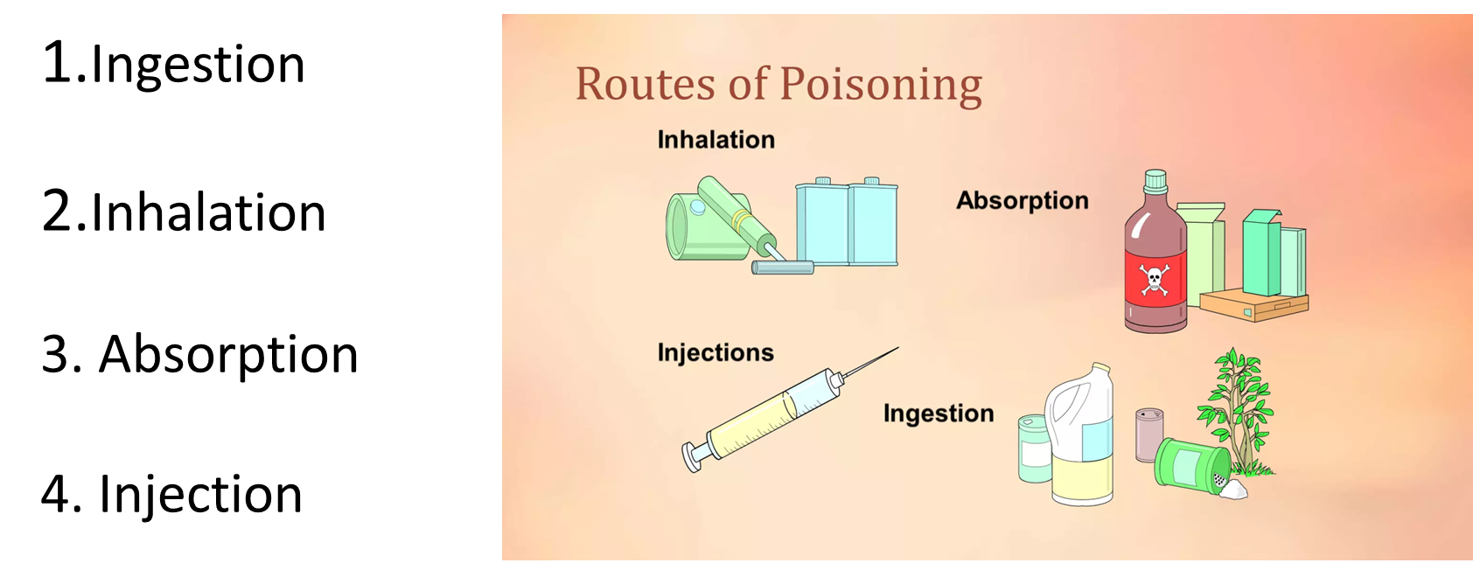
POISONS CAN ENTER THE BODY FOUR WAYS

Slide 5
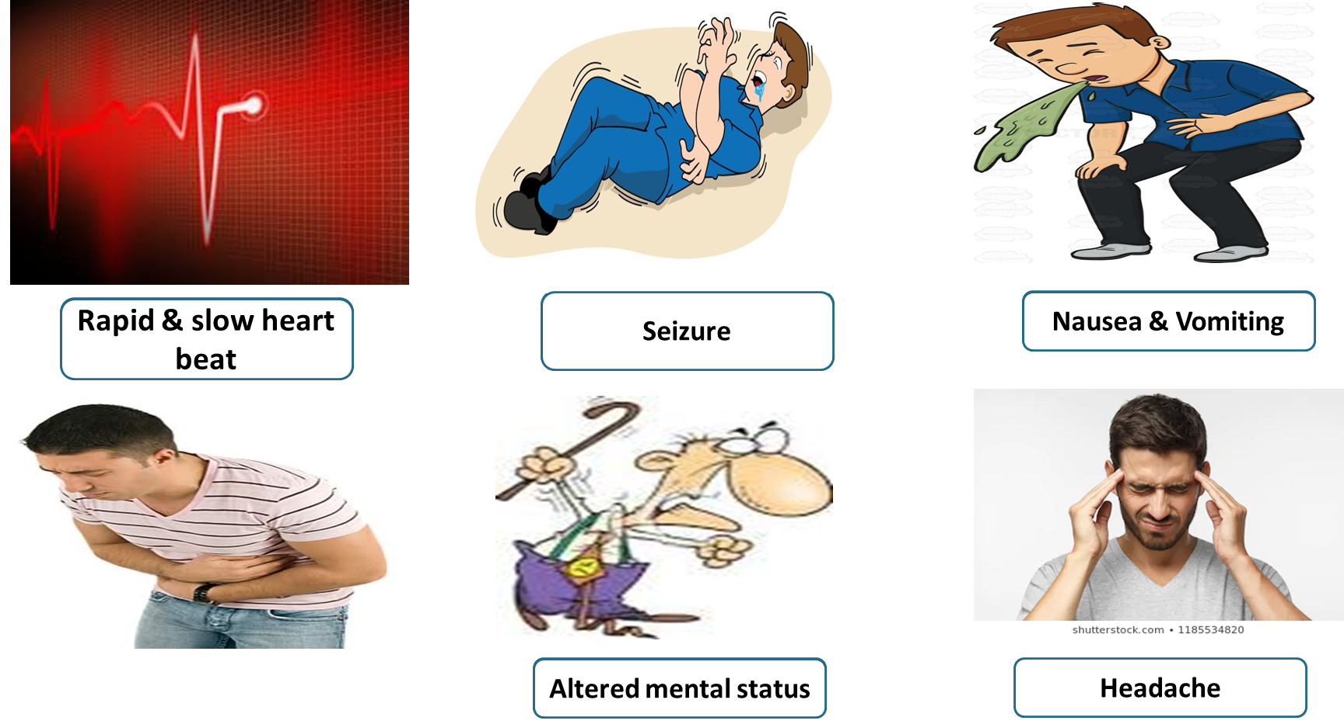
GENERAL SIGNS AND SYMPTOMS OF POISONING
Abdominal pain

Slide 6
GENERAL SIGNS AND SYMPTOMS OF POISONING
Rapid or slow heart rate
High or low blood pressure
Possible dilation or constriction of pupils
Shortness of breath
Injury to skin (discoloration, burns, injection marks, swelling)
Diarrhea

Slide 7
Pre-hospital Treatment for Poisoning
Move the patient away from the source of the poisoning, especially in inhalation and absorbed poisoning
For absorbed poisons:
▪ Remove the patient’s clothing.
▪ Blot the poison from the skin with a dry cloth. If the poison is a dry powder, brush it off.
▪ Wash the affected area with ample amount of water until EMS arrives.

Slide 8
PRE-HOSPITAL TREATMENT FOR POISONING
Maintain open airway. Administer oxygen if needed.
Perform initial assessment. Do not perform mouth to mouth ventilation in case of inhaled or ingested poison. Use the BVM.
Call your local poison control Centre, if available.
Perform physical exam.

Slide 9
PRE-HOSPITAL TREATMENT FOR POISONING
For ingested poisons:
Do not give the patient anything (milk, water or activated charcoal) to dilute the poison.
In case of vomiting, position the patient to prevent aspiration. Save vomit for analysis.
Bring the suspected source, container, labels, or other evidence of the poison to the hospital
Treat for shock.
Continually monitor the patient. Transport the patient.

Slide 10
INGESTED POISONS
An ingested poison is one that is introduced into the digestive tract by way of the mouth.

Slide 11
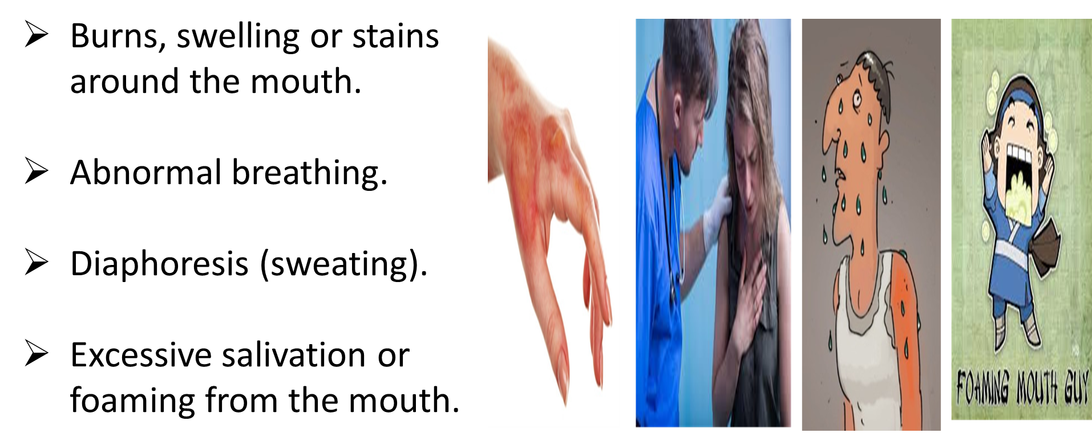
SIGNS AND SYMPTOMS OF INGESTED POISONS

Slide 12
ORGANOPHOSPHORUS POISONING
Organophosphate (OP) compounds are a diverse group of chemicals used in both domestic and industrial settings.

Slide 13
EFFECTS OF ORGANOPHOSPHATE
Salivation secretion.
Lacrimation.
Urination.
Diarrhea.
GI upset

Slide 14
Pre Hospital Treatment for Organophosphorus poisoning
Transfer the patient to safe area (away from exposure).
Remove all clothing and gently clean the patient suspected of organophosphate exposure with soap and water.
Administer oxygen if necessary.
Transfer to hospital immediately.

Slide 15
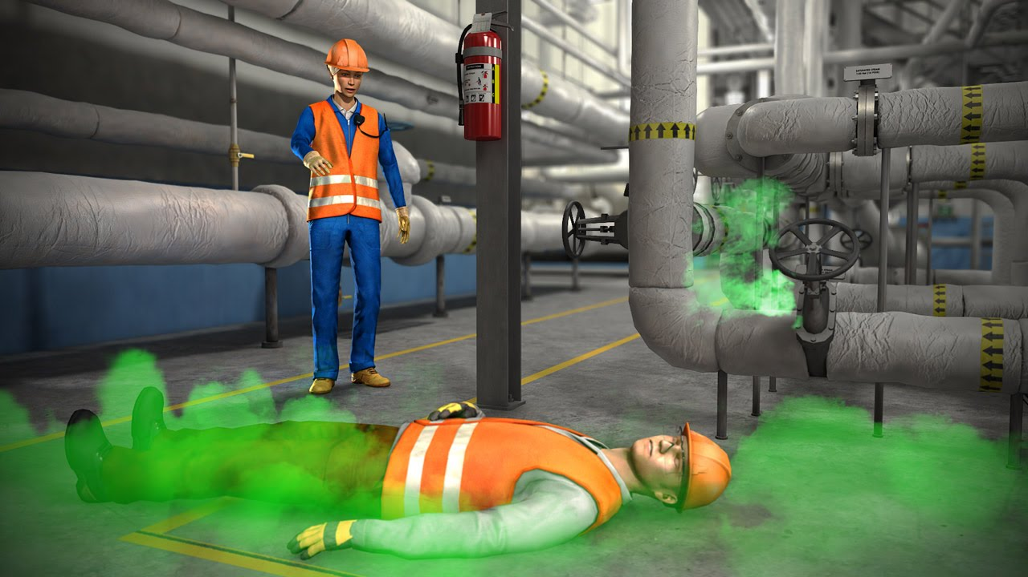
Inhaled poisons
Poisoning caused by fumes and vapors can be swift. The body absorbs inhaled poisons very rapidly. The longer the exposure’s worse the prognosis. Use special mask to gain access to the patient in a hazardous environment.

Slide 16
CARBON MONOXIDE POISONING
Carbon monoxide poisoning occurs after the inhalation of carbon monoxide gas.
Carbon monoxide is colorless, odorless, tasteless, and non-irritating, making it difficult for people to detect.

Slide 17
Pre Hospital Treatment for Carbon monoxide Poisoning
First aid for carbon monoxide poisoning is to immediately remove the victim from the exposure without endangering oneself.
Call for help.
Apply CPR if needed.

Slide 18
Pre Hospital Treatment for Carbon monoxide Poisoning
The main medical treatment for carbon monoxide poisoning is 100% oxygen by a tight fitting oxygen mask. Oxygen hastens the dissociation of carbon monoxide from hemoglobin, improving tissue oxygenation by reducing its biological half-life.
Transport to hospital as soon as possible.

Slide 19

COMMON INHALED POISONS INCLUDE
Carbon monoxide
Carbon dioxide from industrial sites, sewers, and wells
Chlorine gas (common around swimming pools)
Fumes from liquid chemicals and sprays
Ammonia
Sulphur dioxide (used to make ice)
Anesthetic gases (ether, nitrous oxide, chloroform)

Slide 20
COMMON INHALED POISONS INCLUDE
Dry cleaning solvents, degreasing agents, or fire extinguishers
Industrial gases
Incomplete combustion of natural gas
Hydrogen sulphide (sewer gas)

Slide 21
SIGNS AND SYMPTOMS
History of inhalation abuse
Chest pain or chest tightness
Burning sensation in chest or
Throat Coughing, wheezing, or rattling

Slide 22
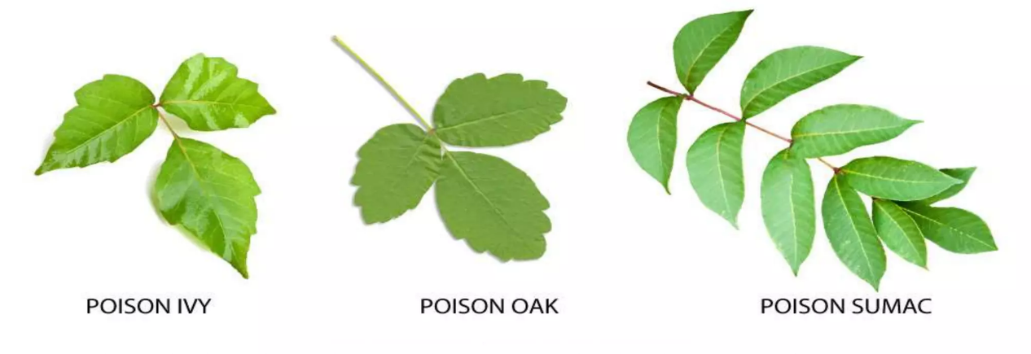
ABSORBED POISONS
An absorbed poison is one that enters the body through contact with the skin.
Natural sources include poison ivy, poison sumac and poison oak.
Man-made sources include corrosive, insecticides, herbicides and cleaning agents

Slide 23
Signs and symptoms of Absorbed poisons
History of exposures.
Liquid or residue on the skin.
Itching or Irritation.
Rash or blisters.

Slide 24
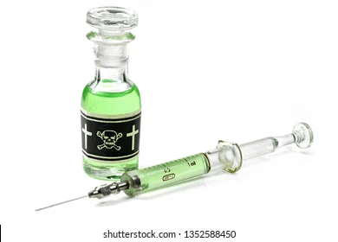

Injected poisons
An injected poison enters the body through a break in the skin. The break can be caused by a needle (drugs), an insect bite or sting, or puncture.

Slide 25
Signs and symptoms of Injected poisons
Needle track.
Pain, swelling, or redness at the injection site.
Bite mark or stinger embedded in the skin.
Numbness at the injury site after a few hours.
Other symptoms similar to ingested poisons.

Slide 26
Pre Hospital Treatment for Injected poisons
Maintain open airway.
Administer oxygen. Be alert for possible vomiting.
Protect yourself and the patient from repeated injections. Cut off patient’s clothing to protect from possible repeated insect stings or bites.
Bring all containers, labels or other evidence of poisoning to the hospital.

Slide 27
Pre Hospital Treatment for Injected poisons
For Bee stings:
A. Remove the stinger together with the poison sac.
B. Use a plastic card and scrape the skin’s surface to keep the sac from breaking inside the patient’s skin.
C. Place a bag of ice or cold pack on the sting.
Conduct a physical exam.
Treat for shock.
Continually monitor the patient during transport.

Slide 28
Snake Bite
These are quite common in certain areas. Signs and symptoms may delay several hours before presenting. Death can occur quickly if the patient has an allergic reaction to the venom.

Slide 29
Signs and symptoms of Snake Bite
Nausea and vomiting.
Weakness, paralysis.
Seizures, decreased level of consciousness.
Puncture wound.
Pain and/or burning sensation around the bite mark.
Blood oozing from the bite mark.
Discoloration and swelling.

Slide 30
Pre Hospital Treatment for Snake Bite
Ensure the scene is safe for you and the patient.
Calm the patient and try to place him/her in a comfortable position.
Locate the bite marks and clean them with water and soap.
Remove rings, bracelets and any restrictive garments from the affected extremity.

Slide 31
Pre Hospital Treatment for Snake Bite
Do not apply tourniquets, do not make incisions around the bite marks, and do not suction the venom from the wound.
Treat for shock and provide basic life support as needed.
Do not give the patient any food or drink.
Identify the Snake.
Administer oxygen if needed.
Continually monitor the patient during transport.
(Only anti-venin works as an antidote for a poisonous snake bite)

Slide 32
Alcohol abuse
Abuse of this drug leads to alcoholism and serious chronic intoxication with great physical and mental deterioration. A patient under the influence of alcohol can be dangerous to him/herself and to others.

Slide 33
Signs and symptoms of Alcohol abuse
Smell of alcohol on the breath and/or clothes.
Staggering.
Slurred speech.
Nausea and vomiting.
Redness of the face.
Altered behavior.

Slide 34
Pre Hospital Treatment for Alcohol abuse
Verify whether it is strictly a case of alcohol abuse (determine if patient is diabetic).
Allow EMS decide if police intervention is required.
Monitor vital signs and stay alert for breathing problems. Be alert for vomiting and take steps to prevent aspiration.
Protect the patient from injury without using restrictive means
Give oxygen if needed. Transport the patient.

Slide 35
Signs and symptoms of Alcohol Withdrawal (Delirium Tremns)
Confusion and restlessness
Altered behavior
Hallucinations
Trembling hands
Spasms or convulsions

Slide 36
Drug Abuse
It is not necessary for the rescuer to know the specific names and the effects of each one of the drugs, but the medical first responder should have the ability to identify a possible case of drug abuse. The five types of frequently abused drugs are:

Slide 37
The five types of frequently abused drugs are:
Stimulants: These stimulate the central nervous system, causing the user to become excited. This group of drugs includes amphetamines, cocaine, caffeine, asthmatic drugs and vasoconstrictive drugs.

Slide 38
The five types of frequently abused drugs are:
2. Depressants: These depress the central nervous system. These reduce pulse and breathing, cause drowsiness and slow the reflexes. (Non- barbiturate sedatives, Diazepam).

Slide 39
The five types of frequently abused drugs are:
3. Analgesic narcotics (Opium-derivatives): Their use produces an intense state of relaxation. Some are easily obtainable, such as codeine found in cough syrups. These drugs reduce body temperature, slow the pulse and breathing, relax the muscles, and cause pupil contraction, drowsiness, and sluggishness. (Morphine, heroin).

Slide 40
The five types of frequently abused drugs are:
4. Hallucinogens: These drugs alter personality and distort perception. Patients often imagine hearing unusual sounds and seeing strange colours. Persons using hallucinogens can become aggressive and pose a threat to you, others, and themselves. (LSD, PCP, STP, mescaline, peyote).

Slide 41
The five types of frequently abused drugs are:
5. Volatile chemicals: The vapors of certain chemical substances cause excitement, euphoria or the sensation of flying. In general these chemicals are solvents, cleaning fluids, glues and gasoline. The effects are temporary loss of reality, loss of the sense of smell, accelerated pulse and breathing and possible coma.

Slide 42
Signs and symptoms of Drug abuse
Excitability.
Drowsiness and slow reflexes.
Reduced pulse and breathing.
Accelerated pulse and breathing.
Relaxed muscles.

Slide 43
Signs and symptoms of Drug abuse
Constricted or dilated pupils.
Distorted perception.
Aggressive behaviors.
Euphoria.
Possible coma

Slide 44
Pre Hospital Treatment for Drug abuse
Provide basic life support.
Induce vomiting if the patient is conscious and if the overdose was taken orally within the last 30 minutes.
If the patient is hyperactive, apply restraints to prevent self-injury and injury to others.
Speak with the patient to win his/her trust and to monitor level of consciousness.

Slide 45
Pre Hospital Treatment for Drug abuse
Monitor the patient‘s breathing carefully because sedatives can cause slow breathing and lead to possible respiratory arrest.
Comfort the patient and provide emotional support.
Watch for allergic reactions.
Keep all evidence of drug abuse.
Call your local poison control Centre, if available.
Administer oxygen if needed. Transport the patient.

Slide 46
REVIEW
We have learned about poisoning.
General signs & symptoms of poisoning
PHT of poisoning
Routes of poisoning.

Slide 47
ANY QUESTIONS

Slide 48
EVALUATION
Q. Morphine is which type of drugs?
Q. What are the four specific signs and symptoms of absorbed poisons?

Slide 49



THANK YOU

