Slide 1




MEDICAL FIRST RESPONDER
LESSON 11
Musculoskeletal Injuries
Presented By:- Kamal Mehra,2IC
NDRF | MFR | INDIA
PPT 11 - 1

Slide 2
OBJECTIVES
Upon completing this lesson, you will be able to:
1
Define an open fracture and closed fracture, and list four signs and symptoms.
Define a dislocation, a sprain, and a strain and list four signs and symptoms.
2

Slide 3
OBJECTIVES
Upon completing this lesson, you will be able to:
3
Give two reasons for immobilizing
a fracture, a sprain or a strain on a patient.
Demonstrate the pre-hospital treatment of fractures and dislocations of
the extremities, hips and shoulder.
4

Slide 4
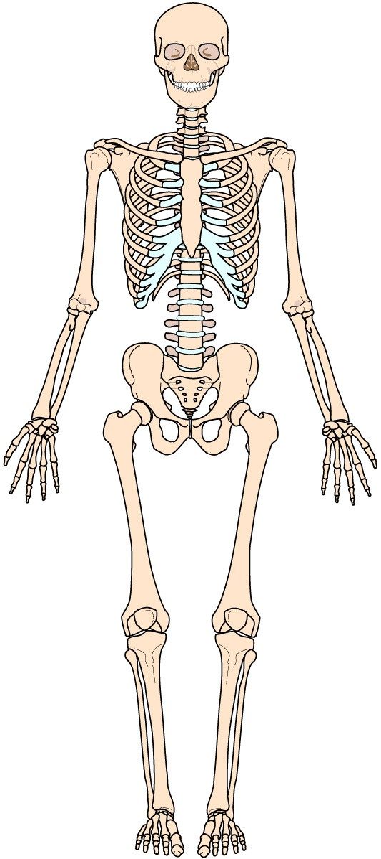
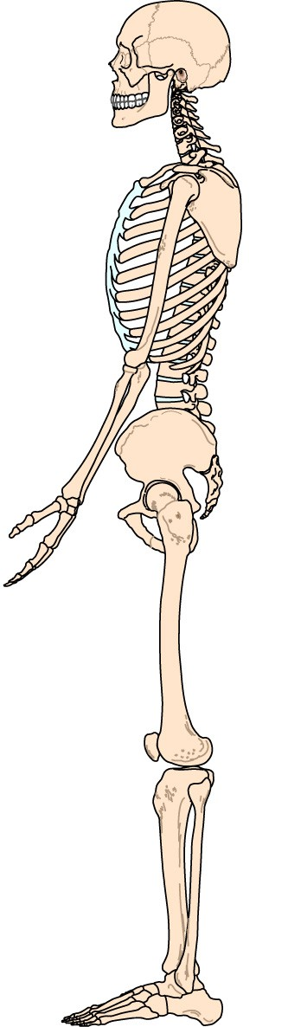
Skeletal System

Slide 5
Fracture
Any break in the continuity of a bone.
PPT 11 -

Slide 6
Dislocation
Injury in which a bone is moved out of its normal position in
a joint and remains that way.
PPT 11 -

Slide 7
Sprain
Injury in which ligaments are stretched or partially torn, commonly associated with joint injuries.
PPT 11 -

Slide 8
Strain
Injury in which a muscle, or a muscle and tendon, are over-extended.
PPT 11 -

Slide 9
Fractures, Dislocations and Sprains
Signs and Symptoms
Deformity or angulation
Pain and tenderness
Crepitus (grating)
Swelling

Slide 10
Fractures, Dislocations and Sprains
Cont.
Signs and Symptoms
Bruising or discoloration
Exposed bone ends
Joint locked in position
Numbness or paralysis
Compromised circulation

Slide 11
Splinting
Applying a device to stabilize any painful, swollen or deformed body part.
PPT 11 -

Slide 12
Reasons for Splinting
Prevent motion of bone fragments or dislocated joints
Reduce pain and suffering
Minimize damage to soft tissues
Prevent closed fracture from becoming open fracture
Minimize blood loss or shock
PPT 11 -

Slide 13
Pre-Hospital Treatment
Initial assessment: identify and treat life-threatening problems
Physical examination
Stabilize injury
Expose injury
Treat open wounds
for suspected fractures, dislocations and sprains/ strains
PPT 11 -

Slide 14
Pre-Hospital Treatment
Prepare splinting materials
Splint injuries / immobilize body
Reassess P.M.S.
Apply cold packs or ice
Treat for shock
for suspected fractures, dislocations and sprains/ strains
Cont.
PPT 11 -

Slide 15


THANK YOU

