Slide 1


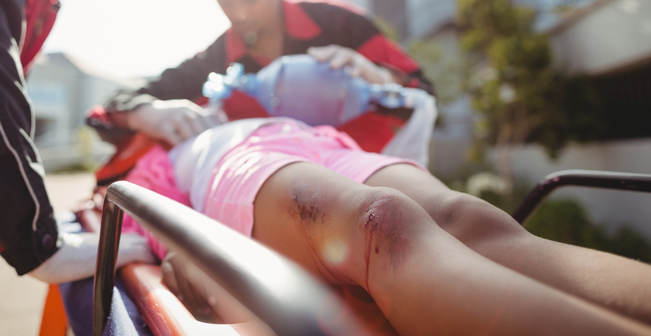

MEDICAL FIRST RESPONDER
LESSON 10
Soft-tissue Injuries
Presented By:- Kamal Mehra,2IC
PPT 10 - 1
NDRF | MFR | INDIA
PPT 2 -

Slide 2
OBJECTIVES
Upon completing this lesson, you will be able to:
1
List two steps to treat a closed wound.
List six steps to treat an open wound.
List the steps for pre-hospital treatment for eye, ear, nose and mouth injuries.
2
3

Slide 3
OBJECTIVES
Upon completing this lesson, you will be able to:
4
List the steps for pre-hospital treatment of abdominal and genital injuries.
Demonstrate the use of dressings and bandages to control bleeding when given a specific area of the body.
5

Slide 4
OBJECTIVES
Upon completing this lesson, you will be able to:
6
Demonstrate the pre-hospital treatment for the following:
Impaled object in the eye or cheek
Bleeding neck injuries

Slide 5
Soft-Tissue Injury
(Also known as “wound.”)
Injury to the skin, muscle, nerves, and blood vessels.
PPT 10 -

Slide 6
Closed Wound
Injury to the soft-tissue beneath unbroken skin.
PPT 10 -

Slide 7
Open
Wound
A soft-tissue injury resulting in breaking of the skin.
PPT 10 -

Slide 8
Types of
Open Wounds
Scratches and abrasions
Lacerations – regular and irregular
Penetration and puncture wounds
Avulsions
Amputations
Crushing injury
Gunshot wounds
Impaled object
PPT 10 -

Slide 9
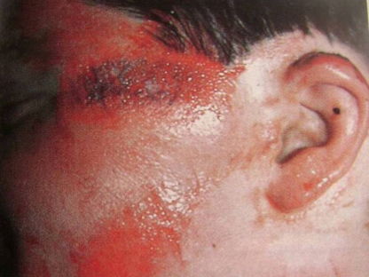
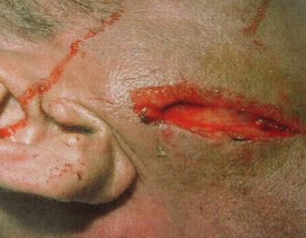
Types of Wounds
Lacerations –
regular and irregular
Scratches and abrasions

Slide 10
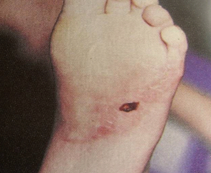
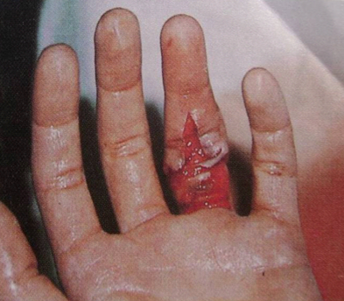
Types of Wounds
Penetration and puncture wounds
Avulsions

Slide 11
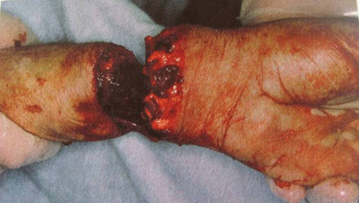
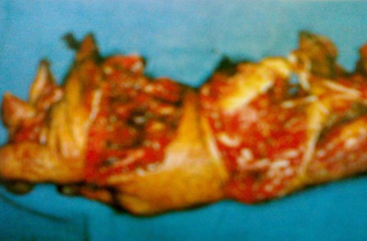
Types of Wounds
Amputations
Crushing injury

Slide 12
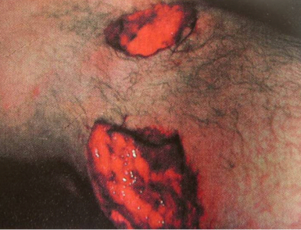
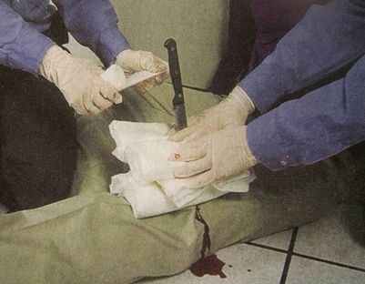
Types of Wounds
Gunshot wounds
Impaled object

Slide 13
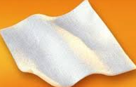
Dressing
Any material used to cover a wound that helps control bleeding and also aids in the prevention of additional contamination.
PPT 10 -

Slide 14
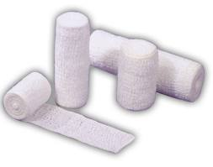
Bandage
Any material used to hold a dressing in place
PPT 10 -

Slide 15
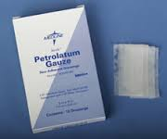
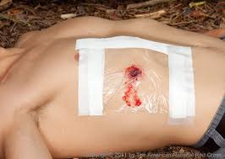
Occlusive Dressing
Any water-resistant material (plastic or waxed paper) that is applied to a wound to prevent the entry of air and loss of moisture from internal organs.
PPT 10 -

Slide 16
Bulky Dressing
Multiple stacked dressings made to form single dressing 2-3 cm thick, such as a thick sanitary napkin or any similar material.
PPT 10 -

Slide 17
Applying Dressings and Bandages
Control bleeding.
Apply the dressing using aseptic technique.
Cover the wounds completely.

Slide 18
Applying Dressings and Bandages
Cont.
Ensure that the dressing and the bandage are firm, fixed and comfortable, but not so tight as to affect circulation.
Ensure there are no loose ends that can get caught.
Avoid covering the fingertips.

Slide 19
Wounds
to the Ear
Never probe the ear.
Never pack it to stop bleeding from the ear canal.
Place a loose, clean dressing across the opening to absorb the fluids.
Do not apply pressure.

Slide 20
PHT of Ear
Minor Laceration: Cover with dressing and apply a bandage.
Severe Laceration: Apply dressings to the injured ear and the side of the head.
Avulsion:
If still attached, use a bulky dressing and secure it with a bandage. If detached, keep the avulsed part wrapped in gauze, moist and cool in a plastic bag. If no plastic bag is available, wrap with gauze.

Slide 21
PHT of Ear
Minor Laceration:
• Never probe the ear.
• Never pack it to stop bleeding from the ear canal.
• Place a loose clean dressing across the opening to absorb the fluids.
• Do not apply pressure.

Slide 22
Wounds
to the eye
Close the BEST ONE EYE to restrict the movement of injured eye.
Close the best one eye to the unconscious patient before dressing to secure the BLINDNESS of the patient.
Apply the cup or card board to the EXTRUDED EYE patient and never try to enter that eye in same place.

Slide 23
PHT of Eye
Minor Laceration:
1) Do not try to remove the impaled object. Give emotional support to the patient.
2) Stabilise the object. Do not apply direct pressure to lacerated globe. Use a roll of 3- inch gauze or folded 4 x 4-inch bandages on either side of the object.
3) Cover the object. Fit a disposable paper drinking cup or paper cone over or around the impaled object. Allow it to rest on the dressing. Do not allow it to apply pressure to the object.
4) Secure the dressings. Have another rescuer stabilise the dressings and cup while you secure them in place with tape or gauze. Do not secure the bandage to the top of the cup.
5) Administer oxygen per to local protocol.
6) Bandage the good eye to prevent movement of injured eye. In an unconscious patient, close the eyes before blindfolding the patient to prevent the eyes from drying, which may cause blindness.
7) Treat for shock • Place a loose clean dressing across the opening to absorb the fluids. • Do not apply pressure.

Slide 24
PHT of Mouth
Mouth Injuries: 1) Maintain open airway.
2) Cuts to the lips. Use rolled gauze. Place the dressing between the lips and gums.
Ensure the dressing does not come loose and enter the airway.
3) Lip avulsions. Apply compression to the wound.
4) Cuts to the inside of the mouth. Do not pack the mouth with a bandage. Any dressing
placed between the cheek and the gum needs to be held in position by hand. This is
necessary to prevent the patient from swallowing the dressing. If possible, position
the patient’s head to allow the mouth to drain.

Slide 25
PHT of Nose
Mouth Injuries: 1) Maintain open airway. 2) Pinch nostrils together or place a bandage between the upper lip and the gum and press. 3) Keep patient seated still. 4) Do not pack the nose; check for clear fluid (CSF) which may indicate a skull fracture. 5) Do not remove any objects you may find inside the nose. 6) For avulsions, apply a compressive dressing.

Slide 26
Injuries
to the Neck
Visible lacerations or other wounds can produce massive bleeding or air embolism
Difficulty speaking; loss of voice
Airway obstructions without foreign bodies in mouth, nose, or airway; often caused by inflammatory process (subcutaneous emphysema)

Slide 27
Injuries
to the Neck
Cont.
Tracheal deviation
Deformities and depressions
Immobilize the patient if you suspect a spinal injury

Slide 28
Abdominal Injury
Signs and Symptoms
Pain or cramps in the abdominal area, local or diffuse
Guarding the abdomen or lying down in fetal position
Tenderness of the abdomen

Slide 29
Abdominal Injury
Cont.
Signs and Symptoms
Signs of shock
Rigid, tense or distended abdomen
Mild discomfort progressing to intolerable pain
Deep, penetrating pain in the pelvis or lower back

Slide 30
Abdominal Injury
Cont.
Signs and Symptoms
Pain radiating to a shoulder or both shoulders
Vomiting blood: bright red or like coffee grounds
Blood in the stool: bright red or tarry black

Slide 31
REVIEW
Now you are able to:
1
List two steps to treat a closed wound.
List six steps to treat an open wound.
List the steps for pre-hospital treatment for eye, ear, nose and mouth injuries.
2
3

Slide 32
REVIEW
Now you are able to:
4
List the steps for pre-hospital treatment of abdominal and genital injuries.
Demonstrate the use of dressings and bandages to control bleeding when given a specific area of the body.
5

Slide 33
REVIEW
Now you are able to:
6
Demonstrate the pre-hospital treatment for the following:
Impaled object in the eye or cheek
Bleeding neck injuries

Slide 34


THANK YOU

