Slide 1

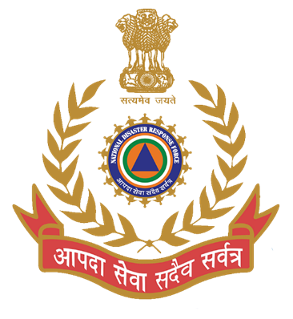
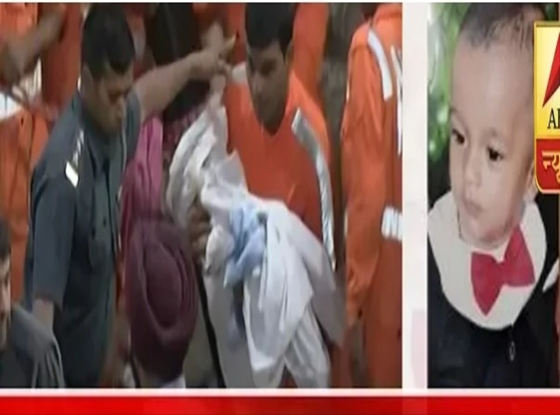

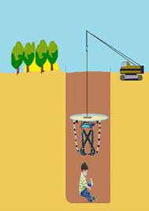
BOREWELL RESCUE
CASE STUDY-02
BORE WELL-2019 SANGRUR , PUNJAB
Presented By:- Pavan Dev Gaur,2IC

Slide 2

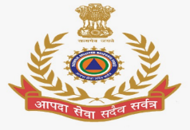
OBJECTIVES
Introduction
Aim
General Profile Of Sangrur District .
Deployment Of 07 Bn NDRF by Search And Rescue Operation
Lesson Learnt
1
Upon completion of this lesson, you will be able to :-
2
3
4
5

Slide 3
A bore-well is a deep, narrow hole drilled into the ground from which water is drawn through a pipe and pump.
Borewell are typically small in diameter ---ranging from 4.5(low-capacity bore-well) inches to 12 inches(high capacity borewell).
Bore-well technology was first introduced in India in the 1970 as a measure to counter water scarcity.
Since water is a state subject , there exists no national –level database of abandoned bore-wells.
INTRODUCTION

Slide 4
About all parts of country Punjab are prone to bore well due to being extensively used by farmer to irrigate the land.
when a bore-well dries up and is no longer in use, its cover, Usually made of cast iron, is removed and the PVC pipe pulled out, leaving behind a naked hole.
Some people even dig bore-wells outside the house, because of which children fall into it while playing & walking.
CAUSE OF INCIDENT

Slide 5
To evaluate the facts and causes of Borewell incident and response by 07th Bn NDRF search and rescue team in Sangrur Distt.
Prepare database of national level bore-well incident for future response.
Structural and formal training to bore-well rescue ops.
AIM OF CASE STUDY

Slide 6
Location: Punjab, Northern India
Division: One of 5 districts in Patiala Division
Neighbouring Districts:
Malerkotla (North)
Barnala (West)
Patiala (East)
Mansa (Southwest)
Fatehabad (Haryana) & Jind (Haryana) (South)
Major Cities:
Sangrur, Dhuri, Lehragaga, Sunam
Other towns: Bhawanigarh, Dirba, Khanauri, Longowal, Cheema, Moonak
Administrative Sub-divisions (7):
Sangrur, Dhuri, Sunam, Lehragaga, Moonak, Bhawanigarh, Dirba
Sangrur District – Key Facts

Slide 7
History:
Till 2006: Barnala was part of Sangrur (now separate district)
2021: Malerkotla district carved out of Sangrur
Demographics (2011 Census – including Malerkotla):
Population: 1,655,169
Males: 878,029
Females: 777,140
All-India Rank: 300th (out of 640 districts)
Population Density: 449 / sq. km (1,160 / sq. mi)
Decadal Growth Rate (2001–2011): 12.3%
Sex Ratio: 885 females / 1000 males
Literacy Rate: 67.99%
Sangrur District – Key Facts

Slide 8

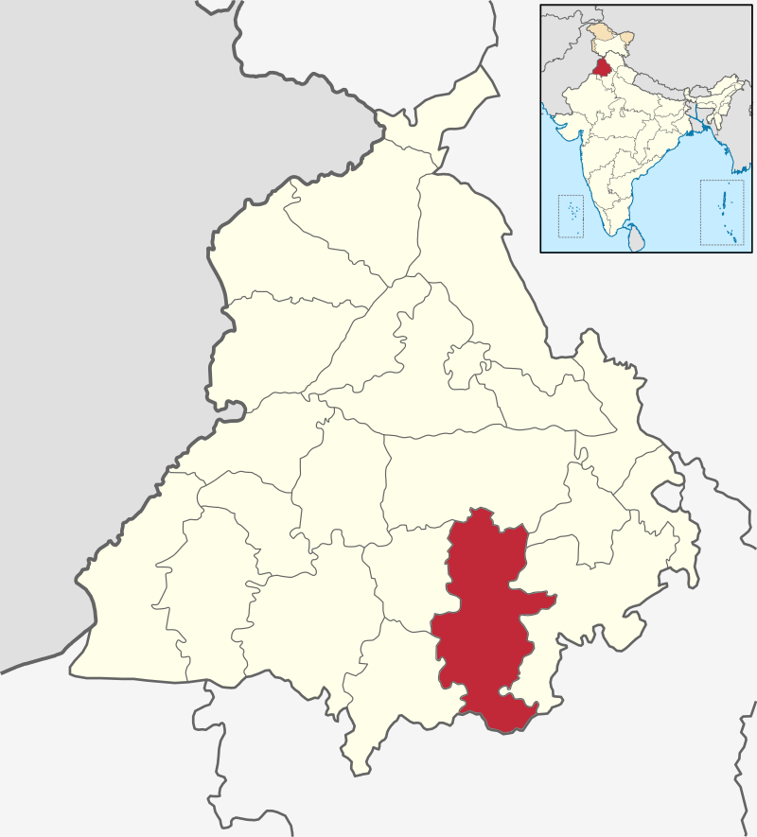
SANGRUR DISTRICT MAP:
30.23°N 75.83°E

Slide 9
07th Bn NDRF deployed one search and rescue team named 7-R along with all necessary rescue equipment under the command of Sh. AJAY VERMA, Asstt. Comdt. At Bhagwanpur sangrur on 06th June ’2019.
The team (Officer-01, SOs-02, Other Personnel-22) left BHQ at 17.35 hrs.
Incident site was 97 Km from the BHQ Bathinda.
DEPLOYMENT OF 07th BN NDRF

Slide 10
Arrival & Initial Actions:
Team arrived at site: 1907 hrs.
Reported to Incident Commander
Team Commander inspected machinery & briefed personnel
Support Provided (Before Rescue Team Arrival):
Oxygen pipes and CCTV cameras arranged by:
District Civil Administration
Local Police
DSS (Dera Sacha Sauda)
CCTV showed:
Child with both hands upwards
Surrounded by sack fragments & soil
Only hands visible, rest of body covered
Borewell Rescue Operation – Key Events

Slide 11
Rescue Attempts:
06.06.19, 2135 hrs – First hand roped
07.06.19, 0410 hrs – Second hand roped
Child had ropes on both hands but could not be pulled up
Decision for Parallel Borewell:
07.06.19: Meeting of Rescue Teams & Civil Administration
Decision: Dig parallel borewell for safe rescue
Visit & Supervision:
09.06.19: Unit Commandant Sh. Ravi Kumar visited
Consulted with Rescue Team & Civil Administration
Took detailed report of operations
Borewell Rescue Operation – Key Events

Slide 12
Team Fatigue & Replacement:
Team worked 79 hours continuously in extreme heat
Personnel exhausted → Commandant ordered Team replacement
Monitoring & Coordination:
08.06.19: Second-in-Command Sh. Shashi Chandra Jha reached site
Monitored rescue
Coordinated with agencies & Civil Administration
Fresh Team Induction:
10.06.19, 0615 hrs: Team led by Sh. Om Prakash Bishnoi, AC left BHQ
0755 hrs: Reached site and replaced earlier team
Borewell Rescue Operation – Key Events

Slide 13
Army Involvement:
Army team called by District Commissioner
Led by a Major-rank officer
Assisted in rescue operations
Successful Rescue:
11.06.19, 0510 hrs.: Child pulled out from borewell
Operation led by Team Leader (AC) at spot
Success reported to Civil Administration
Borewell Rescue Operation – Key Events

Slide 14
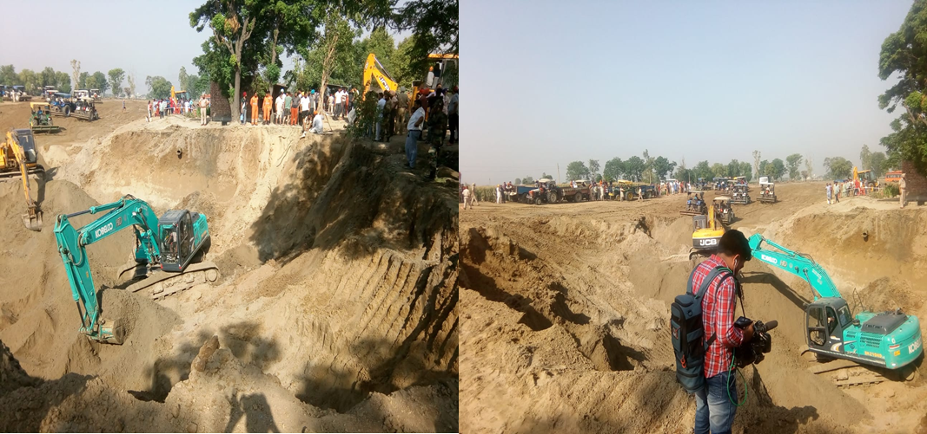
GLIMPSE OF RESCUE OPERATIONS

Slide 15
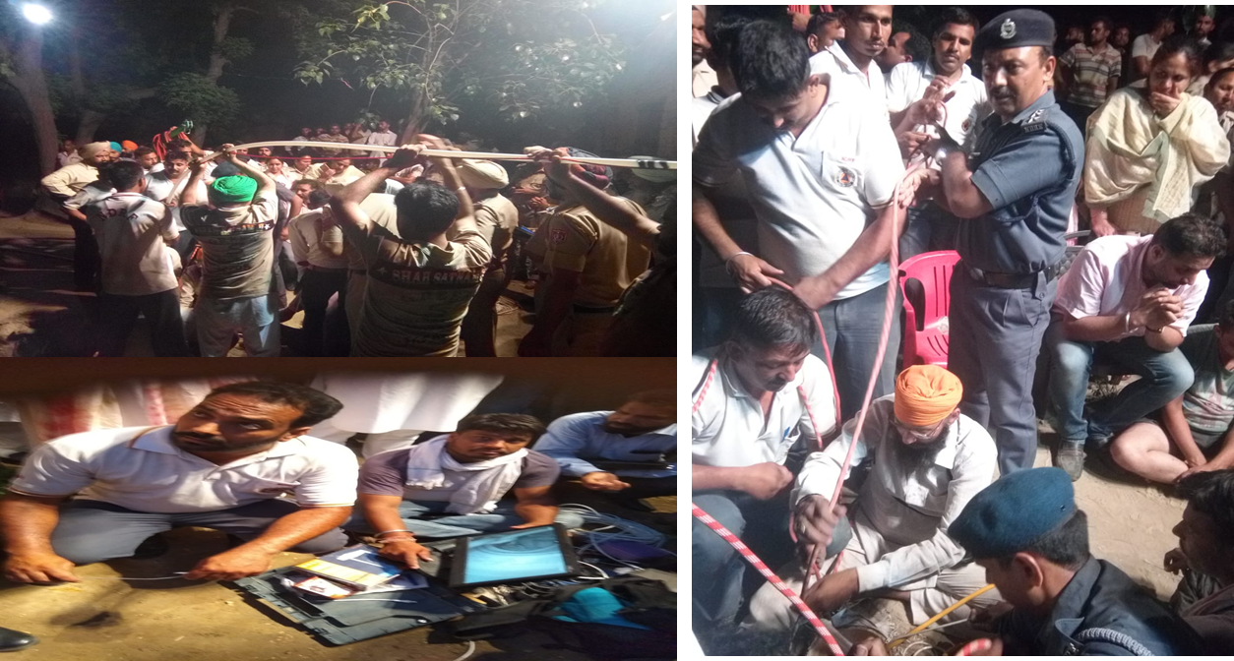
GLIMPSE OF RESCUE OPERATIONS

Slide 16
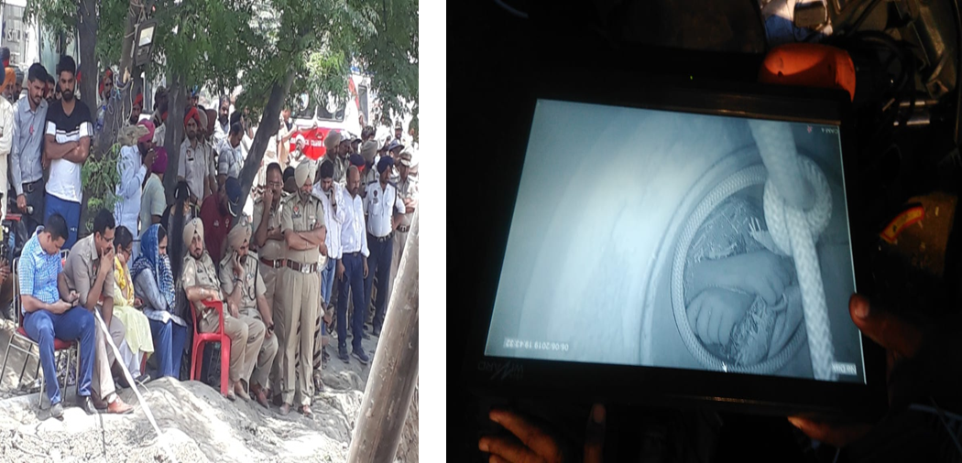
GLIMPSE OF RESCUE OPERATIONS

Slide 17
The rescue ops was very difficult and risky in which the child was trapped in bore well at the depth of 128 ft under the ground with sack fragments and soil all round.
Rescuer had to work in very confined space under the ground . The Age of child in this case was less than 02 year .
One common solution may not fit for every bore well operations.
Position of child inside the bore like in this case may be very difficult for the rescue.
LESSON LEARNT

Slide 18
Since such operations are not routine, use of common sense has to be made and directions for the same must rest with the incident commander only, however, NDRF should suggest as much as the knowledge and experience it has.
More and more mock drills with difficult to most difficult situations may be carried out very frequently by creating similar scenario.
Similar operations carried out worldwide, needed to be studied and to find out the best practices.
LESSON LEARNT

Slide 19
Any Question ?

Slide 20
Review
Introduction
Aim
General Profile Of Sangrur District .
Deployment Of 07 Bn NDRF by Search And Rescue Operation
Lesson Learnt
1
Now you are able to define:
2
3
4
5

Slide 21


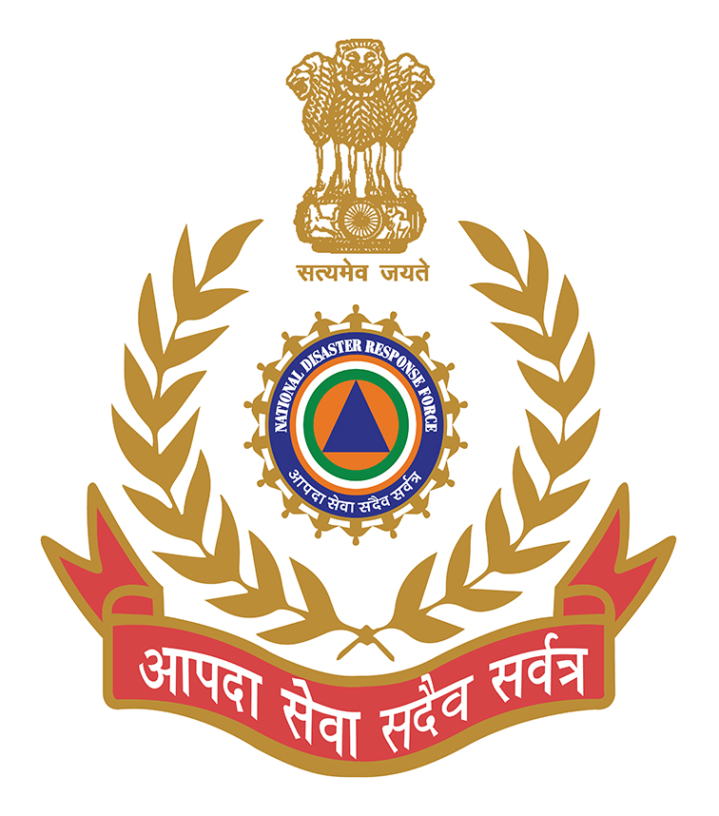
THANK YOU

