Slide 1



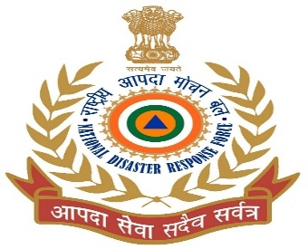

MEDICAL FIRST RESPONDER
BLS & CPR
Presented By:- Kamlesh Dhoundiyal,2IC
PEER | CSSR | INDIA
PPT 2 -

Slide 2

OBJECTIVE
What is chain of survival
Importance of rescue breathing
FBAO and their types
Cardio pulmonary resuscitation
Demonstration of FBAO and CPR
Upon completion of lesson you will be able to know:-

Slide 3
BASIC LIFE SUPPORT
?

Slide 4
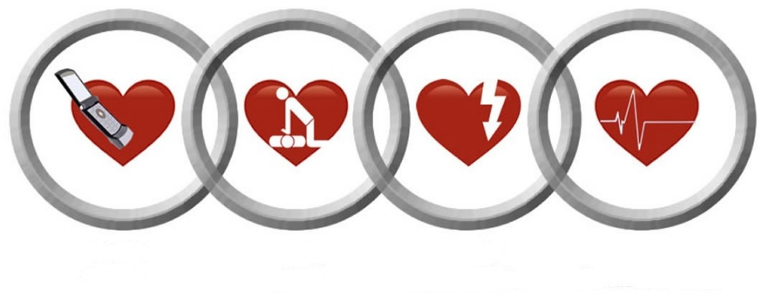
CHAIN OF SURVIVAL
Cardiopulmonary resuscitation (CPR) can save the lives of victims in cardiac arrest. Two-thirds of heart attack victims (due to heart disease) die outside the hospital, most within two hours of the onset of symptoms. Though CPR itself is not enough to save the life of a victim of heart attack, it is a vital link in the chain of survival

Slide 5

CHAIN OF SURVIVAL
Recognize the signs and symptoms of Cardiac and Respiratory Emergencies early and notify/alert Emergency Medical Services (EMS).

Slide 6

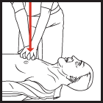
CHAIN OF SURVIVAL EARLY CPR
Perform effective CPR. Starting CPR early greatly increases the patients chances for survival.

Slide 7
CHAIN OF SURVIVAL
If trained on and equipped with automated external defibrillator (AED), use it as soon as possible. This link is the most likely to improve survival rates.

Slide 8

CHAIN OF SURVIVAL
EARLY ADVANCE CARE
It is important that advanced medical care (ACLS) be available rapidly for a positive outcome.

Slide 9
HEART ATTACK
RISK FACTORS THAT CANNOT BE CHANGED
Family history
Sex
Ethnic Background
Age

Slide 10
HEART ATTACK
RISK FACTORS THAT CAN BE CHANGED
Smoking
High blood pressure
High Cholesterol
Physical activity

Slide 11
HEART ATTACK
CONTRIBUTING FACTOR
Obesity
Diabetes
Excessive stress

Slide 12
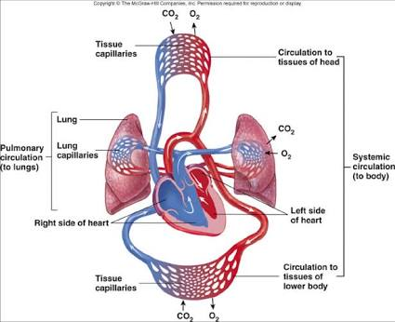
CARDIOVASCULAR SYSTEM
The cardiovascular system
consists of :-
HEART,
BLOOD,
ARTERIES,
CAPILLARIES AND
VEINS.

Slide 13
CARDIOVASCULAR SYSTEM
The heart is a involuntary muscular hollow organ, approximately the size of a fist, and is located in the thoracic cavity behind the sternum and between the lungs.
The coronary arteries are special arteries that supply blood to the heart muscles themselves. The function of the heart is to pump blood.
The left side receives oxygenated blood from the lungs and pumps it to the body through the arteries.
The right side receives the blood from the veins, that has circulated through the body and pumps it to the lungs to be oxygenated once again

Slide 14
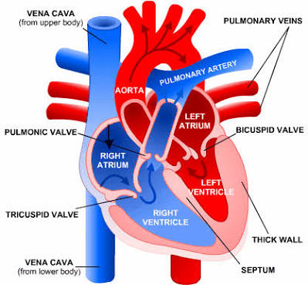
HEART

Slide 15
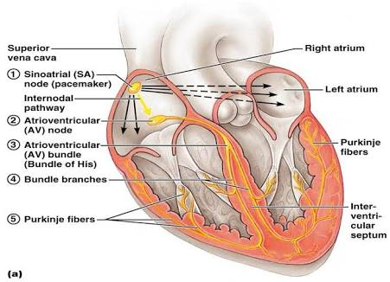
ELECTRICAL IMPULSE IN HEART

Slide 16
RESPIRATORY SYSTEM
The respiratory system is made up of four components:
An airway ( upper and lower)
A neuromuscular system ( includes the respiratory Centre in the brain, respiratory muscles and the nerves that connect the two)
Alveoli – tiny air sacs surrounded by capillaries
Arteries, capillaries and veins

Slide 17
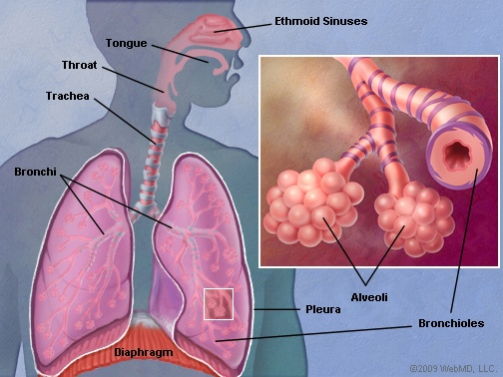
RESPIRATORY SYSTEM

Slide 18
RESPIRATORY SYSTEM
CHARACTERISTICS OF ADEQUATE BREATHING
Chest and abdomen rise and fall with each breath.
Air can be heard and felt exiting the mouth or nose.
Ease of breathing( effortlessness).
Adequate rate.

Slide 19
RESPIRATORY SYSTEM
CHARACTERISTIC OF INADEQUATE BREATHING
Inadequate rise and fall of the chest.
Noisy breathing: Bubbles, rales, Stridor, whistling etc.
Increased respiratory effort.

Slide 20
RESPIRATORY SYSTEM
SIGNS OF INADEQUATE RESPIRATION
Cyanosis
Inadequate rate
Altered mental status

Slide 21
RESPIRATORY SYSTEM
SIGNS OF ABSENT RESPIRATION
No chest or abdominal movement.
Air cannot be heard or felt exiting the mouth or nose.
CYANOSIS
Bluish coloration of the skin and mucous Membranes caused by lack of oxygen in the blood
and tissues.

Slide 22
CLINICAL DEATH
Occurs when a patient is in respiratory arrest (not breathing) or in cardiac arrest (heart not beating). The patient has a period of 4 to 6 minutes to be resuscitated without brain damage.
CLINICAL DEATH CAN BE REVERSED
(ALWAYS REMEMBER)

Slide 23
BIOLOGICAL DEATH
The moment when the brain cells begin to die.
BIOLOGICAL DEATH CANNOT BE REVERSED
(Only a medical doctor can pronounce a person officially dead

Slide 24
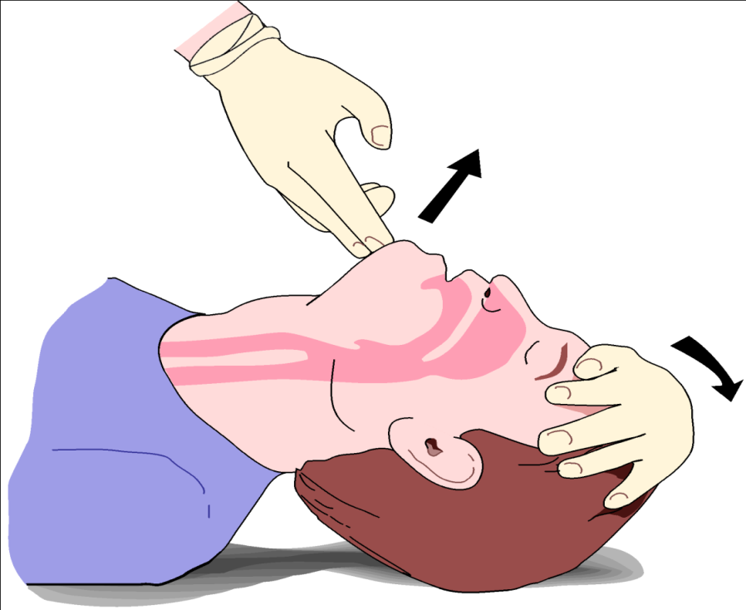
METHOD OF AIRWAY OPENING
HEAD-TILT CHIN-LIFT

Slide 25
HEAD-TILT CHIN-LIFT
Position the patient lying face up.
Kneel by the patient’s shoulders towards the head.
Place one hand on the forehead and place the fingertips of your other hand under the bony part of the patient’s jaw.
Lift up on the chin, supporting the jaw, and at the same time, tilt the head back as far as possible. For infants and children: Place in the “sniffing” position – do not overextend.

Slide 26

METHOD OF AIRWAY OPENING
HEAD-TILT CHIN-LIFT
X
DO NOT USE THIS METHOD IF YOU SUSPECT HEAD,NECK OR SPINAL INJURY.

Slide 27
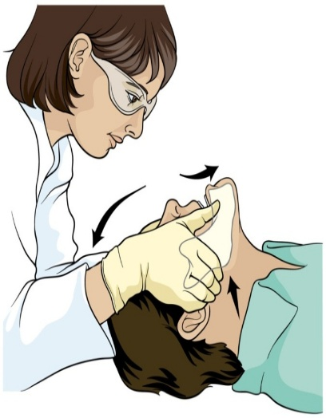
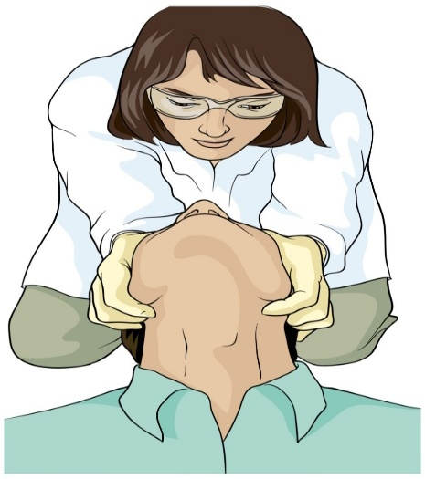
METHOD OF AIRWAY OPENING
JAW THRUST
The jaw thrust is the only maneuver recommended on an unconscious patient with suspected head, neck or spinal injury.

Slide 28
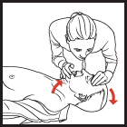
ARTIFICIAL VENTILATION
Once the patient has an open air way obstruction, you can provide artificial ventilation for a patient breathing inadequately or not at all.
How is it possible to maintain a patient alive with exhaled air ?

Slide 29
TECHNIQUE OF ARTIFICIAL VENTILATION
Mouth to Mask
Mouth to Barrier Device
Mouth to Mouth

Slide 30
HAZARDS TO RESCUERS
Diseases
Chemicals
Vomitus

Slide 31
HAZARDS TO VICTIMS
Reduced lung volume
Vomiting
PREVENTIVE MEASURES

Slide 32
F.B.A.O.

Slide 33
CAUSES OF AIRWAY OBSTRUCTION
Foreign Body
Tongue
Tissue damage
Acute epiglottis
Illness

Slide 34
RECOGNIZING FBAO
PARTIAL
An object caught in the throat that does not totally block breathing.
A patient with partial obstruction may have adequate or poor air exchange.
With adequate air exchange, the patient may cough forcefully, though there may be wheezing between coughs.
Do not interfere with patient’s attempt to clear the airway. With poor air exchange, the patient will exhibit a weak, ineffective cough, high-pitched noise while inhaling, increased respiratory difficulty and possible cyanosis;
Treat this situation as a complete airway obstruction.

Slide 35
SIGN OF PARTIAL AIR OBSTRUCTION
Weak ineffective cough
High pitch noise when inhaling
Increased respiratory difficulty and may clutch at the throat
Cyanosis ( Bluish discoloration of the skin and mucous membrane)

Slide 36
RECOGNIZING FBAO
COMPLETE
The patient is unable to speak, breathe or cough.
May clutch neck with thumb and finger
Clutch neck with thumb and finger gesture is known as the universal sign of choking.
Movement of air will be absent.

Slide 37
MANAGING FBAO IN ADULTS AND CHILDREN
Abdominal Thrusts Responsive Adult or Child (Patient Standing or Sitting)
Get in position
Position your hands
Perform an abdominal thrust
Repeat thrusts until the object is expelled from the airway or the patient becomes unconscious. Each new thrust should be a separate and distinct movement.

Slide 38
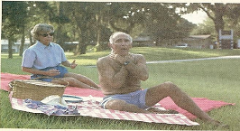
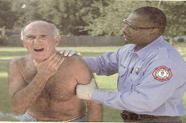
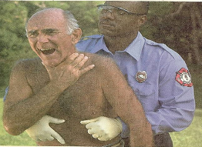
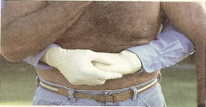
FBAO
UNIVERSAL SIGN OF CHOKING
UNIVERSAL SIGN OF CHOKING
UNIVERSAL SIGN OF CHOKING
UNIVERSAL SIGN OF CHOKING

Slide 39
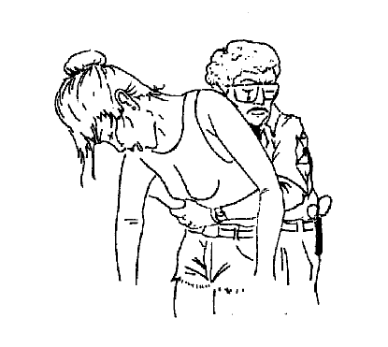
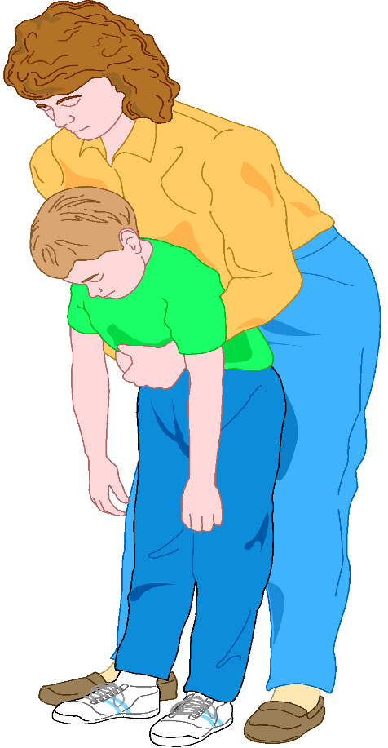
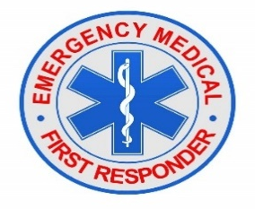
MANAGING FBAO IN ADULTS AND CHILDREN

Slide 40
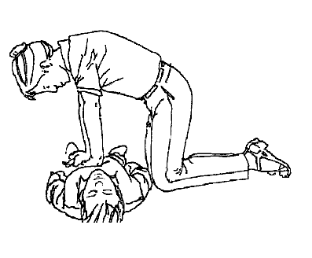
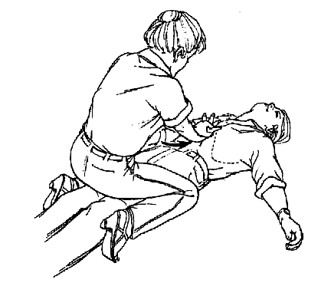
ABDOMINAL THRUST
Unresponsive adult or child ( Lying down)

Slide 41
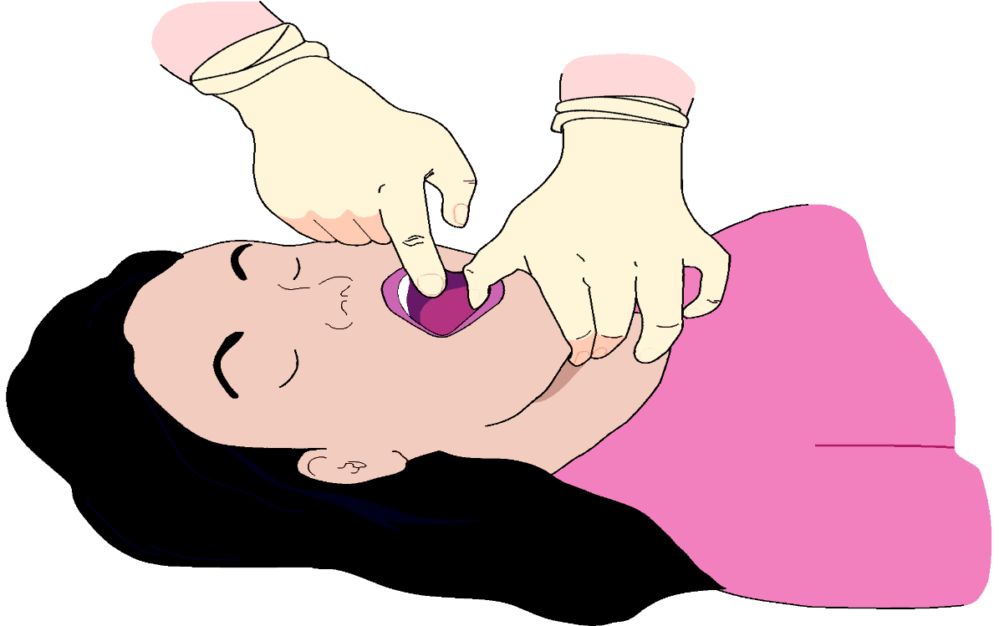
FINGER SWEEP

Slide 42
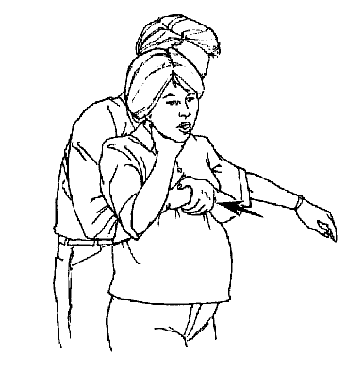
CHEST THRUSTS
Pregnant or Obese Responsive Adult

Slide 43
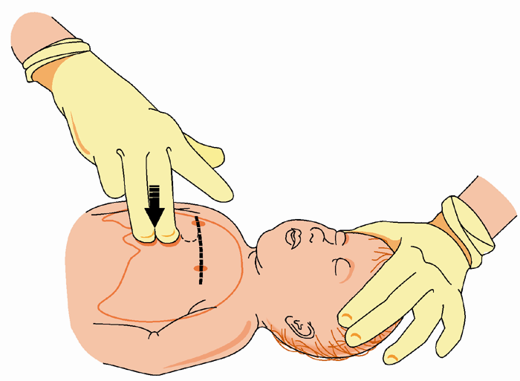
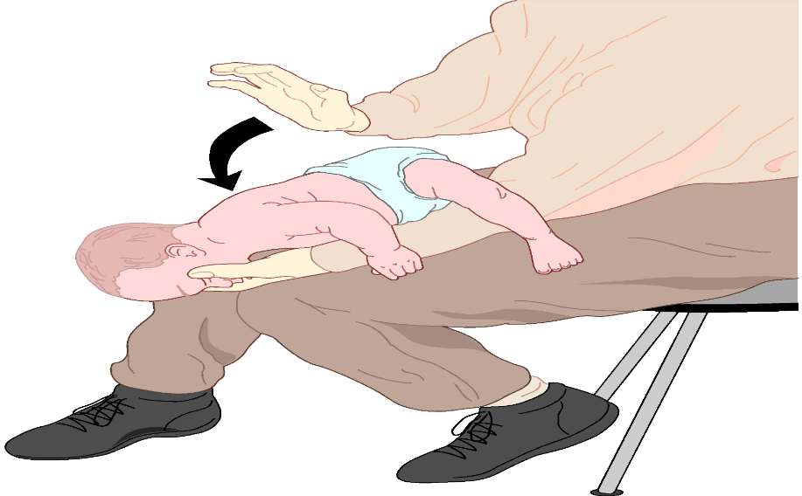
MANAGING FBAO IN INFANTS

Slide 44
Cardiopulmonary Resuscitation (CPR)
During respiratory arrest, the heart can continue to pump for several minutes and circulate oxygen. Without early intervention, respiratory arrest may lead to cardiac arrest. Once cardiac arrest occurs, circulation ceases and vital organs are deprived of oxygen.
When respiratory and cardiac arrest occur together, the patient is considered clinically dead. Within 4 to 6 minutes without circulation, brain damage will begin, and after 8 to 10 minutes, the damage is irreversible.
CPR involves a combination of chest compressions and artificial ventilations designed to revive a person and prevent biological death by mechanically keeping a person’s heart and lungs working.

Slide 45
PREPARING FOR CPR
Before providing CPR you must determine unresponsiveness, breathlessness and pulselessness

Slide 46
PREPARING FOR CPR
Establish unresponsiveness
Activate the EMS
Check CAB
Airway : Use appropriate method
Breathing : check LLF method
Circulation :Carotid for adult and child and brachial for infants.

Slide 47
CPR CHEST COMPRESSION
Chest compressions consist of rhythmic, repeated pressure over the lower half of the sternum
Position the Patient : Must be supine on firm, flat surface with arm along sides
Expose the Patient's chest :
Get in position

Slide 48
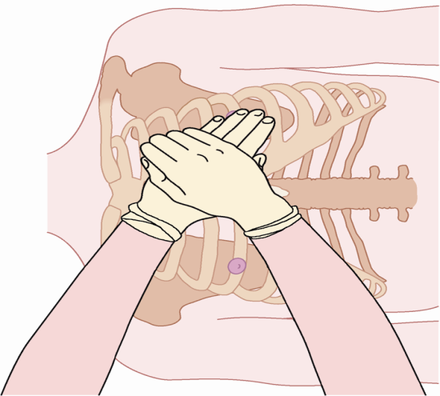
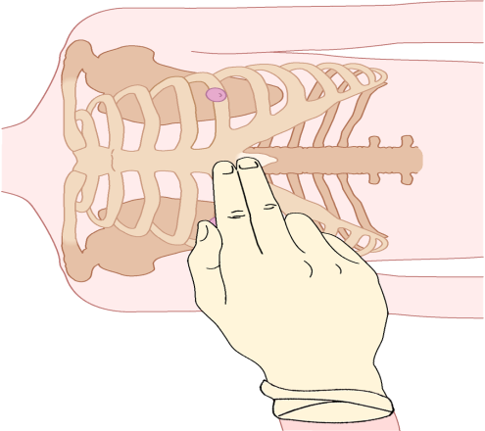
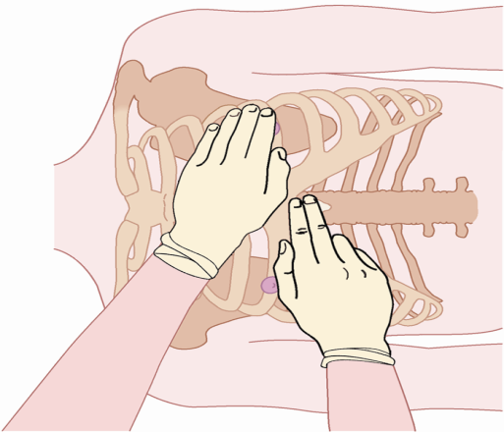
CPR CHEST COMPRESSION
Locate the xiphoid process
Locate the compression site
Position your hands
Position your shoulders
Perform Chest compressions : Keeping your arms straight and your elbows locked

Slide 49
ADULT CPR SUMMARY – 9 YEARS AND OLDER
Compression depth : at least 2 inch
Compression rate ; 100-120 per min
Each ventilation : 5-6 Sec
Pulse location :carotid artery
1Man Rescuer Cycle : 30 : 2
2Man Rescuer Cycle : 30 : 2

Slide 50
CHILD CPR SUMMARY –(1TO9YEARS)
Compression depth : 4-5 cm (or 1/3 to ½ of chest depth). About 2 inches
Compression rate :100-120 per min
Each ventilation : 3-5 Sec
Pulse location :carotid artery
1Man Rescuer Cycle : 30 : 2
2Man Rescuer Cycle : 15 : 2

Slide 51
CPR CHEST COMPRESSION FOR INFANTS
Usual cause of Cardiac arrest in infants is hypoxia due to injuries, suffocation etc. You should resuscitate for one minute before alerting EMS.

Slide 52
CPR CHEST COMPRESSION FOR INFANTS
Position the Patient : Must be supine on firm, flat surface with arm along sides. Place on your forearm, using your palm to support his/her head
Expose the Patient's chest :
Locate the compression site
your Perform Chest compressions

Slide 53
INFANT CPR SUMMARY – 1 YEAR OLD AND UNDER
Compression depth : About 1.5 inches ( 1/3 – ½ total chest depth )
Compression rate : 100-120 per min
Each ventilation : 3- 5 Sec
Pulse location : Brachial Artery
One man Rescuer Cycle : 30:2
Two man rescuer: 15:2

Slide 54
SIGN OF SUCCESSFUL CPR
Successful CPR does not mean the survival – it only means that it has been performed correctly. Very few will survive if they do not receive ACLS. The goal is to prevent the death of cells and organs for a few crucial minutes. Monitoring is essential to see if CPR is effective.

Slide 55
SIGN OF SUCCESSFUL CPR
A pulse should be palpable with every compression.
The chest should rise and fall with each ventilation
The pupils may begin to react normally.
Patient’s skin colour may improve.
Patient may attempt to move and try to swallow.
Heart beat may return.

Slide 56
WHEN NOT TO BEGIN CPR
Obvious mortal wounds
Rigor mortis
Decomposition
Lividity
Still birth
Other ( check local protocol)

Slide 57
SIGN OF CERTAIN DEATH
LIVIDITY
The pooling of blood in the lower areas of the body.
RIGOR MORTIS
Stiffening of the body and limbs that occurs after death, usually within 4 – 10 hours.

Slide 58
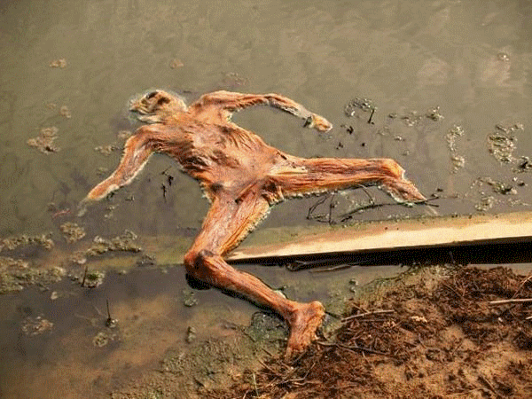
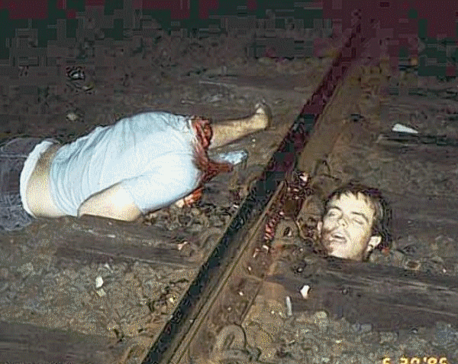
Continue….
DECOMPOSITION
A decomposing body always produces a fetid odour. The rate of decomposition depends on a number of factors, primarily ambient temperature.
OTHER SIGNS
Mortal wounds such as decapitation, dismemberment, incineration, severe crushing injuries, etc.

Slide 59
COLD WATER DROWNING
EXCEPTION
There have been cases of persons resuscitated one hour or more after cold-water drowning. In these cases, victims should receive prolonged resuscitative efforts. In a cold environment, a person should not be considered dead until the victim’s body is warmed.

Slide 60
COMPLICATION CAUSED BY CPR
Fracture of the sternum and ribs
Pneumothorax -
Haemothorax
Cuts and bruises to the lungs
Laceration to the liver
Most of these complications are rare. Even if CPR results in complications, the alternative is death.

Slide 61
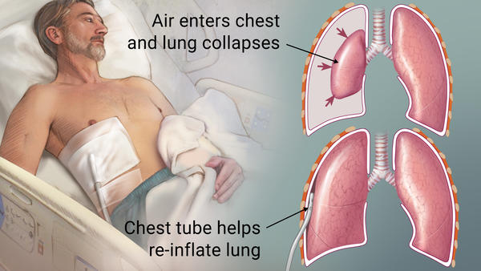
PNEUMOTHORAX
Pneumothorax is defined as the presence of air/gas in the pleural cavity (space between the visceral and pleura of the lungs) which can impair oxygenation and/or ventilation

Slide 62
HAEMOTHORAX
Haemothorax is a collection of blood in the pleural space and may be caused by blunt or penetrating trauma. Most haemothoraces are the result of ribs fracture, lung and minor venous injuries.

Slide 63
MISTAKES IN PERFORMING CPR
Patient is not on hard surface
-- Compressions are not effective
Patient is not on horizontal position
--- If patient`s head is higher than the rest of the body there is insufficient blood to reach the brain

Slide 64
MISTAKES IN PERFORMING CPR
Incomplete seal around the patient`s mouth and / nose
-- Ventilations are not effective
Nostrils are not completely pinched and the patient`s mouth is not fully open during mouth to mouth ventilation – ventilations are not effective

Slide 65
MISTAKES IN PERFORMING CPR
Hands not in correct position or compressions incorrectly place --Fractured ribs ; fractured sternum, lacerated liver, spleen, lungs or heart or injured pluera as a result of fractured rib

Slide 66
MISTAKES IN PERFORMING CPR
Compression too deep or too frequent
-- Insufficient amount of blood pumped
Improper compression/ ventilation ratio
--- Inadequate oxygenation of blood

Slide 67
INTERRUPTION IN CPR
While moving a patient onto a stretcher.
While moving a patient down a flight of stairs or through a hallway.
While loading or unloading a patient into an ambulance.
To allow for defibrillation or ACLS to be initiated.
Recover from physical exhaustion.

Slide 68

REVIEW
Describe and demonstrate CPR in adults, children and infants
What is chain of survival
Importance of rescue breathing
FBAO and their types
Cardio pulmonary resuscitation
Demonstration of FBAO and CPR

Slide 69
ANY QUESTIONS?

Slide 70
EVALUATION
The recommended method for opening the airway of a patient with a possible neck or spine injury is the ?
In adult the appropriate rate of compression during CPR is--------per minute?
The recommended location for assessing for the presence of a pulse on a child is at the ----?

Slide 71


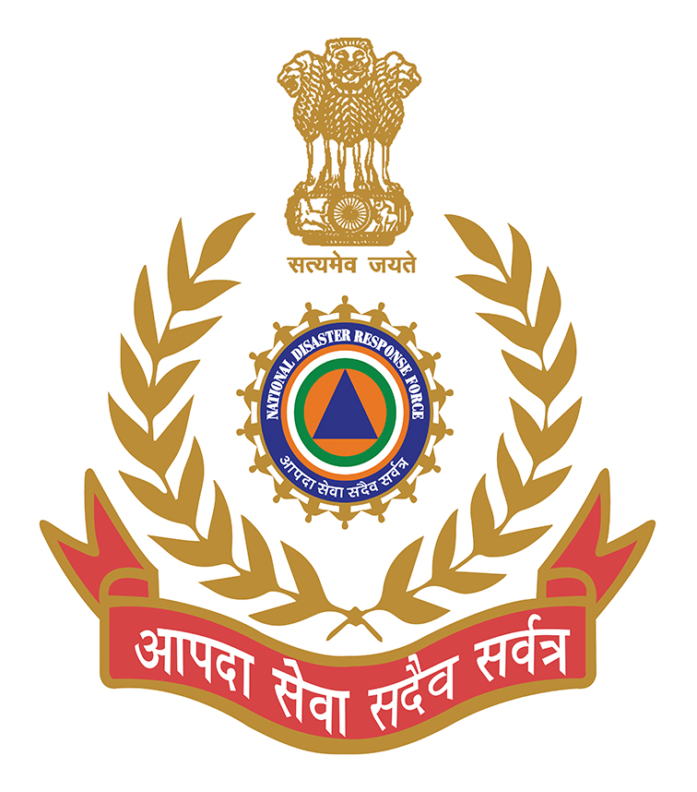
THANK YOU

