Slide 1


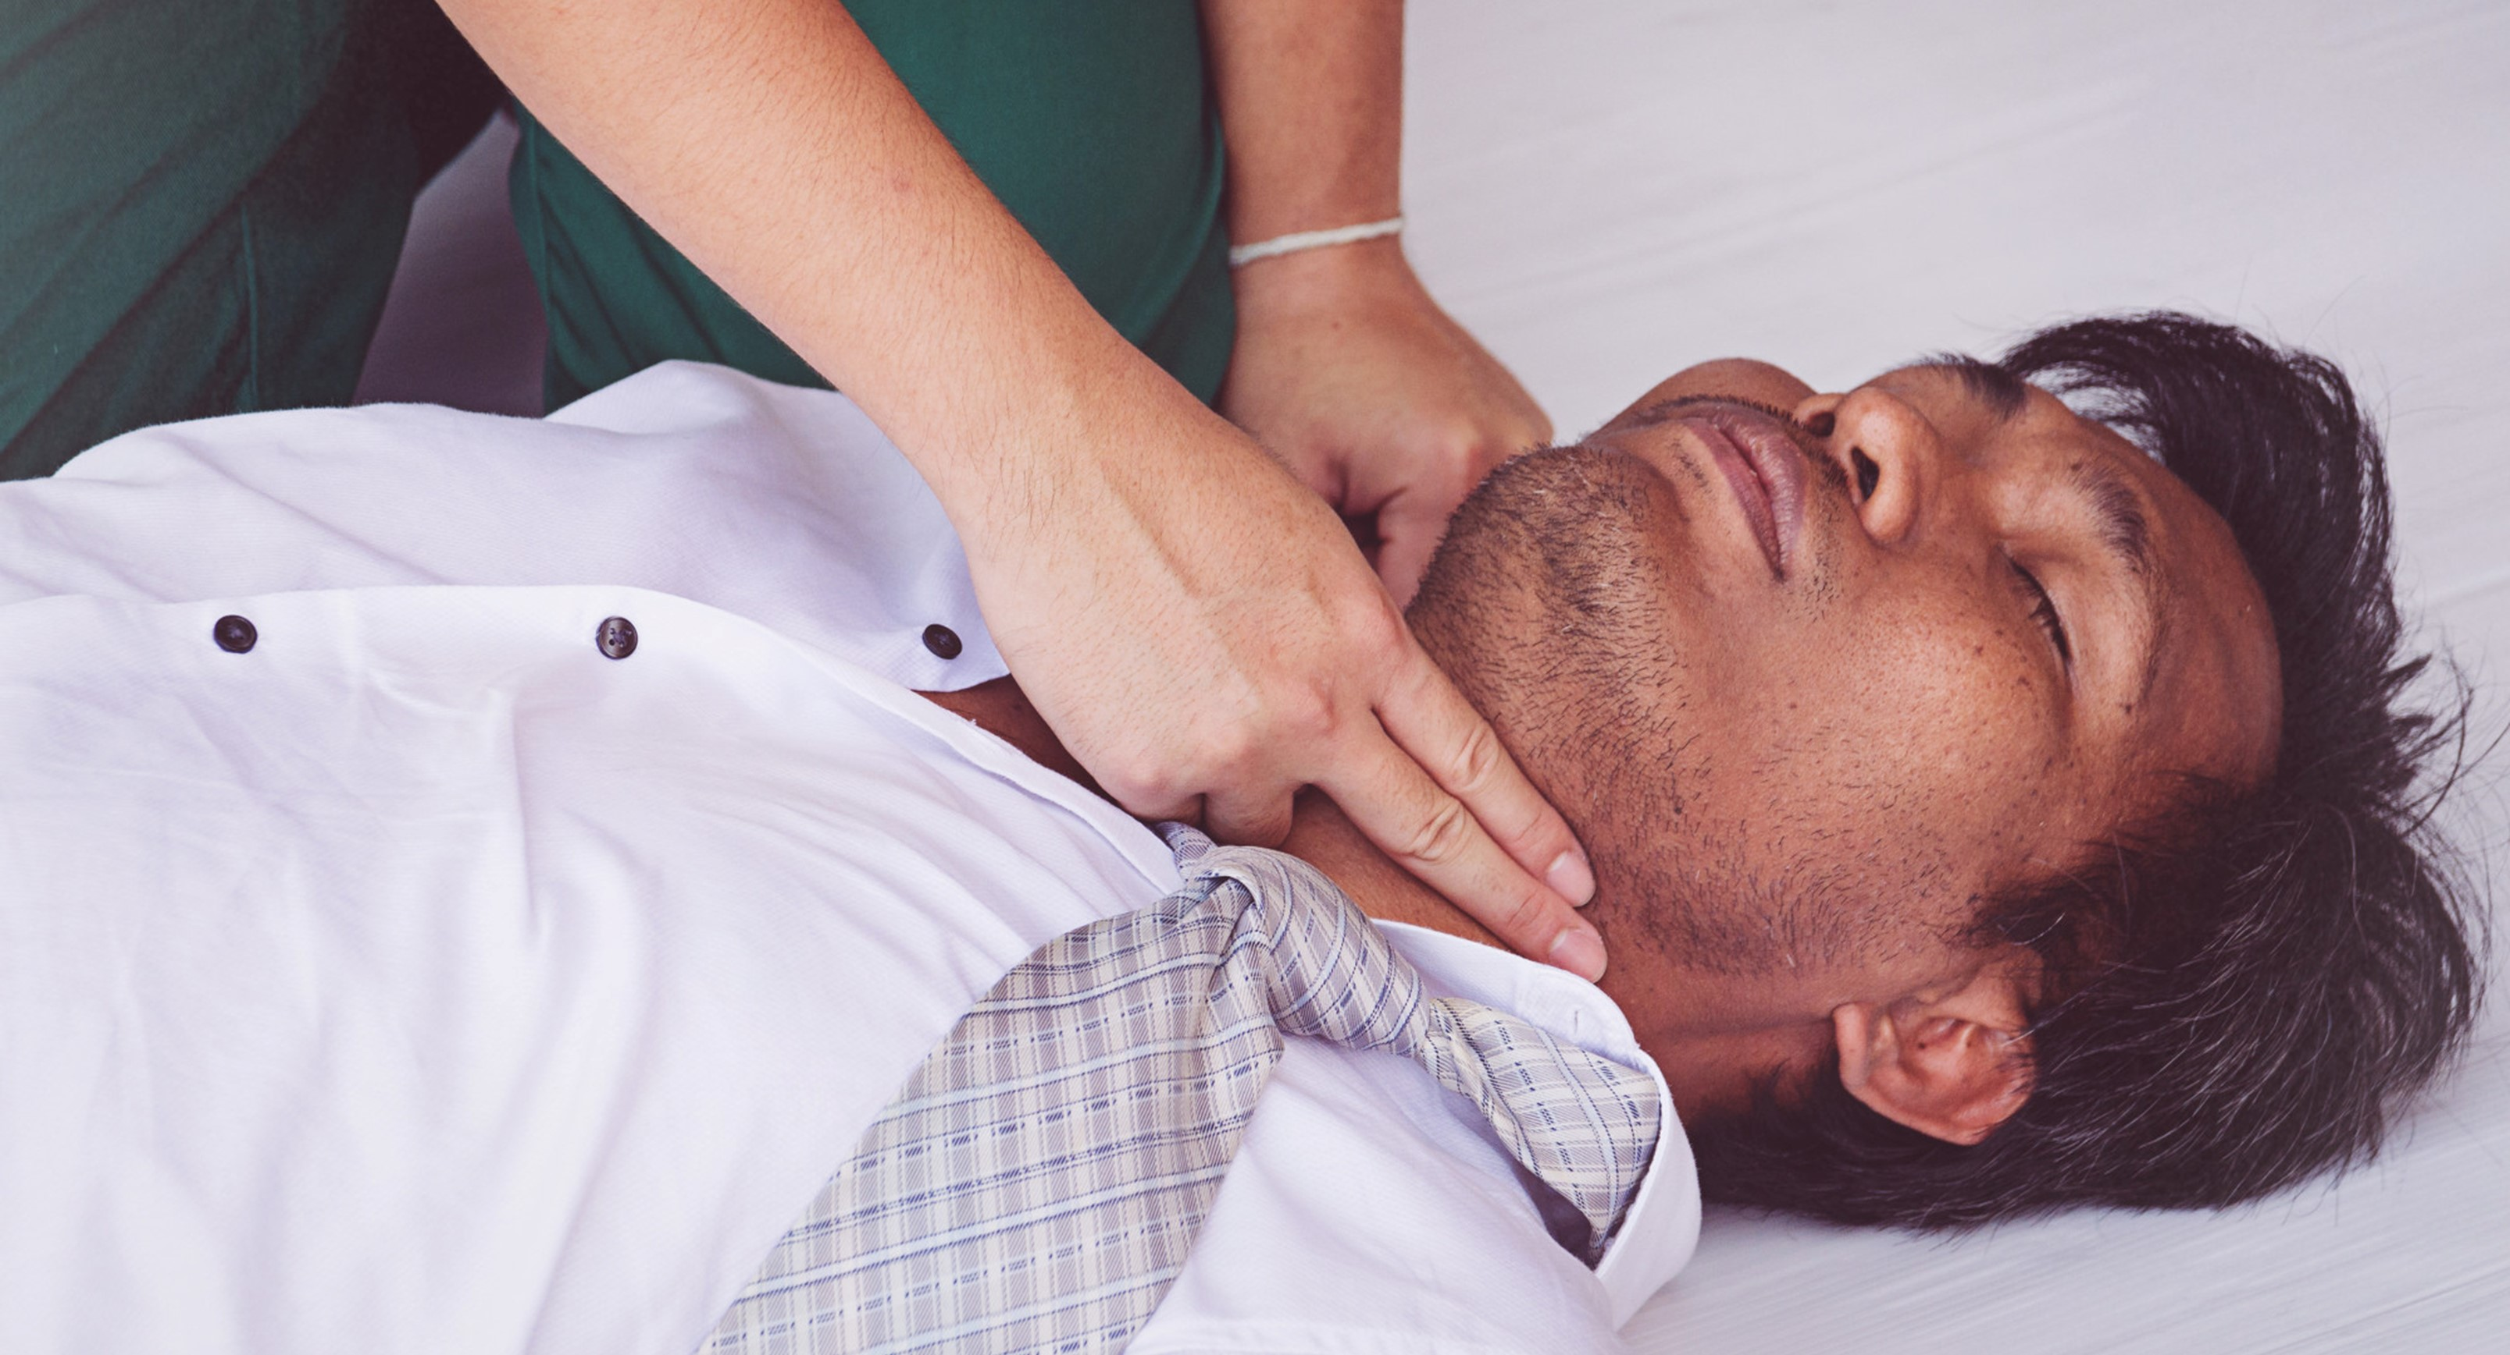

MEDICAL FIRST RESPONDER
LESSON 6
Patient Assessment
Presented By:- Kamal Mehra,2IC
PPT 2 -
NDRF | MFR | INDIA
PPT 6 - 1

Slide 2
OBJECTIVES
Upon completing this lesson, you will be able to:
1
List the five general procedures a medical first responder should complete when arriving at the scene.
List the six phases of the patient assessment plan.
2

Slide 3
OBJECTIVES
Upon completing this lesson, you will be able to:
3
List the six steps of the initial assessment.
Demonstrate a complete physical examination as defined in this lesson.
4

Slide 4
Arrival on the Scene
Ensure your own personal safety.
Ensure patient safety.
Establish a general impression of the scene and begin initial assessment of the patient.
PPT 6 -

Slide 5
Arrival on the Scene
Identify and treat life-threatening conditions.
Stabilize and continue to monitor the patient.
PPT 6 -

Slide 6
Immediate Sources of Information
1
2
3
The scene itself (observe, plan, react)
Patient
(if responsive)
Relatives or bystanders

Slide 7
Immediate Sources of Information
4
5
6
The mechanism of injury (forces that caused the injury; kinematics).
Any remarkable deformity or obvious injury.
Any sign or characteristics of certain types of injury or illness.

Slide 8
Initial Assessment
A process used to identify and treat conditions posing an immediate threat to the patient’s life.
PPT 6 -

Slide 9
Physical Exam
The main purpose of the physical exam is to reveal any injury or medical problem that could pose a threat to patient survival if left untreated.
PPT 6 -

Slide 10


THANK YOU

