Slide 1
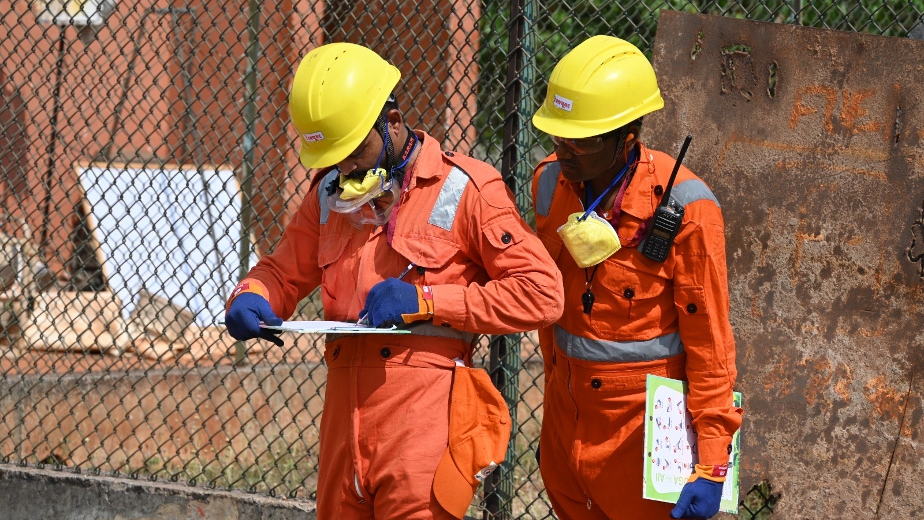



Dead Body Management and Caracas Management
LESSON 05
INFORMATION MANAGEMENT while DEAD BODY management
Presented By:- Kamlesh Dhoundiyal,2IC
NDRF | DBM-CM | INDIA
PPT 5 - 1

Slide 2
OBJECTIVES
Upon completing this lesson, you will be able to:
1
  Acquaint with Information management and 05 steps of information flow.
  Know about various aspect of dissemination of information
  Know about Media management and rumor control during DBM
2
3

Slide 3
OBJECTIVES
Upon completing this lesson, you will be able to:
4
  Know data privacy and inter agency coordination during DBM
  Know information center and 06 important information to be provided
  Understand the role of Media during DBM
5
6

Slide 4
Key role of information?
Most sensitive and essential step
Involving a multi-disciplinary, multi-stage and time-consuming approach
Various categories of information
PPT 5 -

Slide 5
Information Management
The collection, storage, analysis and dissemination of information is to be undertaken under the supervision of a nodal officer or nominated agencies at district, state or central level.

Slide 6
Field Recovery
Verification
Documentation
Central Database
Dissemination
Information Flow Overview

Slide 7
Scene Data Collection (Field)
Record Location (GPS), time, photos (in-situ), witness names
Assign temporary unique ID at recovery point
Record condition of body, belongings, visible IDs
Preparation of Database
Notes:
Minimize handling before police/forensic clearance; use waterproof forms.

Slide 8
Tagging, Chain of Custody & Evidence
Systematic labelling of all evidence and appropriate documentation
Affix durable tags to body and bag; tag belongings separately
Maintain chain of custody log with signatures
Seal and label containers for evidence

Slide 9
Storage of Information
(Central Database)
SITREP with verified numbers and locations
Information, including valuable personal items and photographs
Central dashboard showing status: Recovered, Identified, Released, Unidentified
Access levels for police, health, magistrate, and family liaison

Slide 10
Verification & Identification
(Analysis of Information)
At the level of Incident Command Post (ICP)
Comparison of information
Software based analysis
Primary ID: visual by relatives, documents
Secondary: fingerprints, dental, DNA if needed
Two-step verification before declaring to public

Slide 11
Dissemination of Information
Necessity-based and to be provided by the Nodal Person only
District Authorities to have a Media Plan and the Public Relations Officer
To be provided through the authentic means (Internet, notice boards, newspapers, television, radio)

Slide 12
Dissemination of Information
Cont…
Media should not be allowed direct access to photographs and individual records
Right information to the right person and Need to know basis
Information about various support services

Slide 13
Media Management & Rumour Control
Requires authorities to provide timely, accurate information through multiple channels
Proactive Media Engagement
Timely Information
Monitoring and Active Rumor Countering
Transparency

Slide 14
Data Privacy & Confidentiality
Do not publish personal identifiers without consent
Secure storage and controlled access
Follow legal directives on RTI and sensitive data
Contextual Integrity
Security Measures
PPT 5 -

Slide 15
Unidentified & Unclaimed Bodies Process
Temporary storage and active tracing efforts
Public notices, police registration, DNA sampling where feasible
After statutory period, legal disposal per magistrate order
Document every step; maintain public transparency to avoid mistrust.

Slide 16
Interagency Coordination
Manage info and coordinate assessment activities among stakeholders (Police, Health, AHD, DDMA, NDRF, NGOs, forensic labs)
Identify required resources (forensic teams, morgues, body bags etc.)
Joint briefings and shared dashboards
PPT 5-

Slide 17
Information Centre
An Information Centre will be established at the site of the disaster where the bodies are being kept and the data on dead bodies is being compiled, in the Dead Body Inventory Record register. (Annexure-’E’)

Slide 18
Annexure-E
DEAD BODY INVENTORY RECORD
BODY / BODY PART INDIVIDUAL IDENTIFICATION NUMBER | Recovery |  | Storage |  | Information Recorded |  | Characteristics (Apparent) |  |  | Rmks
 | Date | Place | Date | Location | Dead Body Identification Form | Photographs | Sex | Age | Presumed Identity
 |  |  |  |  | Y=YES N=NO | Y=YES N=NO | Male Female Unknown | I=Infant C=Child A1=Adolesent A2=Adult E=Elderly

Slide 19
Information Centre
Cont…
To serve as a resource center for receiving information on ante-mortem personal data
Maintain Missing Person Form
Any documents or proofs, like the Panchayat Register or photographs provided, will be retained
Maintain both paper and digital copies

Slide 20
Information To Public
Help line number
Display board
Radio and TV announcement
WhatsApp Groups
Multiple SMS facility
Public announcement system in vernacular language: Do’s & Don’t
PPT 5 -

Slide 21
Role of Media
Social media: “Among one of us”
Preventing the spread of rumors
5
1
Info Mgmt
4
Help in the identification of the dead
2
3
Dissemination of factual news
Motivate the mobilization of community volunteers

Slide 22
Challenges & Mitigation
Challenges:
Misinformation
Resource constraints
Cultural sensitivity
Tech Failure
Mitigation:
Pre-scripted messages
Redundancy
Community liaison
Engage religious/community leaders

Slide 23
Key references
NDMA (2010): Guidelines on Management of the Dead
MoHFW COVID-19 Dead Body Management SOPs (2020-21)
NHRC Advisory (2021) and key Supreme Court orders
WHO & ICRC guidance on dead body management

Slide 24



THANK YOU

