Slide 1


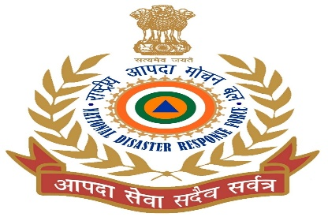


DISASTER MANAGEMENT IN GENERAL
Presented By:- Kamlesh Dhoundiyal,2IC
PEER | CSSR | INDIA
PPT 2 -

Slide 2
OBJECTIVE
Disaster profile of India
Describe disaster management cycle
Describe types of disaster.
Describe Incident response system
Overview of DM Act 2005
Conclusion
Upon completing this lesson, you will become familiar with :-

Slide 3
  58.6% of the landmass is prone to earthquakes of moderate to very high intensity. 12% of these is vulnerable to severe earthquake.
DISASTERS PROFILE OF INDIA
  68% of the cultivable area is vulnerable to Drought.

Slide 4
DISASTERS PROFILE OF INDIA
  About 8% land is vulnerable to cyclone.
  Further, the vulnerability to Chemical, Biological, Radiological and Nuclear (CBRN) emergencies have also increased.

Slide 5
Incidence causing large scale of man and material damage and disrupts the normal functioning of the society that goes beyond their capacity of coping and demands external help.
Category of disaster
Natural disaster
Manmade disaster
DISASTER

Slide 6
FLOOD
VOLCANO ERUPTION
LANDSLIDE
CYCLONE
TSUNAMI
NATURAL DISASTER
EARTHQUAKE
CLOUD BURST
DROUGHT
LIGHTNING

Slide 7
Road accident
Reportedly, at least 462 people died every day in 1,264 road accidents in 2023.
Further breaking down the statistics, the data reveals that at least 17 deaths occurred in road accidents in 55 accidents every hour in our country.
MANMADE DISASTER

Slide 8
MANMADE DISASTER
Fire
Train accident
Plane crash
Boat capsizing /
Drowning

Slide 9
BHOPAL CHEMICAL ACCIDENT, 1984 ( 3,800 PEOPLE DIED)
LATUR EARTHQUAKE, 1993 (22,000 PEOPLE DIED)
ORISSA SUPER CYCLONE, 1999 ( 7,600 PEOPLE DIED)
GUJRAT EARTHQUAKE, 2001 ( 20,000 PEOPLE DIED)
TSUNAMI, 2004 (10,700 PEOPLE DIED)
MUMBAI MONSOON, 2005 (1000 PEOPLE DIED)
MAJOR DISASTERS SINCE 1980

Slide 10
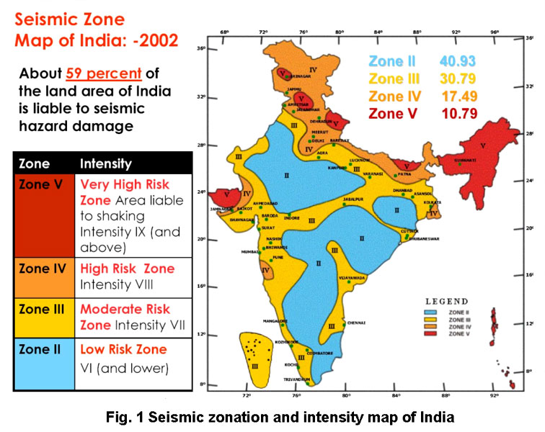
SEISMIC ZONE MAP OF INDIA -2002

Slide 11
The Latur earthquake in 1993 was one of the most devastating ones in modern India.
Measuring 7.4 on Richter scale, the disaster killed more than 20,000 people around 30,000 were injured.
More than 2 lakh houses brutally damaged in 13 neighboring districts.
Nearly 1, 27,000 families were affected by the tragedy in Maharashtra.
1993 LATUR EARTHQUAKE

Slide 12
2001 GUJARAT EARTHQUAKE
On January 26, 2001 an earthquake with a magnitude of 7.7 on Richter scale hit at about 08:46 a.m. in Kutch district of Gujarat.
Around 20,000 people were killed, 1,67,000 injured and about 6,00,000 people were left homeless. The city of Bhuj that lied only 20 km from the epicentre was totally devastated.

Slide 13
A destructive Tsunami in the Indian Ocean in 2004, triggered by a powerful earthquake - measuring 9.0 on the Richter scale - caught the attention of the world as it killed more than 10,000 people in India alone.
Perhaps the most powerful Tsunami in history, the disaster severely affected 150,000 people in 11 countries.
2004 INDIAN OCEAN TSUNAMI

Slide 14
Loss of life
Injury
Damage to and destruction of property.
Loss of livelihood.
Disruption to essential services
Damage to national infrastructure
Disruption to governmental systems
National economic loss
Sociological and psychological after effects.
GENERAL EFFECTS OF DISASTER

Slide 15
DISASTER MANAGEMENT
“AN APPLIED SCIENCE WHICH SEEKS, BY THE SYSTEMATIC OBSERVATION AND ANALYSIS OF DISASTERS, TO IMPROVE MEASURES RELATING TO
PREVENTION,
MITIGATION,
PREPAREDNESS,
RESPONSE AND
RECOVERY.”

Slide 16
PRINCIPLES OF DISASTER MANAGEMENT
        Hazard Assessment
        Planning
        Organization
        Resource Utilization
        Need for Specialists
        Training

Slide 17
Disasters will happen
Disasters don’t know borders
Disasters kill people & livestock
Disasters give bad publicity
Disasters impact the economy
Psychological effects
Harmful for the environment.
DISASTER FACTS

Slide 18
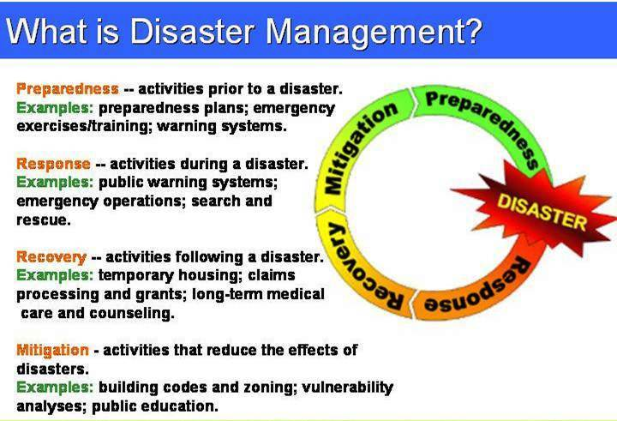
DISASTER MANAGEMENT CYCLE

Slide 19
High Powered Committee set up in August 1999
Until 2001 – Responsibility with Agriculture Ministry
Transferred to Ministry of Home Affairs in June 2002
DM Act was passed by the Parliament on 12th Dec 2005
NDMA constituted in the year 2005 to supervise the DM Plan of the country
DEVELOPMENT : DISASTER MANAGEMENT IN INDIA

Slide 20
Chapter VIII, DM Act - 2005
Sec 44 (I) of the Act :
NDRF : A ‘Specialist Force’ to respond to disasters/ threatening disaster.
Landmark order of MHA dated 19th Jan, 2006, approving conversion of 8 Bns of CAPFs into NDRF (02 each from BSF, CISF, CRPF & ITBP).
Multi-skilled, high-tech specialist force trained & equipped as per international standards capable of responding to natural or manmade disaster.
NATIONAL DISASTER RESPONSE FORCE (NDRF)

Slide 21
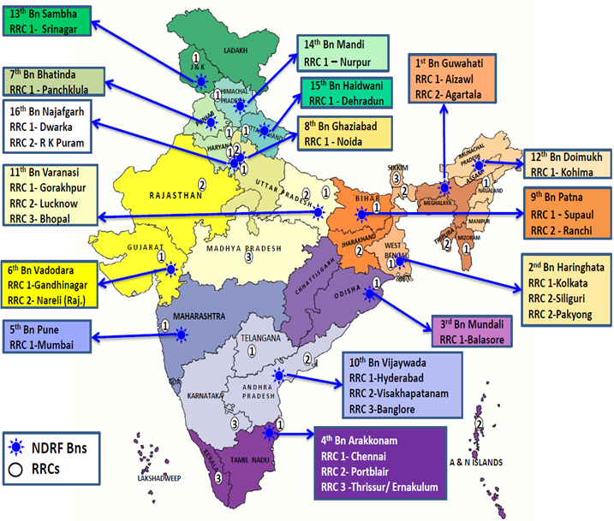
DEPLOYMENT OF NDRF TEAMS

Slide 22
L-O Level | Preparatory activities – preparedness, awareness etc.
L-1 Level | Disaster that can be managed at the district / local level.
L-2 Level | Required assistance of state resources for management of the disasters.
L-3 Level | Need assistance from the Centre.
L - Concept

Slide 23
REVIEW
Disaster profile of India
Describe disaster management cycle
Describe types of disaster.
Describe Incident response system
Overview of DM Act 2005
Conclusion

Slide 24

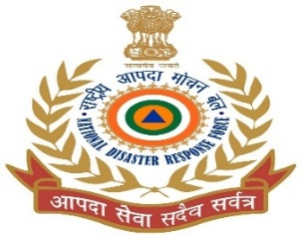
ANY QUESTION ?

Slide 25
EVALUATION
Q1)Incidence causing large scale of man and material damage and disrupts the normal functioning of the society that goes beyond their capacity of coping and demands external help.
Ans_____________________

Slide 26



THANK YOU

