Slide 1




FLOOD WATER AND RESCUE
SNAKE BITE AND FIRST AID KIT
Presented By:- Kamlesh Dhoundiyal,2IC
PEER | CSSR | INDIA
PPT 2 -

Slide 2

OBJECTIVES
Snake bite and its control
PHT
First Aid Kit
After completion of this topic, you will able to describe :

Slide 3
HISTORY OF SNAKE
Jurassic age
Tertiary age

Slide 4
FAMILY OF SNAKE
There are 11 family of snake
Three family are poisonous
Elapidae
Viperidae
Hydrophile

Slide 5
Snake bites are a common occurrence, however 90% of the land snakes found in our country are not poisonous.
In majority of cases, death takes place due to fright and not due to bite from a poisonous snake.
There is considerable color and pattern variation and it takes a trained eye to identify snakes correctly, it is not recommended that you should attempt to handle snakes
SNAKES

Slide 6
SNAKES
2500 - 3000 SPECIES WORLDWIDE
500 VENOMOUS SPECIES
52 POISONOUS SPECIES IN INDIA
INCIDENCE > 5 MILLION PER YEAR
DEATH IN TRANSIT, ? TRUE INCIDENCE

Slide 7
Spectacle cobra
Monocle cobra
King cobra
Common krait
Banded krait
Russell viper
COMMON POISONOUS SNAKES OF INDIA

Slide 8
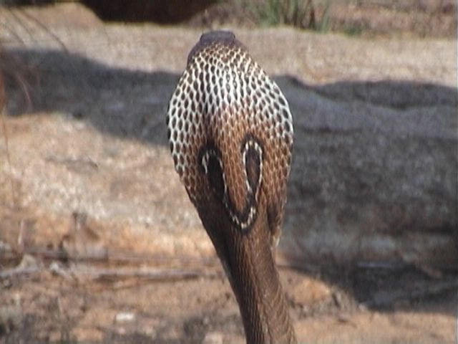
THE INDIAN COBRA
Encountered all over India during day and night
Often found around or in human habitation

Slide 9

This is the Indian Cobra. It is identified by the hood which has a spectacle mark.
Cobras are likely to spread their hood and hiss loudly when agitated.
Found in most parts of the country.
It is often seen in bathrooms, dark corners of houses, dwelling rooms, stable, servants quarters of old bungalows and jungles.
It is active in day as well as night
THE INDIAN COBRA

Slide 10
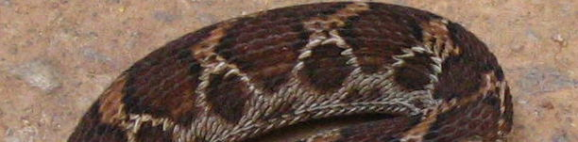
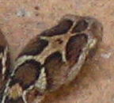
SAW SCALED VIPER
White hoop like marks along body and arrow or birds foot mark on head.
Found all over India, prefers dry scrub or desert.

Slide 11
This is the Pharos or Saw scaled viper. It’s back is usually marked with black blotches of inverted V shaped markings
It is a small viper found all over India.
It abounds in Western India more than in any other part. It prefers open dry rocky country or arid deserts.
SAW SCALED VIPER

Slide 12
RUSSELL’S VIPER
Black edged chain like marks and white V on head
Hisses loudly when disturbed
Hides under trees, bushes and leaf litter during day

Slide 13
This is Russell’s viper. It is a big stumpy snake 1/2 to 2 meters long with a short tail.
It’s back is also marked with black blotches of inverted V shaped markings
It has the loudest hiss and biggest of fangs
It prefers open country, cultivated fields and bushy or grassy fallow lands.
It is nocturnal and slow in its movements but is aggressive and holds its ground when aroused.
RUSSELL’S VIPER

Slide 14
Majority of the snake bites are from these four common poisonous snakes of India :
The Indian Cobra,
The common Krait,
Saw scaled viper and the
Russell’s viper
RUSSELL’S VIPER

Slide 15
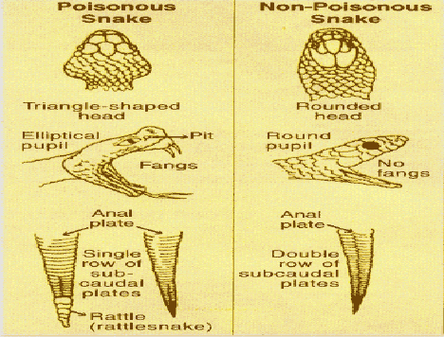
FEATURES OF POISONOUS AND NON-POISONOUS SNAKES

Slide 16
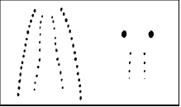
NON-POISONOUS AND POISONOUS FANG MARKS

Slide 17
Neurotoxic: Cobra, Krait
Attacks nervous system and stops breathing
Hemotoxic: All Vipers
Causes blood to stop clotting and punctures blood vessels and victim dies from blood loss.
SNAKE VENOM

Slide 18
EFFECTIVE DOSE
DOSE TIME
Spectacled cobra 15 mg 7 – 8 hrs
Monocled cobra 15 mg 7 - 8 hrs
King cobra 12 mg 5 - 6 hrs
Banded krait 10 mg 4 hrs
Common krait 1-3 mg 2 ½ hrs
Russells viper 42 mg 3 days

Slide 19
SYMPTOMS OF SNAKE BITE
Local symptoms of Bite
Paired fang marks (Although often only a single mark or a scratch may be present)
Swelling
Pain
Bleeding from bite
NB: Kraits often have none of the above

Slide 20
SYMPTOMS OF SNAKE BITE
Symptoms of a snake bite appear quickly these are:
Significant swelling developing within 10 minutes
Nausea
Weakness
Temperature change
Pain
Black and blue discoloration may appear within 3-6 hours.

Slide 21
Drooping Eyelids
Vision disturbances
Difficulty breathing
Hemotoxic
Continuous bleeding from bite site
Bleeding from gums
Appearance of bruise
Dark urine
SYMPTOMS SHOWING SPREAD OF VENOM

Slide 22
FIRST AID
Calm the patient down to slow down blood circulation and retard the spread of venom.
Have the victim lie down with the affected limb lower than the heart.
Notes:
Calm the patient down to slow down blood circulation and retard the spread of venom.
Have the victim lie down with the affected limb lower than the heart.

Slide 23
FIRST AID
Remove any rings, bracelets, boots, or other restricting items from the bitten extremity.
(It may swell.)

Slide 24
FIRST AID
Do not apply ice, cold packs or give alcohol or any other drug to the victim
Do not wait for the symptoms to develop

Slide 25
FIRST AID
Immobilize the bitten limb, using a splint if possible and position it below the level Of the heart
Do not give incision or attempt to suck out venom as it is ineffective at removing venom; and in Viper bites will cause serious bleeding.

Slide 26
FIRST AID
Do not give incision or attempt to suck out venom as it is ineffective at removing venom; and in Viper bites will cause serious bleeding.

Slide 27
FIRST AID
In Cobra and Krait bites, the victim may stop breathing. They are not dead, start
Artificial Respiration
This can be Life Saving

Slide 28
DO’S
Keep victim calm.
Immediately have the victim lie flat without moving.
Immobilize the bitten limb, using a splint if possible and position it below the level of the heart.
Get the victim to hospital urgently, lying flat, if possible.

Slide 29
DONT’S
Do Not apply any tourniquet or compression bandage.
Do Not cool the area of the bite.
Do Not try to catch the snake, we do not need another victim, but take it to hospital if already killed.
Do Not give the victim alcoholic drinks or Aspirin.

Slide 30
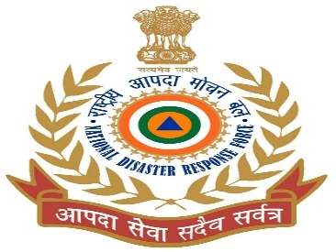
MYTHS ABOUT SNAKES
Cobras, particularly the King Cobras wear a Nagmani that makes one a millionaire!
Snakes suck milk from the udders of cows by coiling around their legs!
Snakes like the sweet pungent smell of the 'Kevada' or the 'Raat Rani’!

Slide 31
REVIEW
Snake bite and its control
PHT
First Aid Kit

Slide 32
ANY QUESTION ?

Slide 33
EVALUATION
Q1)Common poisonous snakes of india are?
Ans__________________________

Slide 34



THANK YOU

