Slide 1





OVERVIEW OF DM ACT, POLICY AND PLAN
Presented By:- Kamlesh Dhoundiyal,2IC
PEER | CSSR | INDIA
PPT 2 -

Slide 2
OBJECTIVES
After completion of this lesson, you will be able to know :-
DM Act-2005.
Salient features of DM Act
Response Policy at local, district state and central level
Response machinery at local, district, state and central level
National Disaster Management Act
Upon completing this lesson, you will become familiar with :-

Slide 3
Evolution can be traced to the events of the decade preceding it – globally and nationally.
Globally, a paradigm shift in the approach towards disaster management.
The UN’s move to observe the 1990s as the International Decade for Natural Disaster Reduction (IDNDR).
The Yokohama Strategy Plan of Action for a Safer World, 1994.
The Hyogo Framework for Action 2005-2015.
Building the Resilience of Nations and Communities to Disasters (HFA), 2005, adopted by the UN provided further impetus to his new holistic approach.
GENESIS

Slide 4





Disaster Management
Authority
at all three level
Passed on 28th Nov in RS
& on 12th Dec. in LS
SALIENT FEATURES OF DM ACT
05
01
The act extends to
the whole of India.
04
02
03
Comprises total 11 chapters
& 79 sections
MHA will be the
Nodal Agency

Slide 5






Constitution of NCDM
& renamed in 2005 as NIDM
1995
KEY PROGRESS
Constitution of HPC&
Recommended for separate dept.
1999
Disaster management
ACT-2005, NDMA
2005

Slide 6



2009
National Disaster
Management Policy
KEY PROGRESS
National Disaster
Management Plan
2016
National Disaster
Management Plan
2019

Slide 7
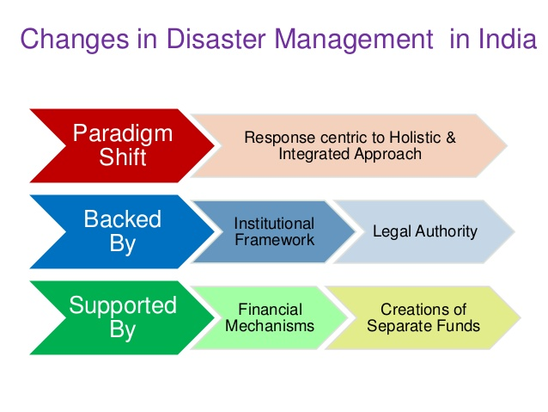
CHANGES IN DISASTER MANAGEMENT

Slide 8
DM ACT 2005
For the effective management of disaster ,it provides institutional mechanisms for drawing up and monitoring the implementation of the disaster management.
Ensures measures by the various wings of the Govt for prevention and mitigation of disasters and prompt response to any disaster situation.
Provides for setting up of NDMA under the chairmanship of PM,SDMA under CM,DDMA under DC/DM.

Slide 9
SECTIONS OF FRAMEWORK
National Disaster Management Framework -2005 comprises these sections:
Institutional Framework
Legal Framework
Financial Framework

Slide 10





INSTITUTIONAL FRAMEWORK
09
01
NDMA (SEC-03) , SDMA
(SEC-14), DDMA (SEC-25)
NEC(SEC-8) , SEC(SEC-20)
02
SECTIONS OF FRAMEWORK
NDRF (44 & 45)
04
03
NIDM ( 42& 43)

Slide 11
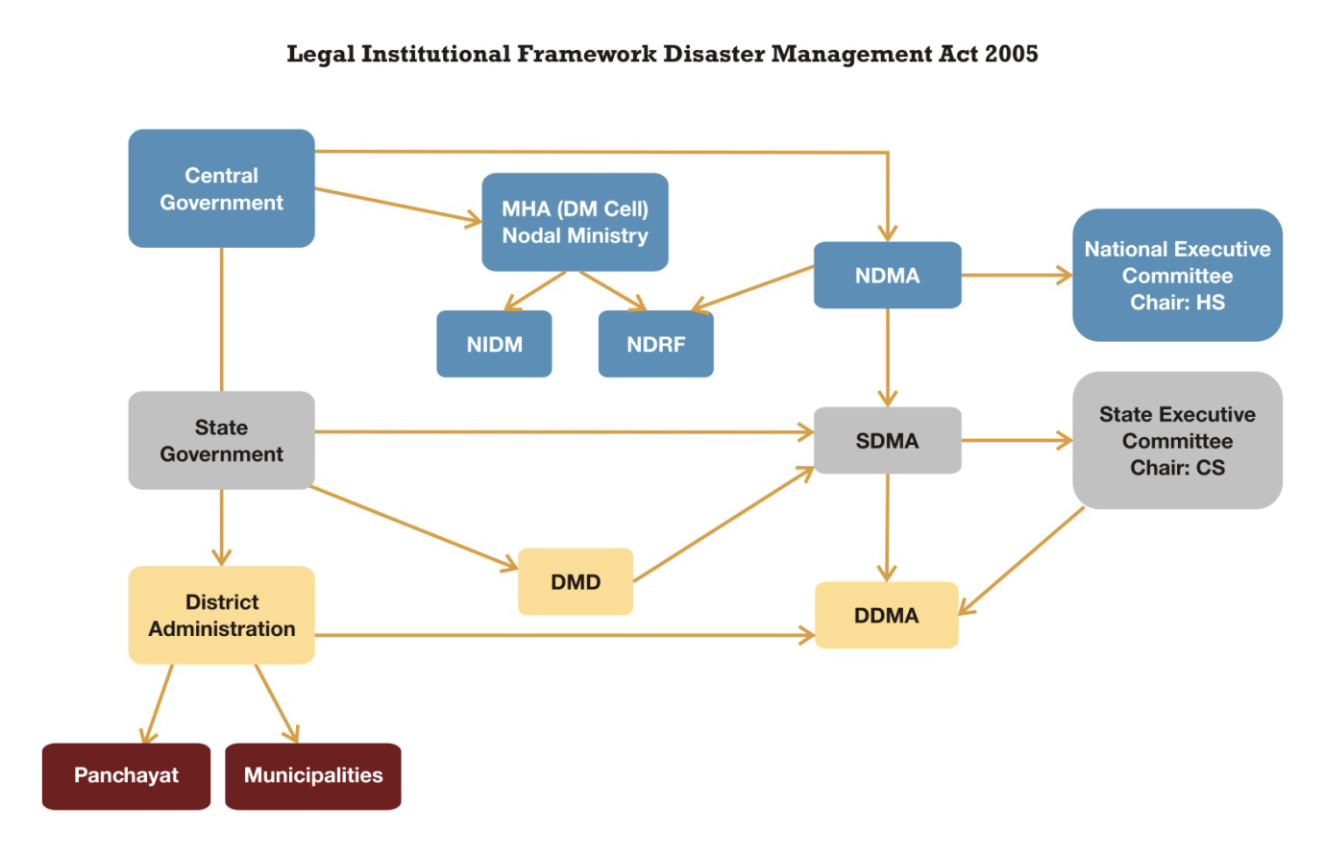
LEGAL INSTITUITIONAL FRAMEWORK DM ACT 2005

Slide 12
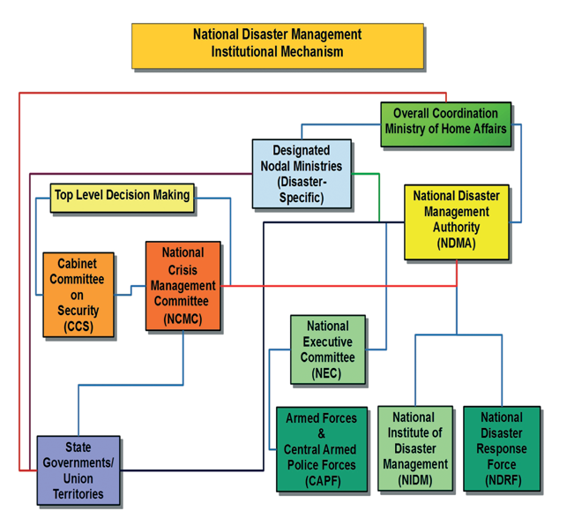
NATIONAL LEVEL DISASTER MANAGEMENT COORDINATION MECHANISM

Slide 13
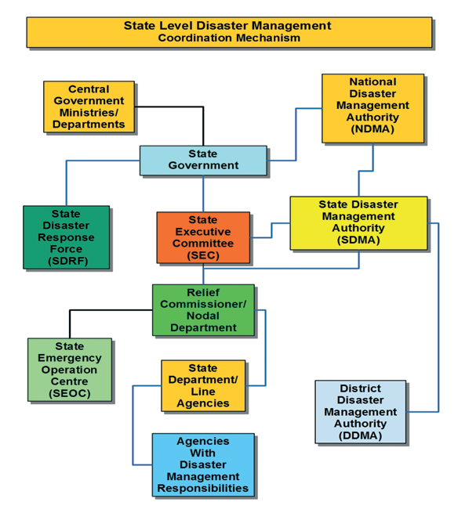
STATE LEVEL DISASTER MANAGEMENT COORDINATION MECHANISM

Slide 14
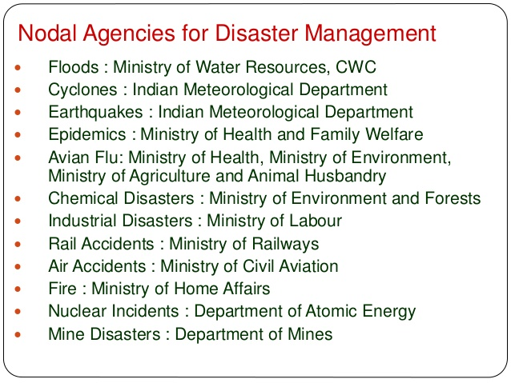
NODAL AGENCIES FOR DM
Notes:
Overall guidance is if MHA

Slide 15
NATIONAL DISASTER MANAGEMENT AUTHORITY (NDMA) CHAPTER II (SEC.03-13)
Established in may 2005 by executive order but constituted on 27th September 2006 under sec – 3(1) of DM act 2005
National Disaster Management Authority (NDMA) under the Prime Minister with nine more members & one vice chairman for laying down the policies, plans and guidelines for disaster management.
The Authority will be assisted by a National Executive Committee (NEC) of Secretaries to Central Government.
The National Authority to lay down policy, plan and to recommend guidelines for the minimum standards of relief.(Shelter ,food , water, sanitation 12(i))

Slide 16
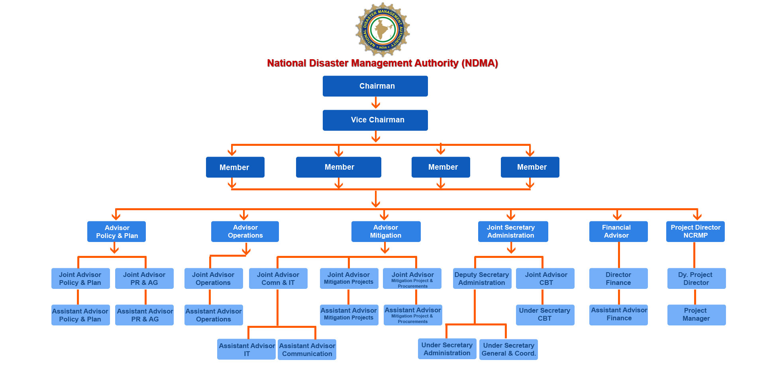
NATIONAL DISASTER MANAGEMENT AUTHORITY

Slide 17
SEC 6. POWERS AND FUNCTIONS OF NATIONAL AUTHORITY
1. Subject to the provisions of this act, the national authority shall have the responsibility for laying down the policies, plans and guidelines for disaster management for ensuring timely and effective response to disaster.
2. Without prejudice to generality of the provisions contained in sub-section (1), the national authority may -
A. Lay down policies on disaster management;
B. Approve the national plan;
C. Approve plans prepared by the ministries or departments of the government of India in accordance with the national plan;
D. Lay down guidelines to be followed by the state authorities in drawing up the state plan

Slide 18
SEC 6. POWERS AND FUNCTIONS OF NATIONAL AUTHORITY
E Lay down guidelines to be followed by the different ministries or departments of the government of India for the purpose of integrating the measures for prevention of disaster or the mitigation of its effects in their development plans and projects;
F. Coordinate the enforcement and implementation of the policy and plan for disaster management;
G. Recommend provision of funds for the purpose of mitigation;
H. Provide such support to other countries affected by major disasters as may be determined by the central government;

Slide 19
SEC 6. POWERS AND FUNCTIONS OF NATIONAL AUTHORITY
I. Take such other measures for the prevention of disaster, or the mitigation, or preparedness and capacity building for dealing with the threatening disaster situation or disaster as it may consider necessary;
J. Lay down broad policies and guidelines for the functioning of the national institute of disaster management.
3. The chairperson of the national authority shall, in the case of emergency, have power to exercise all or any of the powers of the national authority but exercise of such powers shall be subject to ex post facto ratification by the national authority.

Slide 20
11. NATIONAL PLAN
1. There shall be drawn up a plan for disaster management for the whole of the country to be called the national plan.
2. The national plan shall be prepared by the national executive committee having regard to the national policy and in consultation with the state governments and expert bodies or organizations in the field of disaster management to be approved by the national authority.
3. The national plan shall include-
A. Measures to be taken for the prevention of disasters, or the mitigation of their effects;
B. Measures to be taken for the integration of mitigation measures in the development plans;
C. Measures to be taken for preparedness and capacity building to effectively respond to any threatening disaster situations or disaster;
D. Roles and responsibilities of different ministries or departments of the government of India in respect of measures specified in clauses (a), (b) and (c).

Slide 21
11. NATIONAL PLAN
4. The national plan shall be reviewed and updated annually.
5. Appropriate provisions shall be made by the central government for financing the measures to be carried out under the national plan.
6. Copies of the national plan referred to in sub-sections (2) and (4) shall be made available to the ministries or departments of the government of India and such ministries or departments shall draw up their own plans in accordance with the national plan.
11. NATIONAL PLAN

Slide 22
STATE DISASTER MANAGEMENT AUTHORITY (SDMA) CHAPTER III (SEC 14-24)
State Disaster Management Authority (SDMA) chaired by Chief Minister.
Out of eight members one may be designated as the Vice-Chairperson of the State Authority by the Chief Minister.
The State Authority may constitute an Advisory Committee of experts.
The State Authority shall be responsible for laying down the policies and plans for Disaster Management in the State.
The State Authority shall recommend guidelines for providing minimum standards of relief.
The State Authority will be assisted by the State Executive Committee.

Slide 23
SEC 24. POWERS AND FUNCTIONS OF STATE EXECUTIVE COMMITTEE IN THE EVENT OF THREATENING DISASTER SITUATION
a. control and restrict, vehicular traffic to, from or within, the vulnerable or affected area;
b. control and restrict the entry of any person into, his movement within and departure from, a vulnerable or affected area;
c. remove debris, conduct search and carry out rescue operations;
d. provide shelter, food, drinking water, essential provisions, healthcare and services in accordance with the standards laid down by the National Authority and State Authority;
e. give direction to the concerned Department of the Government of the State, any District Authority or other authority, within the local limits of the State to take such measure or steps for rescue, evacuation or providing immediate relief saving lives or property, as may be necessary in its opinion;
f. require any department of the Government of the State or any other body or authority or person in charge of any relevant resources to make available the resources for the purposes of emergency response, rescue and relief;

Slide 24
SEC 24. POWERS AND FUNCTIONS OF STATE EXECUTIVE COMMITTEE IN THE EVENT OF THREATENING DISASTER SITUATION
g. require experts and consultants in the field of disasters to provide advice and assistance for rescue and relief;
h. procure exclusive or preferential use of amenities from any authority or person as and when required;
i. construct temporary bridges or other necessary structures and demolish unsafe structures which may be hazardous to public;
j. ensure that non-governmental organisations carry out their activities in an equitable and non-discriminatory manner;
k. disseminate information to public to deal with any threatening disaster situation or disaster;
l. take such steps as the Central Government or the State Government may direct in this regard or take such other steps as are required or warranted by the form of any threatening disaster situation or disaster.

Slide 25
DISTRICT DISASTER MANAGEMENT AUTHORITY (DDMA) CHAPTER IV (SEC 25-34)
The State Government shall establish a District Disaster Management Authority (DDMA) in each district.
The Chairperson of District Disaster Management Authority (DDMA) will be the Collector or District Magistrate or Deputy Commissioner of the district.
The elected representative of the area is member of the DDMA as Co-Chairperson.
The District Authority shall act as the district planning, coordinating and implementing body for disaster management.

Slide 26
LOCAL AUTHORITY CHAPTER VI (SEC 41)
The Local Authority shall ensure training of its officers and employees and maintenance of resources so as to be readily available for use in the event of a disaster.
It shall also ensure that all construction projects under it conform to the standards and specifications laid down.
It shall carry out relief, rehabilitation and reconstruction activities in the affected area within its jurisdiction.

Slide 27
PENAL PROVISIONS (SEC 51-60)
SECTION 51:Punishment for obstruction and/or non-compliance of the directions given by the Central/State Govt, NEC, SEC, DDMA.
Up to one year imprisonment or fine or both. If such obstruction results in loss of lives or imminent danger thereof : imprisonment may extend to two years.
Punishment for false claim for obtaining relief, assistance etc. SECTION 52:Two years’ imprisonment with fine.

Slide 28
Cont..
PENAL PROVISIONS (SEC 51-60)
Punishment for misappropriation of money or materials Section 53:Two years’ imprisonment and fine.
Punishment for false warning Section 54:One year imprisonment or fine.
Offences by departments of the government Section 55:In case of an offence by the government department, the head of the department to be held guilty unless he proves otherwise any other officer found guilty to be proceeded against and punished.

Slide 29
Cont…
PENAL PROVISIONS (SEC 51-60)
Refusal to perform any duty by any govt. Officer Section 56:
One year imprisonment or fine.
Penalty for contravention of any order of requisitioning
Section 57: One year imprisonment or fine or both

Slide 30
73. ACTION TAKEN IN GOOD FAITH
No suit or prosecution or other proceeding shall lie in any court against the Central Government or the National Authority or the State Government or the State Authority or the District Authority or local authority or any officer or employee of the Central Government or the National Authority or the State Government or the State Authority or the District Authority or local authority or any person working for on behalf of such Government or authority in respect of any work done or purported to have been done or intended to be done in good faith by such authority or Government or such officer or employee or such person under the provisions of this Act or the rules or regulations made there under.

Slide 31
74. IMMUNITY FROM LEGAL PROCESS
Officers and employees of the Central Government, National Authority, National Executive Committee, State Government, State Authority, State Executive Committee or District Authority shall be immune from legal process in regard to any warning in respect of any impending disaster communicated or disseminated by them in their official capacity or any action taken or direction issued by them in pursuance of such communication or dissemination.

Slide 32
DISASTER LEVELS
1)The organization, institution or
community is able to contain the
incident using its own resources
and can respond effectively.
2) Assistance can be required
by external resources,
however it can be obtained
from nearby or higher authorities.
01
Leel
3)The magnitude of the disaster
exceeds the capacity of the
local state or region and
support is needed at national level.

Slide 33
Review
REVIEW
Now you will be able to :-
DM Act-2005.
Salient features of DM Act
Response Policy at local, district state and central level
Response machinery at local, district, state and central level
National Disaster Management Act

Slide 34
ANY QUESTION ?

Slide 35
EVALUATION
Q1)_____________ act For the effective management of disaster ,it provides institutional mechanisms for drawing up and monitoring the implementation of the disaster management .

Slide 36



THANK YOU

