Slide 1
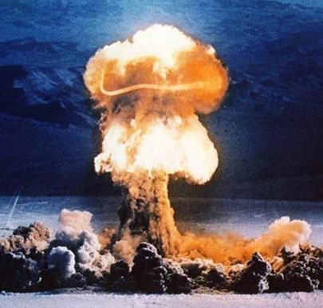





WMD, STRUCTURE OF CBRN TEAM & RESPONSIBILITIES
Presented By:- Amit Kumar, AC

Slide 2
OBJECTIVES
Definition Of WMD
Types Of WMD
When WMD Can Be Used.
CBRN Weapons
CBRN Team Structure & Strength
Role Of CBRN Sub Teams
Conclusion
Upon completion of this lesson you will be able to:

Slide 3
INTRODUCTION
Any weapon that is designed to cause death or serious bodily injury through the release dissemination or impact of toxic or poisonous chemicals or their precursors any weapon involving a biological agent or any weapon that designed to release radiation.

Slide 4
DEFINITION
A weapon such as a Nuclear weapon, a Chemical weapon or a Biological weapon that can destroy large areas, man made structure, natural structure , kill many people.

Slide 5
TYPE OF WMD
Nuclear And Radiological
Biological
Chemical

Slide 6
WHEN WMD CAN BE USED?
During war
By terrorists
By accident

Slide 7
DURING WAR
Dropping of atom bombs at Hiroshima & Nagasaki during world war –II
Chemical attack by Iraqis on kurds during Iran- Iraq war

Slide 8
BY ACCIDENT
The gas leakage at the Union Carbide factory at Bhopal.
The nuclear accident at Chernobyl in Ukraine
The nuclear accident at fukushima in japan

Slide 9
BY TERRORISTS
The chemical gas attack in Tokyo subway
The Sept 11 attack at New York

Slide 10
HIROSIMA & NAGASAKI
Little Boy
U-235
Gun type
Yield : 15 KT
Height of burst : 580 m
Fat Man
Pu-239
Implosive type
Yield : 21 KT
Height of burst : 500 m

Slide 11
NUCLEAR WEAPON TODAY
20,000 nuclear weapons
Several thousand megatons
US and Russia have 13,000 actively deployed warheads
2500 (US) and 2000 (Russia) on high alert
  Fired within 15 minutes, reach targets in 30 minutes

Slide 12
NUCLEAR WEAPON EFFECTS

Slide 13
EFFECTS OF A NUCLEAR EXPLOSION
Immediate:
  Vaporized by thermal radiation
  Crushed by blast wave
  Burned and suffocated by firestorm
  Suffering, painful deaths

Slide 14
EFFECTS OF A NUCLEAR EXPLOSION
Late effects:
  Cancer
  Psychological trauma
  Nuclear winter (mass starvation due to disruption of agricultural, transportation, industrial and health care systems)

Slide 15
TYPES OF INJURIES
Burns
Blinding's
Deafening's
Collapsed lungs
Fractures
Shrapnel wounds

Slide 16
EFFECTS ON HEALTH CARE SYSTEM
Most major hospitals destroyed
EMS system debilitated
No X-ray machines, electricity, water, antibiotics or other meds, blood/plasma, bandages

Slide 17
HISTORY
OF NUCLEAR WEAPONS
On 6th Aug 1945, the world's first atomic bomb was used and dropped in Hiroshima in Japan by US during world war II.
This was followed by another bomb i.e. on 9th Aug 1945 in Nagasaki in Japan only and immediate result was surrender of Japanese.

Slide 18
HISTORY
OF NUCLEAR WEAPONS
For many years after 1945,the US was only power that could make and deliver fission devices but there was no use of such bombs thereafter.
In Aug 1949,the Soviet Union had also detonated a fission device.

Slide 19
BRIEF HISTORY
OF
CWA
CWA are normally man made through use of industrial chemical processes.
First use of chemical agents began with small use of Irritant (known as riot control agents) ie French troops use tear gas grenades against German Positions in 1914 (world war –I)

Slide 20
BRIEF HISTORY
OF
CWA
22 April 1915 - German military used chlorine gas against Allied trenches in Ypres ,Belgium 91,000 deaths and 1.3 million injuries
1983- Iraq begins using chemical warfare agents, including mustard ,in the Iran- Iraq war (1980-1988)

Slide 21
BRIEF HISTORY
OF
CWA
20 May 1995- Aum Shinrikyo releases sarin nerve agent in the Tokyo subway ,killing 12 people and injuring about 1,000.

Slide 22
CHEMICAL WARFARE AGENTS
(CWA)
Blister Agents
- Sulfur Mustards , Nitrogen Mustards, Arsenicals
Nerve Agents
  G Agents
    (Sarin GB,Soman GD, Tabun GA)
  V- Agents (VX)
  Blood Agents
  Hydrogen Cyanide, Cyanogen chloride
  Choking Agents
  - Chlorine, Phosgene

Slide 23
BIOLOGICAL WEAPONS
Biological weapons (BW) are micro organisms like virus, bacteria and fungi that give rise to disease and when deliberately dispersed in an area can incapacitate, reduce resistance and even cause mortality to humans.

Slide 24
BRIEF HISTORY
OF
BWA
World War– I: -
1916-1918- German agents use anthrax to infect livestock and feed for export to Allied forces.
1937- Japan begins its offensive biological weapons program. Over the course of the program, at least 10,000 prisoners of war are killed in Japanese experiments.

Slide 25
BRIEF HISTORY
OF
BWA
World War– I: -
1939- Japanese Army Aircrafts sprayed / dropped fleas infected with bubonic plague over areas in China at least five different occasions.

Slide 26
BIOLOGICAL WEAPONS - AGENTS
Anthrax
Cholera
Pneumonic plague
Tularemia
Fever
Smallpox
Viral Hemorrhagic Fevers (e.g., Ebola)

Slide 27
STRUCTURE OF
CBRN TEAM
Strength 47
Sub Teams
Technical Support Team
Detection & Assessment Cum Evacuation Team
Rescue & Evacuation Team 1
Rescue & Evacuation Team 2
Decontamination Team
Medical Unit
Adm. Support Team

Slide 28
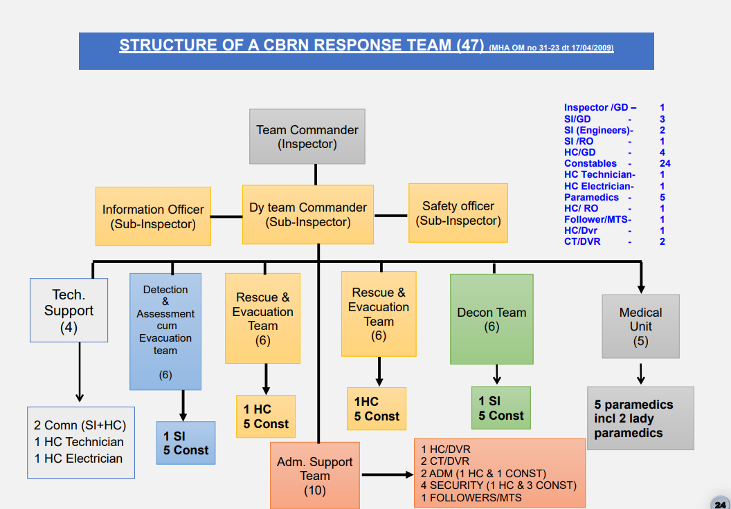
STRUCTURE OF
CBRN TEAM

Slide 29
TECHNICAL TEAM
➢ Establish the communication setup (QDA, VHF, HF, Sat Com etc.)
➢ Cut the utilities at incident site prior to start of rescue operation
➢ Handling the operation of gen-sets and ensure power supply
➢ Ensuring lighting of operation site if required
➢ Carryout minor maintenance work of eqpt.

Slide 30
DETECTION & ASSESSMENT CUM EVACUATION TEAM
➢ The team shall be responsible for functioning of their equipment.
➢ They will cover the equipment with transparent polythene bags to protect
➢ detection of presence of HazMat using appropriate detection equipment
➢ Marking of zones
➢ Marking of victims’ location
➢ Will relay the dose/ dose rate levels indicated by the detectors to the Detection team commander

Slide 31
DETECTION & ASSESSMENT CUM EVACUATION TEAM
➢ They will keep an eye on the cumulative dose received by them during the rescue
➢ Assess and report the situation on ground
➢ Once the task is completed the team shall proceed to the CUWA/decontamination station for decontamination
➢ Team shall only move beyond the Warm zone once the decontamination center is established

Slide 32
DETECTION & ASSESSMENT CUM EVACUATION TEAM
➢ Rescue any victim trapped inside the Warm/Hot zones
➢ Team shall also help evacuate any person
➢ They will ensure that they have worn appropriate PPE
➢ They will look for the victim locations marked by the detection team
➢ They will carry out a primary triage and carry all victims
➢ The team shall take the critically injured victims directly to the waiting medical team
➢ They will keep an eye on the cumulative dose received by them
➢ The team shall be responsible for functioning of their equipment
➢ They shall carry the resuscitator, oxygen and other life-support equipment

Slide 33
DETECTION & ASSESSMENT CUM EVACUATION TEAM
➢ Rescue any victim trapped inside the Warm/Hot zones
➢ Team shall also help evacuate any person
➢ They will ensure that they have worn appropriate PPE
➢ They will look for the victim locations marked by the detection team
➢ They will carry out a primary triage and carry all victims

Slide 34
DETECTION & ASSESSMENT CUM EVACUATION TEAM
➢ The team shall take the critically injured victims directly to the waiting medical team
➢ They will keep an eye on the cumulative dose received by them
➢ The team shall be responsible for functioning of their equipment
➢ They shall carry the resuscitator, oxygen and other life-support equipment

Slide 35
DECONTAMINATION
TEAM
Ensure that all team members have worn appropriate PPE
➢ Ensure that carry to all equipment, sheets, containers, shower stations, fuller earth, decontamination solution, dress for decontaminated personnel
➢ Setting up of decontamination corridors and stations at cold zone

Slide 36
DECONTAMINATION
TEAM
➢ Be ready to quickly shift the decontamination corridor and station
➢ Decontamination of victim and rescuer is primary task, secondary task is decontamination of equipment and vehicle.
➢ To proper decontamination of all victims and rescuers
➢ Victims with severe/life threatening injury will not be decontaminated

Slide 37
DECONTAMINATION
TEAM
➢ Be ready to quickly shift the decontamination corridor and station
➢ Decontamination of victim and rescuer is primary task, secondary task is decontamination of equipment and vehicle.
➢ To proper decontamination of all victims and rescuers
➢ Victims with severe/life threatening injury will not be decontaminated

Slide 38
DECONTAMINATION
TEAM
DS-2 solution will be used for decontamination of vehicle and equipment only
Proper decontamination of equipment will be ensured
All contaminated clothing and disposables will be packed and handed over to expert agency
The contaminated water and other liquid will be collected in containers and it will be ensured that it shouldn’t mix with ground/natural water source or drainage

Slide 39
DECONTAMINATION
TEAM
Will sufficiently carry PDK-I, PDK-II, DS2 solution, detergent powder, bleaching powder, brush long & short and DS2 solution dispersal apparatus. Also carry water jet, hose pipe and shower point.
Reusable TEA will be decontaminated properly
Static Showering unit station will remain in its place

Slide 40
MEDICAL
TEAM
➢ The medical team will be responsible for providing first aid and treatments
➢ Categorize the patient as per their injury/requirement of treatment
➢ Setup treatment centers for providing first aid and treatment
➢ Ascertain the triage level of the victims as per symptoms
➢ Reassure and relocate the psychological causalities

Slide 41


Definition Of WMD
Types Of WMD
When WMD Can Be Used.
CBRN Weapons
CBRN Team Structure & Strength
Role Of CBRN Sub Teams
Conclusion
REVIEW

Slide 42

ANY QUESTION?

Slide 43


1. Which type of disaster is called, when the world's first atomic bomb was used and dropped in Hiroshima in Japan by US during world war II?
Ans- Nuclear Bomb (Nuclear Disaster)
2. How many member in the NDRF CBRN response team?
Ans- 47
EVALUATION

Slide 44



THANK YOU

