Slide 1





INCIDENT RESPONSE SYSTEM
Presented By:- Kamlesh Dhoundiyal,2IC
PEER | CSSR | INDIA
PPT 2 -

Slide 2
After completion of this lesson you will be able to:-
Introduction about IRS
IRS organization
Important concepts and basic features in IRS
IRS facilities and EOC concept at national
State and district levels
OBJECTIVES
DEFINE IRS
DESCRIBE PURPOSE AND NEED OF IRS
DESCRIBE IRTs
LIST DIFFERENT IRS ENTITIES
After completion of this lesson you will be able to describe –

Slide 3
Multi-jurisdictional incidents
Shortages of resources requiring greater use of mutual aid
Accountability requiring standard incident mngt. system
Greater life and property loss risk reduction from natural and man-made disasters
Sophisticated media coverage demanding immediate answers
A well managed response process by providing answers to vital questions such as “who’s in charge?” & “what’s my job?”
NEED FOR IRS

Slide 4
DRAWBACKS EXPERIENCED IN DM
Too many people reporting to one supervisor.
Lack of reliable incident information.
Inadequate & incompatible comn.
No mech for coordinated planning between agencies.
Unclear lines of authority.
Terminology differences between agencies.
Unclear or unspecified incident objectives.

Slide 5

ORIGIN OF IRS
The government of India took a decision to adopt world’s best practice for disaster management
As Incident Command System was one of the world’s best practices and adapted by countries like, Australia, Canada, United Kingdom, etc. The government of India decided to adopt ICS in 2003

Slide 6
ORIGIN OF IRS…
In 2007 the NDMA felt that ICS should be adapted and a authentic guidelines should be released in the country for its successful implementation
NDMA Issued Guideline on “Incident Response System” In July 2010.

Slide 7
WHAT IS IRS ?
Single standardized, on-scene, all hazard incident management system used by all emergency response disciplines.
Provides accurate information, strict accountability, planning, cost effective operations and logistical support for any incident.

Slide 8
BASIC IRS CONCEPTS
Emergency Incidents.
Can be used for both small and large events.
System can grow or shrink to meet differing needs.
Cost effective & efficient management system.

Slide 9
The IRS envisages and lays down various tasks that may need to be performed by the existing administrative machinery at various levels.
It also recommends prior identification of officers for the performance of different tasks and getting them trained in their respective roles, and
Provides a structure under which all departments will function in tandem with the District and State administration.
BASIC IRS CONCEPTS

Slide 10
In the IRS, a need was felt to clearly identify a designated authority responsible and accountable by law to respond to disasters and therefore a position of Responsible Officer (RO) has been introduced.
Incident response management may however not always require the direct intervention of the RO.
On the ground, the management will be done by the IC to whom powers will have to be delegated by the RO.
The CSs and the District Magistrates/DCs will perform the role of ROs
BASIC IRS CONCEPTS

Slide 11
The chairperson of the NCMC / NEC will function as Chief Coordinator for the management of disasters at the National level.
The chairperson may designate a Nodal Officer (NO) for this purpose.
Various Ministries/Departments of Government may also nominate NOs to perform the task of Emergency Support Functionaries (ESFs) which may be required in a particular incident.
BASIC IRS CONCEPTS

Slide 12
INCIDENT COMMAND SYSTEM
INCIDENT COMMANDER
COMMAND STAF
F
FINANCE &
LOGISTICS
ADMINISTRATION
OPERATIONS
PLANNING & INTELLIGENCE

Slide 13
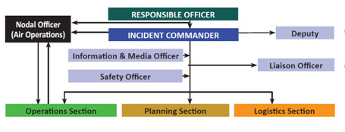
INCIDENT RESPONSE SYSTEM

Slide 14
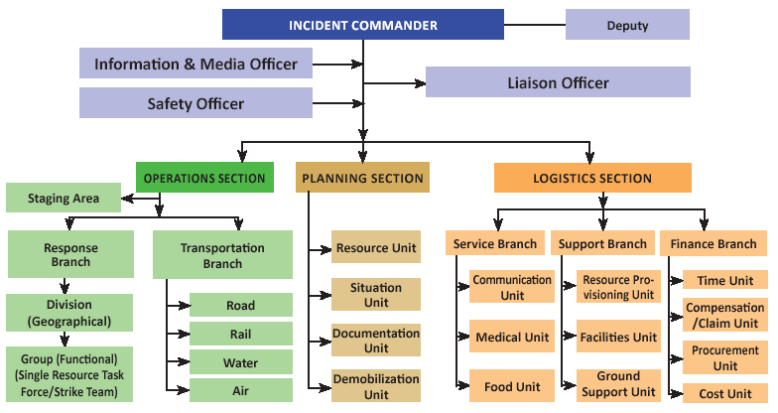
STATE LEVEL
IRT

Slide 15
The organizational structure of IRS at the State level shown in Fig. is not necessarily to be activated in the management of all types and scales of disasters.
For monitoring and support of the incident response, the RO will involve all required Emergency Support Functionaries(ESF) and headquarters IRT to support the on-scene IC.
The IC will work in close coordination with EOC and report to RO.
STATE LEVEL
IRT

Slide 16
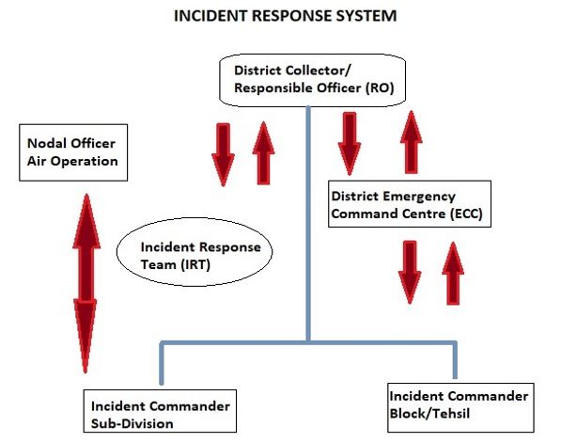
DISTRICT LEVEL
IRT

Slide 17
The complete IRS organizational structure at District level is depicted in Fig. The structure depicted above may be activated as and when required.
For monitoring and support of the incident response, the RO will involve all required ESF and headquarter IRT to support the on-scene IC.
In case when central teams (NDRF, Armed Forces) are deployed, the RO will ensure resolution of all conflicts.
DISTRICT LEVEL
IRT

Slide 18
INCIDENT RESPONSE TEAM (IRT)
IRS functions through incident response teams in the field.
An IRT is a team comprising all positions of IRS organization headed by Incident Commander (IC).
On receipt of early warning, RO shall activate the Incident Response Teams.
In case of a disaster without any warning, local IRT will respond and contact RO for further support, if required.
IRTs pre-designated shall function actively at all levels (i.e. District, Sub-Division and Tehsil/Block).

Slide 19

Incident Response Teams at the lowest administrative unit (Sub-Division /Tehsil/Block) shall be the first responder.
If the incident becomes complex and beyond the control of local IRTs, higher level IRTs will be informed to take over the response management.
In such cases, the lower level IRT will merge with higher level IRTs.
When lower level IRT merge with higher level IRT, IC of lower level may play the role of Dy IC.

Slide 20
EMERGENCY SUPPORT FUNCTIONS (ESFS)
The grouping of governmental and certain private sector capabilities into an organizational structure to provide support, resources, program implementation, and services
that are most likely needed to save lives, protect property and the environment, restore essential services and critical infrastructure, and
help victims and communities return to normal following domestic incidents.

Slide 21
EMERGENCY SUPPORT FUNCTIONS
• ESF #1 -Tpt
• ESF #2 –Comn
• ESF #3 –PW and Engg
• ESF #4 –Firefighting
• ESF #5 –Emergency Mngt
• ESF #6 –Mass Care, Emergency Asstt, Housing, and Human Services
• ESF #7 –Log Mngt and Resource
Sp
• ESF #8 –Pub Health and Med Services
• ESF #9 –Search and Rescue
• ESF #10 –Oil and Hazardous Materials Response • ESF #11 –Agri and Natural Resources
• ESF #12 –Energy
• ESF #13 –Public Safety and Security
• ESF #14 –Long-Term Community Recovery
• ESF #15 –External Affairs

Slide 22
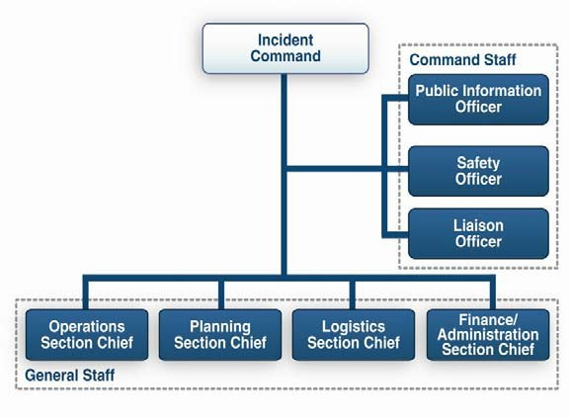
IC & COMMAND STAFF

Slide 23
INCIDENT COMMANDER
•
Overall command of the incident.
Must be fully qualified to manage incident
May be assigned by responsible jurisdiction or agency.
May assign personnel for both command staff and general staff.
•
May have one or more deputies, who must be equally qualified.
•

Slide 24
DEPUTY INCIDENT COMMANDER
A Deputy Incident Commander may be designated to:
Perform specific tasks as requested by the Incident Commander.
Perform the incident command function in a relief capacity.
Represent an assisting agency that shares jurisdiction.

Slide 25
INFORMATION & MEDIA OFFICER (IMO)
Advises Incident Commander on information dissemination and media relations. Incident Commander approves information that the IMO Releases.
Obtains information from and provides information to Planning Section.
Obtains information from and provides information to Community and media.

Slide 26
SAFETY OFFICER
Advises Incident Commander on issues regarding incident safety.
Works with Operations to ensure safety of field personnel.
Ensures safety of all incident personnel.

Slide 27
LIAISON OFFICER
Assists Incident Commander by serving as point of contact for agency representatives who are helping to support the operation.
Provides briefings to and answers questions from supporting agencies.

Slide 28
GENERAL STAFF
General Staff are called Section Chiefs
•
These are Operations, Planning, Logistics,
Each Section Chief may have one or more deputies.
•
Deputies must be as qualified as Section Chief

Slide 29
OPERATIONS SECTION CHIEF
The Operations Section Chief:
Develops and implements strategy and tactics to carry out the incident objectives.
Organizes, assigns, and supervises the tactical field resources.
Supervises air operations and those resources in a staging area.

Slide 30
OPERATIONS SECTION
The Operations Section:
Directs and coordinates all incident tactical operations.
Is typically one of the first organizations to be assigned to the incident.
Has the most incident resources.
Have Staging Areas .

Slide 31
OPERATIONS SECTION: DIVISIONS
Divided geographically based on the needs of the incident.
Labeled using alphabet characters (A, B, C, etc.).
Managed by a Supervisor.

Slide 32
OPERATIONS SECTION: GROUPS
Established based on the needs of an incident.
Labeled according to the job that they are assigned.
Managed by a Supervisor.
Work wherever their assigned task is needed and are not limited geographically.
Operations Section
Health & Safety
Group
Public Works Group

Slide 33
OPERATIONS SECTION: SINGLE RESOURCES
Single Resources may be:
Individuals.
A piece of equipment and its personnel complement.
A crew or team of individuals with an identified supervisor.
Operations Section
Task Force
Strike Team
Single Resource

Slide 34

OPERATIONS SECTION: STRIKE TEAMS
Strike Teams are a set number of resources of the same kind and type with common communications operating under the direct supervision of a Strike Team Leader.
Operations Section
Task Force
Strike Team
Single Resource

Slide 35
OPERATIONS SECTION: TASK FORCES
Task Forces are a combination of mixed resources with common communications operating under the direct supervision of a Task Force Leader.
Operations Section
Task Force
Strike Team
Single Resource

Slide 36
PLANNING SECTION CHIEF
The Planning Section Chief:
Gathers, analyzes, and disseminates information and intelligence.
Manages the planning process.
Compiles the IAP
Manages Tech Specialists.

Slide 37
PLANNING SECTION: RESOURCES UNIT
Conducts all check-in activities and maintains the status of all incident resources.
Plays a significant role in preparing the written Incident Action Plan.
Planning Section
Resources
Unit
Demobilization
Unit
Documentation Unit
Situation
Unit

Slide 38
PLANNING SECTION: SITUATION UNIT
Collects and analyzes information on the current situation.
Prepares situation displays and situation summaries.
Develops maps and projections.
Planning Section
Resources
Unit
Demobilization
Unit
Situation
Unit
Documentation Unit

Slide 39
PLANNING SECTION: DOCUMENTATION UNIT
Provides duplication services, including the written Incident Action Plan.
Maintains and archives all incident-related documentation
Planning Section
Resources
Unit
Demobilization
Unit
Situation
Unit
Documentation Unit

Slide 40
PLANNING SECTION: DEMOBILIZATION UNIT
Assists in ensuring that resources are released from the incident in an orderly, safe, and cost-effective manner.

Slide 41
LOGISTICS SECTION
Responsible for:
Communications.
Medical support to incident personnel.
Food for incident personnel.
Supplies.
Facilities.
Ground support.
Finance Branch (3rd Branch): [Time, Compensation, Procurement, & Cost Units]

Slide 42
LOGISTICS SECTION CHIEF
The Logistics Section Chief:
Provides resources and services required to support incident activities.
Provides Finance & Administration functions
Develops portions of Incident Action Plan and forwards them to Planning Section.
Contracts for and purchases goods and services needed at the incident.

Slide 43
LOGISTICS SECTION: SERVICE BRANCH
The Service Branch may be made up of the following Units:
Service Branch
Communications
Unit
Medical
Unit
Food
Unit

Slide 44
SERVICE BRANCH: COMMUNICATIONS UNIT
Prepares and supports the Incident Communication Plan (IRS Form 009).
Distributes and maintains communications equipment.
Supervises the Incident Communications Center.
Ensures adequate communications over the incident.

Slide 45
SERVICE BRANCH: MEDICAL UNIT
Develops the Medical Plan (IRS Form 008).
Provides first aid and light medical treatment.
Prepares procedures for a major medical emergency.

Slide 46
SERVICE BRANCH: FOOD UNIT
Supplies the food and portable water.
Obtains equipment and supplies to operate food service facilities.
Service Branch
Communications
Unit
Medical
Unit
Food
Unit

Slide 47
LOGISTICS SECTION: SUPPORT BRANCH
Support Branch
Resource
Provisioning Unit
Facilities Unit
Ground Support Unit

Slide 48
SUPPORT BRANCH: RESOURCE PROVISIONING UNIT
Assists in determining the type and amount of supplies needed to support the incident.
Orders, receives, stores, and distributes supplies.
Services nonexpendable equipment.
Places all resource in orders.
Maintains inventory of supplies and equipment.
Support Branch
Resource
Provisioning Unit
Facilities Unit
Ground Support Unit

Slide 49
SUPPORT BRANCH: FACILITIES UNIT
Sets up and maintains facilities.
Provides managers for Base and Camps.
Provides facility, security and maintenance services (sanitation, lighting, cleanup).
Support Branch
Resource
Provisioning Unit
Facilities Unit
Ground Support Unit

Slide 50
SUPPORT BRANCH: GROUND SUPPORT UNIT
Prepares the Transportation Plan.
Arranges for, activates, and documents the fueling and maintenance of ground resources.
Arranges for transportation of personnel, supplies, food, and equipment.
Support Branch
Resource
Provisioning Unit
Facilities Unit
Ground Support
Unit

Slide 51
FINANCE BRANCH DIRECTOR
The Finance Branch Director:
Is responsible for financial and cost analysis.
Oversees contract negotiations.
Tracks personnel and equipment time.
Processes claims for accidents and injuries.
Works with other Logistics Branches to ensure resources are procured.

Slide 52
FINANCE BRANCH / TIME UNIT
Responsible for incident personnel / equipments time recording.
Finance Branch
Time
Unit
Compensation/
Claims Unit
Procurement
Unit
Cost
Unit

Slide 53
FINANCE BRANCH/PROCUREMENT UNIT
Responsible for administering all financial matters pertaining to:
Vendor contracts.
Leases.
Fiscal agreements.
Finance Branch
Time
Unit
Compensation/
Claims Unit
Procurement
Unit
Cost
Unit

Slide 54
LOGISTICS: FINANCE BRANCH /COMP & CLAIMS UNIT
Responsible for management and direction of administrative matters pertaining to:
Compensation for injury.
Claims-related activities kept for the incident.
Finance Branch
Time
Unit
Compensation/
Claims Unit
Procurement
Unit
Cost
Unit

Slide 55
LOGISTICS: FINANCE BRANCH / COST UNIT
Finance Branch
Time
Unit
Compensation/
Claims Unit
Procurement
Unit
Cost
Unit
Collects all cost data.
Performs cost effectiveness analyses.
Provides cost estimates.
Makes cost savings recommendations.

Slide 56
INCIDENT FACILITIES
Incident Command Post (ICP)
Emergency Operation Center (EOC)
Incident Base
Camps
Relief Camp (RC)
Staging Areas
Helibase
Helispots

Slide 57
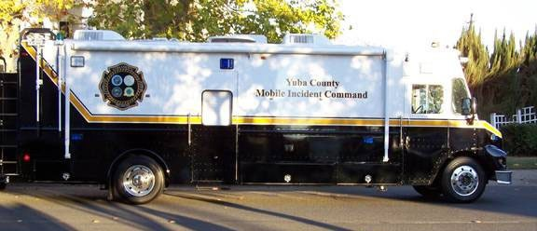
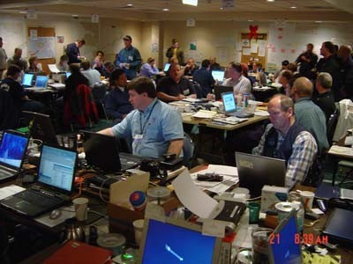
INCIDENT COMMAND POST (ICP)
Mobile ICP
Static ICP
32

Slide 58
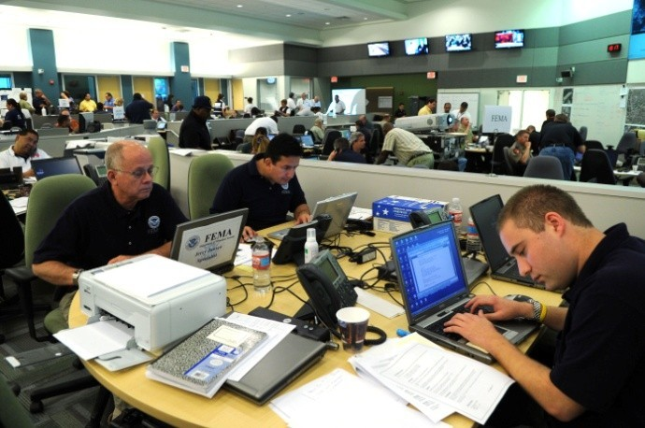
DIFFERENCE BETWEEN ICP AND EOC
Emergency Operation Center (EOC)
1. EOC works
at strategic level big picture of the
the
focusing incident.
the
It doesn’t have
Operational focus.
2. EOC is not located at incident place.
3. ICP is responsible for the operational activities.
resources and
35
3. ICP is located near the incident place.

Slide 59
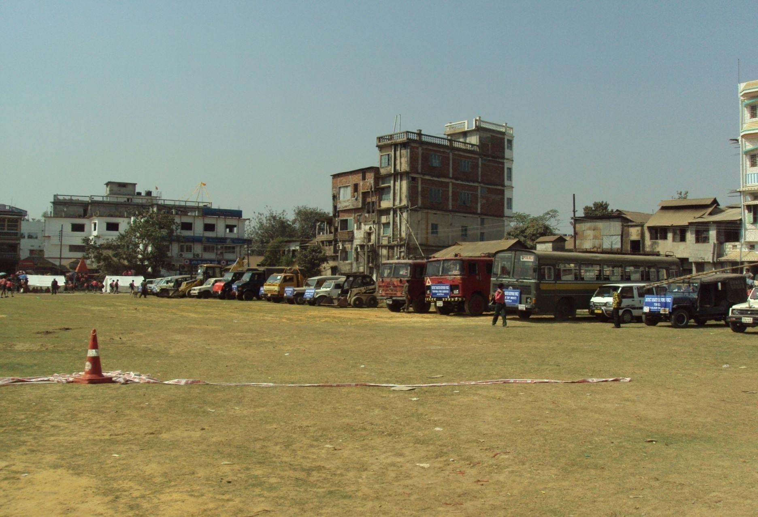
STAGING AREA

Slide 60
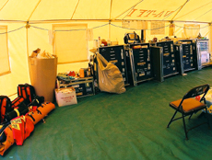
INCIDENT LOCATIONS & FACILITIES
Established by the Incident Commander based on the requirements and complexity of the incident.
Base
Incident Command Post
Staging Area
R Camp

Slide 61
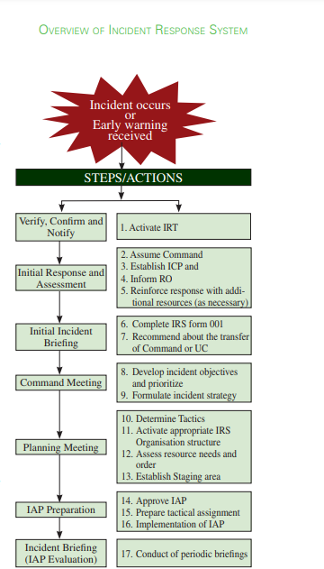
OVERVIEW OF IRS

Slide 62

ANY QUESTION ?

Slide 63
EVALUATION
Q1)What is the full form of IRS?
Ans_____________________

Slide 64



THANK YOU

