Slide 1


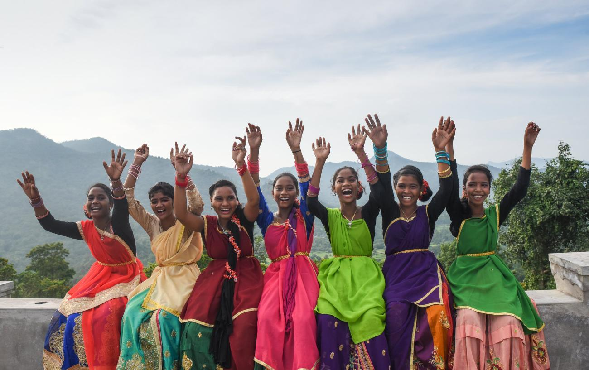
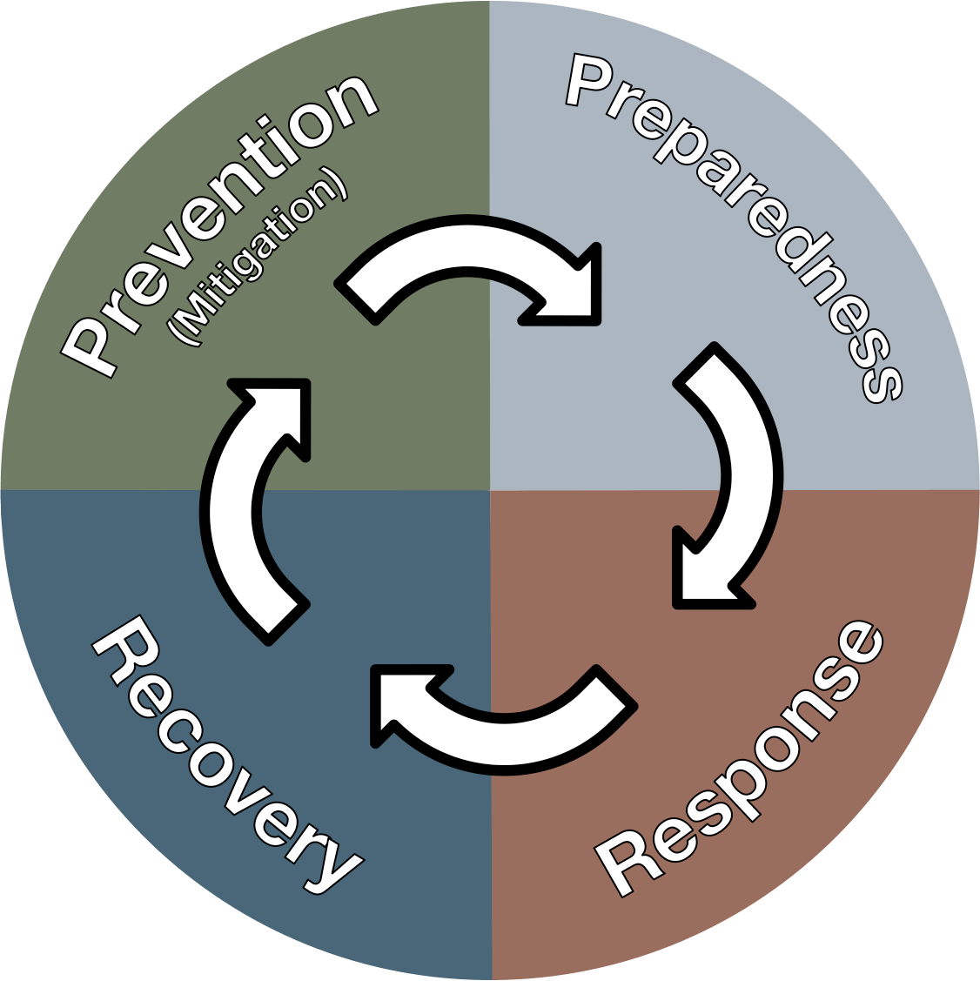
DISASTER MANAGEMENT ORIENTATION
LESSON 06
GENDER SENSITIZATION IN Disaster Response
Presented By:- Sachin Chauhan,2IC
NDRF | DMO | INDIA
PPT 6 - 1

Slide 2
OBJECTIVES
Upon completing this lesson, you will be able to:
1
Understand Gender Stereotype eliciting unequal treatment
Define Gender Based Violence and Gender Sensitization
Aquent with legal mandate and key court orders on gender sensitization
2
3

Slide 3
OBJECTIVES
Upon completing this lesson, you will be able to:
4
Know at least 15 points on Gender Sensitization Checklist for NDRF Teams
Understand the GBV mitigation measures and safety of responders
Get the overview about best practice on gender sensitization on previous disastes
5
6

Slide 4
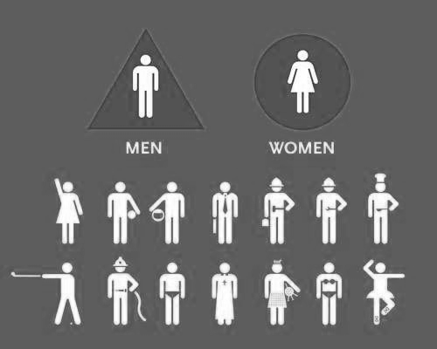
Gender Stereotype
An assumption about a person because they are female or male.
Gender stereotyping contributes to gender inequality because what we believe about women and men influences how we act towards them

Slide 5
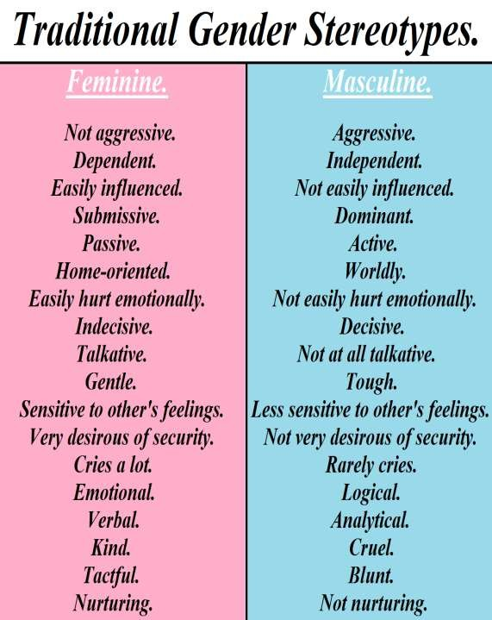

Gender Stereotype

Slide 6
Gender Based Violence
Protection of Women from Domestic Violence Act, 2005
Any act of gender-based violence that results in, or is likely to result in, physical, sexual or psychological harm or suffering to women, including threats of such acts, coercion, or arbitrary deprivations of liberty, whether occurring in public or private life.

Slide 7
Gender Sensitization
A process of raising awareness about gender equality issues to promote changes in attitudes and behaviors, aiming to eliminate gender discrimination and create a more equitable society. It involves understanding and questioning societal norms, stereotypes, and biases related to gender to foster empathy and respect for all genders.

Slide 8
Why Gender Sensitization ?
Promotes Gender Justice
Enhances Productivity
Supports Human Rights
Benefits Society Equally
Providing fair treatment and opportunities
PPT 6 -

Slide 9
Legal mandates: Gender
Disaster Management Act, 2005
Mandates minimum standards of relief (Section 12) and inclusive planning
National/State/District/Local authorities must plan for vulnerable groups

Slide 10
Legal mandates: Gender
National Policy on Disaster Management (2009) – vulnerable sections focus
National Disaster Management Plan (2019) – mainstreaming gender across phases
NDMA Guidelines: Minimum Standards of Relief; MHPSS (2023); HADR (2024); DMEx (2024)

Slide 11
Legal mandates: Gender
NDMA Advisory (2025)
Mainstream gender in preparedness, response, recovery
Sex- and age-disaggregated data (SADD) at all stages
Safe, inclusive shelters and WASH with privacy and lighting
Participation of women’s collectives and trans/queer groups in planning

Slide 12
Key Court Orders
Vishaka v. State of Rajasthan (1997): Zero tolerance for sexual harassment; ICCs even in camps
NALSA v. Union of India (2014): Right to self-identify gender; ensure inclusive registration/shelter access
PPT 6 -

Slide 13
Key Court Orders
Swaraj Abhiyan (2016): Duty of State to implement relief; push for timely drought/relief measures
Gaurav Kumar Bansal (2021–22): NDMA/States bound to relief standards & ex gratia under DMA
CONT.
PPT 6 -

Slide 14
Gender Sensitization Checklist for NDRF Teams
Brief on local gender dynamics & risks
Coordinate with local police, DWCD, Health, One-Stop Centers, NGOs
Logistics: privacy screens, female uniforms/PPE sizes, menstrual hygiene kits etc.
Assign at least one women responder per sub-team where feasible
Pre-Deployment
PPT 6 -

Slide 15
Gender Sensitization Checklist for NDRF Teams
Prioritize pregnant/lactating women, elderly, PwD; buddy system
Separate family spaces; avoid splitting caregivers/children
Maintain dignity: cover cloths, change areas, avoid crowding at embark/disembark points
Keep a log of unaccompanied minors and persons with special needs
Evacuation & Transport
PPT 6 -

Slide 16
Gender Sensitization Checklist for NDRF Teams
Dignity kits incl. sanitary pads, underwear, soap; culturally appropriate clothing
Accessible toilets for PwD; disposal for menstrual waste
Separate queues or token system to prevent jostling
Information boards with pictograms for low-literacy populations
WASH & Supplies
PPT 6 -

Slide 17
Gender Sensitization Checklist for NDRF Teams
Respect self-identified gender; do not insist on prior documents (NALSA)
Record alcohol dependence data; capture special needs discretely
Link to entitlements: PDS, ex gratia, widows/orphans' lists; keep privacy
Report suspected trafficking/missing persons promptly
Registration & Documentation
PPT 6 -

Slide 18
Gender Sensitization Checklist for NDRF Teams
Use multiple channels: local women’s SHGs, ASHA/AWWs, youth clubs
Two-way feedback: daily camp meeting; suggestion box; women & trans reps
Rumour control: verify before broadcast; avoid victim-blaming language
Community Engagement
PPT 6 -

Slide 19
GBV/SEA Risk Mitigation
Map referral pathways: 112/1091, One-Stop Center, police, health, ChildLine 1098
Deployed staff sign Code of Conduct (Vishaka-aligned); visible zero-tolerance posters
Never interview survivors in public; ensure same-sex interviewer if requested
Document only essentials; protect confidentiality

Slide 20
Inclusion: Transgender & Gender-Diverse Persons
Ask for preferred name/pronouns; avoid outing anyone
Provide choice of shelter area/toilets; ensure access to supplies/ID-linked relief
Facilitate documentation without discrimination (NALSA, Transgender Act/Rules)

Slide 21
Safety for Responders
Buddy system and clear reporting lines
Fast-track ICC mechanism for complaints within deployed teams
Stress management and rotation to prevent burnout

Slide 22
Field Example 1
Odisha Cyclones & Women’s SHGs
Women’s SHGs mobilized early warnings, cooked community meals, managed shelters
Co-led queue management & priority lists for vulnerable groups

Slide 23
Field Example 2
Kerala Floods – Privacy & MISP
Partitioned spaces for families and women-only zones reduced distress
Partnership with Health Dept. enabled MISP services within 48 hours

Slide 24
Field Example 2
Assam Floods – Lighting & Patrols
Solar lamps along WASH paths; night patrols with community volunteers
Incident reports of harassment dropped after environmental design changes

Slide 25
4 mantras foR women and weaker section
Beware
Be alert
Be prepared
Be confident
PPT 6 -

Slide 26



THANK YOU

