Slide 1


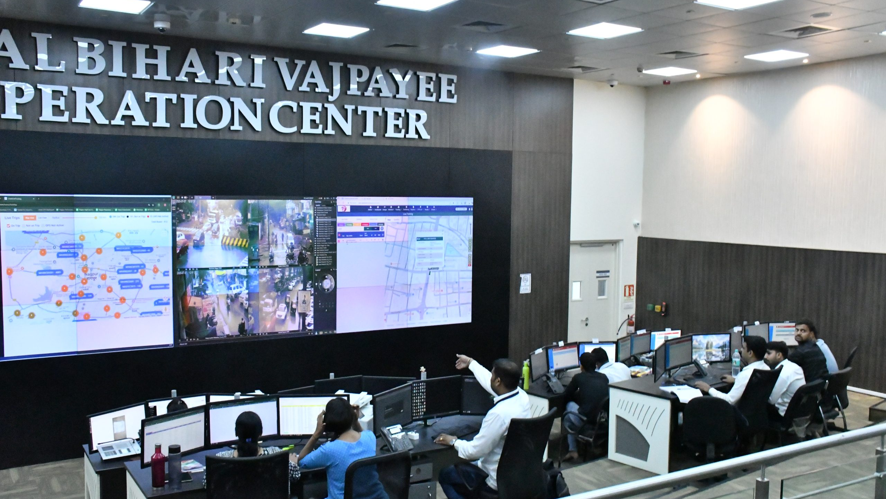
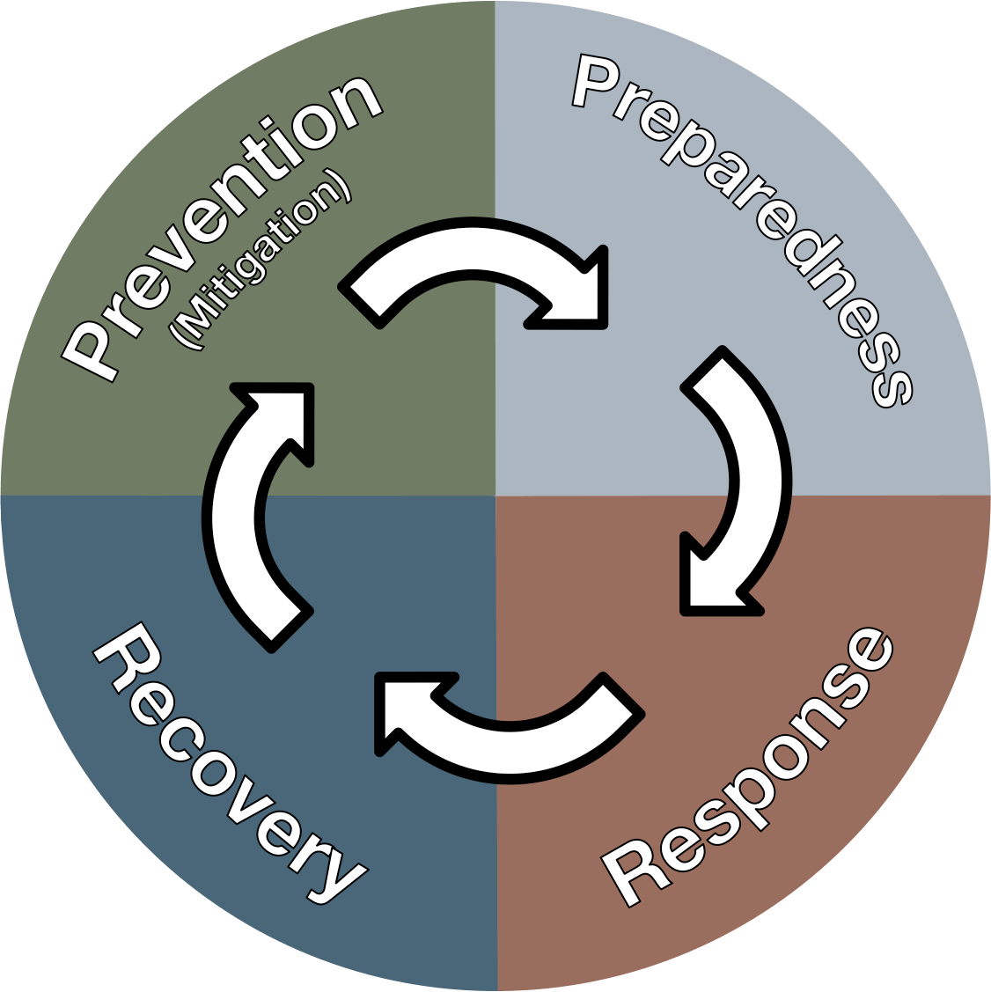
DISASTER MANAGEMENT ORIENTATION
LESSON 02
Concept of Control Room, activation and mobilization
Presented By:- Sachin Chauhan,2IC
NDRF | DMO | INDIA
PPT 2 - 1

Slide 2
OBJECTIVES
Upon completing this lesson, you will be able to:
1
  Acquaint with Emergency Operation Center and its Types.
  Know 05 key features of EOC
  Know 06 important function of EOC
2
3

Slide 3
OBJECTIVES
Upon completing this lesson, you will be able to:
4
  List 03 different level of EOC and their task.
  Know the EOC Structure and operational procedure.
5

Slide 4
  Emergency - a serious event that needs immediate action
  Operation – process of response, rescue and relief
  Center – institutional organisation responsible for managing the operation

Slide 5
Emergency Operation Center
An EOC is the focal point where different organizations comes together during an emergency to coordinate response and recovery actions and resources. These centers may be alternatively called command centers, control rooms, situation rooms or crisis management centres.

Slide 6
EOC: Overview
Offsite facility – 24 x 7
Combination of various line departments - Multi-agency representation
Empowered Authorities and Trained personnel
Fail safe communication facility
Advanced technology and Ideal information technology solution
Perform and log all necessary response and relief activities
PPT 2 -

Slide 7
EOC: Overview
EOC serves as the primary hub for –
Situation assessment
Decision-making
Communication
Resource management
Response coordination
PPT 2 -

Slide 8
FEATURES OF THE EOC
Flexibility
Sustainability
Security
Survivability
Interoperability
PPT 2 -
Notes:
Flexibility: There is need to plan operations and adapt operational space to meet the needs of hazard events.
Sustainability: It should be able to support operations for extended duration; for example, could be 24 hours/seven days a week during all emergency situations without interruption; to the extent practicable, be located in a place that is not a high-risk area for known hazards
Security: It should be guarded against potential risks and its operations should be protected from unauthorised disclosure of sensitive information. There should be sufficient security and structural integrity to protect the facility.
Survivability: It should be able to sustain the effects of a realised risk and continue operations from the EOC or a fully capable alternate location. This implies that there should be an alternate EOC that can be activated and used if the primary one is destroyed, damaged, or is not accessible for some reason.
Interoperability: They should be able to share common principles of operations and exchange routine and time-sensitive information with other EOCs,

Slide 9
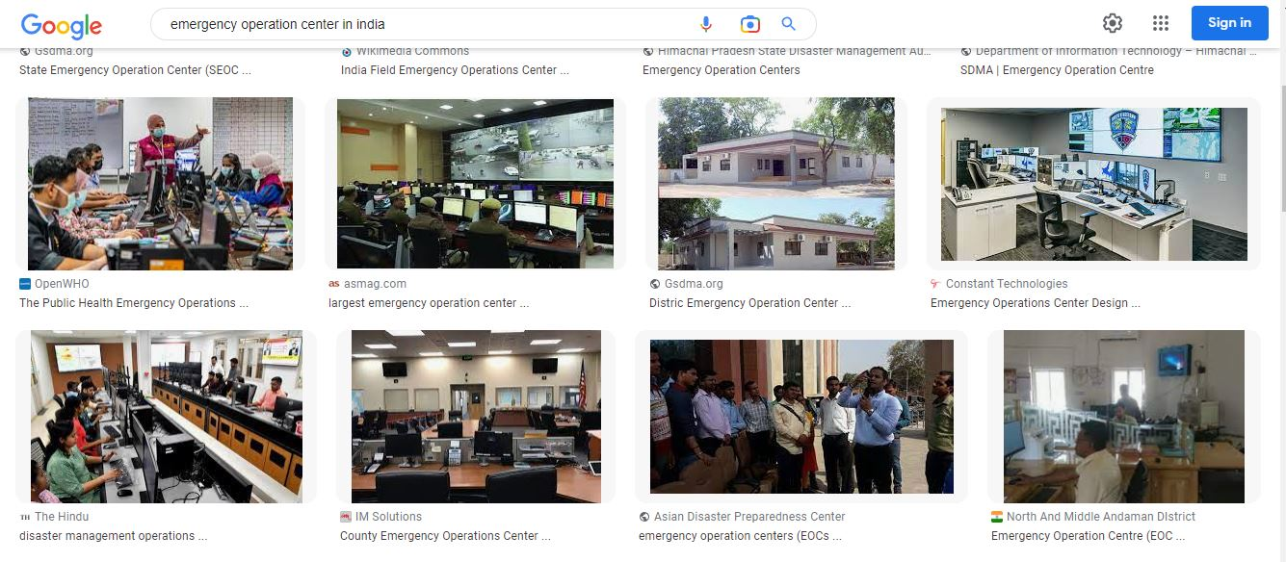

Slide 10
Functions of an EOC
Coordinating immediate response efforts
Managing the overall response and recovery efforts
Coordinating long-term recovery and rebuilding efforts
Ensuring continuity of critical operations and services
Community outreach
PPT 2 -

Slide 11
TYPES OF EOC
Single Agency Operation Centre
Multi – Agency Operation Centre
Single Agency
Dedicated personnel and other resources
Single channel for orders and direction
One focal point for timing and priorities
More than one Agency
Monitoring of operation by multiple agency
Coordination
Resource sharing
Supporting element for DSS

Slide 12
LEVEL OF EOC
National level
Hub of all the activities related with disaster response and Effective management at National level
State level
Hub of all the activities related with disaster response and Effective management at State level
District level
Main Functional Unit at the time of emergency
District and sub-level operation
Organisational level
Specific to organisation or ministry

Slide 13
ROLE OF NATIONAL AND STATE EOC
Plan and coordinate emergency operation
Communication and warning
Mobilisation of additional resources during the disaster phase
Coordinating overseas support and aid
Information management at national and international level
PPT 2 -
Notes:
Flexibility: There is need to plan operations and adapt operational space to meet the needs of hazard events.
Sustainability: It should be able to support operations for extended duration; for example, could be 24 hours/seven days a week during all emergency situations without interruption; to the extent practicable, be located in a place that is not a high-risk area for known hazards
Security: It should be guarded against potential risks and its operations should be protected from unauthorised disclosure of sensitive information. There should be sufficient security and structural integrity to protect the facility.
Survivability: It should be able to sustain the effects of a realised risk and continue operations from the EOC or a fully capable alternate location. This implies that there should be an alternate EOC that can be activated and used if the primary one is destroyed, damaged, or is not accessible for some reason.
Interoperability: They should be able to share common principles of operations and exchange routine and time-sensitive information with other EOCs,

Slide 14
ROLE OF DISTRICT AND ORG EOC
Receive and process disaster alerts and warnings from nodal agencies
Collecting information about the vulnerable areas
Sharing data related to disaster and vulnerable areas
Coordination for preparation, mitigation and response
Monitor emergency operations
PPT 2 -
Notes:
Flexibility: There is need to plan operations and adapt operational space to meet the needs of hazard events.
Sustainability: It should be able to support operations for extended duration; for example, could be 24 hours/seven days a week during all emergency situations without interruption; to the extent practicable, be located in a place that is not a high-risk area for known hazards
Security: It should be guarded against potential risks and its operations should be protected from unauthorised disclosure of sensitive information. There should be sufficient security and structural integrity to protect the facility.
Survivability: It should be able to sustain the effects of a realised risk and continue operations from the EOC or a fully capable alternate location. This implies that there should be an alternate EOC that can be activated and used if the primary one is destroyed, damaged, or is not accessible for some reason.
Interoperability: They should be able to share common principles of operations and exchange routine and time-sensitive information with other EOCs,

Slide 15
ROLE OF DISTRICT AND ORG EOC
Consolidate, analysis, and disseminate of damage, loss and needs assessment data
Information gathering and record keeping
Public information and communication (IEC) on DM
Resource management through web based techniques
CONT.
PPT 2 -
Notes:
Flexibility: There is need to plan operations and adapt operational space to meet the needs of hazard events.
Sustainability: It should be able to support operations for extended duration; for example, could be 24 hours/seven days a week during all emergency situations without interruption; to the extent practicable, be located in a place that is not a high-risk area for known hazards
Security: It should be guarded against potential risks and its operations should be protected from unauthorised disclosure of sensitive information. There should be sufficient security and structural integrity to protect the facility.
Survivability: It should be able to sustain the effects of a realised risk and continue operations from the EOC or a fully capable alternate location. This implies that there should be an alternate EOC that can be activated and used if the primary one is destroyed, damaged, or is not accessible for some reason.
Interoperability: They should be able to share common principles of operations and exchange routine and time-sensitive information with other EOCs,

Slide 16


This was the case handled by the district and State level authorities.
Local bodies and other sub level corporation also took part in supplying and helping
NDRF team come forward and put plan into the Actions
This was the case handled by State and National authorities of concern.
Conditions were worst, so not was the case of any local body to come forward.
CAPF, trained forces were made available to help the livelihood.

Slide 17
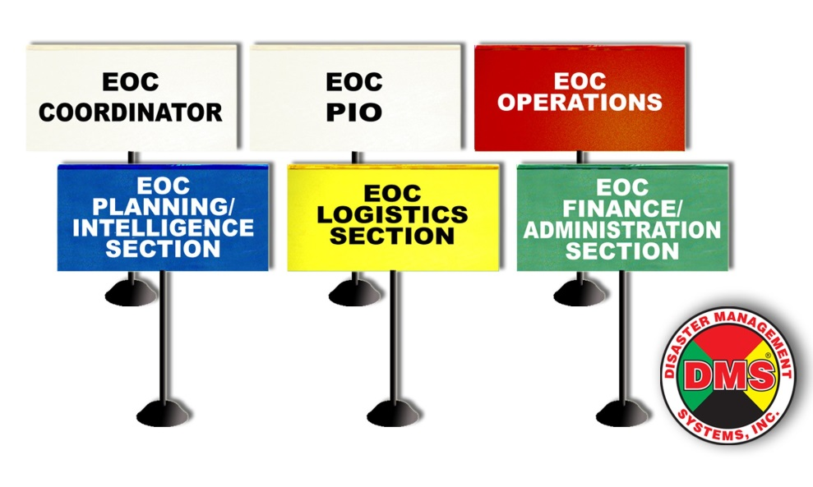
EOC Structure
Management Section
Operations Section
Planning Section
Logistics Section
Finance Section
PPT 2 -

Slide 18
Representatives of ESF Org
Communication
Public Health (Dist. Med, Red cross)
PWD
Transport
SAR Teams (NDRF, SDRF, CD)
Relief Material (Department of Revenue)
Food & Supplies, Drinking water, Shelter
Media and Helplines (Public Relations)
Law and Order
Damage Assessment
PPT 2 -

Slide 19
Supporting EOC Staff
Administrative Support
Disaster Assessment Officer
Communication and Warning Officer
Liaison Officer
Radio Operators and Telephone Attendants
Shelter Operations Managers
Messengers
Security Officer
PPT 2 -

Slide 20
EOC Operations
Situation assessment and monitoring
Resource allocation and management
Communication and coordination
Decision-making and planning
PPT 2 -

Slide 21
EOC Establishment Norms
Adequate space with proper infrastructure to accommodate the participating agencies
Communication facilities with last mile connectivity
A vehicle mounted with HF, VHF and satellite telephone for deployment in the affected site
PPT 2 -

Slide 22
EOC Establishment Norms
Map depicting affected site, resources deployed, facilities like Incident Command Post
DM plans of all line departments
Contact details of all emergency services and Database of NGOs
Geographic Information System (GIS) for DSS
CONT.
PPT 2 -

Slide 23



THANK YOU

