Slide 1


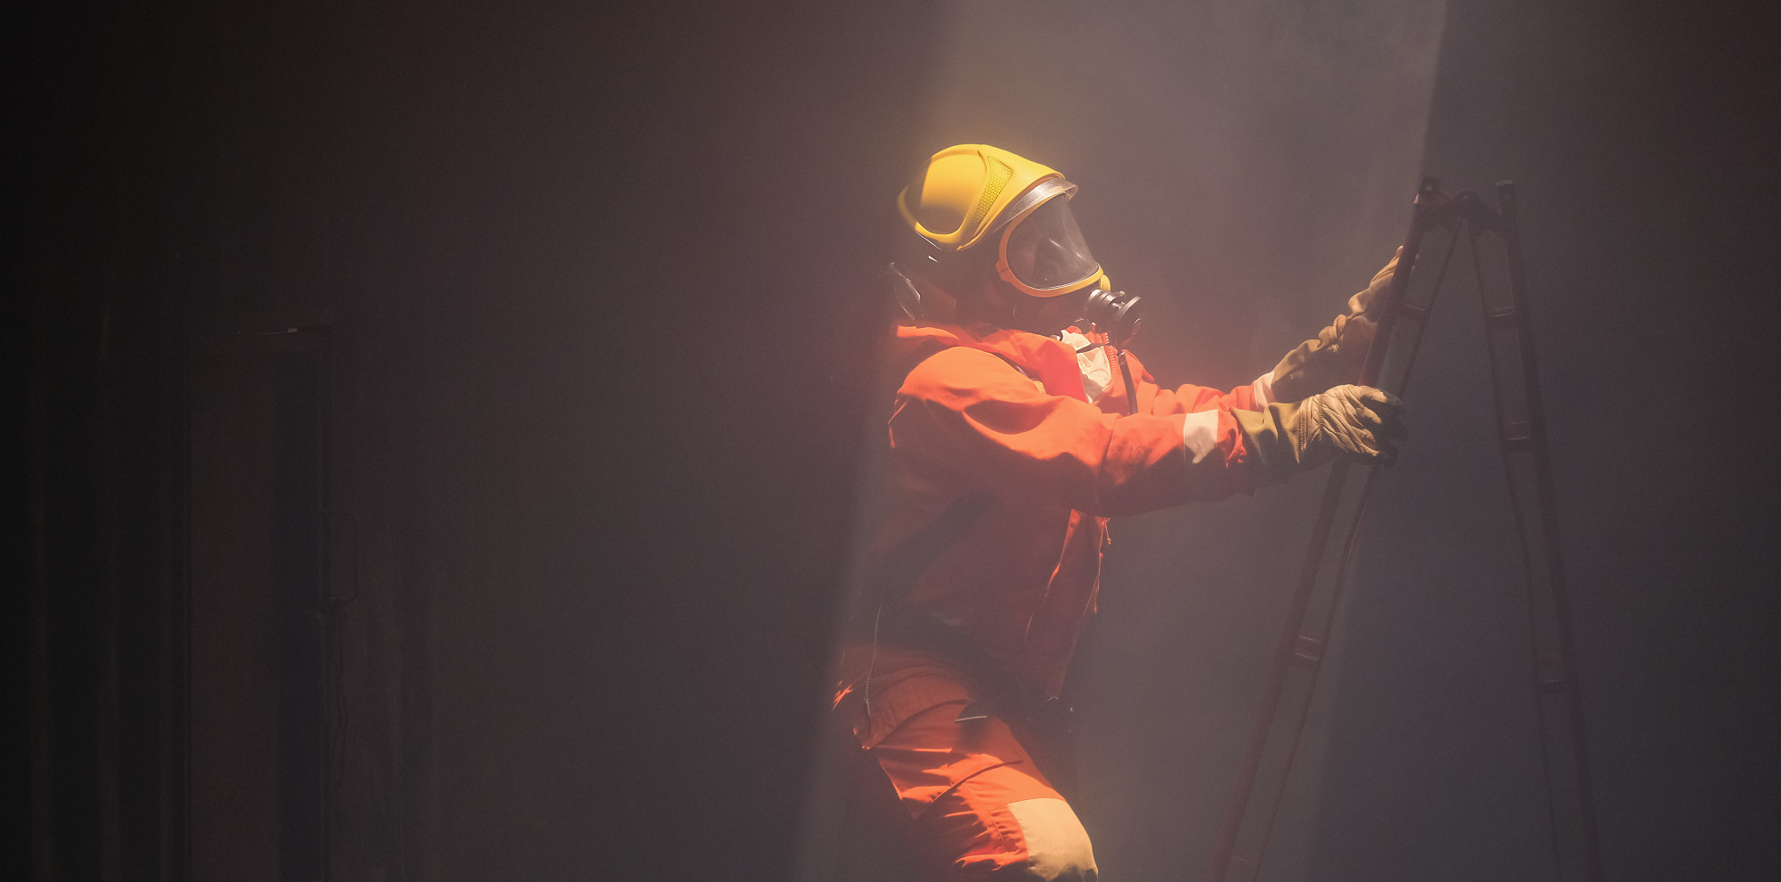


COLLAPSED STRUCTURE SEARCH AND RESCUE
LESSON 1
COURSE INTRODUCTION
LESSON 2
Organizing and Starting
a CSSR Operation
LESSON 6
Search and Location Techniques
Presented By:- Sachin Chauhan,2IC
PEER | CSSR | INDIA
PPT 6-1
NDRF | CSSR | INDIA

Slide 2
OBJECTIVES
Upon completing this lesson, you will be able to:
1
Define search and location and describe its importance in the success of a CSSR operation.
Describe the composition of a search team and the basic equipment used.
List and describe the steps for searching and locating.
2
3
NDRF | CSSR | INDIA
PPT 6 -

Slide 3
OBJECTIVES
4
Define void space and identify probable locations in the four basic collapse patterns.
List and describe the steps for searching and locating.
Demonstrate in two practical exercises the steps for a physical search and location, using two different patterns.
Upon completing this lesson, you will be able to:
5
6
NDRF | CSSR | INDIA
PPT 6 -

Slide 4
Searching and Locating
A set of techniques and procedures whose purpose is to obtain a response or indication of the presence of live victims in a void space within
a collapsed structure.
NDRF | CSSR | INDIA
PPT 6 -

Slide 5
Survival Rate
NDRF | CSSR | INDIA
PPT 6 -

Slide 6
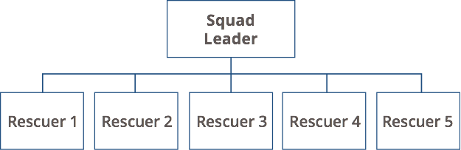
Search Squad
NDRF | CSSR | INDIA
PPT 6 -

Slide 7
Basic Equipment for Physical Search
Personal protective equipment
Personal supplies (unassisted for 12 hours)
Marking supplies
Communication devices
Warning and alert devices
Reconnaissance and vision
PEER | CSSR | INDIA
PPT 6 -
NDRF | CSSR | INDIA

Slide 8
Steps to Search and Locate
Compile and analyse information.
Secure the scene.
Inspect and evaluate the structure.
Rescue surface victims.
PEER | CSSR | INDIA
PPT 6 -
NDRF | CSSR | INDIA

Slide 9
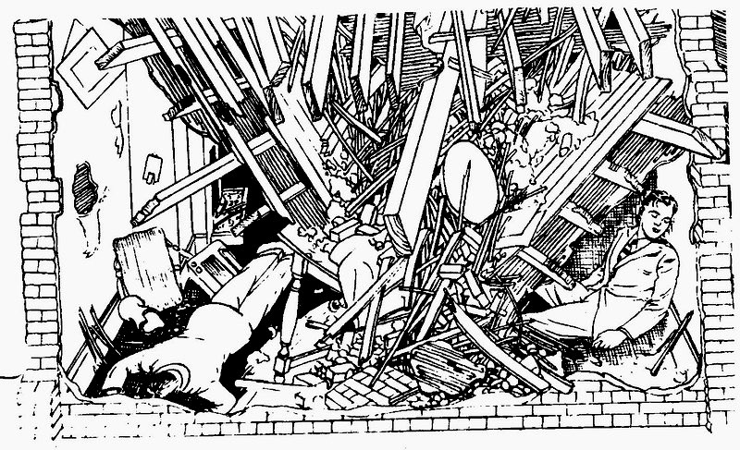
15% victims trapped in void spaces
PEER | CSSR | INDIA
PPT 6 -
NDRF | CSSR | INDIA

Slide 10
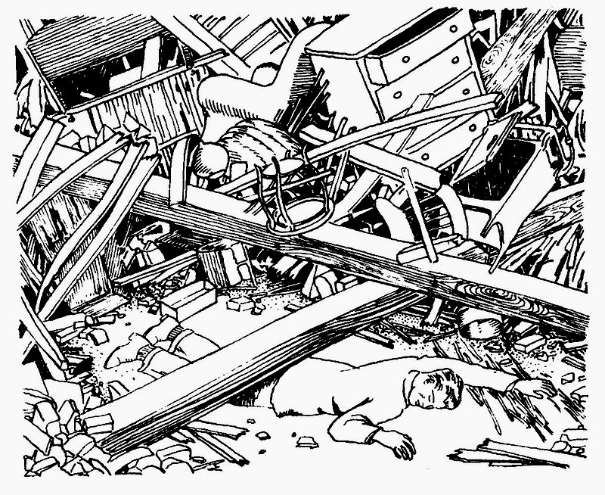
35% victims
lightly trapped
PEER | CSSR | INDIA
PPT 6 -
NDRF | CSSR | INDIA

Slide 11
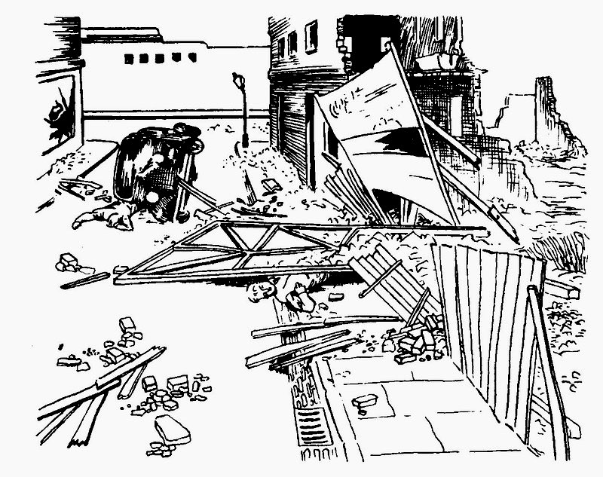
50% victims
on surface
PEER | CSSR | INDIA
PPT 6 -
NDRF | CSSR | INDIA

Slide 12
Steps to Search and Locate
Make markings on the structure.
Create a diagram.
Select search area.
Select search method.
PEER | CSSR | INDIA
PPT 6 -
NDRF | CSSR | INDIA

Slide 13
Steps to Search and Locate
Conduct search and place INSARAG markings on structure and diagram.
Analyse results and re-evaluate.
Pre-hospital treatment.
Confirm potential victim location.
PEER | CSSR | INDIA
PPT 6 -
NDRF | CSSR | INDIA

Slide 14
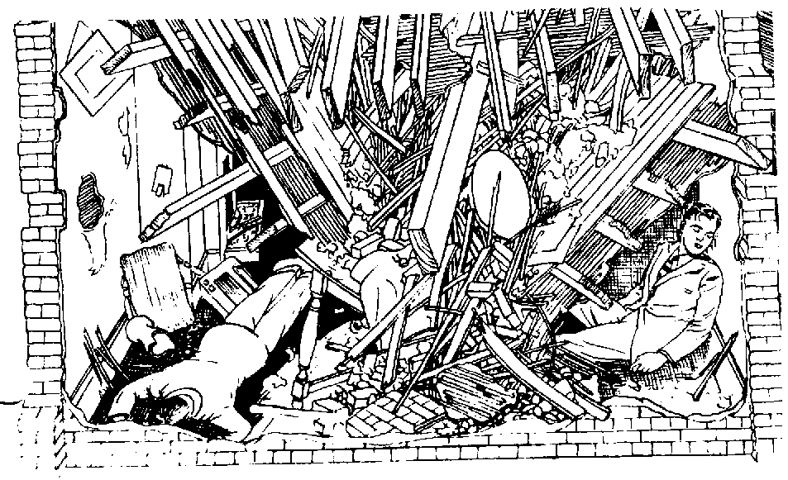
Void Spaces
PEER | CSSR | INDIA
PPT 6 -
NDRF | CSSR | INDIA

Slide 15
Possible Location of Void Spaces
Structurally resistant areas:
Basements
Elevator shafts
Bathrooms
Inside hallways
Concrete walls
PEER | CSSR | INDIA
PPT 6 -
NDRF | CSSR | INDIA

Slide 16
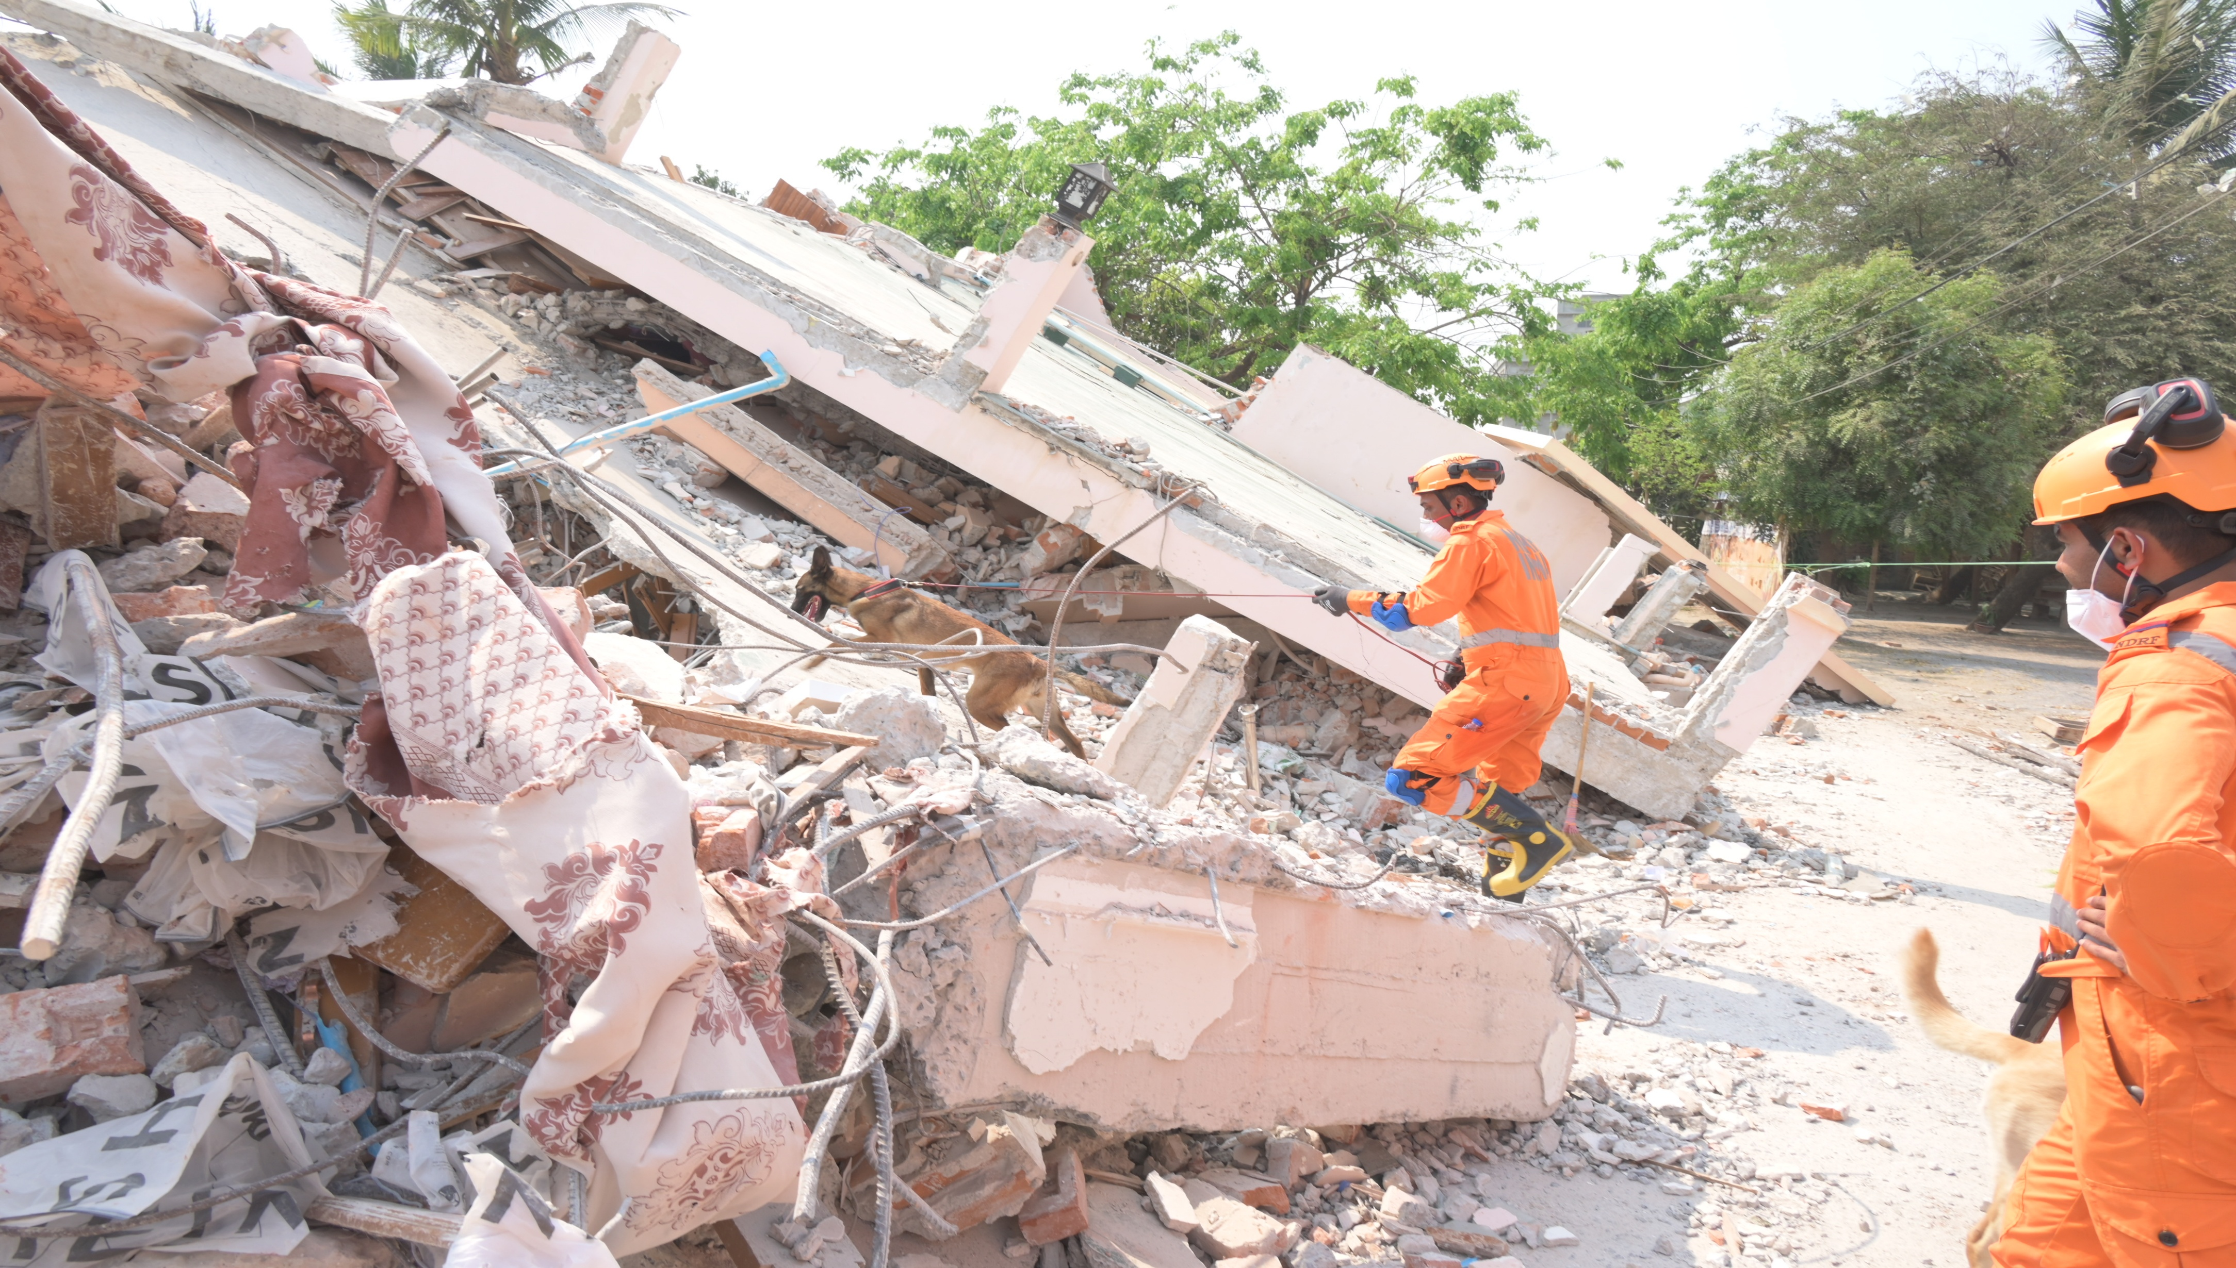
PEER | CSSR | INDIA
PPT 6 -
NDRF | CSSR | INDIA

Slide 17
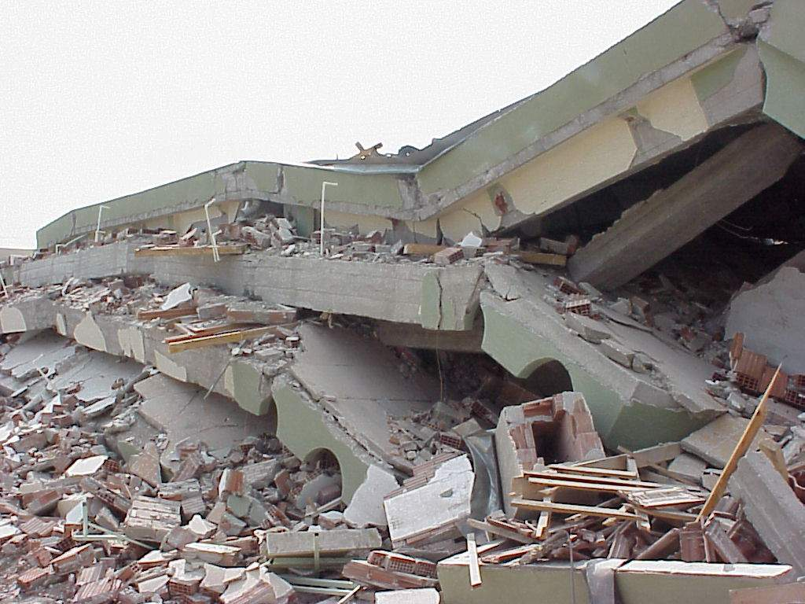
PEER | CSSR | INDIA
PPT 6 -
NDRF | CSSR | INDIA

Slide 18
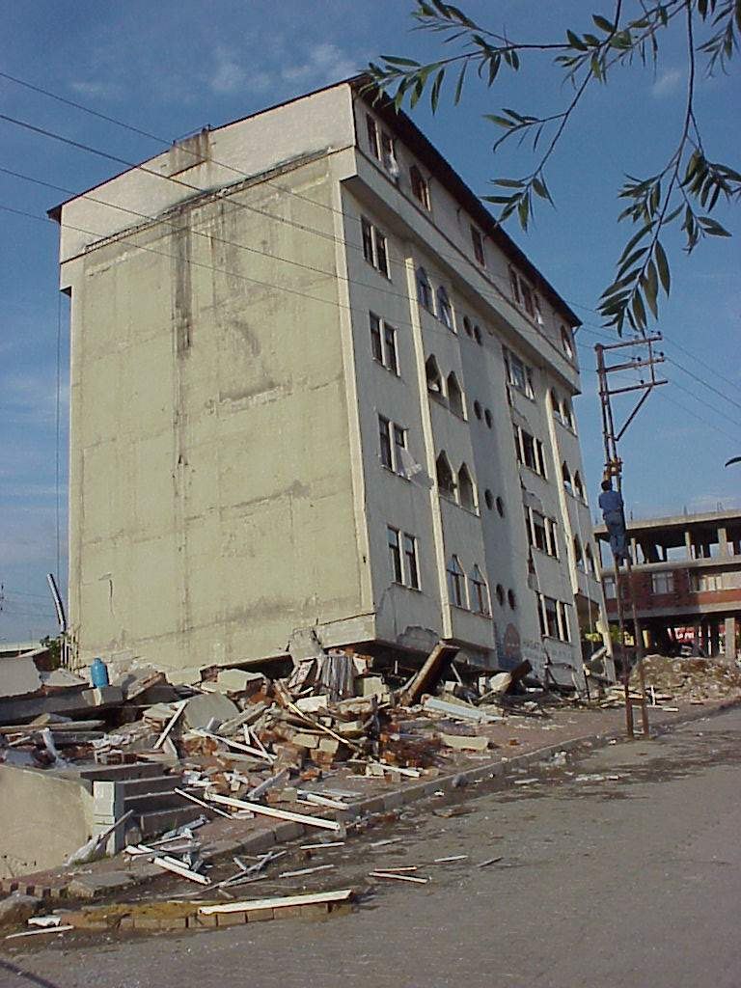
PEER | CSSR | INDIA
PPT 6 -
NDRF | CSSR | INDIA

Slide 19
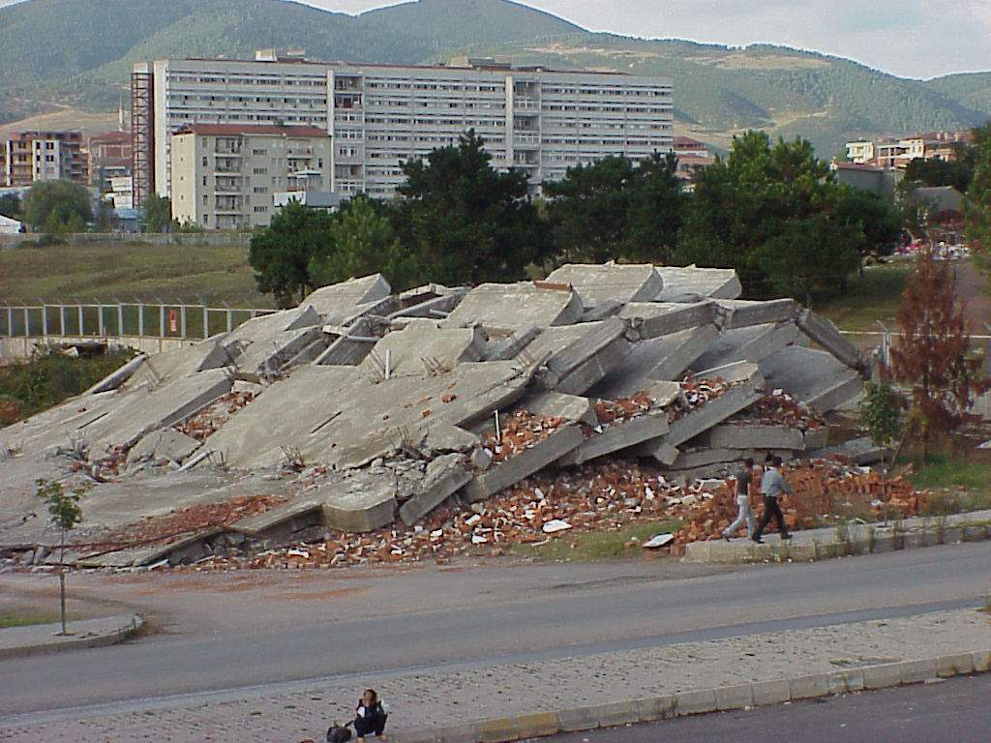
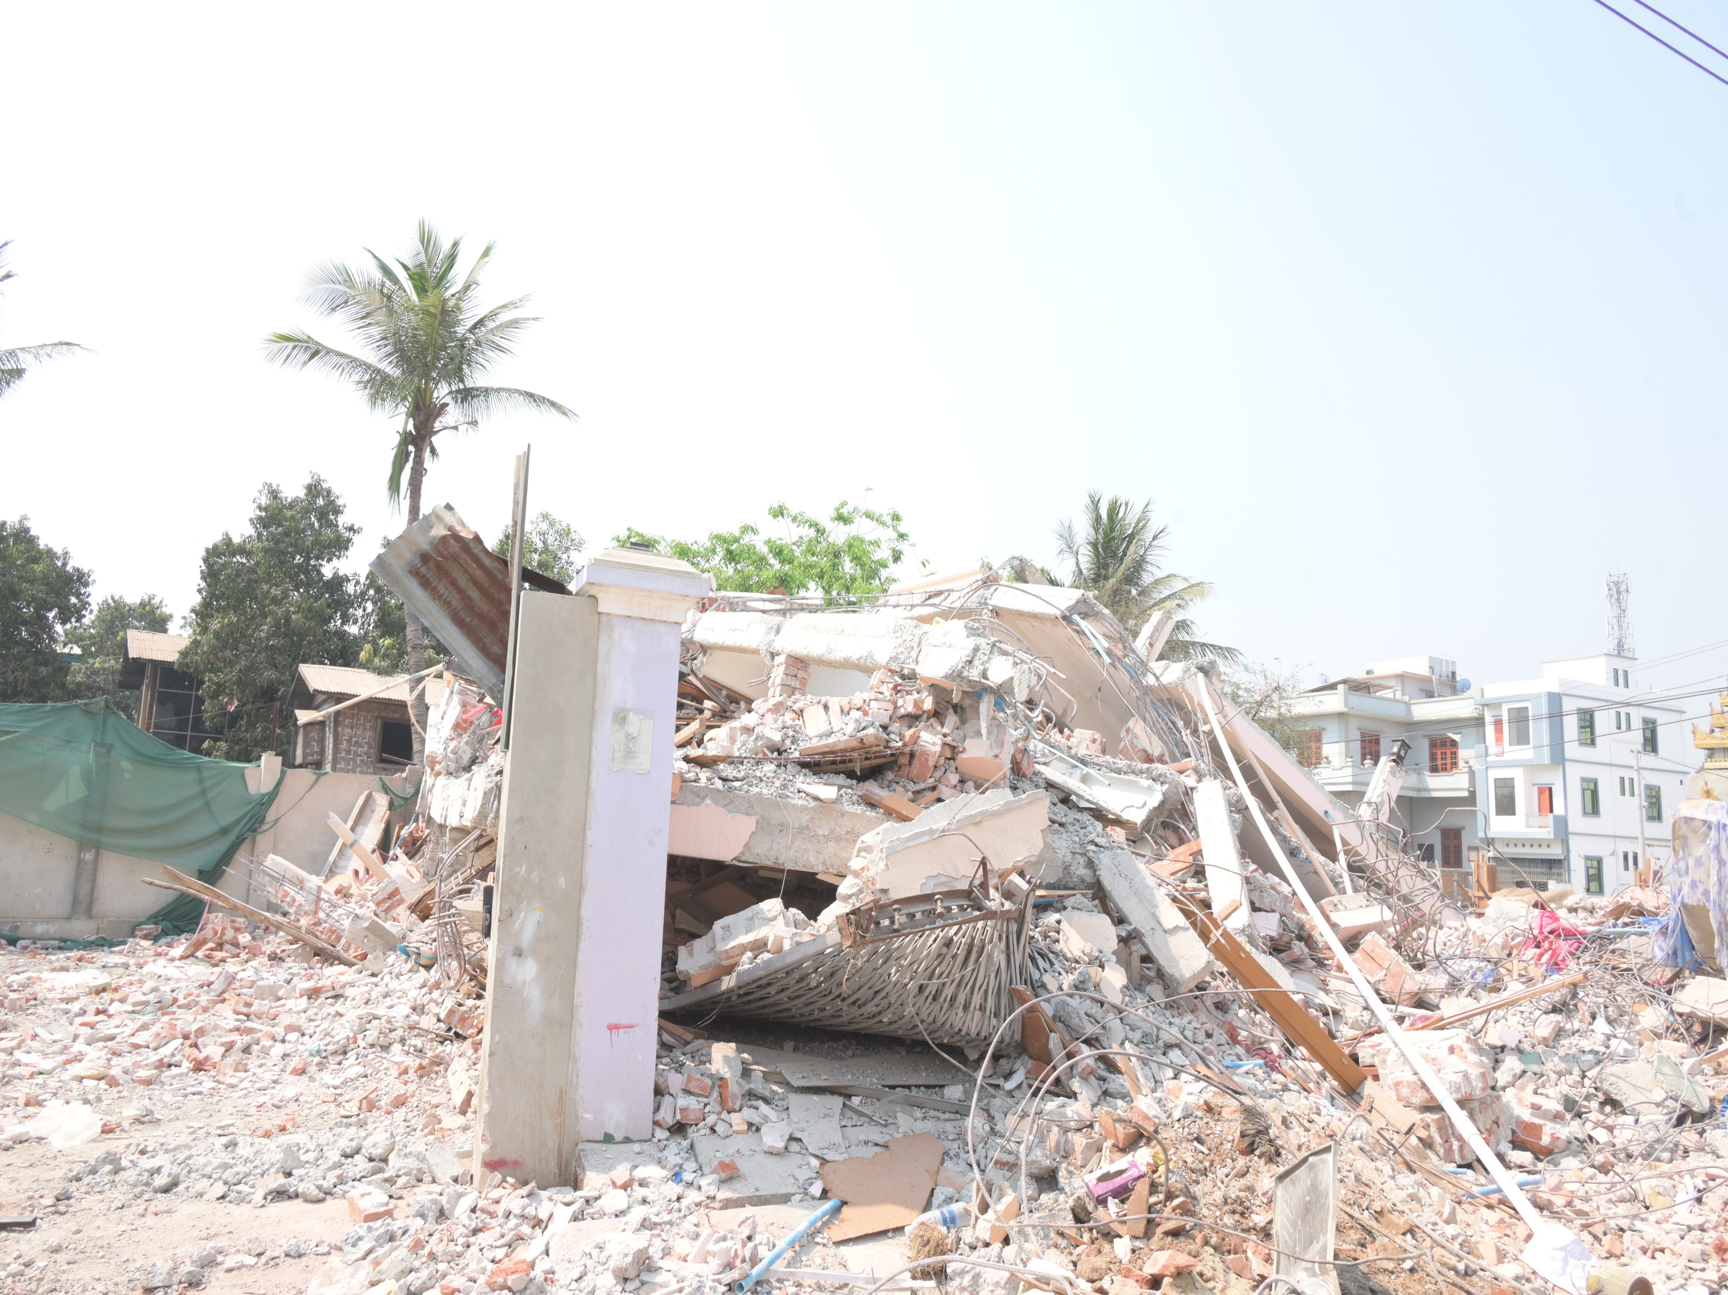
PEER | CSSR | INDIA
PPT 6 -
NDRF | CSSR | INDIA

Slide 20
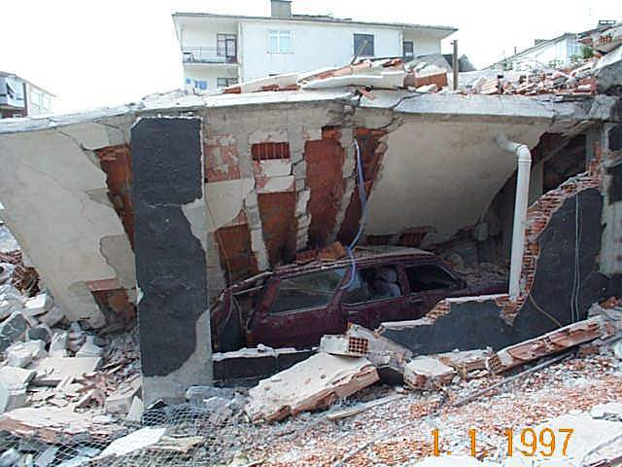
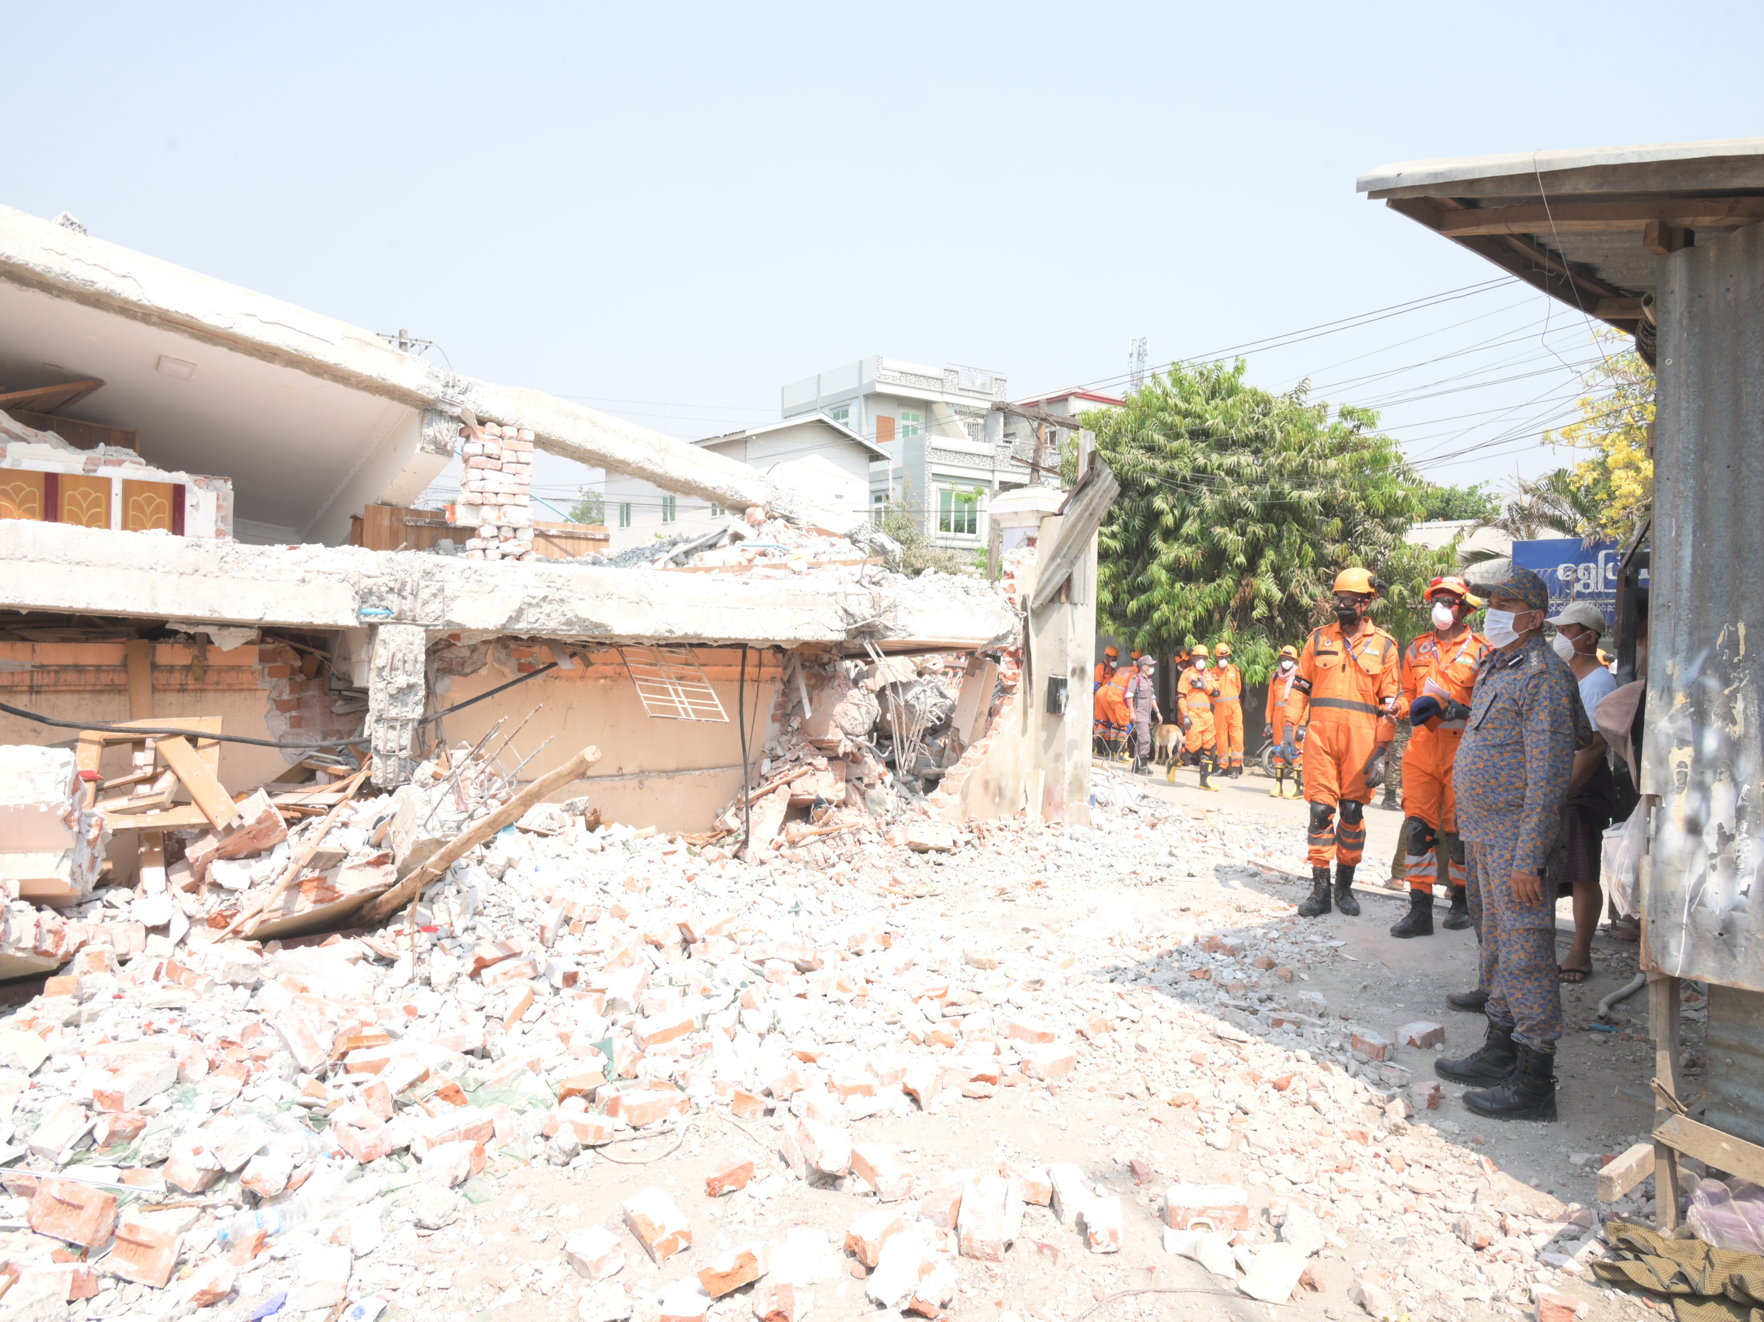
PEER | CSSR | INDIA
PPT 6 -
NDRF | CSSR | INDIA

Slide 21
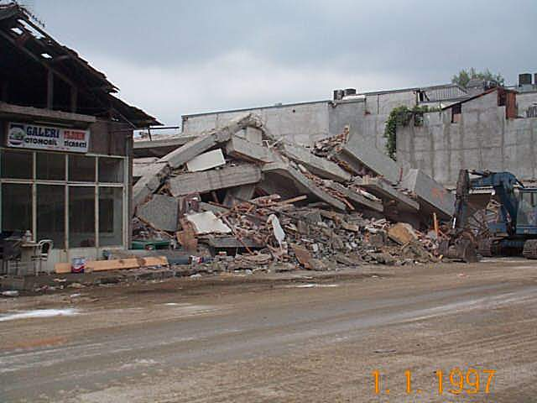
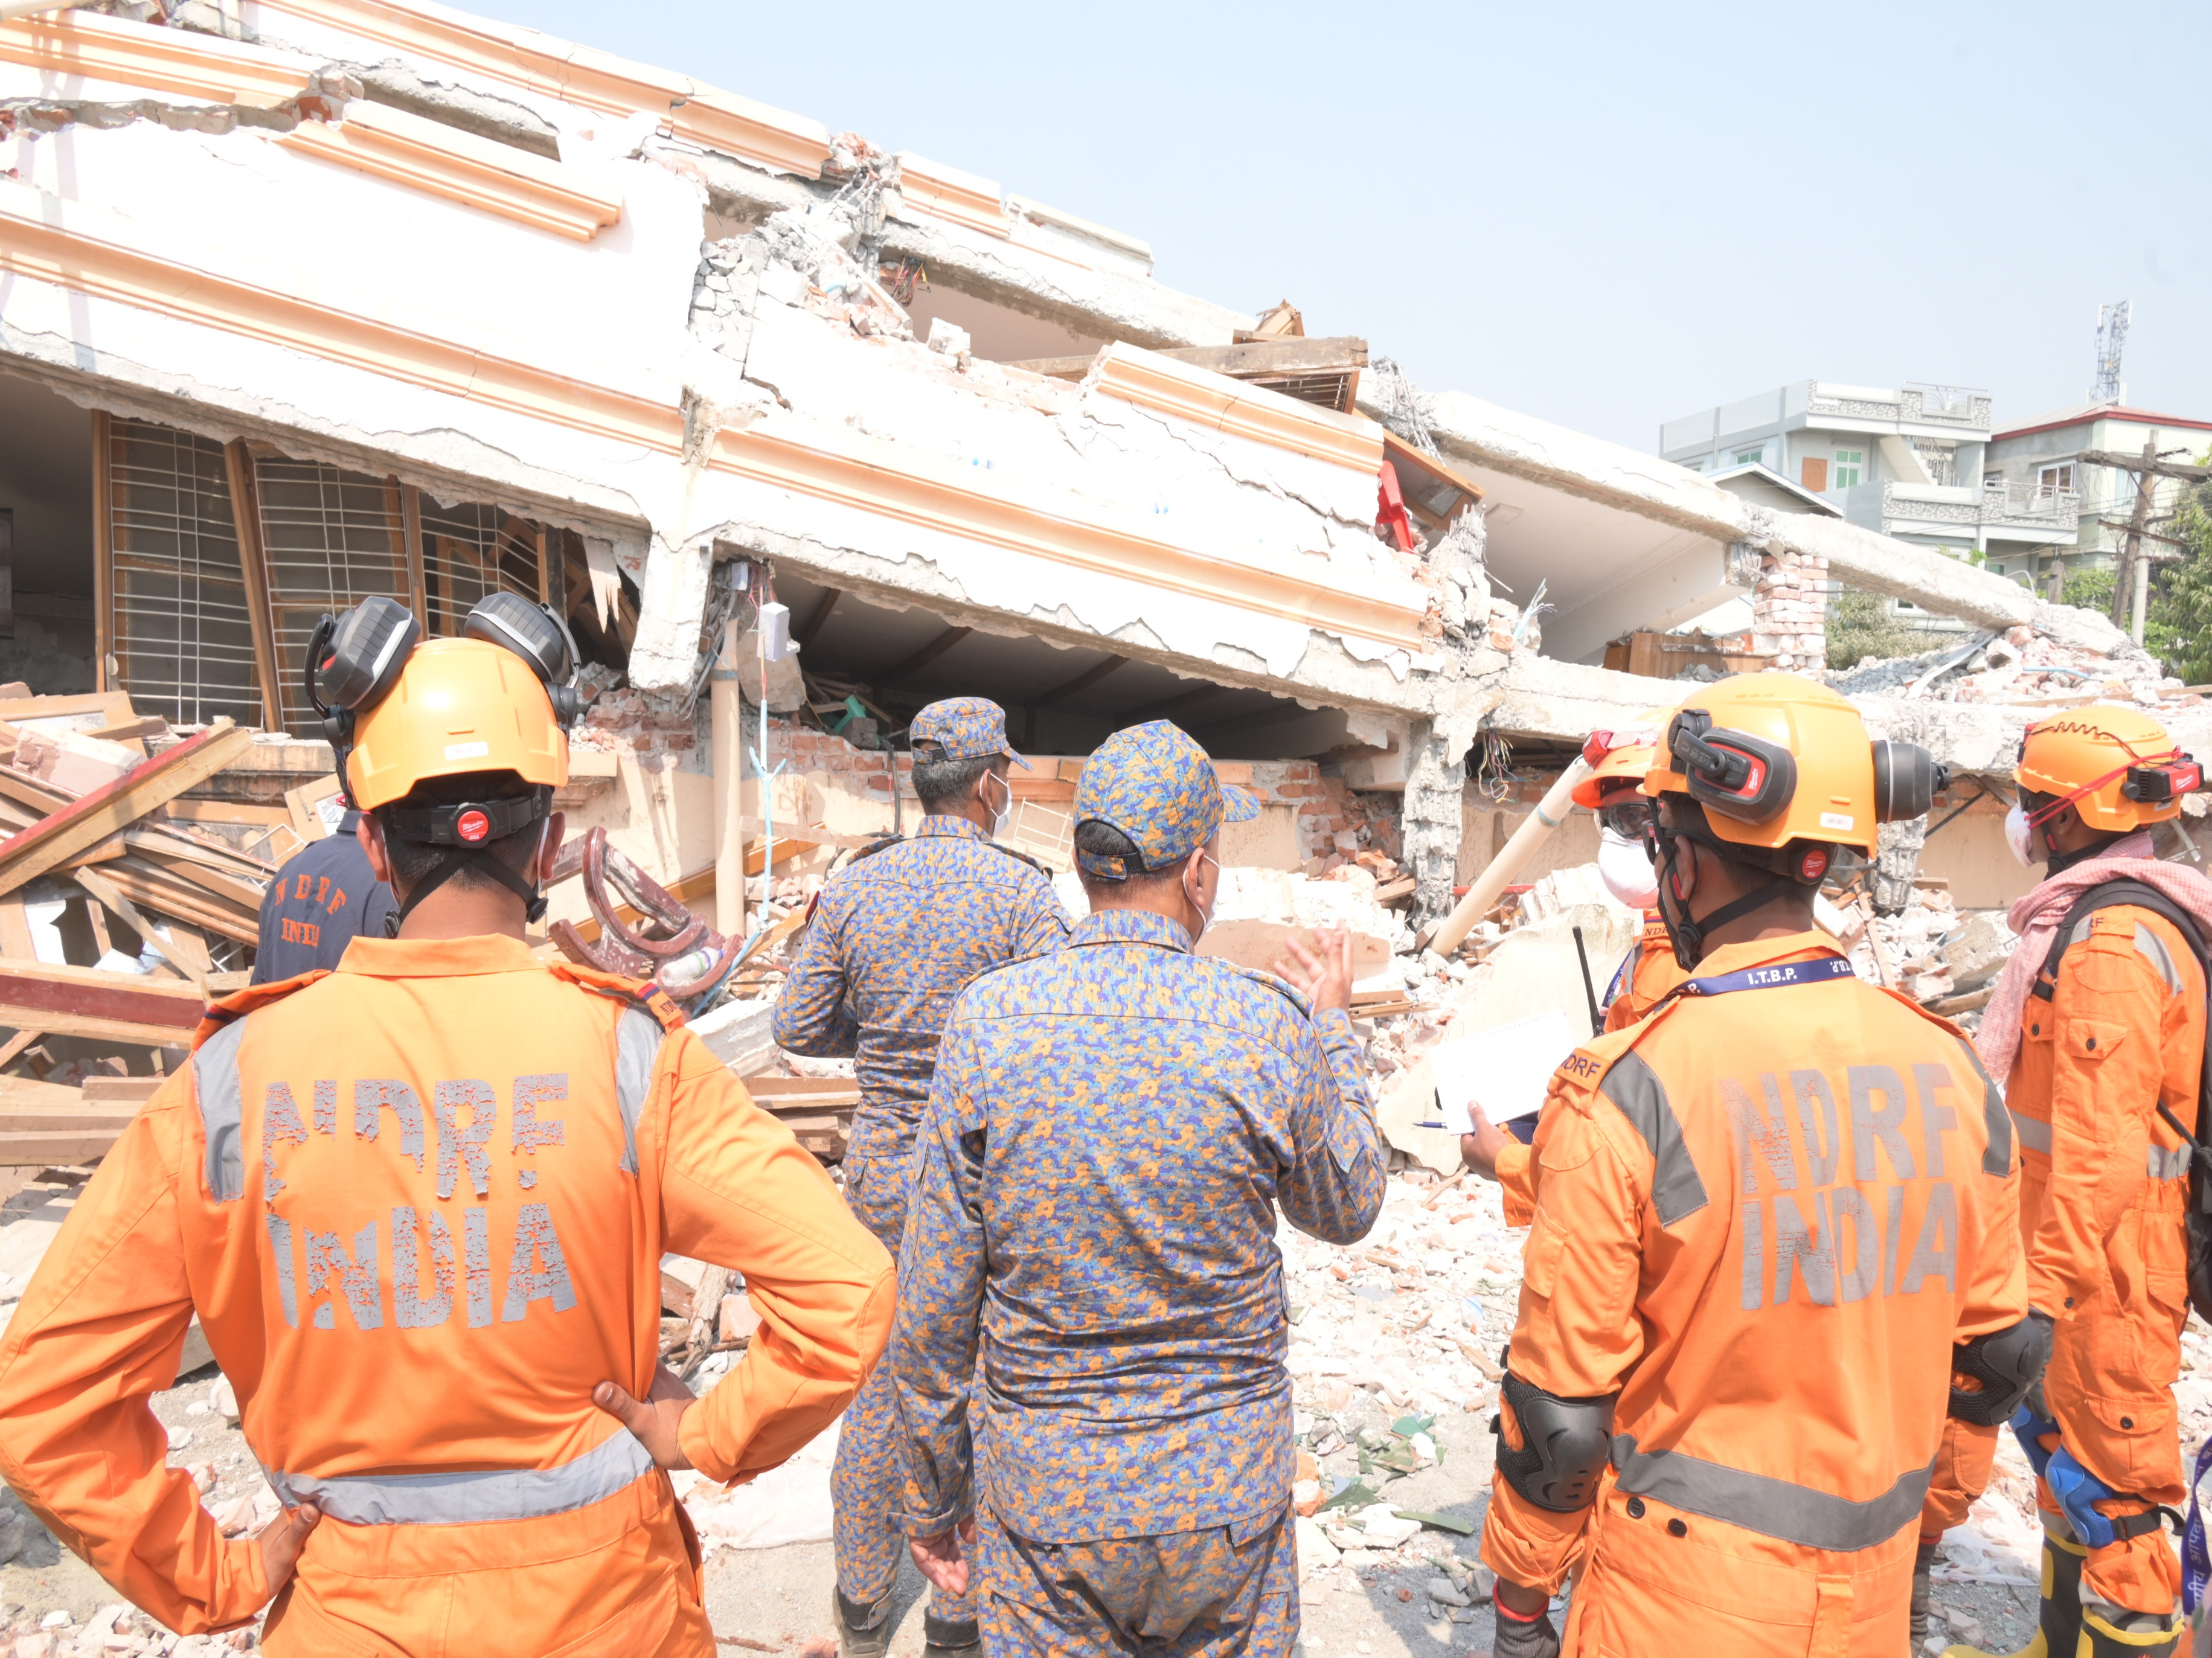
PEER | CSSR | INDIA
PPT 6 -
NDRF | CSSR | INDIA

Slide 22
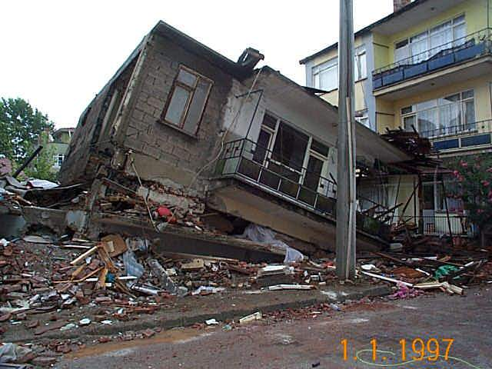
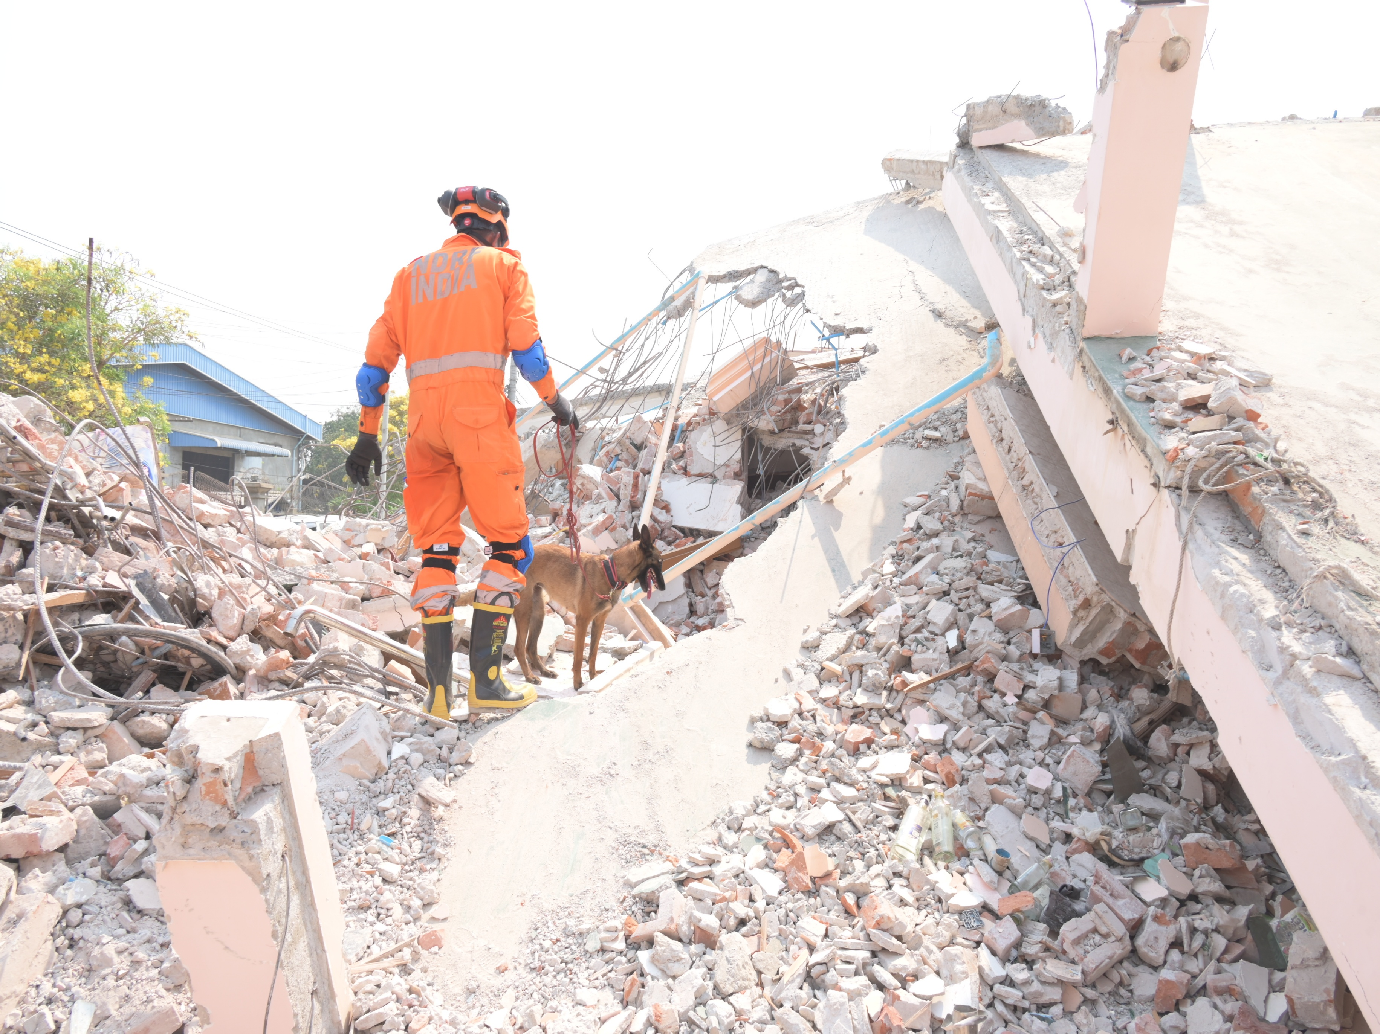
PEER | CSSR | INDIA
PPT 6 -
NDRF | CSSR | INDIA

Slide 23
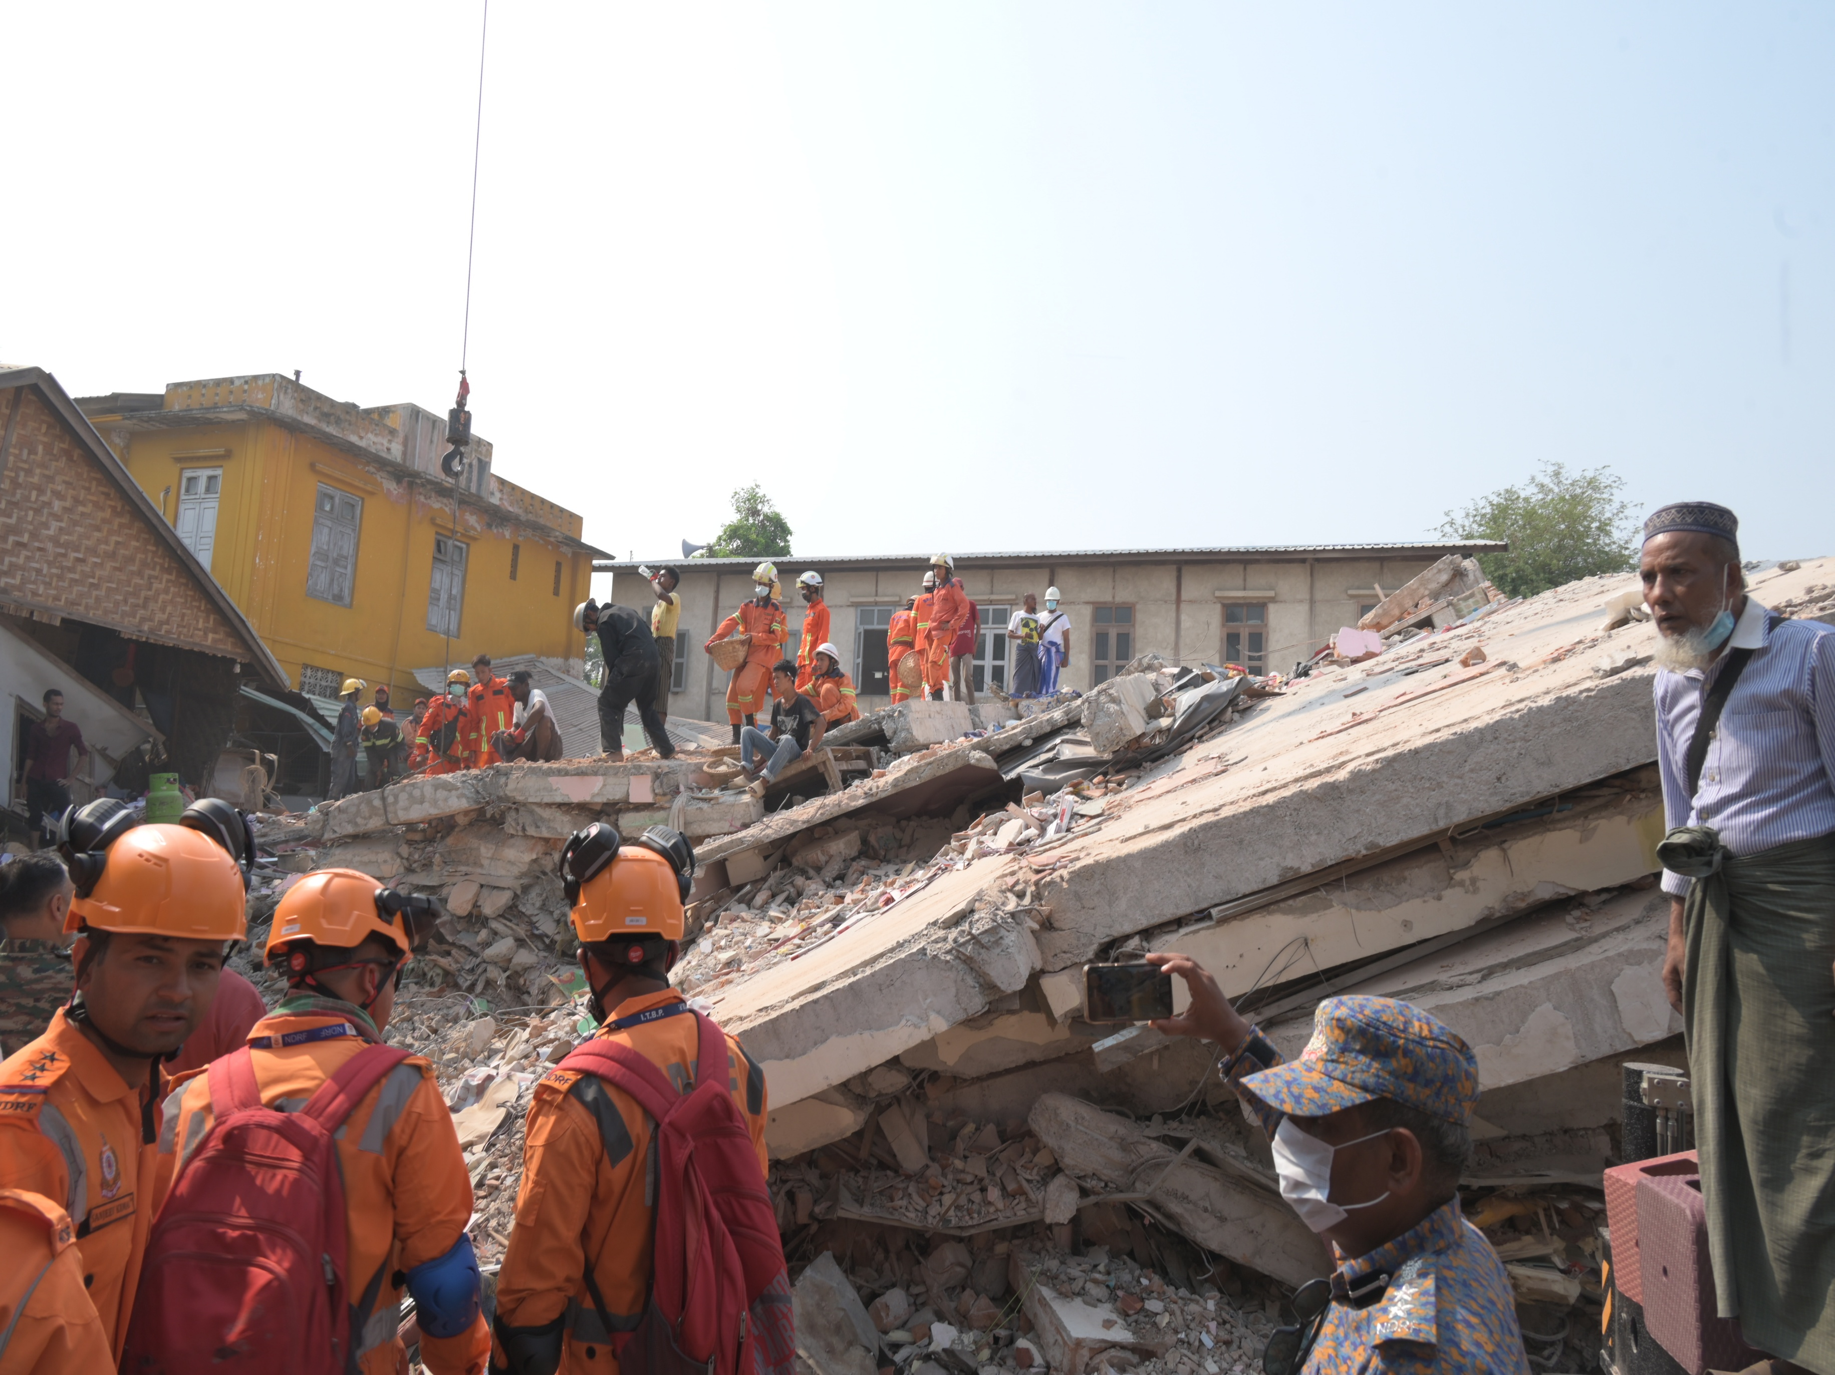
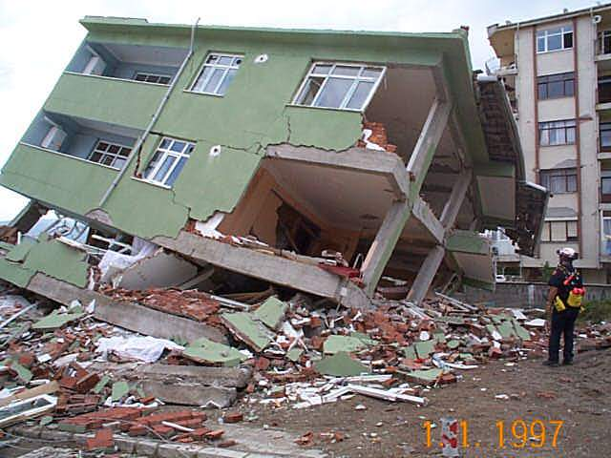
PEER | CSSR | INDIA
PPT 6 -
NDRF | CSSR | INDIA

Slide 24
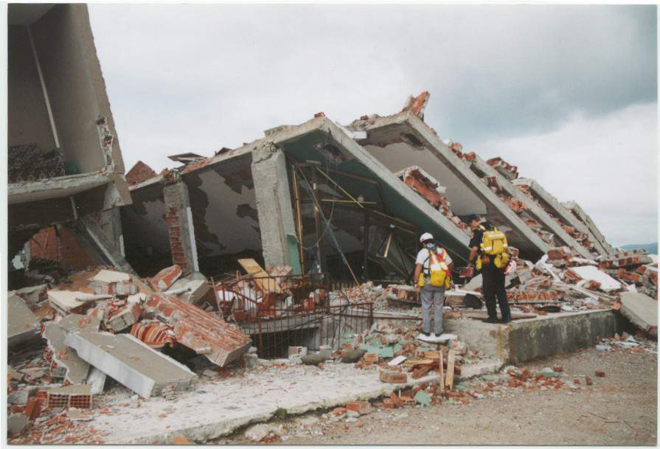
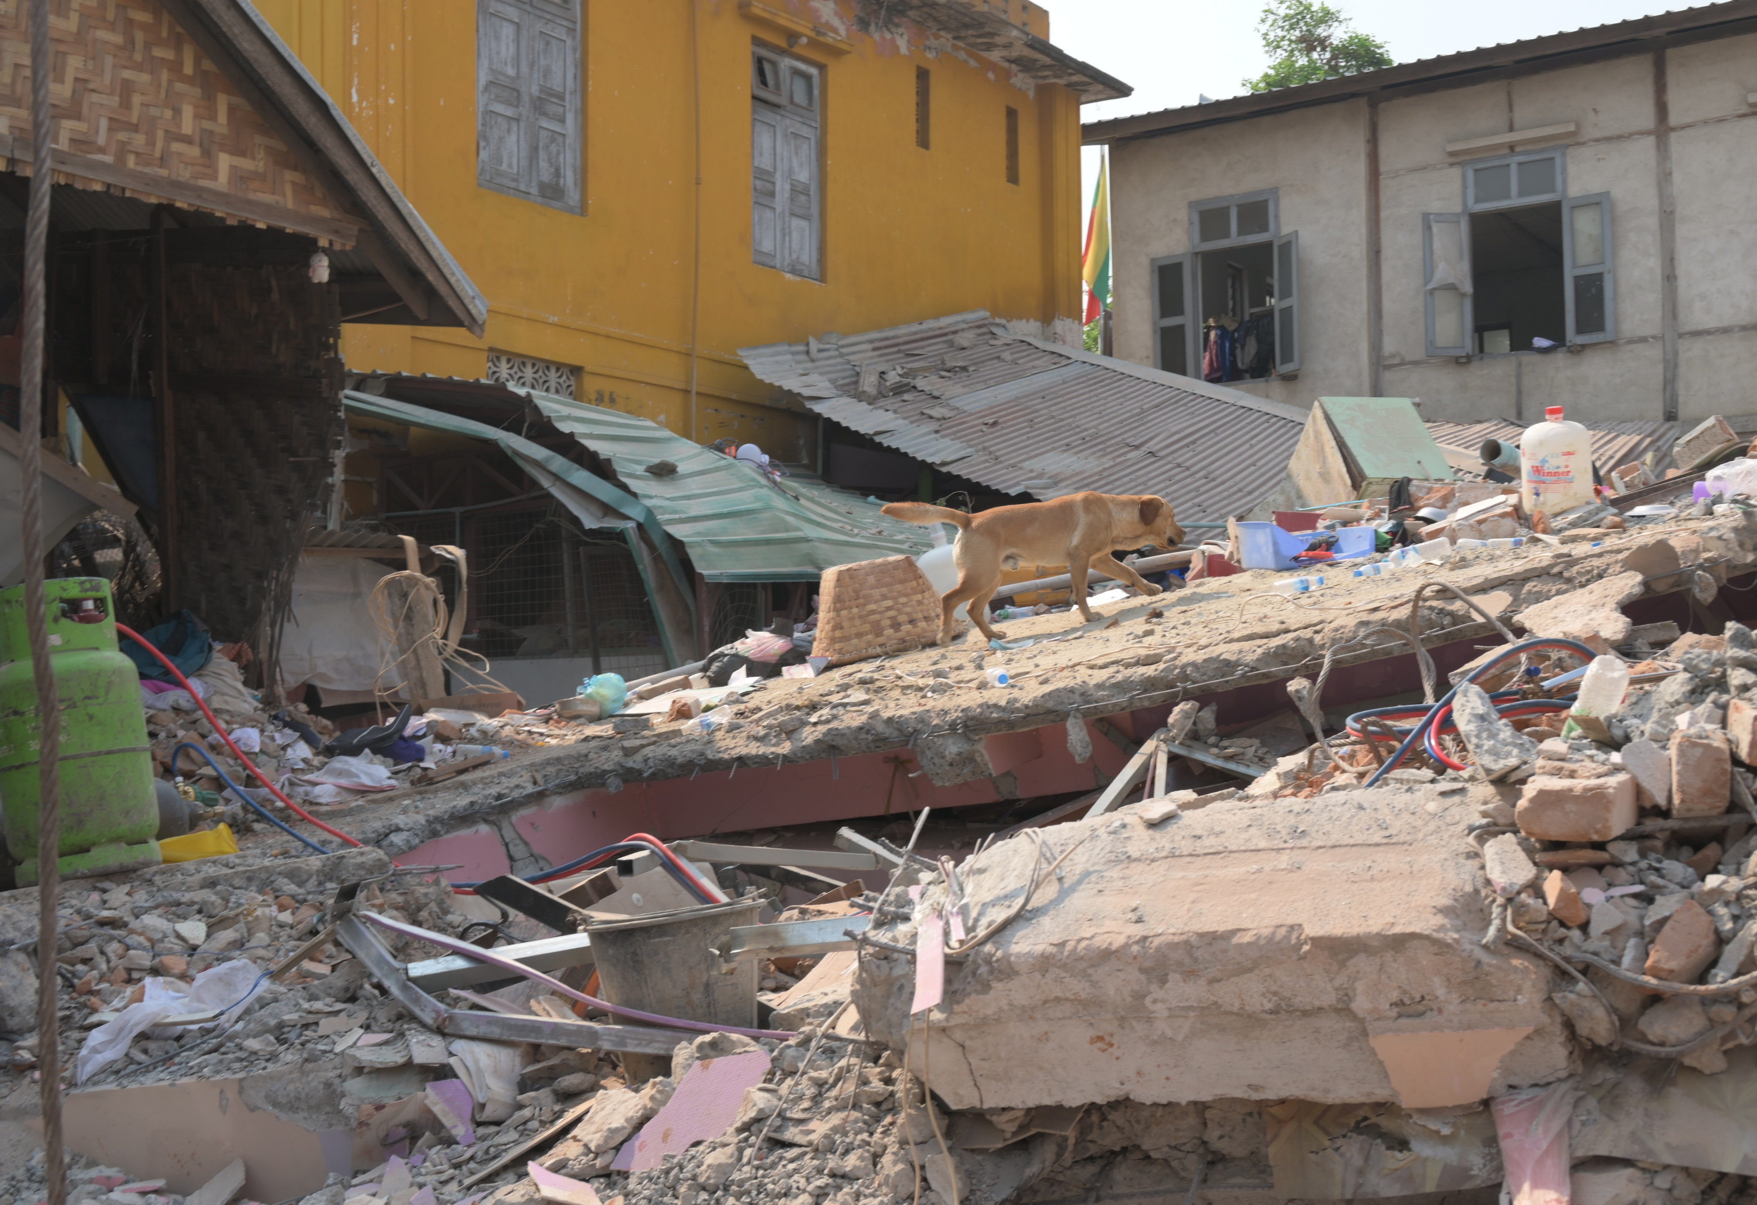
PEER | CSSR | INDIA
PPT 6 -
NDRF | CSSR | INDIA

Slide 25
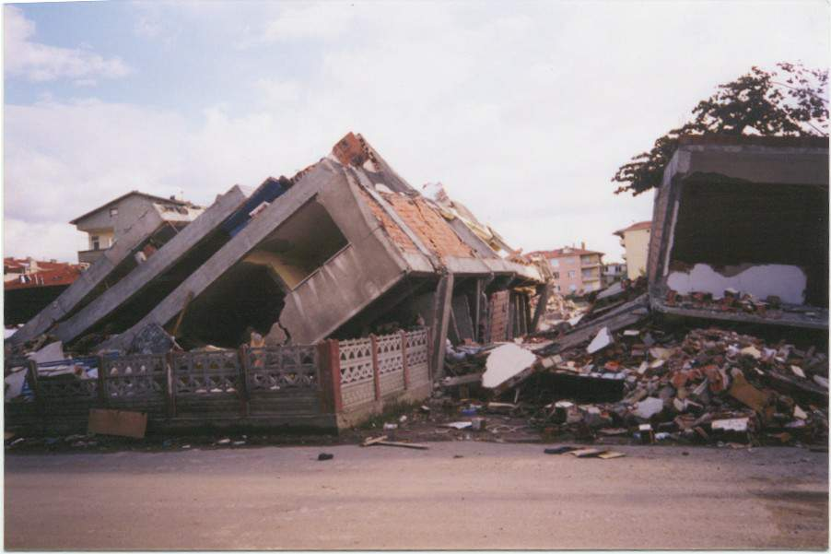
PEER | CSSR | INDIA
PPT 6 -
NDRF | CSSR | INDIA

Slide 26
Search Modalities
1
2
Hasty search
Extensive search
PEER | CSSR | INDIA
PPT 6 -
NDRF | CSSR | INDIA

Slide 27
Search Methods
1
2
3
Physical search
Canine search
Technical search
PEER | CSSR | INDIA
PPT 6 -
NDRF | CSSR | INDIA

Slide 28
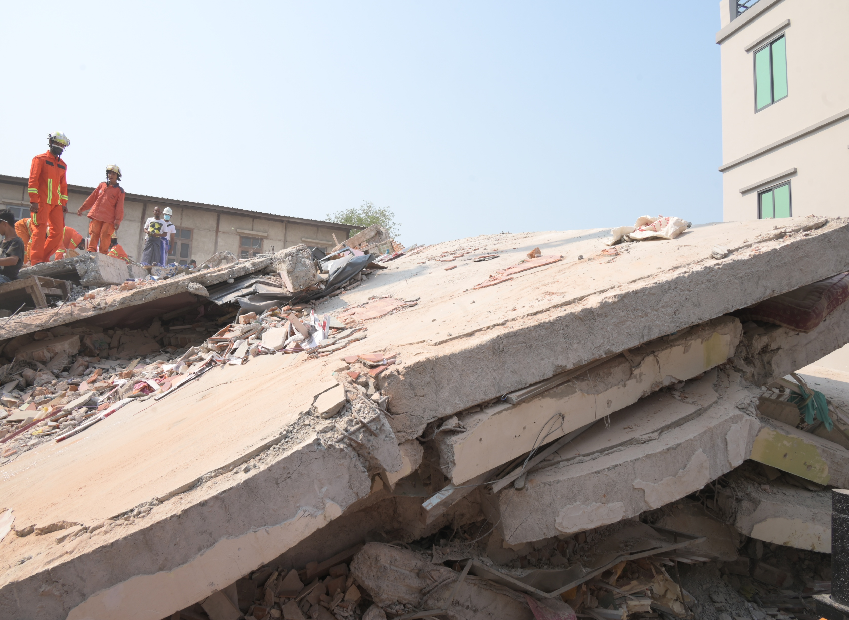
Physical Search
PEER | CSSR | INDIA
PPT 6 -
NDRF | CSSR | INDIA

Slide 29
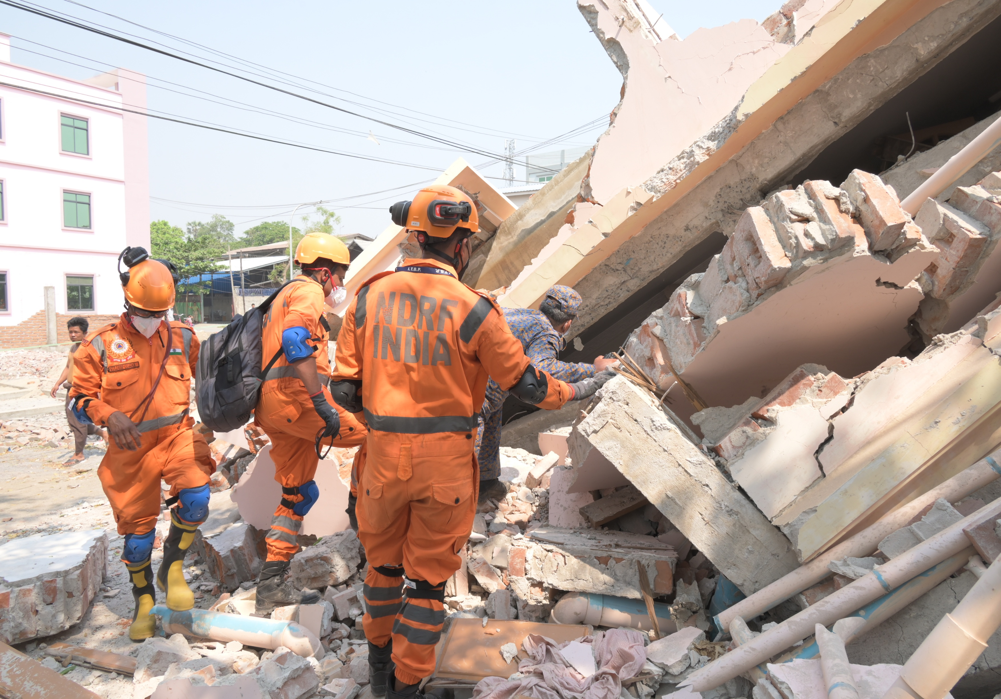
Void Search
PEER | CSSR | INDIA
PPT 6 -
NDRF | CSSR | INDIA

Slide 30
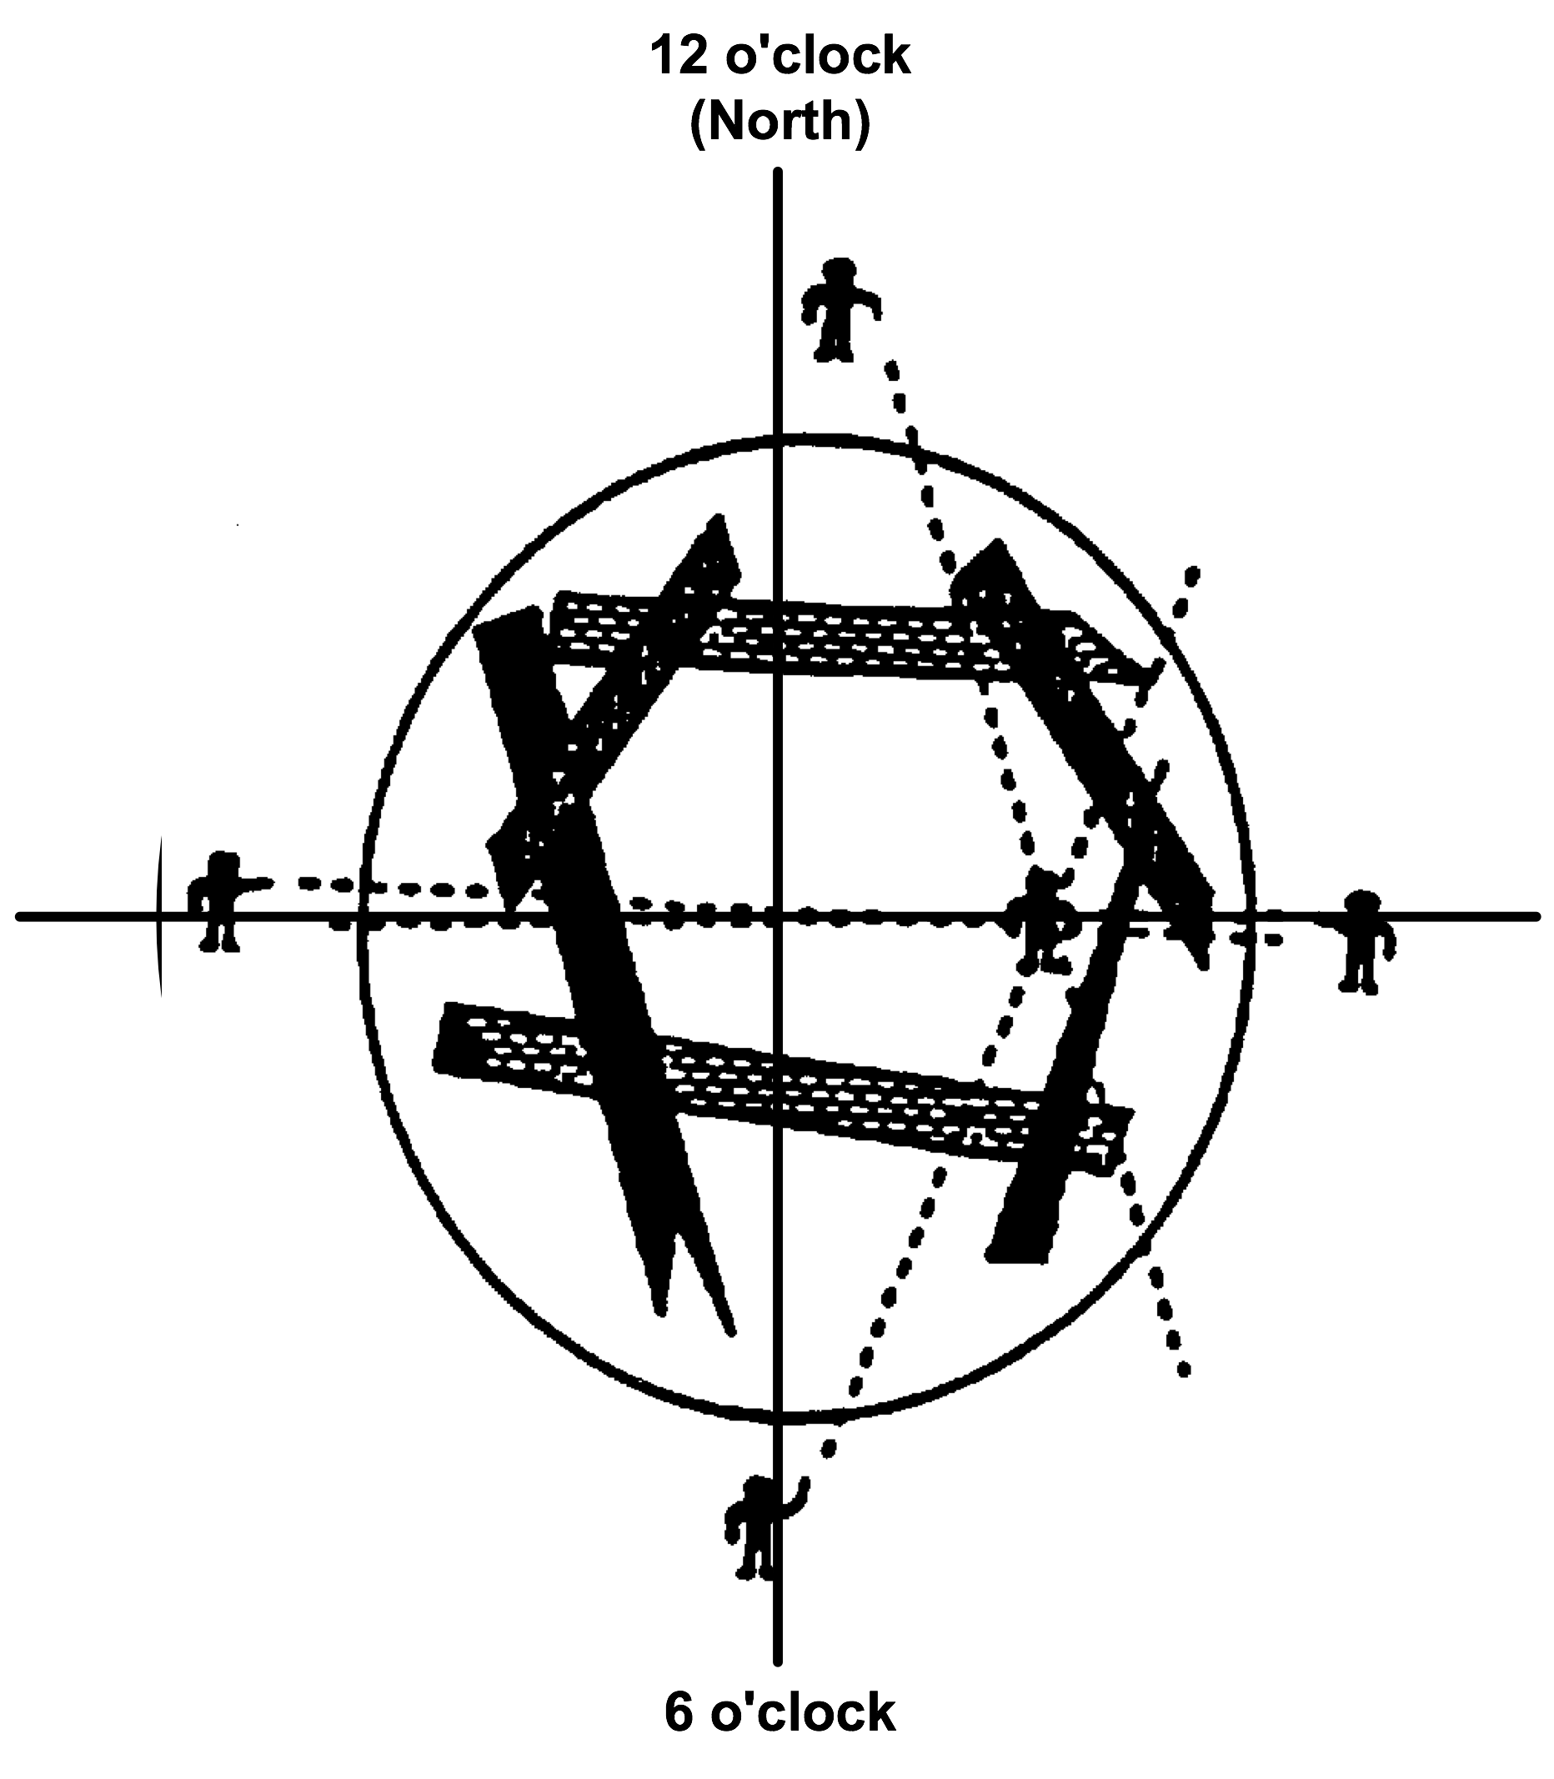
Hailing Method
“We are rescuers – make some noise so we can hear you!!”
Silence is essential
PEER | CSSR | INDIA
PPT 6 -
NDRF | CSSR | INDIA

Slide 31
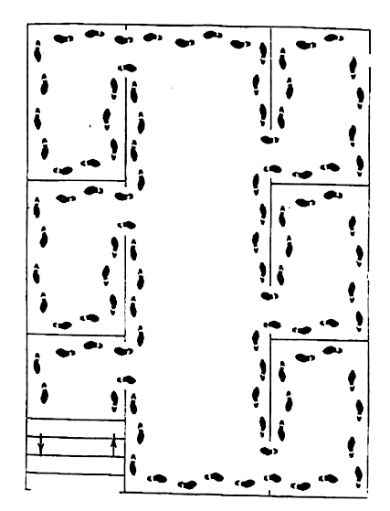
Search Patterns:
Multiple Rooms
“Go right,
stay right.”
PEER | CSSR | INDIA
PPT 6 -
NDRF | CSSR | INDIA

Slide 32
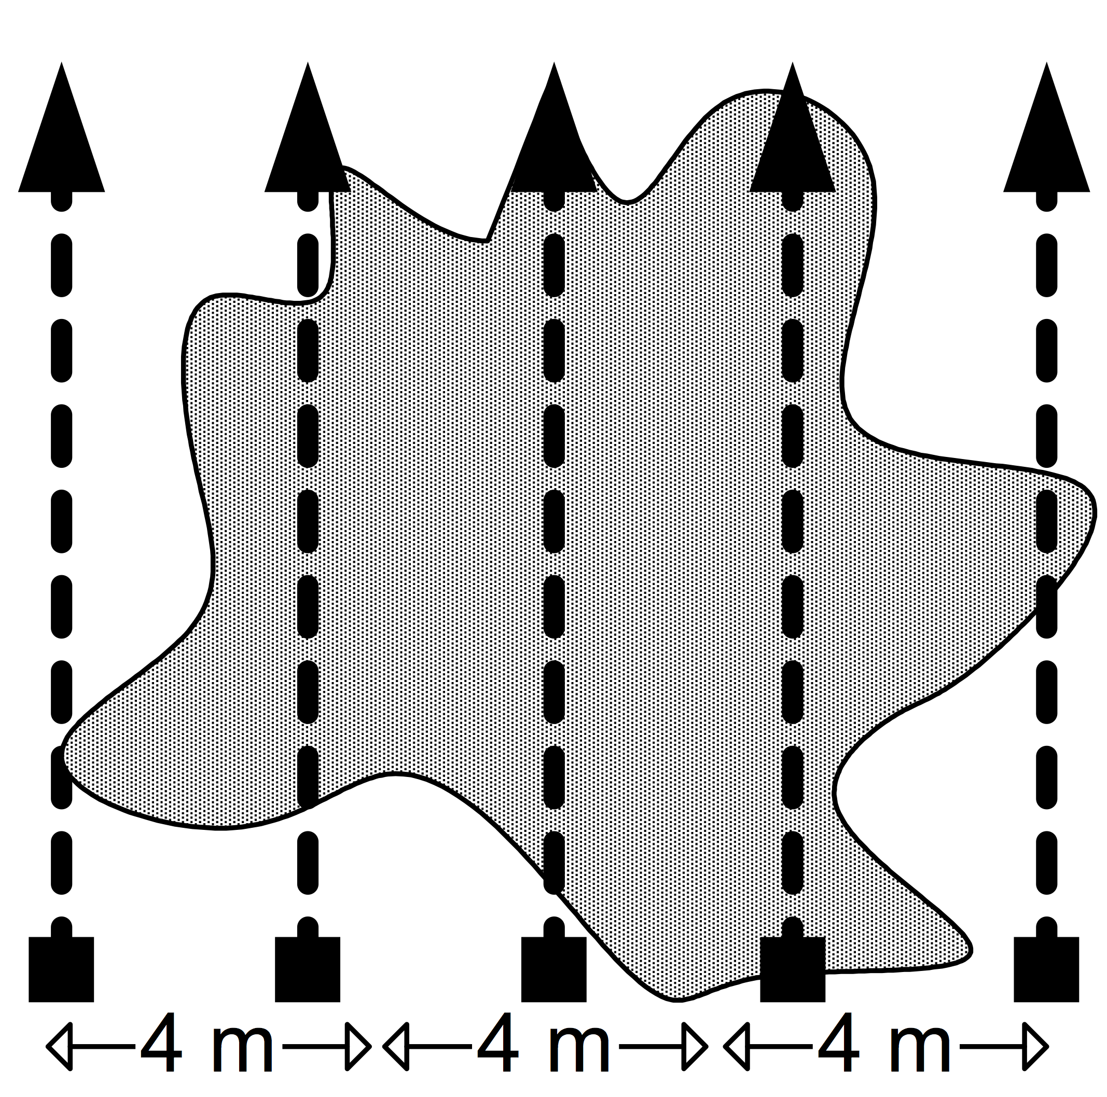
Search Patterns:
Line Search
PEER | CSSR | INDIA
PPT 6 -
NDRF | CSSR | INDIA

Slide 33
Victim Management
1
Precautions during a search
2
Steps for initial contact with a located victim
PEER | CSSR | INDIA
PPT 6 -
NDRF | CSSR | INDIA

Slide 34
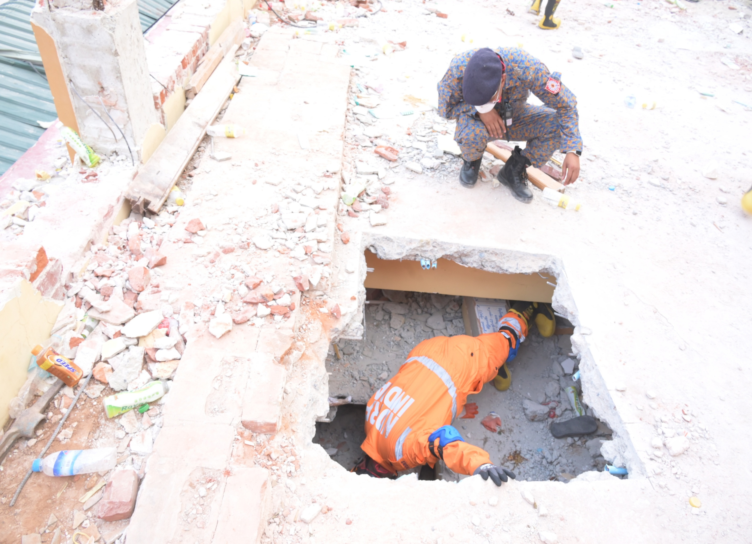
Victim Contact
PEER | CSSR | INDIA
PPT 6 -
NDRF | CSSR | INDIA

Slide 35


THANK YOU

