Slide 1





COLLAPSED STRUCTURE SEARCH AND RESCUE
LESSON 1
COURSE INTRODUCTION
LESSON 3
Construction Materials,
Structures and
Damage Types
LESSON 3
Construction Materials,
Structures and
Damage Types
LESSON 5
Operational Safety
Presented By:- Sachin Chauhan,2IC
NDRF | CSSR | INDIA
PPT 5-1

Slide 2
OBJECTIVES
Upon completing this lesson, you will be able to:
1
List at least five dangers a rescuer
faces in a CSSR operation.
Identify unsafe actions and unsafe conditions.
Identify the CSSR Course safety rules.
2
3
NDRF | CSSR | INDIA
PPT 5 -

Slide 3
OBJECTIVES
Upon completing this lesson, you will be able to:
4
Identify the four parts of a CSSR safety plan and briefly describe each one.
Describe the purpose of the Safety Briefing and list its eight components.
5
NDRF | CSSR | INDIA
PPT 5 -

Slide 4
CSSR Operational Safety
After the Mexico City earthquake in 1985 almost as many rescuers were killed as there were victims of
the actual earthquake.
NDRF | CSSR | INDIA
PPT 5 -

Slide 5
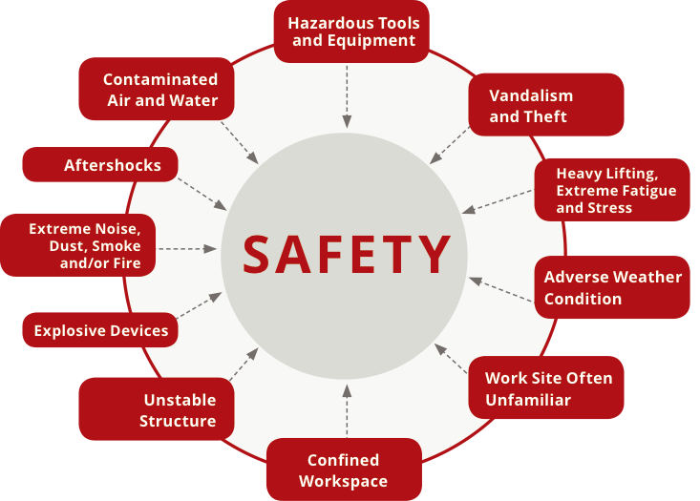
Factors Affecting Safety
NDRF | CSSR | INDIA
PPT 5 -

Slide 6
Unsafe Actions
and Conditions
Unsafe Actions
Unsafe Conditions
NDRF | CSSR | INDIA
PPT 5 -

Slide 7
Course Safety Rules
Practice areas
Personal Protective Equipment (PPE)
Hygiene
Safety Officer
Group safety
NDRF | CSSR | INDIA
PPT 5 -

Slide 8
Course Safety Rules (cont.)
Whistle signals
      Stop: —
      Evacuate: •••
      Continue: — •
NDRF | CSSR | INDIA
PPT 5 -

Slide 9
Course Safety Rules (cont.)
Safety Zone
EMS
Fire extinguishers
Drinking water
NDRF | CSSR | INDIA
PPT 5 -

Slide 10
Course Safety Rules (cont.)
Maintenance
Rotations
Trash
Smoking and drinking
NDRF | CSSR | INDIA
PPT 5 -

Slide 11
Course Safety Rules (cont.)
Weather conditions
Safety markings
Team safety
Safety violations
Miscellaneous
NDRF | CSSR | INDIA
PPT 5 -

Slide 12
CSSR Mission Phases
Preparation
Activation and mobilisation
Operations
Deactivation and demobilisation
Post-mission activities
NDRF | CSSR | INDIA
PPT 5 -

Slide 13
Safety Officer
The Safety Officer has the authority to alter, suspend or terminate activities involving an imminent hazard to personnel.
NDRF | CSSR | INDIA
PPT 5 -

Slide 14
Safety Officer Categories
1
2
3
Overall
Site-specific
Special Hazards
NDRF | CSSR | INDIA
PPT 5 -

Slide 15
Safety Plan
L
C
E
S
Lookouts
Communication
Escape routes
Safe zones
NDRF | CSSR | INDIA
PPT 5 -

Slide 16
Safety Briefing Components
Chain of Command
Identifying the Safety Officer
Safety Plan (LCES)
Communication Plan
NDRF | CSSR | INDIA
PPT 5 -

Slide 17
Safety Briefing Components (Cont.)
Medical Plan
Rehabilitation Plan
Special hazards
General safety message
NDRF | CSSR | INDIA
PPT 5 -

Slide 18


THANK YOU

