Slide 1





STRUCTURAL TRIAGE & THE INSARAG MARKING SYSTEM
Presented By:- Sachin Chauhan,2IC
PEER | CSSR | INDIA
PPT 2 -

Slide 2

OBJECTIVES
1. Describe Sectorization, its identification and five
ASR levels.
2. List four categories of Worksite Triage.
3. List at least eight factors to consider in Worksite Triage.
4. Define the INSARAG Marking System, list and describe
the eight categories of INSARAG Marking System.
Upon Completion of this lesson, you will be able to:
Structural Triage and the INSARAG Marking System

Slide 3
SECTORIZATION
In case of large-scale events, effecting large area or numerouscities, or even more than one country, sectorization done toallow effective co-ordination of Search and Rescue efforts for better operational planning and effective deployment of search and rescue teams.
Structural Triage and the INSARAG Marking System

Slide 4
CREATION OF SECTORS
Areas of large-scale destruction are geographically divided into smaller areas / sectors to ensure effective coordination of search and rescue teams.
It improves operational planning and effective deployment of search and rescue teams.
Sectorization should be undertaken at the earliest possible stage of a disaster response to ensure its effectiveness.
Structural Triage and the INSARAG Marking System

Slide 5
SECTOR IDENTIFICATION
A simple lettering system is used to code each sector, like A, B, C, D and so on and a local name or description can also be added to ensure clarity. e.g. sector A, Kashmir etc.
If the LEMA has its own a coded sector identification system in place e.g. Sector 1, 2, 3, or Red, Blue, Green etc., it should be adopted and allow for it in any documentation or markings.

Slide 6
Worksite Identification
It is defined as “any site where significant Urban Search & Rescue operations are carried out”. Significant USAR operation normally only take place when there is thought to be the potenti-al for a live rescue. It can range from a single site in a building to much larger area or complex of buildings. Each worksite should be allocated its own worksite ID using following protocols:
The first part is the sector letter allocated to the area the site is in e.g. A.
As a worksite is identified, a number is then sequentially allocated; 1, 2, 3 etc.
more…
Structural Triage and the INSARAG Marking System

Slide 7
WORKSITE IDENTIFICATION
If more than one team is in the same sector, then the UCC will instruct teams on which numbers to use e.g. Team 1 uses 1 to 20, Team 2 uses 21 to 40 etc.
If the LEMA uses a different sector code, e.g. numbers, then this should be used as the first part of the Worksite ID, e.g. 1-1 rather than A-1. In either case the sector code must be separated from the worksite number by a hyphen to prevent any possible confusion.
A Worksite can further be subdivided into smaller sites and identification can be done by adding suffix letter to the original single Worksite ID, e.g. A-1a, A-1b etc.

Slide 8
TEAM IDENTIFICATION CODE
Each USAR Team is identified by a unique Team Identification Code, and it is done in the following manner:
The three letter Olympic code of the country
A number to differentiate team from the same country e.g. JPN-1, AUS-1, PAK-1.
For IEC classified teams the number will be decided by the home country at the time of classification and registered in the INSARAG USAR Team Directory. For non-IEC classified teams, the same country code system will be used; however, the number will be assigned by the RDC based upon sequence of arrival, starting from the number ten.
more…
Structural Triage and the INSARAG Marking System

Slide 9
TEAM IDENTIFICATION CODE
…continued
If the team does not want 3 lettered country codes, the following process shall be used:
The letters “SAR” will be used to replace the country code.
Followed by a number starting at 10, e.g. SAR-10 (Country 1), SAR-11 (Country). This is also the method for non-IEC country.
Structural Triage and the INSARAG Marking System

Slide 10
2. ASSESSMENT, SEARCH AND RESCUE LEVELS
The five operational levels can define the phases of potential USAR related work. It should be remembered that not all these levels will always be carried out by international USAR teams; often the LEMA resources will do certain aspects.
Levels can also be combined when appropriate and it is also possible that different levels of work are being carried out in different areas of the incident at the same time.
Structural Triage and the INSARAG Marking System

Slide 11
ASSESSMENT, SEARCH AND RESCUE LEVELS
LEVEL 0: Pre Deployment Research of
the Affected Area
LEVEL 1: Wide Area Assessment
LEVEL 2: Worksite Triage Assessment
LEVEL 3: Rapid Search and Rescue
LEVEL 4: Full Search and Rescue
LEVEL 5: Total Coverage Search and Recovery
Structural Triage and the INSARAG Marking System

Slide 12
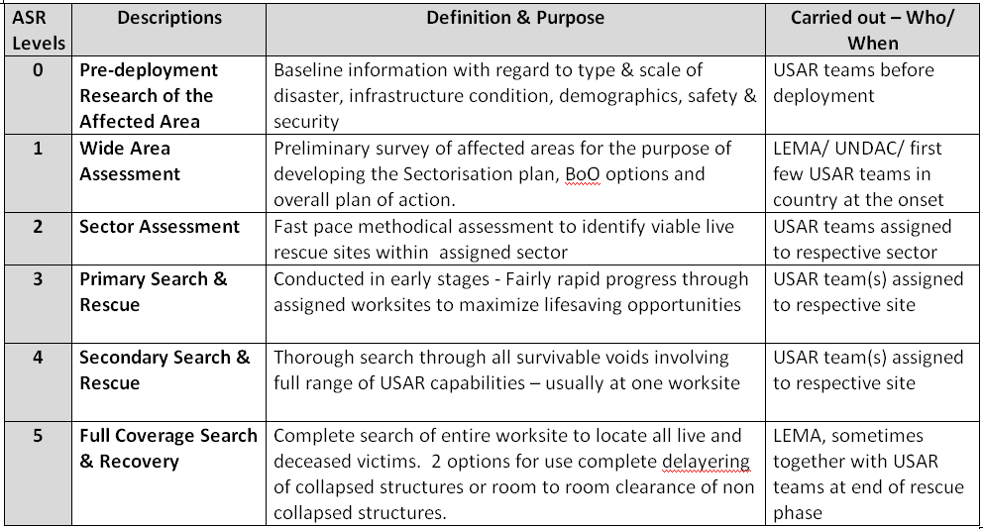
ASSESSMENT, SEARCH & RESCUE (ASR) LEVELS

Slide 13
CONSIDERATIONS FOR PRIORITY OF TRIAGE
Confirmed live victims: Means that the assess-ment team knows that there are people alive in the collapsed structure.
Unknown victims or possible victims: Means that people are missing, but the assessment team does not know whether these people are alive or even in the structure.
Structural Triage and the INSARAG Marking System

Slide 14
CONSIDERATIONS FOR PRIORITY OF TRIAGE
A BIG VOID - is big enough for a person to crawl. The chances of survival for a victim are greater in big voids than small voids.
A SMALL VOID - is where a person can hardly move and has to lie more or less still while waiting for help. In small voids, the chances of injury are higher as people trapped inside have less space to avoid falling objects and collapsing structural elements
Structural Triage and the INSARAG Marking System

Slide 15
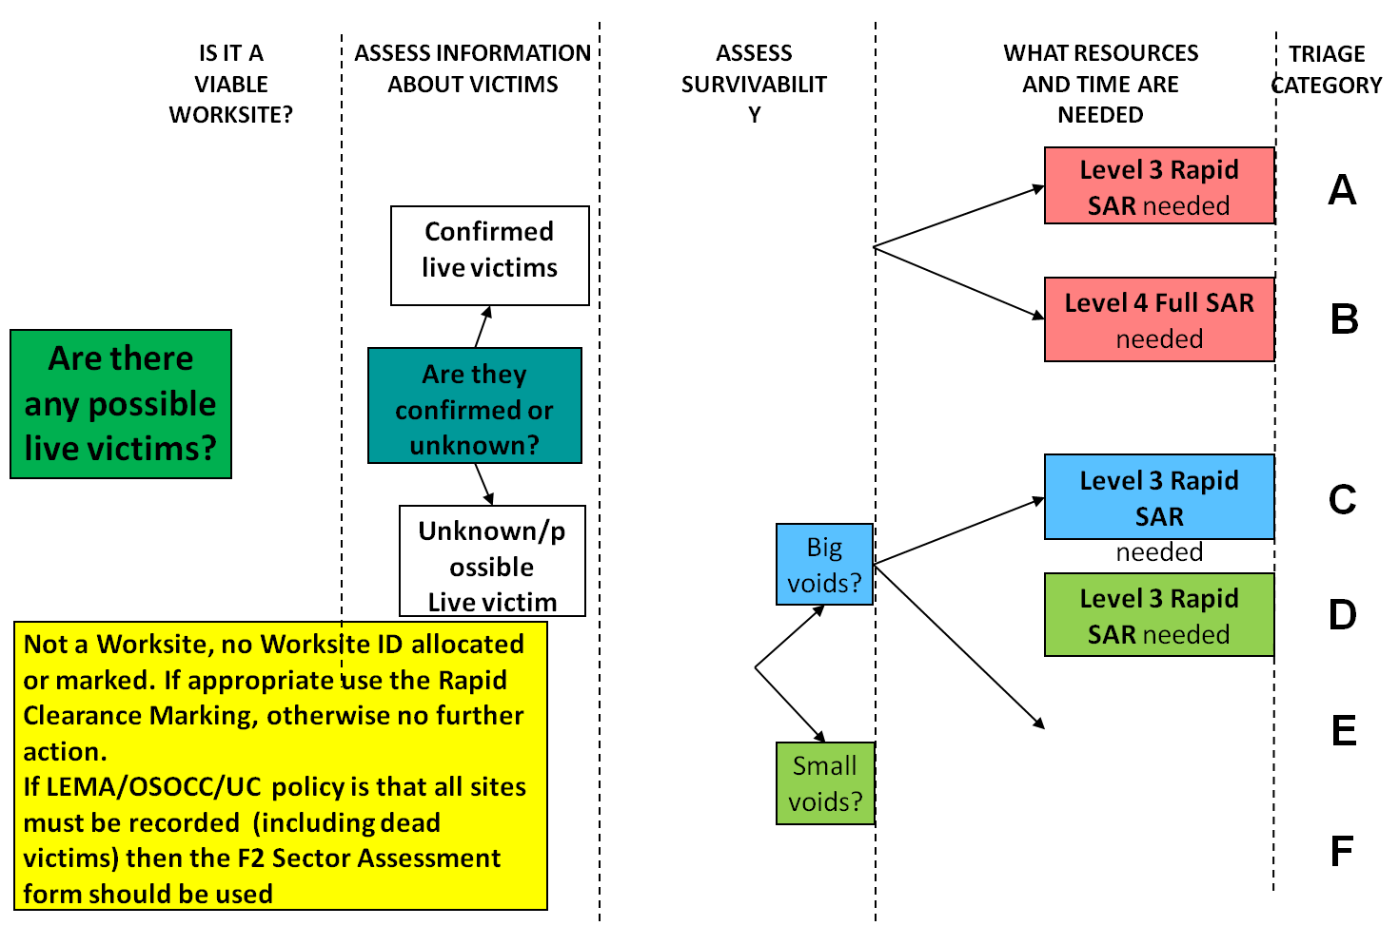

TRIAGE TREE: VICTIMS, SURVIVABILITY, RESOURCES NEEDED
YES
Allocate Worksite ID and
complete Worksite Triage form
NO
Are there survivable voids?
YES
Level 4 Full SAR needed
NO
Level 4 Full SAR needed
Structural Triage and the INSARAG Marking System
Notes:
15
Here is a Triage Tree. It can be useful to help people understand the thinking behind the triage method.
DEEPAK BAMORIYA

Slide 16
TRIAGE TREE: VICTIMS, SURVIVABILITY, RESOURCES NEEDED
Triage Categories | Type of Victims | Expected Duration Of Operation
A | Confirmed live victims | Less than 12 hours
B | Confirmed live victims | Longer than 12 hours
C | Possible live victims | Not assessed
D | Deceased only | Not assessed
Structural Triage and the INSARAG Marking System

Slide 17

POTENTIAL VICTIM LOCATION
Draw a large “V” as close as possible to the location of known or potential victim(s).
Structural Triage and the INSARAG Marking System

Slide 18

CONFIRMED LIVE VICTIMS
Structural Triage and the INSARAG Marking System

Slide 19
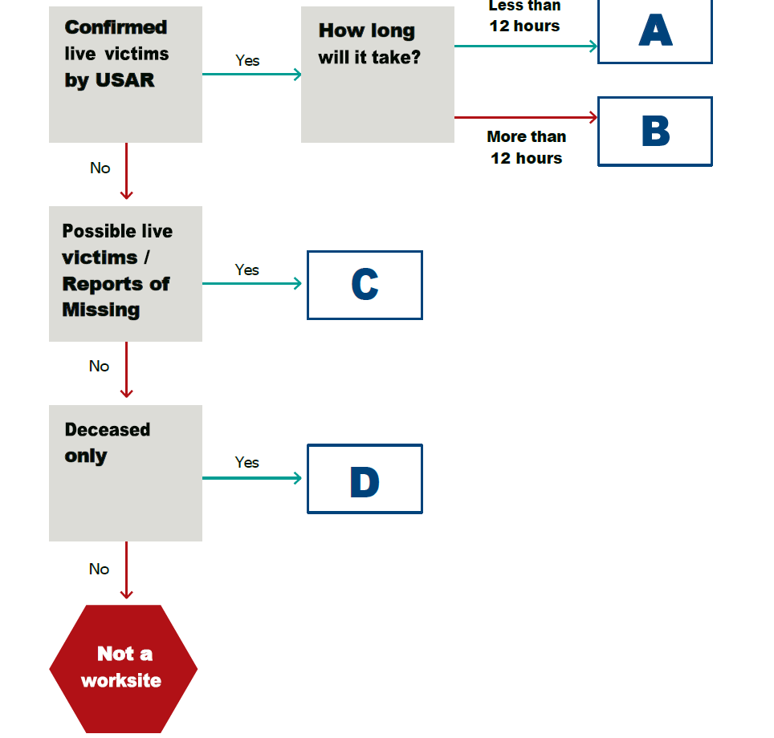
SECTOR ASSESSMENT WORKSITE TRIAGE CATEGORY FLOWCHART

Slide 20
FACTORS IN WORKSITE TRIAGE
Prior intelligence
Type of structure
Condition of the structure
Mechanism of collapse
Day, date & time of collapse
Prior intelligence
Availability of resources
Location of utility shut-offs
Possible presence of hazardous materials
Structural Triage and the INSARAG Marking System

Slide 21
4.INSARAG MARKING SYSTEM
The international search and rescue advisory group ( INSARAG) marking system uses symbols to identify the condition of structure , the presence of hazards and status of victims in a standardised, simple and clear fashion that can be understood by all local, national and international rescue personnel.
Structural Triage and the INSARAG Marking System

Slide 22
CLEAR MARKINGS
All markings must be obvious and made using a high contrast, durable, fluorescent colour.
Structural Triage and the INSARAG Marking System

Slide 23
LOCATION REFERENCES OF A STRUCTURE
It is important to identify locations within and around a single structure. On the exterior of the structure, the address side of the structure is defined as Side 1. Other sides of the structure shall be assigned numerically in a clockwise manner from Side 1
Structural Triage and the INSARAG Marking System

Slide 24

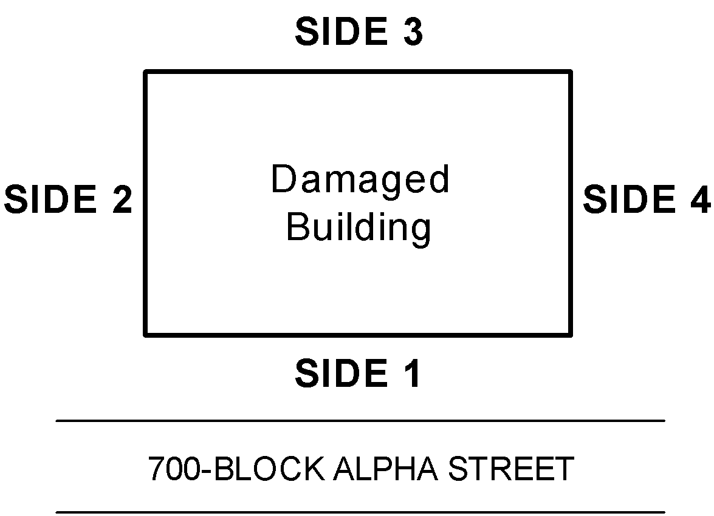
LOCATION REFERENCES — EXTERIOR
Structural Triage and the INSARAG Marking System

Slide 25
THE INTERIOR OF THE STRUCTURE
The interior of the structure will be divided into quadrants.
The quadrants are identified alphabetically in a clockwise manner starting from where SIDE 1 and SIDE 2 meet.
The centre core, where all four quadrants meet, is identified as QUADRANT E.
Structural Triage and the INSARAG Marking System

Slide 26
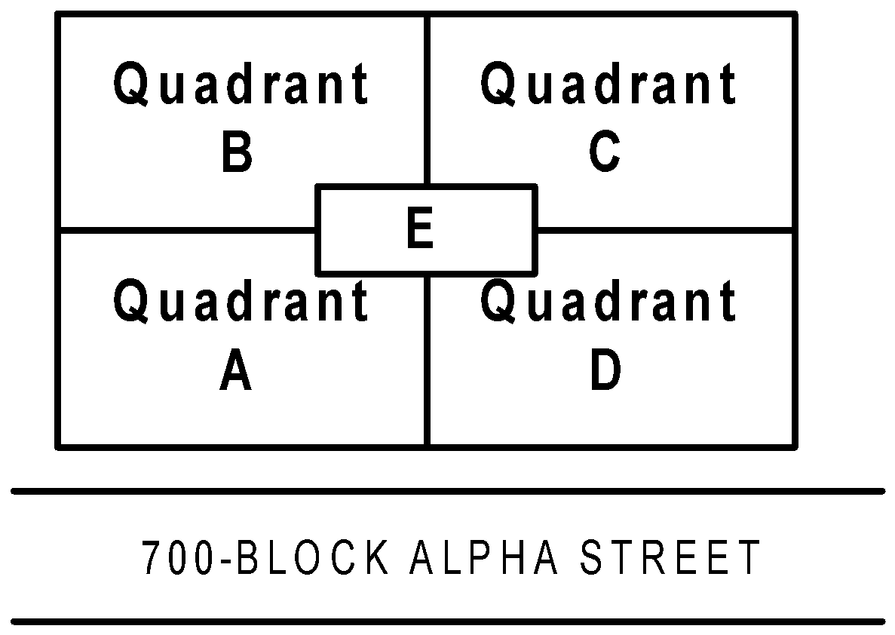
LOCATION REFERENCES -INTERIOR
Structural Triage and the INSARAG Marking System

Slide 27
IDENTIFYING FLOORS
Multi-story structures must have each floor clearly identified.
If not clearly identifiable, floors should be numbered in relation to ground level. The grade-level floor is designated as the ground floor.
The floors above are numbered as Floor 1, Floor 2, etc. Conversely, the floors below the ground floor are Basement 1, Basement 2, etc.
If possible, floors should be permanently marked at each landing of accessible stairways.
Structural Triage and the INSARAG Marking System

Slide 28
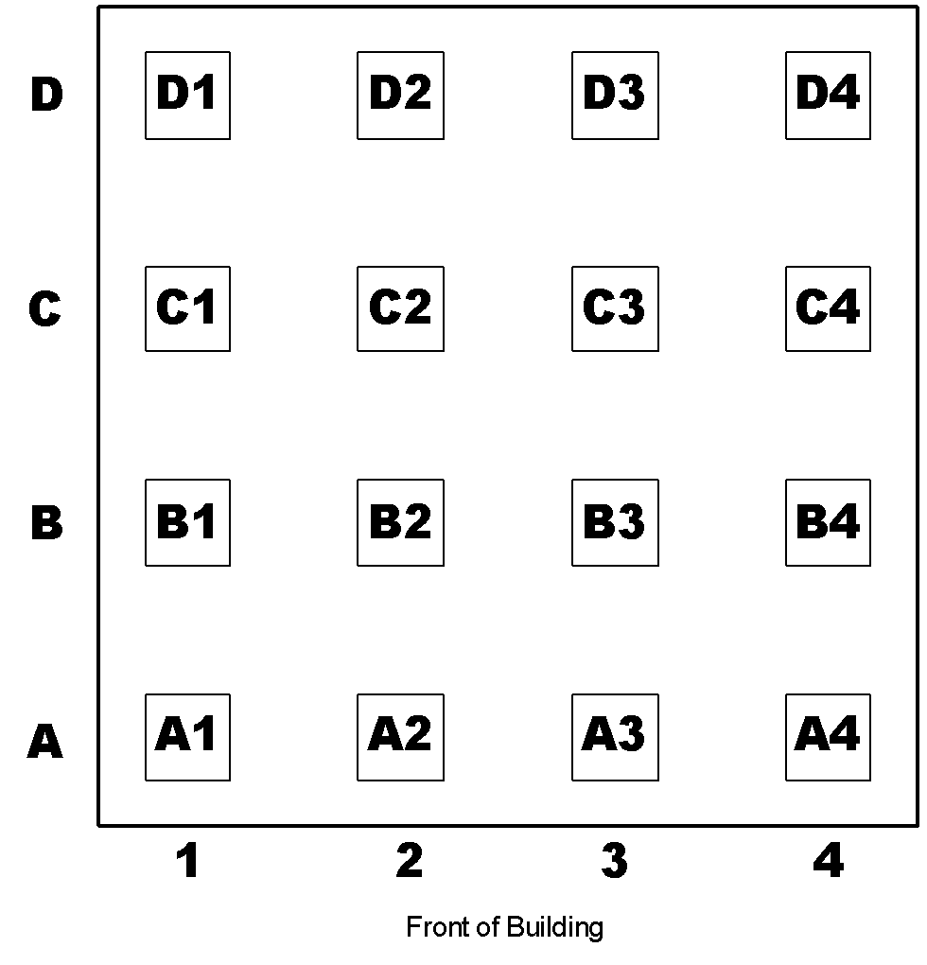
IDENTIFYING COLUMNS
Structural Triage and the INSARAG Marking System

Slide 29
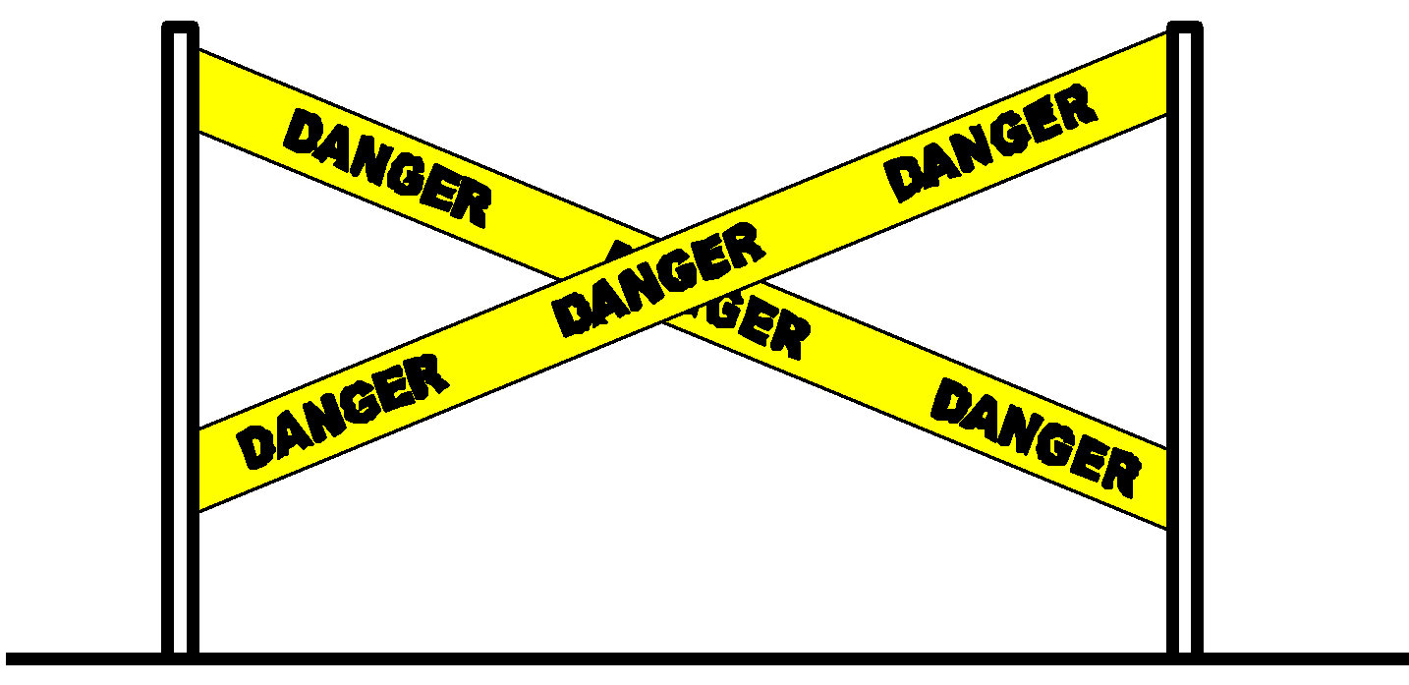
COLLAPSE / HAZARD ZONE
Structural Triage and the INSARAG Marking System
Notes:
Lesson 4: Structural Triage and the INSARAG Marking System
Rev. Oct. 2002
29
DEEPAK BAMORIYA

Slide 30
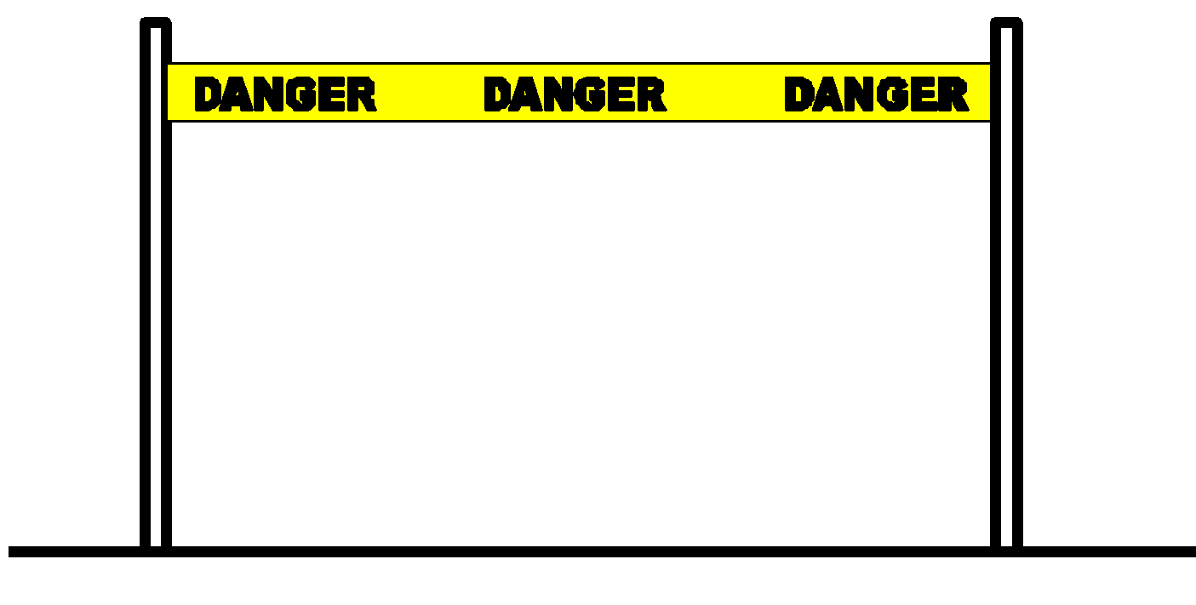
OPERATIONS WORK ZONE
Structural Triage and the INSARAG Marking System

Slide 31
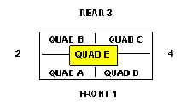
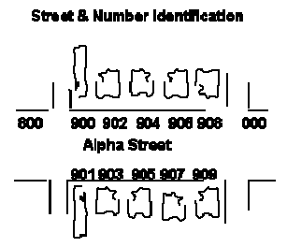
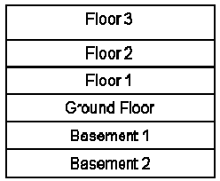
INSARAG GUIDELINES (F) GENERAL AREA MARKING
Structure Orientation
Street & Number Identification
orange spray
each assigned area or work-site
Interior Identification
Structural Triage and the INSARAG Marking System
Notes:
Stand TT.MM.JJ
Bezeichnung des Anlasses mit Datum bzw Geschäft / Vorhaben
DEEPAK BAMORIYA
31
1

Slide 32

INSARAG GUIDELINES Rectangular box
1.2 m
1 m
Place the mark at the primary access point into the structure
Structural Triage and the INSARAG Marking System
Notes:
Stand TT.MM.JJ
Bezeichnung des Anlasses mit Datum bzw Geschäft / Vorhaben
DEEPAK BAMORIYA
32

Slide 33
INSARAG GUIDELINES ABBREVIATIONS OF HAZARDS
WATER
GAS
HAZMAT
RADIATION
EXPLOSE
VOLTAGE
COLLAPSE
FUEL
CHEMICAL
Structural Triage and the INSARAG Marking System
Notes:
Stand TT.MM.JJ
Bezeichnung des Anlasses mit Datum bzw Geschäft / Vorhaben
DEEPAK BAMORIYA
33
1

Slide 34
INSARAG GUIDELINES MARKING OF HAZARD
HAZMAT
C-26
IND-1 ASR3 30may
AUS-1 ASR4 31may
A
Structural Triage and the INSARAG Marking System
Notes:
Stand TT.MM.JJ
Bezeichnung des Anlasses mit Datum bzw Geschäft / Vorhaben
DEEPAK BAMORIYA
34
1

Slide 35
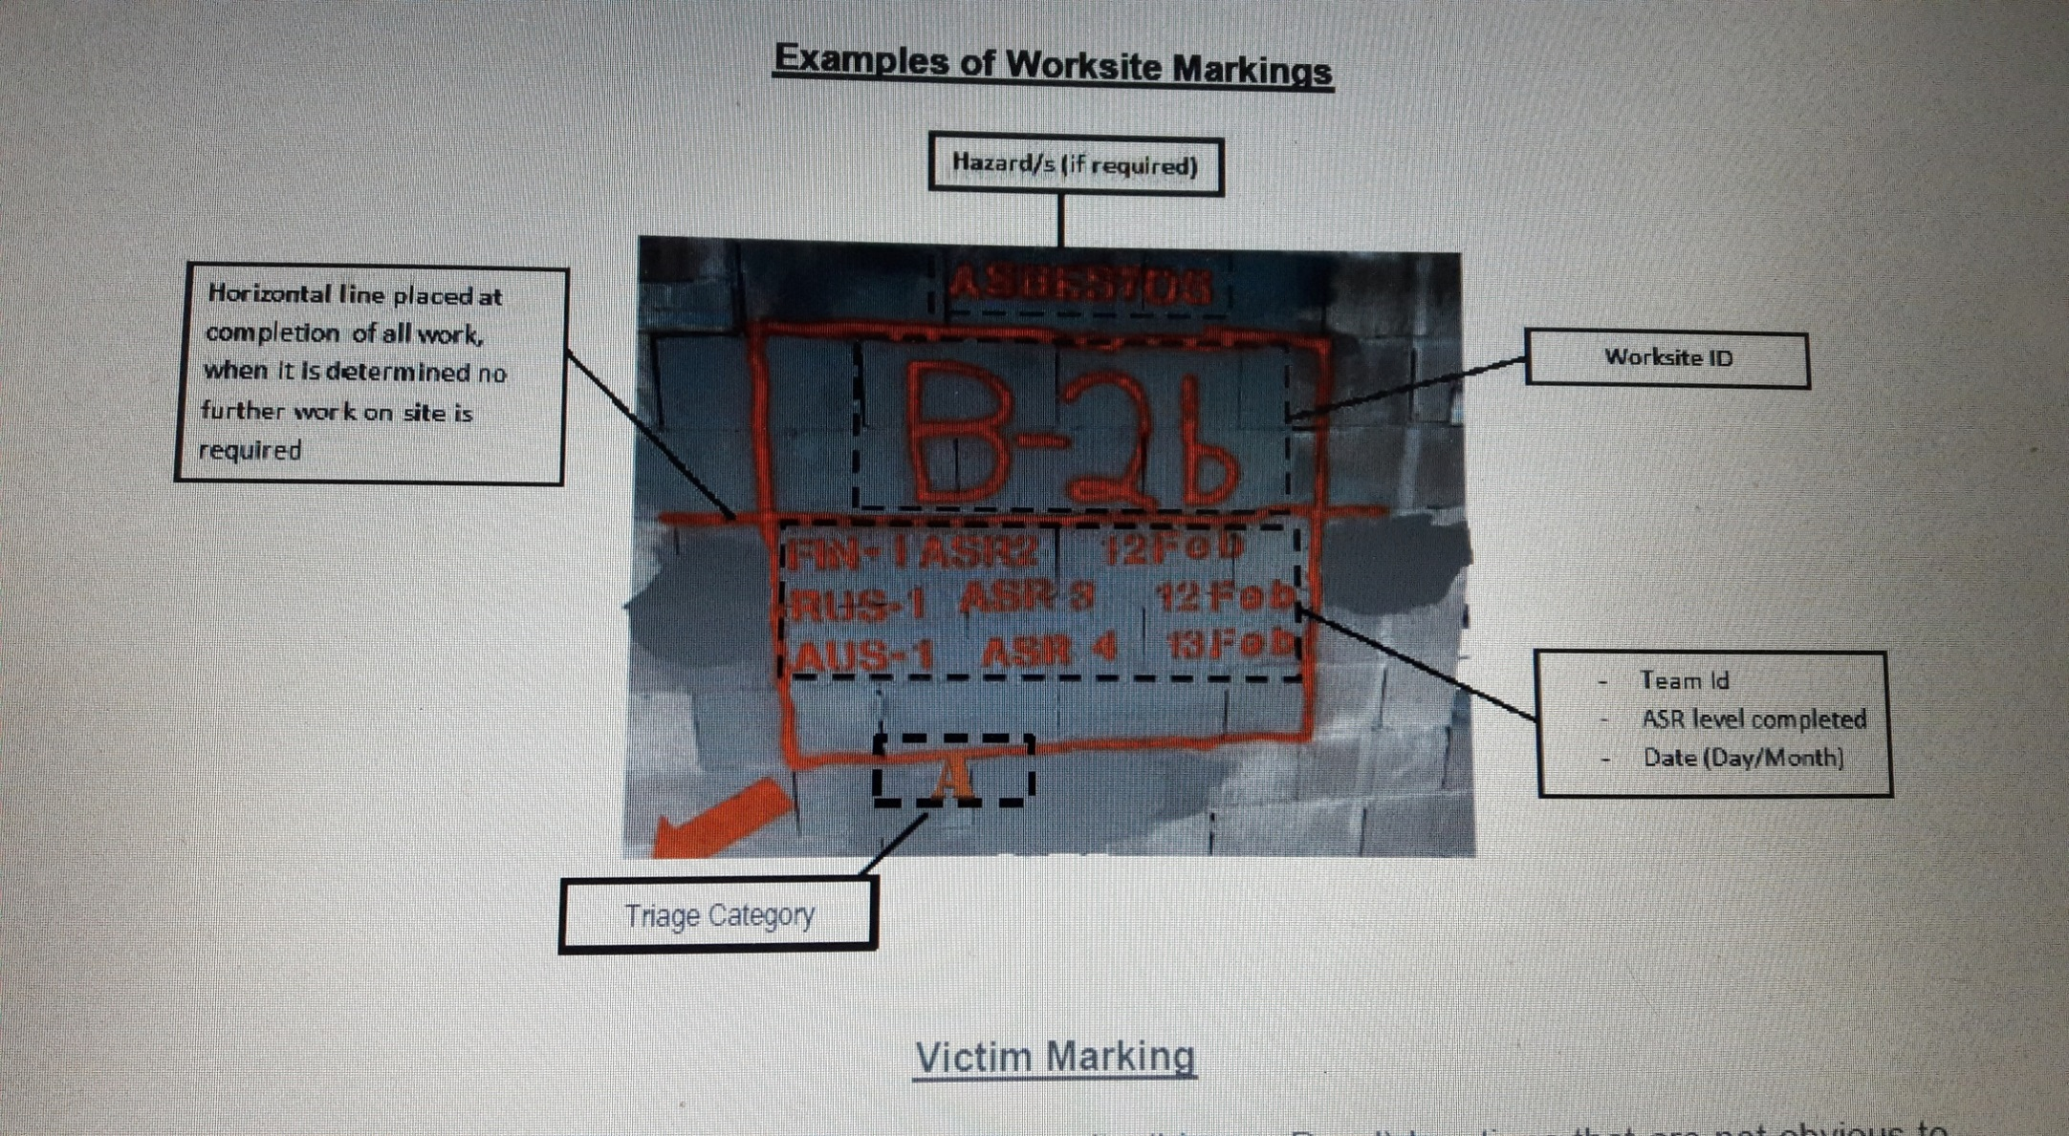
Outside of box – any hazard requiring identification at top e.g asbestos - triage category (bottom) The worksite ID should be appox 40 cm. The team ID , ASR Level and date should be smaller e.g appox 10 cm
INSARAG GUIDELINES MARKING OF HAZARD
Structural Triage and the INSARAG Marking System

Slide 36

RAPID CLEARANCE MARKING
Areas able to be rapidly searched to Level 5 standards
Light or undamaged structures, cars, outbuildings, small debris piles
Method:
Apply a diamond box with a C inside
Visible obvious position
Immediately below add Team ID and date
Structural Triage and the INSARAG Marking System

Slide 37
victims or only deceased remain.
Can be applied to Non Structural areas – cars/objects/outbuildings/debris piles etc, that have been searched to
standards indicated above.
Diamond shape with a large ‗C‘ inside for Clear, or with a large ‗D‘ inside for Deceased Only. Immediately below,
the following is applied:
Team ID: _ _ _-_ _ e.g. AUS-1
Date of Search: _ _/ _ _ _ e.g. 31/may
Material to be used can be spray paint, builders crayon, stickers, waterproof card etc at the discretion of the teams
Size: approximately 20cm x 20cm
Colour: bright, contrasting colour to background.
Structural Triage and the INSARAG Marking System

Slide 38
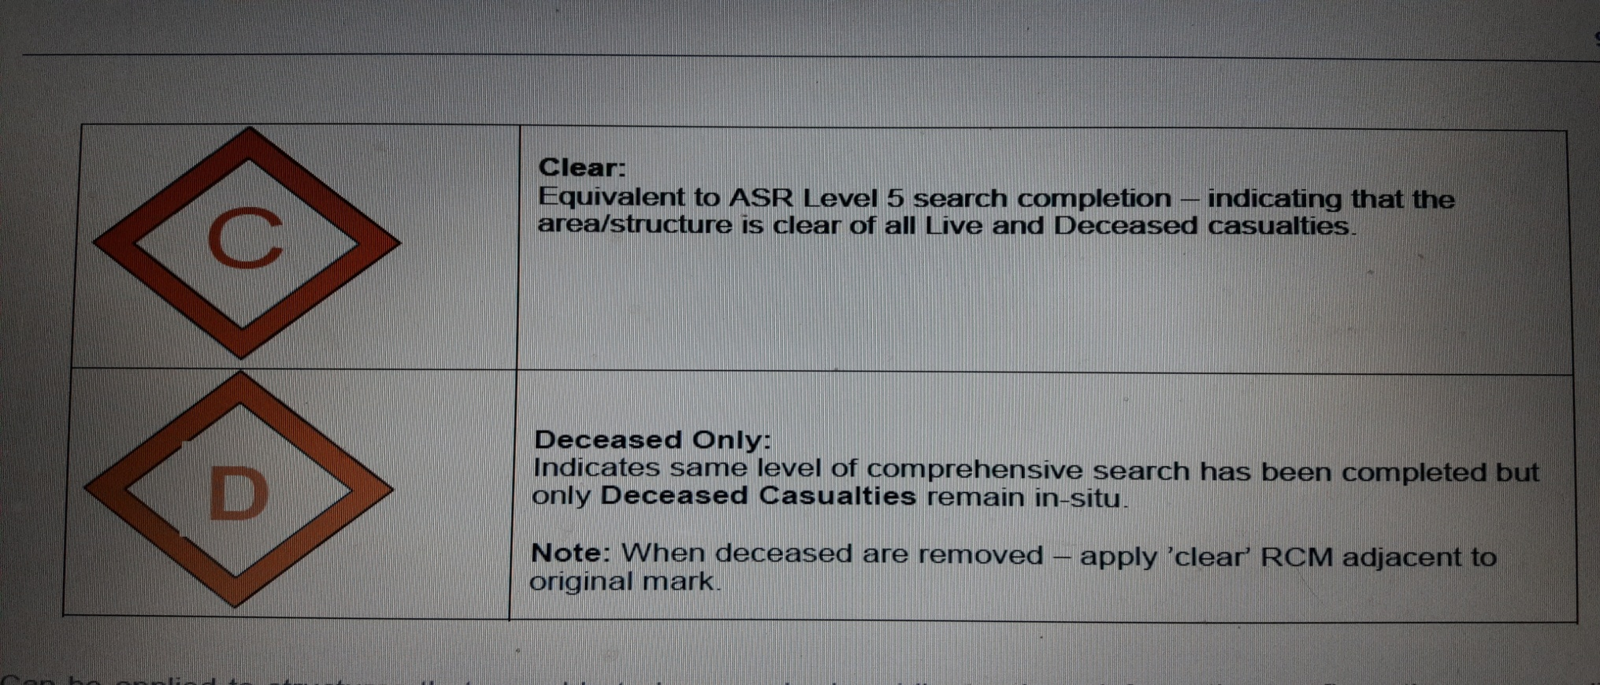
RAPID CLEARANCE MARKING
Structural Triage and the INSARAG Marking System

Slide 39
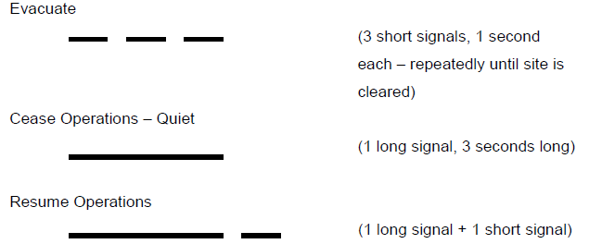
INSARAG GUIDELINES SIGNALLING
emergency signalling 🡪 should be universal for all USAR member🡪 INSARAG!
all USAR team members have to be briefed
signals must be clear and concise
USAR teams have to respond immediately to all emergency signals
use air horns or other appropriate hailing devices
Structural Triage and the INSARAG Marking System
Notes:
Stand TT.MM.JJ
Bezeichnung des Anlasses mit Datum bzw Geschäft / Vorhaben
DEEPAK BAMORIYA
39
1

Slide 40
DIFFERENT COLOURS CAN BE USED ON SITUATION MAPS IN ORDER TO MARK INSTALLATIONS, DANGERS, OPERATIONAL ACTIVITIES OR DEPLOYED UNITS OR FORMATIONS .
Possible meaning of the colours :
Black Colour: Damages, work sites / LEMA, national, regional or local disaster relief units or installations (fire fighters, civil defense, military forces, civil protection etc.)
RED COLOUR: Fire, explosions / International usar team
BLUE COLOUR: Un organizations : rdc, osocc etc. / international ngos
GREEN COLOUR: BOO, other logistical installations(fuel, drinking water etc)
YELLOW COLOUR: Chemical, nuclear dangers etc. (white colour)
Structural Triage and the INSARAG Marking System
Notes:
Lesson 4: Structural Triage and the INSARAG Marking System
Rev. Oct. 2002
40
DEEPAK BAMORIYA

Slide 41
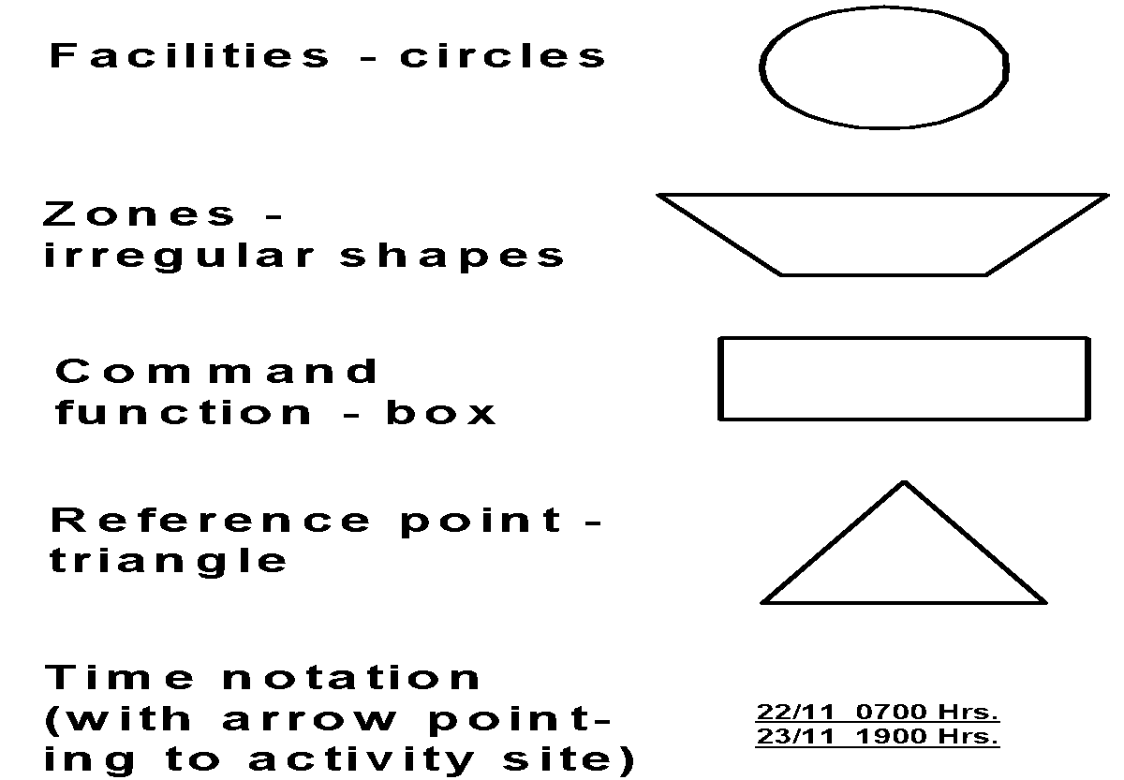
STANDARD SYMBOL SHAPES
Structural Triage and the INSARAG Marking System

Slide 42
REVIEW
After Completion of this lesson, you are able to:
1. Describe Sectorization, its identification and five
ASR levels.
2. List four categories of Worksite Triage.
3. List at least eight factors to consider in Worksite Triage.
4. Define the INSARAG Marking System, list and describe
the eight categories of INSARAG Marking System.
Structural Triage and the INSARAG Marking System

Slide 43

ANYQUESTIONS ?

Slide 44
EVALUATION
Q1) INSARAG stands for?
Ans___________

Slide 45


THANK YOU

