Slide 1
STORAGE OF DEAD BODIES
Presented by:- Pavan Dev Gaur, 2IC

Slide 2
OBJECTIVES
Upon completion of this lesson you will be able to know :-
Storage overview
Refrigeration
Temporary Burial
ICE and Dry Ice,
Upon completing this lesson, you will become familiar with:

Slide 3
Whichever storage option is used, each body or body part should be kept in a body bag or wrapped in a sheet before storage.
Waterproof labels (e.g., paper in sealed plastic) with a unique identification number should be used (see Box 6.1 in Chapter 6, Identification of Dead Bodies). Do not write identification numbers on bodies or body bags/sheets as they are erased easily during storage.
STORAGE OVERVIEW

Slide 4
REFRIGERATION
Refrigeration between 2°C and 4°C is the best option.
Refrigerated transport containers used by commercial shipping companies can be used to store up to 50 bodies.
Enough containers are seldom available at the disaster site and alternative storage options should be used until refrigeration becomes available

Slide 5
TEMPORARY BURIAL
Temporary burial provides a good option for immediate storage where no other method is available, or where longer term temporary storage is needed.
Temperature underground is lower than at the surface, thereby providing natural refrigeration.
Temporary burial sites should be constructed in the following way to help ensure future location and recovery of bodies:

Slide 6
- Use individual burials for a small number of bodies and trench burial for larger numbers.
- Burial should be 1.5m deep and at least 200m from drinking water sources.
- Leave 0.4m between bodies.
- Lay bodies in one layer only (not on top of each other).
- Clearly mark each body and mark their positions at ground level.

Slide 7
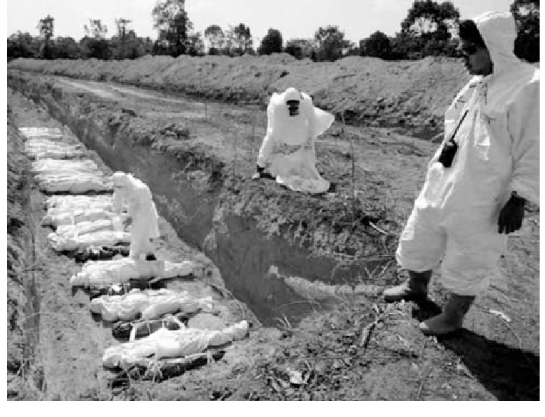
Temporary burial of dead bodies in Thailand following the tsunami disaster on 26 December 2004.

Slide 8
DRY ICE
Dry ice [carbon dioxide (CO2) frozen at -78.5°C] may be suitable for short-term storage.
✴ Dry ice should not be placed on top of the bodies, even when wrapped, because it damages the body.
✴ Build a low wall of dry ice (i.e., 0.5m high) around groups of about 20 bodies and cover with a plastic sheet, tarpaulin, or tent.
✴ About 10 kg of dry ice per body, per day is needed, depending on outside temperature.

Slide 9
✴ Dry ice must be handled carefully as it causes “cold burns” if touched without proper gloves.
✴ When dry ice melts it produces carbon dioxide gas, which is toxic. Closed rooms or buildings should be avoided when using dry ice in preference to areas with good natural ventilation.
DRY ICE

Slide 10
ICE
The use of ice (frozen water) should be avoided where possible because:
✴ In hot climates ice melts quickly and large quantities are needed.
✴ Melting ice produces large quantities of dirty waste water that may cause concern about diarrheal disease. Disposal of this waste water creates additional management issues.
✴ The water may damage bodies and personal belongings (e.g., identity cards).

Slide 11
REVIEW
Upon completion of this lesson you will be able to know:-
Storage overview
Storage Options
Long term storage and disposal of dead bodies
Method of storage and disposal of dead bodies.
Upon completing of this lesson, you are able to learn about :-

Slide 12

Any question ?

Slide 13


THANK YOU

