Slide 1
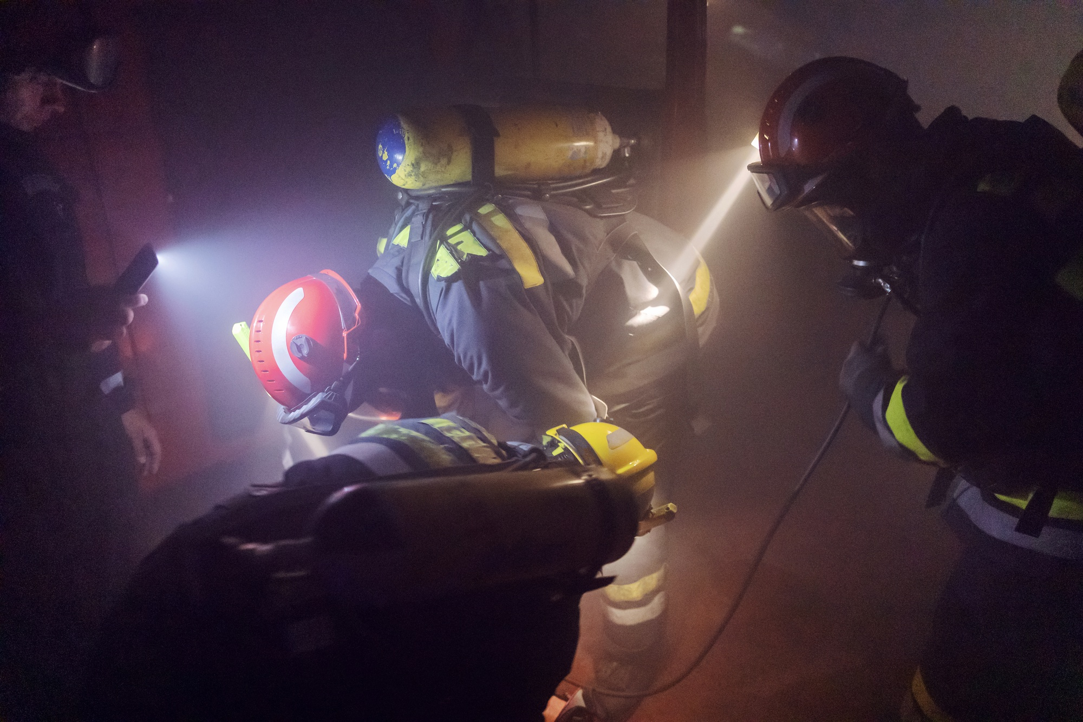




COLLAPSED STRUCTURE SEARCH AND RESCUE
LESSON 1
COURSE INTRODUCTION
LESSON 3
Construction Materials,
Structures and
Damage Types
LESSON 3
Construction Materials,
Structures and
Damage Types
LESSON 3
Structural Triage and
INSARAG Marking System
Presented By:- Sachin Chauhan,2IC
NDRF | CSSR | INDIA
PPT 4-1

Slide 2
OBJECTIVES
1
Define Sectorization, its identification and five ASR Levels.
List four categories of Worksite Triage.
List at least 8 factors to consider in worksite triage.
Upon completing this lesson, you will be able to:
2
3
NDRF | CSSR | INDIA
PPT 4 -

Slide 3
OBJECTIVES
4
Define the INSARAG marking system, list and describe 8 categories of INSARAG Marking System
Upon completing this lesson, you will be able to:
NDRF | CSSR | INDIA
PPT 4 -

Slide 4
Sectorization
In case of large scale events, effecting large area or numerous cities, or even more than one country, Sectorization is done to allow effective co-ordination of Search and Rescue efforts for better operational planning and effective deployment of search and rescue teams.
NDRF | CSSR | INDIA
PPT 4 -

Slide 5
Sector
identification
A simple lettering system is used to code each sector, like A, B, C, D and so on and a local name or description can also be added to ensure clarity.
e.g. sector A, Kashmir etc.
NDRF | CSSR | INDIA
PPT 4 -

Slide 6
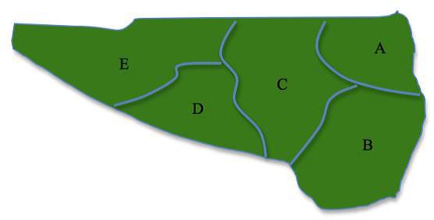
Sector
identification
NDRF | CSSR | INDIA
PPT 4 -

Slide 7
Worksite Triage
Triage categories | Expected duration of operation | Expected duration of operation
A | Confirmed live victims | Less than 12 hours
B | Confirmed live victims | Longer than 12 hours
C | Possible live victims | Not assessed
D | Deceased only | Not assessed
NDRF | CSSR | INDIA
PPT 4 -

Slide 8
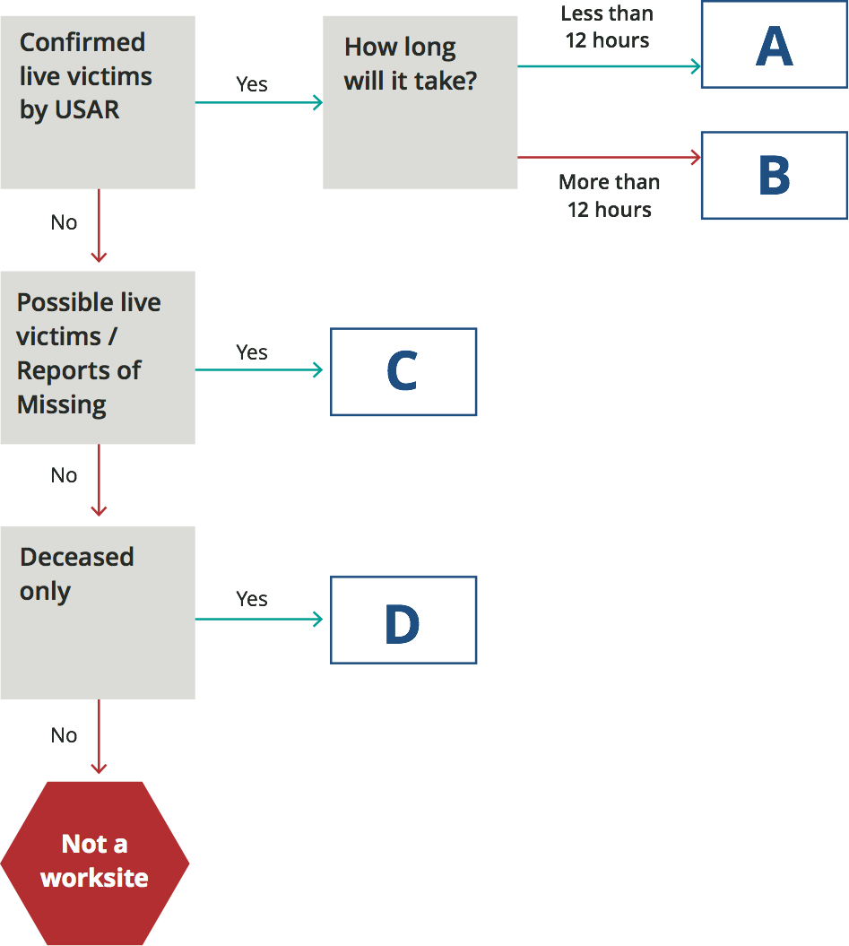
Sector Assessment
worksite Triage Category Flowchart
NDRF | CSSR | INDIA
PPT 4 -

Slide 9
Factors in Worksite Triage
Occupancy type
Type of structure
Condition of the structure
Mechanism of collapse
Day, date, and time of collapse
NDRF | CSSR | INDIA
PPT 4 -

Slide 10
Factors in Worksite Triage
(Cont.)
Prior intelligence
Availability of resources
Possible presence of hazardous materials
Location of utility shut-offs
NDRF | CSSR | INDIA
PPT 4 -

Slide 11
The International Search and Rescue Advisory Group (INSARAG) Marking System uses symbols to identify the condition of structures, the presence of hazards and the status of victims in a standardized, simple and clear fashion that can be understood by all local, national and international rescue personnel.
The INSARAG Marking System consists of three principle Marking elements, these being:
Worksite Marking
Victim Marking
Rapid Clearance Marking
INSARAG Marking System
NDRF | CSSR | INDIA
PPT 4 -

Slide 12
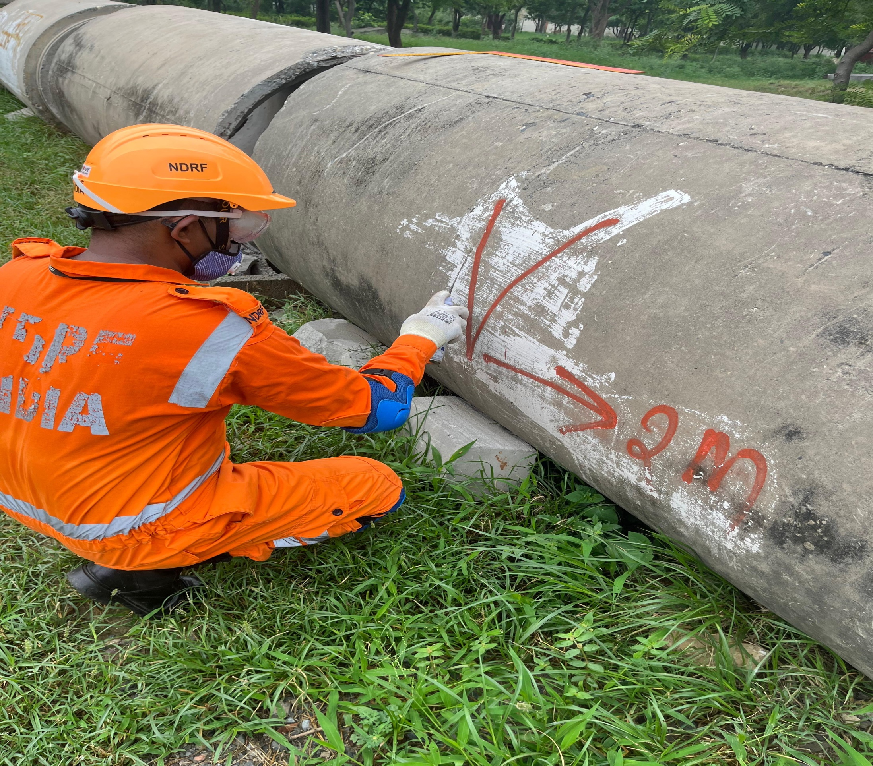
Clear Markings
All markings must be conspicuous and made using a high contrast, durable, fluorescent colour.
NDRF | CSSR | INDIA
PPT 4 -

Slide 13
Marking System Information Categories
1
General Area Marking
Structure Orientation
Cordon Markings
Worksite Marking
2
3
4
NDRF | CSSR | INDIA
PPT 4 -

Slide 14
Marking System Information Categories (Cont.)
5
Victim Marking
Rapid Clearance Marking (RCM)
Facilities and Vehicle Markings
Team and Function Markings
6
7
8
NDRF | CSSR | INDIA
PPT 4 -

Slide 15
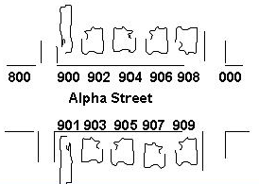
General Area Marking
Street & Number Identification
NDRF | CSSR | INDIA
PPT 4 -

Slide 16
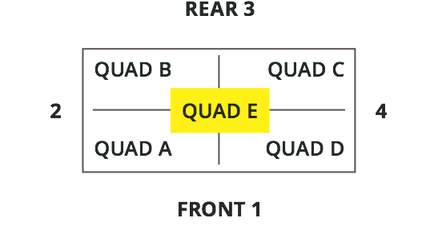
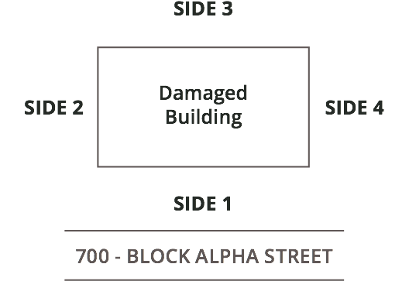
Location References — Exterior and Interior
NDRF | CSSR | INDIA
PPT 4 -

Slide 17
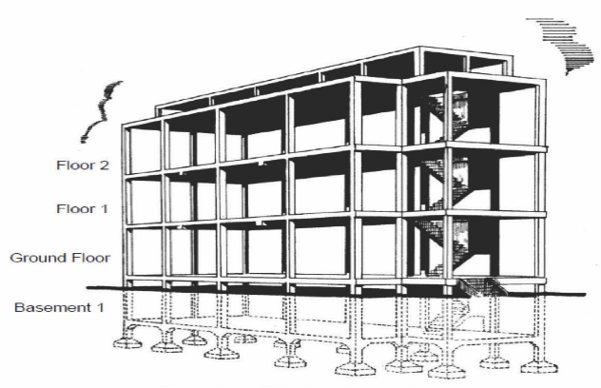
Identifying Floors
NDRF | CSSR | INDIA
PPT 4 -

Slide 18
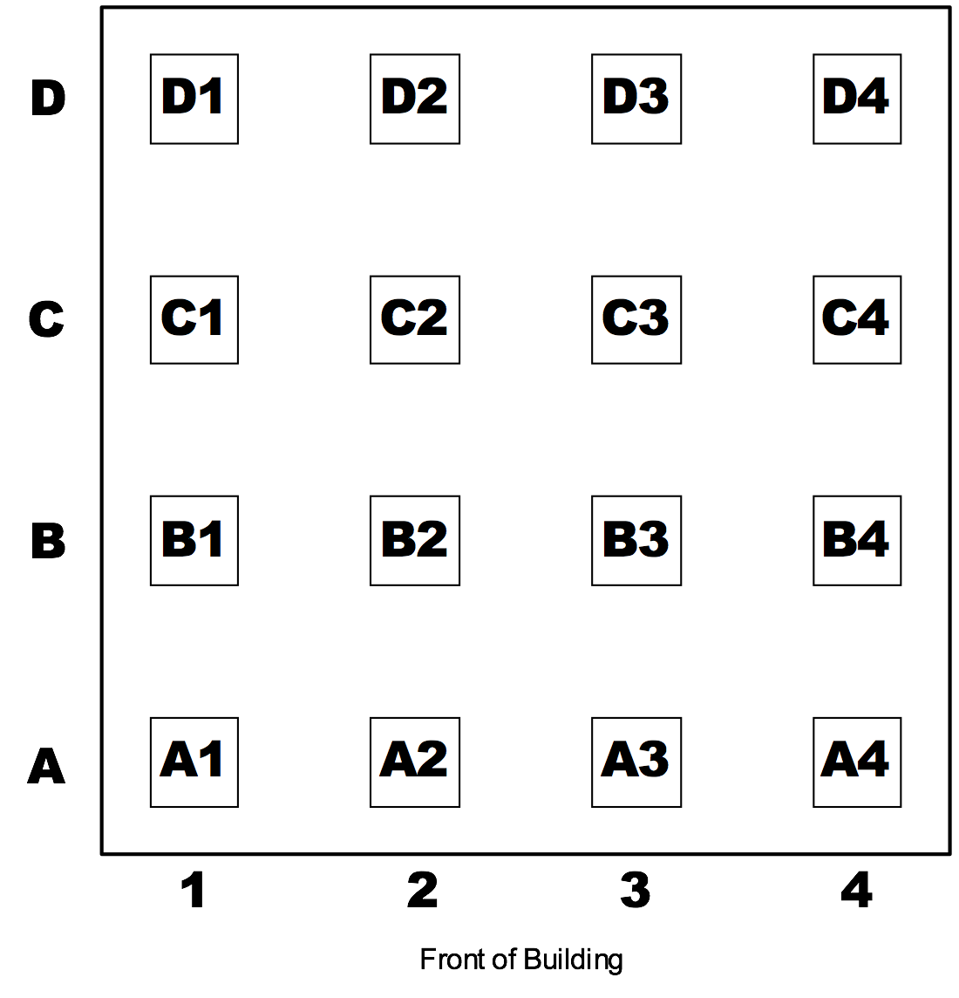
Identifying Columns/ Pillars
NDRF | CSSR | INDIA
PPT 4 -

Slide 19
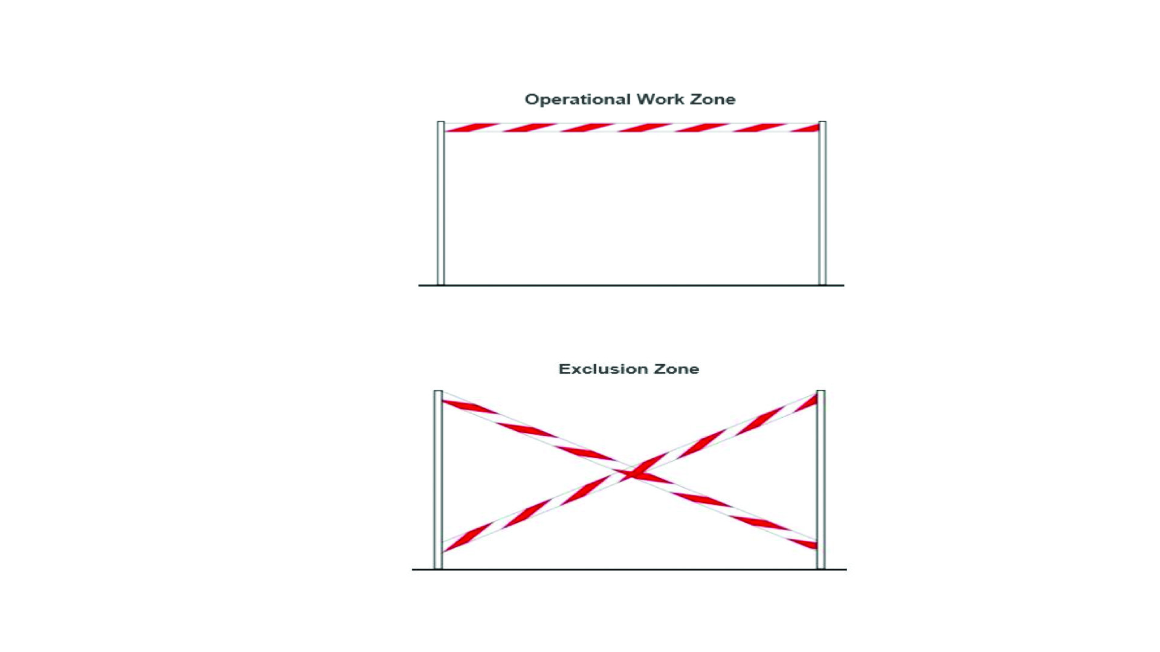
Operations Work Zone
NDRF | CSSR | INDIA
PPT 4 -

Slide 20
Collapse / Hazard Zone
NDRF | CSSR | INDIA
PPT 4 -

Slide 21
1 M
Place the mark at
the primary access point into the structure.
1.2 M
NDRF | CSSR | INDIA
PPT 4 -

Slide 22
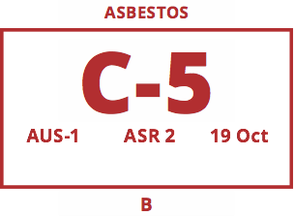
Marking Format
NDRF | CSSR | INDIA
PPT 4 -

Slide 23
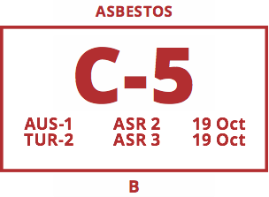
Sample Marking:
“Work in Progress”
NDRF | CSSR | INDIA
PPT 4 -

Slide 24
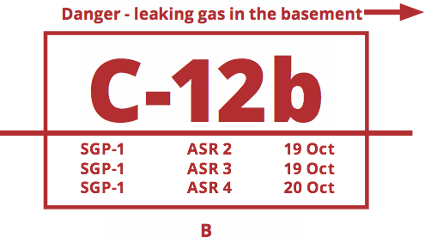
Sample Marking:
“Work Completed”
NDRF | CSSR | INDIA
PPT 4 -

Slide 25
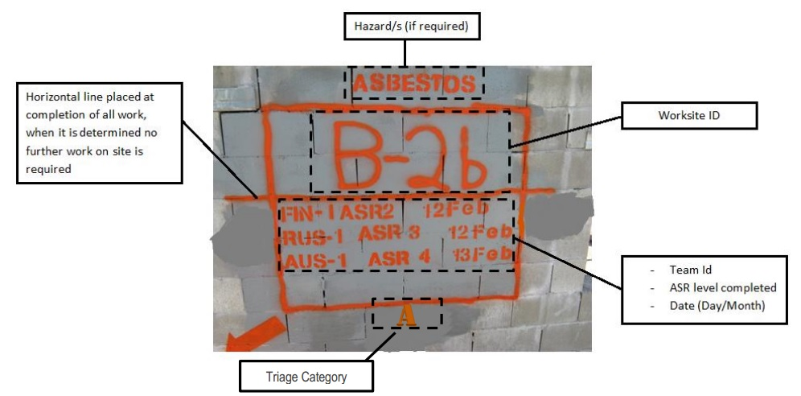
Sample Marking:
“Work Completed”
NDRF | CSSR | INDIA
PPT 4 -

Slide 26

Potential Victim Location
Draw a large “V” as close as possible to the location of known or potential victim(s).
NDRF | CSSR | INDIA
PPT 4 -

Slide 27
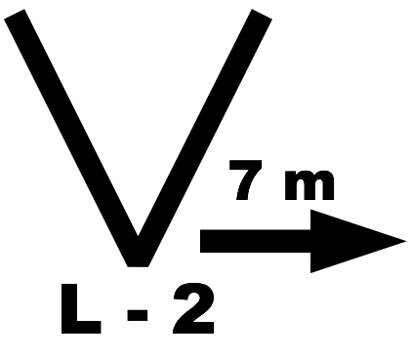
Confirmed
Live Victims
NDRF | CSSR | INDIA
PPT 4 -

Slide 28
Update of Victims
NDRF | CSSR | INDIA
PPT 4 -

Slide 29
Extricated
All Victims
NDRF | CSSR | INDIA
PPT 4 -

Slide 30


Rapid Clearance Marking (RCM)
Clear
Deceased
NDRF | CSSR | INDIA
PPT 4 -

Slide 31
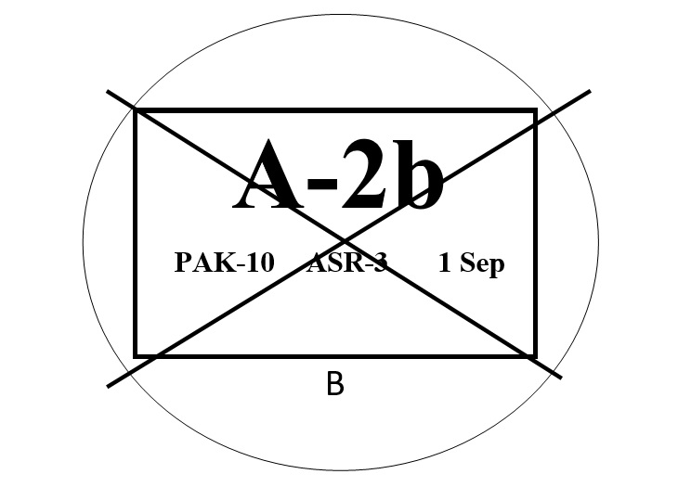
Table Top Exercise
NDRF | CSSR | INDIA
PPT 4 -

Slide 32
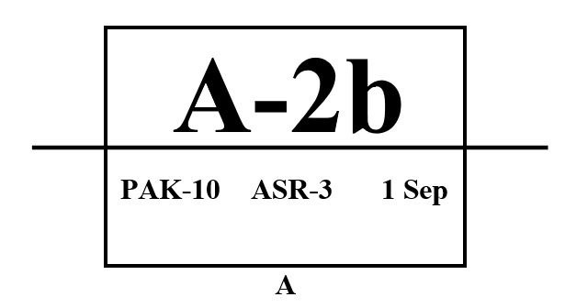
Table Top Exercise
NDRF | CSSR | INDIA
PPT 4 -

Slide 33


THANK YOU

