Slide 1
DISPOSAL / LONG TERM STORAGE OF DEAD BODIES
Presented by:- Pavan Dev Gaur, 2IC

Slide 2
OBJECTIVES
Upon completion of this lesson you will be able to know:-
Storage overview
Storage Options
Long term storage and disposal of dead bodies
Method of storage and disposal of dead bodies.
Upon completing this lesson, you will become familiar with:

Slide 3
STORAGE OVERVIEW
Without cold storage decomposition advances rapidly.
Within 12 to 48 hours in hot climates, decomposition will be too advanced to allow facial recognition.
Cold storage slows the rate of decomposition and preserves the body for identification.

Slide 4
Whichever storage option is used, each body or body part should be kept in a body bag or wrapped in a sheet before storage.
Waterproof labels (e.g., paper in sealed plastic) with a unique identification number should be used (see Box 6.1 in Chapter 6, Identification of Dead Bodies). Do not write identification numbers on bodies or body bags/sheets as they are erased easily during storage.
STORAGE OVERVIEW

Slide 5
REFRIGERATION
Refrigeration between 2°C and 4°C is the best option.
Refrigerated transport containers used by commercial shipping companies can be used to store up to 50 bodies.
Enough containers are seldom available at the disaster site and alternative storage options should be used until refrigeration becomes available

Slide 6
TEMPORARY BURIAL
Temporary burial provides a good option for immediate storage where no other method is available, or where longer term temporary storage is needed.
Temperature underground is lower than at the surface, thereby providing natural refrigeration.
Temporary burial sites should be constructed in the following way to help ensure future location and recovery of bodies:

Slide 7
- Use individual burials for a small number of bodies and trench burial for larger numbers.
- Burial should be 1.5m deep and at least 200m from drinking water sources.
- Leave 0.4m between bodies.
- Lay bodies in one layer only (not on top of each other).
- Clearly mark each body and mark their positions at ground level.

Slide 8
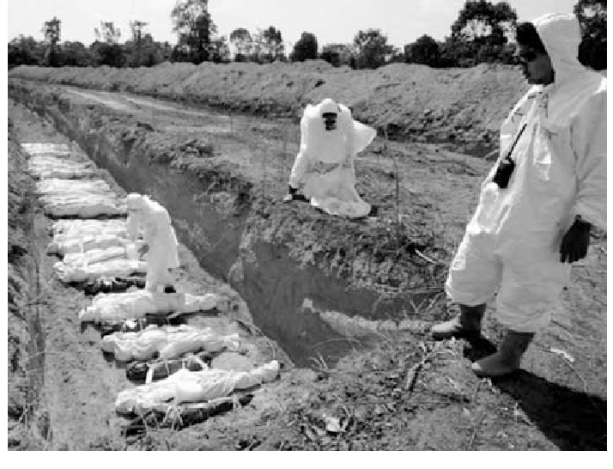
Temporary burial of dead bodies in Thailand following the tsunami disaster on 26 December 2004.

Slide 9
DRY ICE
Dry ice [carbon dioxide (CO2) frozen at -78.5°C] may be suitable for short-term storage.
✴ Dry ice should not be placed on top of the bodies, even when wrapped, because it damages the body.
✴ Build a low wall of dry ice (i.e., 0.5m high) around groups of about 20 bodies and cover with a plastic sheet, tarpaulin, or tent.
✴ About 10 kg of dry ice per body, per day is needed, depending on outside temperature.

Slide 10
✴ Dry ice must be handled carefully as it causes “cold burns” if touched without proper gloves.
✴ When dry ice melts it produces carbon dioxide gas, which is toxic. Closed rooms or buildings should be avoided when using dry ice in preference to areas with good natural ventilation.
DRY ICE

Slide 11
ICE
The use of ice (frozen water) should be avoided where possible because:
✴ In hot climates ice melts quickly and large quantities are needed.
✴ Melting ice produces large quantities of dirty waste water that may cause concern about diarrheal disease. Disposal of this waste water creates additional management issues.
✴ The water may damage bodies and personal belongings (e.g., identity cards).

Slide 12
LONG-TERMSTORAGE AND DISPOSAL OF DEAD BODIES
All identified dead bodies should be released to relatives or their communities for disposal according to local custom and practice.
Long-term storage will be required for remaining unidentified bodies.

Slide 13
Method of disposal / Long-term storage
Burial is the most practical method as it preserves evidence for future forensic investigation, if required.
Cremation of unidentified bodes should be avoided for several reasons:-
✴ Cremation will destroy evidence for any future identification.
✴ Large amounts of fuel are needed (usually wood). ✴ Achieving complete incineration is difficult, often resulting in partially incinerated remains that have to be buried.
✴ It is logistically difficult to arrange for the cremation of a large number of dead bodies

Slide 14
LOCATION OF BURIAL SITES
Careful thought must be given to the location of any burial site.
Soil conditions, highest water table level, and available space must be considered.
The site should be acceptable to communities living near the burial site.
The site should be close enough for the affected community to visit.
The burial site should be clearly marked and surrounded by a buffer zone that is at least 10m wide to allow planting of deep-rooted vegetation and to separate the site from inhabited areas

Slide 15
DISTANCE FROM WATER SOURCES
Burial sites should be at least 200m away from water sources such as streams, lakes, springs, waterfalls, beaches, and the shoreline.
Suggested burial distance from drinking-water wells are provided in the following table. Distances may have to be increased based on local topography and soil conditions

Slide 16
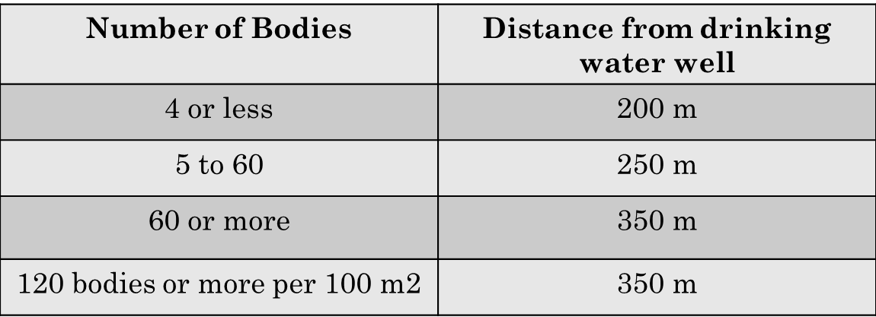
Recommended distance of graves from drinking water wells

Slide 17
GRAVE CONSTRUCTION
If possible, human remains should be buried in clearly marked, individual graves.
For very large disasters, communal graves may be unavoidable.
Prevailing religious practices may indicate preference for the orientation of the bodies (i.e., heads facing east, or toward Mecca, etc.)
Communal graves should consist of a trench holding a single row of bodies each placed parallel to the other, 0.4m apart.
Each body must be buried with its unique reference number on a waterproof label. This number must be clearly marked at ground level and mapped for future reference.

Slide 18
GRAVE CONSTRUCTION
Although there are no standard recommendations for grave depth, it is suggested that:-
✴ Graves should be between 1.5m and 3m deep.
✴ Graves with fewer than five people should allow for at least 1.2m (1.5m if the burials are in sand) between the bottom of the grave and the water table, or any level to which ground water rises.
✴ For communal graves there should be at least 2m between the bottom of the grave and water table, or any level to which groundwater rises.
✴ These distances may have to be increased depending on soil conditions.

Slide 19
REVIEW
Upon completion of this lesson you will be able to know:-
Storage overview
Storage Options
Long term storage and disposal of dead bodies
Method of storage and disposal of dead bodies.
Upon completing of this lesson, you are able to learn about :-

Slide 20

Any question ?

Slide 21


THANK YOU

