Slide 1
PSYCHOSOCIAL, LEGAL ASPECTS AND BODY RECOVERY
Presented by:- Pavan Dev Gaur, 2IC

Slide 2
OBJECTIVES
1. Describe legal aspects of Deceased management.
2.Describe policy, plan and guidelines for Deceased management.
3. Provisions for deceased management at district level.
Upon completing this lesson, you will become familiar with:

Slide 3
INTRODUCTION
India due to its unique geo-climatic conditions has been experiencing natural disasters like earthquakes, tsunamis, cyclones, floods, droughts and landslides and man-made disasters like chemical, biological, radiological and nuclear emergencies.
These disasters usually leave a trail of human agony, including loss of human life and injuries, Emotional trauma, loss of livestock, property and livelihood, resulting in long-term psychosocial and mental health problems.
Apart from logistic and material help, the affected community requires Psycho-Social Support and Mental Health Services(PSSMHS).

Slide 4
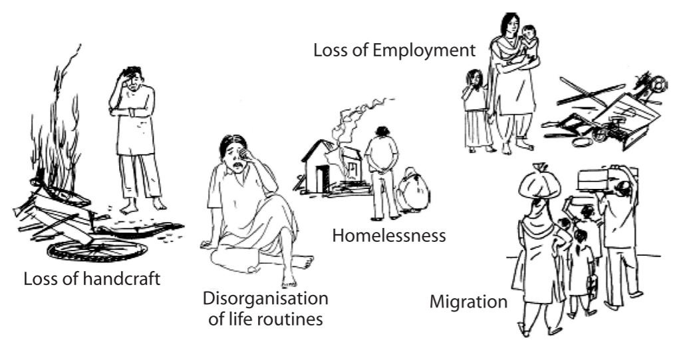
Disaster-affected people experience various psychological reactions. These reactions immediately follow the event while socio-economic impacts like lack of employment; homelessness, environmental destruction and disorganization emerge as a consequence, following the devastation caused by the disaster.

Slide 5
1. Shock
2. Denial
3. Numbness
4. Fear
5. Anger
Common emotional reactions and behavioral responses after disasters
6. Crying
7. Apathy
8. Disorientation
9. Flashbacks and Nightmares
10. Anxiety
11. Worrying

Slide 6
12. Helplessness
13. Feeling Sad
14. Withdrawal
15. Frustration
16. Negativity
17. Inability to Think
18. Sleeplessness
19. Leaving the Place
20. Apprehensive about Future
21. Remembering / Praying to God
22. Participating in Rescue / Relief Work
23. Feeling of Brotherhood

Slide 7
Community is the first responder in the event of any disaster and plays an important role in response and rehabilitation and provision of PSSMHS to the survivors of disaster. A large number of community level workers (CLWs) participate as important team members for providing psycho-social support to the community. To standardize and streamline community participation in PSSMHS the following things are important
Community Participation

Slide 8
i) Training the community, especially CLWs, will enhance the reach of PSSMHS to the community and there is a need to sustain them in all the phases of disaster and for all hazards. These community level workers must be utilized in all phases of disasters especially in preparedness phases to create awareness and information dissemination among the community.

Slide 9
ii) Civil Defence personnel, Panchayati Raj functionaries, local non-government and community-based organizations and civil society will be involved in preparedness, mitigation, response and rehabilitation.
iii) They understand the local culture and customs better than the outsiders. Therefore, it is essential to associate them in strengthening awareness, and resilience of the society. They can be involved in activities like street plays, dramas, posters, distribution of reading material, school exhibitions and interaction with media and publicity.

Slide 10
iv) Standardized training and intervention modules shall be prepared by the nodal institutions for training community level workers so that services provided by them are uniform throughout the ccountry.
v) For promoting group work in the community, there is a need to inculcate the belief that a majority of the problems in the community are common, needing collective response.
This will result in better community relationship and harmony for collective response to non-disaster related community problems, likely to become an appropriate context for community response in a disaster situation.

Slide 11
Community level workers help the community in the following ways:-
Helping survivors understand the changes.
ii) Helping in one undergoes due to traumatic experiences and losses.
iii) Emotional support by establishing a good rapport.
iv) To strengthen and improve the quality of response by the response teams.
Role of Community Level Workers

Slide 12
v) To define the immediate impact of the disasters and provide immediate psycho-social support especially when there may be lot of panic, fear and apprehension.
vi) To understand and identify local hazards, vulnerability and risks of different communities.
vii) To rehabilitate and help in recovery by training them for follow-up and referralprogrammes, designed for psycho-social support interventions for various types of disasters.

Slide 13
Exacerbation of pre-existing (pre-disaster) social problems (e.g. extreme poverty, belonging to a group that is discriminated against or marginalized).
Social problems (e.g. family separation; disruption of social network; destruction of the community structure; resources and trust; unemployed, homelessness, increased gender-based violence).
3. Humanitarian aid induced social problems.
Psycho-social consequences

Slide 14
1. Exacerbation of pre-existing problems (e.g. severe mental disorder; alcohol abuse).
2. Disaster induced problems (e.g. grief, non-pathological distress, depression and anxiety disorders, like post-traumatic stress disorder (PTSD).
3. Humanitarian aid related problems (e.g. anxiety due to lack of information about food distribution). It should be noted that mental health and psycho-social problems in disasters encompass far more than the experience of PTSD.
Mental health consequences

Slide 15
SOCIAL ISSUES
Displacement of the individual
Unemployment
Change in marital status
Single parent families
Orphans
Disruption in the social fabric
Breakdown of the traditional forms of SS

Slide 16
LIVELIHOOD ISSUES
Loss of boats, catamarans
Fishing nets
Sand upheaval near shores
Destruction of allied micro livelihood
Loss of tourism kiosks
Small time trades in the sea shores
Inundation of sea water into the farming lands

Slide 17
DISASTER LIFESTYLE CHANGES
Worse change in lifestyle subsequent to a disaster
Cigarette smoking
Consuming alcohol
Eating
Sleeping hours
Working hours
Physical exercise
Nutrition
Mental stress

Slide 18
SINGLE PARENT CHILDREN
ORPHAN CHILDREN
Children who have lost either one of their parents, find it difficult to accept the loss of the parent.
They should be encouraged to speak about their loss and reassured with support from the remaining parent and siblings.
It is important that such children remain with immediate family members who can look after them.
A secure and non-threatening environment can provide a space where they can explore their grief, come to terms with their loss and begin to relate to their new surroundings.

Slide 19

PSC - SPECTRUM OF CARE
Reconstruction initiatives need to integrate psycho social care as an essential part of the overall care and rehabilitation.
Those who receive a spectrum of care would have less emotional reactions, better functionality and quality of life.
Psychosocial
Education
Nutrition
Health
Care
Housing
Livelihood
Compen
-sation
INDIVIDUAL
Self Help

Slide 20
COMMUNITY LEVEL HELPERS ROLE
Can lead to
DISTRESS
AND
DISABILITY
DISASTER
ROLE OF COMMUNITY LEVEL HELPER
Help the people understand the changes that they experience in their body and mind by
Ventilation
Active listening
Empathy
Decrease the physical and emotional effects by
Relaxation
Externalization of
interests
Lifestyle choices
Social Support
Health Care
Spirituality
Support and rebuild their shattered lives through
Help with housing
Assistance for
compensation
Paralegal aid
Educational help
Employment
All the above three lead to:
ADJUSTMENT AND MASTERY OVER
EMOTIONAL DISTRESS

Slide 21
COMMUNITY LEVEL HELPERS ROLE
Can lead to
DISTRESS
AND
DISABILITY
DISASTER
ROLE OF COMMUNITY LEVEL HELPER
Help the people understand the changes that they experience in their body and mind by
Ventilation
Active listening
Empathy
Decrease the physical and emotional effects by
Relaxation
Externalization of
interests
Lifestyle choices
Social Support
Health Care
Spirituality
Support and rebuild their shattered lives through
Help with housing
Assistance for
compensation
Paralegal aid
Educational help
Employment
All the above three lead to:
ADJUSTMENT AND MASTERY OVER
EMOTIONAL DISTRESS

Slide 22
MEDIUMS USEFUL FOR PSC AMONG CHILDREN
Children can be aided in recovery through the use of various mediums suiting their age group,
Drawing
Story telling
play
modeling
Games
Worksheets
Puppetry

Slide 23
MEDIUMS USEFUL FOR PSC AMONG ADULTS
Listening
Ventilation
Empathy
Externalization
Spirituality
Social Support
Relaxation

Slide 24
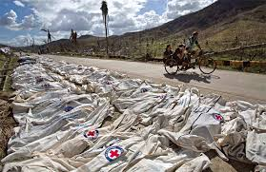
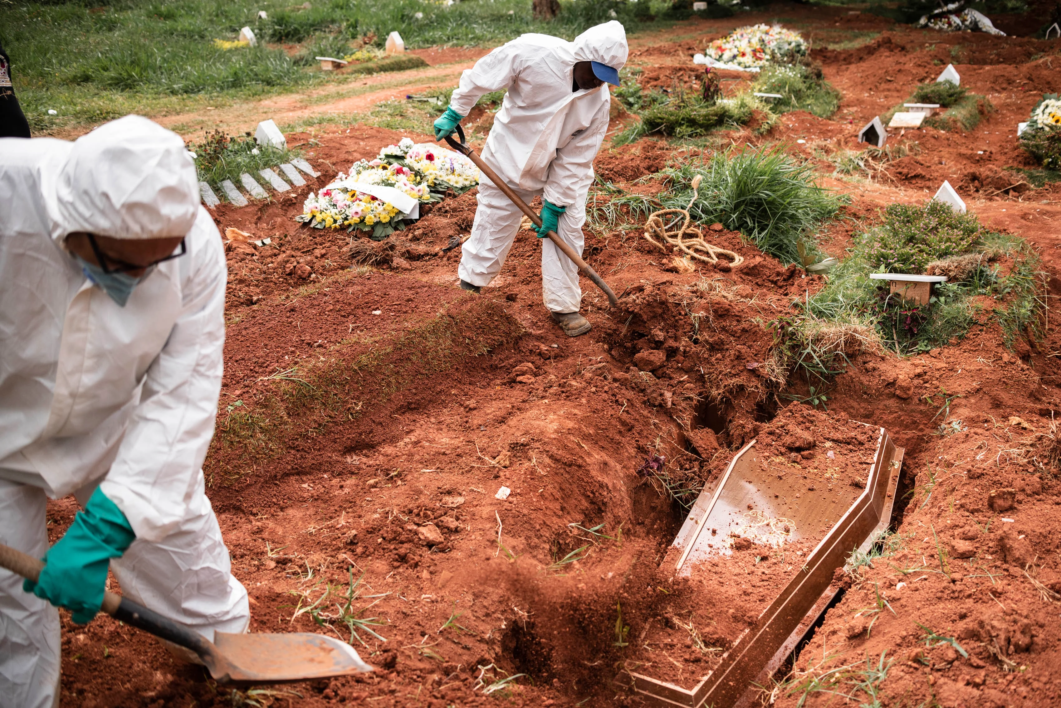
Legal Aspects

Slide 25
DM ACT-2005
Section 34 (g) chapter iv (DDMA) of the DM act, 2005, states that, for the purpose of assisting, protecting or providing relief to the community, in response to any threatening disaster situation or disaster, the disaster authority may make arrangements for disposal of the unclaimed dead bodies.
The NDMA has decided to issue guidelines which will culminate into proper planning for management of the dead at all levels.

Slide 26
DM ACT-2005
Section 53 of the DM Act, 2005, which makes theft of the belongings of, or misappropriation of the relief material for, disaster victims, punishable with imprisonment and fine.
Section 54 of the DM Act, 2005, states that, to curtail distress and anxiety caused by rumors in the community, penal provisions can be imposed to deal with such situations.

Slide 27
Protection of Personal and Genetic Data
A fair amount of personal data is gathered while dealing with management of the dead, especially during the process of identification where personal data is collected and biological samples including Deoxyribonucleic Acid (DNA) profile may be required for analysis, before final disposal.

Slide 28
Genetic data obtained through DNA analysis can also be used in the person's identification.
Therefore, genetic data obtained through DNA profiling is to be handled carefully and confidentially, thus ensuring the right to privacy as per the International principles.
Protection of Personal and Genetic Data

Slide 29
Protection of Personal and Genetic Data
However, International law does not have any specific provisions on the protection of genetic data but it relates to general principles on confidentiality, privacy, non-discrimination and human dignity. Notwithstanding the same, at the National level, the proposed Human DNA Profiling Bill would address the various aspects relating to confidentiality of, and access to, DNA profiles, biological samples and records.

Slide 30
INTERNATIONAL LEGAL PRINCIPLES
United Nations Educational, Scientific and Cultural Organization (UNESCO), in October 2003, finalized the text of the International Declaration on Human Genetic Data.
As of year 2009, this Declaration and UNESCO's earlier Universal Declaration on the Human Genome and Human Rights (1997) were the only international declarations that addressed the issue of protecting genetic data.

Slide 31
INTERNATIONAL LEGAL PRINCIPLES
The 2003 Declaration emphasizes that any practice involving the collection, processing, use and storage of human genetic data should be consistent with both domestic legislation and international human rights law.
The International Committee of the Red Cross (ICRC) has compiled a list of Legal Principles, relating to the protection of personal and genetic data, to be respected in all circumstances which have been developed, keeping international agreements and recommendations together with national legislations.

Slide 32
Institutional and Policy Framework
National Policy on Disaster Management
National Policy on Disaster Management (2009) at Para 5.2.9 stresses the need for creating adequate mortuary facilities in disaster prone areas.
The Policy also accords due weightage to proper and speedy disposal of dead bodies and animal carcasses.
Therefore, it is essential to lay down Guidelines for management of the dead, including animal carcasses in disaster situations.

Slide 33
Role of International Org
International Committee of the Red Cross
The ICRC, an impartial, neutral and independent humanitarian organization is playing an important role in the training of first responders involved in management of the dead bodies after disasters.
A number of courses have been conducted by them internationally and in our country for National Disaster Response Force (NDRF).
Due to its expertise, exhibited around the world, the ICRC has been approached to render advice on procedures and guidelines related to disaster management issues.

Slide 34
POLICY AND PLANS
Before the enactment of Disaster Management Act, 2005, policy, plans or guidelines for management of the dead in the aftermath of disasters were not available in our country.
Based on the National Policy on Disaster Management and the Disaster Management Act, 2005, it is essential to prepare National Guidelines on Management of the Dead in the aftermath of Disasters.

Slide 35
POLICY AND PLANS
On the basis of these National Guidelines, the Plans and Standard Operating Procedures (SOPs) will be prepared at various levels, on priority basis, for recovery, retrieval, identification and other components related to management of the dead.

Slide 36
COMMAND,CONTROL AND COORDINATION
Under the control of District Authorities, there is a need to establish a coordination mechanism for management of the dead.
The National Guidelines on Incident Response System directs the appointment of a nodal officer viz. Dead Body Management Group-in-charge in the Response Branch of Operations Section who will coordinate with all the stakeholders involved in streamlining proper management of dead bodies.

Slide 37
DISPOSAL OF DEAD BODIES AT
DISTRICT LEVEL
Activate the DM Plan.
Activate Search and Rescue teams of Fire & Emergency Services, Police, SDRF, Civil Defence, NDRF and NGOs for the retrieval of the injured and the dead.
Associate relatives and community members for the identification of the bodies.

Slide 38
Hand over the identified bodies to the relatives or the community, and if necessary after cross-matching Dead Body Identification Form with that of the Missing Person Form, for the last rites as per local, cultural and religious denomination.
Unidentified or unclaimed dead bodies/body parts shall be transported to the mortuaries for proper preservation and storage at the designated sites.
DISPOSAL OF DEAD BODIES AT
DISTRICT LEVEL

Slide 39
DISPOSAL OF DEAD BODIES AT
DISTRICT LEVEL
Consult relatives, legal and forensic experts for positive identification.
Final disposal of unidentified bodies/body parts shall be done by District authorities after applying all the possible means of identification as per the legal provisions.

Slide 40
REVIEW
1. Describe legal aspects of Deceased management.
2.Describe policy, plan and guidelines for Deceased management.
3. Provisions for deceased management at district level.
Upon completing of this lesson, you are able to learn about :-

Slide 41

Any question ?

Slide 42
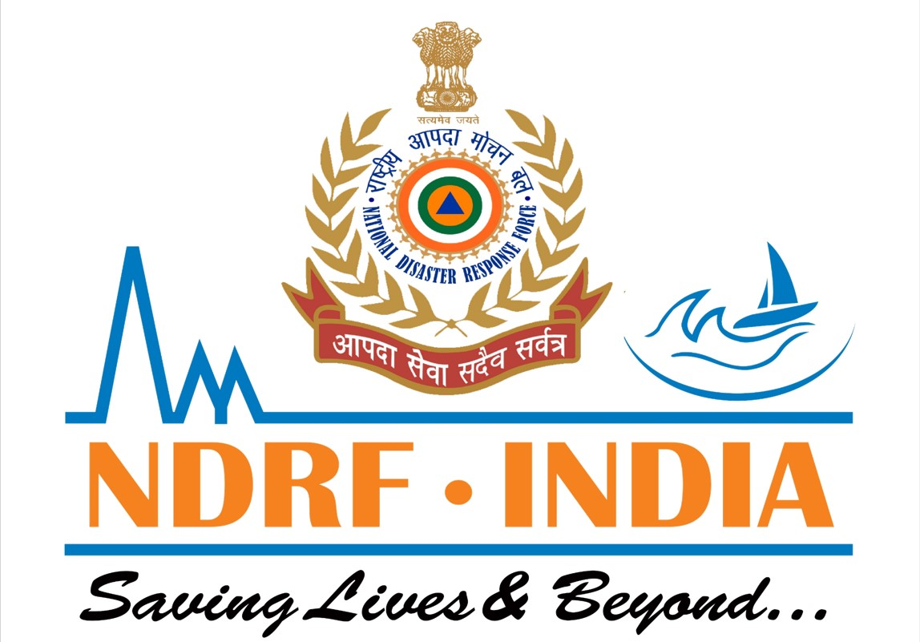

THANK YOU

