Slide 1



TRAIN ACCIDENT & EVACUATION DRILL
Presented By:- Sachin Chauhan,2IC

Slide 2
OBJECTIVES
Upon completion of this lecture, you will be able to: -
List characteristics of railway accidents.
Describe SAR during train accidents.
Organize rescue in train disaster.
Important points.

Slide 3
INTRODUCTION
A railway disaster is a serious train accident or an untoward event of grave nature occurring due to natural or man-made causes, that may lead to loss of many lives and/or grievous injuries to a large number of people, and/or severe disruption of traffic, necessitating a need of large scale of help from other govt/non-govt and private organizations.

Slide 4
FIRST RESPONDERS
Instant Action Team – Loco-Pilot / Assistant Loco-Pilot, Guard & other on-board staff
Volunteers from Surrounding areas
Nearest Engineering Gang, Station Masters
Other Departmental Officials
DM TEAM – Nominated officials from various Departments arriving at site by ARMVs and ARTs form part of the DM Team.

Slide 5
CAUSES OF TRAIN DISASTER
HUMAN/EQUIPMENT FAILURE:
Collisions
Derailment
Accidents at level Xg
Fire/explosion
NATURAL CALAMITY
Landslide
Storms/Cyclones
Earthquakes
Floods
SABOTAGE
Setting trains to fire
Bombing
Obstruction on tracks
Tampering with railway fittings

Slide 6
CHARACTERISTICS
Usually happens unexpectedly, without any warning.
Result in fatalities/injuries.
Attracts lot of media attention.
Causes psychological problems for the survivors, rescuers and families.

Slide 7
CONSEQUENCES
SHOCK STAGE: Victims are stunned, dazed and apathetic.
SUGGESTIBLE STAGE: Victims tend to be passive and willing to take directions from rescue workers.
RECOVERY STAGE:
Spontaneous reaction of men available on the train.
Rescue and relief work by men and material available locally.
Longest phase consists of meticulously planned efforts by DM teams.

Slide 8
SAR DURING ACCIDENTS
Common rescue functions are to:
Access, support and remove trapped victims.
Assist in evacuating the dead.
Provide support to other services, authorities or specialist team.
Planning:
List types of entrapment.
List types of releases.
Define a structure of search & rescue team.
List out the duties of team members.

Slide 9
PRINCIPLES
Rescue will occur in phases.
Each phase must be completed before beginning of the next phase.
Method to use: SAVER
S: Systematic
A: Approach to
V: Victim
E: Entrapment
R: Rescue

Slide 10
ENTRAPMENTS TYPES
MECHANICAL ENTRAPMENT: The train compartment/coach is blocked up or damaged in such a manner that the occupants are unable to normally exit the compartment.
PHYSICAL ENTRAPMENT:
Type-I: The occupants are injured in such a manner that additional space is required for providing relief/rescue and removal of the casualty.
Type-II: The casualty is pinned by the wreckage either by encasement or by impalement.

Slide 11
RELEASE TYPES
CONTROLLED RELEASE: Due to stable condition of the casualty, time can be taken for disentanglement providing appropriate care and extrication is possible.
IMMEDIATE RELEASE:
The condition of the casualty deteriorates and is life-threatening.
Requirement of advanced life support.
Presence of danger.

Slide 12
ORGANIZING FESCUE
RESCUE TEAM:
Team leader
Technical rescuer(s)
Safety officer
Medical assistant
General assistant
WORK AREA:
Selection of appropriate work area
Emergency vehicles safe parking
Tool & equipment staging area
Area for dumping unwanted material
Fire prevention

Slide 13
DUTIES OF TEAM LEADER
To be easily recognized by all by distinctive clothing.
To conduct reconnaissance of accident scene.
To direct proceedings.
To liaise with other units.
Ensure safety of site with assistance of Safety officer.
To supervise the access and extrication.

Slide 14
TASKS
TECHNICAL RESCUER
Stabilization
Gaining access
Disentanglement
GENERAL ASSISTANT
Assembles equipment for use.
Attends “Lever” on hydraulic rescue equipment
Attends all material, if necessary
Acts as a Logistic co-ordinator.

Slide 15
RESCUE PLAN
Reconnaissance
Appreciation process
Consider the Factors
Evaluation of plan

Slide 16
RESCUE PLAN: RECONNAISSANCE
Preferably by Team Leader.
Exploit all sources to obtain information.
Number & location of casualties.
Extent and type of damage.
Dangerous situations & material.
Access to the casualties.
Available resources, (personnel and equipment).
Tentative time it will take to complete the task with available resources.

Slide 17
RESCUE PLAN: APPRECIATION
Appreciation process is a simple method of problem solving.
It involves the logical assessment of the situation, which includes-
Definition of the problem
Stating Aim
Factors
Planning

Slide 18
RESCUE PLAN: FACTORS
Factors are points relevant to the problem:
No & loc of casualties
Time and space
Topography
Weather
Support requirements and availability
Communications and logistics
Priority of tasks

Slide 19
RESCUE PLAN: PLAN EVALUATION
Plan must be simple.
Plan must relate directly to the aim.
Plan will result from the choice of best solution.
It will be the solution with “max advantages” and “least disadvantages”.

Slide 20
SAFETY
BASIC PRECAUTIONS:
Carefully check equipment on a regular basis.
Adherence to the use of standard techniques.
Follow safety limits.
PROTECTIVE CLOTHING & SAFETY
PPE
Safety boots in accordance with the laid down procedure/ system.
CASUALTY SAFETY
Use of proper techniques and Equipment.
Use proper route for extrication and transportation.

Slide 21
SAFETY
EQUIPMENT SAFETY:
Direct the cutting blades away from casualty.
Use of blades, fuel, oil, hydraulic fluids and parts which are recommended by the manufacturer.
Never refuel petrol driven motors while they are hot.
Carry out safety checks before and after use on a regular basis.
CORRECT LIFTING TECHNIQUES
Follow basis principles of Lifting and moving.
Position your feet properly.
Keep your back as straight as possible while lifting.
Grip the load correctly and start the lift by thrust of the legs.
Use reverse of Lifting technique while Lowering the load.

Slide 22
SEARCH & EXTRICATION METHODS
Procedure for penetrating.
Evaluating access conditions.
Approaching a located trapped victim.
Extrication.

Slide 23
If a coach is involved , the emergency exits at the sides provide ambulatory occupants with a means of escape
Also provide good access for crews assigned to interior rescues
SEARCH & EXTRICATION METHODS

Slide 24
A large portion of the passenger area is made up of window, if all the exits blocked, then remove:
* window glass
* window rebar
Interior procedures used to free victims after access has been gained by breaching door/window or opening of roof
SEARCH & EXTRICATION METHODS

Slide 25
Careful inspection of the components responsible for victims entanglement provide a basis for selection of TEA and procedures
Opening exits, or simply cutting a roof may open up enough space for removing victims immobilized on backboard
SEARCH & EXTRICATION METHODS

Slide 26
APPROACH STRATEGIES
Once the search has ended and the trapped victim has been located, it is then necessary to make a decision on how to approach the victim.
Vertical Approach
Horizontal Approach

Slide 27
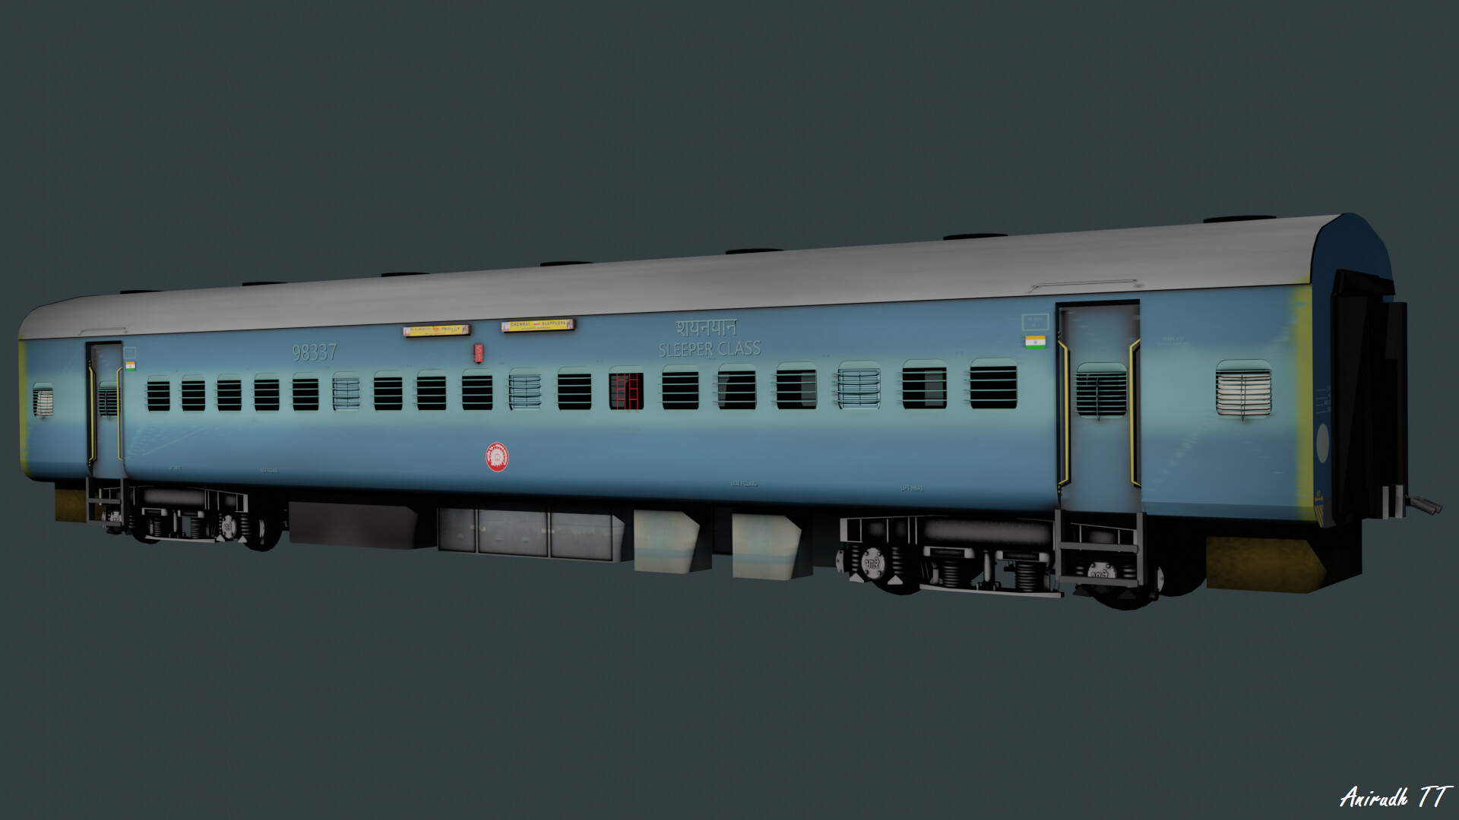

Slide 28
VERTICAL APPROACH
APPROACH STRATEGIES…
HORIZONTAL
APPROACH
Access into victim is made from either above or below.
Access into victim is made from either sides.

Slide 29
EVALUATING ACCESS CONDITONS
The following steps must be taken :
Ensure presence of any hazards
Proceed to victim location
Mitigate hazards, if any
Establish Safety Zones and Escape Routes
Secure your access area and remove rubble

Slide 30
PROCEDURES FOR CUTTING AND PENETRATING MATERIALS
Always be aware that a trapped victim may be in direct contact with the other side of the material.
Use extreme caution while cutting and penetrating to avoid accidentally injuring a trapped victim.

Slide 31
PROCEDURES FOR CUTTING AND PENETRATING MATERIALS…
Properly select a TEA for a task.
Must have good understanding of the capabilities and limitation of TEA.
Must always work within the capabilities of the TEA.

Slide 32
EVALUATING ACCESS CONt…
Check presence of hazards, mitigate hazards, if any.
Establish Safety Zones and Escape routes.
Secure your access and remove rubble.
Proceed to victim loc.
Non-AC coaches have 02 emergency exit windows on each side and AC coaches have 01 on each side.
In case of collision, generally end coaches are badly smashed.
Max no of Railway staff and extra volunteers from amongst passengers should be directed to GS coaches for forming of groups, and taking out critically injured passengers.

Slide 33
APPROACH STRATEGIES
VERTICAL APPROACH
Access to the victim is made from either above or below.
Mark a square hole large enough to permit access.
Make a small hole in the center of the piece.
Cut to marked sides of the square.
Then lift out the piece using the hole.
Take care of sharp edges.

Slide 34
APPROACH STRATEGIES
HORIZONTAL APPROACH
Access to the victim is made from either side.
Cut a rectangular access hole, large enough to permit access (70 cm all sides).
Remove the piece.
Take care of sharp edges.

Slide 35
IMP INSTRUCTIONS
Compile & analyze available info.
Secure the scene.
Inspect and evaluate the train and wreckage.
Rescue victims with easy access on or near the emergency window.
Select the portion of train to be searched.
Select approach method.
Create approach route and ensure safety while extrication.
Continually analyse the results and re-evaluate the search plan.
Initiate PHT.

Slide 36
GOLDEN HOUR
If a critical trauma patient is not given definite medical care within one hour from the time of accident, chances of his ultimate recovery reduce drastically, even with the best of medical attention thereafter. This initial one hour period is generally known as “The Golden Hour”.
THINGS TO DO:
Render definite medical care within Golden Hour.
Arrestbleedingandrestoreblood pressure within an hour.
Persons under shock shall immediately be relieved of shock.
Transport the casualties to the nearest hospital.

Slide 37
ACCIDENT RELIEF TRAIN
Speedy & Accurate information to the Concerned
Provision of Satellite Phone : Can work even in absence of Network
Provision of Laptop in ART

Slide 38
ANY QUESTION

Slide 39


THANK YOU

