Slide 1
IDENTIFICATION OF DEAD BODIES
Presented by:- Pavan Dev Gaur, 2IC

Slide 2
Upon completion of this lesson you will be able to know:-
Identification of dead bodies procedures.
Dead bodies identification form .
General principles
Key steps
Unique reference number.
OBJECTIVES
Upon completing this lesson, you will become familiar with:

Slide 3

If perfectly match
Information
from
individuals who
are missing
or presumed dead.
Information
from
the deceased

Slide 4
Mobilizing forensic resources may take several days. This means that early opportunities to help identify bodies may be lost as the bodies decompose.
Forensic
Identification
Notes:
Acquaintances _ Parichit

Slide 5
Visual recognition of cadavers should be complemented with forensic identification.
Visual
recognition
Notes:
मृतकों के परिचितों द्वारा कैडवर्स या उनकी तस्वीरों की दृश्य पहचान पहचान का सबसे सरल रूप है, लेकिन यह त्रुटियों से ग्रस्त है। इसलिए, जब भी संभव हो, इसे बाद के चरण में फोरेंसिक पहचान के अन्य साधनों के साथ पूरक किया जाना चाहिए।

Slide 6
Forensic Procedures
can be used after visual identification of bodies or photographs becomes impossible.
Autopsies Fingerprinting Dental examinations DNA

Slide 7

Success of future identifications by forensic specialists.
Early work of non-specialists in managing the dead
Notes:
The early work of non-specialists in managing the dead (especially proper recovery, documentation and storage methods) will determine much of the success of future identifications by forensic specialists.

Slide 8
Dead Bodies Identification Form
The Dead Bodies Identification Form can be used to collect basic and invaluable information that will aid later forensic identification procedures.
Notes:
मृत निकाय पहचान पत्र का उपयोग मूल और अमूल्य जानकारी एकत्र करने के लिए किया जा सकता है जो बाद में फोरेंसिक पहचान प्रक्रियाओं की सहायता करेगा

Slide 9
General Principles
Sooner is better for victim identification. Decomposed bodies are much more difficult to identify and require forensic expertise.
The key steps to identification are:
Unique reference number,
Label,
Photograph,
Record &
Secure.

Slide 10
General Principles
It should be appreciated that visual recognition, while simple, can result in mistaken identifications causing serious embarrassment, distress to the bereaved and legal difficulties. It is always preferable to ensure that accurate identification is achieved by evaluating a combination of criteria and not solely on visual recognition.
Injuries to the deceased, or the presence of blood, fluids, or dirt, especially around the head, will increase the chance of mistaken visual recognition.
Any separate body part which proves that a person is dead can aid in the identification and should therefore be managed as though it is a whole body

Slide 11
Key steps to identification
Unique reference number
Label
Photograph
Record
Secure

Slide 12
Unique Reference Number
Assign a sequential, unique reference number to each body or body part.
Reference numbers must not be duplicated.
Each body or body part must have a Unique Reference Number.
PLACE +RECOVERY TEAM/ PERSON + BODY COUNT

Slide 13
PLACE +RECOVERY TEAM/ PERSON + BODY COUNT
Unique Reference Number
For example:
Bibiwala Chowk – Team A - 001
or
Bibiwala Chowk – Abhishek Rawat - 001

Slide 14
PLACE: Indicate the place of recovery. If recovery place is unknown, use instead the place where the body was taken for identification/storage.
RECOVERY TEAM/PERSON
BODY COUNT: A sequential count of bodies at each site. Use list of sequential numbers.
Note: Other detail information such as where and when the body was found and the person/organization who found it should also be recorded on the Dead Bodies Identification Form.
Unique Reference Number

Slide 15
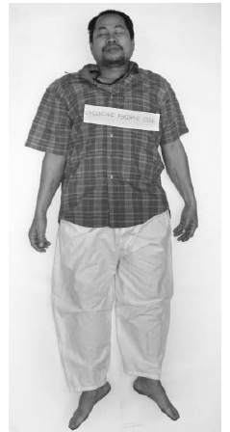
Label
7 NDRF – Team A- 001
Write the unique reference number on a waterproof label then securely attach it to the body or body part.

Slide 16
Label
A waterproof label with the same unique reference number must also be attached to the container for the body or body part (e.g., body bag, cover sheet or bag for the body part).

Slide 17
PHOTOGRAPH (mandatory – if photographic equipment is available)
Unique Reference Number must be visible in all photographs.
Use digital cameras for easier storage and distribution of photographs.
Clean the body sufficiently to allow facial features and clothing to be properly represented in the photographs.

Slide 18
A full length of the body, front view
Whole face
Any obvious distinguishing features
At least
Upper and lower part of the body
All clothing, personal effects, and
distinguishing features
If
circumstances
permit

Slide 19
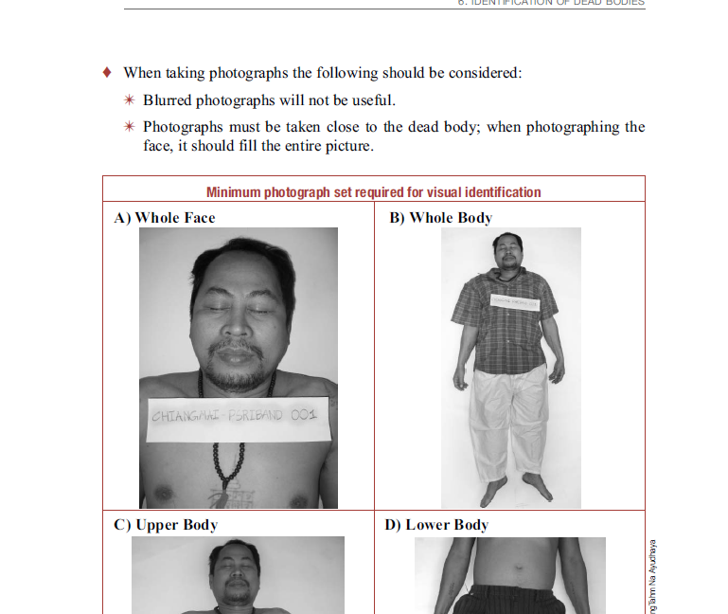
Minimum photograph set required for visual identification
A) Whole Face | B) Whole Body
7 NDRF – Team A- 001
7 NDRF – Team A- 001

Slide 20
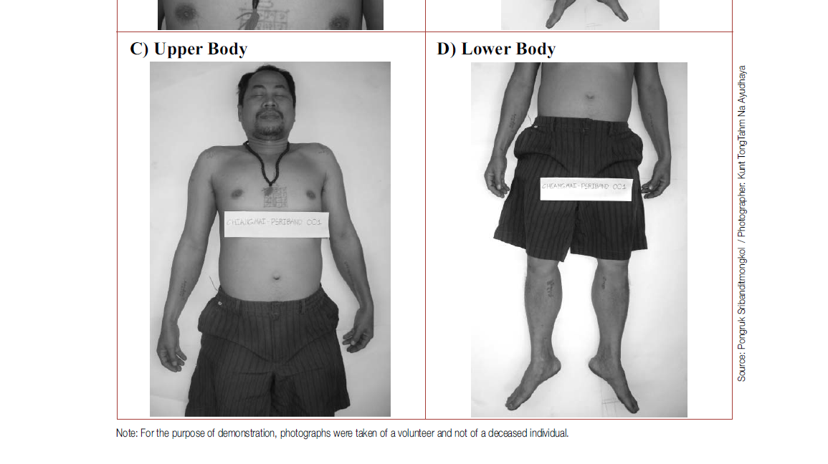
Minimum photograph set required for visual identification
C) Upper Body | D) Lower Body
7 NDRF – Team A- 001
7 NDRF – Team A- 001

Slide 21
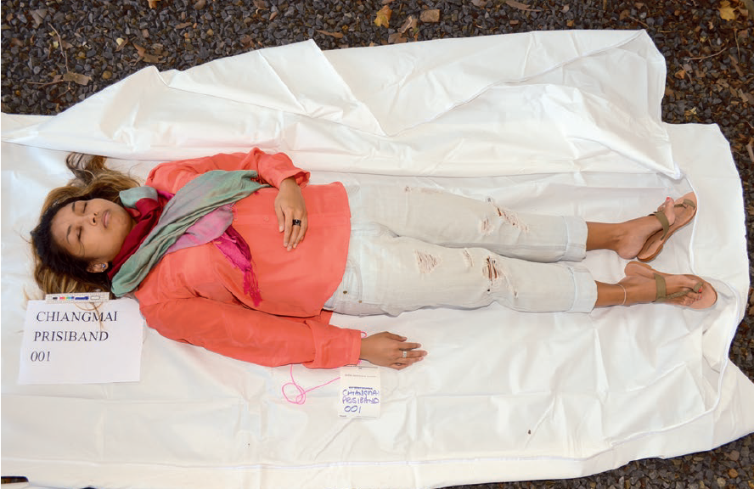
Full length of the body, front view

Slide 22
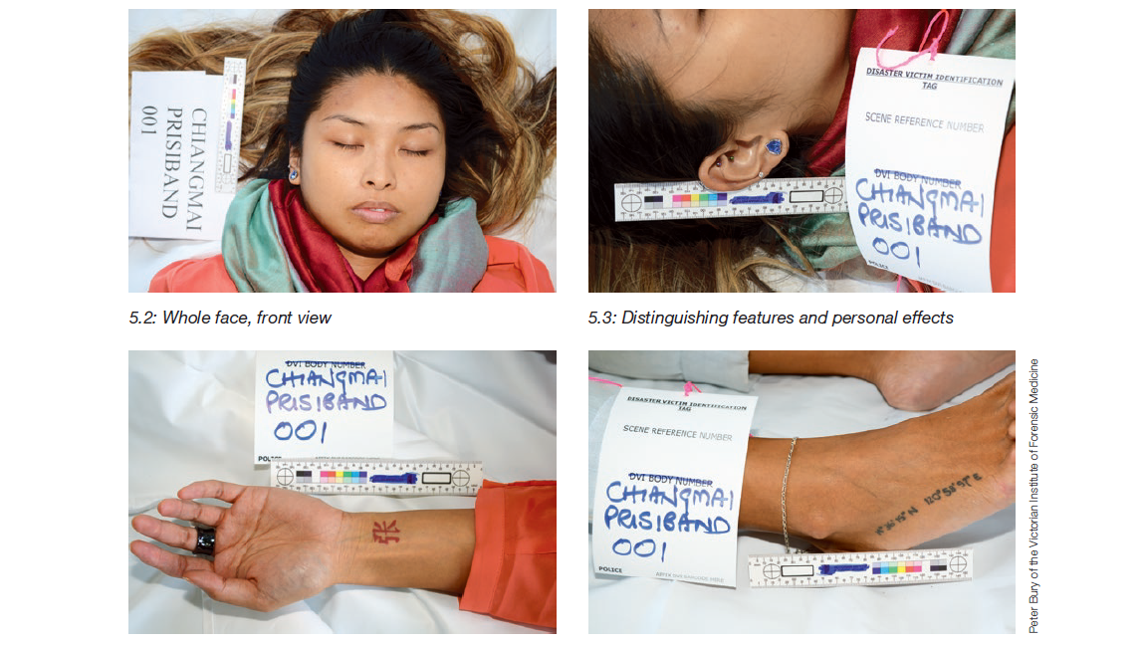
Whole face, front view
Photographs must be taken close to the dead body; when photographing the face, it should fill the entire picture.

Slide 23
Distinguishing features & Personal effects

Slide 24
Distinguishing features & Personal effects

Slide 25
Distinguishing features & Personal effects
Must include the visible unique reference number & Scale (to calculate the size of features in the photo).

Slide 26
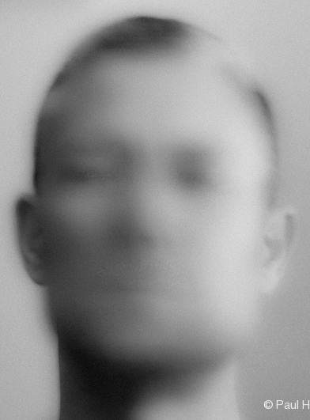
Blurred photographs will not be useful.

Slide 27
RECORD (Mandatory)
If photographs have been taken, fill following data in Dead Bodies Identification Form together with URN.
Gender
Approximate age range
Personal belongings
Obvious specific marks on the skin
Notes:
URN :- Unique reference Number, If photographs have been taken, record the following data together with the unique reference using the Dead Bodies Identification Form:
Gender (confirmed by looking at the genital organs).
Approximate age range (infant, child, adolescent, adult, or elderly).
Personal belongings (jewellery, clothes, identity card, driver’s license, etc.).
Obvious specific marks on the skin (e.g., tattoos, scars, birthmarks) or any obvious deformity.

Slide 28
RECORD (Mandatory)
If no photographs have been taken, also record:
Race.
Height.
Color and length of hair.
Color of eyes.

Slide 29
SECURE
Clothing should be left on the body.
Personal belongings should be securely packaged, labelled with the same unique
reference number, and stored with the body or body part. This is mandatory

Slide 30
Release of a body
A dead body should only be released when identification is certain.
Visual recognition should be confirmed by other information such as identification of clothing or personal effects.
Information collected about missing people can be used to cross-check visual recognition (Missing Persons Form).
A body should only be released by the responsible authority, which must also provide documentation of the release (a letter or death certificate).

Slide 31
Release of a body
Record the name and contact details of the person or relatives who claimed the body together with the body’s unique reference number.
Bodies that can not be recognized by visual means, should be properly stored (see Chapter 5, Storage of Dead Bodies) until forensic specialists can investigate.
Care should be taken before releasing bodies that are not whole, as this may complicate subsequent management of body parts.

Slide 32
REVIEW
Now you will be able to know:-
Identification of dead bodies procedures.
Dead bodies identification form .
General principles
Key steps
Unique reference number.
Upon completing of this lesson, you are able to learn about :-

Slide 33

Any question ?

Slide 34


THANK YOU

