Slide 1

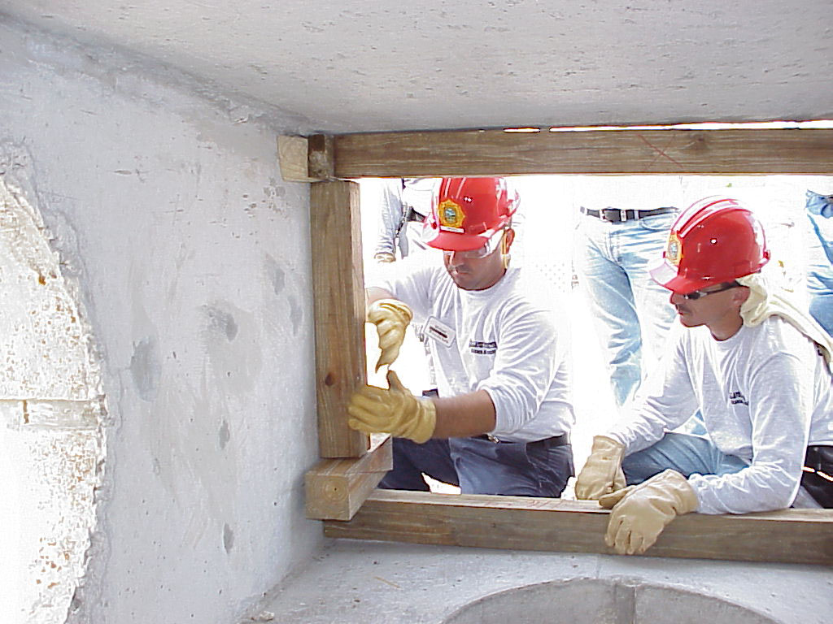






LESSON 9
Shoring Methods
Photo Credit: PEER South Asia/ADPC
Presented By:- Sohel Lakhani. DC
PPT 9 -
PEER | CSSR | INDIA
PPT 9 - 1

Slide 2
OBJECTIVES
Upon completing this lesson, you will be able to:
1
Define shoring and identify its components.
List the factors that determine
the design and method of shoring.
Describe four types of shoring.
2
3
PEER | CSSR | INDIA
PPT 9 -

Slide 3
OBJECTIVES
Upon completing this lesson, you will be able to:
4
List the positions and functions of
the members of a shoring team.
List the procedures for building
a window/door shore and a vertical shore. Demonstrate these procedures in a practical exercise.
5
PEER | CSSR | INDIA
PPT 9 -

Slide 4
Shoring
The temporary support of only that part of a damaged, collapsed, or partly collapsed structure that is required for conducting search and rescue operations at reduced risk to the victims and the rescue team.
PEER | CSSR | INDIA
PPT 9 -

Slide 5
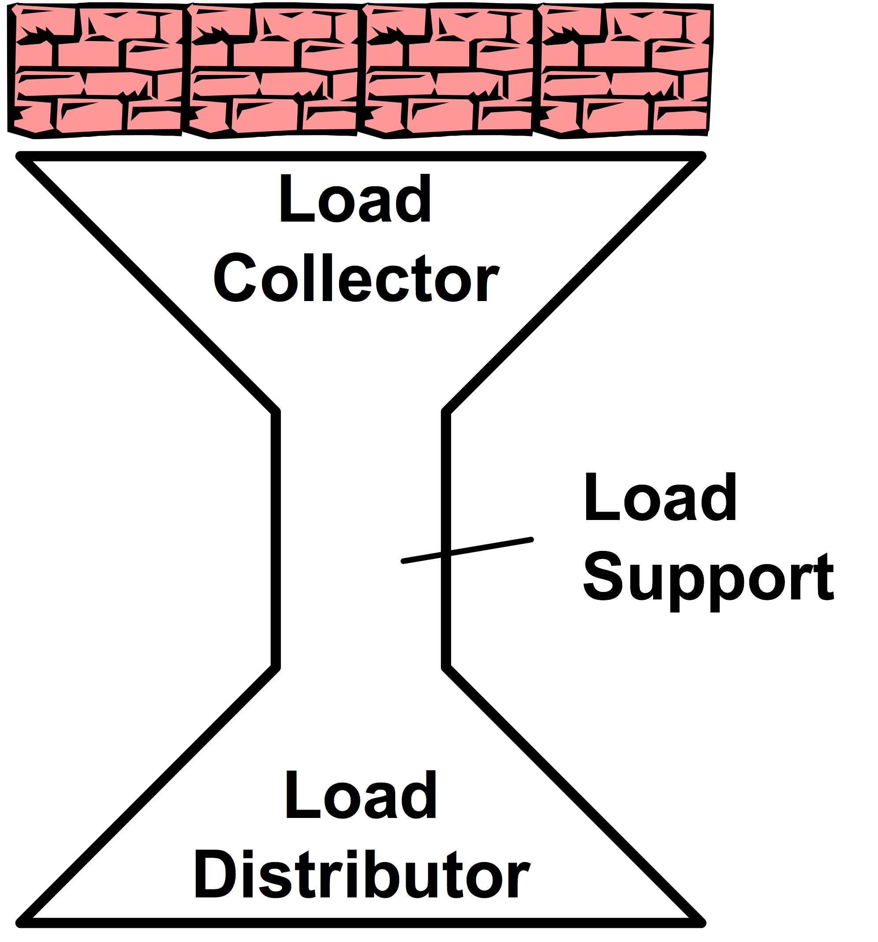
Double-Funnel Principle
PEER | CSSR | INDIA
PPT 9 -

Slide 6
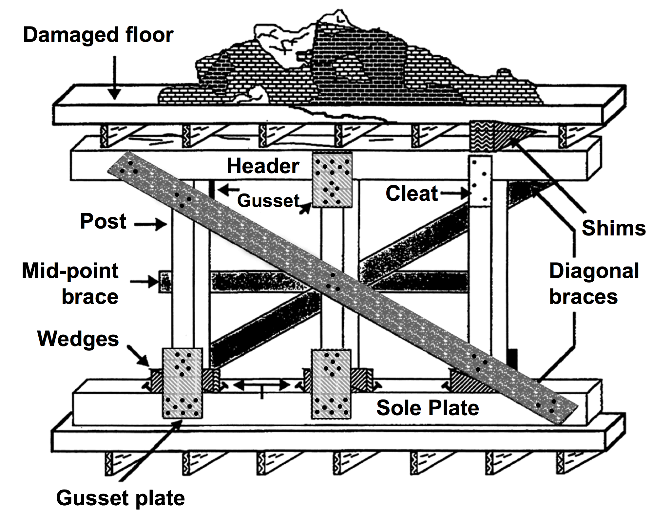
Shore Components
PEER | CSSR | INDIA
PPT 9 -

Slide 7
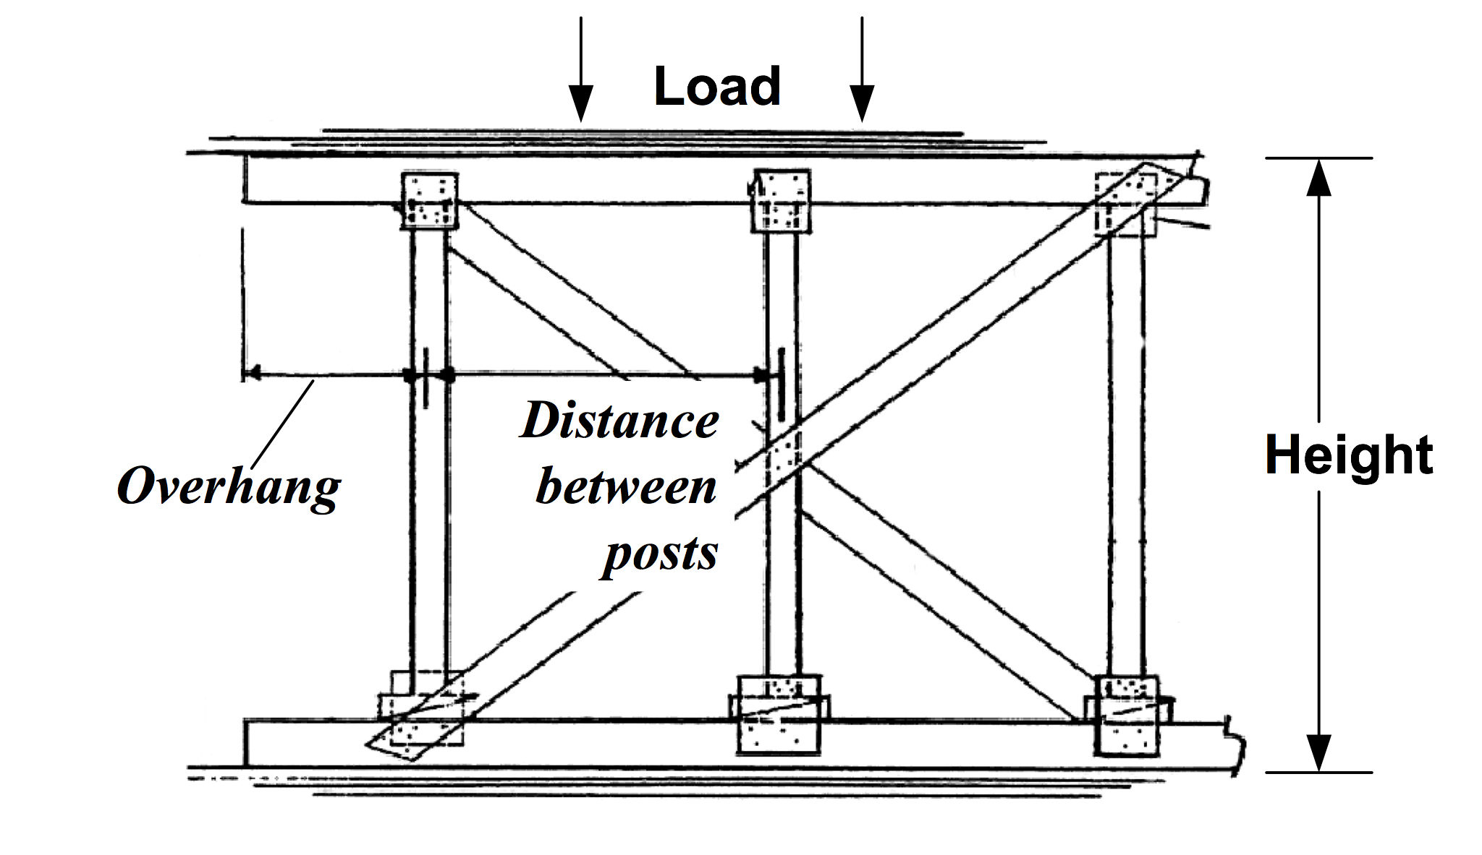
Determining Factors
PEER | CSSR | INDIA
PPT 9 -

Slide 8
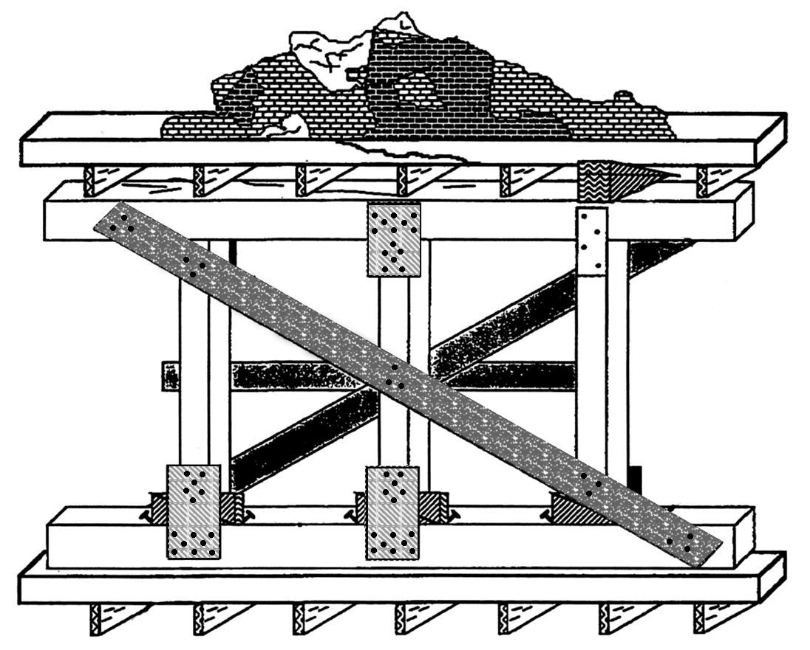
Vertical Shore
PEER | CSSR | INDIA
PPT 9 -

Slide 9
Vertical Shore Specifications
with 10 x 10 cm POST, HEADER and SOLE PLATE
Maximum Height | Maximum Distance Between Posts | Maximum Overhang | Load-bearing Capacity per Post
2.5 m (8’0”) | 1.25 (4’0”) | 60 cm (2’0”) | 3,600 kg (8,000 lbs.)
3.0 m (10’0”) | 1.50 (5’0”) | 80 cm (2’6”) | 2,270 kg (5,000 lbs.)
3.7 m (12’0”) | 1.80 (6’0”) | 90 cm (3’0”) | 1,600 kg (3,500 lbs.)
PEER | CSSR | INDIA
PPT 9 -

Slide 10
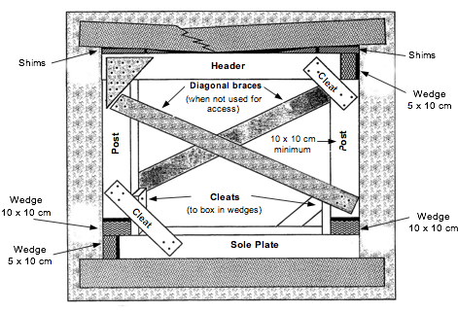
Window / Door Shore
PEER | CSSR | INDIA
PPT 9 -

Slide 11
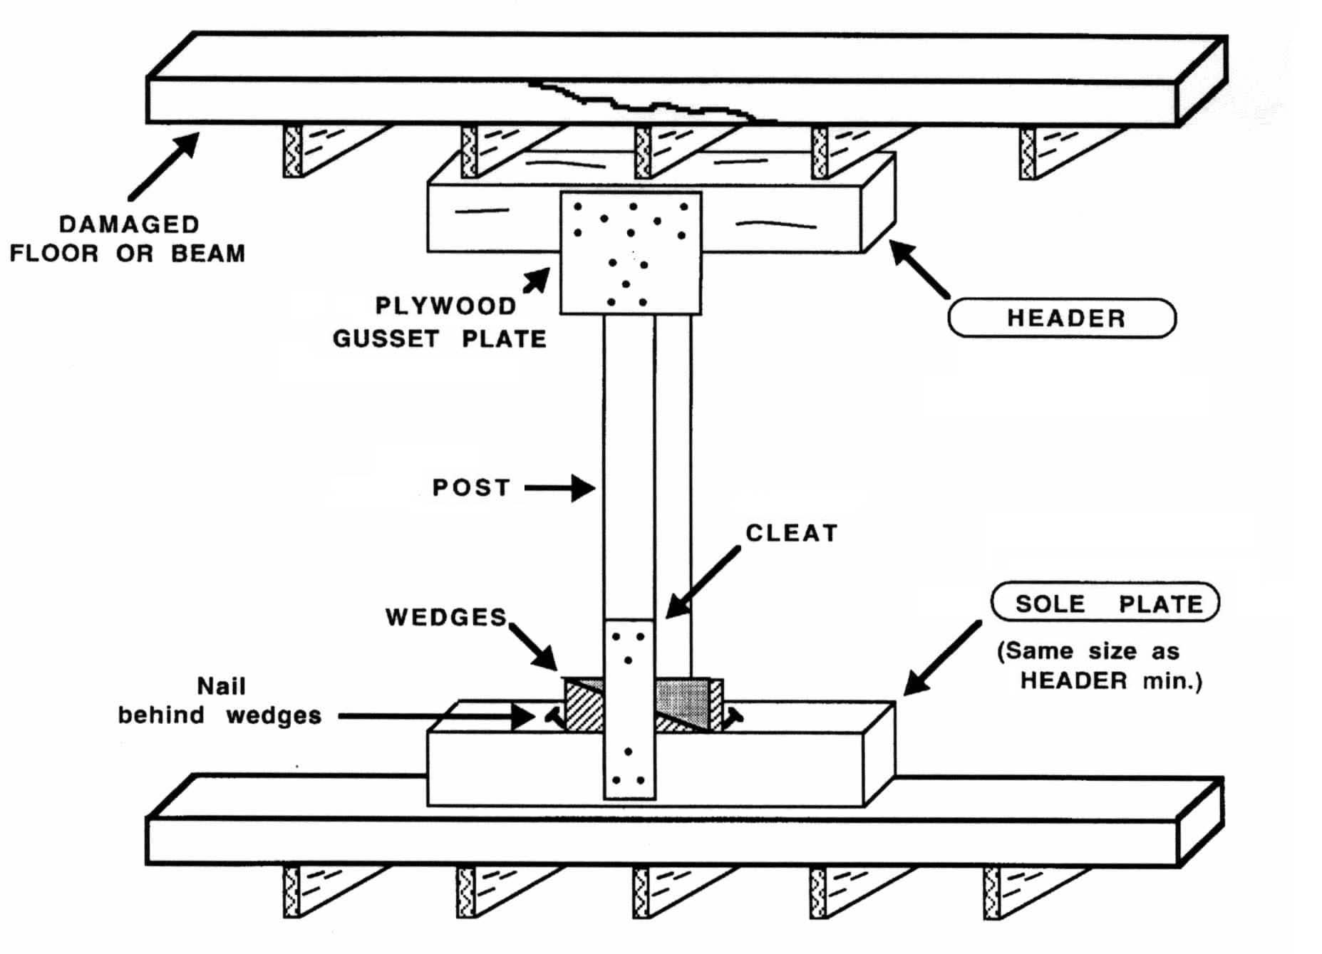
“T”-Spot Shore
PEER | CSSR | INDIA
PPT 9 -

Slide 12
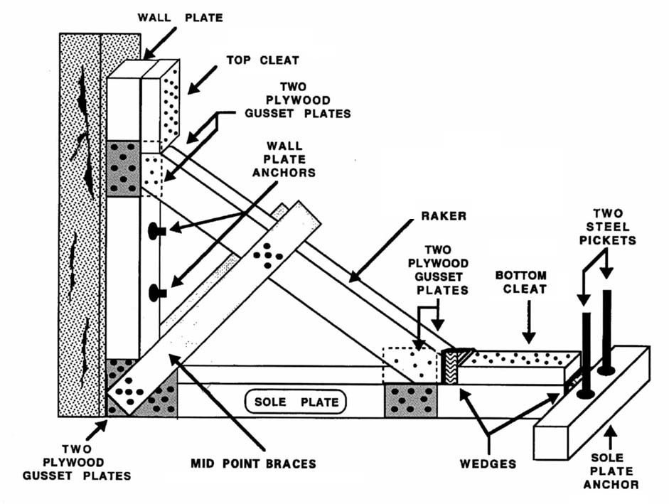
Raker Shore
PEER | CSSR | INDIA
PPT 9 -

Slide 13
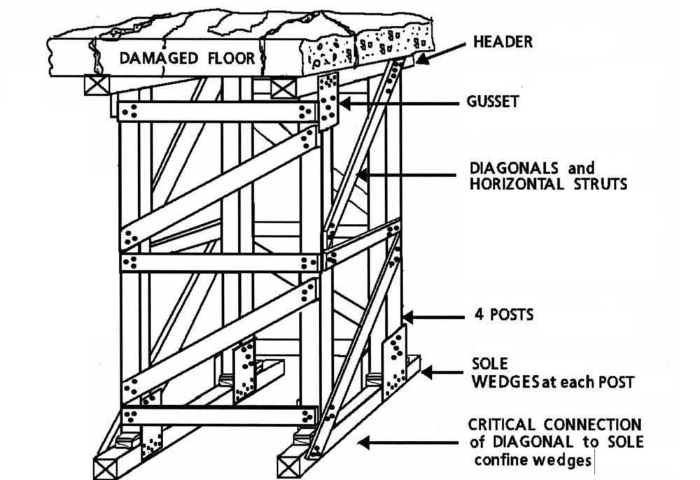
Laced Post Shore
PEER | CSSR | INDIA
PPT 9 -

Slide 14
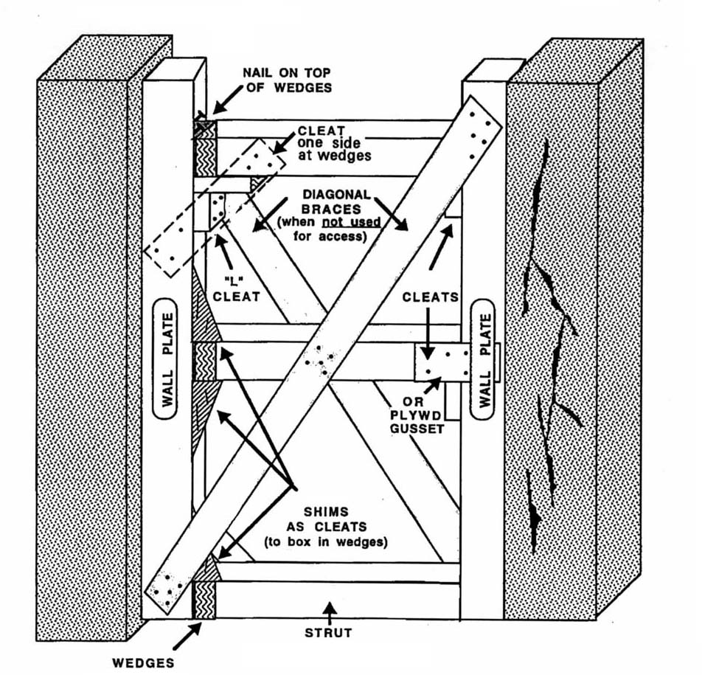
Horizontal Shore
PEER | CSSR | INDIA
PPT 9 -

Slide 15
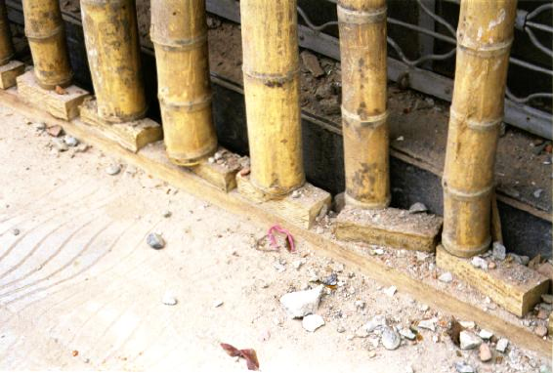
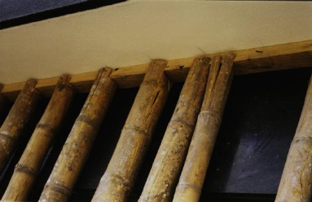
Bamboo Shore
PEER | CSSR | INDIA
PPT 9 -

Slide 16
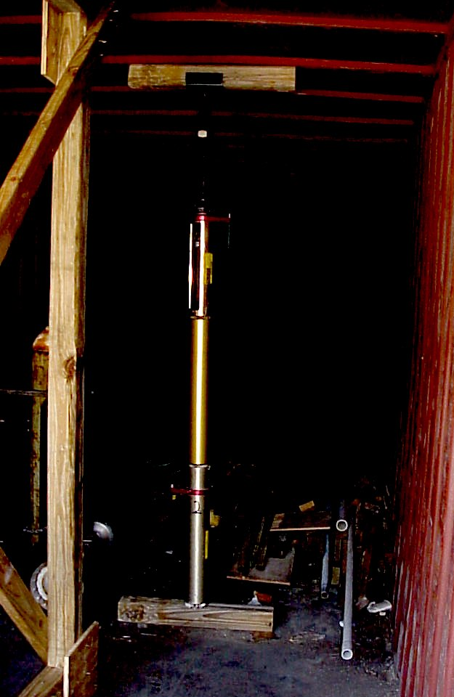
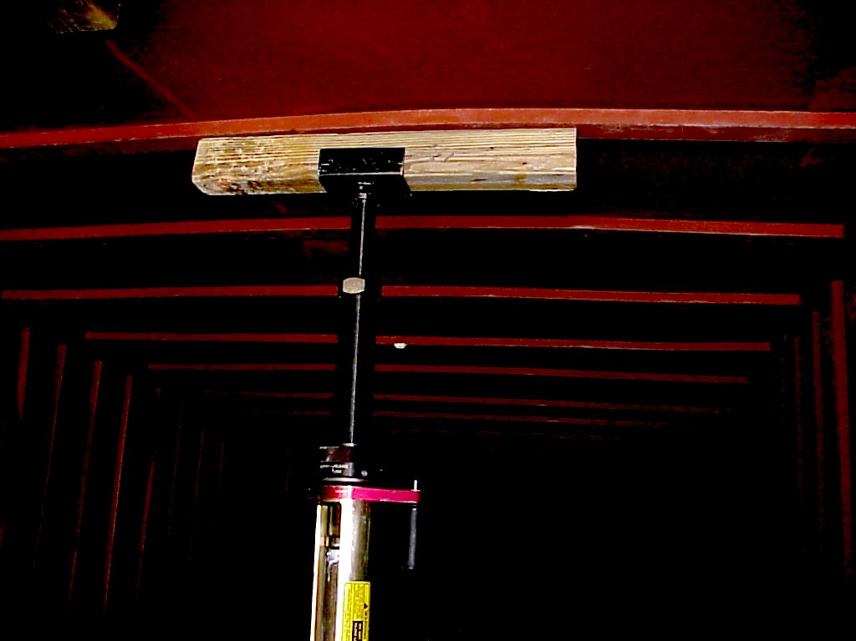
Air Shore
PEER | CSSR | INDIA
PPT 9 -

Slide 17
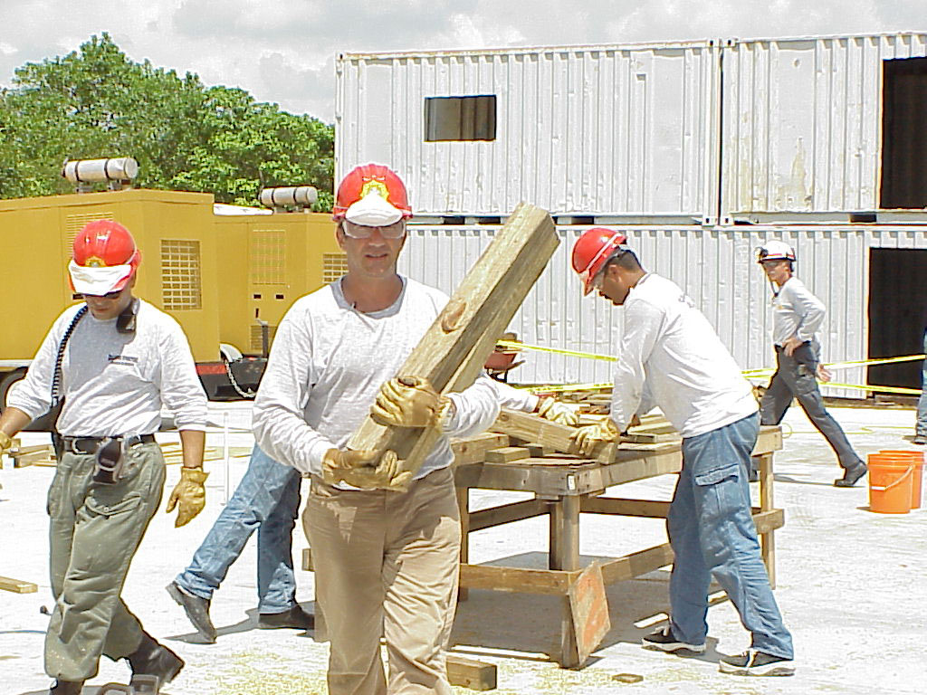
Shoring Team Composition
Assembly Group
Cutting Group
PEER | CSSR | INDIA
PPT 9 -

Slide 18
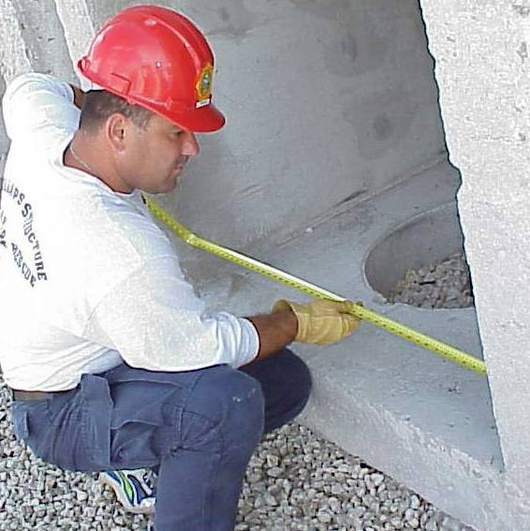
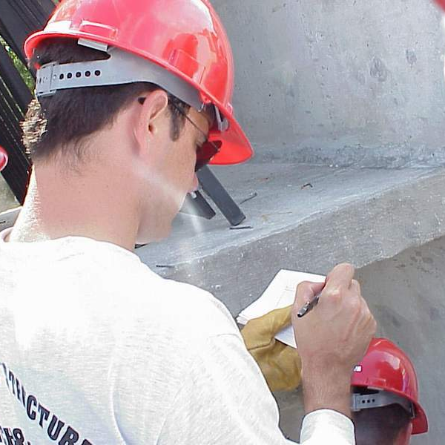
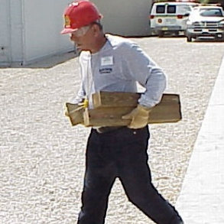
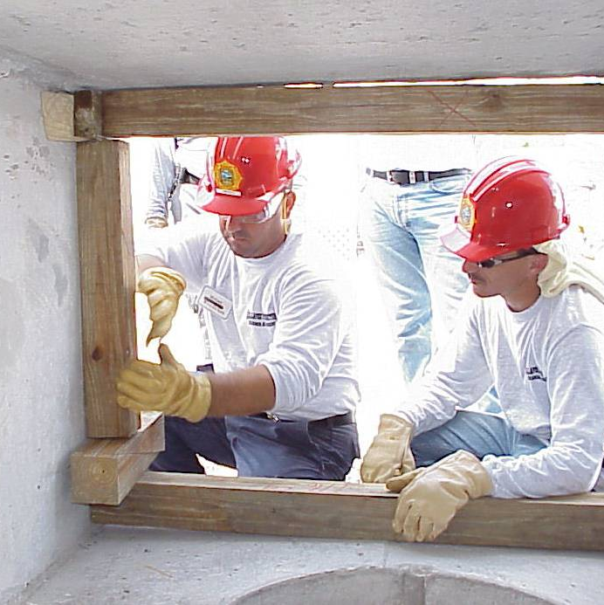
Assembly Group
Shoring Officer
Measurer
Safety
Runner
Shorers
PEER | CSSR | INDIA
PPT 9 -

Slide 19
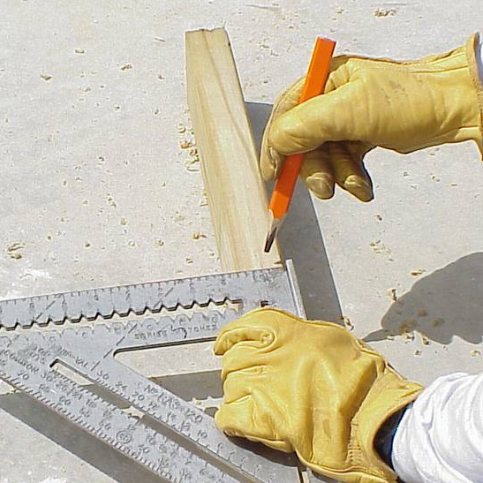
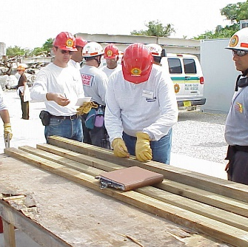
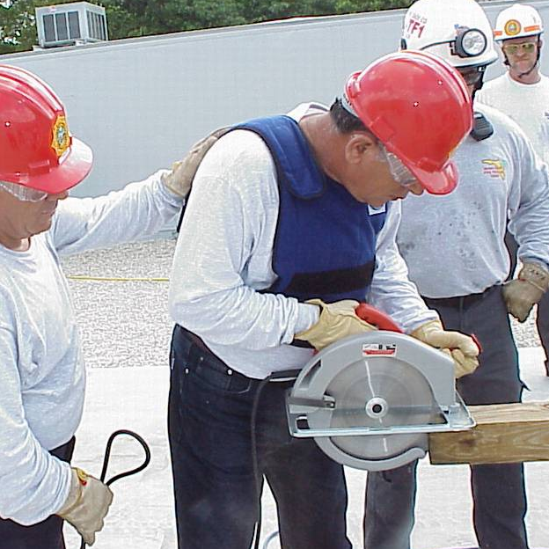
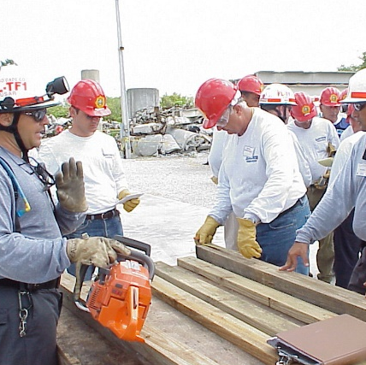
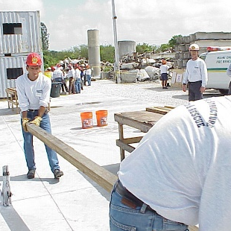
Cutting Group
Cutting Officer
Layout
Feeder
Cutter
Tools/Equipment
Runner
PEER | CSSR | INDIA
PPT 9 -

Slide 20


THANK YOU

