Slide 1
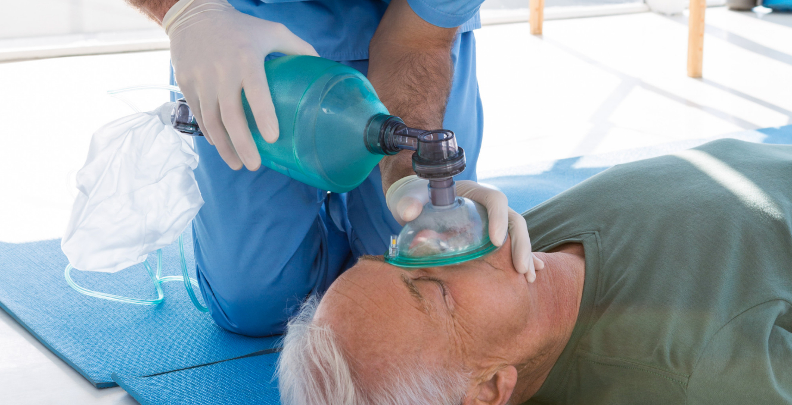







LESSON 8
Oxygen Therapy
Photo Credit: Freepik
PPT 8 -
PEER | MFR | INDIA
PPT 8 - 1

Slide 2
OBJECTIVES
Upon completing this lesson, you will be able to:
1
Name five situations in which
the application of oxygen is indicated.
Describe an oropharyngeal airway, a CPR mask, a bag valve mask and demonstrate their uses.
List four key pieces of equipment in
an oxygen delivery system.
2
3
PEER | MFR | INDIA
PPT 8 -

Slide 3
Oxygen Therapy
Heart failure/heart attack
Respiratory deficiency
Bleeding
Complications of childbirth
Poisoning
PEER | MFR | INDIA
PPT 8 -

Slide 4
Hazards Associated with Oxygen
1
2
3
Explosion
(oil, grease)
Fire
Valve damage
PEER | MFR | INDIA
PPT 8 -

Slide 5
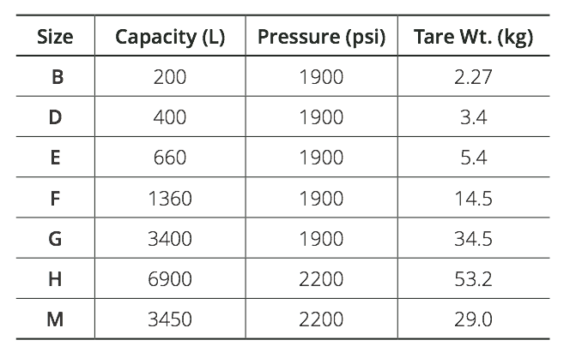
Cylinder Types
PEER | MFR | INDIA
PPT 8 -

Slide 6
Precautions When Giving Oxygen
Reduce the pressure to 40-70 psi before administering oxygen. The pressure in a full cylinder is 2,000-2,200 psi.
Use a flow meter and pressure regulator.
PEER | MFR | INDIA
PPT 8 -

Slide 7


THANK YOU

