Slide 1
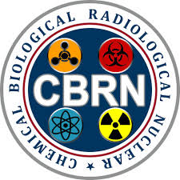

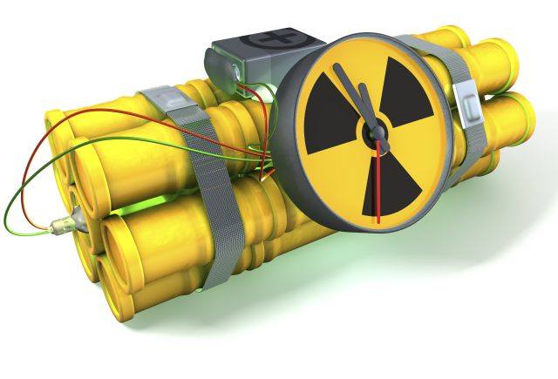



RADIOLOGICAL DISPERSAL DEVICES (RDD)
Presented By:- Amit Kumar, AC

Slide 2
To define radiological dispersal device
Characteristics of radiological dispersal device
To define the effect of radiological dispersal device
Preventive and safety measures for radiological dispersal device
Emergency Response
OBJECTIVES
Upon completion of this lesson you will be able to:

Slide 3
INTRODUCTION
Radiological Dispersal Devices otherwise called dirty bombs are nothing but adding a radiation source to a conventional explosive like dynamite, RDX etc.
After the initial blast of the explosives radioactive material is dispersed, spreading out radiation and contamination

Slide 4
WHAT IS RDD?
Radiological dispersal devices (RDDs), also known as "dirty bombs," are conventional explosives designed to disperse radioactive material over a specific area.
While RDDs do not produce a nuclear explosion, they can cause significant contamination and pose a serious threat to public health and safety. While their immediate physical impact may be limited, their psychological and economic consequences can be profound.

Slide 5
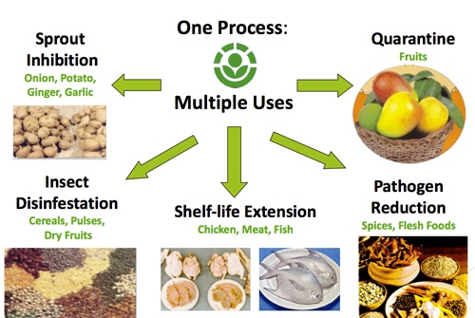
USE OF RADIOISOTOPS IN NORMAL LIFE
Cobalt- 60
Cesium-137
Plutonium- 238
Americium-241
Iridium-192
Radium- 226

Slide 6
HISTORY
1995 rebels of Chechnya planted a dirty bomb in Moscow, fortunately it did not explode. The source used was Cs-137 tagged on to a Dynamite. It was safely defused.
In June 2002 US captured a dirty bomb planted by Al-Qaeda in Chicago Airport.
10 Radiological substances stolen in history.

Slide 7
TERRORISTS MAINLY TARGET
Enclosed spaces
Large crowd
high profile events
Critical facilities and infrastructure

Slide 8
CHARACTERISTICS
OF RADIOLOGICAL DISPERSAL DEVICE
A terrorist event
Low technology
Low cost To make
Wide range of Radioactive Materials
Contamination restricts to use of area until It can be decontaminated

Slide 9
CHARACTERISTICS
OF RADIOLOGICAL DISPERSAL DEVICE
Disperses radioactive contaminated dust into the air and onto surfaces.
Most RDDs will use low-level radioactive materials.
May destroy or damage structures (buildings, infrastructure, utilities, etc).
Economic Impact.
Psychological Impact.
Spread Fear.

Slide 10
RDD IS NOT A NUCLEAR DEVICE
A nuclear device or Improvised Nuclear Device (IND) releases an enormous amount of energy (atomic bomb) while a RDD releases a comparatively small amount of energy.

Slide 11
EFFECTS
OF
RDD
Medical/Health
Psychosocial
Economic

Slide 12
MEDICAL OR HEALTH
EFFECTS
Destroys Cells
May Produce Genetic Effects
Affects Embryo And Fetus
Increases Cancer Risk

Slide 13
PSYCHOSOCIAL
EFFECTS
Transportation Paralysis
Demand For Medical Evaluation
Social Withdrawal
Potential For Immediate And Long-term Care

Slide 14
ECONOMIC
EFFECTS
Loss Of Facilities, Resources, And Personnel.
Massive Requirements For New Services.
Clean Up Cost
Impact On Market

Slide 15
PREVENTION
Prevent inhalation or ingestion of radioactive dust or deposition of radioactive dust on skin or A wound.
Use the steps of controls:
  Eliminate the hazard (leave the area)
  Engineer the hazard out (use wet methods to control dust)
  Administrative (use standard operating procedures (SOPs))
  Personal protective equipment (PPE) (I.E., Respirators)

Slide 16
SAFETY MEASURE
Cover your nose and mouth with a cloth
Don’t touch objects thrown off by an explosion,
Quickly go into a building,
Take off your outer clothing and seal it in a plastic bag,
Isolate the plastic bag, store until authorities decide
Tune to the local radio or television news

Slide 17
IF YOU ARE INSIDE AND CLOSE TO THE INCIDENT
Shut all windows and doors.
Turn off fans and heating and air-conditioning systems
If the walls and windows are broken, go to an interior room & do not leave.
Building badly damaged: Go inside a building where the walls & windows are not broken.
If you go outside, cover your nose & mouth with a cloth.
Once inside, take off your outer clothing and seal it in a plastic bag. Store it in isolation.
Shower / wash with soap & water. Washing hair must.

Slide 18
IF YOU ARE INSIDE AND CLOSE TO THE INCIDENT
Close the windows and turn off the AC, heater and vents.
Cover your nose and mouth with a cloth.
If you are close to your home, office, or a public building, go there immediately and go inside quickly.
If you cannot get to your home or another building safely, pull over to the side of the road and stop in the safest place possible.
Turn off the engine and listen to the radio for instructions.
Stay in the car until you are told it is safe to get on the road.

Slide 19
EMERGENCY RESPONSE
Protection
Detection/Assessment
Evacuation
Mitigation
Decontamination
Medication
Transportation
documentation

Slide 20


To define radiological dispersal device
Characteristics of radiological dispersal device
To define the effect of radiological dispersal device
Preventive and safety measures for radiological dispersal device
Emergency Response
REVIEW

Slide 21

ANY QUESTION?

Slide 22


1. What is medical and health effects of RDD?
Ans- -Nuclear Bomb Destroys Cells
-May Produce Genetic Effects
-Affects Embryo And Fetus
-Increases Cancer Risk
2. What is the full form of IND?
Ans- Improvised Nuclear Device
EVALUATION

Slide 23



THANK YOU

