Slide 1
HILL CLIF RESCUE OPERATION AT PALLAKAD, KERALA
&
DEOGHAR ROPEWAY MISHAP, JHARKHAND
CASE STUDIES
Presented By:- Dileep Kumar,2IC

Slide 2
Objective
Upon the completion of session you will be able to know about:-
Hill Cliff Rescue Operation At Palakkad, Kerala
Deoghar Ropeway Mishap, Jharkhand

Slide 3
HILL CLIF RESCUE OPERATION AT PALLAKAD, KERALA

Slide 4
1. On 07.02.2022 at about 1500 hrs Babu N aged 23 year along with his two friends went trekking at kurumbachi hill Malampuzha, Palakkad distict. 2. During the trekking Babu N was slipped and fell down from hill and got stuck in crevices. 3. On 08.02.2022, District collector, Palakkad requested to NDRF Team to rescue trapped person.
Sequences of Events in Time Line

Slide 5
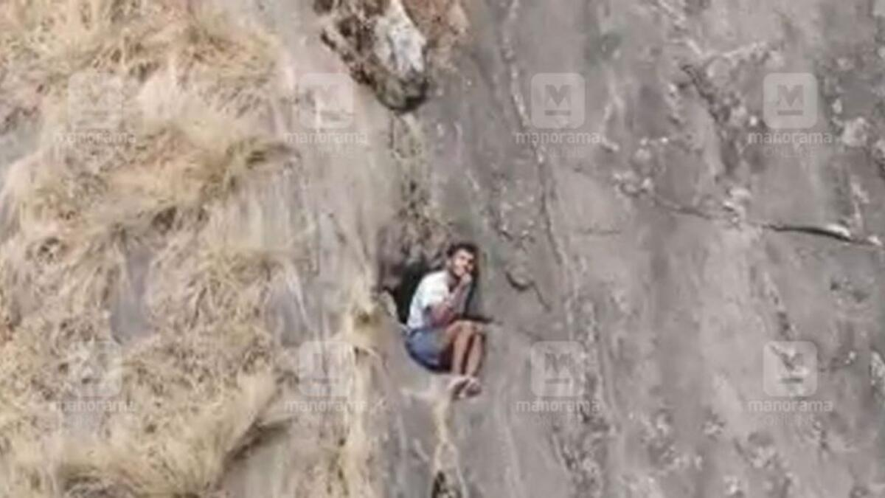
Location of victim
300 mtr from top
LOCATION OF VICTIM
1200 mtr from base

Slide 6
Sequences of Events in Time Line
On 08.02.2022 at about 1206 hrs a team from PPT Thrissur consist of 15 Personnel (01 SO + 14 ORs) reached base of Operation kurumbachi hill Malampuzha, Palakkad district and started Ops at 1220 hrs along with Forest Guard, Fire Force and Civil Defense.

Slide 7
Sequences of Events in Time Line
Team tried to reach to the top of hill through forest to make access to the victim, but to failing of light the pace of the team was reduced and team continuously climbing even in the night and reached the hill top on 09.02.2022 at about 0500 hrs.
Further additional sub team (02 SO and 13 ORs) left from RRC Thrissur at about 082155 hrs and reached Ops site at 0915 hrs.

Slide 8
Response of Team
After reaching to base of operation, team commander met with the Local Authorities and get information about incident.
It was planned to reach the top of the hill first by passing through forest, locate victim and to get access to the victim from hill top by using rope rescue techniques and pull him back to hill top.

Slide 9
Response of Team
Team commander divided team in two sub teams, first team consisting of 06 personnel accompanied by Forest guards, Fire force person and civil defense moved towards incident site at 081220 hrs, passes through forest inhabited by wild animals like Elephants, Tigers, Cobras etc. and reached at hill top at around 090500 hrs and remaining team kept as back up team at base of ops.
After reaching to the incident site team tries to locate victim but could not be located then team requested local administration for a drone to locate the victim.

Slide 10
Response of Team
Another team of 07 NDRF personnel along with a Army team who started from base of operation at 0823 hrs reached to the hill top at 090730 hrs.
After locating the victim NDRF and Army made joint efforts to rescue the trapped victim, established anchoring point, 01 member of army mountaineer team descended from hill top with the help of rope and approached to the victim and pulled him back along with him with the help of seat harness and rope.

Slide 11
Achievement
Reached near by victim : On 090500 hrs NDRF team accompanied by other agencies at through forest, team reached to the victim with the help of rope rescue equipment.
Rescue the Victim: The victim was recued and pulled back to the hill top at about 091010 hrs. NDRF team stabilized the victim and give some food and water to him. The victim was airlifted by Helicopter at 091218 hrs and shifted to nearest hospital.

Slide 12
Achievement
Joint Ops: This was a successful operation of NDRF team which was accomplished with Army Troops and the state agencies.

Slide 13
Short Comings/ Gaps in Ops
This is first operation in which victim trapped in crevices of steep hill at about 300 mtrs from hill top and more than 1000 mtrs from foot hills.
NDRF team had not Drone camera to locate the victim.
NDRF team neither trained for such high hill rescue ops nor having any experience of such type of operations.

Slide 14
Lesson Learned
Static ropes, carabineers and body harness are more effective for this type of operations.
Learned how to anchor rope across the hills and descending and ascending

Slide 15
Lesson Learned
Learned how to coordinate with multiagency and immediate rescue/evacuation of victims in adverse condition like in the case of trapped incident.
Learned how to move through an area frequented by wild animals

Slide 16
Challenges for the Future
Operations at hilly areas.
Handling of Drones and Rope guns.
Specialized training of mountain rescue to execute such risky and challenging mountain rescues.

Slide 17
DEOGHAR ROPEWAY MISHAP, JHARKHAND

Slide 18
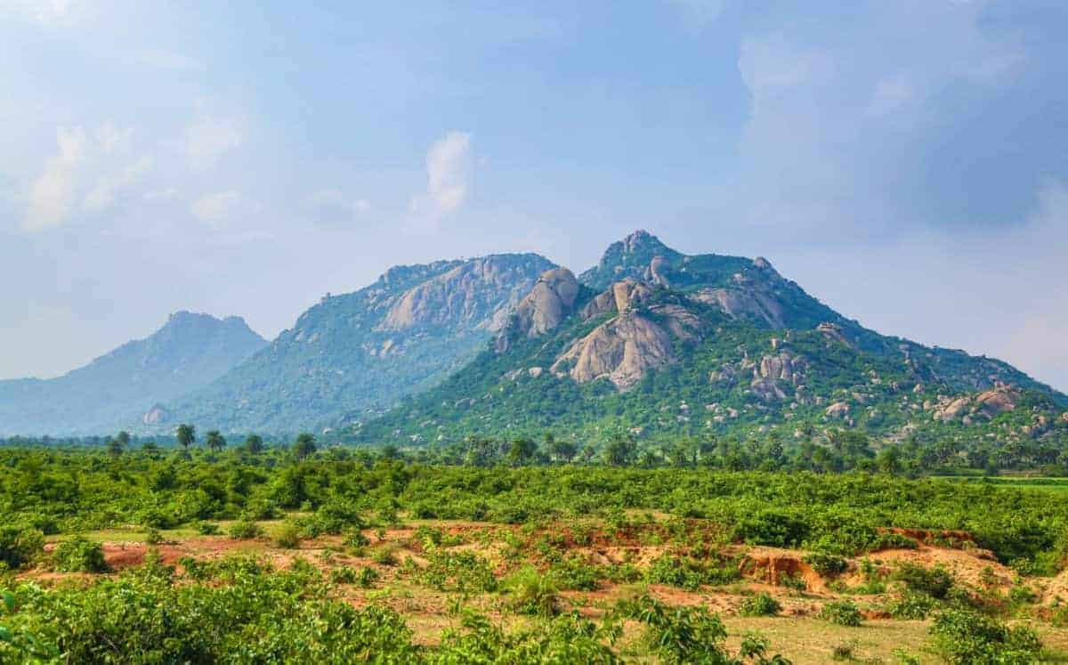

Slide 19
Preview
PREVIEW
The Deoghar ropeway service in Trikut offers beautiful panoramic views of the holy town. The three peaks of the Trikut hill signify the holy trinity of Brahma, Vishnu and Mahesh.
The cable car has been built to take pilgrims to the top of the hill all throughout the year.
This presentation will shed light on the accident and the rescue operations by 9th bn NDRF from the 10th to the 12th of April 2022.

Slide 20
Introduction
A first of its kind rescue operation was carried out by 9th bn NDRF, Bihta, Patna along other agencies from the 10th to 12th of april 2022. the operation comprised of the following aspects which will be covered as fol. :-
Location & description of the incident site
Sequence of events
Activation & mob. (planning & exe.)
Demobilization
Lessons learnt
Way forward

Slide 21
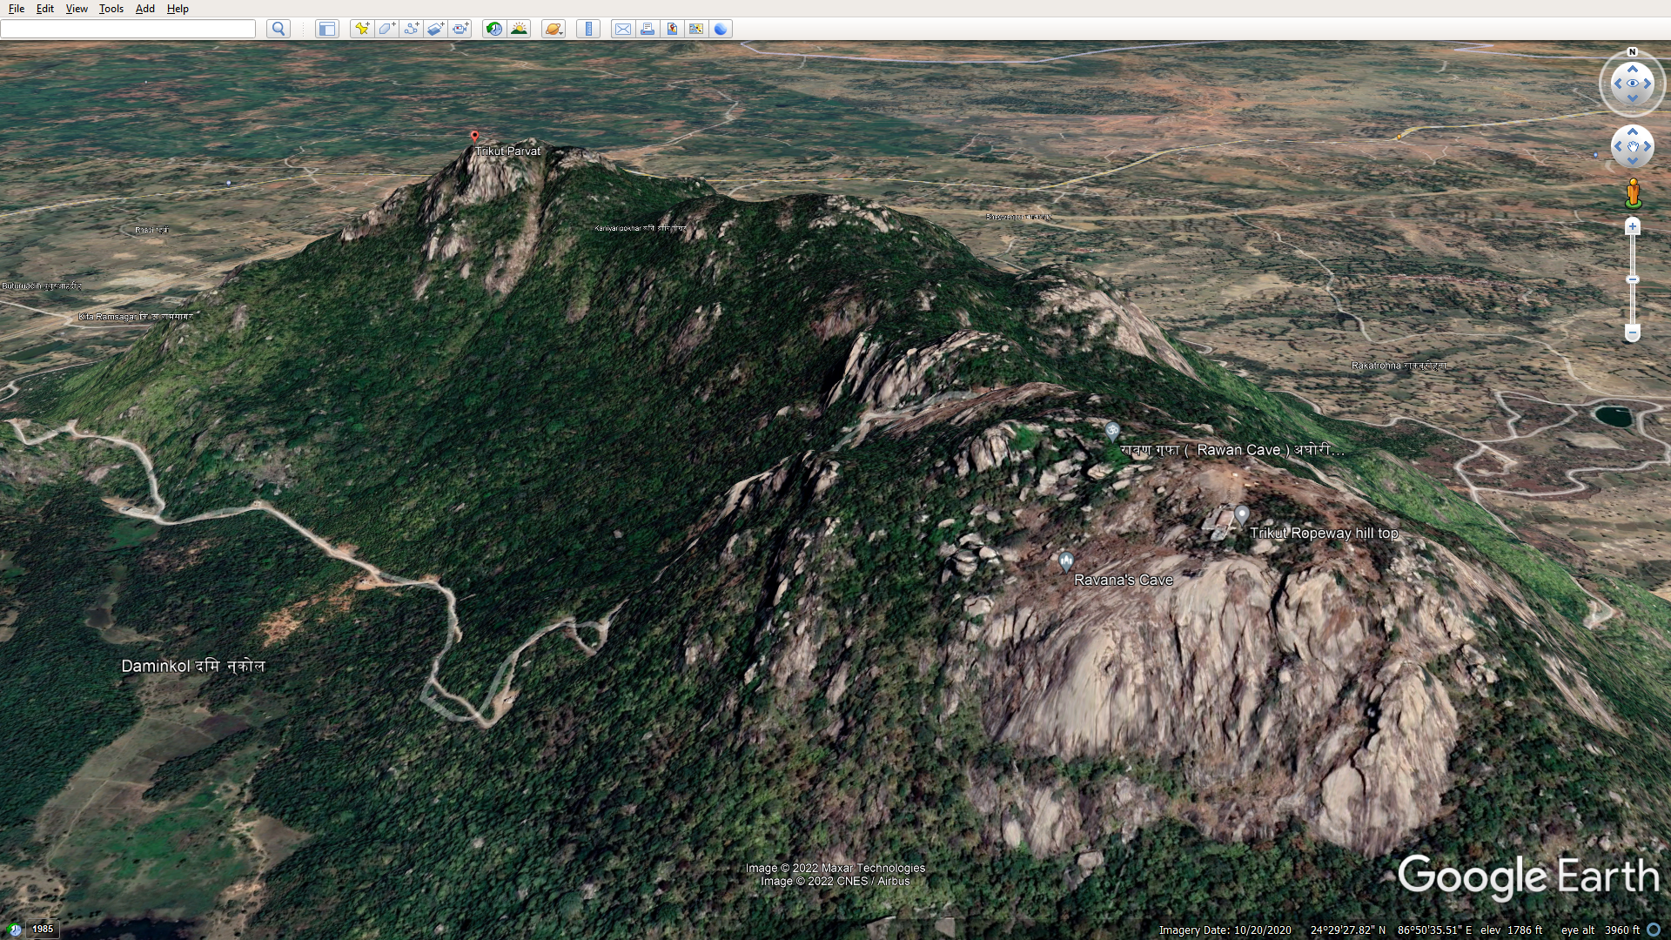
TRIKUT PAHAD
Location Of The Incident Site
RAVAN GUFA
ROPE WAY TERMINAL

Slide 22
Location: Trikut Parvat
Nearest RRC/TPL: TPL Deoghar
Distance from nearest rrc/tpl: appx 18 km
Terrain: Hilly with steep slopes
Apprx 1500 feet from the ground.
Religious, adventurous and natural beauty
Description Of The Incident Site

Slide 23
On 10.04.2022 at about 1720 hrs, a call was received from SDM, Deoghar by team cdr NDRF regarding the incident involving ropeway at trikut parvat.
Sequence Of Events

Slide 24
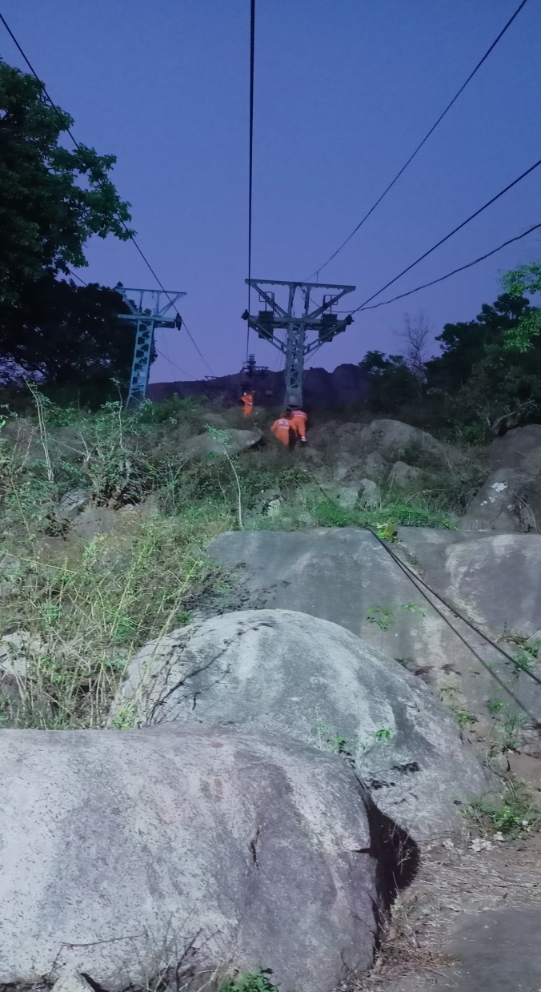
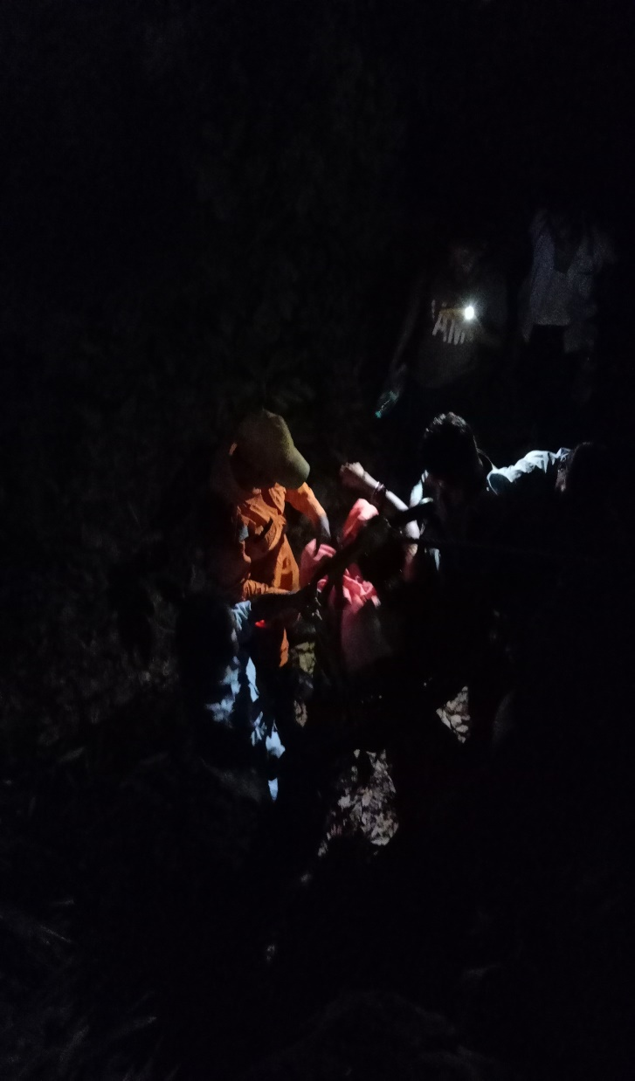
ACTIVATION & MOBILISATION
DAY –1
10TH APRIL 2022
18:35 HRS ONWARD

Slide 25
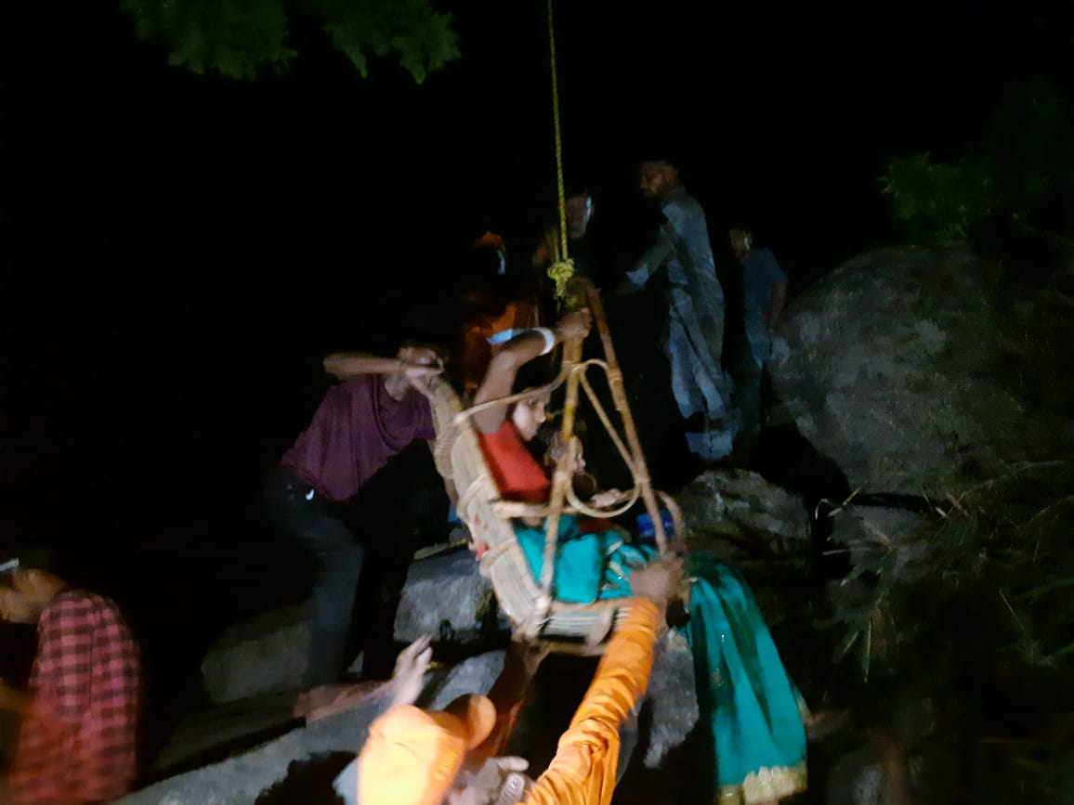
Immediately, alert team reached the site and started rescue op at about 1835 hrs.
Local people were engaged in rescue work.
NDRF rescued 11 stranded people incl. one seriously injured female. She was evacuated to nearest Sadar Hospital, Deoghar where she succumbed to her injuries.

Slide 26
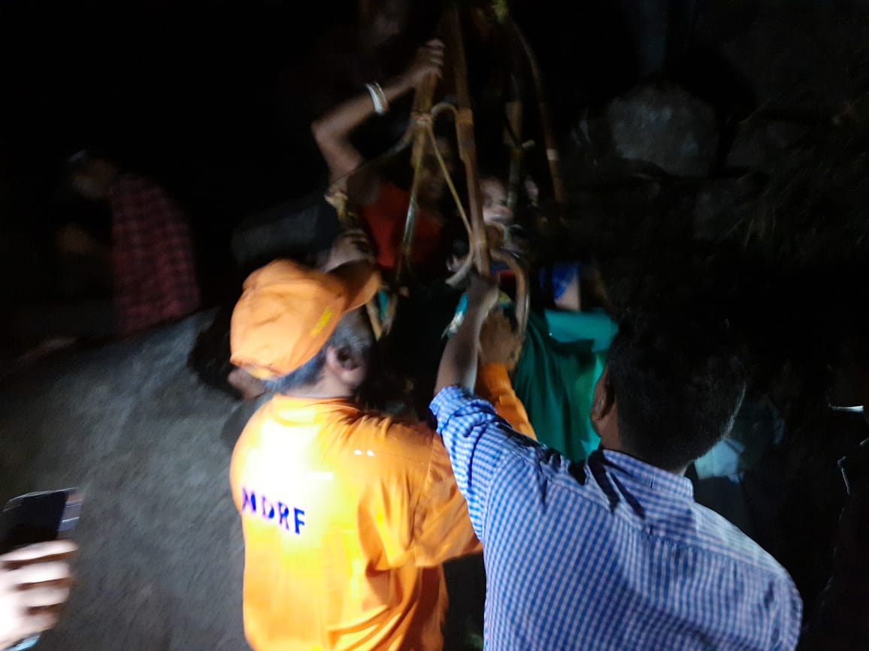
The servicing trolley was utilized by NDRF in dark hours to ascertain & assure the persons stranded in cable cars. trolley was also used to provide food and water.

Slide 27
RESCUE OPERATION
DAY – 2 (11TH APR 2022)

Slide 28
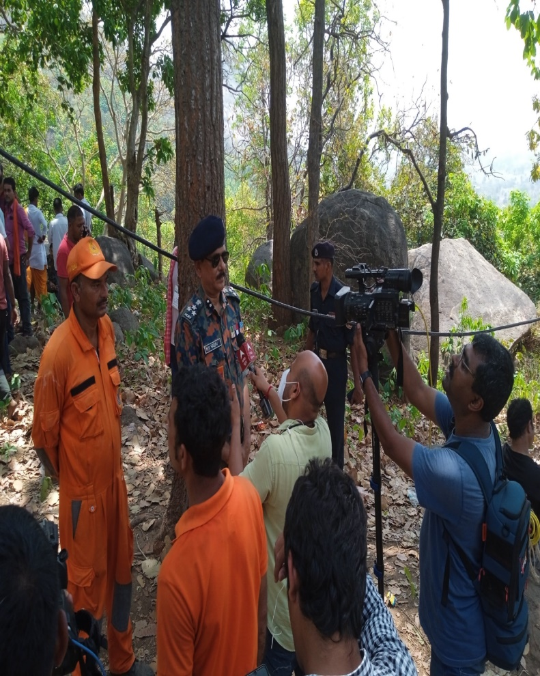
On 11th april 2022, another team of NDRF from Bn HQ Patna also reached the incident site.
10 officers &100 troops of Indian Army & 3 officers 50 troops of ITBP from Ranchi reached the incident site.
In the meantime, 02 air force helicopters also landed at Deoghar airport for heli-rescue.
After initial recce by air force first heli-rescue attempt made by chopper from 0900 to 0940 hrs did not succeed.

Slide 29
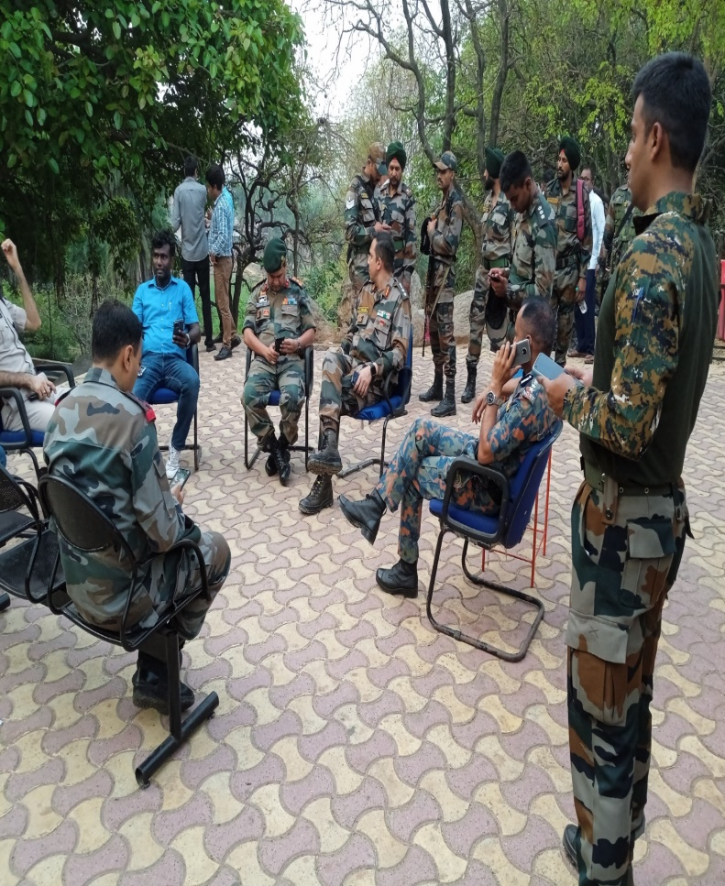
The manager of the ropeway came up with the idea of using a bamboo chair for the rescue operation. ITBP & NDRF rescued 11 persons with the help of bamboo chair.
NDRF rescuers also accompanied and assisted IAF staff in initial 05 rescue sorties which rescued 07 persons. After a break, air rescue ops resumed at about 1500 hrs & by evening a total of 22 people were rescued.

Slide 30
Rescue Operation Day –3

Slide 31
Joint rescue operation of NDRF, Airforce, ITBP, Army and Civil administration continued for 48 hrs.
Teams of NDRF, Airforce, ITBP, Army , ropeway staff and district administration rescued 46 out of 48 trapped passengers in the cable cars of rope way.
On 12th april 2022, at about 1540, after final confirmatory check, ops was called off.

Slide 32
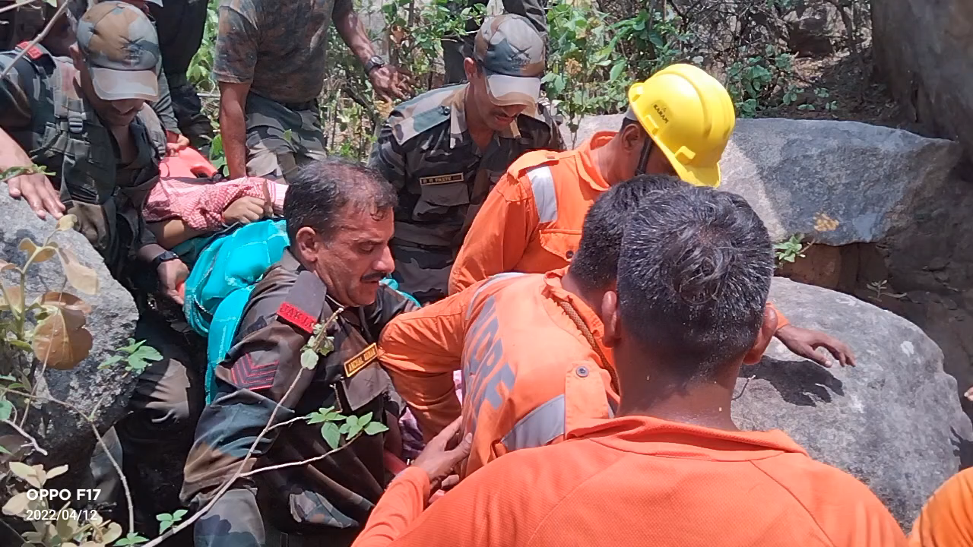

Slide 33
Lessons Learnt/Challenges
Absence of trained and experienced rescuers was felt due to a large no. of rescuers being repatriated. (Total- 494 personnel were repatriated in 2020 & 2021).
Insufficient training on slithering from helicopter.
Such type of challenging operations requires high level of professional skill besides physical and mental toughness.

Slide 34
Way Forward
Training on mid-air rescue is required for this type of operation.
Review of vulnerability profile of aor considering presence of hilly area and accordingly equipping rrc.
Effective coordination with other operational agencies.
Brain storming on capacity building for such unexpected disaster situations.

Slide 35
Review
After the completion of lecture you learnt the followings.
Hill Cliff Rescue Operation At Palakkad, Kerala
Deoghar Ropeway Mishap, Jharkhand

Slide 36
Any Question ?

Slide 37
EVALUATION
Ques:- 1 How would you construct an improvised anchor system ?
Ques:- 2 List out the knots & hitches used for Rope Rescue ?

Slide 38


THANK YOU

