Slide 1

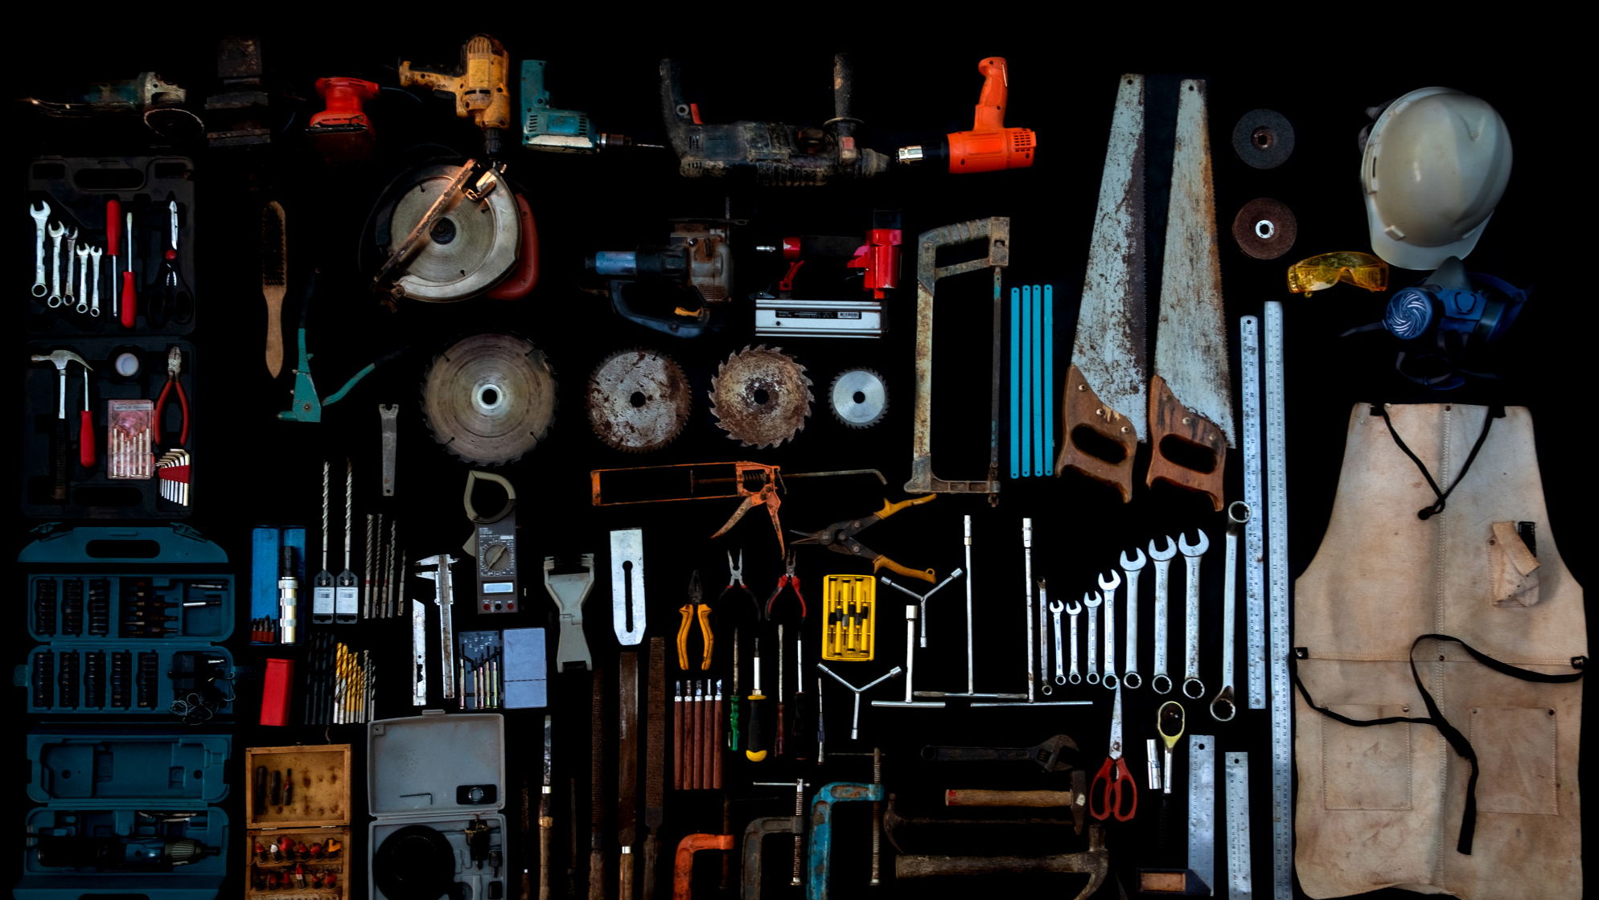






LESSON 7
Tools and Location Techniques
Photo Credit: Freepik
Presented By:- Sohel Lakhani. DC
PPT 7 -
PEER | CSSR | INDIA
PPT 7-1

Slide 2
OBJECTIVES
Upon completing this lesson, you will be able to:
1
Define tools, equipment and accessories (TEA).
List four categories of TEA according to their use.
List five power sources for equipment and tools.
2
3
PEER | CSSR | INDIA
PPT 7 -

Slide 3
OBJECTIVES
Upon completing this lesson, you will be able to:
4
List the general steps for use and maintenance of tools and equipment (before, during and after their use).
Demonstrate in four practical exercises the correct use of TEA.
5
PEER | CSSR | INDIA
PPT 7 -

Slide 4
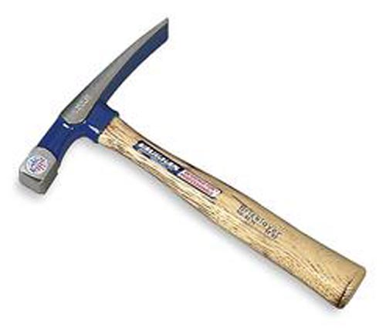
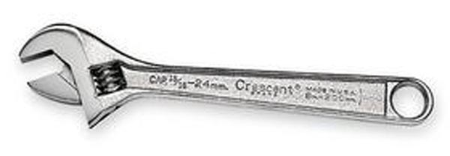
Tool
A device that is used to perform or facilitate manual or mechanical work, using only the strength of the operator.
PEER | CSSR | INDIA
PPT 7 -

Slide 5
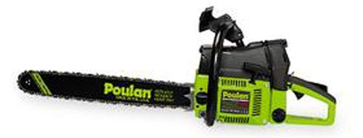
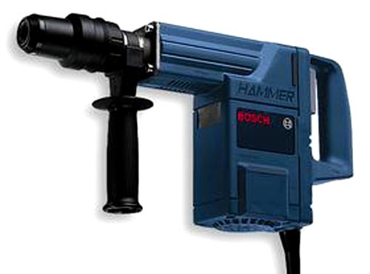
Equipment
A machine or device that performs
a physical task, whose operation depends on an outside power source in order to increase work capacity.
PEER | CSSR | INDIA
PPT 7 -

Slide 6
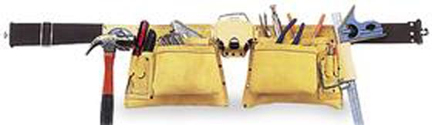
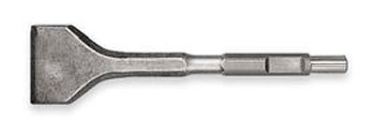
Accessory
A component that supplements or completes a tool or piece of equipment, and which increases the operator’s ability to perform a task.
PEER | CSSR | INDIA
PPT 7 -

Slide 7
Classifying TEA by Use
1
2
3
4
Search
Rescue
Operations support
Personal protection
PEER | CSSR | INDIA
PPT 7 -

Slide 8
Classifying TEA by Power Source
1
2
3
4
5
Electric
Pneumatic (air)
Internal combustion
Hydraulic
Other: mechanical advantage, etc.
PEER | CSSR | INDIA
PPT 7 -

Slide 9
Use and Maintenance
Before
PPE, verify fuel/power source
During
proper operation
After
cleaning/maintenance
PEER | CSSR | INDIA
PPT 7 -

Slide 10
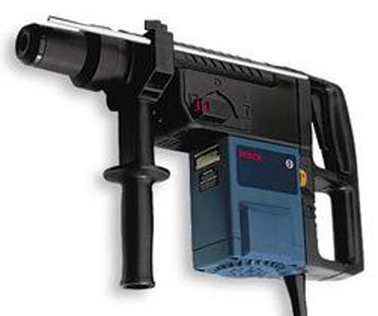
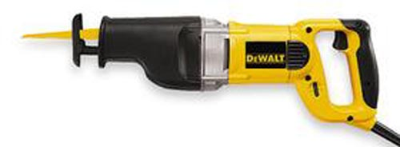
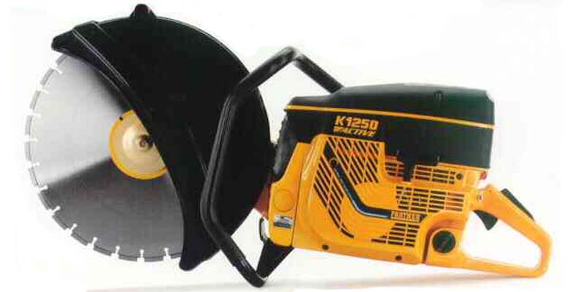
Before using
power tools,
read manufacturer’s instructions
PEER | CSSR | INDIA
PPT 7 -

Slide 11


THANK YOU

