Slide 1
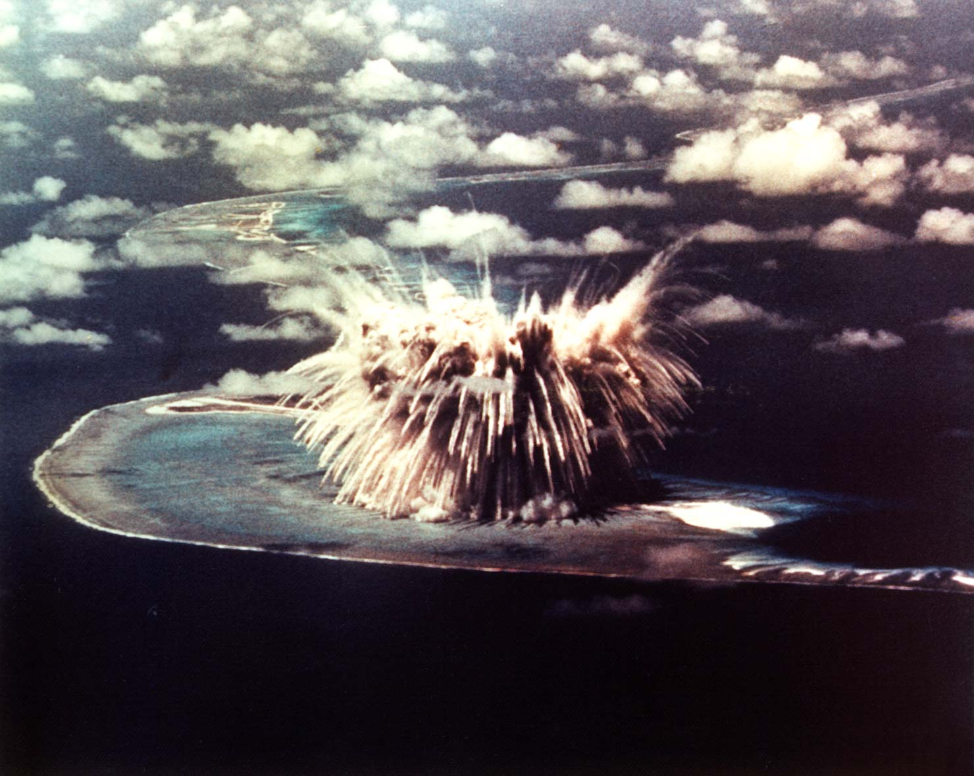

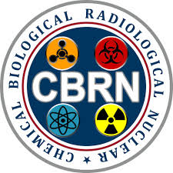



PHENOMENA OF NUCLEAR EXPLOSION
Presented By:- Amit Kumar, AC

Slide 2
What is Nuclear Explosion
Distribution of energy in Nuclear Explosion
Types of Nuclear Explosion
Effects of Nuclear Explosion
Effects of Nuclear Explosion on Hiroshima & Nagasaki
7. Cause of Immediate death
8. Conclusion
OBJECTIVES
Upon completion of this lesson you will be able to:

Slide 3
NUCLEAR EXPLOSION
Energy from NUC reaction distributes as KE.
Temp reaches millions of degrees and Vaporizes non-fission parts of the weapon into gases.
Vaporized gases radiate EM Radiation, mostly soft x-rays.
X-rays absorbed by surrounding air within a few feet.
A Hot luminous air mass created, called fireball.
Fireball re-emits energy in the form of Thermal radiation.

Slide 4
NUCLEAR EXPLOSION
Fireball grow rapidly, rises and expands.
Within a millisecond after detonation, the diameter from a 1 Megaton is 150m
Increases to max 2200m within 10 Sec, rises @ 100m/sec.
Temp falls and condensation happens.
After 1 min – fireball cooled to such an extent that it no longer emits visible Radiation.
Explosion also creates high pr. waves (Shock/Blast wave).

Slide 5
NUCLEAR EXPLOSION
Pr. waves mov away from fireball (@10sec – 3 miles ahead of fireball
50sec – 12 miles ahead)
Air is compressed.
Shock front created.
Radioactive particles and gamma rays emitted.
Gamma rays reach long distance within no time.
Cloud attains its max height – 10 min, said to be stabilized
Cont. to grow laterally.
Absorbed by the atm – 1 hour or more.

Slide 6
NUCLEAR EXPLOSION
Neutrons have high energy and mov faster than other products, knock off electrons - ionization around fireball.
Positively charged nuclei remain closer to fireball. Electrons mov away. Potential difference leads to a high intensity short duration EM pulse (EMP).
Some neutrons are captured by nuclei in the atm and some by nuclei of ground surface material. Induced radioactivity. Gamma rays emitted.

Slide 7
NUCLEAR EXPLOSION
Rising fireball sucks up debris and dust. Condensed material deposits on it.
Radioactive dust carried to long distance and settles down slowly in the form of fallout.

Slide 8
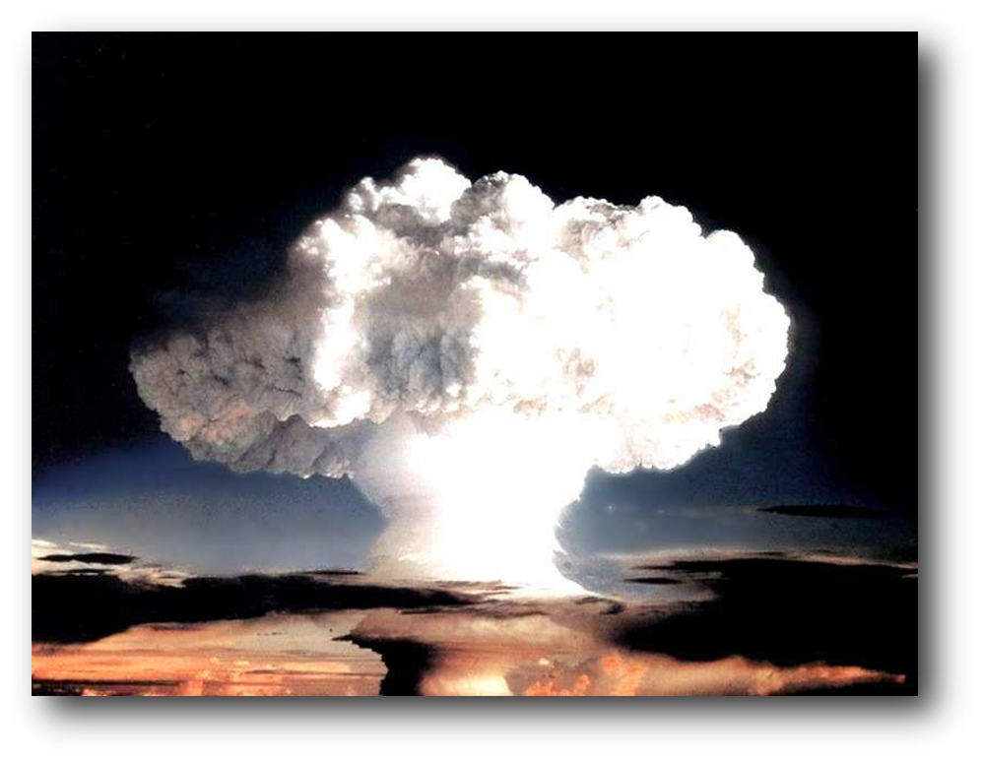
DISTRIBUTION OF ENERGY IN A NUCLEAR EXPLOSION

Slide 9
TYPES OF NUCLEAR EXPLOSION
A nuclear device can be exploded or detonated in any of the following ways depending on the purpose :
Air burst
High altitude burst
Underwater burst
Underground burst
Surface burst

Slide 10
AIR BURST
A weapon is detonated in air at an altitude below 30 km but at sufficient height that the fireball does not contact the surface of the earth.
The altitude can be varied to obtain maximum effects
Blast causes considerable damage and injury.
Burns to exposed skin may be produced over many square kilometres
Eye injuries over a still larger area.

Slide 11
AIR BURST
Initial nuclear radiation will be a significant hazard with smaller weapons, but the fallout hazard can be ignored as there is essentially no local fallout from an air burst.
In the vicinity of ground zero, there may be a small area of neutron-induced activity which could be hazardous to troops required to pass through the area.
Tactically, air bursts are the most likely to be used against ground forces.

Slide 12
HIGH ALTITUDE BURST
A weapon is exploded at such an altitude (above 30km) that initial soft x-rays generated by the detonation dissipate energy as heat in a much larger volume of air molecules.
There the fireball is much larger and expands much more rapidly.
The ionizing radiation from the high-altitude burst can travel for hundreds of miles before being absorbed.

Slide 13
HIGH ALTITUDE BURST
Significant ionization of the upper atmosphere (ionosphere) can occur.
Severe disruption in communications can occur.
Also lead to generation of an intense electromagnetic pulse (EMP) which can significantly degrade performance of or destroy sophisticated electronic equipment.

Slide 14
SURFACE BURST
A weapon is detonated on or slightly above the surface of the earth so that the fireball actually touches the land or water surface.
The area affected by blast, thermal radiation and initial nuclear radiation will be less extensive than for an air burst of similar yield, except in the region of ground zero where destruction is concentrated.

Slide 15
SURFACE BURST
In contrast with air bursts, local fallout can be a hazard over a much larger downwind area than that which is affected by blast and thermal radiation.

Slide 16
UNDERGROUND BURST
Where the point of burst is beneath the ground, it is an underground burst.
Very shallow bursts are indistinguishable from the surface burst; because the fireball will still be produced above the ground.
In deeper bursts, instead of fireball a gas bubble will be formed.

Slide 17
UNDERGROUND BURST
When the point of burst is below the water surface, it is called an underwater burst.
Subsurface bursts
Most of the shock energy of the explosion appears as underground or underwater shock
Heating of the ground or body of water
Depending upon the depth of the explosion, some of the thermal and nuclear radiations will escape
Water in the vicinity of the explosion will be contaminated with radioactive fission products

Slide 18
EFFECTS OF NUCLEAR EXPLOSION
FLASH
HEAT
BLAST
RADIATION
(a) INITIAL
(b) RESIDUAL

Slide 19
FLASH EFFECTS
Flash burn
*100% near fireball
* Burn exposed skin up to 4 km
Flame burn
* Burns flammable objects in an environment
Eye injury
* Flash blindness
* Burn of retina

Slide 20
HEAT OR THERMAL RADIATION
50% casualty by heat/thermal radiation
- First degree burn
- Second degree burn
- Third degree burn

Slide 21
BLAST
Explosion
Wave intensity increase as trailing wave catches up with wave front.
Shock front created.
Peak power at shock front immediately after its creation.

Slide 22
BLAST AND SHOCK WAVE EFFECTS
Injury to ear drum
Damage to lungs
Serious injury
Death
Building break down
Field defence broken
Vehicle, Tank, Trees destroy

Slide 23
NUCLEAR RADIATION
- Initial radiation
- Residual radiation
Radiation from nuclear explosion causing ionization of matter.
Particles of nuclear origin i.e. Α and β particles, Neutrons, γ rays.

Slide 24
NUCLEAR RADIATION
Initial Nuclear Radiation : That ionizing radiation emitted within the first min after detonation.
Residual Nuclear Radiation
That radiation which is emitted later than one minute after the detonation and arises principally from the decay of radioisotopes produced.
Mainly composed of :-
Radioactive fallout.

Slide 25
RADIATION EFFECTS
Immediate effect
- Vomiting
- Difficulty in breathing
- Weakness
- Headaches
- Sleeping
- Giddiness

Slide 26
RADIATION EFFECTS
Delayed effect
- Short age
- Cancer
- Eye diseases
- Skin diseases
- Fall in hair
- Diseases spread in born child

Slide 27
HIROSHIMA
Date : 6 August 1945
Name : Little Boy
Type : Uranium gun-type fission
Weight : 4400 kg
Length : 10 ft, 6 in (3.2m)
Diameter : 29 in (0.737m)
Explosive yield :15 k tons of TNT
Casualty : 80 thousand appx

Slide 28
EFFECTS ON HIROSHIMA
Within 1.2 km. of the hypocenter there was probably a 50% death rate of the 350,000 people estimated to have been in Hiroshima at the time. Hiroshima City Survey estimated 118,661 civilian deaths up to 10 August 1946.
Among those who survived, the long-term effects of radiation sickness, genetic and chromosome injury, and mental trauma have been catastrophic, even unborn children having been stunted in growth and sometimes mentally retarded.

Slide 29
EFFECTS ON HIROSHIMA
85% of Hiroshima's buildings were within 3 km of where the atomic bomb exploded over the heart of the city.
The damage extended to virtually the entire city, with 90% buildings burned or destroyed beyond repair.

Slide 30
NAGASAKI
Date : 9 August 1945
Name : Fat Man
Type : Plutonium fission
Weight : 4535 kg
Length : 11 ft, 4 inch
Diameter : 5 ft (1.52 m)
Explosive Yield : 21 k tons of TNT

Slide 31
EFFECTS ON NAGASAKI
Nicknamed 'Fat Man‘ Bomb was dropped by parachute at 1102 hours on 9 August 1945 by an American B29 bomber from the Pacific island of Tinian.
The aircraft's first target was the city of Kokura, now part of Kitakyushu, but as it was covered by heavy cloud the aircraft was diverted to its second target, Nagasaki.

Slide 32
EFFECTS ON NAGASAKI
Among the 270,000 people present when the bomb was dropped, about 2,500 were labour conscripts from Korea and 350 were prisoners-of-war.
About 73,884 were killed and 74,909 injured, with the affected survivors suffering the same long-term catastrophic results of radiation and mental trauma as at Hiroshima.

Slide 33
RADIATION EFFECTS
Those exposed within about 1 Km of the hypocenter received life-threatening doses, and most died within a few days.
Decades later, that radiation was still producing harmful after effects. Leukemia and other cancers appeared over the course of 2 to 20 years, and radiation effects still threaten the health of the survivors.

Slide 34
CAUSE OF IMMEDIATE DEATHS
Hiroshima
Cause of Death | Per-cent of Total
Burns | 60%
Falling debris | 30
Other | 10
Nagasaki
Cause of Death | Per-cent of Total
Burns | 95%
Falling debris | 9
Flying glass | 7
Other | 7

Slide 35
PERCENT MORTILITY AT VARIOUS DISTANCES
Per-Cent Mortality at Various Distances
Distance from X, in feet | Per-cent Mortality
0 - 1000 | 93.0%
1000 - 2000 | 92.0
2000 - 3000 | 86.0
3000 - 4000 | 69.0
4000 - 5000 | 49.0
5000 - 6000 | 31.5
6000 - 7000 | 12.5
7000 - 8000 | 1.3
8000 - 9000 | 0.5
9000 - 10,000 | 0.0

Slide 36


What is Nuclear Explosion
Distribution of energy in Nuclear Explosion
Types of Nuclear Explosion
Effects of Nuclear Explosion
Effects of Nuclear Explosion on Hiroshima & Nagasaki
Cause of Immediate death
REVIEW

Slide 37

ANY QUESTION?

Slide 38


1. What is Surface Burst?
Ans- A weapon is detonated on or slightly above the surface of the earth so that the fireball actually touches the land or water surface.
2. What are the effects of nuclear explosion?
Ans- Flash
Heat
Blast
Radiation
(A) Initial
(B) Residual
EVALUATION

Slide 39



THANK YOU

