Slide 1
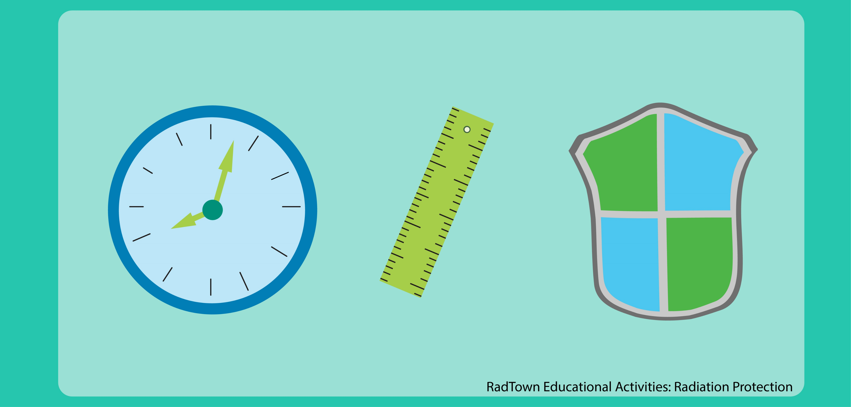





PROTECTION AGAINST RADIATION (TIME DISTANCE SHIELDING)
Presented By:- Amit Kumar, AC

Slide 2
Radiation.
Types of Radiation hazard (Internal, External)
Describe effect of TDS.
Define HVL and TVL.
Conclusion
OBJECTIVES
Upon completion of this lesson you will be able to:

Slide 3
CAN HUMAN BEINGS SENSE THE RADIATION?
No

Slide 4
RADIATION
Transmission of energy as particles or as electromagnetic waves from the nucleus of an atom .
Radiation are two type
1 Ionizing Radiation
2 Non- Ionizing Radiation

Slide 5
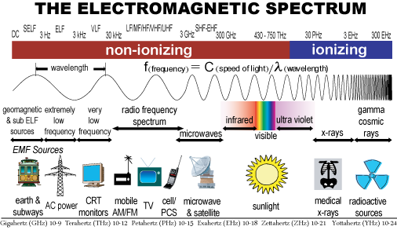
RADIATION

Slide 6
TYPE OF RADIATION HAZARDS
Radiation hazards are broadly classified as:
External Radiation Hazard: External radiation hazards occur when the source of radiation is outside body .
Internal Radiation Hazard: Internal radiation hazards results when the body is contaminated internally with a radioisotope.

Slide 7
PROTECTION AGAINST INTERNAL EXPOSURE
Use additional caution with potential sources of airborne radiation.
No eating, drinking, smoking in potentially contaminated areas .
Wear proper protective equipment.
Cover open wounds.
Perform frequent surveys.

Slide 8
PATHWAYS OF INTERNAL EXPOSURE
Inhalation (Nose)
Ingestion (food & Water)
Injection (Through Cut And Wounds)

Slide 9
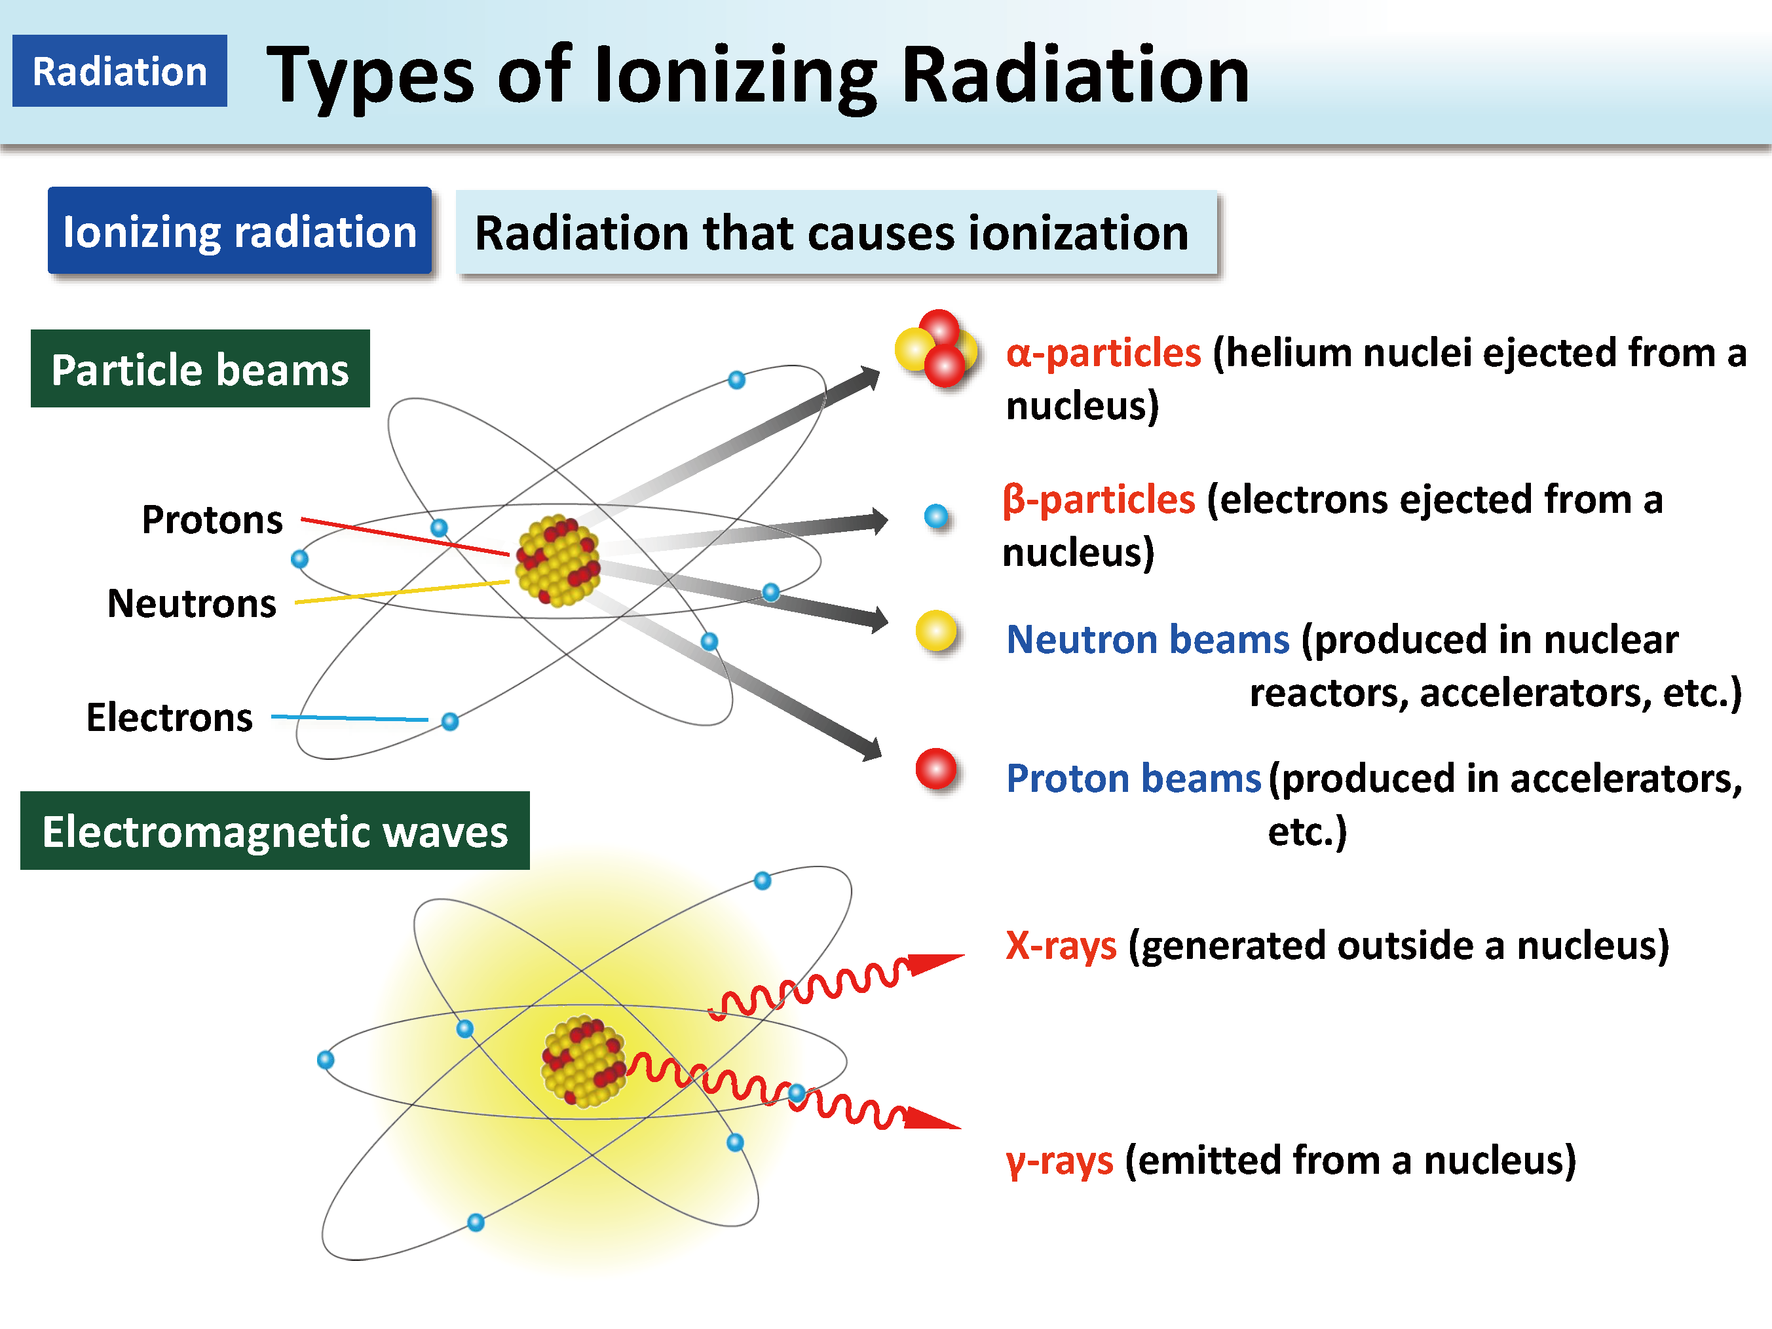
IONIZING RADIATION

Slide 10
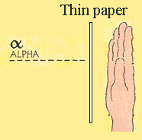
ALPHA PARTICLE
Weight : Heavy
Range in air : < 5 cm
Charge : +2
Shielding : A sheet of paper
Hazard : Internal only

Slide 11
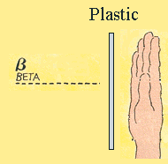
BETA PARTICLE
Charge : -1
Weight : very light
Range in air : Energy dependent
Hazard : Both internal & external
Shielding : Low Z (ie Lucite , plastic)

Slide 12
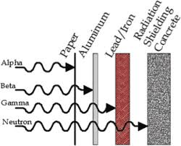
PENETRATION POWER OF RADIATION

Slide 13
PENETRATION POWER OF RADIATION
α
Paper
Plastic
Lead
Concrete
++
Alpha
Beta
Gamma and X-rays
γ
n
Neutron

Slide 14
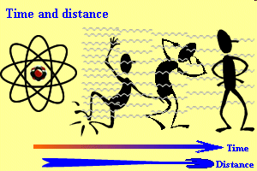
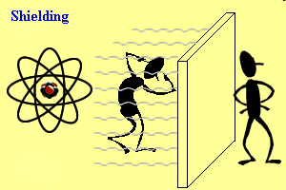
RADIATION PROTECTION TECHNIQUES
ALARA Principle
The three basic factors by which external radiation hazard can be controlled are :
Time
Distance
Shielding

Slide 15
TIME
Time is used as a safety factor by keeping the time of exposure to a practical minimum to execute the work. The dose received by a individual for a given exposure time follows the simple equation.
Total Dose = Dose Rate x Exposure time
Thus, lesser the time spend near the radioactive source, lesser would be radiation dose.

Slide 16
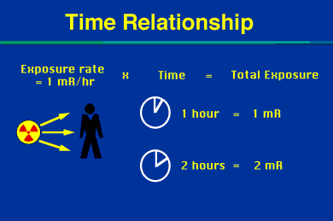
TIME RELATIONSHIP

Slide 17
TIME MANAGEMENT
Minimize the time of exposure.
Any work with radiation source should be planned in advance.
Dummy operations should be carried out to familiarize the anticipated situations.
Work should be shared by the group/staff to minimize the individual dose.

Slide 18
DISTANCE
The most effective and economical method of reducing external radiation hazard is to increase the distance between the radiation source and the person at work.
The intensity of radiation falls off by the square of distance from the source. This is known as inverse square law.

Slide 19
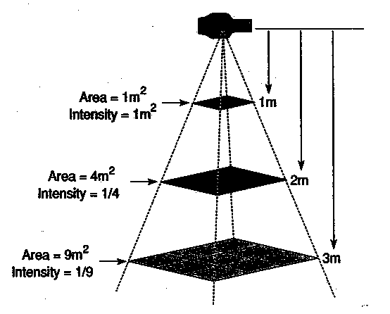
DISTANCE EFFECT

Slide 20
DISTANCE EFFECT
Mathematically it can be expressed as
R = k/D²
Where R-Rad. Dose, D- Distance from source
and k-constant for particular radioactive source.
As k is constant for particular source and if source is not changed then we have
I₁D₁² = I₂D₂²
where,
I₁ is the radiation intensity at distance D₁
I₂ is the radiation intensity at distance D₂

Slide 21
SHIELDING
When available maximum distance and minimum time do not bring the radiation to an acceptably low value.
Materials like concrete, steel, lead and other high Z materials are used as a shield, between x-ray or gamma radiation sources and personnel.
These shielding materials absorb the radiation.

Slide 22
SUGGESTED SHIELDING MATERIALS
Alpha : Nil
Beta : plastic sheet, Perspex, Aluminum
Gamma : sand bags, bricks, steel, concrete, lead.
X-ray : concrete, lead
Neutron : water, concrete

Slide 23
HVL & TVL
HVL - (Half value layer): -
Which reduces the intensity of radiation by one half of its initial value.
TVL (Tenth value layer): -
It is a thickness of a specified substance which reduces the intensity of radiation by one-tenth (1/10) of its initial value.

Slide 24


Radiation.
Types of Radiation hazard (Internal, External)
Describe effect of TDS.
Define HVL and TVL.
Conclusion
REVIEW

Slide 25

ANY QUESTION?

Slide 26


1. What is HVL?
Ans- It is the thickness of a specific material needed to reduce the intensity of radiation by one half of its initial value.
2. What is the full form of TDS?
Ans- Time Distance Shielding
EVALUATION

Slide 27



THANK YOU

