Slide 1




Medical First Responder Instructor Workshop
(MFRIW)
Maintaining and Storing Equipment and Supplies
Notes:
1

Slide 2
Lesson 5 Objectives
Follow the correct procedures for cleaning and maintaining the various supplies and pieces of equipment for the MFR Course.
List the basic requirements for properly storing the various supplies and pieces of equipment for the MFR Course.
Notes:
2

Slide 3
Structure of a CPR Mannequin
Adult Mannequin
Infant Mannequin

Slide 4
Structure of a CPR Mannequin Adult Mannequin
A –Mannequin Face
B – Mannequin’s Chest cover
C – Head
D –Jaw Assembly
E – Rib Plate
F- Back Section
G- Compression spring
H- Compression clicker
I- Clicker activator
J- Battery board
K- Airway package

Slide 5
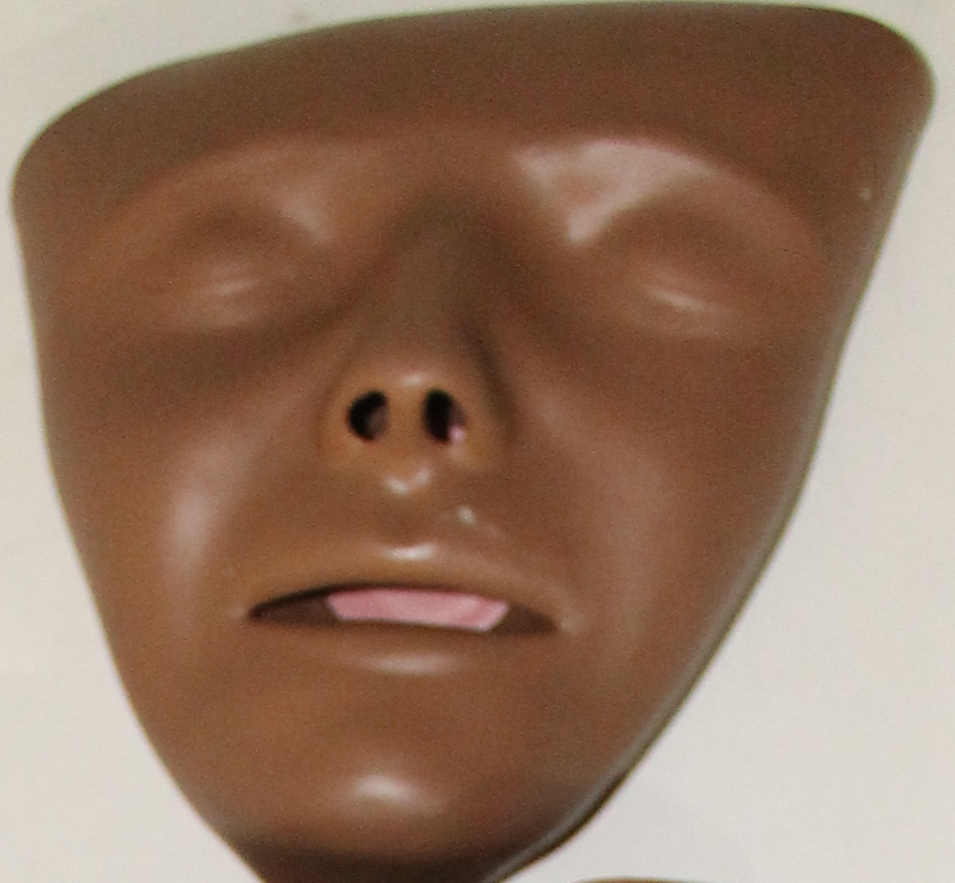
A –Mannequin Face

Slide 6
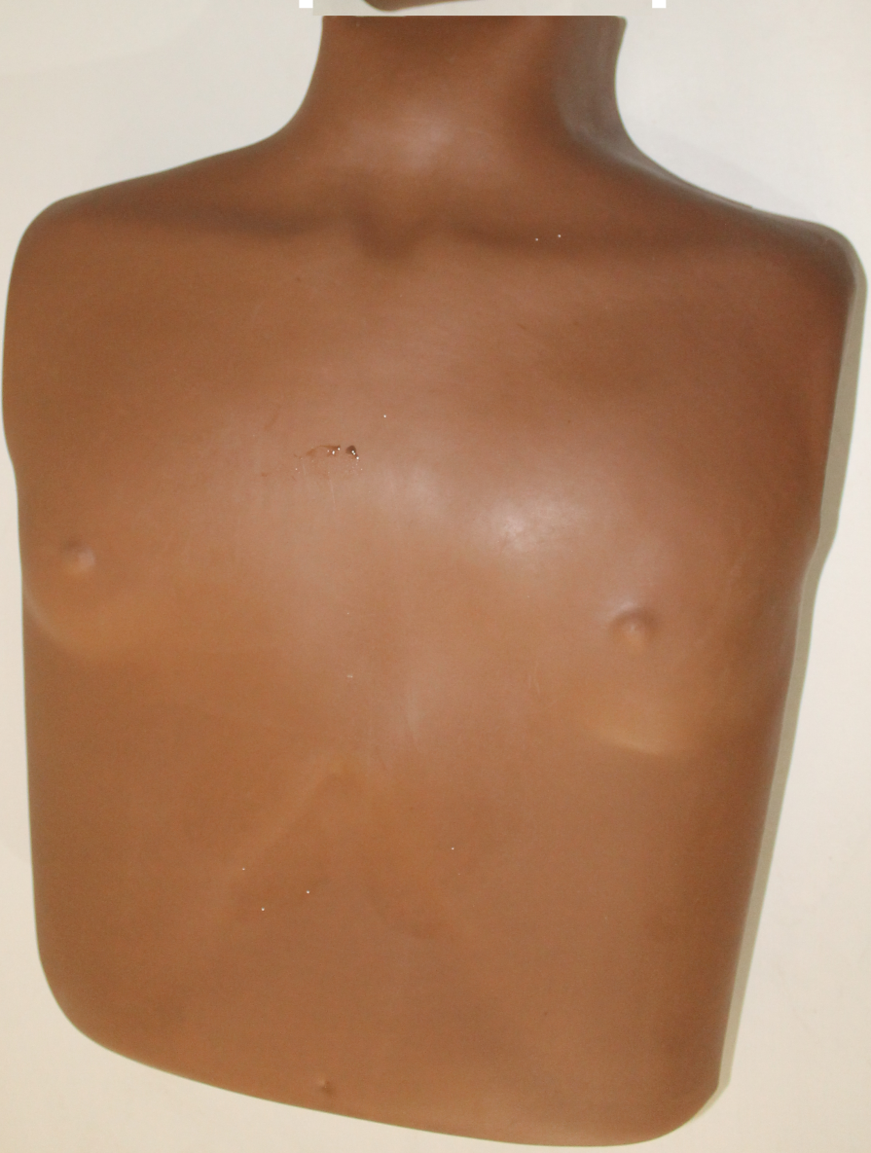
B – Mannequin’s Chest cover

Slide 7
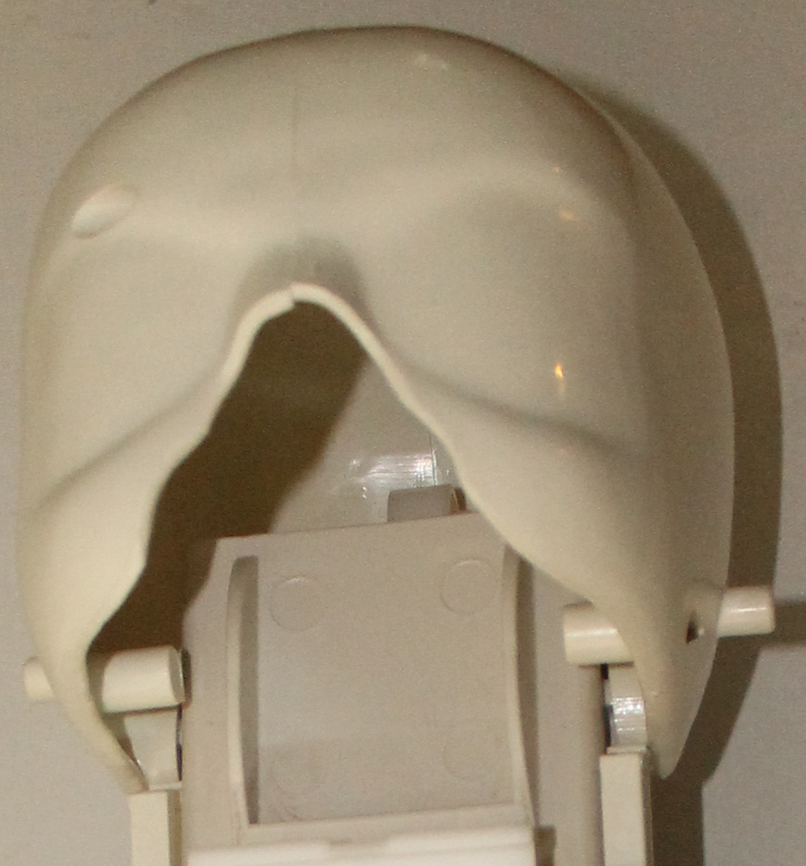
C – Head

Slide 8
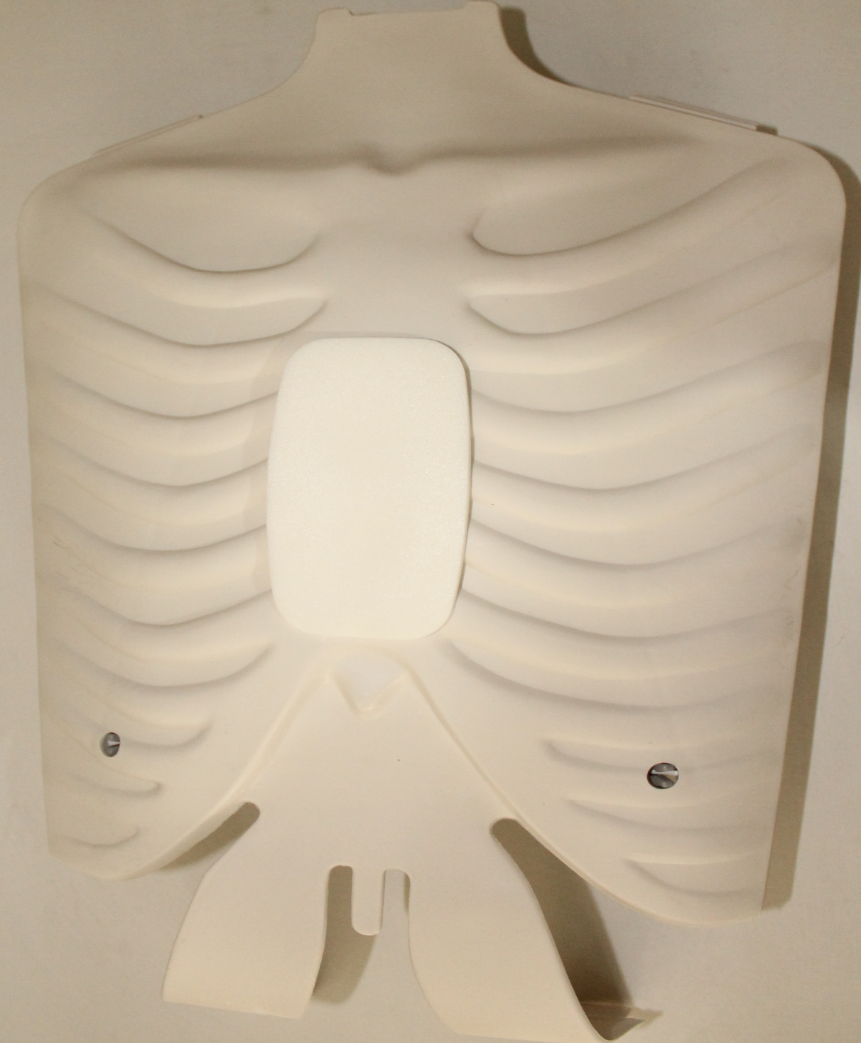
E – Rib Plate

Slide 9
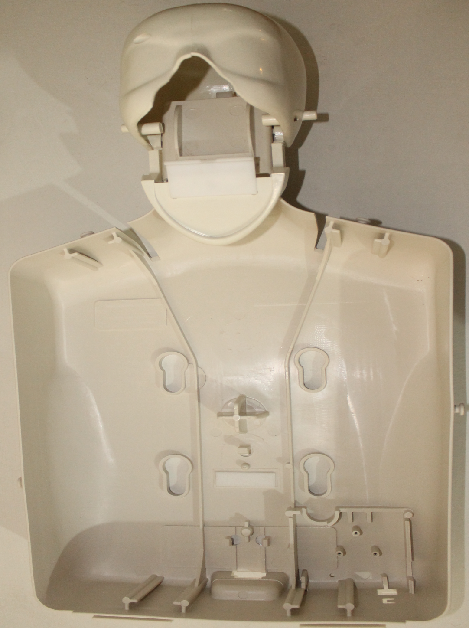
F- Back Section

Slide 10


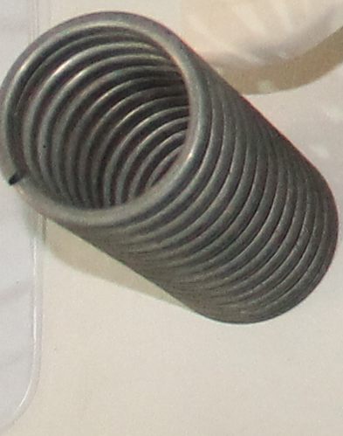
G- Compression spring

Slide 11
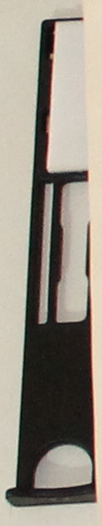
H- Compression clicker

Slide 12
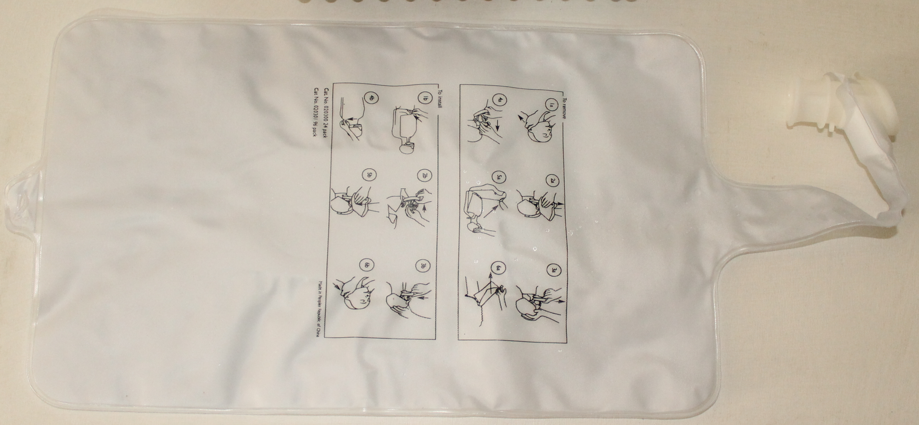
K- Airway package

Slide 13
Structure of a CPR Mannequin Infant Mannequin
A – Head of the Infant Mannequin
B –Airway assembly
C – Lung Bags
D – Infant’s Body
E – Face mask
F- Face Connector
G- Airway tubing

Slide 14
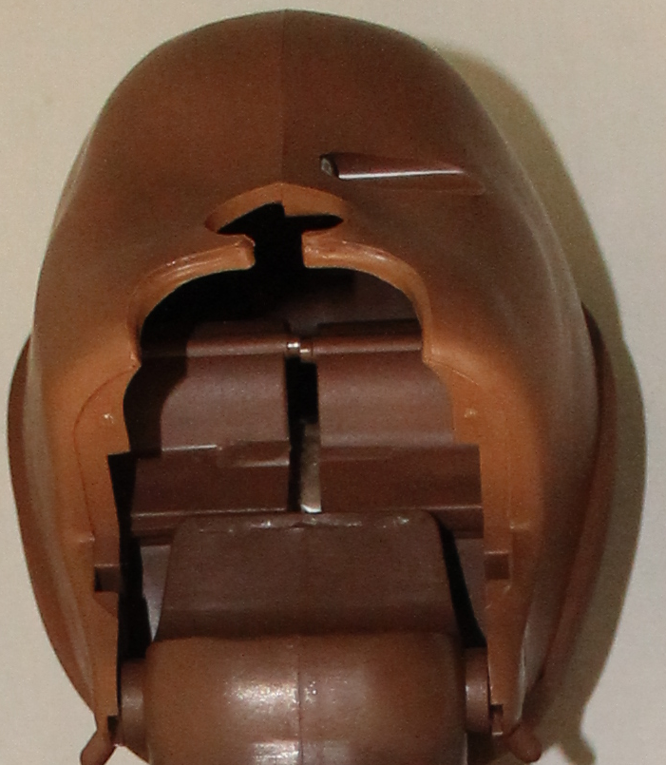
A – Head of the Infant Mannequin

Slide 15
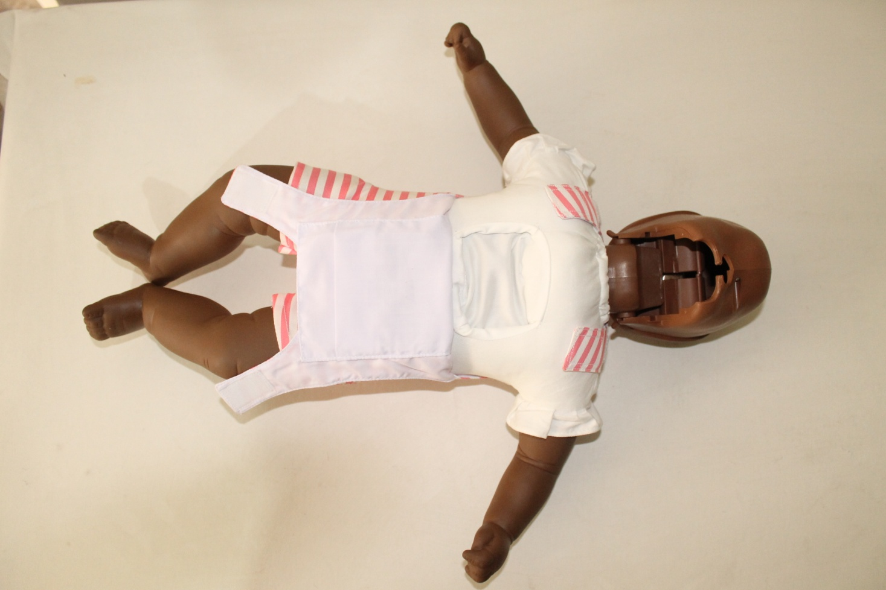
D – Infant’s Body

Slide 16
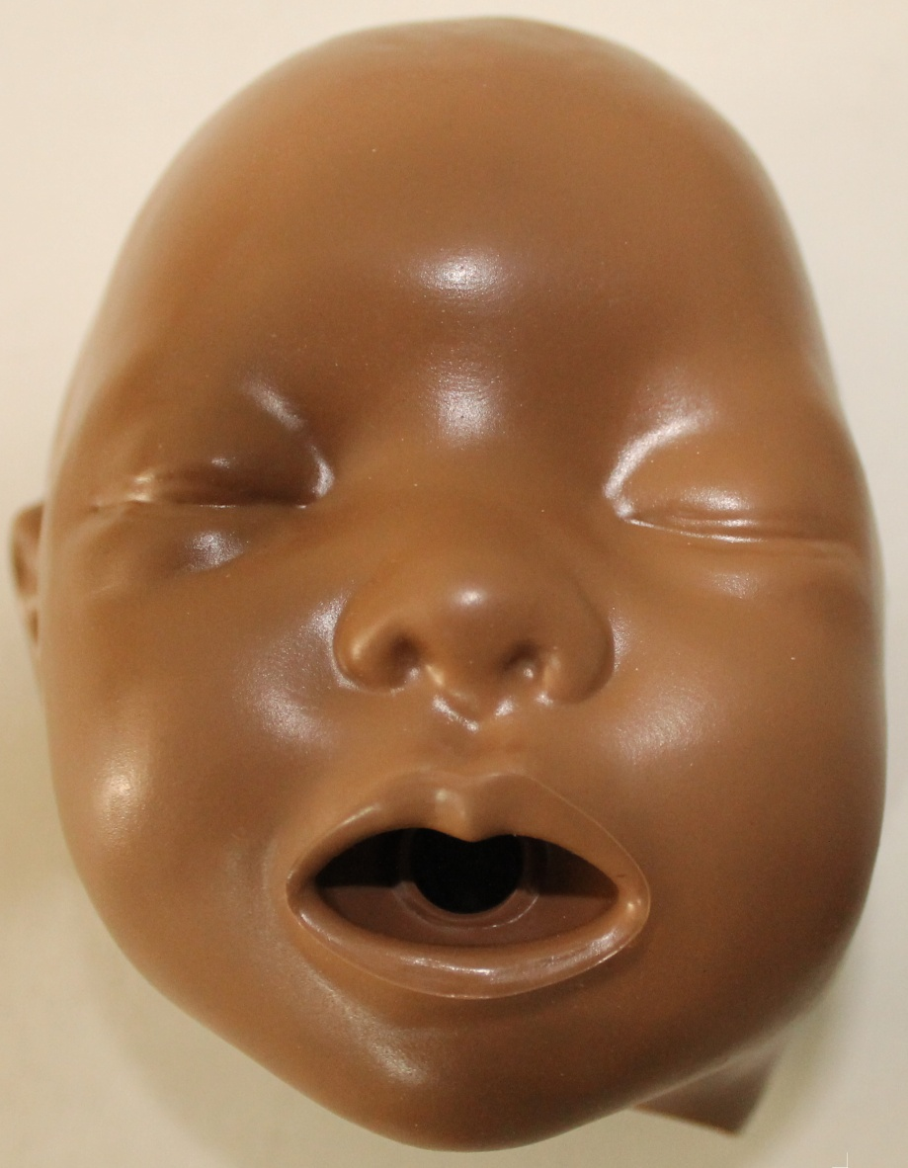
E – Face mask

Slide 17
CPR Mannequin Disassembly Adult Mannequin
Detach mannequin face at each ear
Lift mannequin face off valve coupling
Remove jaw from posts in head and Remove valve
Open chest cover
Remove used airway and discard
Remove chest plate
Remove spring and clicker

Slide 18
CPR Mannequin Assembly Adult Mannequin
Fixed clicker and spring
Lay lung flat on torso and attached to hook,
Snap airway valve on to jaw
Reattach jaw to posts in head
Fasten chest cover on to the six retainers
Push face coupling in to airway valve
Fasten face on to retainers at each ear

Slide 19
CPR Mannequin Assembly Infant Mannequin
Open the chest cover
Remove face mask assembly by unhooking the mask from the 2 pegs at the back of the skull
Install an airway by pressing the airway tubing onto the face connector. Align the lung with the face mask

Slide 20
CPR Mannequin Assembly Infant Mannequin
Reinstall the face mask / airway assembly. Guide the points on the jaw into the matching slots in the skull.
e. Position the lung into the chest cavity. Make sure the airway tubing is not bent or kinked. Close the chest cover

Slide 21
Mannequin Assembly Childbirth Mannequin
• Identify the parts of the mannequin and the needed accessories for childbirth
• Attach the placenta into the newborn mannequin
• Apply enough powder or silicon gel in the vagina and newborn mannequin. Talcum powder is preferred over silicone gel.

Slide 22
Mannequin Assembly Childbirth Mannequin
• Place the fetus mannequin inside the womb then button the womb in place
• To store, replace all accessories into the packet
• Pack all parts and accessories required in the OB bag.

Slide 23
Storing Equipment and supplies in the Med-Boxes
Have an inventory of all equipment and supplies prior to storing. Do not store any soiled linen or dressing.
Clean it before storing
Check the med kit and its contents.
Have the boxes named and place a copy of the inventory in the inside of the box for future use.

Slide 24
General Inventory
Label all boxes
Make the list of materials (current inventory and required) and label it on each box. This will serve as easy reference.

Slide 25
Lesson 5 Objectives
Follow the correct procedures for cleaning and maintaining the various supplies and pieces of equipment for the MFR Course.
List the basic requirements for properly storing the various supplies and pieces of equipment for the MFR Course.
Notes:
25

Slide 26

THANK YOU

