Slide 1

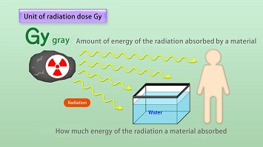




DOSIMETRIC QUANTITIES
Presented By:- Amit Kumar, AC

Slide 2
Radiation & Exposure.
Absorbed Dose.
Equivalent Dose.
Effective Dose.
Describe Weighing factors
Conclusion
OBJECTIVES
Upon completion of this lesson you will be able to:

Slide 3
RADIATION
Radiation is emission or transmission of energy in the form of particles or as electromagnetic waves from the nucleus of an atom through space or any material medium.

Slide 4
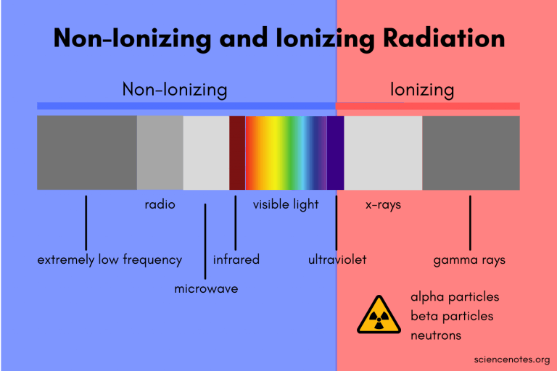
IONINZING AND
NON- IONIZING
RADIATION

Slide 5
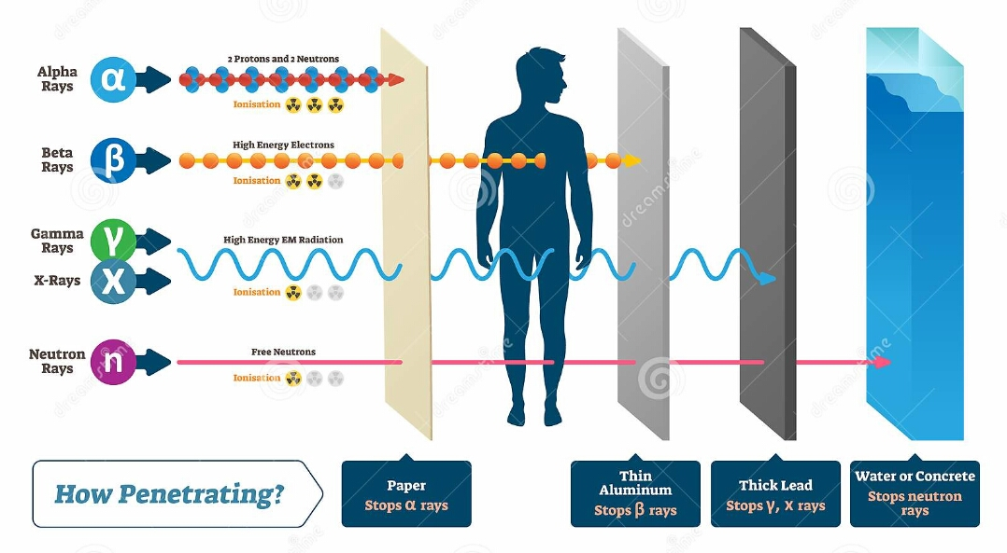
RADIATION PENETRATING

Slide 6
SEQUENCE
OF
DOSIMETRIC QUANTITIES
Radioactivity
Exposure
Absorbed dose
Equivalent dose
Effective dose

Slide 7
RADIO-
ACTIVITY
It is defined as the no. of disintegration (decay of unstable nucleus) per second of a radioactive material.
The unit of radioactivity is Becquerel (Bq) which is one disintegration or decay per second.
Earlier unit of radioactivity was Curie (Ci).
1 Ci =3.7 x 10¹⁰ Bq

Slide 8
EXPOSURE
Exposure is related to the amount of energy transferred from X or gamma rays to unit mass of air
It is the quantity of X or gamma radiation that produces ions carrying 1coulomb of charge (of either that is +ve or –ve charge) per kg in air.
SI unit of Exposure is coulomb/kg
Another & popular unit of exposure is Roentgen
1R=2.58*10⁻⁴ coulomb/kg

Slide 9
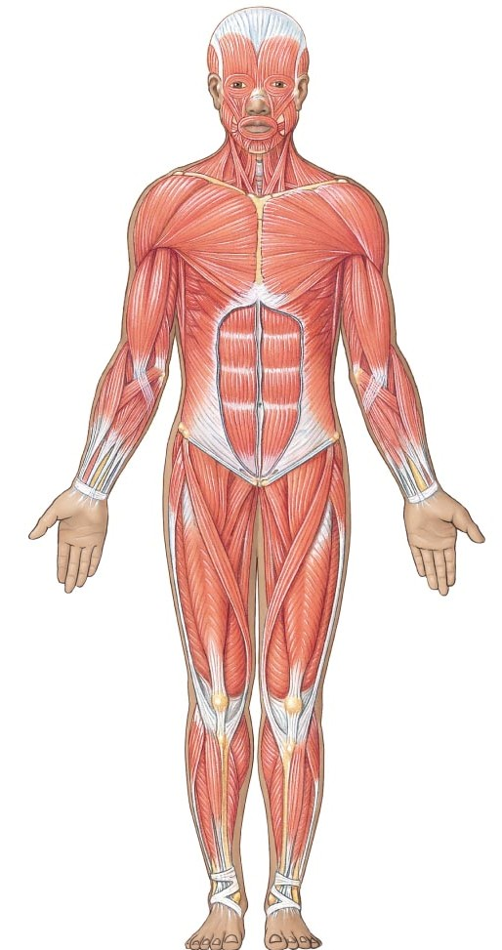
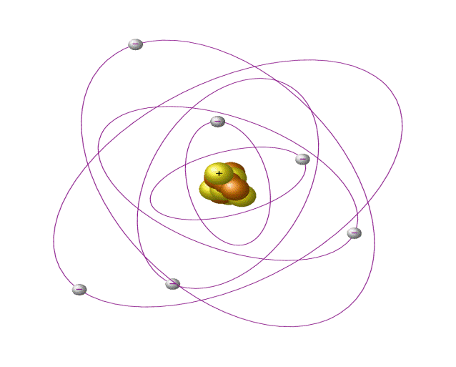
DOSE
The amount of radiation received by living or non living being is referred as dose.
The measurement of such doses is known as dosimetry.

Slide 10
ABSORBED DOSE (D)
Quantity of absorbed dose (simply Dose) at a point is the amount of energy absorbed per unit mass of the medium at that point.
The unit of Dose : Gray (Gy)
1 Gy = 100 rad
Joules/Kg is being denoted by another name Gray (Gy)

Slide 11
EQUIVALENT DOSE (H)
Equivalent dose is defined as the product of absorbed dose and Radiation Weighting Factor. The unit of equivalent dose is Sievert (Sv)
H_{T} =Σ W_{R} * D_{TR}
H_{T} is equivalent dose in Sievert.
W_{R} is Radiation Weighting Factor
D_{TR} is absorbed dose in Gray in Tissue T due to radiation R
The unit of equivalent dose is Joules/kg with the name as Sievert (Sv)
H_{T} = D_{T1}W_{R1} + D_{T2}W_{R2} + D_{T3}W_{R3} +…

Slide 12
EQUIVALENT DOSE
R₁
D_{T1}
R₃
D_{T3}
D_{T2}
R₂
H_{T} = D_{T1}W_{R1} + D_{T2}W_{R2} + D_{T3}W_{R3} +…

Slide 13
RADIATION WEIGHTING FACTORS(W_{R})
Radiation Type and Energy Range | Radiation Weighting Factor(W_{R})
X and γ rays, all energies | 1
Neutrons: < 10 keV 10 keV to 100 keV > 100 keV to 2 MeV > 2 MeV to 20 MeV > 20 MeV 5 | 5 10 20 10 5
α particles, fission fragments, heavy nuclei | 20

Slide 14
ROENTGEN EQUIVALENT MAN (REM)
The rem is a old unit used to derive a quantity called equivalent dose.
Equivalent dose is often expressed in terms of rem.
1 Sv = 100 rem

Slide 15
EQUIVALENT DOSE
If the absorbed dose from α is 1Gy ; equivalent dose is 20 Sv.
If the absorbed dose from γ is 20Gy ; equivalent dose is 20 Sv.
Hence in terms of biological damage 1Gy of α dose is equivalent to 20Gy of γ dose.

Slide 16
EFFECTIVE DOSE
As we know, the sensitivity of different tissue to radiation is different. So to accommodate it concept of effective dose was introduced
Radiation dose may occur either as uniform exposure(whole body dose) or non uniform exposure. When non uniform exposure occurs; only certain individual tissues are likely to receive the dose.

Slide 17
EFFECTIVE DOSE
R₁
H_{T1}
H_{T2}
R₂
R₃
H_{T3}
E = H_{T1} W_{T1} + H_{T2} W_{T2} + H_{T3} W_{T3} …….

Slide 18
EFFECTIVE DOSE
The Effective dose is computed by multiplying the tissue dose by a Tissue weighting factor (W_{T} ) appropriate to the tissue.
Effective Dose(E) = Σ W_{T}* H_{T}
Unit of effective dose = sievert

Slide 19
TISSUE WEIGHTING FACTORS(W_{T})
Organ | Tissue weighting factor W_{T}
Gonads | 0.20
Colon | 0.12
Bone marrow (red) | 0.12
Lung | 0.12
Stomach | 0.12
Bladder | 0.05
Chest | 0.05
Liver | 0.05
Thyroid gland | 0.05
Oesophagus | 0.05
Skin | 0.01
Bone surface | 0.01
Adrenals, brain, small intestine, kidney, muscle, pancreas, spleen, thymus, uterus (the weighting factor 0.05 is applied to the average dose of these organs) | 0.05

Slide 20
RADIATION UNIT
Quantity | Symbol | SI Unit Name | Conversion
Absorbed Dose | D | Gray (Gy) | 1 Gy = 100 Rad
Equivalent Dose | H | Sievert (Sv) | 1 Sv = 100 Rem
Effective Dose | E | Sievert (Sv) | 1 Sv = 100 Rem

Slide 21
ANNUAL LIMITS FOR RADIATION EXPOSURE
Occupational workers - 20 msv
General public - 1 msv
These limits are in addition to exposures from natural and medical sources.
A simple chest X-ray gives 0.2 msv!!!

Slide 22


Radiation & Exposure.
Absorbed Dose.
Equivalent Dose.
Effective Dose.
Describe Weighing factors
Conclusion
REVIEW

Slide 23

ANY QUESTION?

Slide 24


1. The absorbed dose is denoted by the symbol..
Ans- D
2. 1 Sievert is equal to …… REM.
Ans- 100 REM
EVALUATION

Slide 25



THANK YOU

