Slide 1

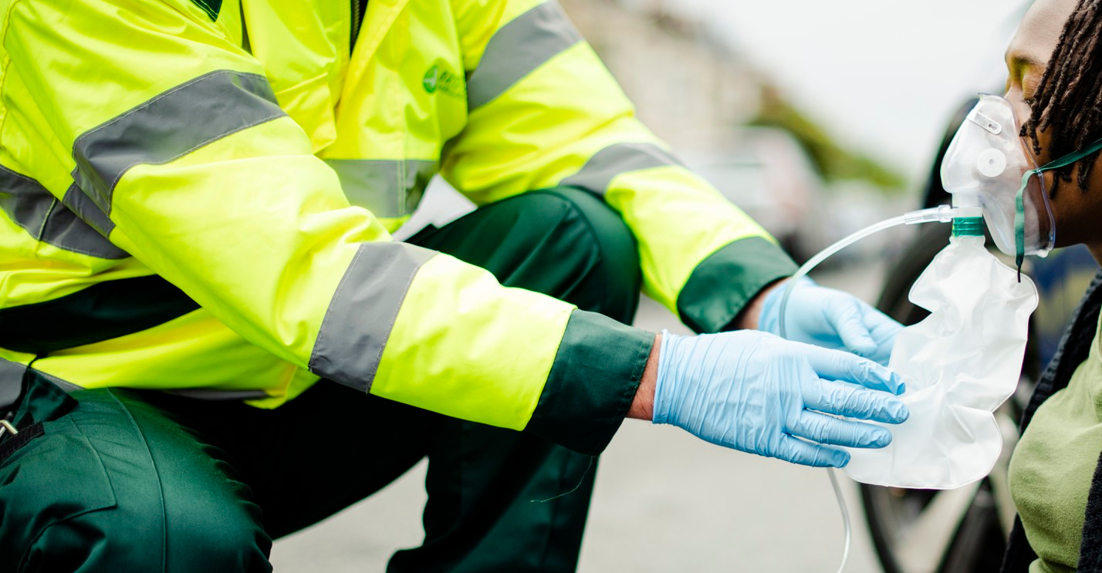






LESSON 4
The Incident
Photo Credit: Freepik
PPT 4 -
PEER | MFR | INDIA
PPT 4 - 1

Slide 2
OBJECTIVES
Upon completing this lesson, you will be able to:
1
  List the five items of information to obtain when receiving a call for assistance.
  List five factors to consider when responding to a call.
  List the three steps for scene size-up,
  in proper order.
2
3
PEER | MFR | INDIA
PPT 4 -

Slide 3
OBJECTIVES
Upon completing this lesson, you will become familiar with:
  List the six items of information that should be included in the initial report when arriving at the scene.
  List three priorities when securing the scene.
4
5
PEER | MFR | INDIA
PPT 4 -

Slide 4
OBJECTIVES
Upon completing this lesson, you will be able to:
6
  List five basic tools used to gain access to a patient trapped in a vehicle.
  List two ways to gain access to a patient trapped in a vehicle.
7
PEER | MFR | INDIA
PPT 4 -

Slide 5
Incident
An event caused by a natural phenomenon or human activity that requires the intervention of emergency service personnel to prevent or mitigate loss of life and damage to property and the environment.
PEER | MFR | INDIA
PPT 4 -

Slide 6
Steps to Assess
the Scene
What is the current situation?
Where is it going?
How do I control it?
(operations and resources needed)
PEER | MFR | INDIA
PPT 4 -

Slide 7
Reporting
Address/Location
Incident type
Environmental conditions
Current situation
Number of victims
Resources needed
PEER | MFR | INDIA
PPT 4 -

Slide 8
Securing
the Scene
Place vehicle properly
Isolate and mark the scene
Mitigate risks
PEER | MFR | INDIA
PPT 4 -

Slide 9
Basic Tools
Pliers
Screwdriver
Tin snips
Hammer
Knife
Rope
Kelly tool
Padlock remover
Pry bar
Vise grip
Axe
Hacksaw
Rubber mallet
Automatic center punch
Personal protective equipment
PEER | MFR | INDIA
PPT 4 -

Slide 10
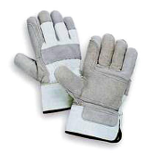

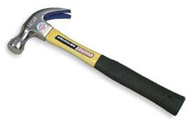
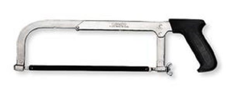

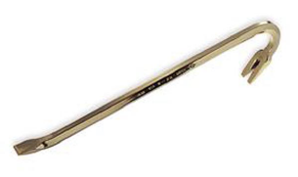
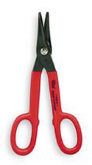
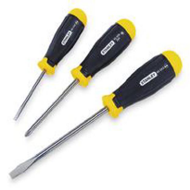
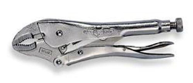
PEER | MFR | INDIA
PPT 4 -

Slide 11


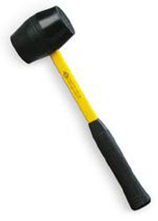
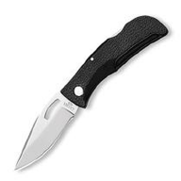
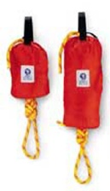
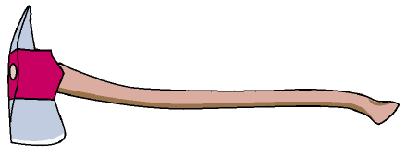
PEER | MFR | INDIA
PPT 4 -

Slide 12

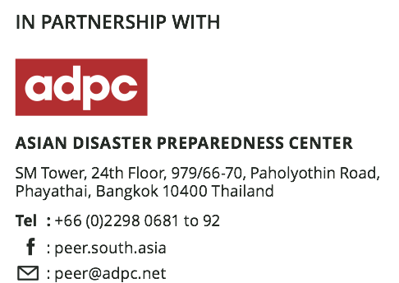

PEER | MFR | INDIA
PPT 4 -

Slide 13


THANK YOU

