Slide 1

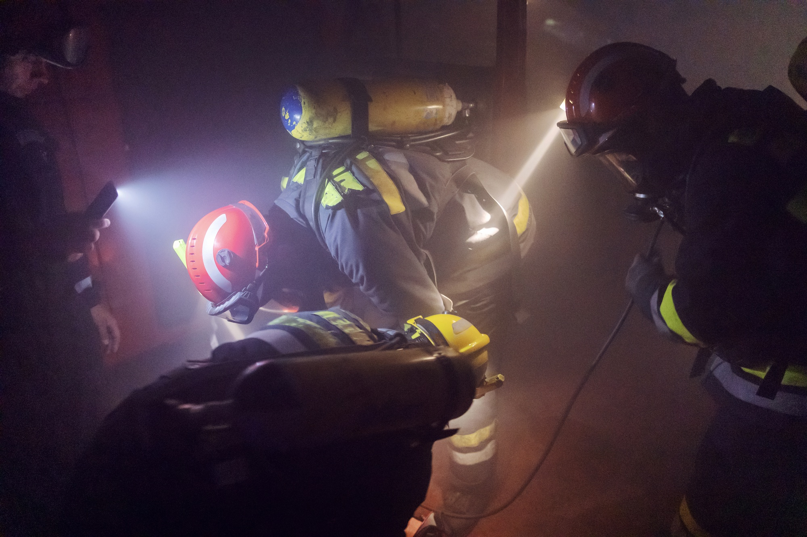






LESSON 4
Structural Triage and
INSARAG Marking System
Photo Credit: Freepik
Presented By:- Sohel Lakhani. DC
PPT 4-1
PEER | CSSR | INDIA
PPT 4 -

Slide 2
OBJECTIVES
Upon completing this lesson, you will be able to:
1
Define Sectorization, its identification and five ASR Levels.
List four categories of Worksite Triage.
List at least 8 factors to consider in worksite triage.
2
3
PEER | CSSR | INDIA
PPT 4 -

Slide 3
OBJECTIVES
Upon completing this lesson, you will be able to:
4
Define the INSARAG marking system, list and describe 8 categories of INSARAG Marking System
PEER | CSSR | INDIA
PPT 4 -

Slide 4

OCHA - UNO
UN OCHA serves as the INSARAG Secretariat of the INSARAG Steering Group.
Mandated to coordinate international assistance in disasters exceeding the capacity of the affected country.
UN OCHA works with all participants to assist the government of the affected country in an effort to ensure the most effective use of international resources.

Slide 5
International Search and Rescue Advisory Group (INSARAG)
UN Resolution 46/182 from 19th Dec 1991
INSARAG is a global network of more than 80 countries and organizations under the United Nations umbrella.
INSARAG deals with urban search and rescue (USAR) related issues, aiming to establish minimum international standards for USAR teams in earthquake response

Slide 6
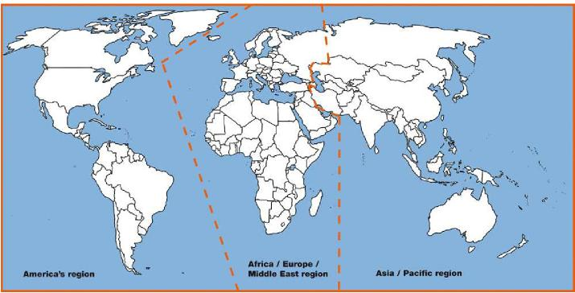
INSARAG REGIONAL GROUPS

Slide 7

UNDAC = United Nations Disaster Assessment and Coordination
UNDAC was created in 1993
It is designed to help the United Nations and governments of disaster-affected countries during the first phase of a sudden-onset emergency
UNDAC also assists in the coordination of incoming international relief at national level and/or at the site of the emergency.

Slide 8

UNDAC teams can deploy at short notice (12-48 hours) anywhere in the world.
They are provided free of charge to the disaster-affected country,
They are deployed upon the request of the United Nations Resident or Humanitarian Coordinator and/or the affected Government.

Slide 9
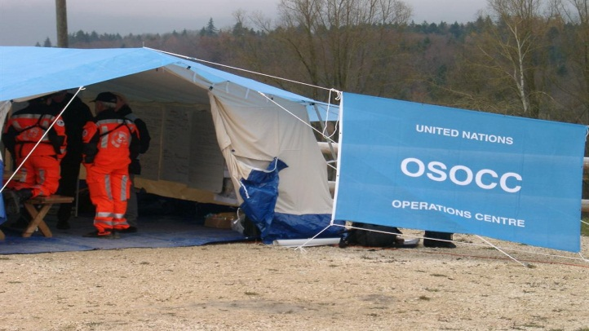
Specifically in response to earthquakes, UNDAC teams set up and manage the On-Site Operations Coordination Centre (OSOCC) to help & coordinate international Urban Search and Rescue (USAR) teams responding to the disaster.

Slide 10
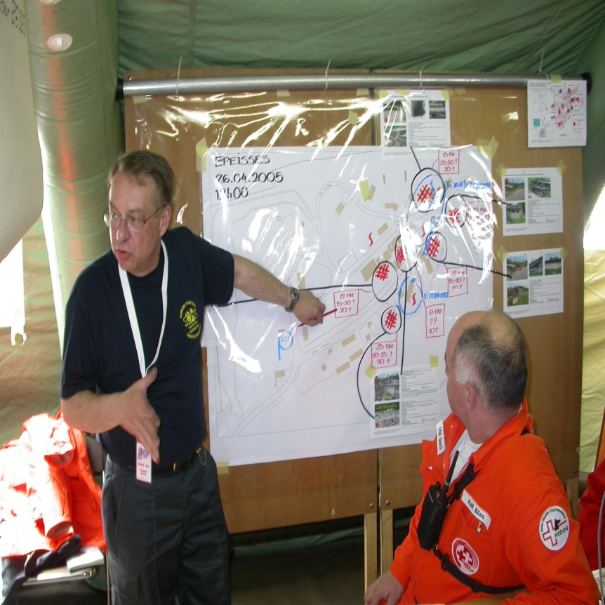
LEMA
LEMA (Local Emergency Management Authority) is the ultimate responsible authority for the overall command, coordination and management of the response operation.
LEMA can refer to national, regional or local authorities, or combinations thereof, which are collectively responsible for the disaster response operation.

Slide 11
1. Reception / Departure Centre
At entry/exit points (e.g. airports) to assist airport authorities with registration of international relief actors and facilitate their arrival and departure in terms of provision of information updates and logistics and administration support

Slide 12
Sectorization
In case of large scale events, affecting large area or numerous cities, or even more than one country, Sectorization is done to allow effective co-ordination of Search and Rescue efforts for better operational planning and effective deployment of search and rescue teams.
PEER | CSSR | INDIA
PPT 4 -

Slide 13
Sector
identification
A simple lettering system is used to code each sector, like A, B, C, D and so on and a local name or description can also be added to ensure clarity.
e.g. Sector A, Kashmir etc.
PEER | CSSR | INDIA
PPT 4 -

Slide 14
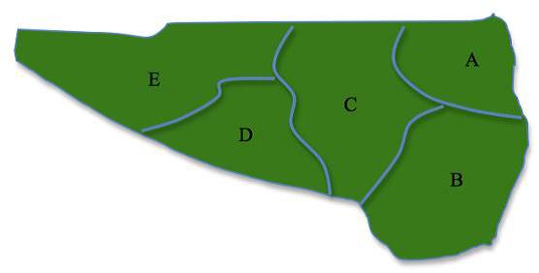
Sector
identification
PEER | CSSR | INDIA
PPT 4 -

Slide 15
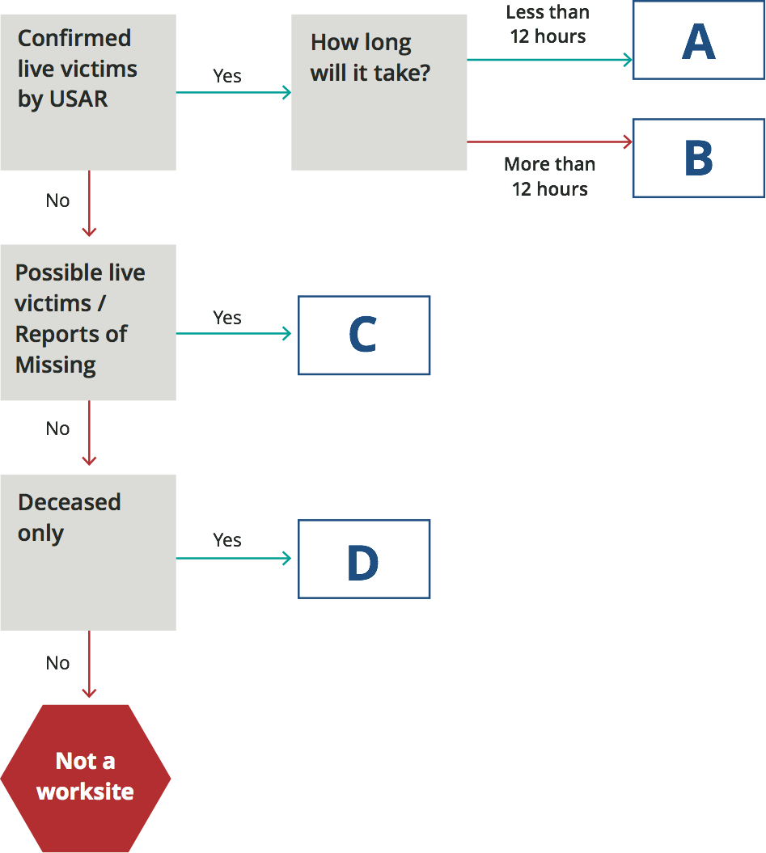
Sector Assessment
worksite Triage Category Flowchart
PEER | CSSR | INDIA
PPT 4 -

Slide 16
Factors in
Worksite Triage
Occupancy type
Type of structure
Condition of the structure
Mechanism of collapse
Day, date, and time of collapse
PEER | CSSR | INDIA
PPT 4 -

Slide 17
Factors in
Worksite Triage
(Cont.)
Prior intelligence
Availability of resources
Possible presence of hazardous materials
Location of utility shut-offs
PEER | CSSR | INDIA
PPT 4 -

Slide 18
INSARAG Marking System
The International Search and Rescue Advisory Group (INSARAG) Marking System uses symbols to identify the condition of structures, the presence of hazards and the status of victims in a standardized, simple and clear fashion that can be understood by all local, national and international rescue personnel.
The INSARAG Marking System consists of three principle Marking elements, these being:
Worksite Marking
Victim Marking
Rapid Clearance Marking
PEER | CSSR | INDIA
PPT 4 -

Slide 19
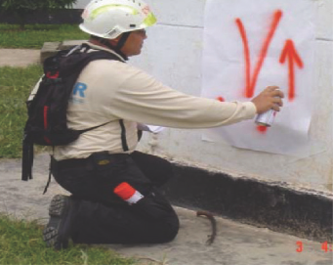
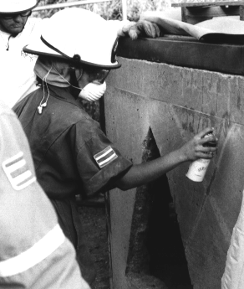
Clear Markings
All markings must be conspicuous and made using a high contrast, durable, fluorescent colour.
PEER | CSSR | INDIA
PPT 4 -

Slide 20
Marking System
Information Categories
1
General Area Marking
Structure Orientation
Cordon Markings
Worksite Marking
2
3
4
PEER | CSSR | INDIA
PPT 4 -

Slide 21
Marking System
Information Categories (Cont.)
5
Victim Marking
Rapid Clearance Marking (RCM)
Facilities and Vehicle Markings
Team and Function Markings
6
7
8
PEER | CSSR | INDIA
PPT 4 -

Slide 22
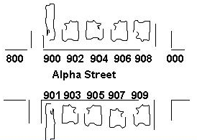
General Area Marking
Street & Number Identification
PEER | CSSR | INDIA
PPT 4 -

Slide 23
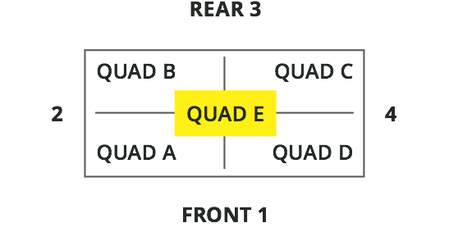
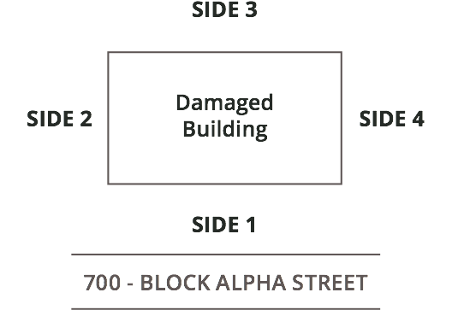
Location References — Exterior and Interior
PEER | CSSR | INDIA
PPT 4 -

Slide 24
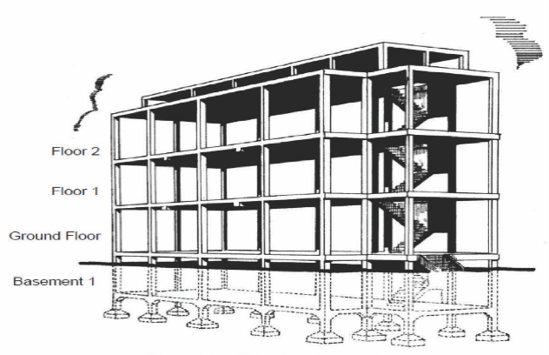
Identifying Floors
PEER | CSSR | INDIA
PPT 4 -

Slide 25
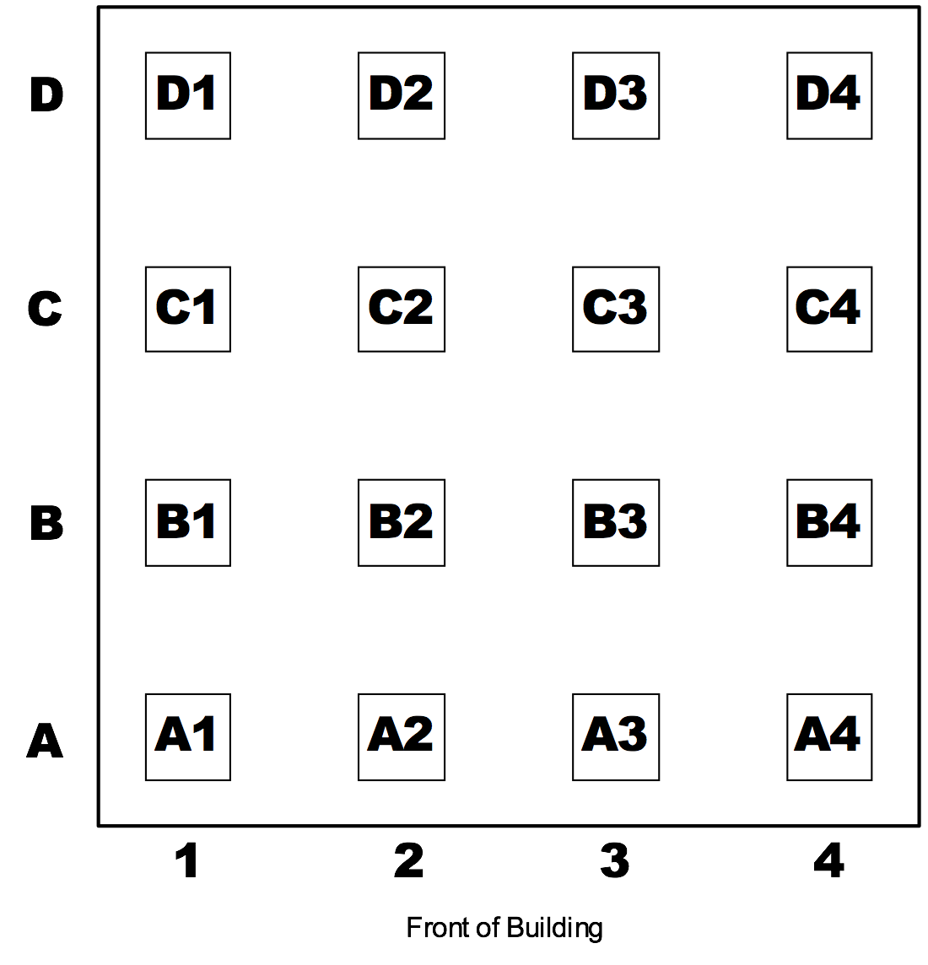
Identifying Columns/ Pillars
PEER | CSSR | INDIA
PPT 4 -

Slide 26
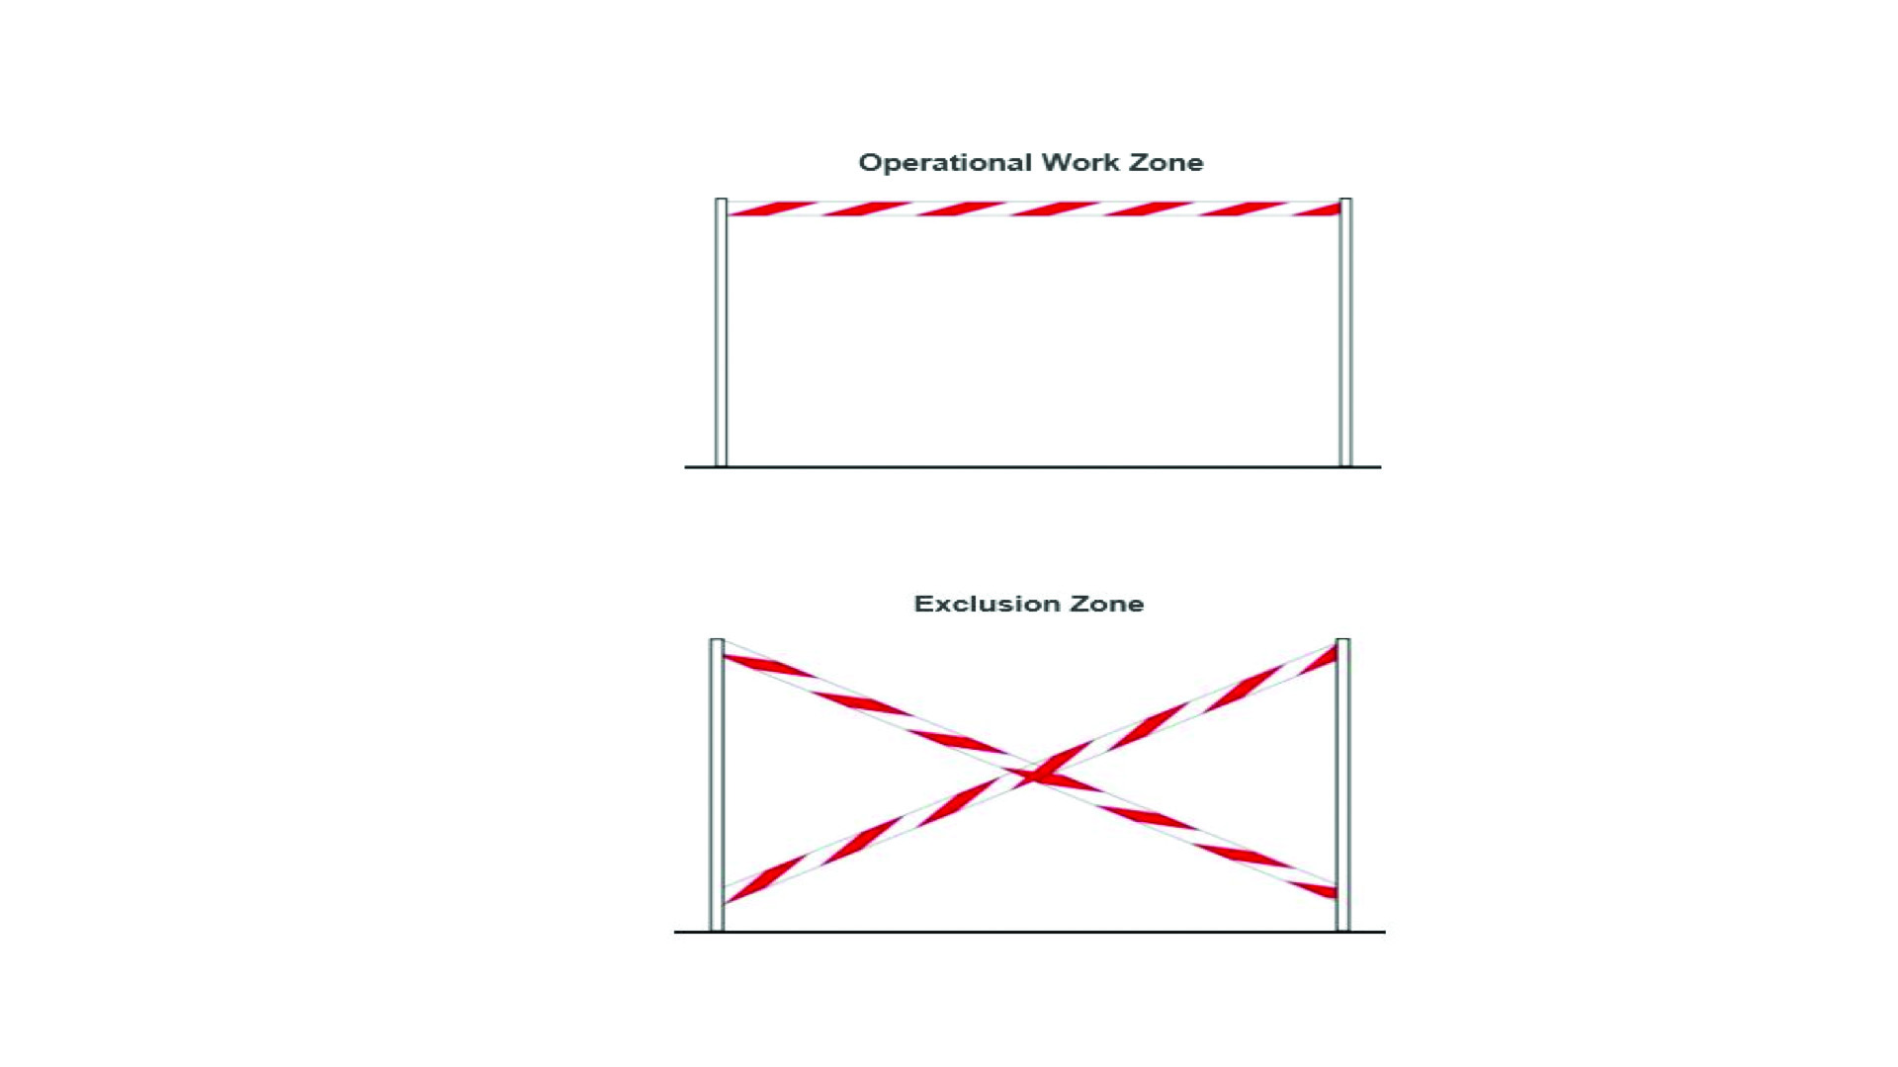
Operations Work Zone
PEER | CSSR | INDIA
PPT 4 -

Slide 27
Collapse / Hazard Zone
PEER | CSSR | INDIA
PPT 4 -

Slide 28
1 M
Place the mark at
the primary access point into the structure.
1.2 M
PEER | CSSR | INDIA
PPT 4 -

Slide 29
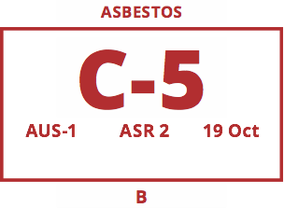
Marking Format
PEER | CSSR | INDIA
PPT 4 -

Slide 30
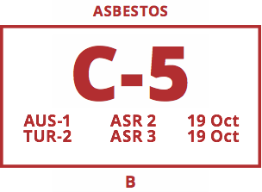
Sample Marking:
“Work in Progress”
PEER | CSSR | INDIA
PPT 4 -

Slide 31
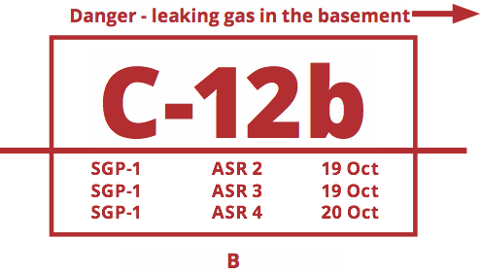
Sample Marking:
“Work Completed”
PEER | CSSR | INDIA
PPT 4 -

Slide 32
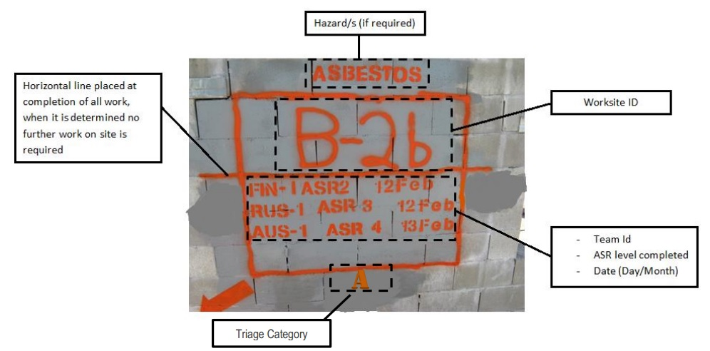
Sample Marking:
“Work Completed”
PEER | CSSR | INDIA
PPT 4 -

Slide 33

Potential Victim Location
Draw a large “V” as close as possible to the location of known or potential victim(s).
PEER | CSSR | INDIA
PPT 4 -

Slide 34
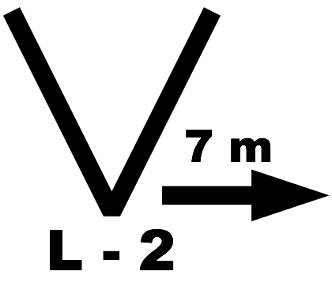
Confirmed
Live Victims
PEER | CSSR | INDIA
PPT 4 -

Slide 35
Update of Victims
PEER | CSSR | INDIA
PPT 4 -

Slide 36
Extricated
All Victims
PEER | CSSR | INDIA
PPT 4 -

Slide 37


Rapid Clearance Marking (RCM)
Clear
Deceased
PEER | CSSR | INDIA
PPT 4 -

Slide 38
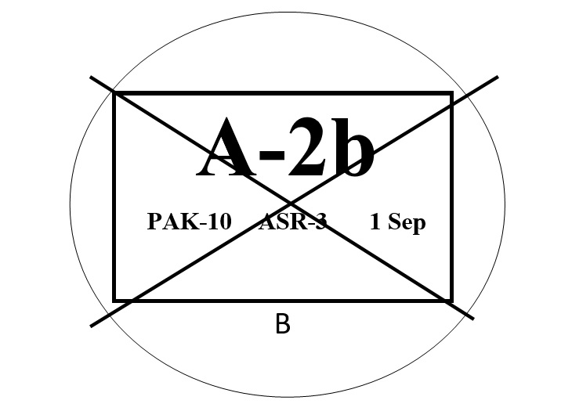
Table Top Exercise
PEER | CSSR | INDIA
PPT 4 -

Slide 39
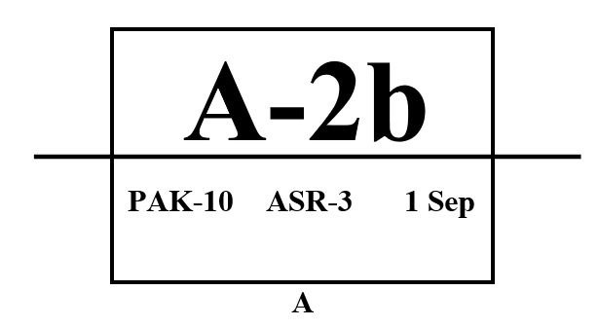
Table Top Exercise
PEER | CSSR | INDIA
PPT 4 -

Slide 40

THANK YOU

Slide 41
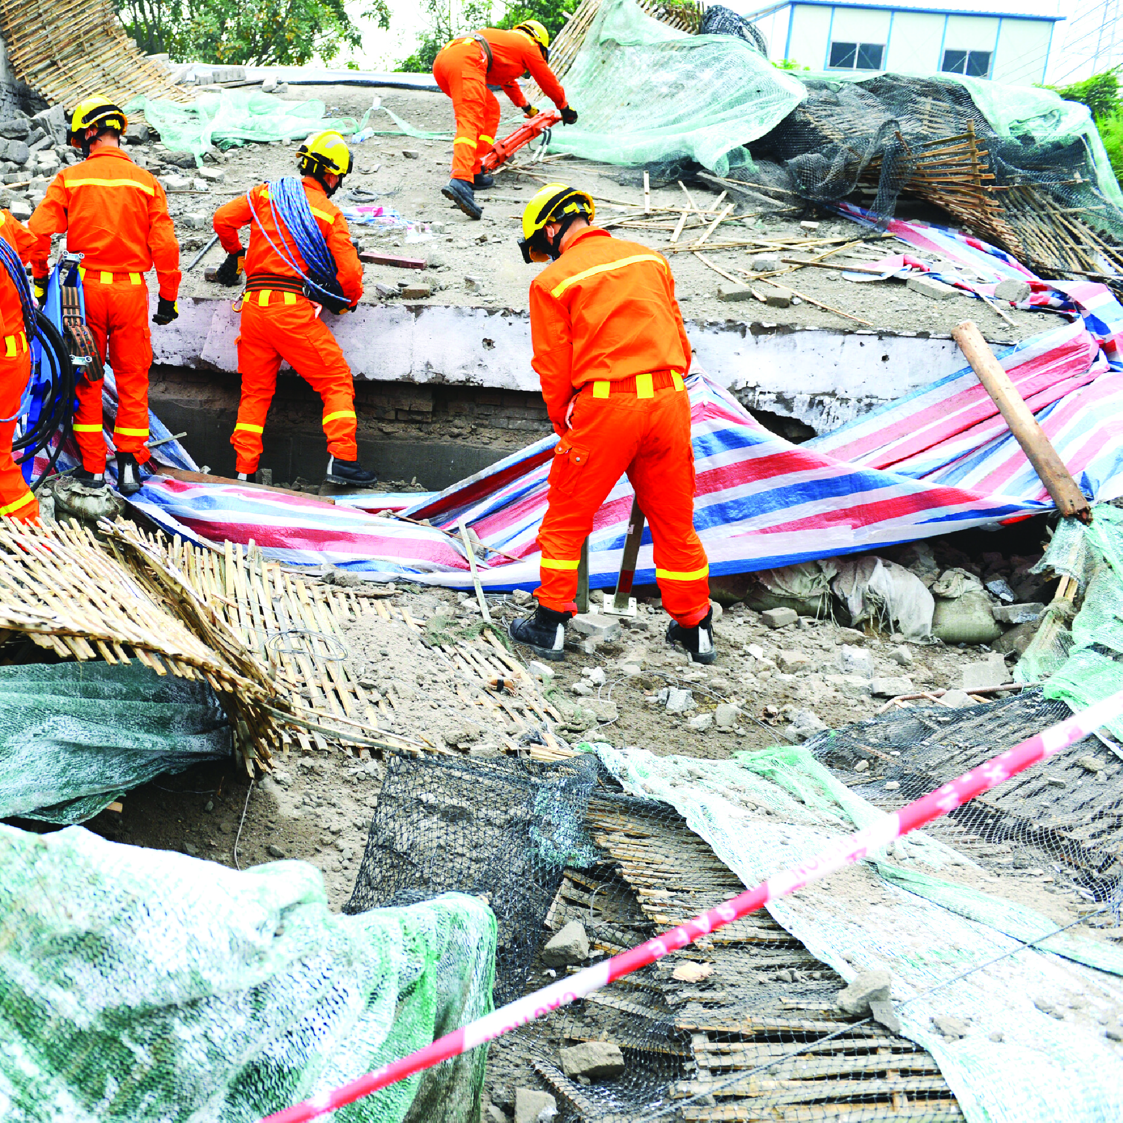


PEER | CSSR | INDIA

