Slide 1


SWIMMING SKILLS
Presented By:- Kamal Mehra,2IC

Slide 2
OBJECTIVES
Upon completion of this lesson, you will be able to learn about:-
Introduction
Styles of Swimming.
Back Stroke without use of Arm.
Side stroke use of one Arm.
Endurance swimming.
Underwater swimming.
Night Swimming.

Slide 3
INTRODUCTION
Swimming is an activity of propelling oneself through water using the limbs.
DEFINITION
Swimming is the self-propulsion of a person through water by combined arm and leg motions and the natural flotation of the body.
It can be a fun leisure and sports activity.
It is really a good low-impact way of staying in shape.
It could potentially save your life and others.

Slide 4
Cont….
IMPORTANCE:-
It helps the rescuer to overcome the fear of water and as well as build the confidence of rescuer during rescue.
It helps the rescuer to save their life as well as of other during disaster or any unforeseen situation.
It provides full body exercise.
Increases heart rate without putting stress on the body.
Improves strength.

Slide 5
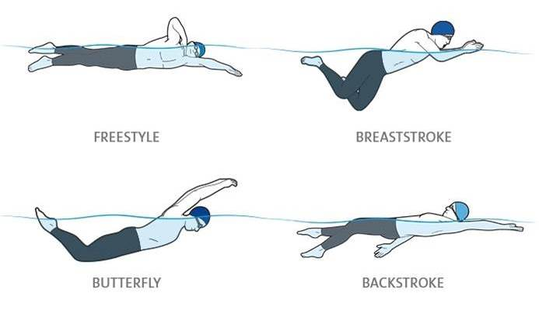
STYLES OF SWIMMING
There are four swimming strokes-
Freestyle
Backstroke
Breaststroke
Butterfly

Slide 6
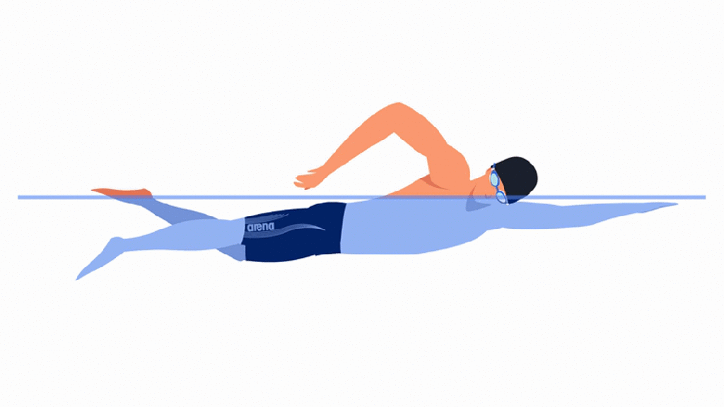
FREESTYLE
This is the most popular stroke and the easiest for beginners to learn. It is a simple flutter kick and windmill arm motion.
The leg kick:
The legs kick in an alternating order.
Bend the knees slightly.
Emphasize the down-kick for propulsion.

Slide 7
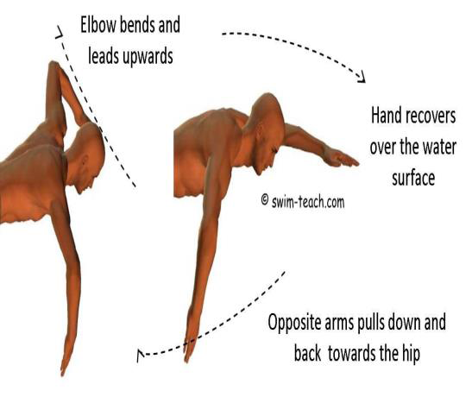
Cont…..
The arm stroke:
Move the arms in an alternating windmill motion.
Pull each arm through the water with equal strength.
Pull arms underwater in an "s" pattern.
Cup the hands but keep the wrist and hand relaxed during recovery.

Slide 8
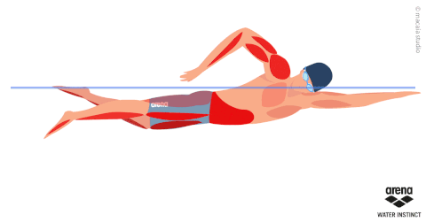
Cont….
Breathing:
Raise one arm to begin the stroke. As the shoulder rises, turn the head to catch a breath.
Take as many breaths as necessary and then exhale through the nose and mouth when the head returns to the water.
Repeat the head turn to the other side in coordination with the beginning of the opposite arm stroke.

Slide 9
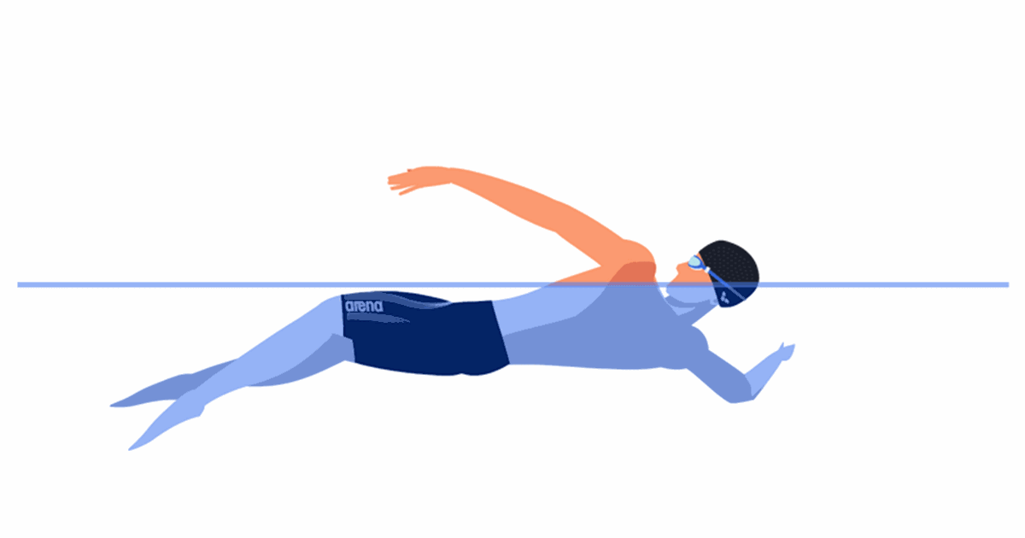
BACK STROKE
Similar to the freestyle in that you use an alternate windmill arm stroke and flutter kick.
The leg kick:
It's a flutter kick where the legs kick in an alternating order.
Bend the knees slightly.
Relax the feet and ankles (they should be almost floppy).
Emphasize the up-kick for propulsion.

Slide 10
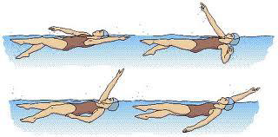
Cont…
The arm stroke:
Move the arms in an alternating, windmill pattern as they rotate and pass your face.
Cup the hands, and the thumb leaves the water first.
Move the hands in an "s" pattern when they are pushing the water.

Slide 11
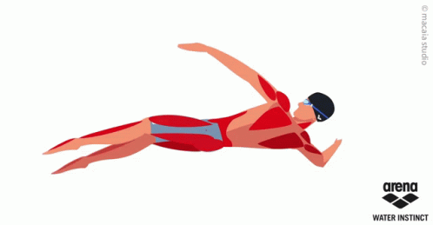
Cont….
Breathing:
Keep your head back and eyes toward the ceiling.
You can find your own breathing pattern with the backstroke .

Slide 12
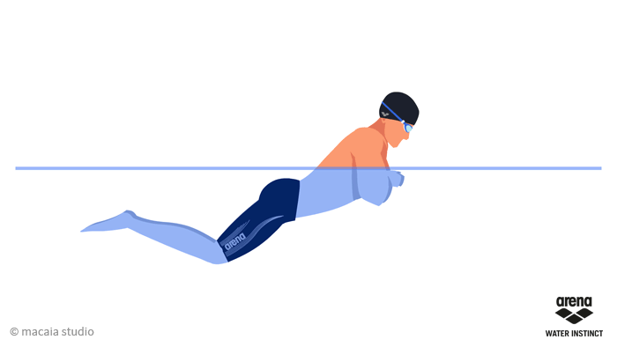
BREAST STROKE
The leg kick
Bring the knees to chest.
Thrust the legs backward and straight.
Snap the legs together to push the water and propel you forward (frog kick).

Slide 13
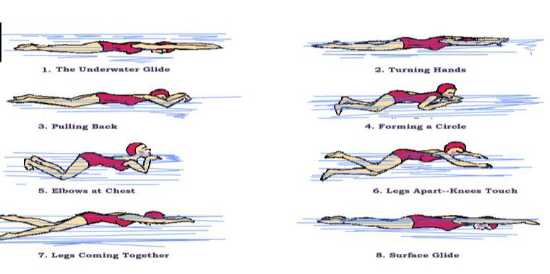
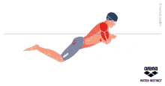
Cont….
The arm stroke
Start with the arms overhead.
Pull on the water, and bring arms toward the chest.
Keep the hands cupped.
Return arms to starting position.
Breathing:
Breathe every time you stroke with your arms.

Slide 14
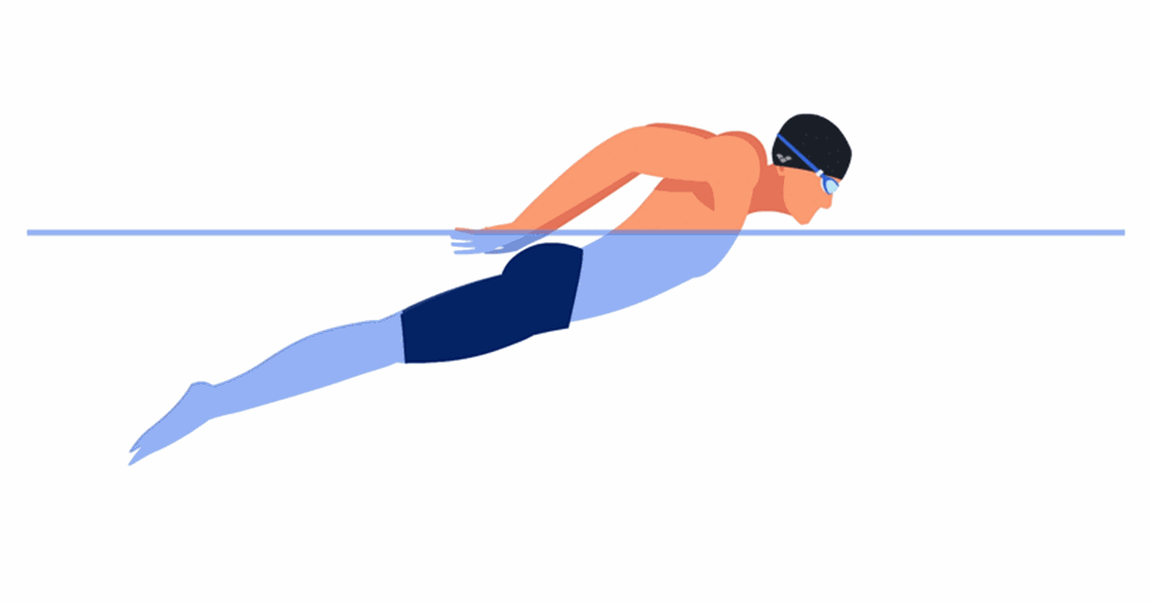
BUTTER FLY STROKE
During the stroke, the legs move together in a dolphin kick, the arms move together to push the water downward and backward.
The leg kick
Bend the knees slightly, and keep them together.
Make a downward thrust by straightening the knees and whipping the feet downward.
Two kicks for every arm stroke.

Slide 15
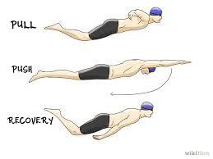
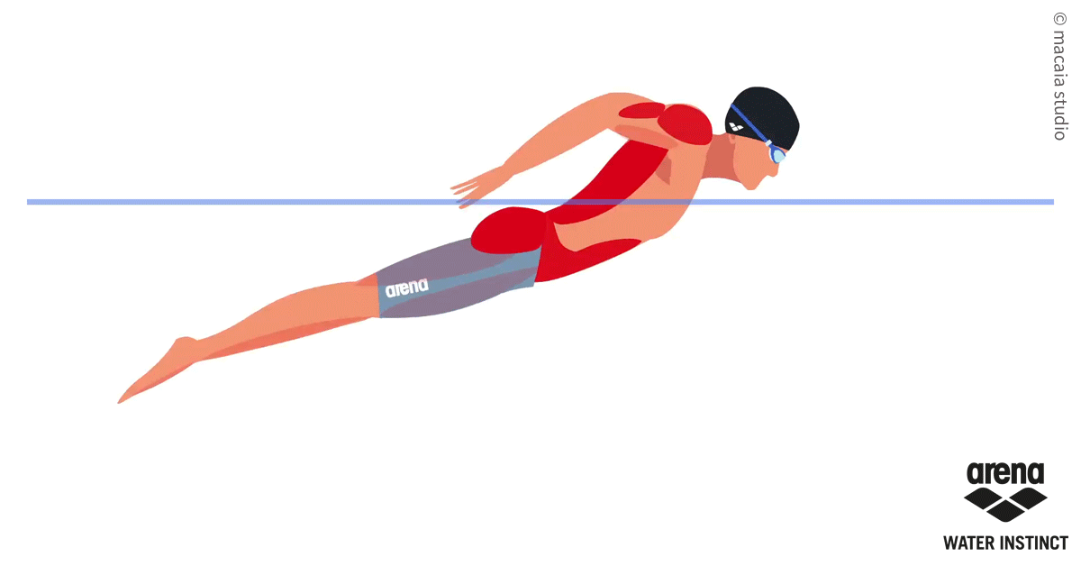
Cont….
The arm stroke:
Move the arms together, and pull through the water with the hands cupped.
Face the palms outward, and press down and outward.
Swing the arms forward above the water in a sweeping motion to complete the stroke.
Breathing:
Breathe at the end of the arm stroke.

Slide 16
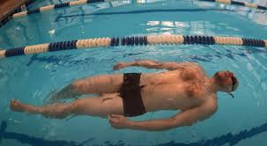
BACK STROKE WITHOUT USE OF ARMS
Body Position
Float on your back, body flat and horizontal.
Keep your head relaxed, looking up, with ears in the water.
Hips up! Engage your core to keep your hips from sinking.

Slide 17
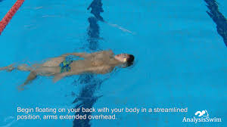
Cont..
Leg Kick (Flutter Kick)
Use a small, fast flutter kick from the hips (not the knees).
Legs should be straight but loose — knees bend slightly.
Toes pointed; don’t splash too much.
Breathing
Since you're face-up, breathe naturally — keep it relaxed and steady.
Don’t hold your breath; exhale and inhale slowly.

Slide 18
Cont..
Arm Position
If you want to stabilize without moving your arms.
Keep arms at your sides or straight by your thighs.
Or try a "streamline" position (hands together above your head) if you want more glide.

Slide 19
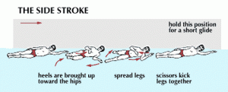
SIDE STROKE WITH USING OF ONE ARMS
Body Position
Lie on your side in the water.
Head should be above water.
Shoulders stacked, and body straight.
Keep your lower arm along your side and the top arm either extended along your body or resting on your hip (just not stroking).

Slide 20
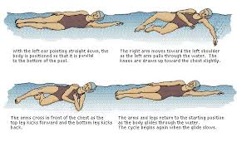
Cont…
Scissor Kick
Start with legs together, then:
Kick top leg forward, bottom leg backward — open like scissors.
Breathing
One of the easiest strokes for breathing since your face is above water.

Slide 21
ENDURANCE SWIMMING
Endurance swimming elements:-
Good Technique
Pacing
Breathing
Mental Toughness

Slide 22
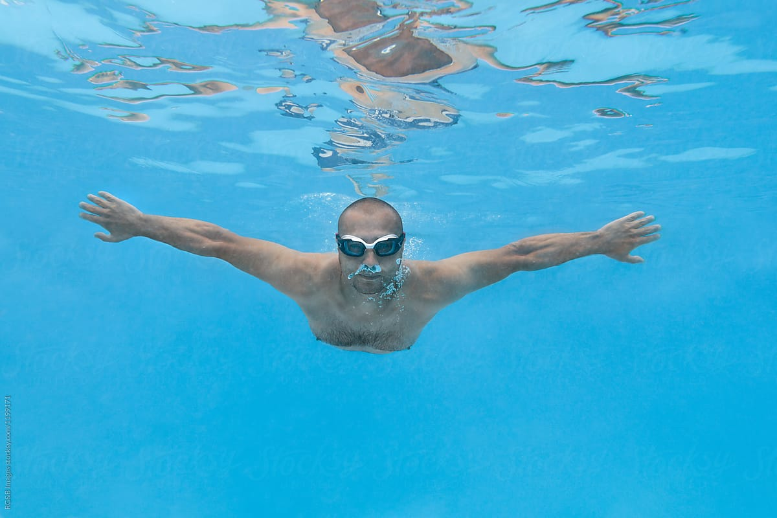
UNDER WATER SWIMMING
\Swimming underwater is an important skill to learn. It can help to develop water confidence, breath holding techniques, relaxation in the water and develop an awareness of body movement in water.

Slide 23
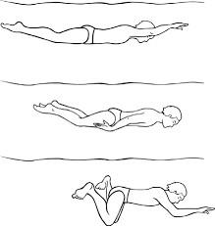
Cont…
The stroking is slow with a prolonged glide after the arm pull and a short pause after the kick.
The arm pull is extended past the hips.
The arms recover close to the body as the legs kick.
To maintain depth the head is kept low and the chin is inclined to the chest.
Eyes should be open during the underwater swim.

Slide 24
NIGHT SWIMMING
Visibility & Lighting:- If you’re in a pool, make sure the underwater and perimeter lights are on.
For open water (like a lake or ocean), wear a swim light or glow stick .
Swim with a Buddy
Wear Bright or Reflective Gear
Know Your Surroundings:- In natural water, be aware of currents, depth, obstacles, or wildlife.

Slide 25
REVIEW
The participants has learn about:-
Introduction
Styles of Swimming.
Back Stroke without use of Arm.
Side stroke with using of one Arm.
Endurance swimming.
Underwater swimming.
Night Swimming.

Slide 26
ANY QUESTION ?

Slide 27
EVALUATION
Ques-1:Which of the following is considered the fastest competitive swimming stroke? a. Breaststroke b. Backstroke c. Butterfly d. Freestyle
Ques-2 In which swimming style do both arms move symmetrically and the legs perform a frog kick?
a. Freestyle b. Backstroke c. Butterfly d. Breaststroke

Slide 28


THANK YOU

