Slide 1


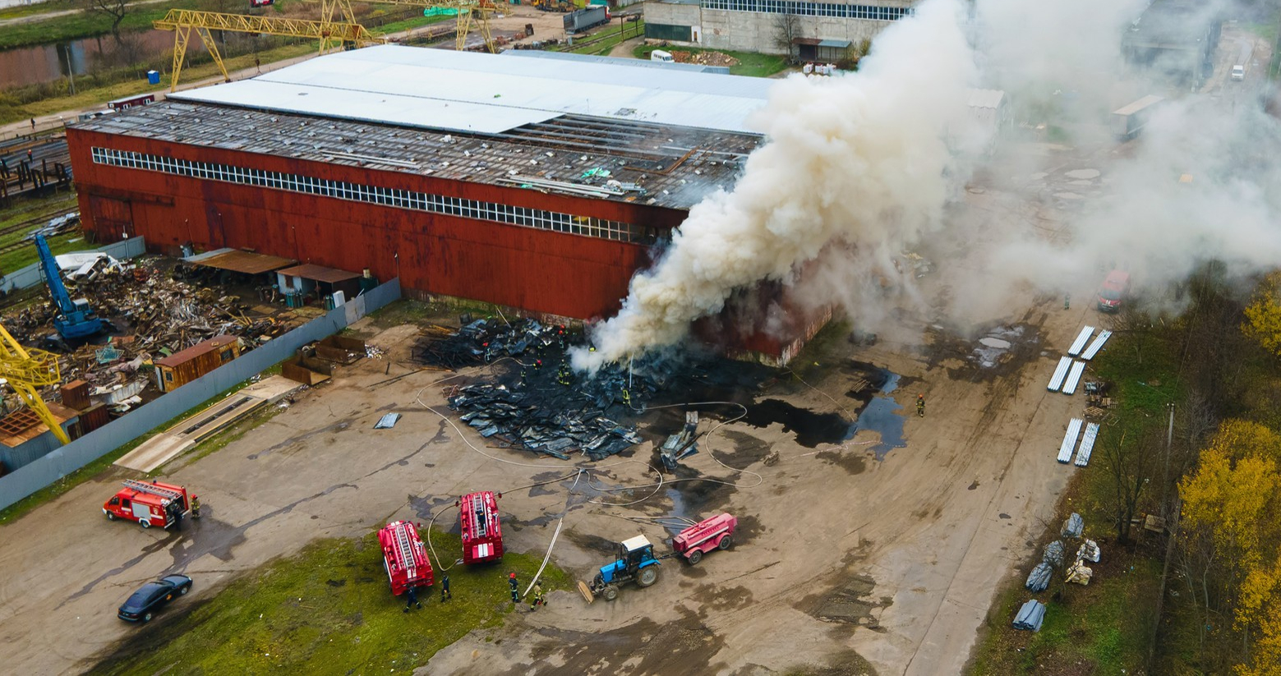





LESSON 3
Construction Materials,
Structures and
Damage Types
Photo Credit: Freepik
Presented By:- Sohel Lakhani. DC
PPT 3 -
PEER | CSSR | INDIA
PPT 3-1

Slide 2
OBJECTIVES
Upon completing this lesson, you will be able to:
1
Define construction materials and classify them by their composition types and uses.
List and describe three forces that can affect construction materials.
List three properties of each material: concrete, steel and wood.
Describe two methods of construction.
2
3
4
PEER | CSSR | INDIA
PPT 3 -

Slide 3
OBJECTIVES
Upon completing this lesson, you will be able to:
5
List four types of structures.
List at least three characteristics of
a building in each of the following
four categories:
general
architecture
structural elements
non-structural elements
6
PEER | CSSR | INDIA
PPT 3 -

Slide 4
OBJECTIVES
Upon completing this lesson, you will be able to:
7
List and describe two types of damage in a structure and their potential resulting failures.
Name and describe the four basic collapse patterns.
8
PEER | CSSR | INDIA
PPT 3 -

Slide 5
Construction
Materials
Classified by composition
Organic materials
Stone
Metal
Conglomerates
Ceramics
Glass
Plastics
PEER | CSSR | INDIA
PPT 3 -

Slide 6
Construction
Materials
Classified by Use
Structural/load-bearing elements
Decorative elements
Non-structural walls and partitions
Covering elements (roofing)
PEER | CSSR | INDIA
PPT 3 -

Slide 7
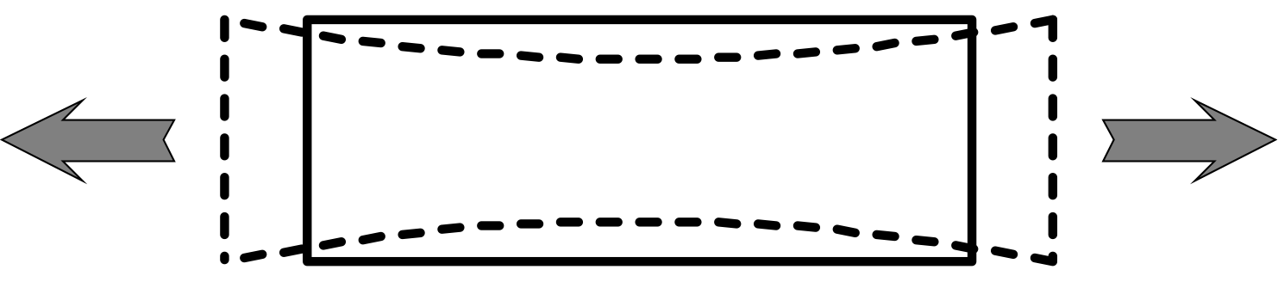
Tension
PEER | CSSR | INDIA
PPT 3 -

Slide 8
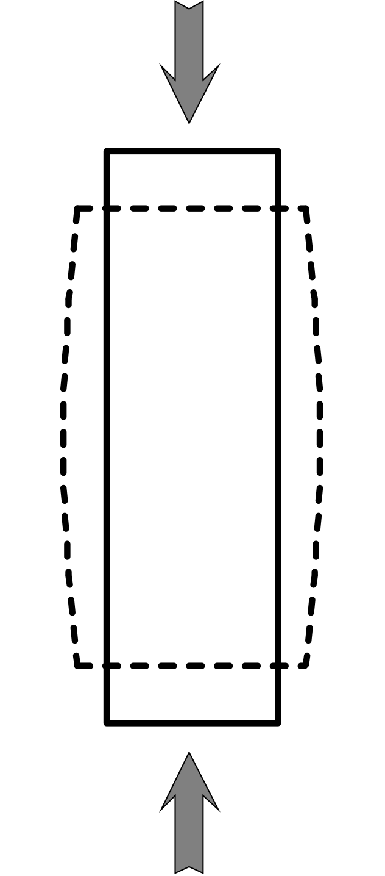
Compression
PEER | CSSR | INDIA
PPT 3 -

Slide 9
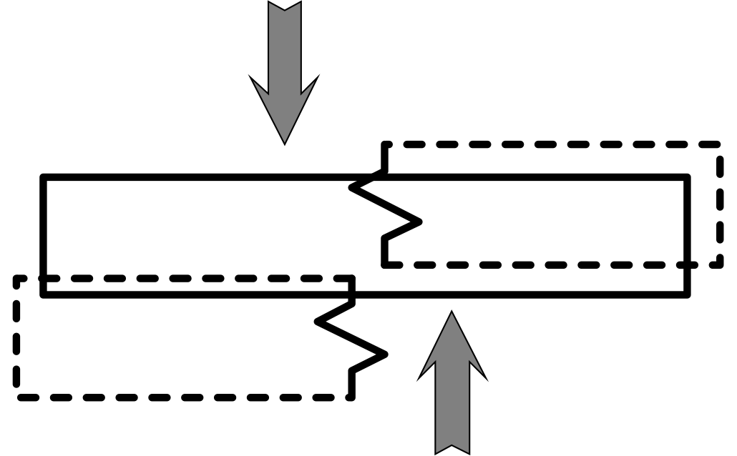
Shear
PEER | CSSR | INDIA
PPT 3 -

Slide 10
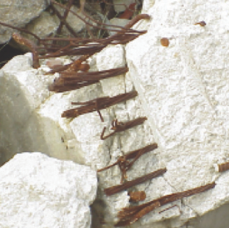
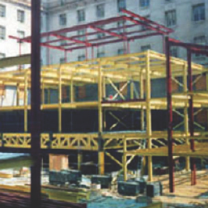
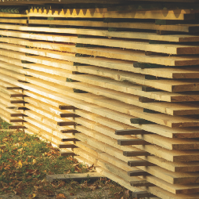
Properties of Construction Materials
Concrete
Steel
Wood
PEER | CSSR | INDIA
PPT 3 -

Slide 11
Methods of Construction
UNFRAMED STRUCTURES: those in which the weight of the floors and roof are supported by the bearing walls.
PEER | CSSR | INDIA
PPT 3 -

Slide 12
Methods of Construction
FRAMED STRUCTURES: consist of a structural steel or reinforced concrete skeleton made of horizontal beams and vertical columns.
PEER | CSSR | INDIA
PPT 3 -

Slide 13
Structural Types
Light frame
Heavy wall
Heavy floor
Pre-cast concrete
PEER | CSSR | INDIA
PPT 3 -

Slide 14
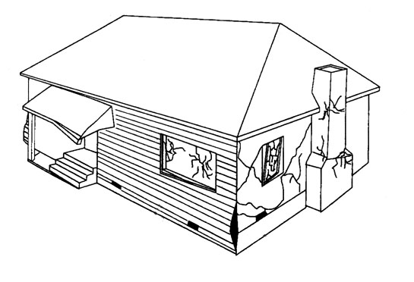
Light Frame Structure
PEER | CSSR | INDIA
PPT 3 -

Slide 15
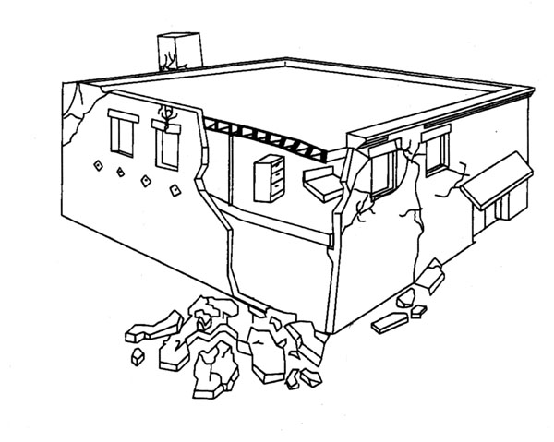
Heavy Wall Structure
PEER | CSSR | INDIA
PPT 3 -

Slide 16
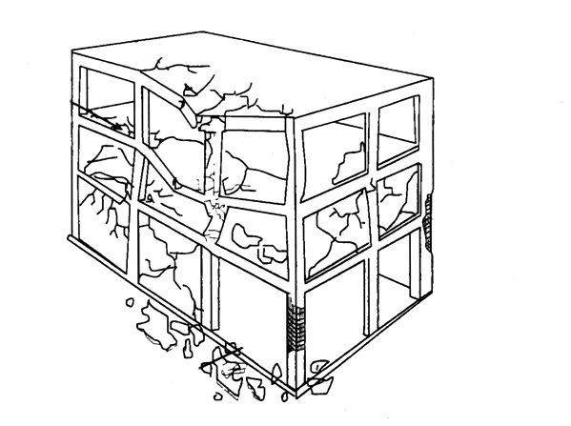
Heavy Floor Structure
PEER | CSSR | INDIA
PPT 3 -

Slide 17
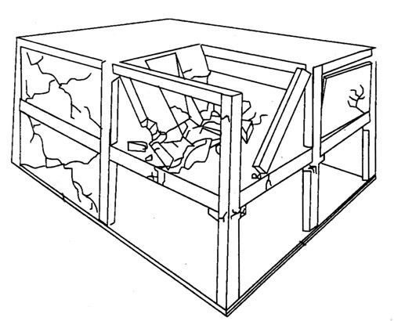
Pre-Cast Concrete Structure
PEER | CSSR | INDIA
PPT 3 -

Slide 18
Characteristics of a Structure
General
Architecture
Structural elements
Non-structural elements
PEER | CSSR | INDIA
PPT 3 -

Slide 19
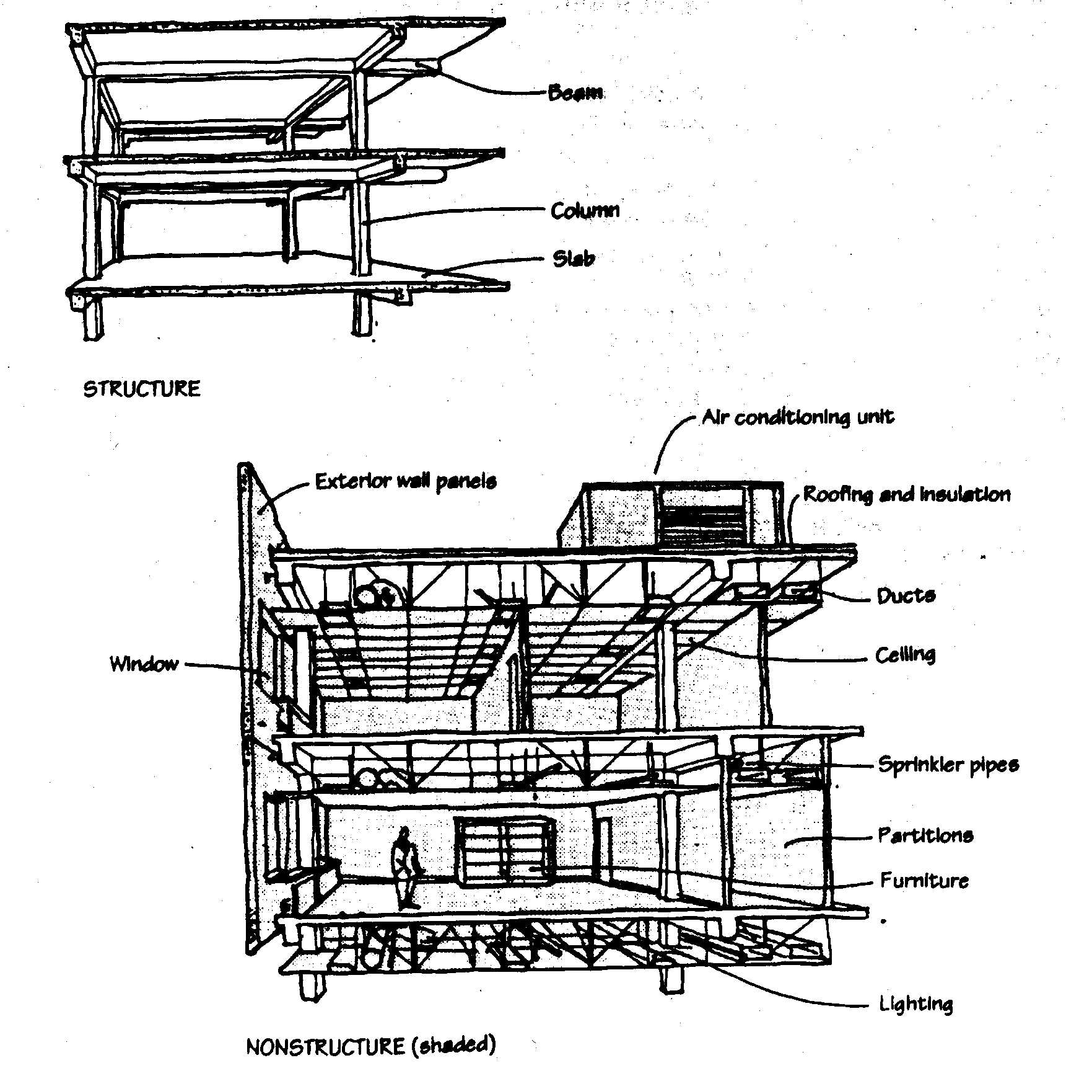
Structural Elements
Beam
Cantilever
Foundation
PEER | CSSR | INDIA
PPT 3 -

Slide 20
Non-Structural Elements
PEER | CSSR | INDIA
PPT 3 -

Slide 21
Damage Types
Damage to a building can be classified as two types:
STRUCTURAL: affecting structural (load-bearing) elements
NON-STRUCTURAL: affecting
non-structural and decorative elements
PEER | CSSR | INDIA
PPT 3 -

Slide 22
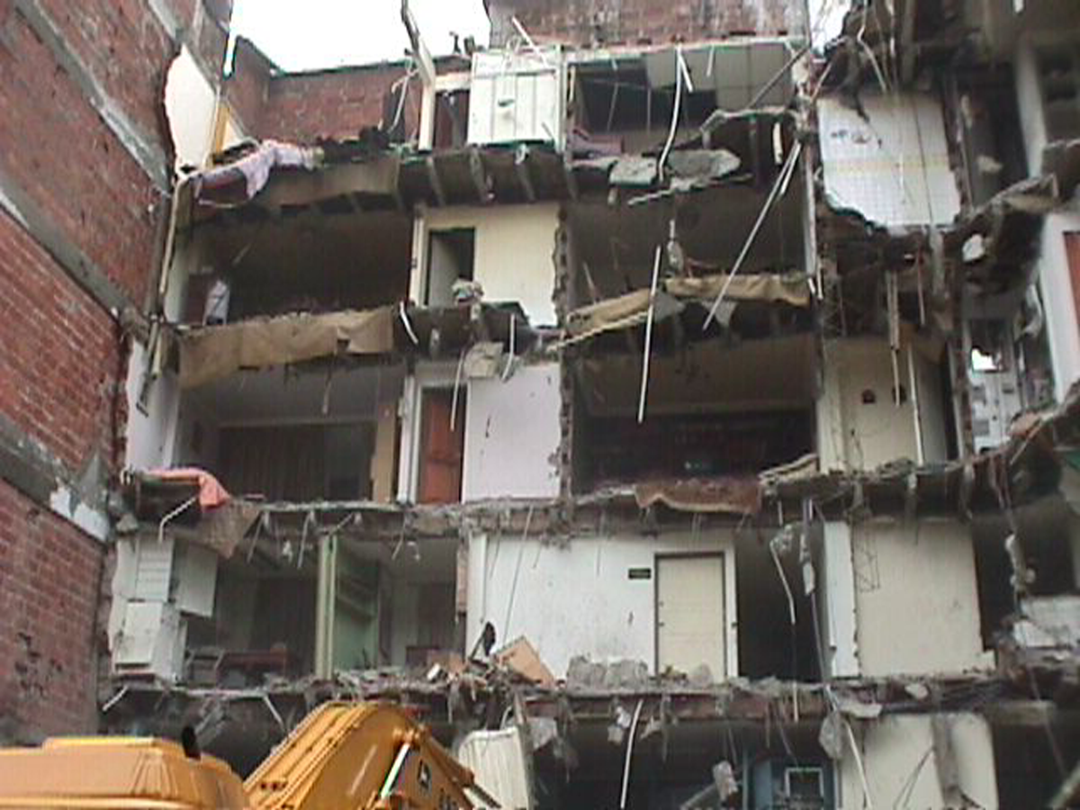
Colombia earthquake:
structural and non-structural damage
PEER | CSSR | INDIA
PPT 3 -

Slide 23
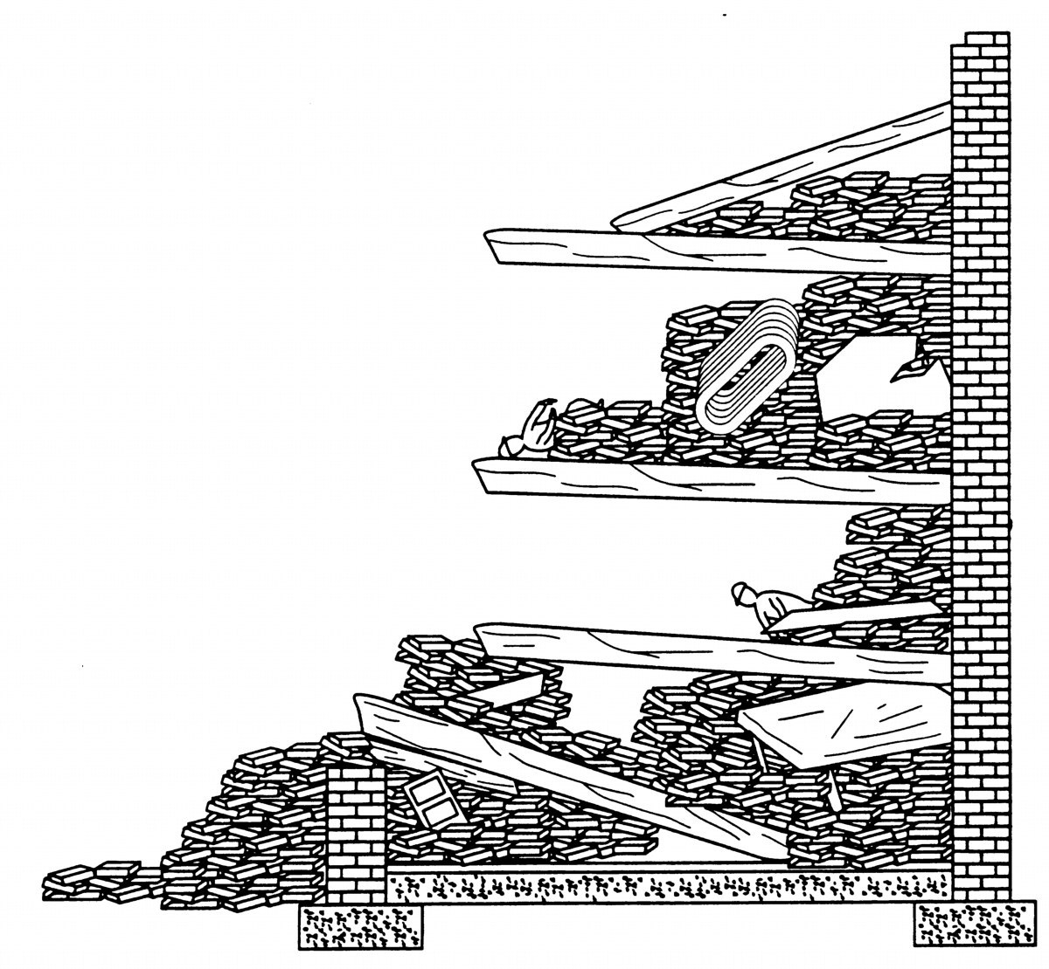
Basic Collapse Patterns
Cantilever
PEER | CSSR | INDIA
PPT 3 -

Slide 24
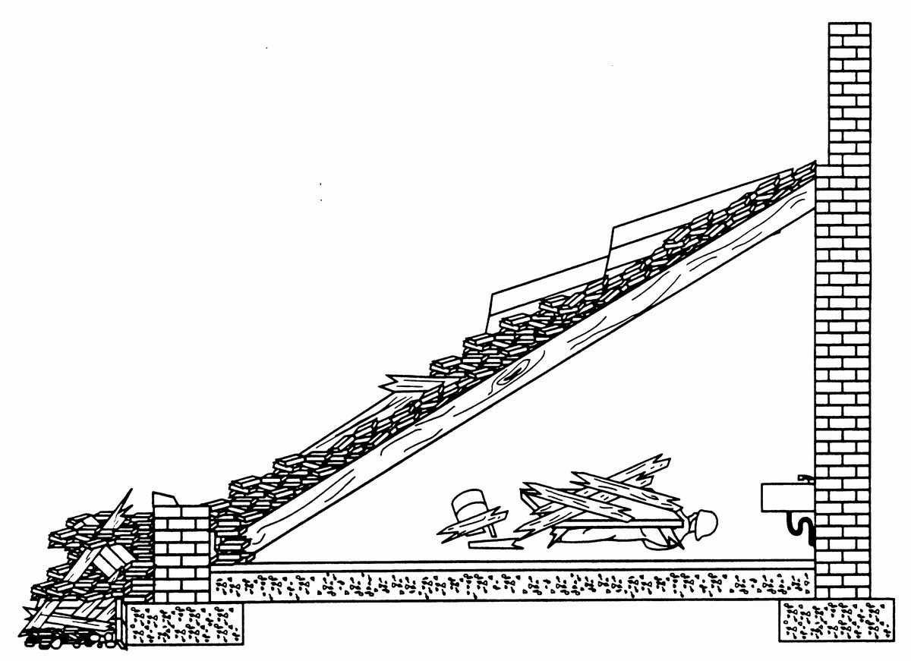
Basic Collapse Patterns
Lean-to
PEER | CSSR | INDIA
PPT 3 -

Slide 25
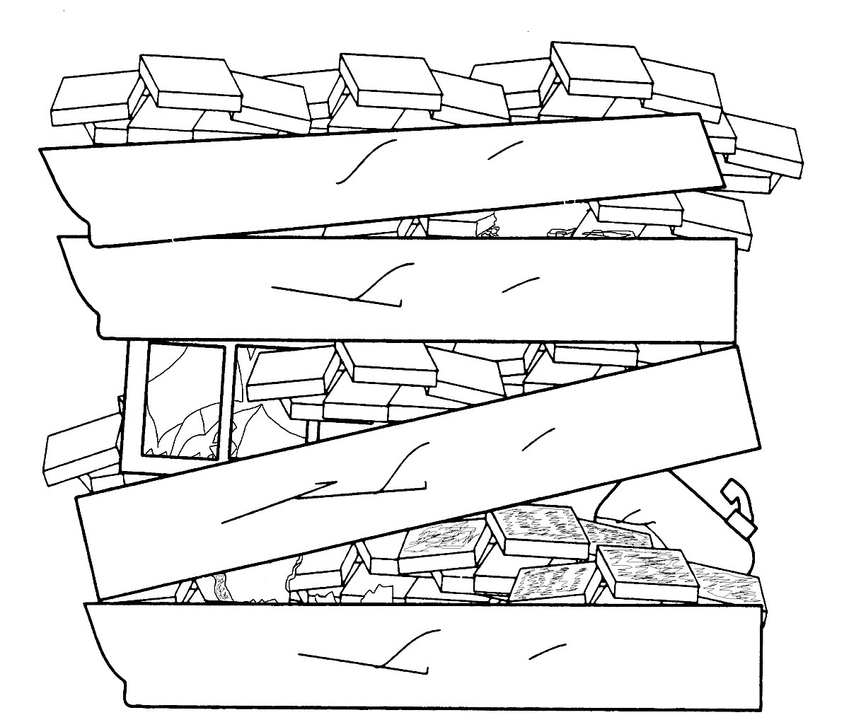
Basic Collapse Patterns
Pancake
PEER | CSSR | INDIA
PPT 3 -

Slide 26
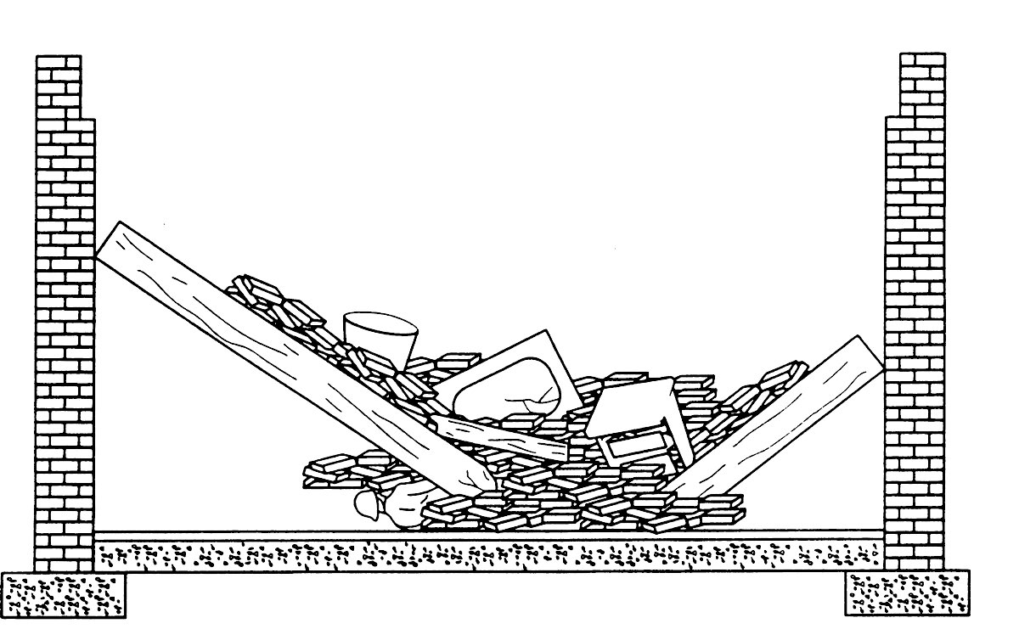
Basic Collapse Patterns
V-Shape
PEER | CSSR | INDIA
PPT 3 -

Slide 27
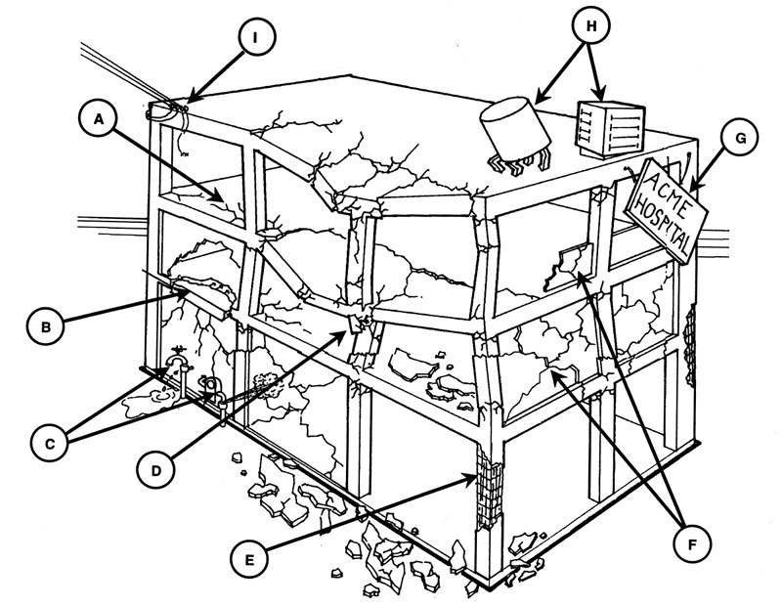
Identify Structural Damage
PEER | CSSR | INDIA
PPT 3 -

Slide 28


THANK YOU

